Slide 2
Section 1: Introduction to the Structure and Growth of Bones
Learning Outcomes
6.1 Describe the two main divisions of the skeleton, and list the major functions of the skeletal system.
6.2 Classify bones according to their shapes, identify the major types of bone markings, and explain the functional significance of bone markings
6.3 Identify the parts of a typical long bone, and describe its internal structures.
6.4 Identify the types of cells in bone, and list their major functions.

Slide 3
Section 1: Introduction to the Structure and Growth of Bones
Learning Outcomes (continued)
6.5 Compare the structures and functions of compact bone and spongy bone.
6.6 Describe the process of appositional bone growth.
6.7 Describe the process of endochondral ossification.
6.8 Describe the process of intramembranous ossification.
6.9 Clinical Module: Discuss various abnormalities of bone formation and growth.

Slide 4
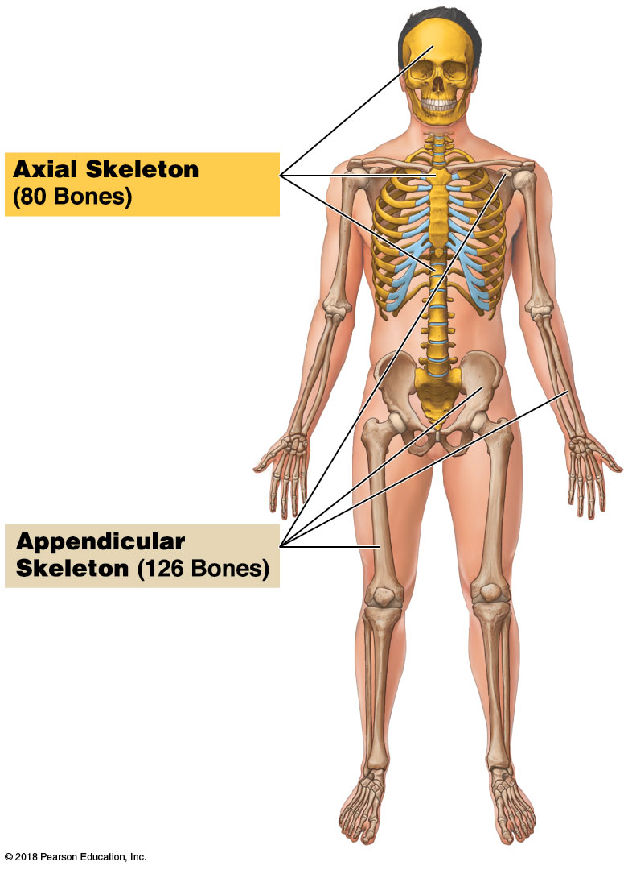
Module 6.1: The skeletal system is made up of the axial and appendicular divisions
Bones (~206 total)
​Axial skeleton (80 bones)
Bones of skull, thorax, and vertebral column
Form longitudinal axis of body
​Appendicular skeleton (126 bones)
Bones of the limbs and girdles that attach them to the axial skeleton
Associated cartilages
Ligaments and other connective tissues
Notes:
1. Students may not notice the different colors used to differentiate between the axial and appendicular parts of the skeleton.
2. Additional resource: PAL 3.0—Anatomical Models → Axial Skeleton

Slide 5
Functions of the skeletal system

Slide 6
Module 6.1: Review
Describe the axial and appendicular divisions of the skeleton.
Identify the functions of the skeletal system.
Learning Outcome: Describe the two main divisions of the skeleton, and list the major functions of the skeletal system.

Slide 7
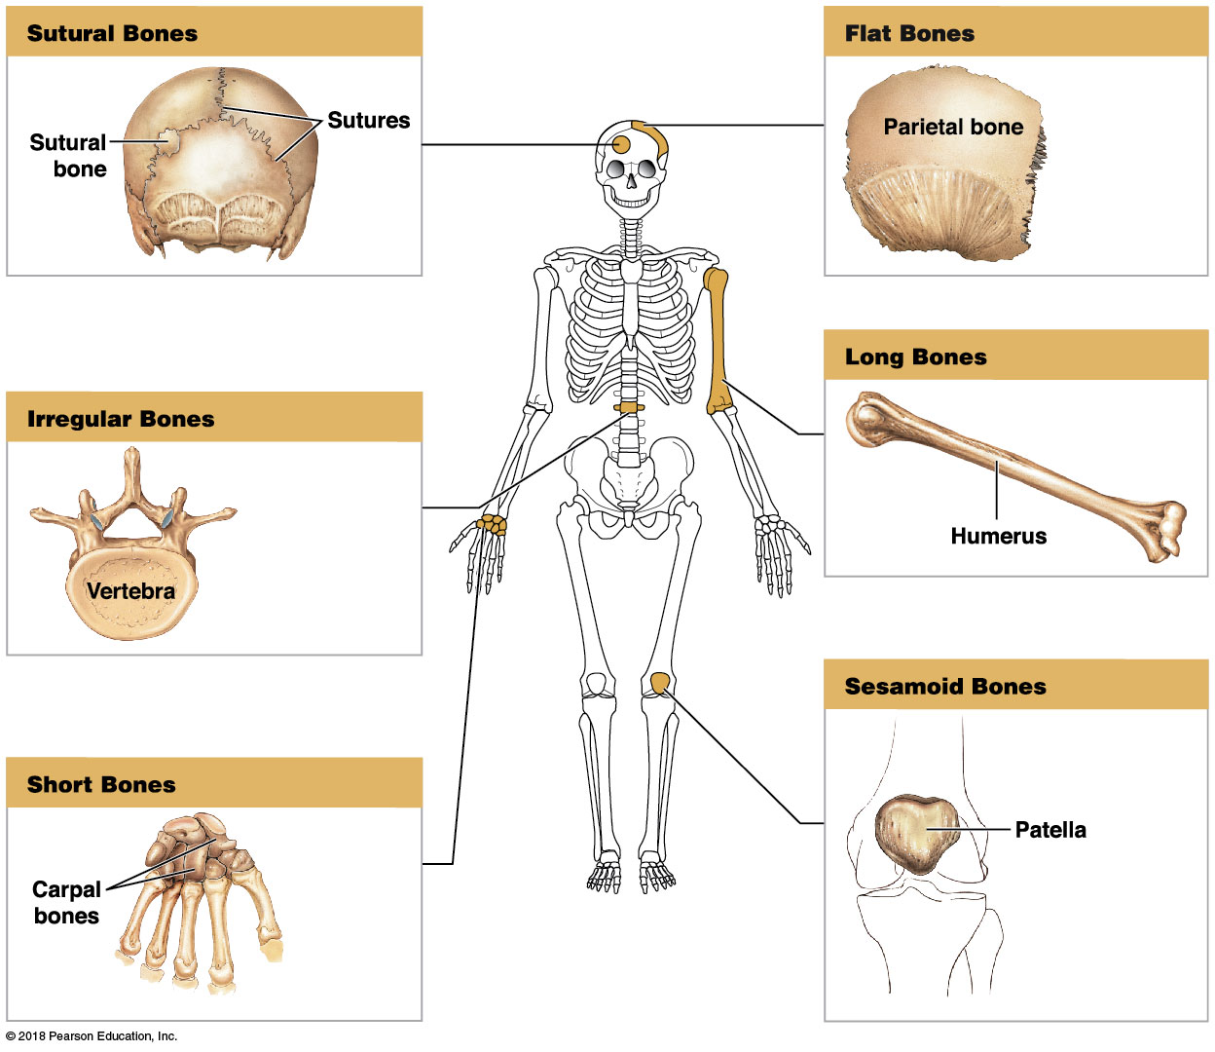
Module 6.2: Bones are classified according to shape and structure and have varied bone markings
Six categories of bone based on shape
​Flat bones
​Sutural bones
​Long bones
​Irregular bones
​Sesamoid bones
​Short bones

Slide 8
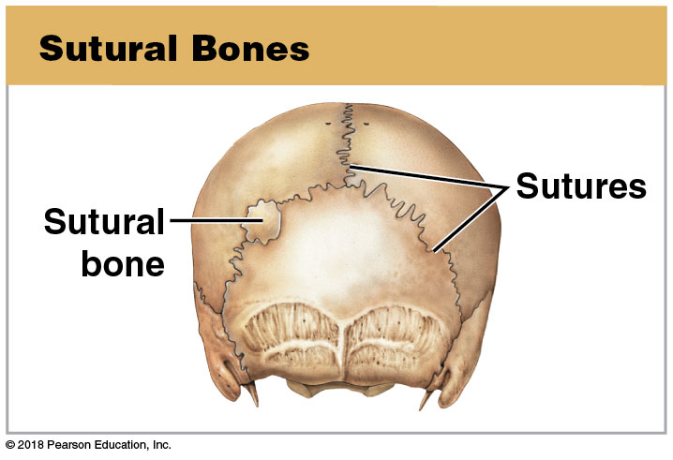
Module 6.2: Bone classification and surface markings
​Flat bones
Thin, roughly parallel surfaces
Examples: cranial bones, sternum, ribs, scapulae
Protect underlying soft tissues
Provide surface area for skeletal muscle attachment
​Sutural bones (Wormian bones)
Irregular bones formed between cranial bones
Number, size, and shape vary

Slide 9
Module 6.2: Bone classification and surface markings
​Long bones
Relatively long and slender
Examples: various bones of the limbs
​Irregular bones
Complex shapes with short, flat, notched, or ridged surfaces
Examples: vertebrae, bones of pelvis, facial bones

Slide 10
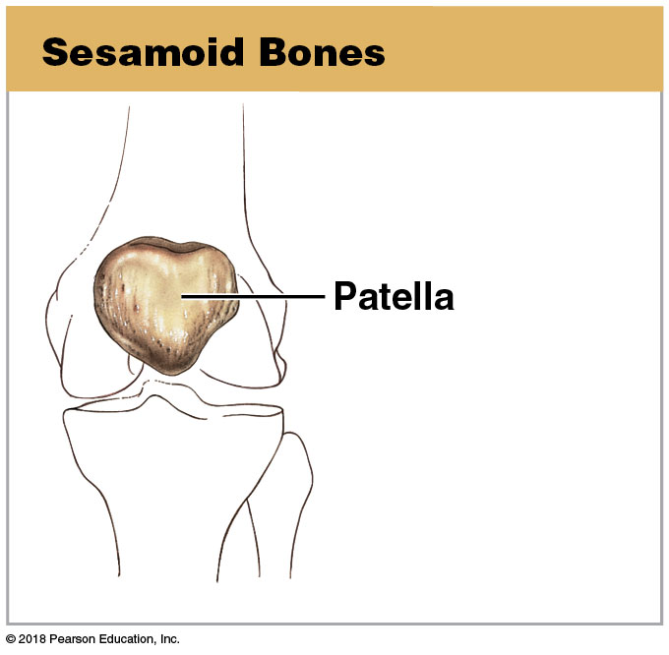
Module 6.2: Bone classification and surface markings
​Sesamoid bones
Small, flat, and somewhat shaped like sesame seed
Develop inside tendons of knee, hands, and feet
Individual variation in location and number
​Short bones
Small and boxy
Examples: bones of the wrist (carpals) and ankles (tarsals)

Slide 11
Bone classifications

Slide 12
Module 6.2: Bone classification and markings
Bone markings
Also known as surface features
Related to particular functions
Elevations/projections
Muscle, tendon, and ligament attachment
At joints where adjacent bones articulate
Depressions/grooves/tunnels
Sites for blood vessels or nerves to lie alongside or penetrate bone

Slide 13
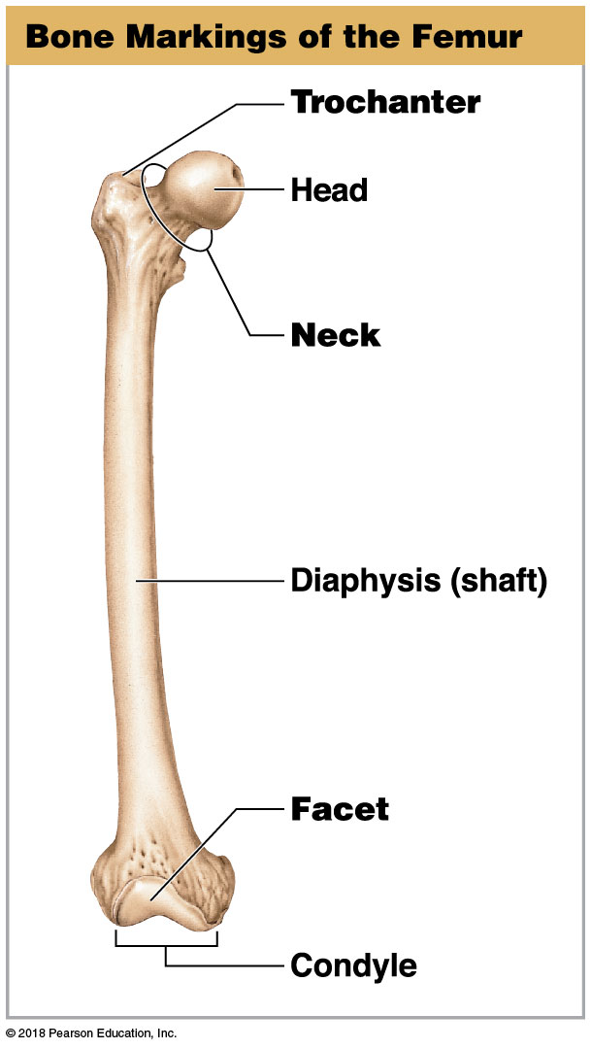
Module 6.2: Bone classification and markings
Bone markings—general
Head
Expanded proximal end of a bone that forms part of a joint
Diaphysis (shaft)
Elongated body of a long bone
Neck
Narrow connection between the head and diaphysis of a bone
Notes:
It helps students with orientation if you can also show them an actual femur while going over these bony markings.

Slide 14
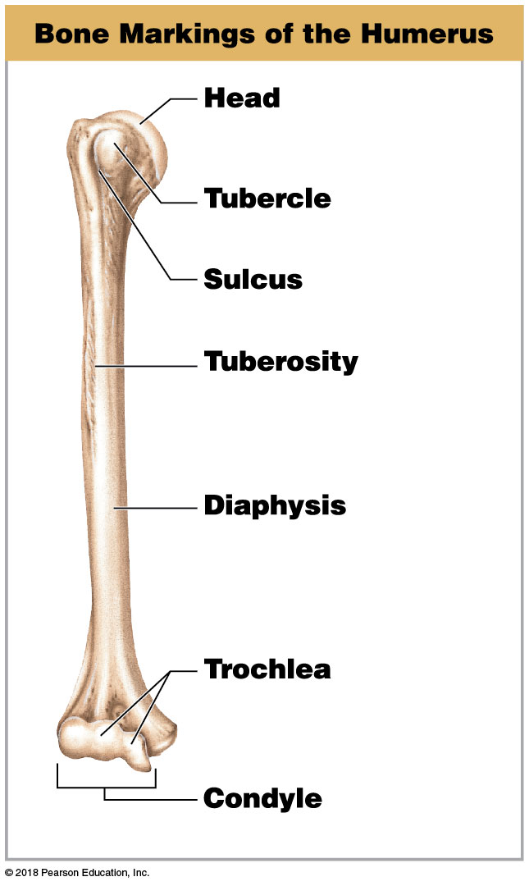
Module 6.2: Bone classification and markings
Bone markings—elevations or projections
Process—any projection or bump
Tubercle—small, rounded projection
Tuberosity—small, rough projection that takes up a broad area
Trochlea—smooth, grooved articular process shaped like a pulley
Condyle—smooth, rounded articular process
Notes:
If you can show actual bones while going over this slide, it is an opportunity to compare and contrast the features of the humerus and femur. For example, both have heads and necks, but they are quite different.

Slide 15
Module 6.2: Bone classification and markings
Bone markings—elevations or projections (continued)
Trochanter—large, rough projection
Facet—small, flat articular surface

Slide 16
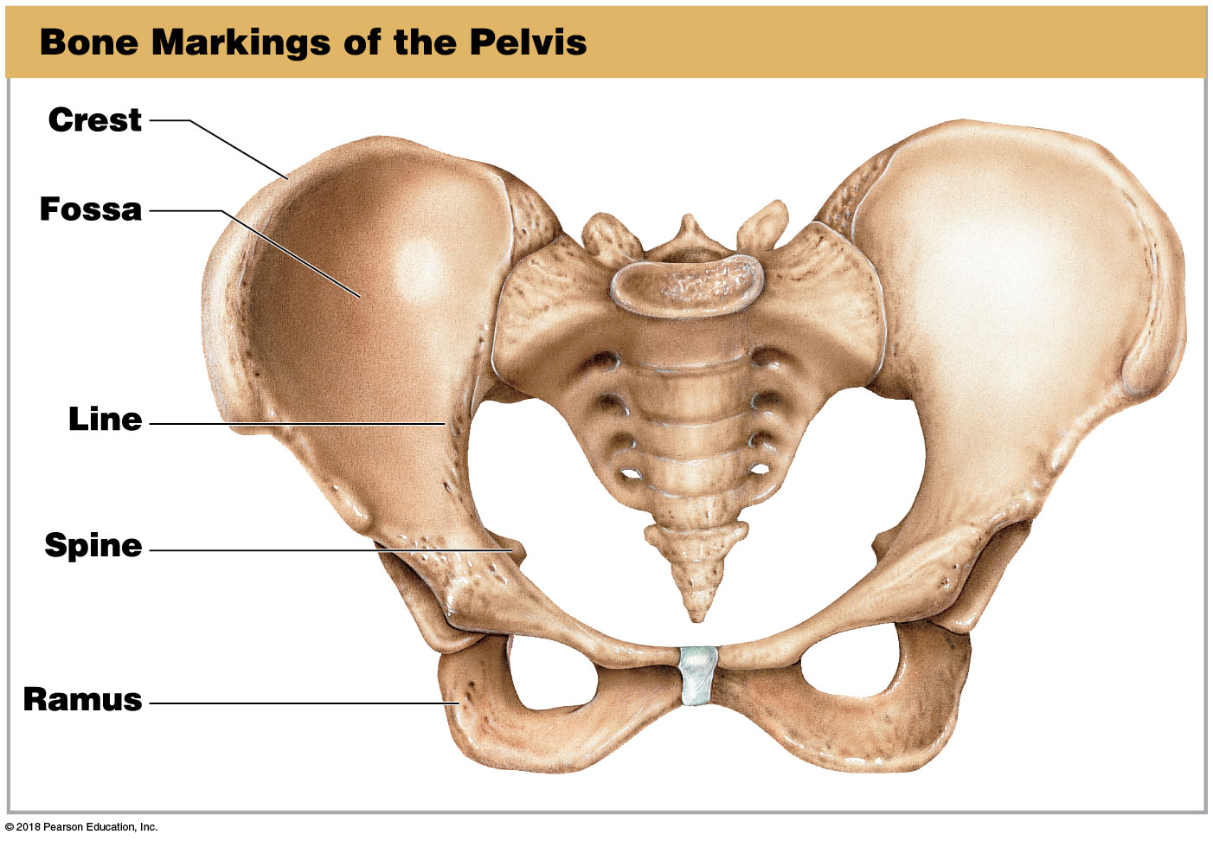
Module 6.2: Bone classification and markings
Bone markings—elevations or projections (continued)
Crest—prominent ridge
Line—low ridge, more delicate than a crest
Spine—pointed or narrow process
Ramus—extension of a bone that makes an angle with the rest of a structure

Slide 17
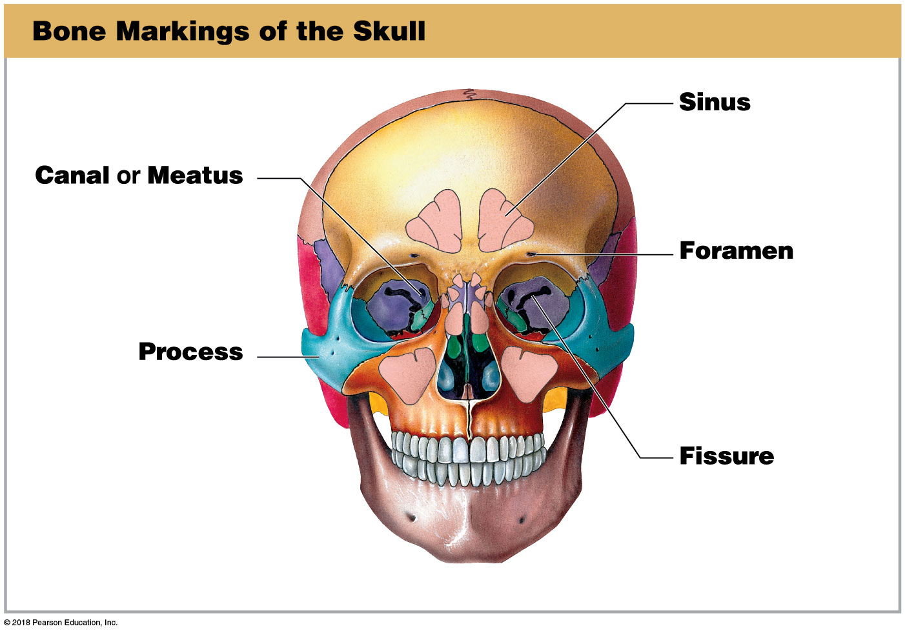
Module 6.2: Bone classification and markings
Bone markings—depressions, grooves, and tunnels
Canal or meatus—large passageway through a bone
Sinus—chamber within a bone, normally filled with air
Foramen—small, rounded passageway for blood vessels or nerves to pass through bone

Slide 18
Module 6.2: Bone classification and markings
Bone markings—depressions, grooves, and tunnels (continued)
Fissure—elongated cleft or gap
Sulcus—deep, narrow groove
Fossa—shallow depression or recess in bone surface

Slide 19
Module 6.2: Review
Identify the six broad categories for classifying a bone according to shape.
Define bone markings.
List the different terms used to describe projections.
Learning Outcome: Classify bones according to their shapes, identify the major types of bone markings, and explain the functional significance of bone markings.

Slide 20
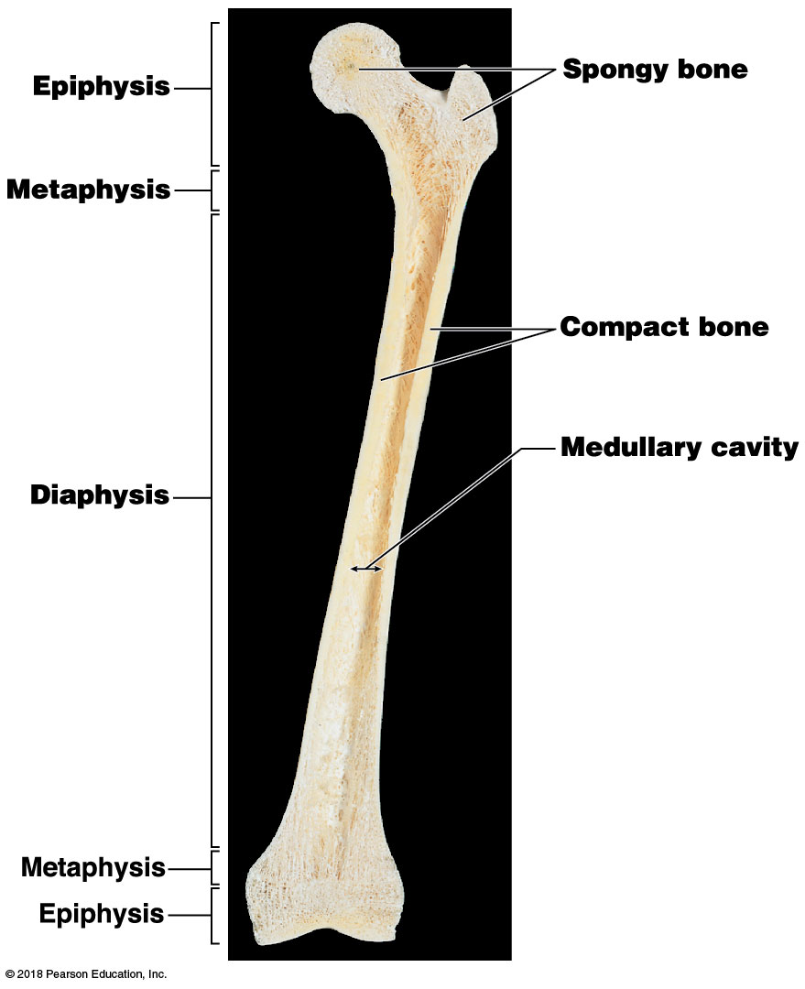
Module 6.3: Long bones transmit forces along the shaft and have a rich blood supply
Long bone features
Epiphysis (expanded area at each end of the bone)
Consists largely of spongy bone (trabecular bone)
Outer covering of compact bone (cortical bone)
Strong, organized bone
Articular cartilage
Covers portions of epiphysis that form articulations
Notes:
If you have an actual femur, you can use it to help students get oriented by having a student hold the bone up in the same position as depicted in this image. Then ask the students what type of section is shown.

Slide 21
Module 6.3: Functional anatomy of a long bone
Long bone features (continued)
Metaphysis (connects epiphysis to shaft)
Diaphysis (shaft)
Contains medullary cavity (marrow cavity)
Filled with two types of marrow
Red bone marrow (involved in red blood cell production)
Yellow bone marrow (adipose tissue; important as energy reserve)
Notes:
To help students move past memorization, ask them to explain the coloration of red and yellow bone marrow.

Slide 22
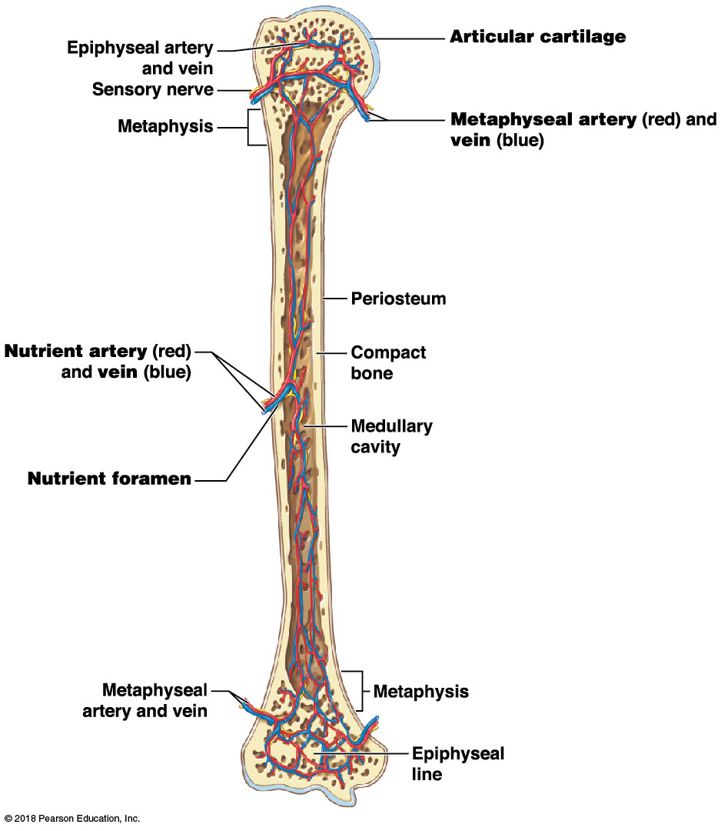
Module 6.3: Functional anatomy of a long bone
Growth and maintenance require extensive blood supply
Vascular features
Nutrient artery and nutrient vein (commonly one of each per bone)
Nutrient foramen (tunnel providing access to marrow cavity)
Metaphyseal artery and metaphyseal vein
Carry blood to/from metaphysis
Connect to epiphyseal arteries/veins

Slide 23
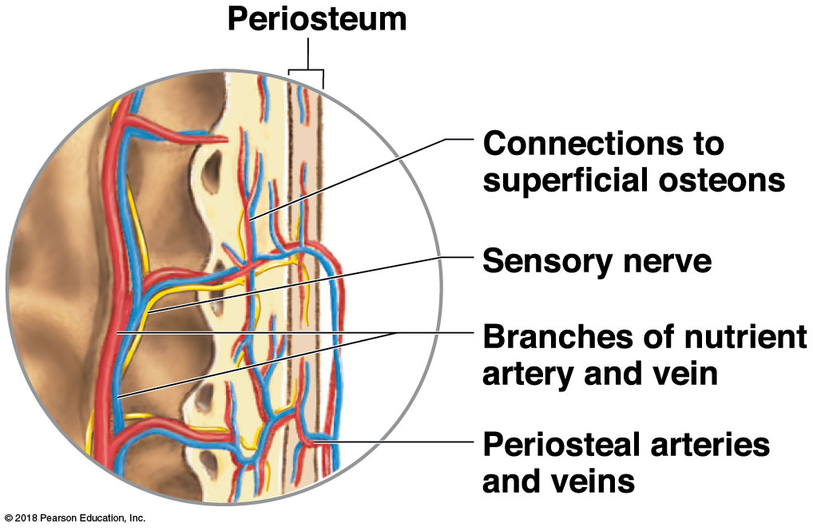
Module 6.3: Functional anatomy of a long bone
Blood supply and innervation of the periosteum
Smaller blood vessels supply superficial osteons
Lymphatic vessels collect lymph from bone and osteons
Sensory nerves innervate diaphysis, medullary cavity, and epiphyses
Notes:
This image provides little context. Be sure students understand it is a closeup of a longitudinal section through a long bone. Or, scroll back to the image on the previous slide and show where this type of section comes from.

Slide 24
Module 6.3: Review
List the major parts of a long bone.
Describe the function of the medullary cavity.
Where is articular cartilage found, and how is it nourished?
Why are bone injuries usually painful?
Learning Outcome: Identify the parts of a typical long bone, and describe its internal structures.

Slide 25
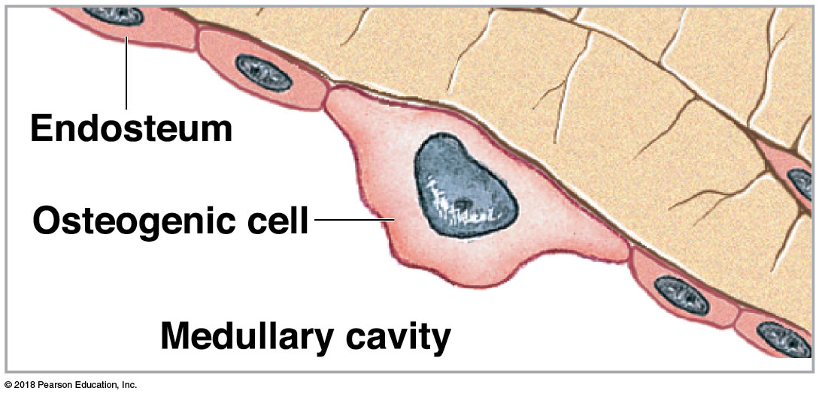
Module 6.4: Bone has a calcified matrix maintained and altered by osteogenic cells, osteoblasts, osteocytes, and osteoclasts
Osteogenic cells (osteoprogenitor cells)
Mesenchymal (stem) cells that produce cells that differentiate into osteoblasts
Important in fracture repair
Locations
Inner lining of periosteum
Lining endosteum in medullary cavity
Lining passageways containing blood vessels

Slide 26
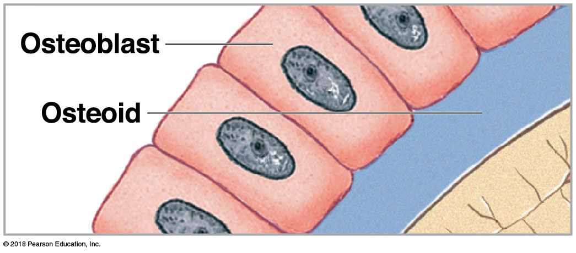
Module 6.4: Bone tissue
Osteoblasts (blast, precursor)
Produce new bony matrix (osteogenesis or ossification)
Produces unmineralized matrix (osteoid)
Then assists in depositing calcium salts to convert osteoid to bone
Become osteocytes once surrounded by bony matrix

Slide 27
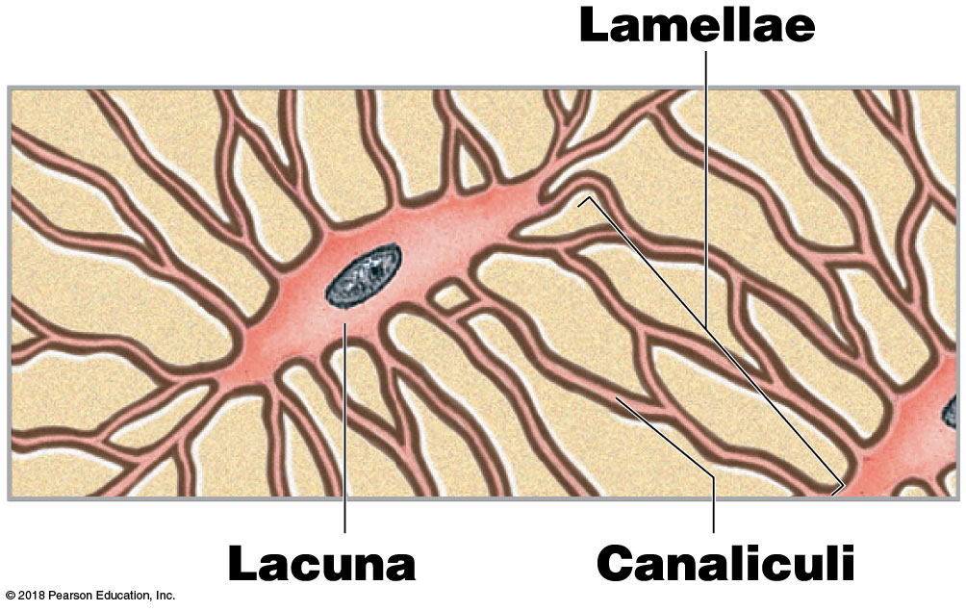
Module 6.4: Bone tissue
Osteocytes (osteo-, bone + cyte, cell)
Mature bone cells that cannot divide
Maintain protein and mineral content of surrounding matrix
Occupy lacunae (pockets)
Separated by layers of matrix (lamellae)
Interconnected by canaliculi
Notes:
This image is good for showing how canaliculi are formed. The extensions of the osteocytes are surrounded by bone matrix, thus forming little tubes like tunnels through the bone matrix, the canaliculi.

Slide 28
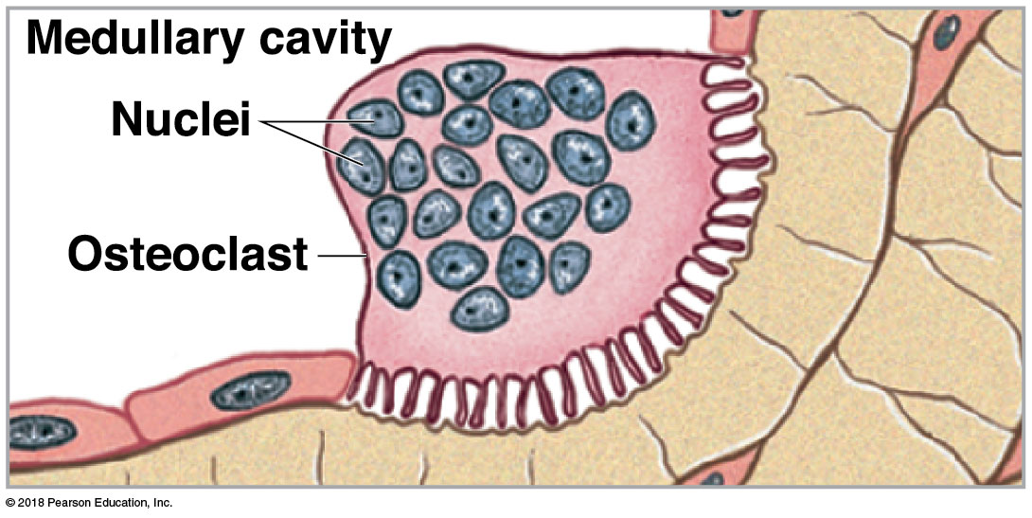
Module 6.4: Bone tissue
Osteoclasts (klastos, broken)
Remove and remodel bone matrix
Release acids and proteolytic enzymes to dissolve matrix and release stored minerals
Process called osteolysis (lysis, loosening)

Slide 29
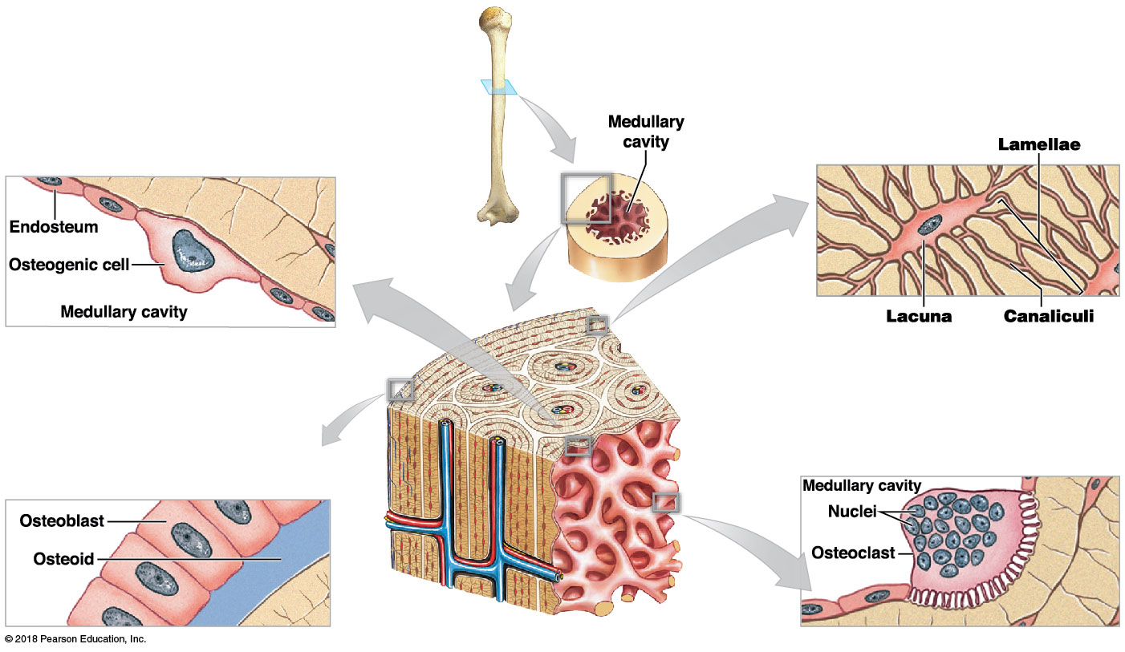
Bone tissue

Slide 30
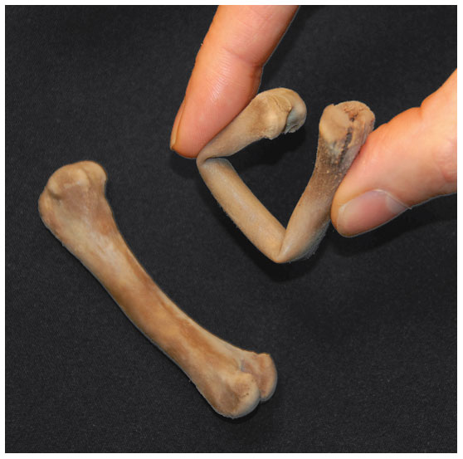
Module 6.4: Bone tissue
Bone matrix
Collagen fibers account for ~1/3 bone weight
Provide flexibility
Calcium phosphate (Ca₃(PO₄)₂) accounts for ~2/3 bone weight
Interacts with calcium hydroxide (Ca(OH)₂) to form crystals of hydroxyapatite (Ca₁₀(PO₄)₆(OH)₂) salts
Incorporates other salts (calcium carbonate, CaCO₃) and ions (Na⁺, Mg²⁺, F–)
Provides strength
Notes:
To help students understand the composition of bone matrix, soak some chicken leg bones in vinegar for about a week. They become rubbery, as shown in this image, because the acid leaches out the minerals, leaving mostly pliable collagen fibers.

Slide 31
Module 6.4: Review
Describe the functions of osteogenic cells and osteoblasts.
Describe the functions of osteocytes.
How would the compressive strength of a bone be affected if the ratio of collagen to hydroxyapatite increased?
If osteoclast activity exceeds osteoblast activity in a bone, how will the bone mass be affected?
Learning Outcome: Identify the types of cells in bone, and list their major functions.

Slide 32
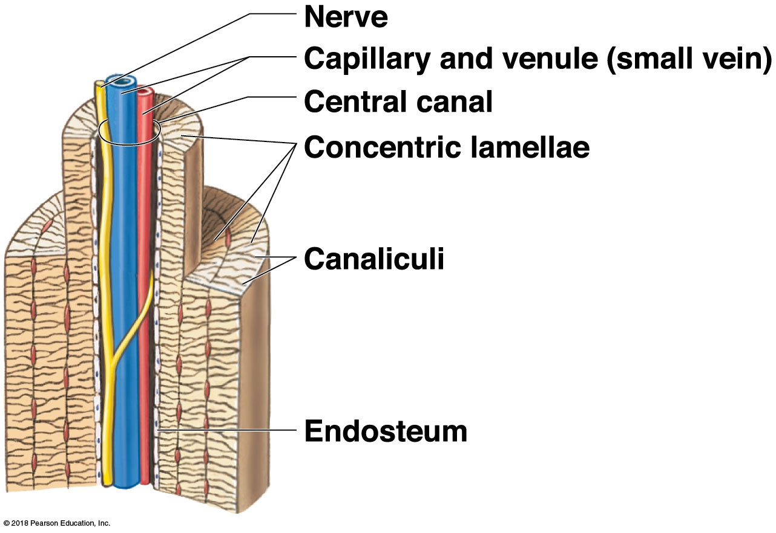
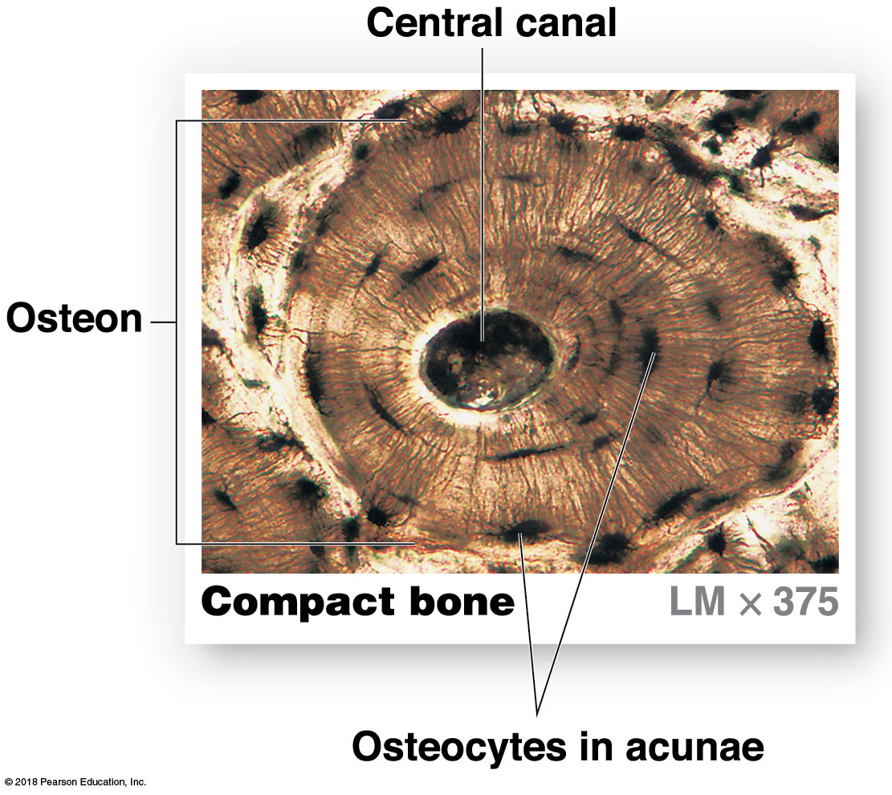
Module 6.5: Compact bone consists of parallel osteons, and spongy bone consists of a network of trabeculae
Compact bone
Functional unit is osteon (Haversian system)
Organized concentric lamellae around a central canal
Osteocytes (in lacunae) lie between lamellae
Central canal contains small blood vessels
Notes:
These images are from different orientations: the top is a longitudinal section and the bottom is a cross section. To help students interpret these two representations of compact bone, try cross-mapping: point out a structure in the top image, for example the central canal, and then show it in the micrograph. This orientation helps students interpret both images.

Slide 33
Module 6.5: Compact and spongy bone structure
Compact bone (continued)
Functional unit is osteon (Haversian system) (continued)
Canaliculi connect lacunae with each other and central canal
Strong along its length
Notes:
These images are from different orientations: the top is a longitudinal section and the bottom is a cross section. To help students interpret these two representations of compact bone, try cross-mapping: point out a structure in the top image, for example the central canal, and then show it in the micrograph. This orientation helps students interpret both images.

Slide 34
Module 6.5: Compact and spongy bone structure
Long bone organization
Periosteum—outermost layer
Compact bone—outer bone tissue layer
Circumferential lamellae (circum-, around + ferre, to bear) at outer and inner surfaces
Interstitial lamellae fill spaces between osteons
Osteons
Connected by perforating canals (perpendicular to surface)
Spongy bone—innermost layer

Slide 35
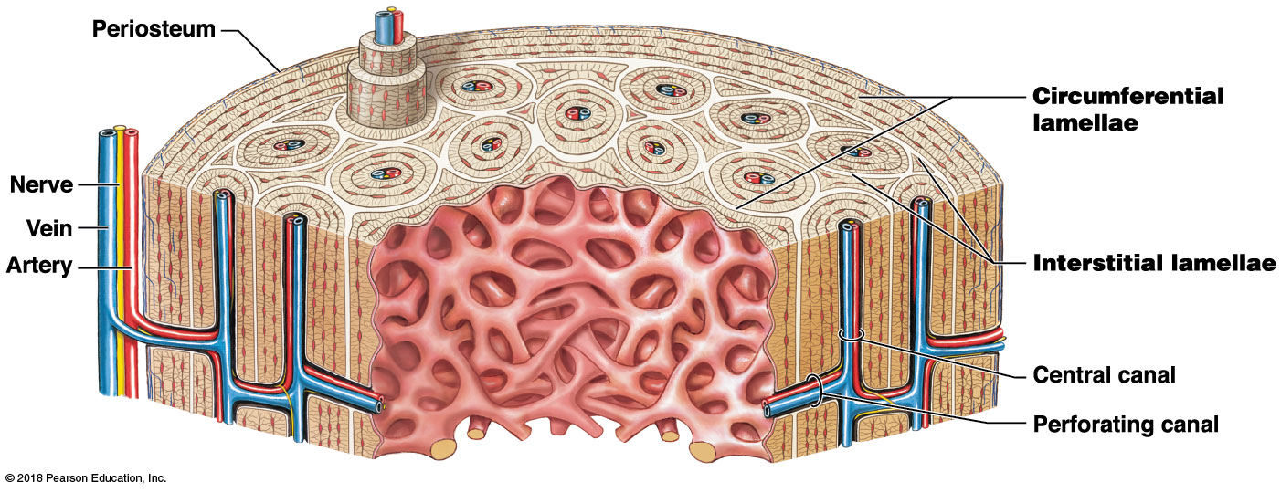
Long bone organization

Slide 36
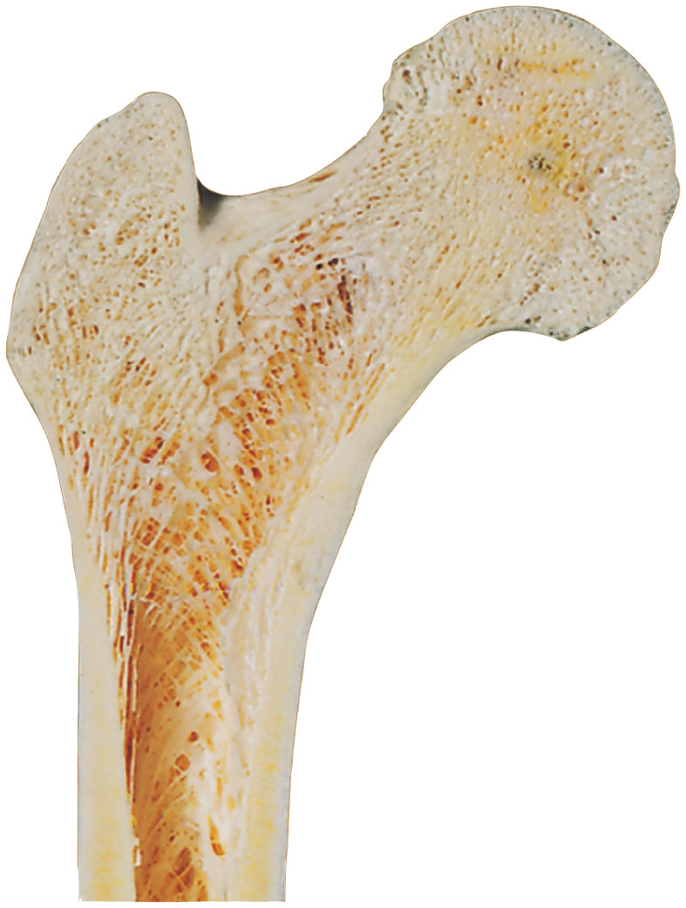
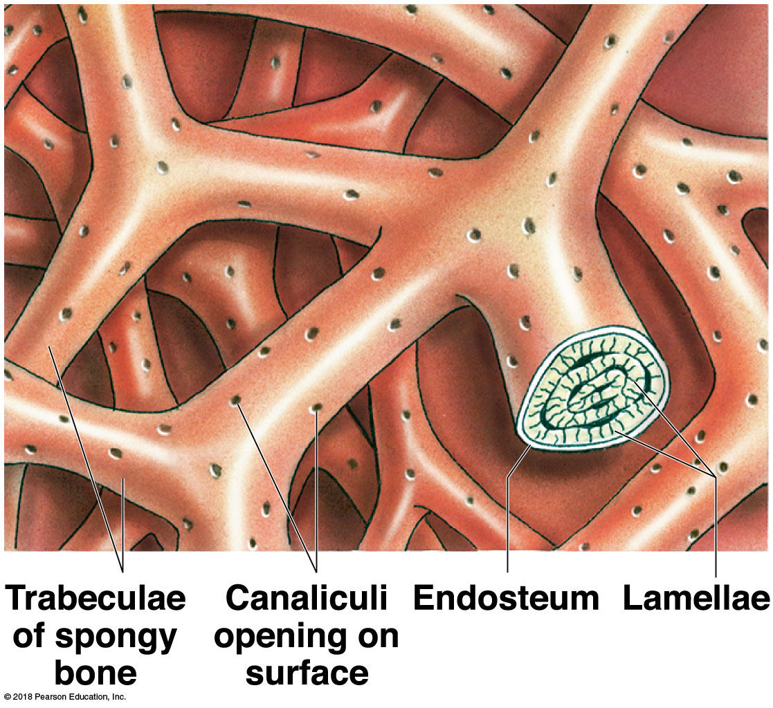
Module 6.5: Compact and spongy bone structure
Spongy bone
Lamellae form struts and plates (trabeculae) creating an open network
No blood vessels in matrix
Nutrients reach osteons through canaliculi open to trabeculae surfaces
Red bone marrow is found between trabeculae
Notes:
These images are from different scales: the first is a longitudinal section of an epiphysis of a long bone and the second is a drawing of the microscopic structure of the trabeculae. This change in scale often confuses students.

Slide 37
Module 6.5: Review
Define osteon.
Compare compact bone and spongy bone.
A sample of bone has lamellae that are not arranged in osteons. Is the sample more likely from the epiphysis or from the diaphysis?
Learning Outcome: Compare the structures and functions of compact bone and spongy bone.

Slide 38
Module 6.6: Appositional bone growth involves the periosteum and the endosteum
Appositional growth in bones
Increases bone diameter of existing bones
Osteogenic cells differentiate into osteoblasts that add bone matrix under periosteum
Adds successive layers of circumferential lamellae
Trapped osteoblasts become osteocytes

Slide 39
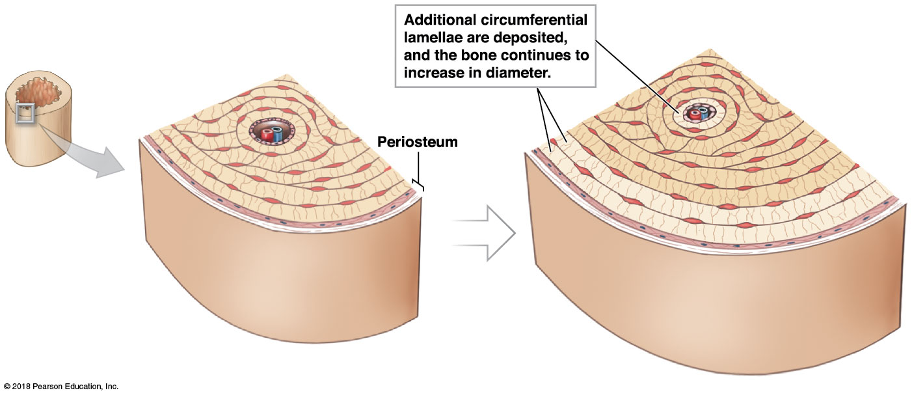
Appositional growth

Slide 40
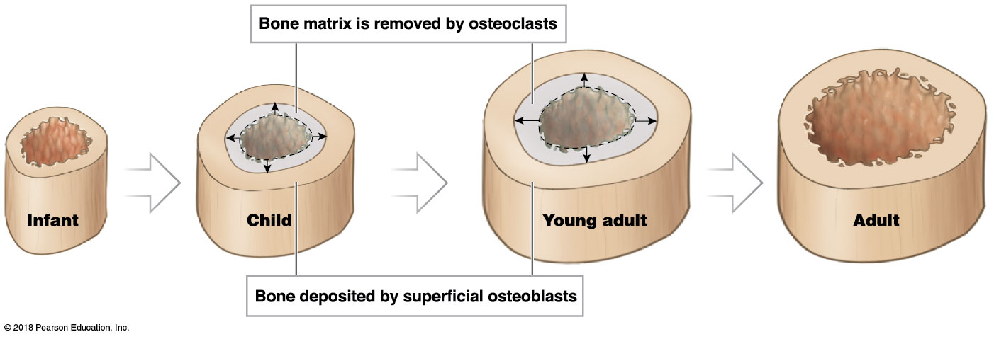
Module 6.6: Appositional bone growth
Appositional growth in bones (continued)
Deeper lamellae recycled and replaced by osteons
Osteoclasts remove matrix at inner surface to enlarge medullary cavity

Slide 41
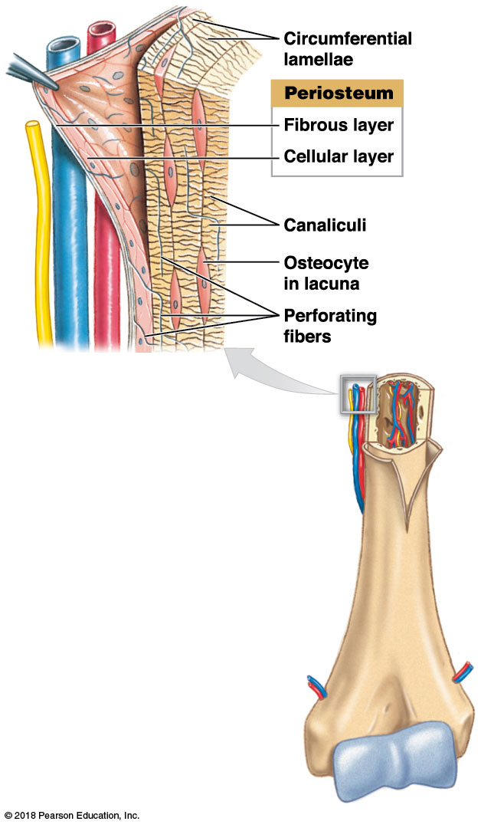
Module 6.6: Appositional bone growth
The periosteum
Wraps the superficial layer of compact bone
Two layers
Fibrous outer layer
Cellular inner layer
Functions
Isolates bone from surrounding tissues
Route for blood and nervous supply
Actively participates in bone growth and repair
Perforating fibers allow for strong attachment

Slide 42
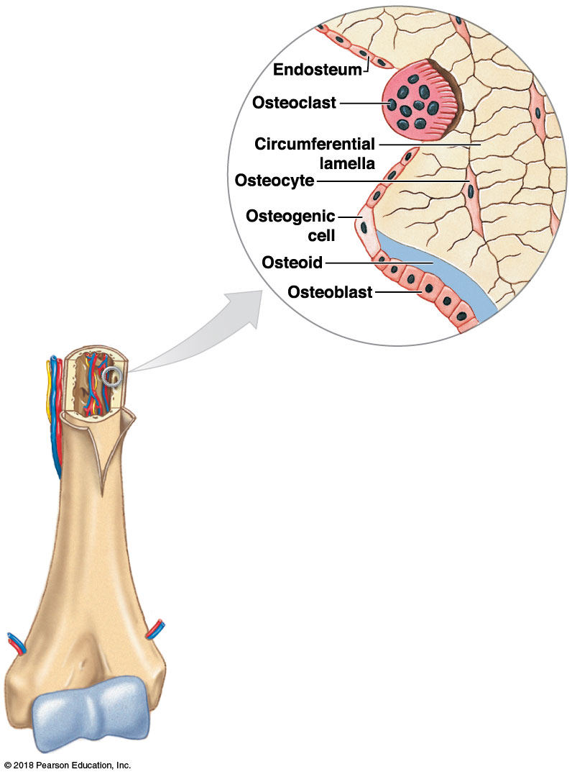
Module 6.6: Appositional bone growth
Endosteum
Incomplete cellular layer lining medullary cavity
Active during bone growth, repair, remodeling
Covers spongy bone and lines central canals
Where layer is incomplete, exposed matrix is remodeled by osteoclasts and osteoblasts
Osteoclasts in shallow depressions called osteoclastic crypts (Howship’s lacunae)
Notes:
Be sure students realize the difference in position of the pullout image here compared to the previous slide. Because the larger images on each slide are similar, some students overlook the details.

Slide 43
Module 6.6: Review
Define appositional growth.
As a bone increases in diameter, what happens to the medullary cavity?
Distinguish between the periosteum and the endosteum.
Learning Outcome: Describe the process of appositional bone growth.

Slide 44
Module 6.7: Endochondral ossification replaces a cartilage model with bone
Endochondral ossification
Initial skeleton of embryo formed of hyaline cartilage
Cartilage gradually replaced by bone through endochondral (endo-, inside + chondros, cartilage) ossification
Uses cartilage as small model
Bone grows in diameter and length
Diameter growth involves appositional bone deposition
Notes:
Additional resource: SmartArt Module 6.7—Endochondral Ossification.

Slide 45
Module 6.7: Endochondral ossification
Steps in endochondral ossification
Cartilage model enlarges
Chondrocytes near center of shaft enlarge
Enlarged chondrocytes die and disintegrate
Disintegration leaves cavities within cartilage

Slide 46
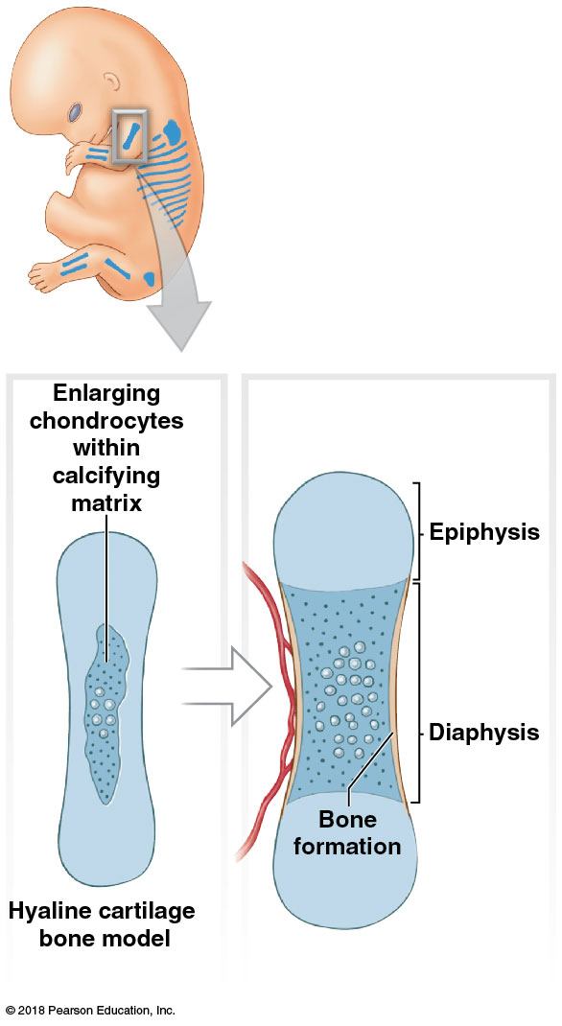
Module 6.7: Endochondral ossification
Steps in endochondral ossification (continued)
Blood vessels grow around the edge of the cartilage model
Cells of perichondrium convert to osteoblasts
Osteoblasts form superficial layer of bone along the shaft

Slide 47
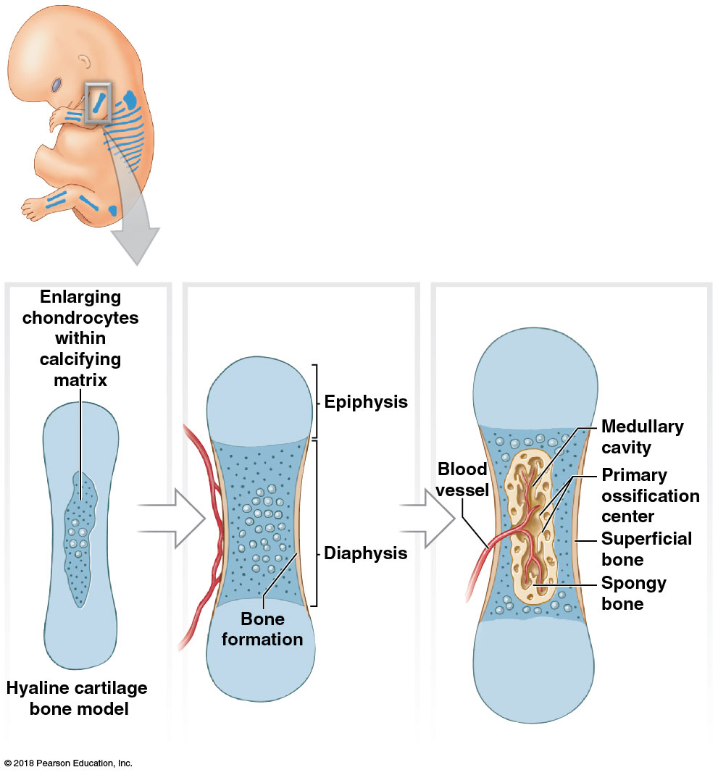
Module 6.7: Endochondral ossification
Steps in endochondral ossification (continued)
Blood vessels penetrate cartilage and enter central region
Entering fibroblasts differentiate into osteoblasts
Begin spongy bone production at primary ossification center
Bone formation spreads along the shaft toward both ends

Slide 48
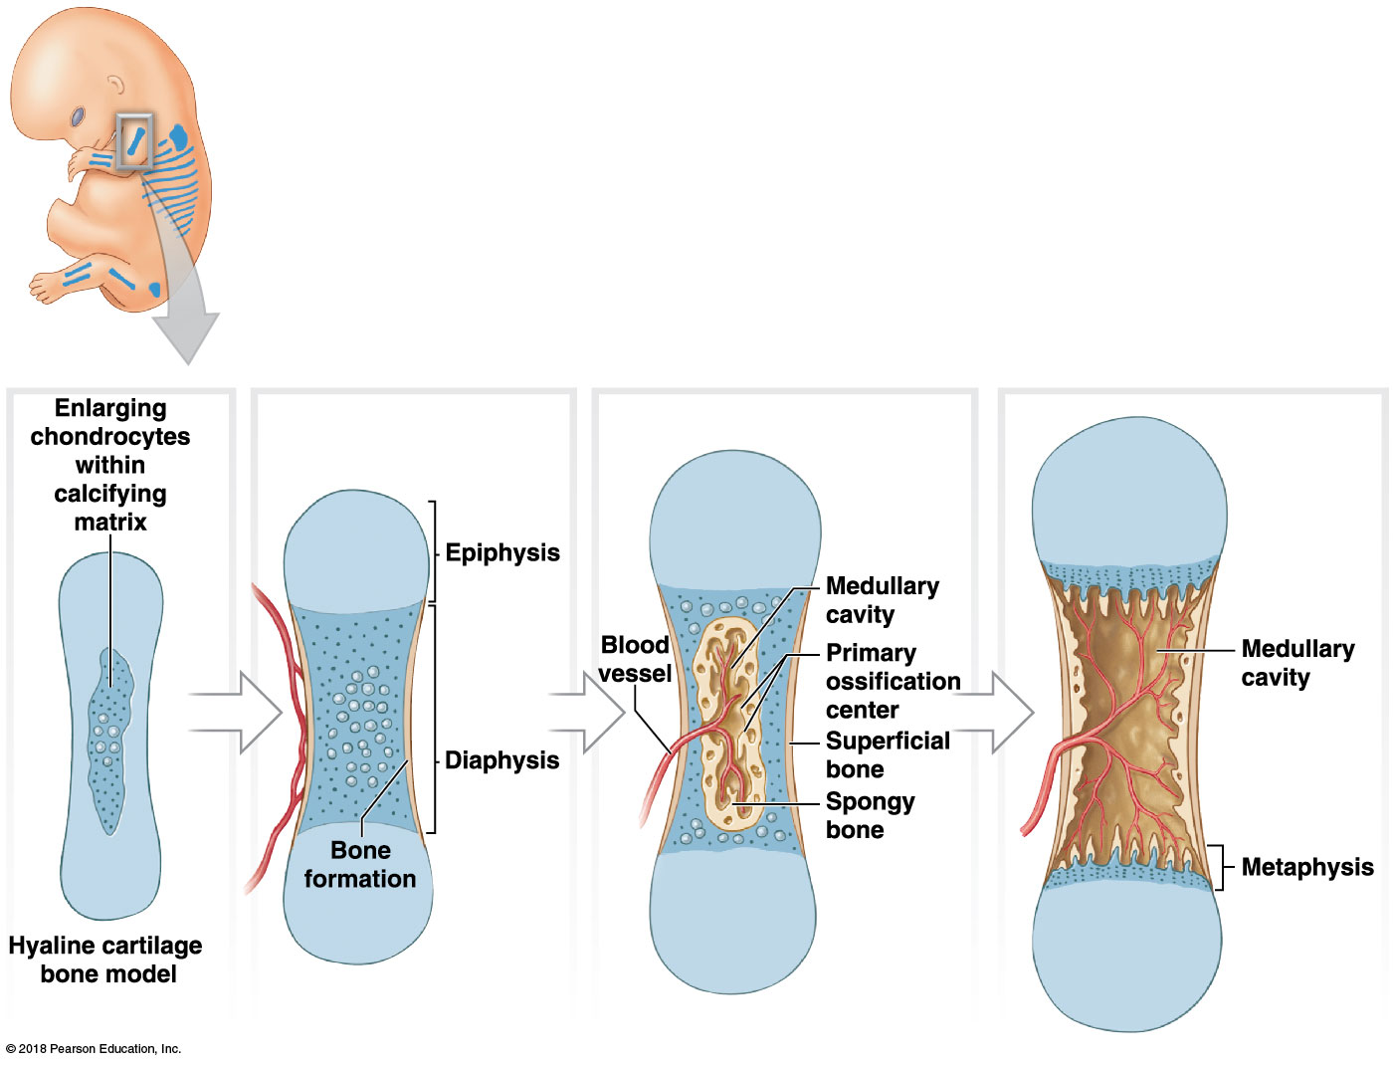
Module 6.7: Endochondral ossification
Steps in endochondral ossification (continued)
Growth continues along with remodeling
Medullary cavity created
Osseous tissue of the shaft thickens
Cartilage near the epiphyses is replaced by shafts of bone
Bone grows in length and diameter

Slide 49
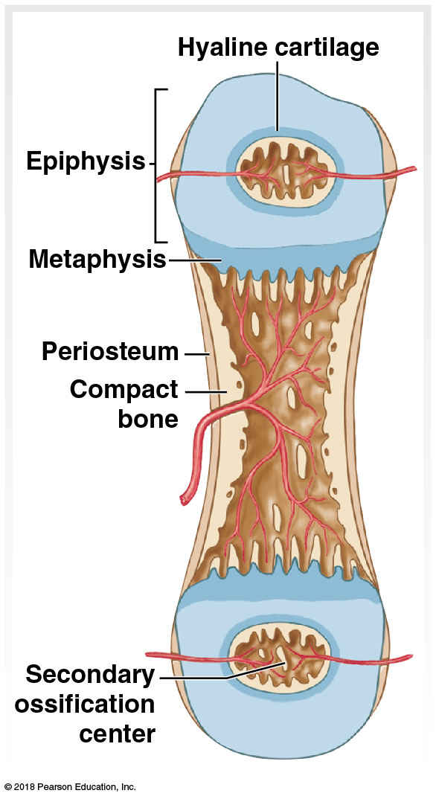
Module 6.7: Endochondral ossification
Steps in endochondral ossification (continued)
Capillaries and osteoblasts migrate into the epiphyses
Create secondary ossification centers

Slide 50
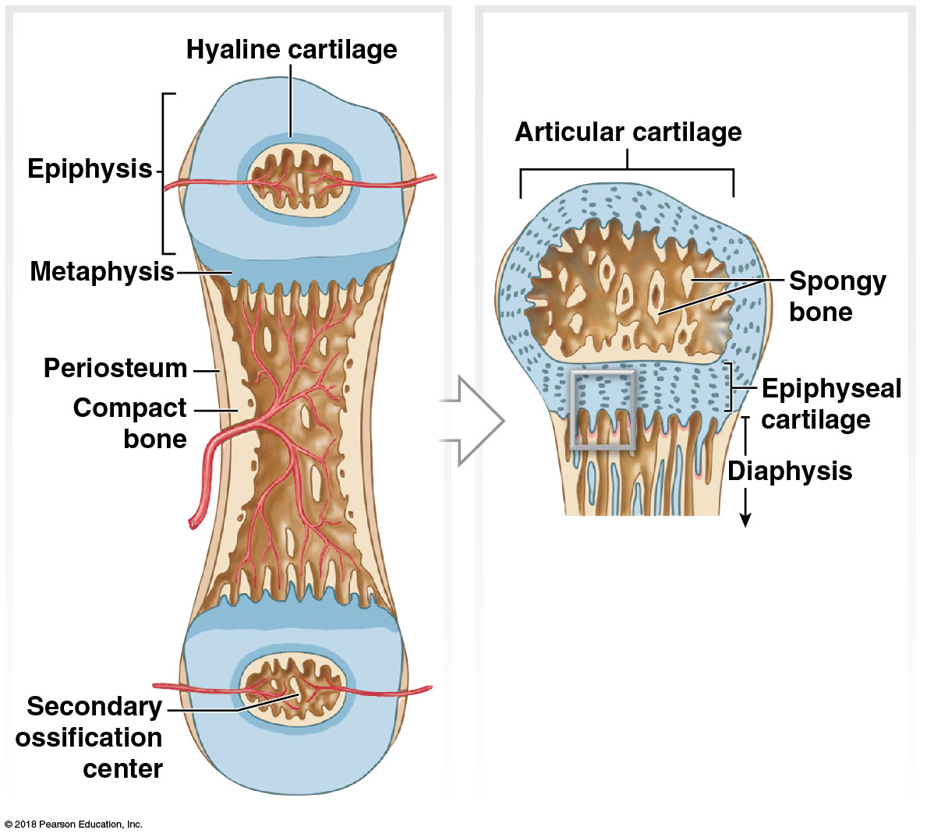
Module 6.7: Endochondral ossification
Steps in endochondral ossification (continued)
Epiphyses fill with spongy bone
Articular cartilage remains exposed to joint cavity
Epiphyseal cartilage (epiphyseal plate) separates epiphysis from diaphysis

Slide 51
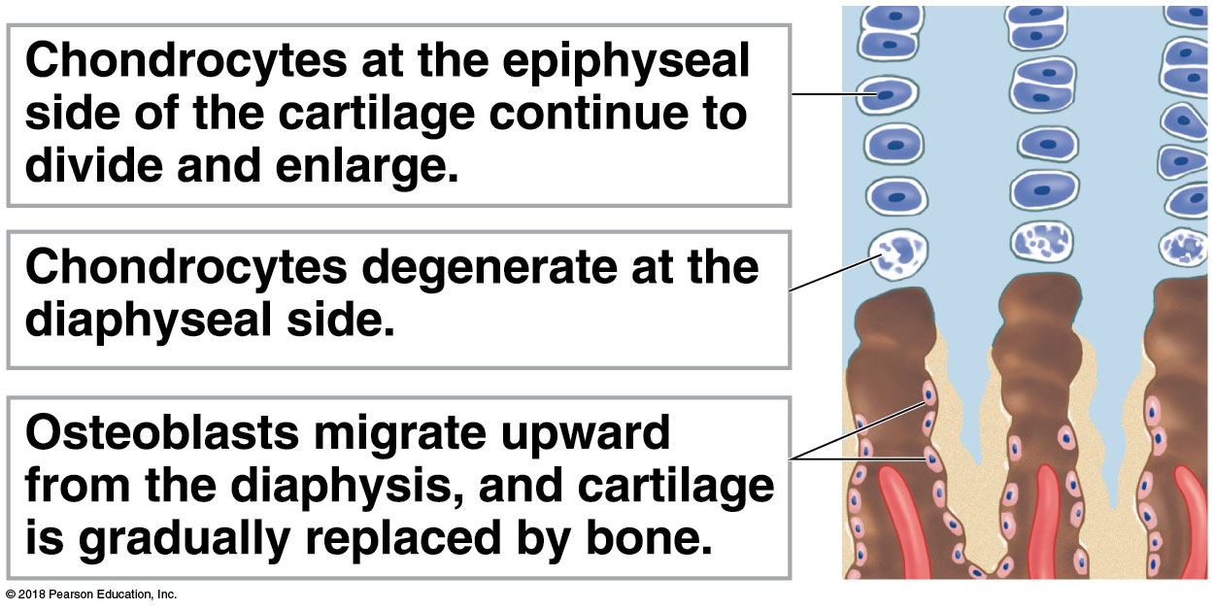
Module 6.7: Endochondral ossification
Steps in endochondral ossification (continued)
Bone grows in length at the epiphyseal cartilage
Chondrocytes actively produce more cartilage on epiphyseal side
Osteoblasts actively replace cartilage with bone on diaphyseal side
Epiphyses are pushed away by continued production of new cartilage
Notes:
To understand the progression of endochondral ossification, have students read from the bottom up. The chondrocytes in the lacunae are replaced by osteoblasts which start secreting bone matrix. As long as there is still cartilage to divide, the bone can continue to elongate, but eventually all the cartilage is replaced by bone.

Slide 52
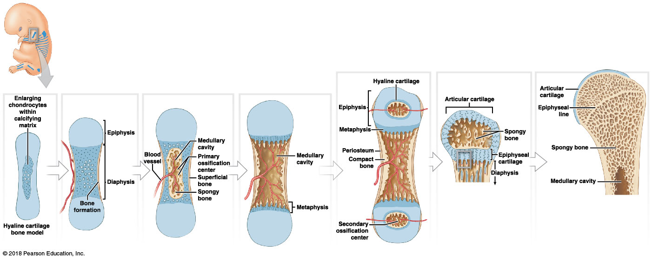
Endochondral ossification

Slide 53
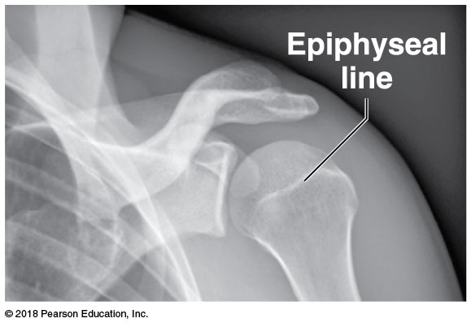
Module 6.7: Endochondral ossification
Bone growth
At puberty, hormones stimulate increased bone growth, and epiphyseal cartilage is replaced
Osteoblasts produce bone faster than chondrocytes produce cartilage
Epiphyseal cartilage narrows until it disappears
Process called epiphyseal closure
Leaves epiphyseal line in adults

Slide 54
Module 6.7: Review
Define endochondral ossification.
In endochondral ossification, what is the original source of osteoblasts?
How could x-rays of the femur be used to determine whether a person has reached full height?
Learning Outcome: Describe the process of endochondral ossification.

Slide 55
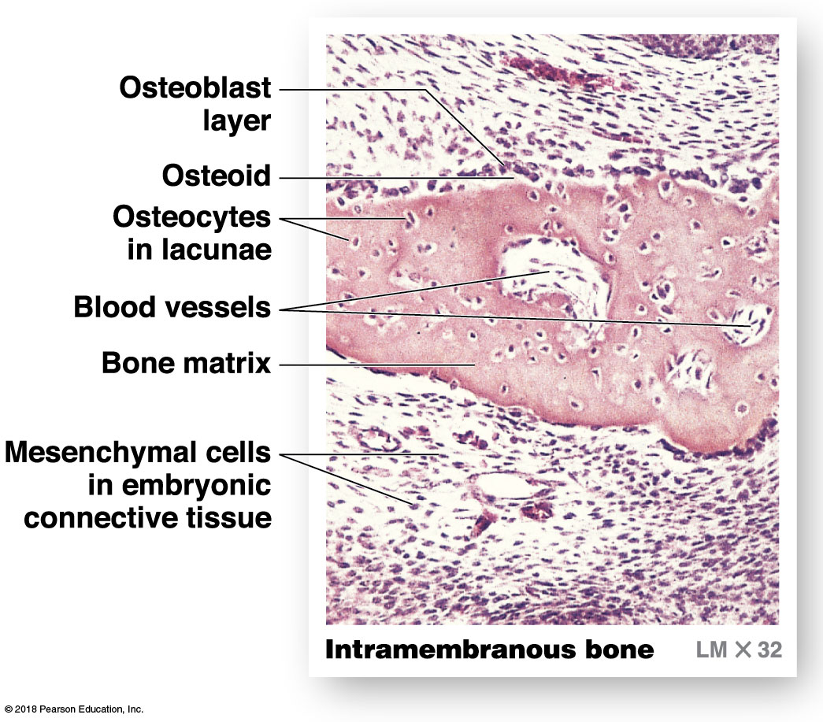
Module 6.8: Intramembranous ossification forms bone without a prior cartilage model
Begins when mesenchymal (stem) cells differentiate into osteoblasts within embryonic or fibrous connective tissue
Normally occurs in deeper layers of dermis
Bones called dermal bones or membrane bones
Examples: roofing bones of skull, lower jaw, collarbone, sesamoid bones (patella)

Slide 56
Module 6.8: Intramembranous ossification
Steps of intramembranous ossification
Mesenchymal cells cluster
Differentiate into osteoblasts
Secrete osteoid matrix
Osteoid matrix becomes mineralized
Forms bone matrix
Location in tissue where ossification begins is ossification center

Slide 57
Module 6.8: Intramembranous ossification
Steps of intramembranous ossification (continued)
Bone grows out in small struts (spicules)
Osteoblasts become trapped in pockets and mature into osteocytes
Mesenchymal cells produce more osteoblasts

Slide 58
Module 6.8: Intramembranous ossification
Steps of intramembranous ossification (continued)
Blood vessels enter area
Bone spicules meet and fuse
Blood vessels trapped in developing bone

Slide 59
Module 6.8: Intramembranous ossification
Steps of intramembranous ossification (continued)
Continued deposition of bone by osteoblasts close to blood vessel
Results in spongy bone with interwoven blood vessels

Slide 60
Module 6.8: Intramembranous ossification
Steps of intramembranous ossification (continued)
Remodeling around blood vessels produces osteons of compact bone
Connective tissue around bone organizes into fibrous layer of the periosteum
Osteoblasts near bone surface remain as cellular layer of periosteum

Slide 61
Intramembranous ossification

Slide 62
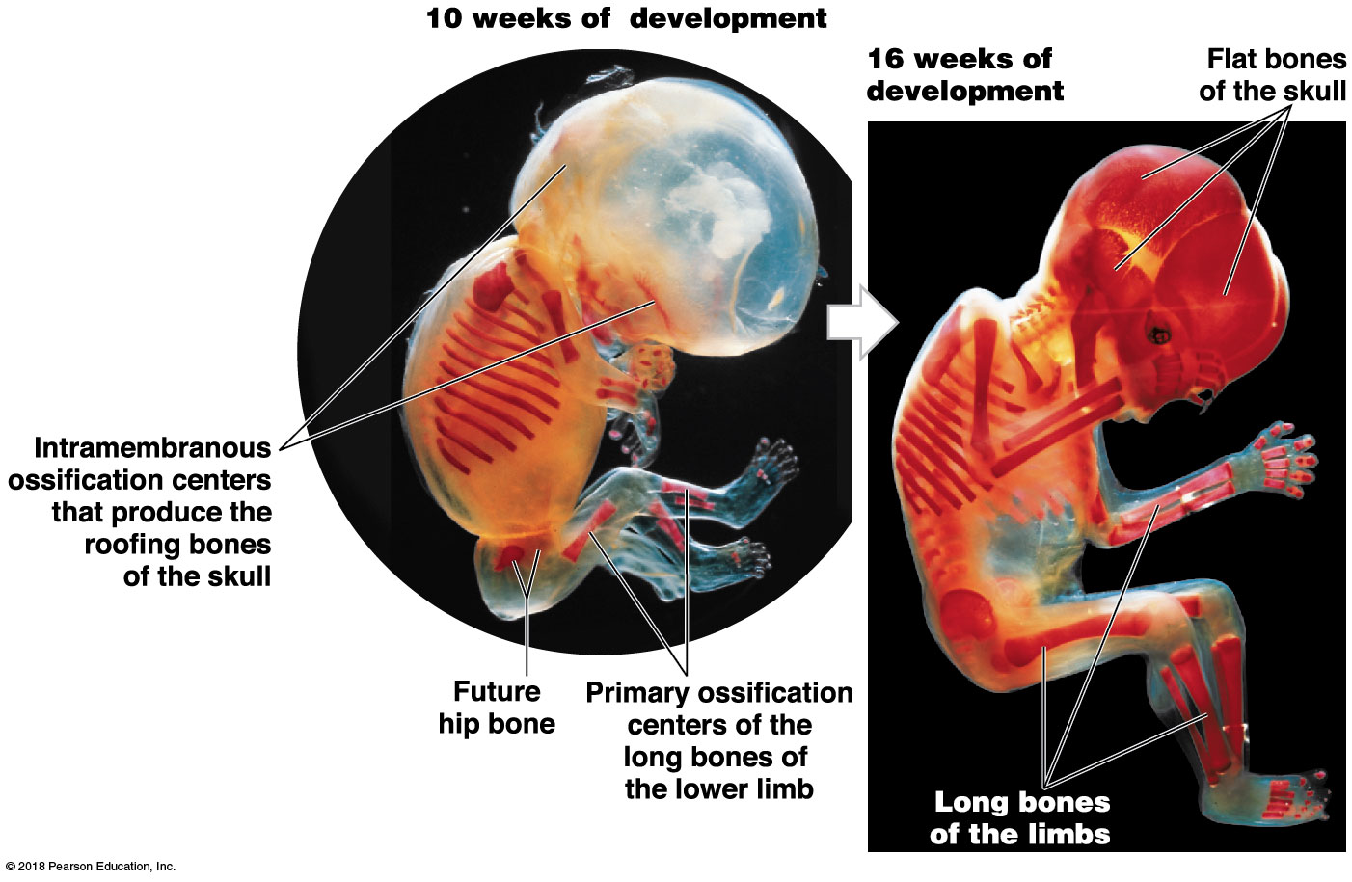
Module 6.8: Intramembranous ossification
Intramembranous ossification in development
Begins during the eighth week of embryonic development
Can see ossification centers and progressing bone formation at 10 weeks
At 16 weeks, most of the bones of the adult skeleton can be identified
Notes:
Because students are drawn directly to an image, they may overlook the number of weeks for each of these developmental stages. This is important information to help them assess the amount of development that occurs during the elapsed time.

Slide 63
Module 6.8: Review
Define intramembranous ossification.
During intramembranous ossification, bone replaces which type of tissue?
Explain the primary difference between endochondral ossification and intramembranous ossification.
Learning Outcome: Describe the process of intramembranous ossification.

Slide 64
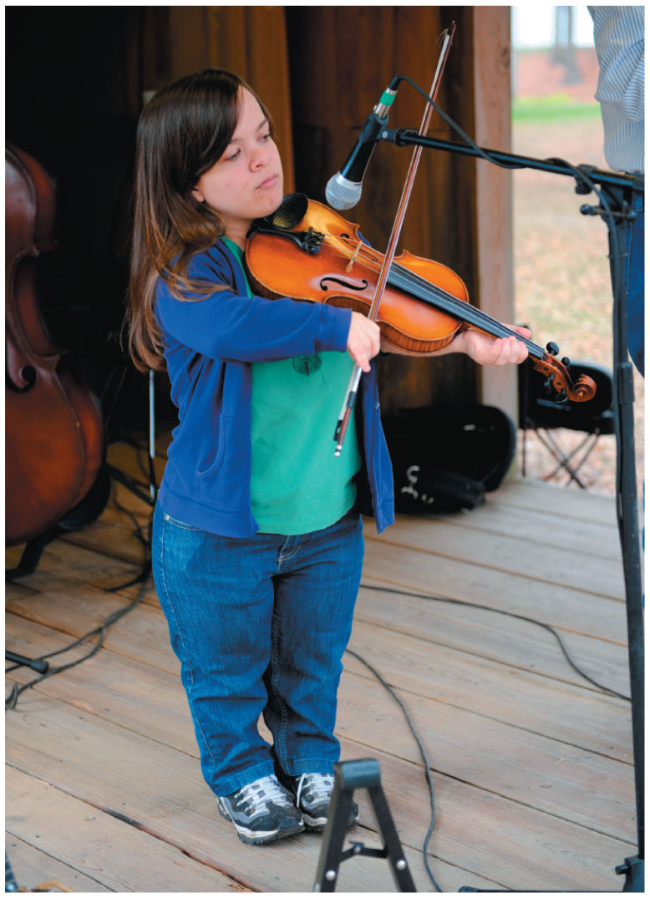
Module 6.9: CLINICAL MODULE: Abnormalities of bone growth and development produce recognizable physical signs
Disorders causing shortened bones
Pituitary growth failure
Inadequate growth hormone production
Reduced epiphyseal cartilage activity; abnormally short bones
Rare in United States due to treatment with synthetic growth hormone

Slide 65
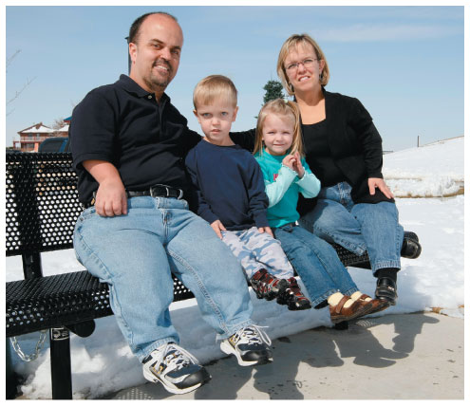
Module 6.9: CLINICAL MODULE: Abnormalities of bone growth
Disorders causing shortened bones (continued)
Achondroplasia
Epiphyseal cartilage of long bones grows slowly
Replaced by bone early in life
Short, stocky limbs result
Trunk is normal size
No effects on sexual or mental development

Slide 66
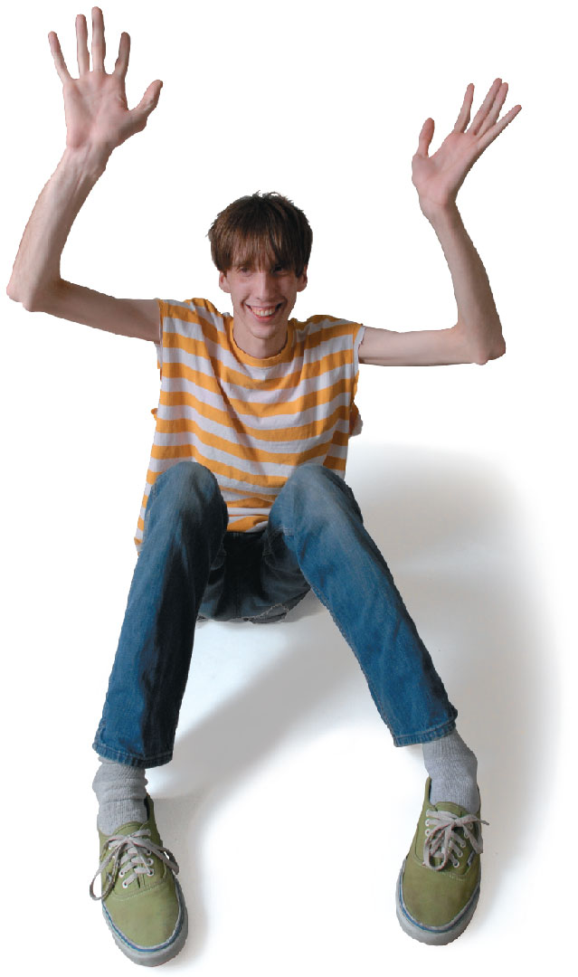
Module 6.9: CLINICAL MODULE: Abnormalities of bone growth
Disorders causing lengthened bones
Marfan syndrome
Inherited metabolic condition
Excessive cartilage formation at epiphyseal cartilages
Results in very tall person with long, slender limbs
Affects other connective tissues throughout the body
Commonly causes cardiovascular problems

Slide 67
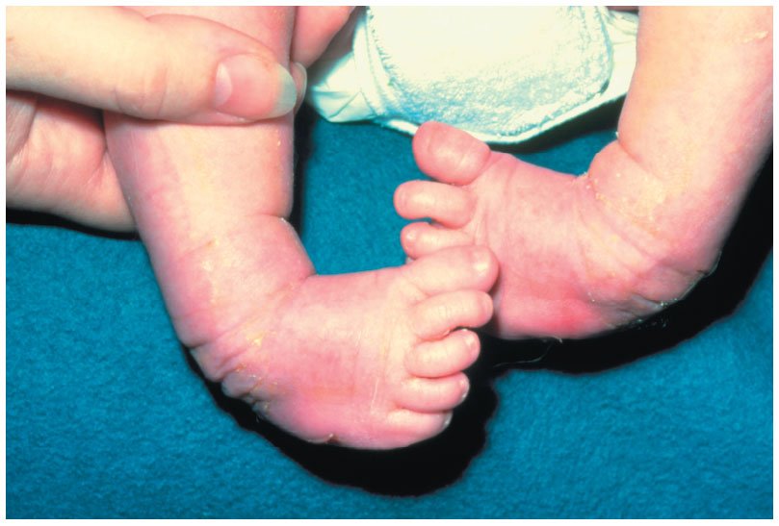
Module 6.9: CLINICAL MODULE: Abnormalities of bone growth
Other skeletal growth abnormalities
Congenital talipes equinovarus (clubfoot)
Inherited developmental abnormality
Affects 2 in 1000 births
Boys roughly twice as often as girls
May affect one or both feet
Abnormal muscle development distorts growing bones
Feet turn medially and are inverted
Treated with casts or supports

Slide 68
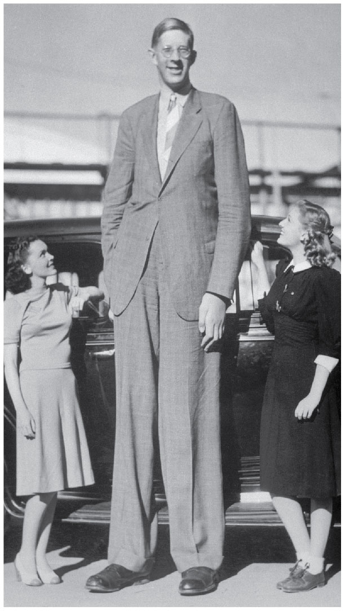
Module 6.9: CLINICAL MODULE: Abnormalities of bone growth
Gigantism
Disorder causing lengthened bones
Overproduction of growth hormone before puberty
Can reach heights of over 2.7 m (8 ft. 11 in.)
Puberty often delayed
Most common cause is a pituitary tumor
Treated by surgery, radiation, or medications suppressing growth hormone release
Notes:
This is a photo of Robert Wadlow, from Alton, Illinois, who grew to 8’ 11” and weighed 490 pounds. His shoe size was 37, and his large feet and the heavy load on them caused frequent foot problems. He died at age 22 from a fatal foot infection.

Slide 69
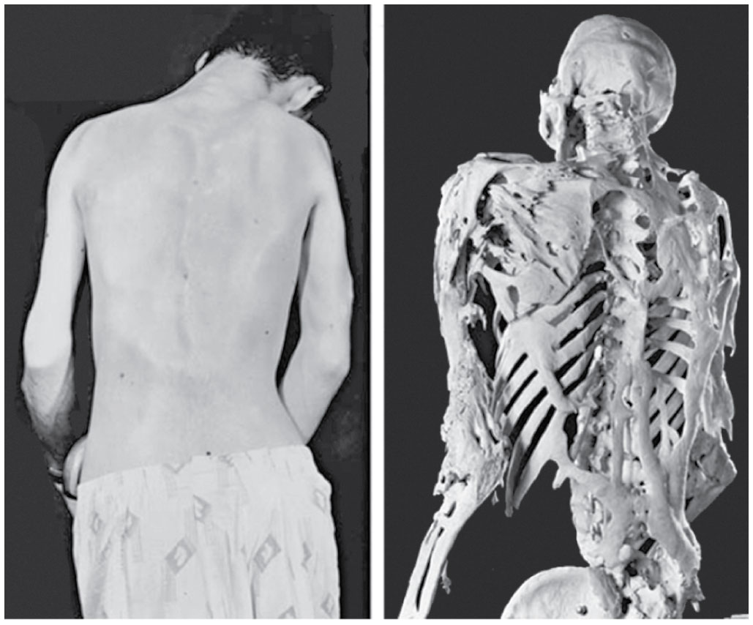
Module 6.9: CLINICAL MODULE: Abnormalities of bone growth
Other skeletal growth abnormalities
Fibrodysplasia ossificans progressiva (FOP)
Gene mutation that causes bone deposition around skeletal muscles
Bones develop in unusual places
Called heterotopic (hetero, place) or ectopic (ektos, outside) bones
No effective treatment
Notes:
A complete skeleton showing this disorder is on display at the Mütter museum in Philadelphia, Pennsylvania.

Slide 70
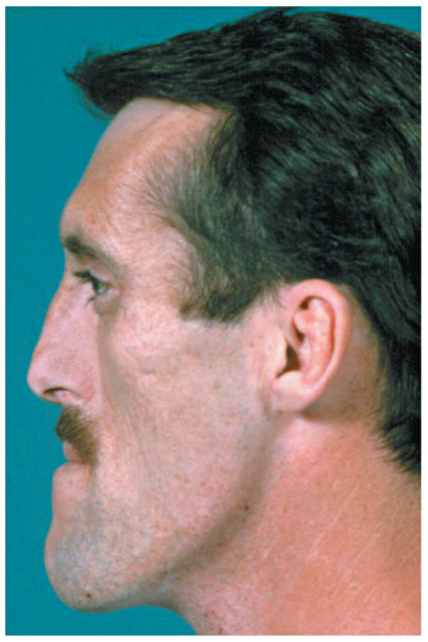
Module 6.9: CLINICAL MODULE: Abnormalities of bone growth
Other skeletal growth abnormalities (continued)
Acromegaly
Overproduction of growth hormone after epiphyseal plates close
Bones get thicker, not longer
Especially those in face, jaw, and hands
Alterations in soft-tissue structure changes physical features

Slide 71
Module 6.9: Review
Why is pituitary growth failure less common today in the United States?
Describe Marfan syndrome.
Compare gigantism with acromegaly.
Learning Outcome: Discuss various abnormalities of bone formation and growth.

Slide 72
Section 2: Physiology of Bones
Learning Outcomes
6.10 List the minerals stored in the bones, and identify the organs involved in calcium homeostasis.
6.11 Discuss the effects of hormones on bone development, and explain the homeostatic mechanisms involved.
6.12 Clinical Module: Describe the types of fractures, and explain how fractures heal.

Slide 73
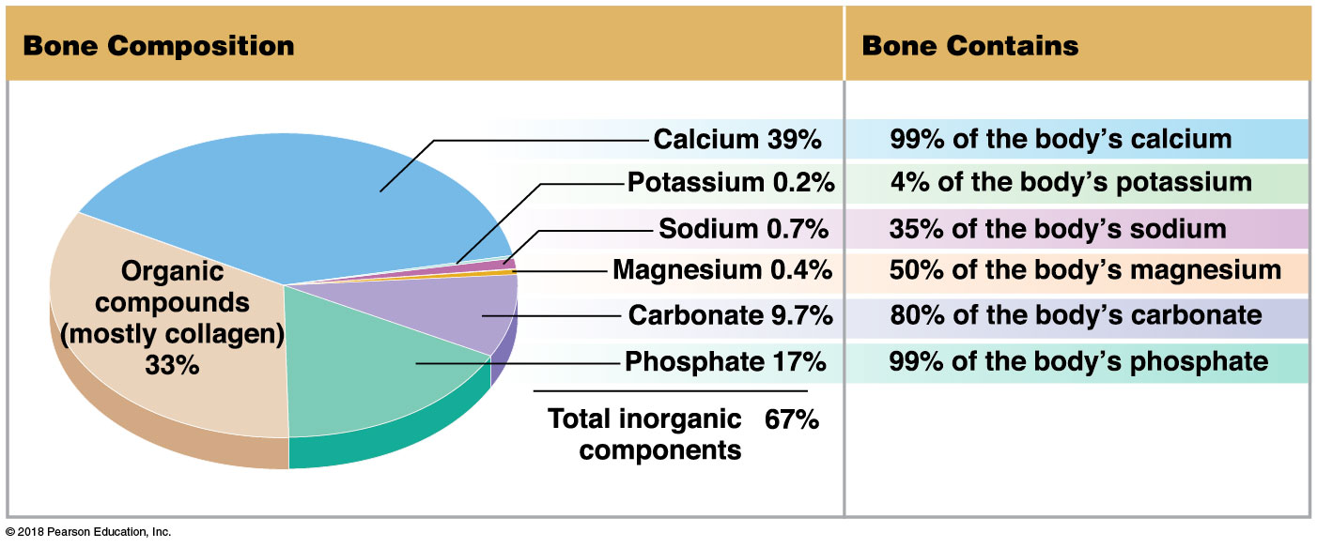
Module 6.10: Bones play an important role as mineral reservoirs
Minerals
Inorganic ions contributing to the osmotic balance of body fluids
Vital in many physiological processes
Notes:
When students look at this graphic too quickly they may think the numbers are contradictory because they don't read the titles for each image. The pie chart on the left shows the percentage of the various components that make up bone (bone composition). The table on the right, instead, shows how much of the body's total amount of those specific substances is located in bone.

Slide 74
Module 6.10: Bones as mineral reservoirs
The importance of calcium
Most abundant mineral in body
1–2 kg (2.2–4.4 lb)
~99 percent deposited in skeleton
Variety of physiological functions (muscle contraction, blood coagulation, nerve impulse generation)
Concentration variation greater than 30–35 percent affects neuron and muscle function
Normal daily fluctuations are <10 percent

Slide 75
Module 6.10: Bones as mineral reservoirs
Maintaining calcium levels
Controlled by activities of:
Intestines
Absorb calcium and phosphate under hormonal control
Bones
Osteoclasts erode matrix and release calcium
Osteoblasts use calcium to deposit new matrix
Kidneys
Varying levels of calcium and phosphate loss in urine under hormonal control

Slide 76
Calcium level maintenance

Slide 77
Module 6.10: Review
What is the ratio of organic compounds to inorganic components in the composition of bone?
Which three organ systems coordinate to maintain normal blood calcium levels?
What physical signs would be expected in a person whose blood calcium was abnormally low?
Learning Outcome: List the minerals stored in the bones, and identify the organs involved in calcium homeostasis.

Slide 78
Module 6.11: The primary hormones regulating calcium ion metabolism are parathyroid hormone, calcitriol, and calcitonin
Factors that increase blood calcium levels
Parathyroid hormone (PTH)
Secreted from parathyroid glands
Responses
In bones:
Osteoclasts stimulated to erode matrix, releasing stored calcium

Slide 79
Module 6.11: Hormones regulating calcium ion metabolism
Factors that increase blood calcium levels (continued)
Parathyroid hormone (PTH) (continued)
Responses (continued)
In intestines:
Calcitriol effects enhanced and calcium absorption increased
In kidneys:
Increased release of hormone calcitriol, stimulating calcium reabsorption in kidneys

Slide 80
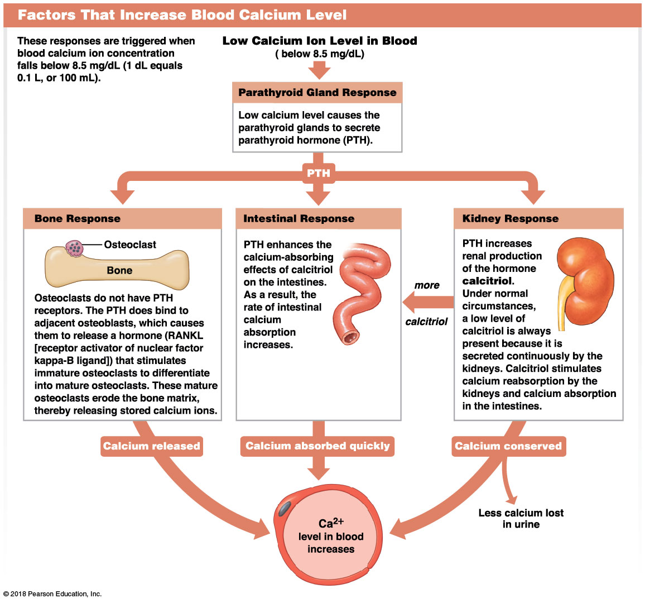
Parathyroid hormone and calcium
Notes:
This image is complex and some students may need some guidance through it. Be sure they start with the caption at the top which is often overlooked. Also, be sure they follow the arrows. Use the same treatment for slide 80.

Slide 81
Module 6.11: Hormones regulating calcium ion metabolism
Factors that decrease blood calcium levels
Calcitonin
Secreted from C cells in the thyroid gland
Responses
In bones:
Osteoclast activity inhibited; calcium deposited in bone matrix
In intestines:
Calcium absorption decreased with decreasing PTH and calcitriol
In kidneys:
Inhibits calcitriol release and calcium reabsorption
Notes:
Additional resource: SmartArt Module 6.11—Calcium ion metabolism.

Slide 82
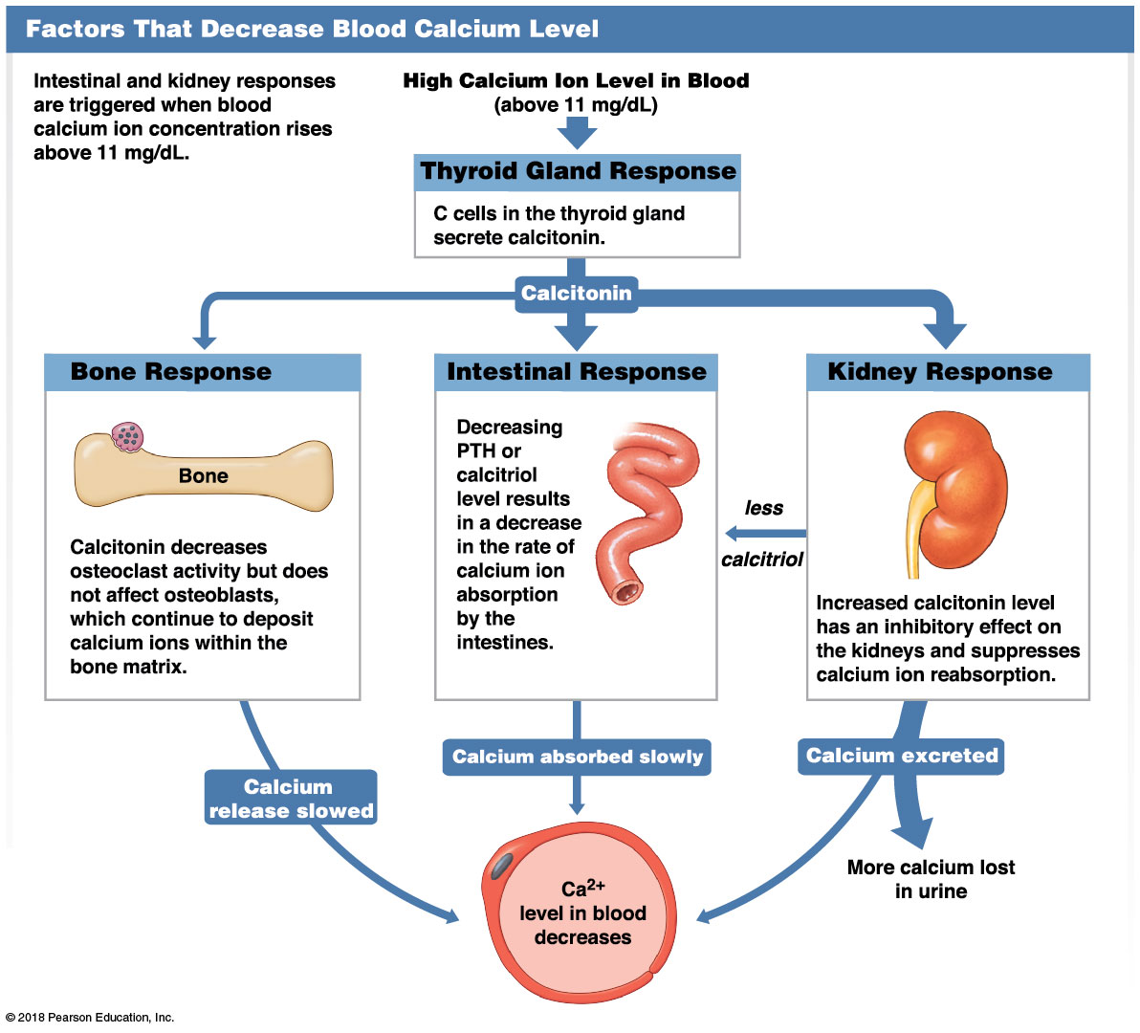
Thyroid regulation of calcium

Slide 83
Module 6.11: Hormones regulating calcium ion metabolism
Calcium and the skeleton
As a calcium reserve, skeleton has primary role in calcium homeostasis
Has direct effect on shape and strength of bones
Release of calcium into blood weakens bones
Deposition of calcium salts strengthens bones

Slide 84
Module 6.11: Review
Identify the hormone that stimulates the release of calcium ions from bone matrix. Explain its mechanism of action.
Describe the kidney and intestinal responses to PTH.
How does calcitonin act to lower blood calcium?
Learning Outcome: Discuss the effects of hormones on bone development, and explain the homeostatic mechanisms involved.

Slide 85
Module 6.12: CLINICAL MODULE: A fracture is a crack or a break in a bone
Fracture
Crack or break due to extreme mechanical stress
Most heal as long as blood supply and cellular parts of periosteum and endosteum survive
Repair involves four steps

Slide 86
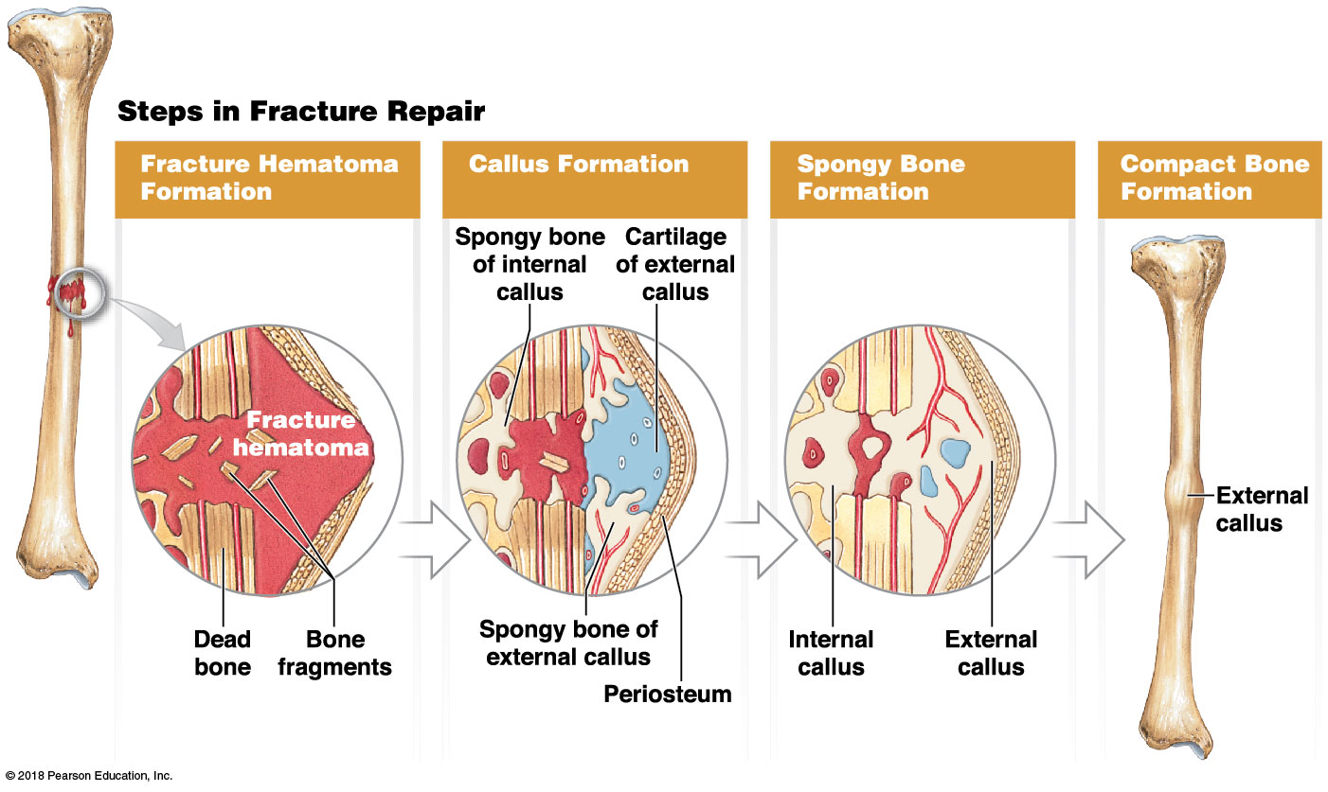
Module 6.12: CLINICAL MODULE: Bone fractures
Steps in fracture repair
​Fracture hematoma formation
Large clot closes injured vessels
Develops within several hours

Slide 87
Module 6.12: CLINICAL MODULE: Bone fractures
Steps in fracture repair (continued)
Callus formation
Internal callus
Network of spongy bone
Unites inner edges of fracture
External callus
Composed of cartilage and bone
Stabilizes outer edges of fracture

Slide 88
Module 6.12: CLINICAL MODULE: Bone fractures
Steps in fracture repair (continued)
Spongy bone formation
Cartilage of external callus replaced by spongy bone
Bone fragments and dead bone are removed and replaced
Ends of fracture held firmly in place

Slide 89
Module 6.12: CLINICAL MODULE: Bone fractures
Steps in fracture repair (continued)
Compact bone formation
Spongy bone replaced by compact bone
Remodeling over time eliminates evidence of fracture

Slide 90
Module 6.12: CLINICAL MODULE: Bone fractures
General categories of fractures
Closed or simple
Completely internal (no break in skin)
Only seen on x-rays
Open or compound
Project through the skin
More dangerous due to:
Infection
Uncontrolled bleeding

Slide 91
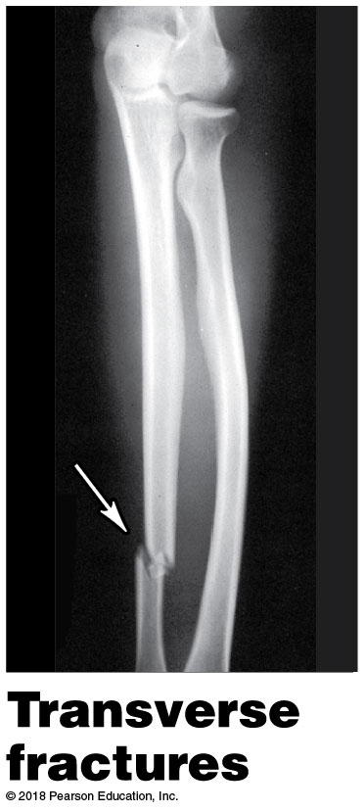
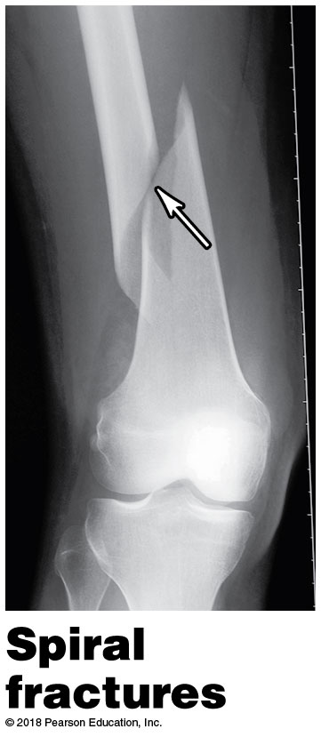
Module 6.12: CLINICAL MODULE: Bone fractures
Specific types of fractures
Transverse fractures
Break shaft across long axis
Spiral fractures
Produced by twisting stresses
Spread along length of bone

Slide 92
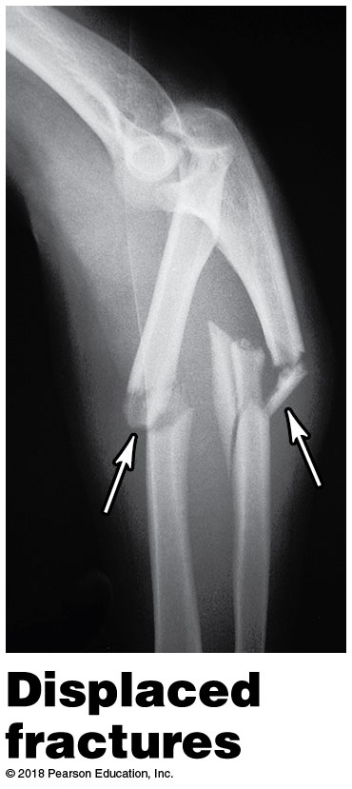
Module 6.12: CLINICAL MODULE: Bone fractures
Specific types of fractures (continued)
Displaced fractures
Produce new and abnormal bone arrangements
Nondisplaced fractures retain normal alignment
Compression fractures
Occur in vertebrae subjected to extreme stresses
Often associated with osteoporosis
Notes:
For fractures, consider asking students to bring in any images they might have of their own fractures, if they are willing to share. Or pull some online images. Have students categorize the fractures that are shown.

Slide 93
Module 6.12: CLINICAL MODULE: Bone fractures
Specific types of fractures (continued)
Greenstick fractures
One side of shaft broken, one side bent
Generally occurs in children
Long bones have yet to fully ossify
Comminuted fractures
Shatter affected area producing fragments

Slide 94
Module 6.12: CLINICAL MODULE: Bone fractures
Specific types of fractures (continued)
Epiphyseal fractures
Occur where bone matrix is calcifying
A clean transverse fracture of this type heals well
If not monitored, breaks between epiphyseal plate and cartilage can stop growth at site

Slide 95
Module 6.12: CLINICAL MODULE: Bone fractures
Specific types of fractures (continued)
Pott’s (bimalleolar) fracture
Occurs at ankle and affects both medial malleolus and lateral malleolus
Colles fracture
Break in distal radius

Slide 96
Module 6.12: Review
List the steps involved in fracture repair, beginning just after the fracture occurs.
Define open fracture and closed fracture.
Learning Outcome: Describe the types of fractures, and explain how fractures heal.

