Slide 2
Section 1: Axial Skeleton
Learning Outcomes
7.1 List the four major components of the axial skeleton, and describe its major functions.
7.2 Identify the bones of the cranium and face, and locate and identify the cranial sutures.
7.3 Explain the significance of the markings and locations of the anterior and posterior aspects of the facial and cranial bones.
7.4 Explain the significance of the markings and locations of the lateral and medial aspects of the facial and cranial bones.

Slide 3
Section 1: Axial Skeleton
Learning Outcomes (continued)
7.5 Explain the significance of the markings and locations of the inferior and interior aspects of the facial and cranial bones.
7.6 Describe and locate the bone markings of the sphenoid, ethmoid, and palatine bones.
7.7 Describe the structure of the orbital complex and nasal complex and the functions of their individual bones.
7.8 Describe the mandible and the associated bones of the skull.

Slide 4
Section 1: Axial Skeleton
Learning Outcomes (continued)
7.9 Describe key structural differences among the skulls of infants, children, and adults.
7.10 Identify and describe the curves of the spinal column and their functions, and identify the vertebral regions.
7.11 Describe the distinctive structural and functional characteristics of the cervical and thoracic vertebrae.
7.12 Describe the distinctive structural and functional characteristics of the lumbar vertebrae.

Slide 5
Section 1: Axial Skeleton
Learning Outcomes (continued)
7.13 Describe the distinctive structural and functional characteristics of the sacrum and coccyx.
7.14 Explain the significance of the articulations between the thoracic vertebrae and the ribs, and between the ribs and the sternum.

Slide 6
Module 7.1: The axial skeleton includes bones of the head, vertebral column, and trunk
Axial skeleton
Forms the longitudinal axis of the body
Components include:
Skull and associated bones
Thoracic cage
Vertebral column
Supplemental cartilages
In total, about 80 bones
About 40 percent of the bones in the human body
Notes:
Additional resource: PAL 3.0—Anatomical Models—Axial Skeleton.

Slide 7
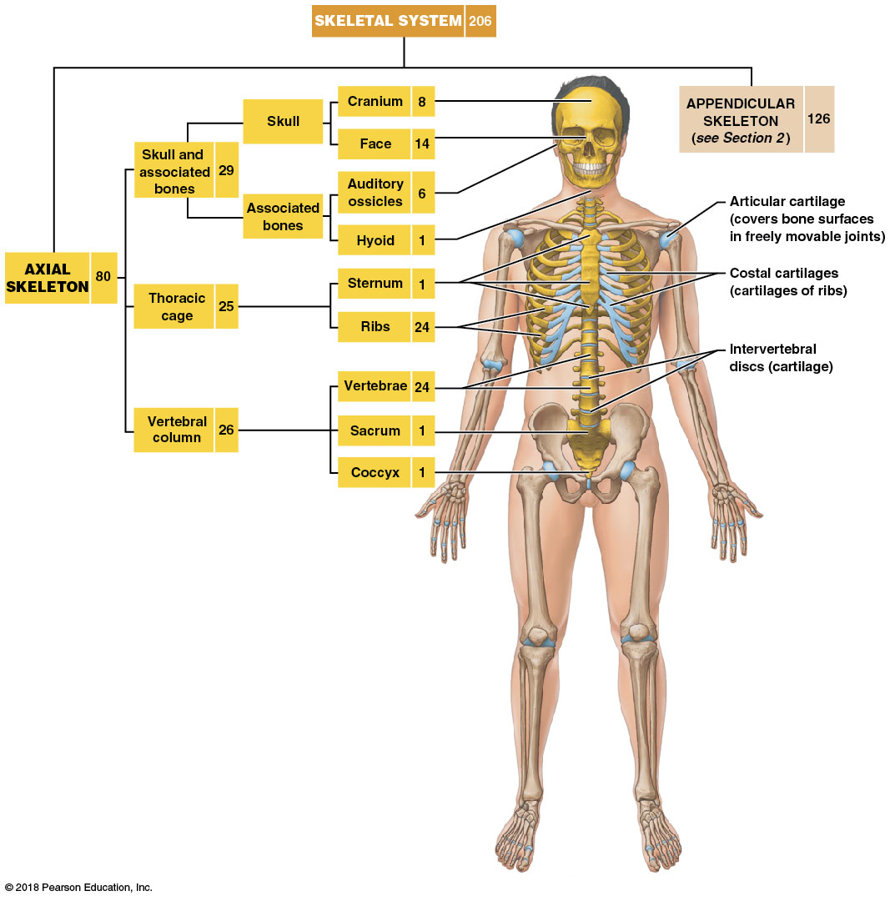
Module 7.1: The axial skeleton
Forms the longitudinal axis of the body
Components include:
Skull and associated bones
Thoracic cage
Vertebral column
Supplemental cartilages
In total, about 80 bones (40%)

Slide 8
Module 7.1: The axial skeleton
Axial skeleton functions
Supports and protects brain, spinal cord, and organs in trunk body cavities
Provides attachment sites for certain muscles that:
Adjust the position of the head, neck, and trunk
Perform respiratory movements
Stabilize or position parts of the appendicular skeleton that support the limbs
Joints of the axial skeleton
Limited in movement but very strong

Slide 9
Module 7.1: Review
How many bones comprise the skull and its associated bones?
What are the primary functions of the axial skeleton?
Describe the general role of the muscles that attach to the axial skeleton.
Learning Outcome: List the four major components of the axial skeleton, and describe its major functions.

Slide 10
Module 7.2: The skull has cranial and facial components that are usually bound together by sutures
Skull bones
22 bones in total
14 facial bones
8 cranial bones form the cranium, or braincase
7 associated bones
6 auditory ossicles
Located within the temporal bones (3 on each side)
1 hyoid
Connected by ligaments to the inferior surface of the temporal bones

Slide 11
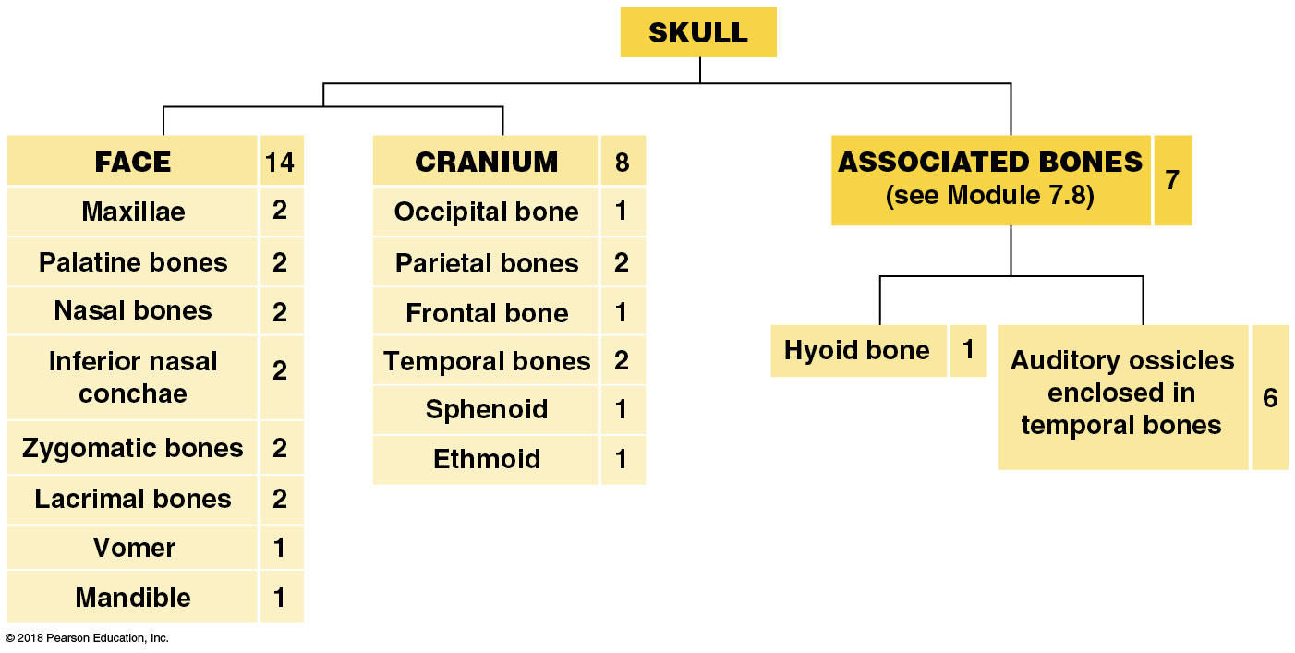
Module 7.2: Skull components
Skull bones
22 bones in total
14 facial bones
8 cranial bones form the cranium, or braincase
7 associated bones

Slide 12
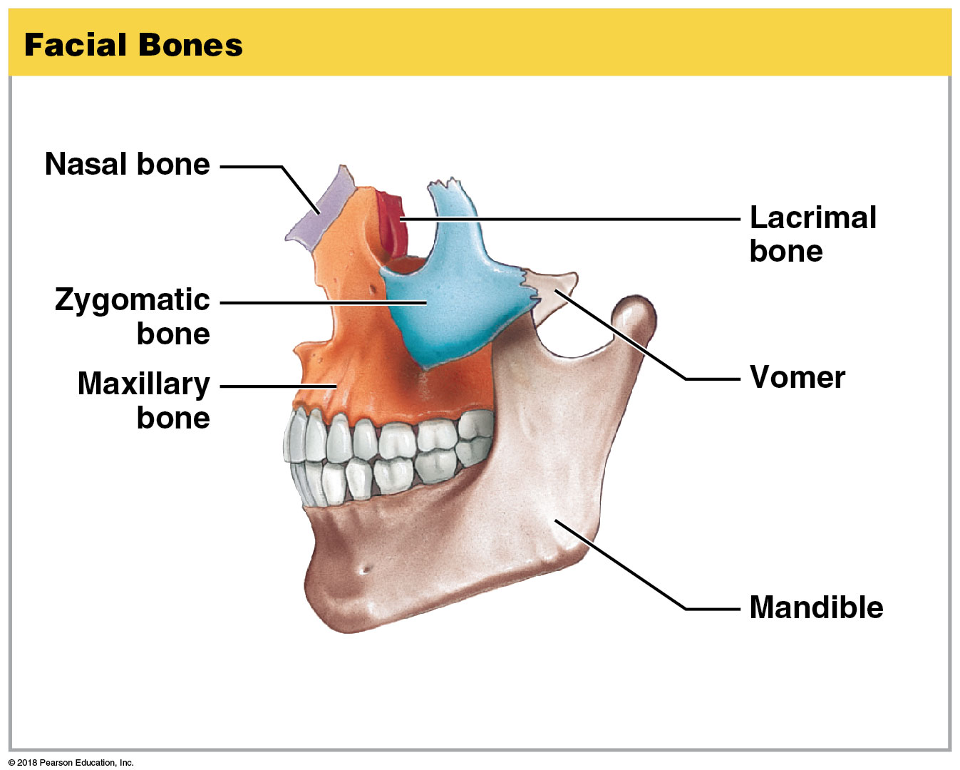
Module 7.2: Skull components
Facial bones (14)
Protect and support entrances to the digestive and respiratory tracts
Provide attachment points for muscles that:
Control facial expression
Assist in manipulation of food
Notes:
This slide does not show all the facial bones, so students may ask how there are 14 when they are not all here. Be prepared to list them: 2 maxillae (which fuse into one), 2 palatine, 2 nasal, 2 inferior nasal conchae, 2 zygomatic, and 2 lacrimal bones, and the unpaired vomer and mandible.

Slide 13
Video: Facial Bones

Slide 14
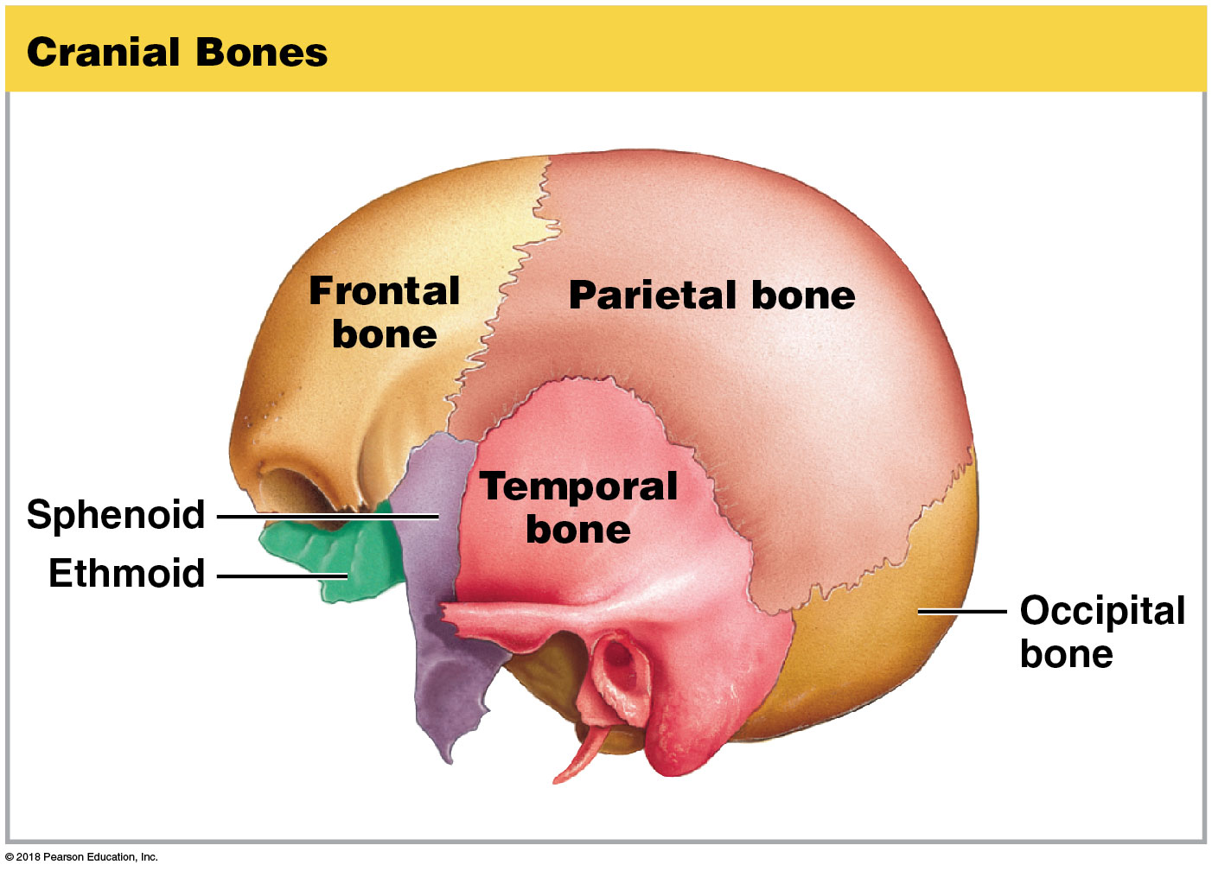
Module 7.2: Skull components
Cranial bones (8)
Form the cranium
Enclose the cranial cavity
Fluid-filled chamber that cushions and supports the brain
Inner surface
Attachment point for blood vessels, nerves, and membranes stabilizing the position of the brain
Notes:
This image shows six of the eight cranial bones. There are two parietal and temporal bones. In addition, there are originally two frontal bones, which usually fuse to form one. However, in some individuals they do not fuse.

Slide 15
Module 7.2: Skull components
Cranial bones (continued)
Outer surface
Attachment point for muscles that move the eyes, jaws, and head
Calvaria (skullcap)
Roof of the skull formed by the occipital, parietal, and frontal bones
Notes:
This image shows six of the eight cranial bones. There are two parietal and temporal bones. In addition, there are originally two frontal bones, which usually fuse to form one. However, in some individuals they do not fuse.

Slide 16
Video: Cranial Bones

Slide 17
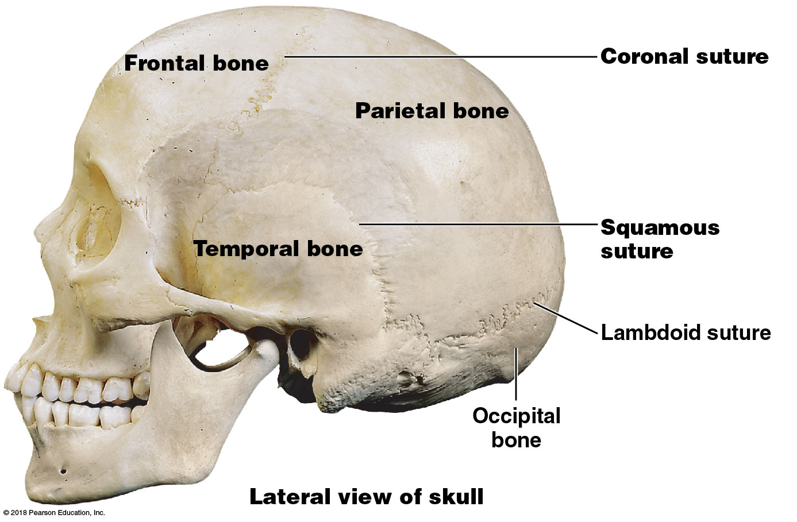
Module 7.2: Skull components
Sutures: Joints (articulations) between the skull bones of adults
Four major sutures:
​Coronal (attaches frontal to parietal bones)
​Squamous (attaches temporal and parietal bones)
Notes:
The squamous suture is also referred to as the squamosal suture.

Slide 18
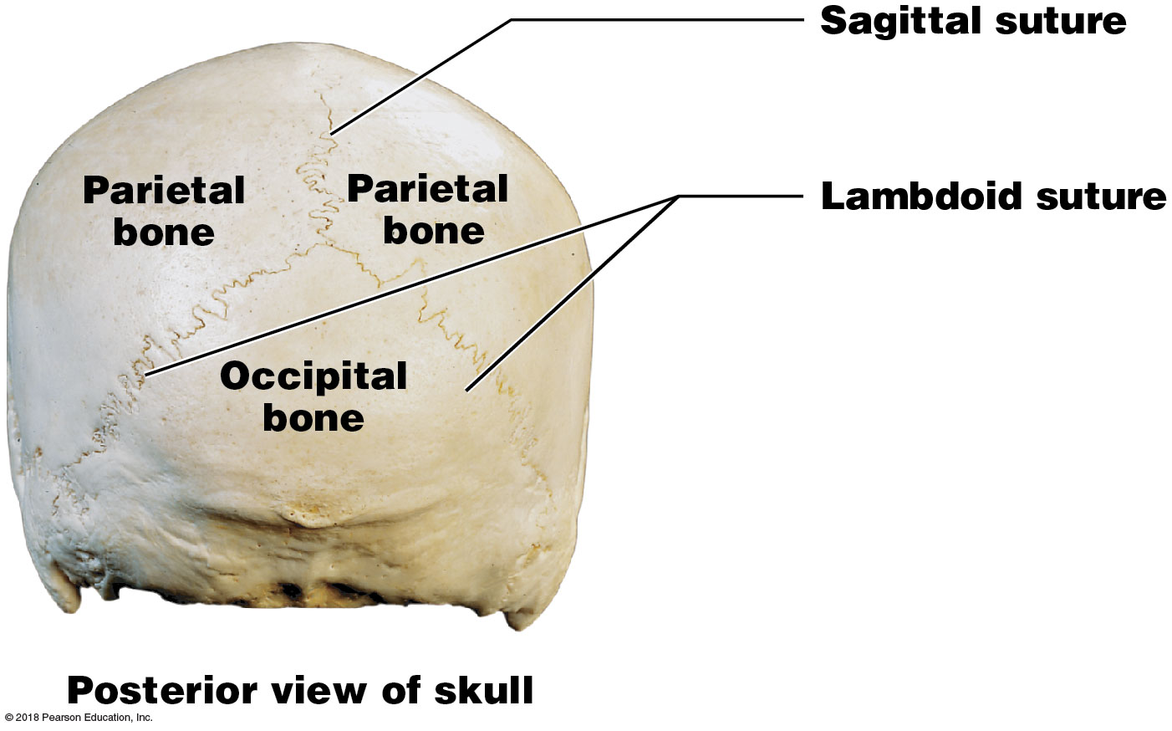
Module 7.2: Skull components
Four major sutures (continued):
​Sagittal (attaches parietal bones)
​Lambdoid (attaches occipital to parietal bones)
Sutural bones may be present along this suture

Slide 19
Module 7.2: Review
Identify the bones of the cranium.
Describe the functions of the facial bones.
Define suture.
Name the sutures that mark the boundaries of each parietal bone.
Learning Outcome: Identify the bones of the cranium and face, and locate and identify the cranial sutures.

Slide 20
Module 7.3: Facial bones dominate the anterior aspect of the skull, and cranial bones dominate the posterior surface
Paired facial bones
Nasal bones
Support superior portion of the bridge of the nose
Connected to cartilage supporting distal portions of the nose
Lacrimal bones
Form part of medial wall of the orbit (eye socket)
Palatine bones
Form the posterior portion of the hard palate
Contribute to the floor of each orbit

Slide 21
Module 7.3: Facial and cranial bones
Paired facial bones (continued)
Zygomatic bones
Form part of the cheekbone
Contribute to the rim and lateral wall of the orbit
Maxillae
Support the upper teeth
Form inferior orbital rim, the upper jaw, lateral margins of the external nares, and most of hard palate

Slide 22
Module 7.3: Facial and cranial bones
Paired facial bones (continued)
Inferior nasal conchae
Create turbulence in air entering the nasal cavity
Increase epithelial surface area to warm and humidify inhaled air

Slide 23
Module 7.3: Facial and cranial bones
Single facial bones
Vomer
Forms the inferior portion of the bony nasal septum
Mandible
Forms the lower jaw
Facial bones dominate the anterior aspect of the skull

Slide 24
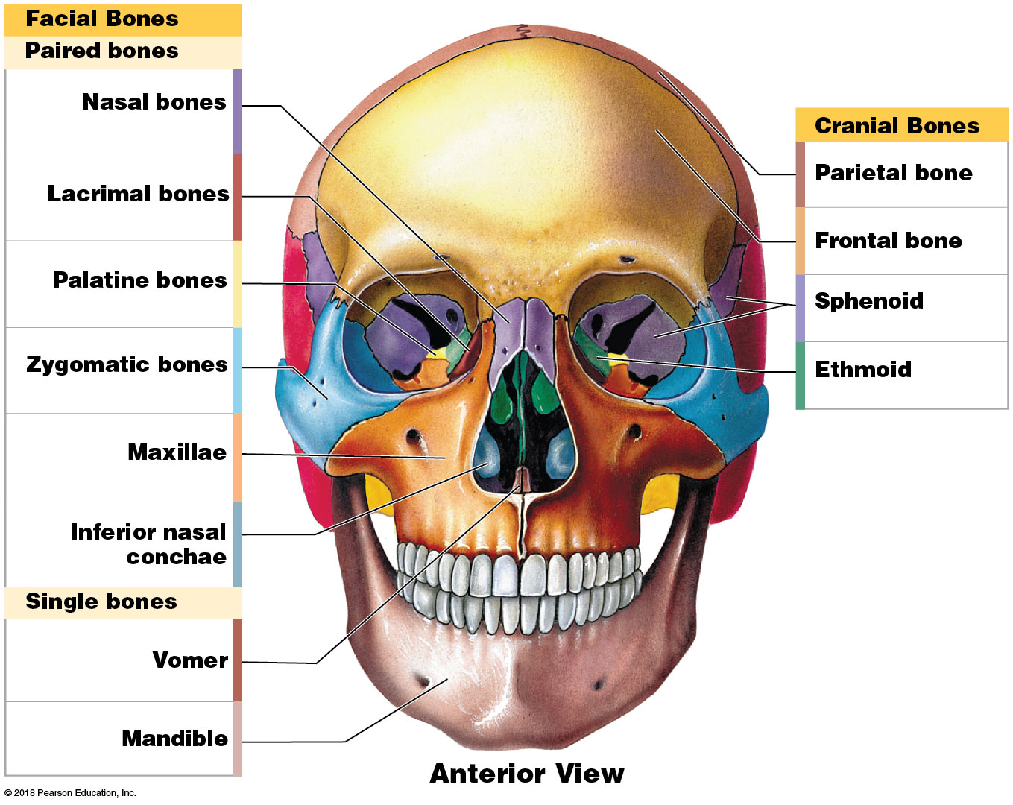
Facial and cranial bones, anterior view

Slide 25
Module 7.3: Facial and cranial bones
Cranial bones seen from an anterior view
Frontal bone
Forms the anterior portion of the cranium and roof of the orbits
Fontal sinuses secrete mucus that helps flush the nasal cavities
Sphenoid bone
Forms part of the floor of the cranium
Unites facial and cranial bones
Acts as a cross-brace to strengthen sides of the skull

Slide 26
Module 7.3: Facial and cranial bones
Cranial bones seen from an anterior view (continued)
Ethmoid bone
Forms the anteromedial floor of the cranium, the roof of the nasal cavity, and part of nasal septum and medial orbital wall

Slide 27
Module 7.3: Facial and cranial bones
Cranial bones seen from a posterior view
Parietal bones
Form part of the superior and lateral surfaces of the cranium
Occipital bone
Contributes to the posterior, lateral, and inferior cranial surfaces
External occipital crest
Extends from the external occipital protuberance
Attachment point for ligament that helps stabilize the vertebrae of the neck

Slide 28
Module 7.3: Facial and cranial bones
Cranial bones seen from a posterior view (continued)
Temporal bones
Form part of the lateral wall of the cranium
Articulate with the mandible and facial bones
Surround the sense organs of the inner ear

Slide 29
Module 7.3: Facial and cranial bones
Cranial bones seen from a posterior view (continued)
Temporal bones (continued)
Attachment site for muscles closing the jaw and moving the head
Mastoid process
Attachment for muscles that rotate or extend head
Styloid process
Attached to ligaments supporting the hyoid bone and tendons of several muscles

Slide 30
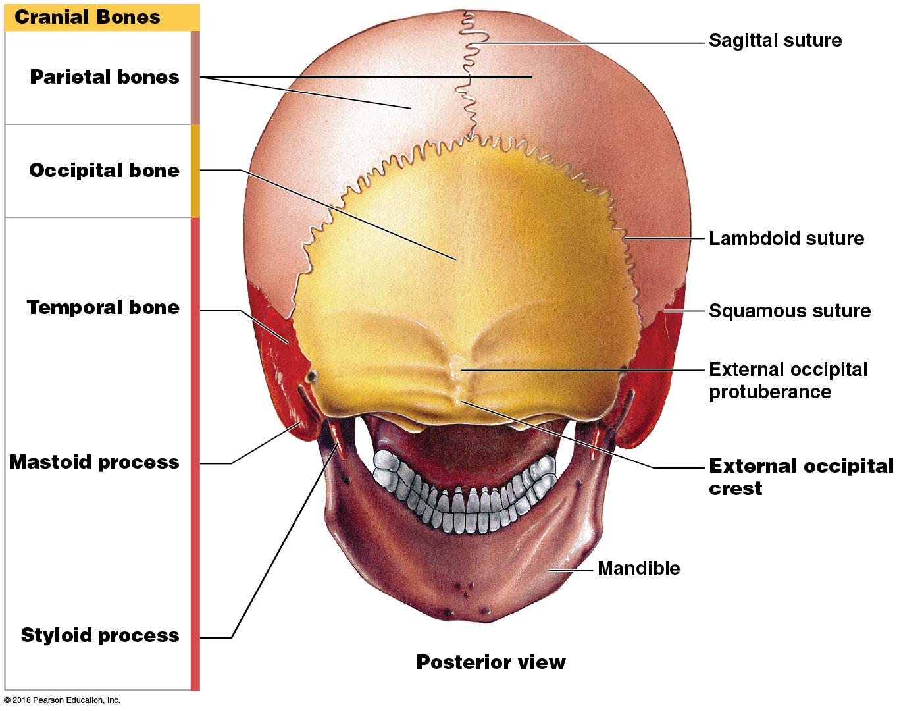
Facial and cranial bones, posterior view

Slide 31
Module 7.3: Review
Identify the facial bones.
Identify the following bones as either a facial bone or a cranial bone: vomer, ethmoid, sphenoid, temporal, and inferior nasal conchae.
The mandible articulates with which other cranial bones?
Quincy suffers a hit to the skull that fractures the right superior lateral surface of his cranium. Which bone is fractured?
Learning Outcome: Explain the significance of the markings and locations of the anterior and posterior aspects of the facial and cranial bones.

Slide 32
Module 7.4: The lateral and medial aspects of the skull share many bone markings
Bone markings on the lateral aspect
Forehead
Forms anterior, superior portion of the cranium
Provides attachment site for facial muscles
Superior and inferior temporal lines
Ridges marking attachment sites of the temporalis muscle
Squamous part of the temporal bone (temporal squama)
Convex, irregular surface bordering the squamous suture

Slide 33
Module 7.4: Bone markings on lateral and medial aspects of skull
Bone markings on the lateral aspect (continued)
External acoustic meatus
Canal beginning on lateral surface of the temporal bone
Ends at the tympanic membrane
Zygomatic process of the temporal bone
Articulates with the temporal process of the zygomatic bone to form the zygomatic arch

Slide 34
Module 7.4: Bone markings on lateral and medial aspects of skull
Bone markings on the lateral aspect (continued)
Mandibular angle
Posterior, inferior corner of lower jaw
Mental protuberance (mentalis, chin)
Attachment site for several facial muscles
Alveolar part of mandible
Surrounds and supports lower teeth
Alveolar processes
Projecting ridges of maxillae and mandible
Support the upper and lower teeth

Slide 35
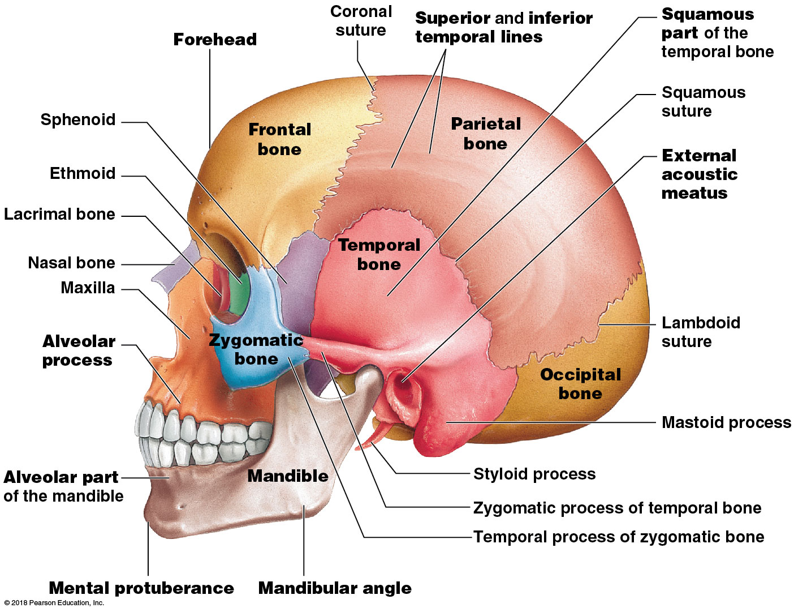
Skull bone markings, lateral view

Slide 36
Module 7.4: Bone markings on lateral and medial aspects of skull
Bone markings on the medial aspect
Frontal sinuses
Hollow spaces in the bone
Petrous part of the temporal bone
Encloses structures of the inner ear and auditory ossicles in the middle ear
Internal acoustic meatus
Passageway for blood vessels and facial and vestibulocochlear nerves
Hypoglossal canal
Passageway for hypoglossal nerves

Slide 37
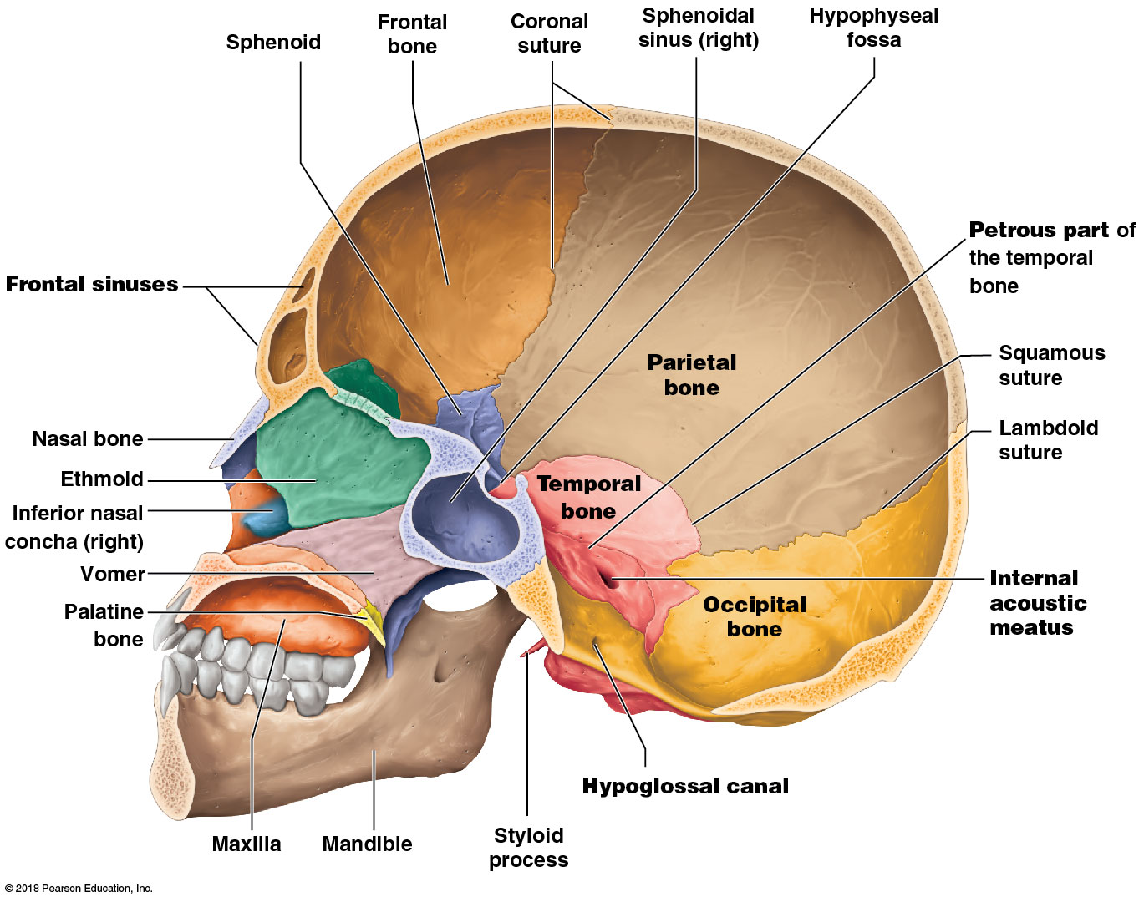
Skull bone markings: sagittal section
Notes:
Be sure students realize this is a midsagittal section.

Slide 38
Module 7.4: Review
Describe the alveolar process.
What bone processes form the zygomatic arch?
Name each meatus found in the temporal bone.
What is the function of the internal acoustic meatus?
Learning Outcome: Explain the significance of the markings and locations of the lateral and medial aspects of the facial and cranial bones.

Slide 39
Module 7.5: The foramina on the inferior surface of the skull mark the passageways for nerves and blood vessels
Foramina on the inferior aspect
Foramen lacerum (lacerare, to tear)
Jagged slit between sphenoid and petrous portion of temporal bone
Contains hyaline cartilage and small arteries
Foramen ovale
Passage for nerves innervating the jaws
Carotid canal
Passage for the internal carotid artery
Notes:
The inferior view of the skull is challenging for many students. To help them learn the foramina, provide them with the descriptions of each foramen's location, and have them work collaboratively to identify the openings on the skull, using a pipe cleaner to trace the paths through the foramina. This lets students appreciate the internal and external positions of these passageways.

Slide 40
Module 7.5: Bone markings on inferior and interior aspects of skull
Foramina on the inferior aspect (continued)
Stylomastoid foramen
Posterior to the base of the styloid process
Passage for facial nerve
Jugular foramen
Located between the occipital and temporal bone
Passage for internal jugular vein
Foramen magnum
Connects cranial cavity with the vertebral canal
Surrounds the connection between the brain and spinal cord

Slide 41
Module 7.5: Bone markings on inferior and interior aspects of skull
Bone markings on the inferior aspect
Mandibular fossa
On the inferior surface of the temporal bone
Articulation site for temporal bone and mandible
Occipital condyles
Articulation site between skull and first cervical vertebra
Inferior and superior nuchal lines
Intersect at the occipital crest
Attachment sites for muscles and ligaments that stabilize the head over the cervical vertebrae

Slide 42
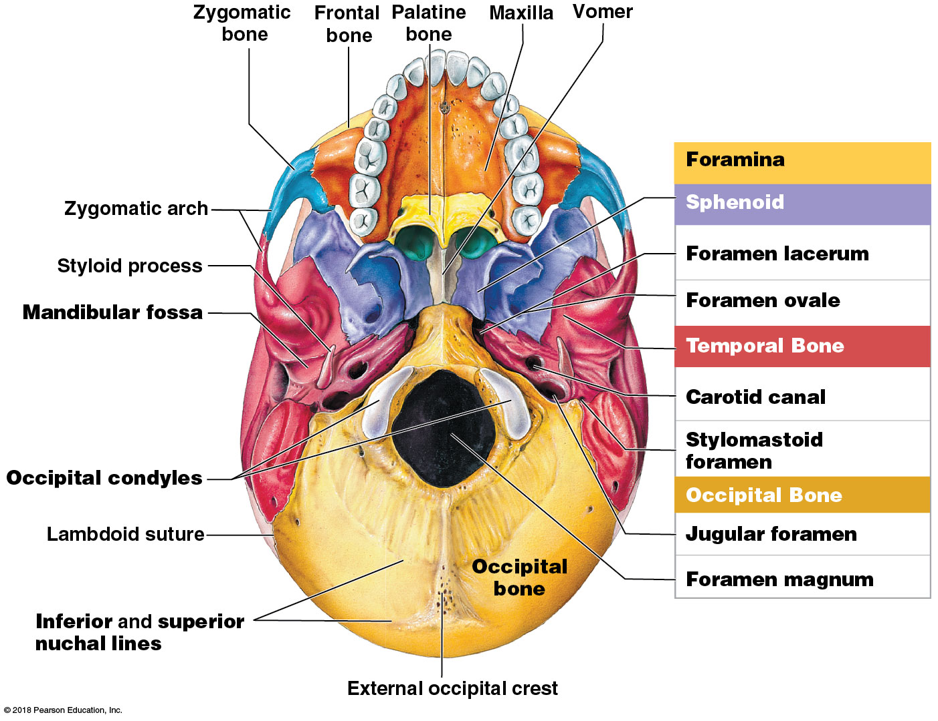
Inferior view of foramina

Slide 43
Module 7.5: Bone markings on inferior and interior aspects of skull
Bone markings on the interior aspect
Olfactory foramina
Permit passage of olfactory nerves
Optic canals
Permit passage of optic nerves
Foramen rotundum
Permit passage of a branch of trigeminal nerve
Foramen spinosum
Passage of blood vessels to CNS membranes

Slide 44
Module 7.5: Bone markings on inferior and interior aspects of skull
Bone markings on the interior aspect (continued)
Hypoglossal canal
Passage of hypoglossal nerve
Internal occipital crest
Anchors blood vessels and membranes that stabilize the position of the brain

Slide 45
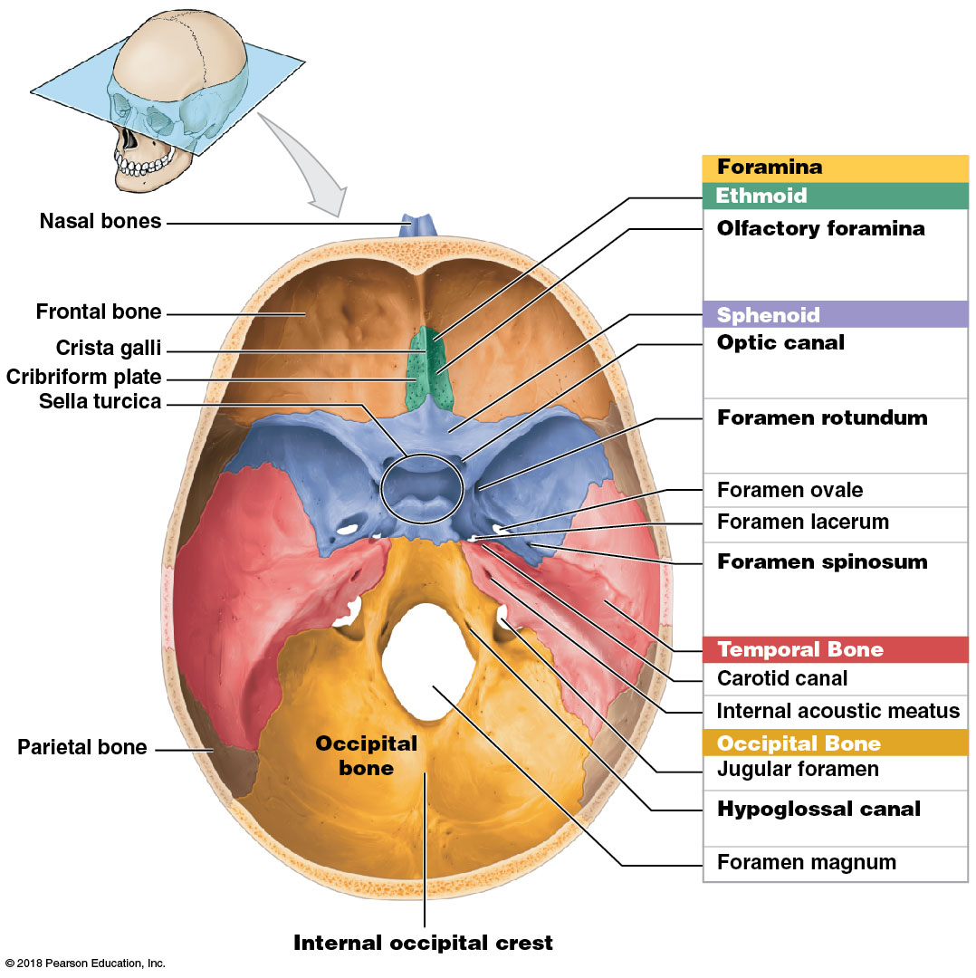
Superior view of foramina

Slide 46
Module 7.5: Review
Identify the bone containing the carotid canal, and name the structure that runs through this passageway.
Which foramen provides a passageway for nerves innervating the jaw?
In which bone is the foramen magnum located, and what is significant about this opening?
Learning Outcome: Explain the significance of the markings and locations of the inferior and interior aspects of the facial and cranial bones.

Slide 47
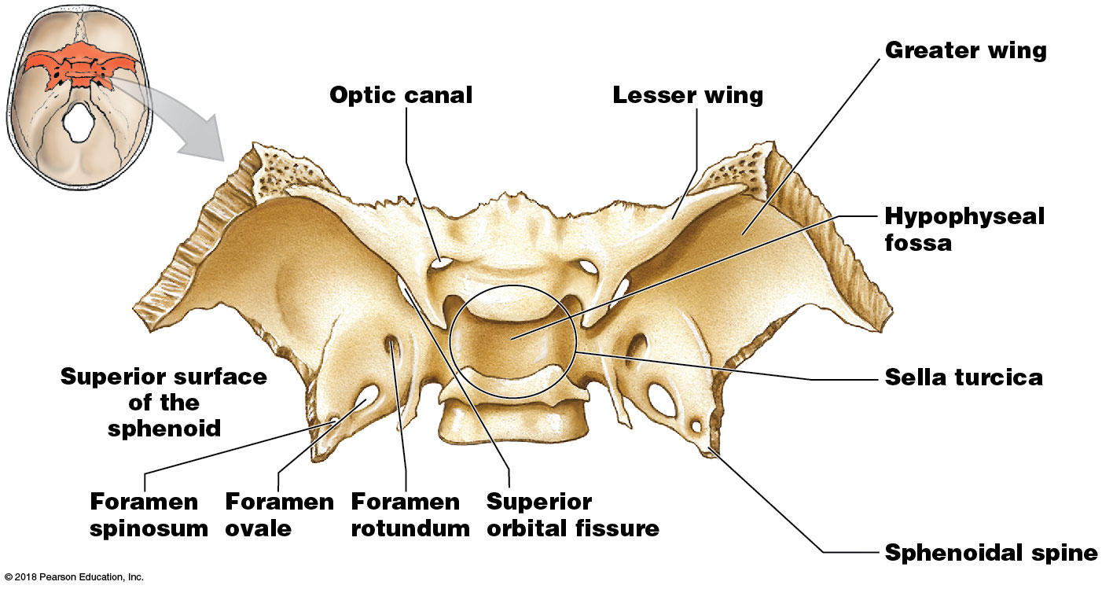
Module 7.6: The shapes and markings of the sphenoid, ethmoid, and palatine bones are best seen in the isolated bones
Sphenoid bone features
Optic canals
Passage for optic nerves from eyes to the brain
Lesser wings
Extend horizontally anterior to the sella turcica
Greater wings
Extend laterally from the body
Notes:
The sphenoid seems to be the most challenging bone for students to learn, partly because of its unusual shape, and also because of its centralized location. It helps if they study an individual disarticulated sphenoid bone first, and then study its position within the skull.

Slide 48
Module 7.6: The sphenoid, ethmoid, and palatine bones
Sphenoid bone features (continued)
Hypophyseal fossa (pituitary fossa)
Depression in the sella turcica
Supports and protects the pituitary gland
Sella turcica
Saddle-shaped enclosure

Slide 49
Module 7.6: The sphenoid, ethmoid, and palatine bones
Sphenoid bone features (continued)
Sphenoidal spine
Projection at the posterior, lateral corner of each greater wing
Foramina penetrate each greater wing
Foramen spinosum (to orbit)
Foramen ovale (to face)
Foramen rotundum (to jaws)
Superior orbital fissure (to cranial cavity membranes)

Slide 50
The sphenoid bone

Slide 51
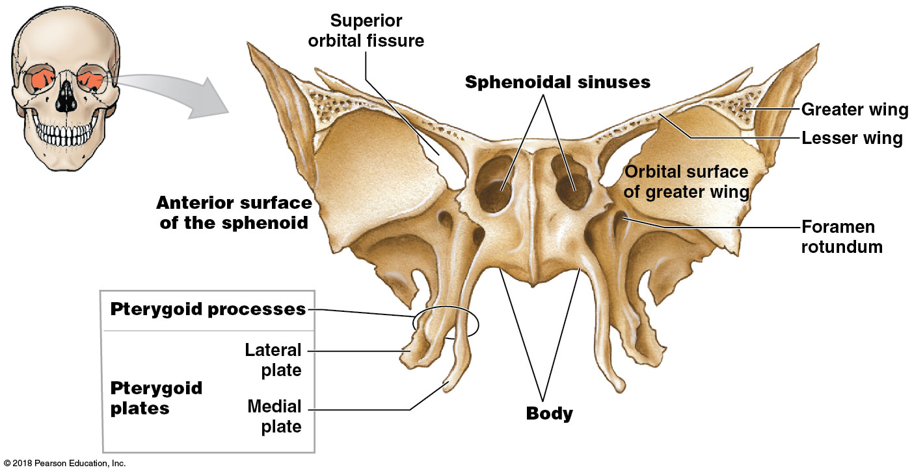
Module 7.6: The sphenoid, ethmoid, and palatine bones
Sphenoid bone features (continued)
Body
Forms the central axis of the sphenoid
Sphenoidal sinuses
Inferior to the sella turcica
Hollow spaces on either side of the body

Slide 52
Module 7.6: The sphenoid, ethmoid, and palatine bones
Sphenoid bone features (continued)
Pterygoid processes
Vertical projections on either side of the body
Each forms pair of pterygoid plates
Attachment sites for muscles moving the mandible and soft palate

Slide 53
Module 7.6: The sphenoid, ethmoid, and palatine bones
Ethmoid bone
Three parts
​Cribriform plate (cribrum, sieve)
Forms anteromedial cranial floor and nasal cavity roof
Olfactory foramina permit passage of olfactory nerves for sense of smell
Crista galli (crista, crest + gallus, rooster; cock’s comb)
Bony ridge that projects superior to cribriform plate
Attachment point for falx cerebri (membrane that stabilizes the brain)
Notes:
The ethmoid bone is also challenging, for the same reasons as the sphenoid bone. As with that bone, have students learn the bone individually first, and then learn its orientation within the skull.

Slide 54
Module 7.6: The sphenoid, ethmoid, and palatine bones
Ethmoid bone (continued)
Three parts (continued)
Paired ethmoidal labyrinth
Interconnected air-filled cavities that open into the nasal cavity
Two sets of delicate projections
Superior nasal conchae
Middle nasal conchae
​Perpendicular plate
Forms part of the nasal septum

Slide 55
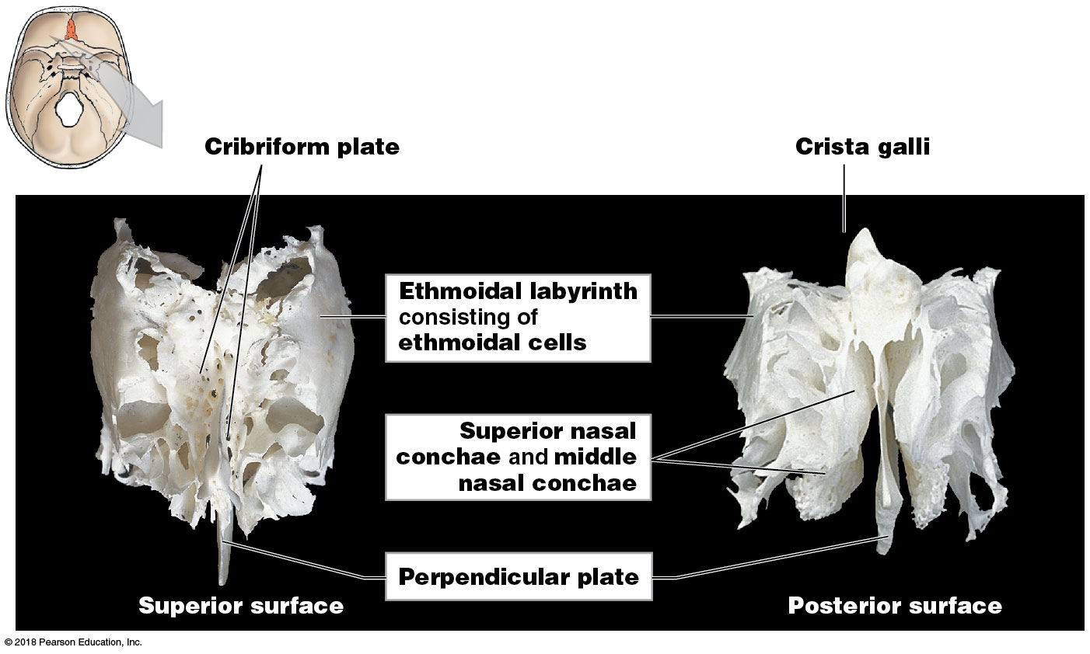
The ethmoid bone

Slide 56
Module 7.6: The sphenoid, ethmoid, and palatine bones
Palatine bone
Forms posterior portion of the hard palate and contributes to the floor of each orbit
Orbital process
Forms part of the floor of the orbit
Contains a small sinus that usually opens into the sphenoidal sinus
Horizontal plate
Forms the posterior part of the hard palate
Perpendicular plate
Extends from the horizontal plate to the orbital process

Slide 57
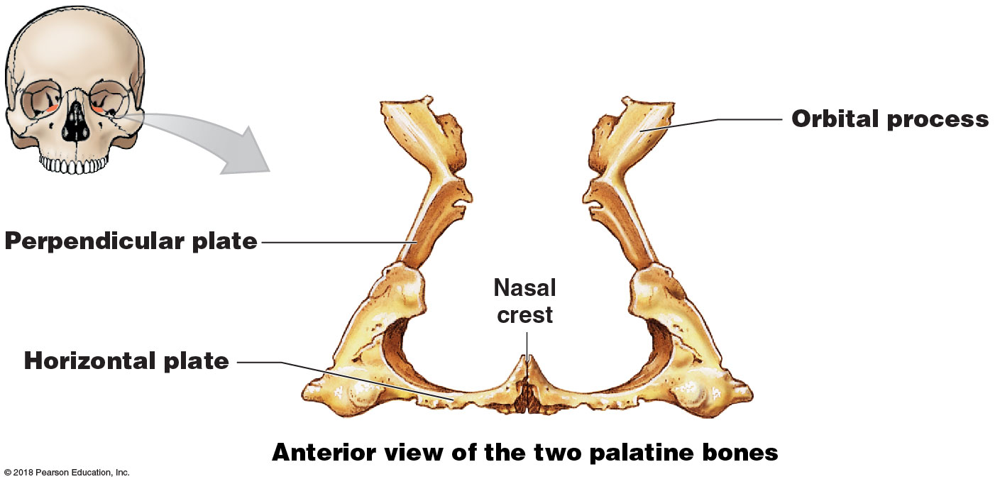
Palatine bone
Notes:
Point out that the two palatine bones fuse at the nasal crest.

Slide 58
Module 7.6: Review
Identify the bone containing the optic canals, and cite the structures using this passageway.
Which bone contains the sella turcica? What structure is found within the sella turcica depression?
Identify the bone containing the cribriform plate. What is significant about this structure?
Which bone acts as a uniting bridge between cranial and facial portions of the skull?
Learning Outcome: Describe and locate the bone markings of the sphenoid, ethmoid, and palatine bones.

Slide 59
Module 7.7: Each orbital complex contains one eye, and the nasal complex encloses the nasal cavities
Complexes
Collections of facial bones protecting sense organs
Two orbital complexes
Form the orbits
Each contain an eye
Nasal complex
Surrounds the nasal conchae

Slide 60
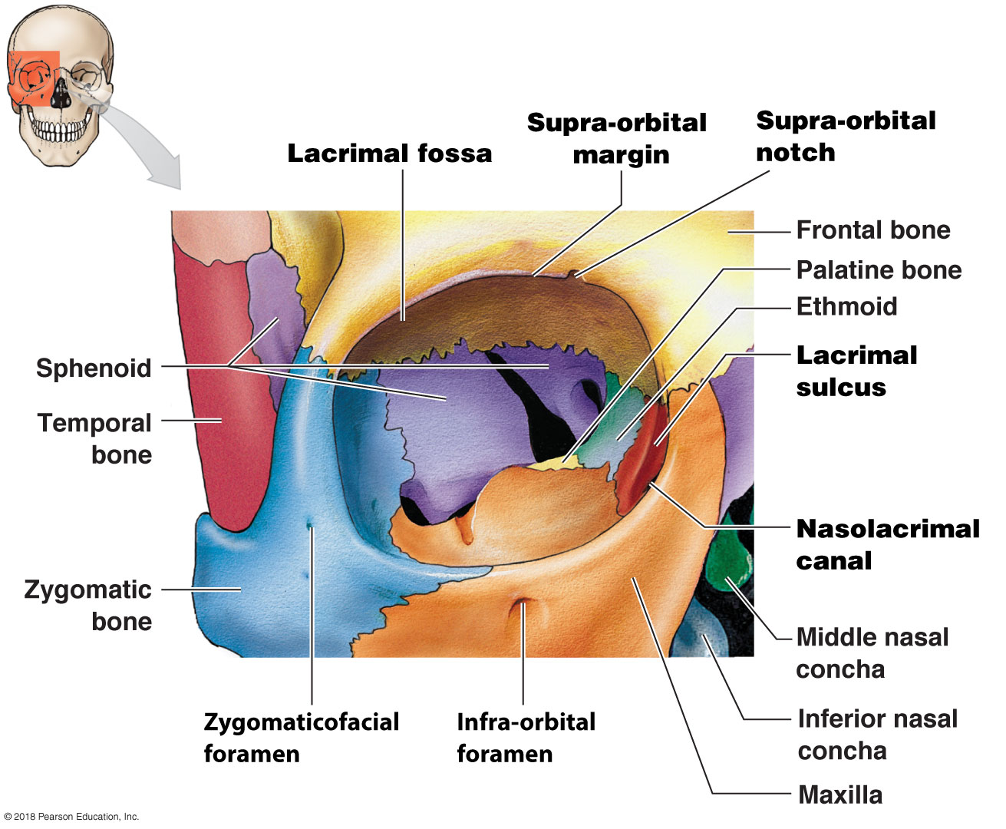
Module 7.7: Complexes: Orbital and nasal
Orbital complex
Frontal (roof)
Zygomatic (lateral wall)
Maxilla (most of the floor)
Lacrimal (medial wall)
Ethmoid (medial wall)
Sphenoid (posterior wall)
Palatine (posterior wall)
Notes:
Students often struggle with the seven bony contributions to the orbital complex. Having them study a color-coded illustration like this helps them delineate the seven bones, and it is easier then to transfer that knowledge to an intact skull by focusing on the suture lines.

Slide 61
Module 7.7: Complexes: Orbital and nasal
Orbital complex (continued)
Bony features
Lacrimal fossa
Marks location of the lacrimal (tear) gland
Supra-orbital margin
Thickened part of frontal bone that helps protect the eye
Supra-orbital notch
Passageway for blood vessels to eyebrow, eyelids, and frontal sinuses

Slide 62
Module 7.7: Complexes: Orbital and nasal
Orbital complex (continued)
Bony features (continued)
Lacrimal sulcus
Marks location of lacrimal sac
Nasolacrimal canal
Protects lacrimal sac and nasolacrimal duct
Nasolacrimal duct carries tears to nasal cavity

Slide 63
Module 7.7: Complexes: Orbital and nasal
Orbital complex (continued)
Bony features (continued)
Infra-orbital foramen
Sensory nerve path
Zygomaticofacial foramen
Carries sensory nerve that innervates the cheek

Slide 64
Module 7.7: Complexes: Orbital and nasal
Nasal complex
Paranasal sinuses
Lighten skull weight
Allow the voice to resonate
Provide extensive area of mucous epithelium
Found in the sphenoid, ethmoid, frontal bone, palatine bone, and maxillae
Inflammation of the sinuses is sinusitis

Slide 65
Module 7.7: Complexes: Orbital and nasal
Nasal complex (continued)
Includes bones that enclose the nasal cavities and paranasal sinuses (Air-filled chambers connected to the nasal cavities)
Sphenoidal sinuses
Found on either side of body of sphenoid
Ethmoid air cells
Secrete mucus to flush the nasal cavity surfaces

Slide 66
Module 7.7: Complexes: Orbital and nasal
Nasal complex (continued)
Paranasal sinuses (continued)
Frontal sinuses
Generally appear after age 6; may not develop
Palatine sinuses
Open into the sphenoidal sinuses
Maxillary sinuses
Secrete mucus to flush inferior nasal cavity surfaces
Largest sinuses

Slide 67
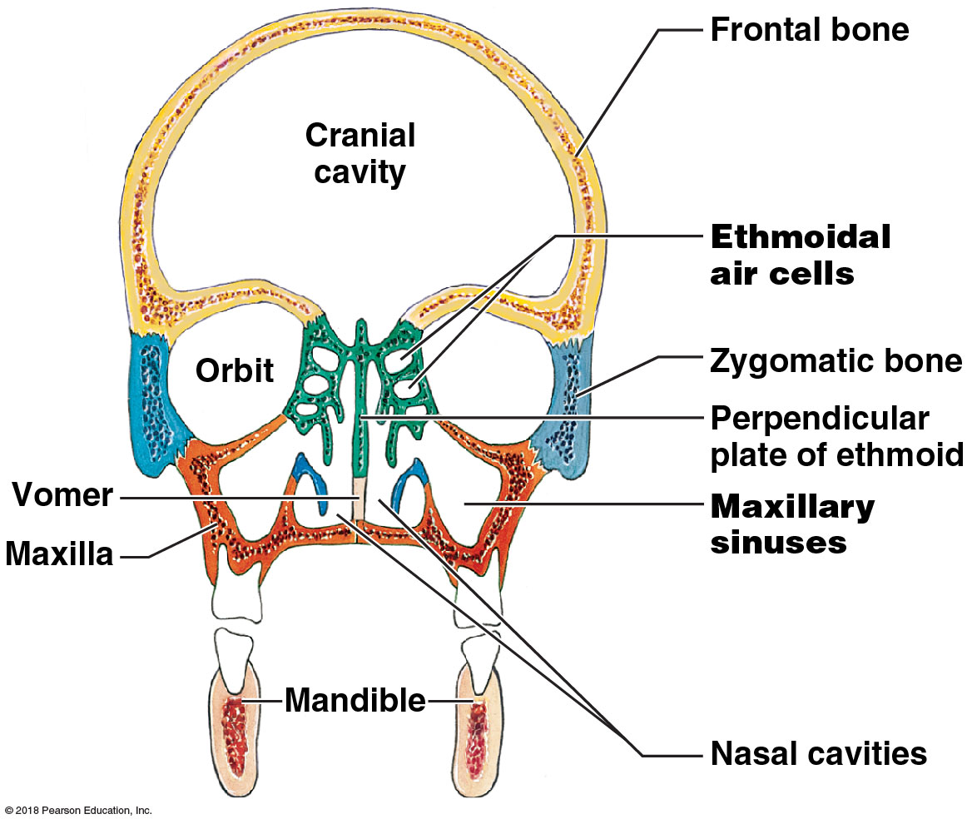
Paranasal sinuses
Notes:
Be sure students understand the orientation of this image. It is a coronal section.

Slide 68
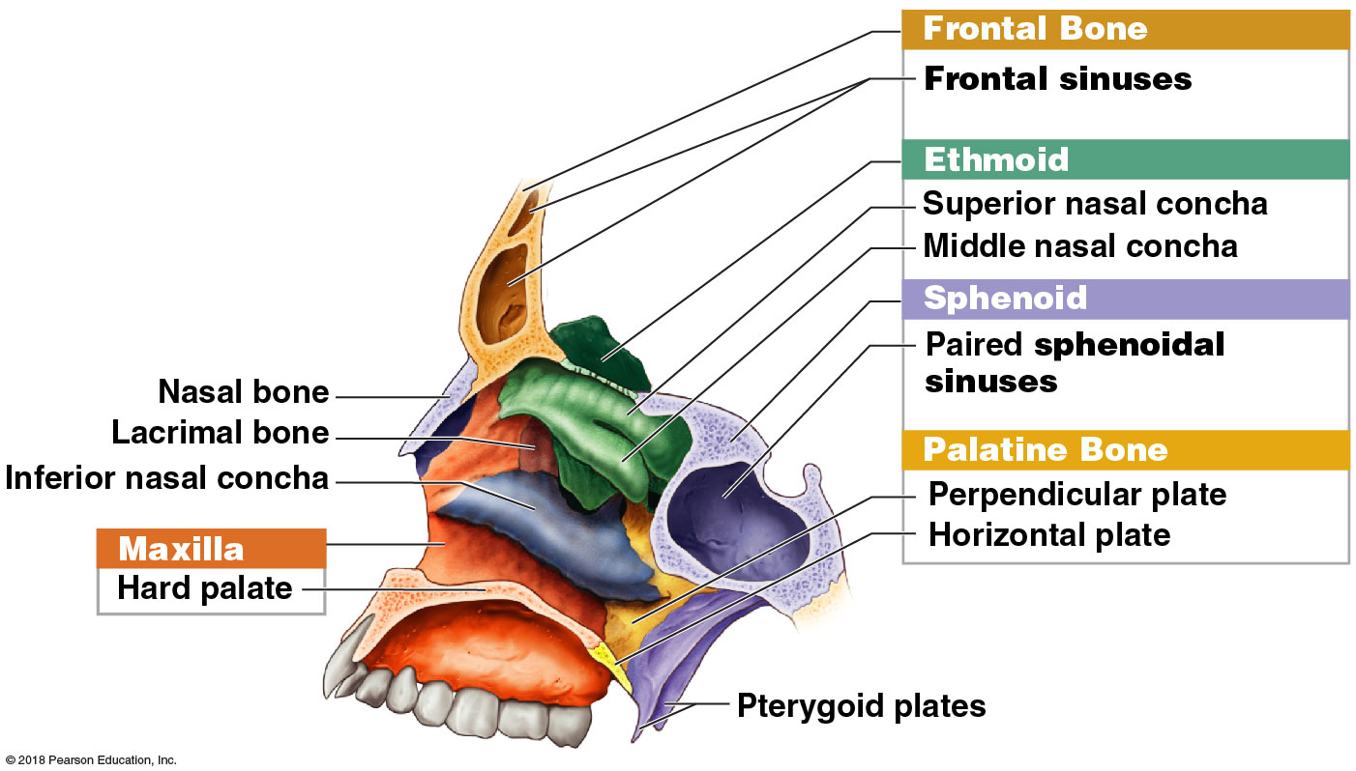
Sagittal section of paranasal sinuses
Notes:
This is a parasagittal section, not midsagittal, because all three nasal conchae are visible. Also note that its sphenoidal sinus is referred to as paired—but only one is shown due to the position of this section.

Slide 69
Module 7.7: Review
Identify the bones of the orbital complex.
What are the functions of the paranasal sinuses?
Name the complex—nasal, orbital, or both—where you find each of the following bones: frontal, maxilla, palatine, and nasal bones.
Learning Outcome: Describe the structure of the orbital complex and nasal complex and the functions of their individual bones.

Slide 70
Module 7.8: The mandible forms the lower jaw…
The mandible
Forms the entire lower jaw
Articulates with the mandibular fossae of the temporal bones
Subdivided into:
Horizontal body
Ascending rami (singular, ramus)

Slide 71
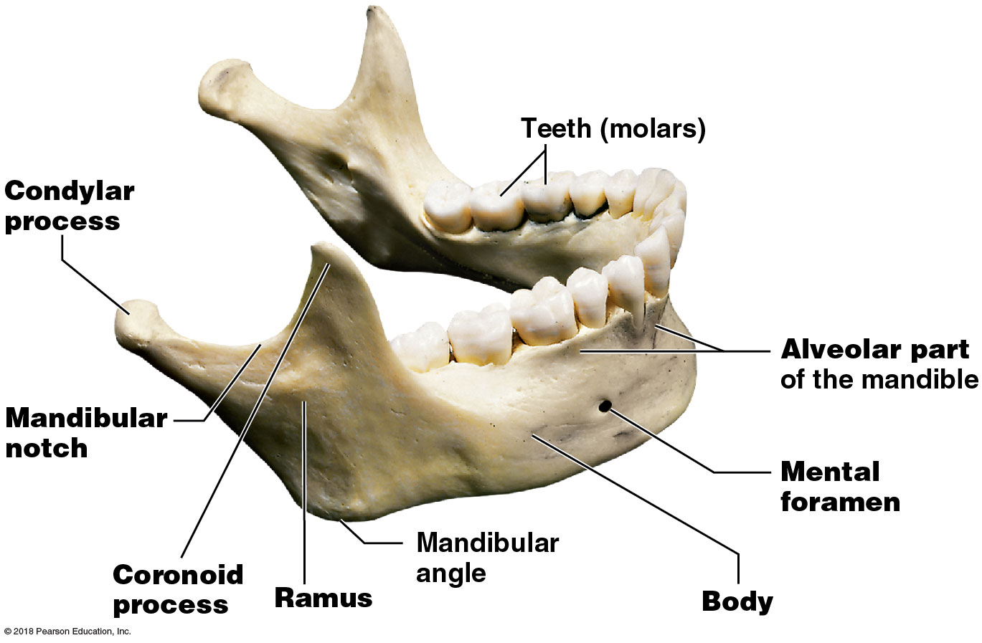
Module 7.8: The mandible
Features of the mandible
Ramus
Begins at the mandibular angle
Attachment site for the masseter muscle
Condylar process
Articulates with the temporal bone at the temporomandibular joint
Mandibular notch
Depression that separates the condylar and coronoid processes
Coronoid process
Insertion point for the temporalis muscle

Slide 72
Module 7.8: The mandible
Features of the mandible (continued)
Body
Horizontal portion of the mandible
Alveolar process
Supports the lower teeth

Slide 73
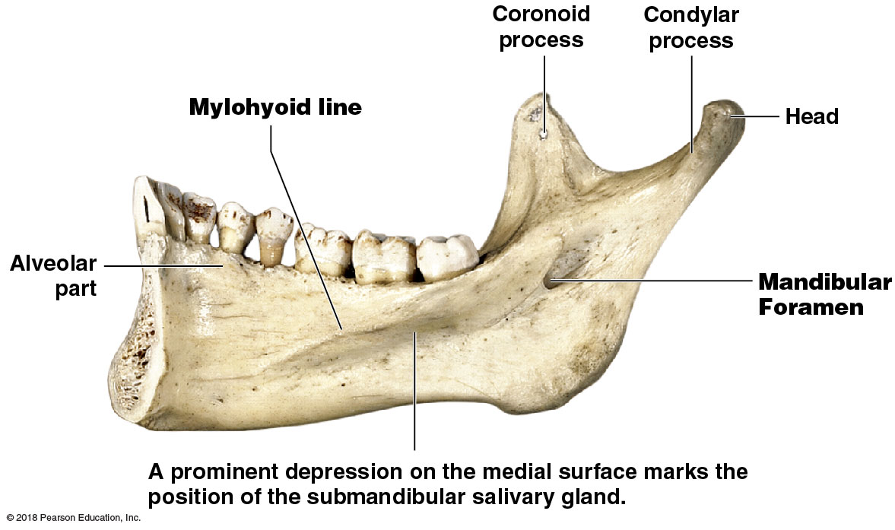
Module 7.8: The mandible
Features of the mandible (continued)
Medial surface features
Mylohyoid line
Marks the insertion of the mylohyoid muscle (which supports the floor of the mouth)
Mandibular foramen
Passageway for blood vessels and nerves supplying the lower teeth
Depression marking position of submandibular salivary gland
Notes:
Be sure students realize they are viewing the inner surface of the mandible in this view. It helps their orientation if you present an actual mandible and then show the surface.

Slide 74
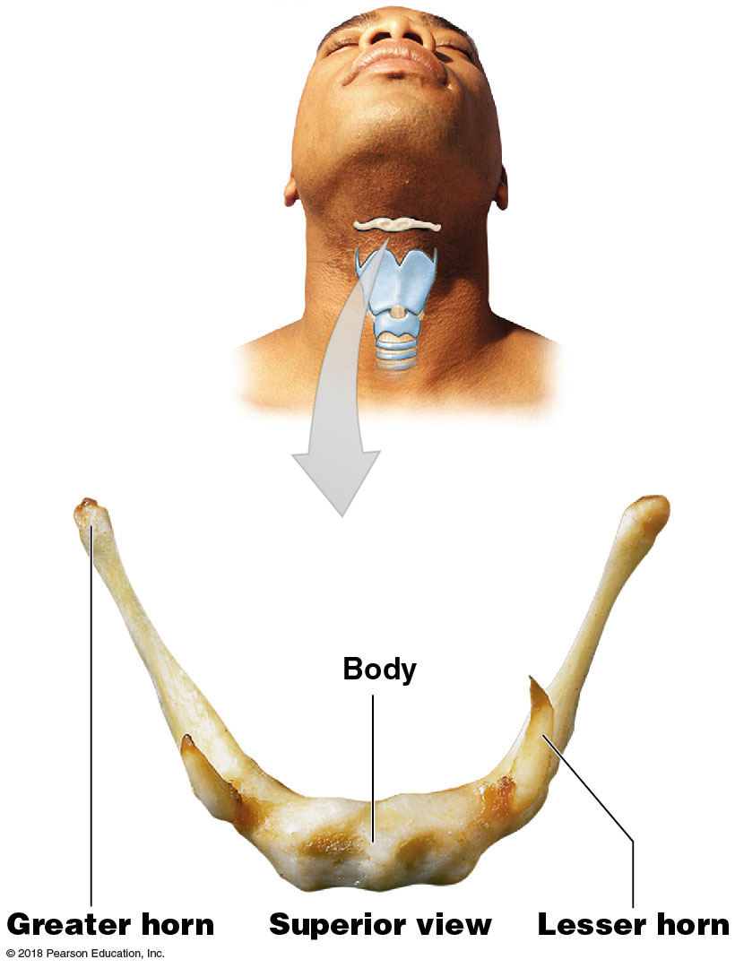
Module 7.8: …and the associated bones of the skull perform specialized functions
Associated bones of the skull
Hyoid bone
Supports the larynx
Greater horn (greater cornu)
Attachment for muscles that move the tongue
Lesser horn (lesser cornu)
Attachment for hyoid and laryngeal ligaments

Slide 75
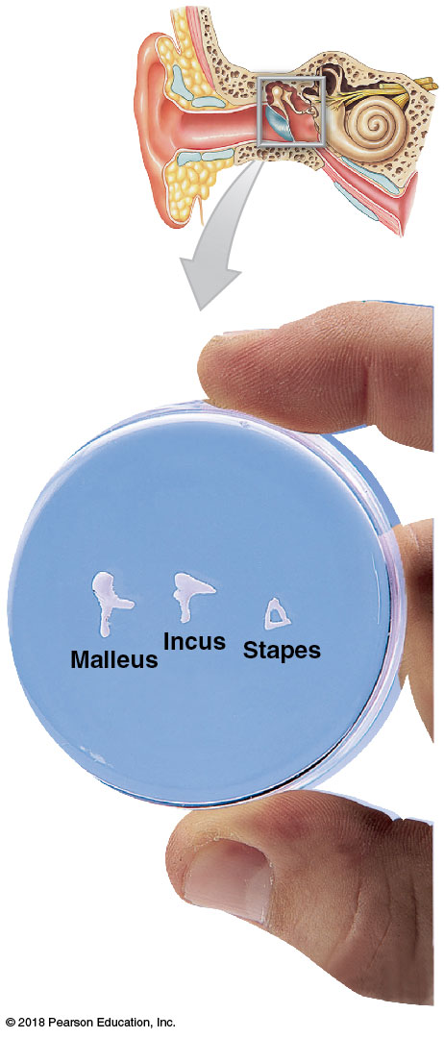
Module 7.8: Associated bones of the skull
Associated bones of the skull (continued)
Auditory ossicles
Located within each middle ear cavity
Enclosed in petrous part of the temporal bone
Play key role in hearing
Conduct vibrations from the tympanic membrane to internal ear
Three bones
Malleus
Incus
Stapes

Slide 76
Module 7.8: Review
Name the foramina of the mandible.
Explain why your lab partner is correct when she claims that the hyoid bone does not join directly with any other bone.
Describe the location and function of the auditory ossicles.
Learning Outcome: Describe the mandible and the associated bones of the skull.

Slide 77
Module 7.9: Fontanelles permit cranial growth in infants and small children
Fontanelles
Allow for cranial growth to keep pace with brain growth in later fetal stages
Ease passage of head through birth canal
Over time, fontanelles are replaced with sutures
Occipital, sphenoidal, and mastoid fontanelles disappear a month or two after birth
All fontanelles replaced before age 5, when brain stops growing

Slide 78
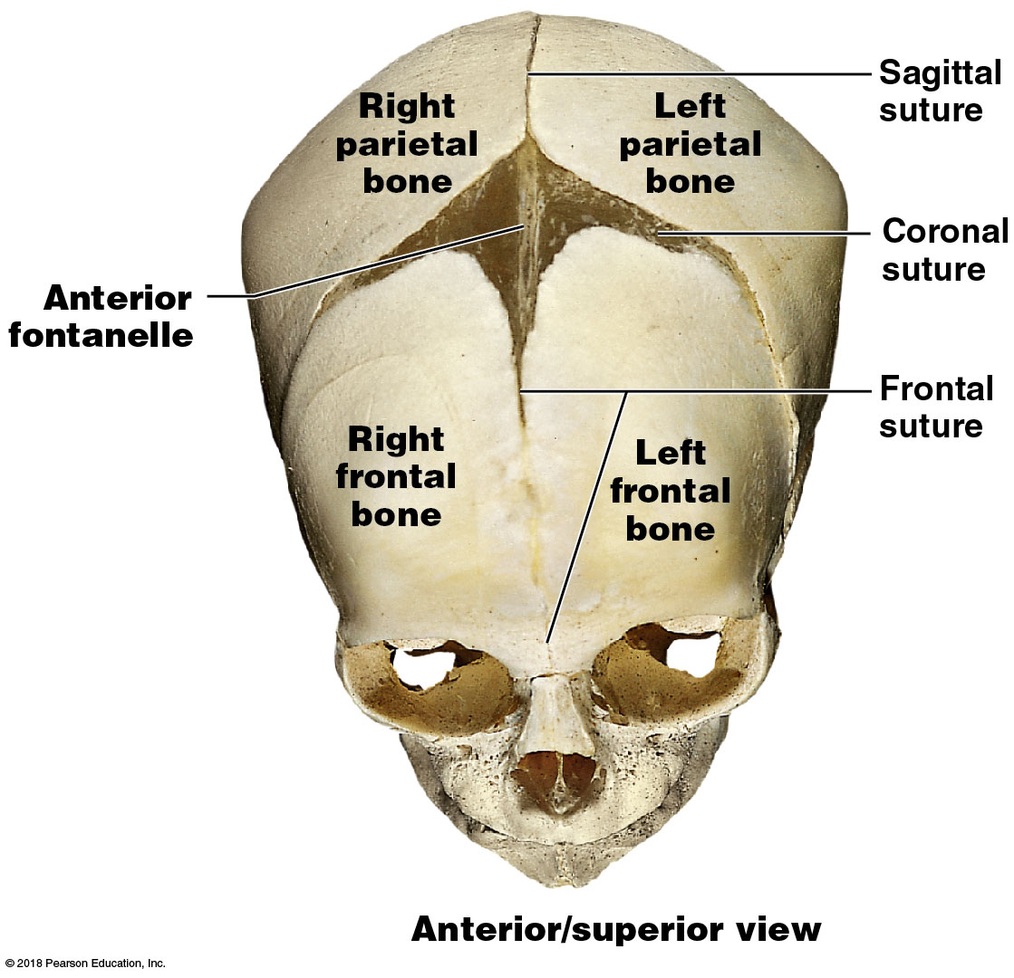
Module 7.9: Fontanelles
Anterior fontanelle
Intersection of frontal, sagittal, and coronal sutures
Largest fontanelle
Commonly called the “soft spot”
Persists until about age 2
Covers a major blood vessel
Pulses as heart beats

Slide 79
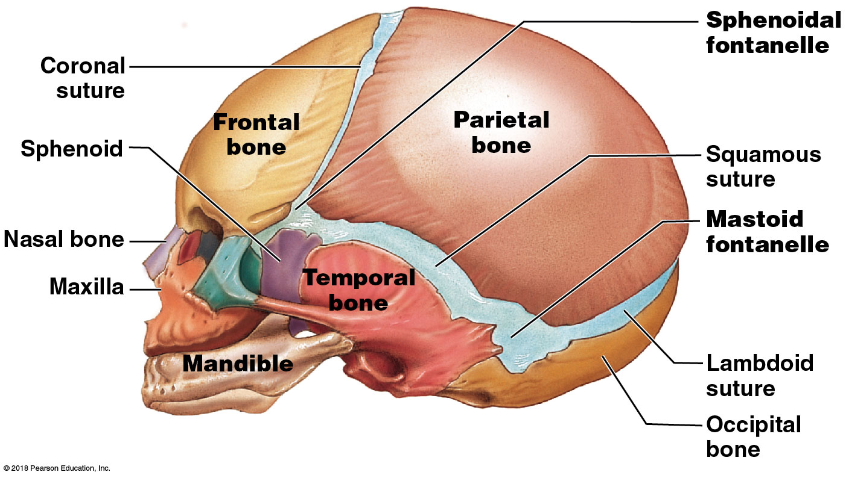
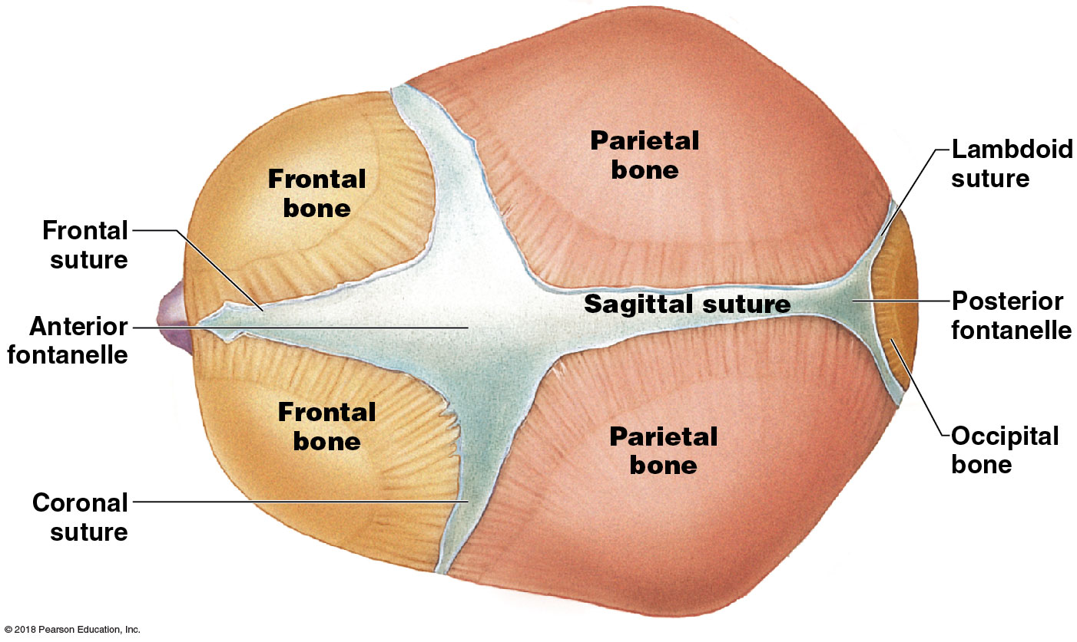
Module 7.9: Fontanelles
Sphenoidal fontanelle
Junction of squamous and coronal sutures
Mastoid fontanelle
Junction of squamous and lambdoid sutures
Posterior fontanelle
Junction of lambdoid and sagittal sutures

Slide 80
Module 7.9: Review
Identify the major fontanelles.
What purposes do fontanelles serve?
Why are an infant’s facial bones so small compared with its cranium?
Learning Outcome: Describe key structural differences among the skulls of infants, children, and adults.

Slide 81
Module 7.10: The vertebral column has four spinal curves, and vertebrae share a basic structure that differs regionally
Vertebral column (spine) anatomy
Composed of 26 bones
Separated into vertebral regions defined by anatomical characteristics of individual vertebrae
Cervical region (7 vertebrae)
Thoracic region (12 vertebrae)
Lumbar region (5 vertebrae)
Sacral region (sacrum)
Coccygeal region (coccyx, or tailbone)
Average length in an adult is 71 cm (28 in.)

Slide 82
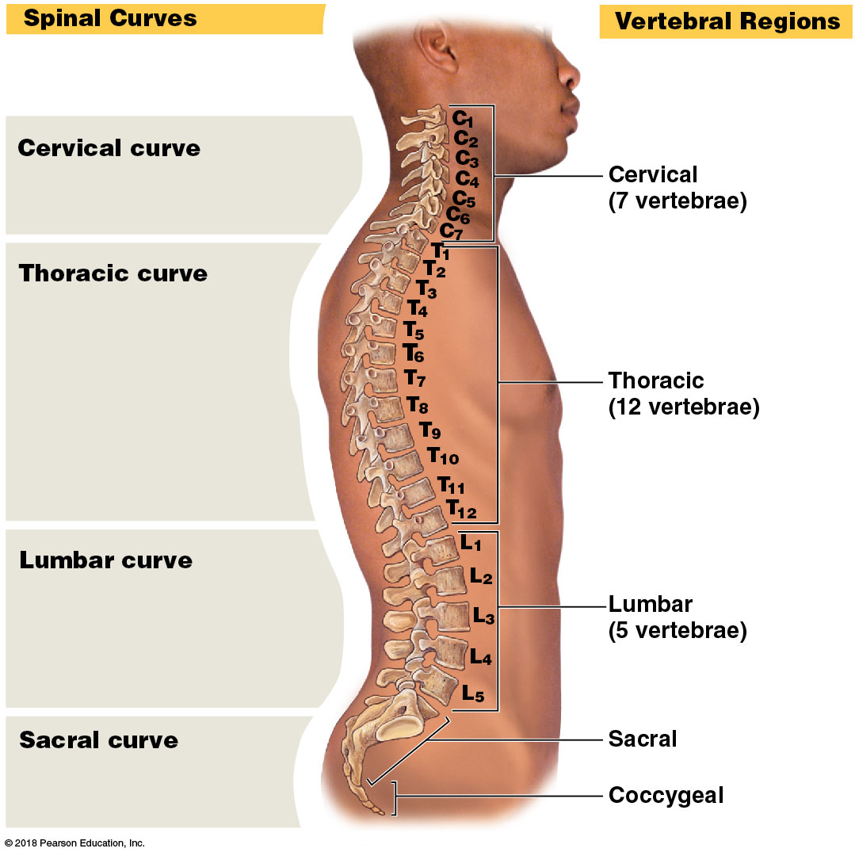
Module 7.10: The vertebral column and vertebrae
Vertebral column curvatures
Primary curves (develop before birth)
Thoracic curve
Accommodates the thoracic organs
Sacral curve
Accommodates the abdominopelvic organs

Slide 83
Module 7.10: The vertebral column and vertebrae
Secondary curves (develop after birth)
Cervical curve
Develops as an infant learns to lift the head
Balances the head on the neck
Lumbar curve
Balances the weight of the trunk over lower limbs
Develops with the ability to stand

Slide 84
Module 7.10: The vertebral column and vertebrae
Vertebrae
Each consists of three basic parts
​Articular processes
Extend superiorly and inferiorly to articulate with adjacent vertebrae
​Vertebral arch
Forms posterior and lateral margins of the vertebral foramen
​Vertebral body
Transfers weight along the axis of the vertebral column
​Vertebral foramen
The opening framed by the vertebral body and the vertebral arch

Slide 85
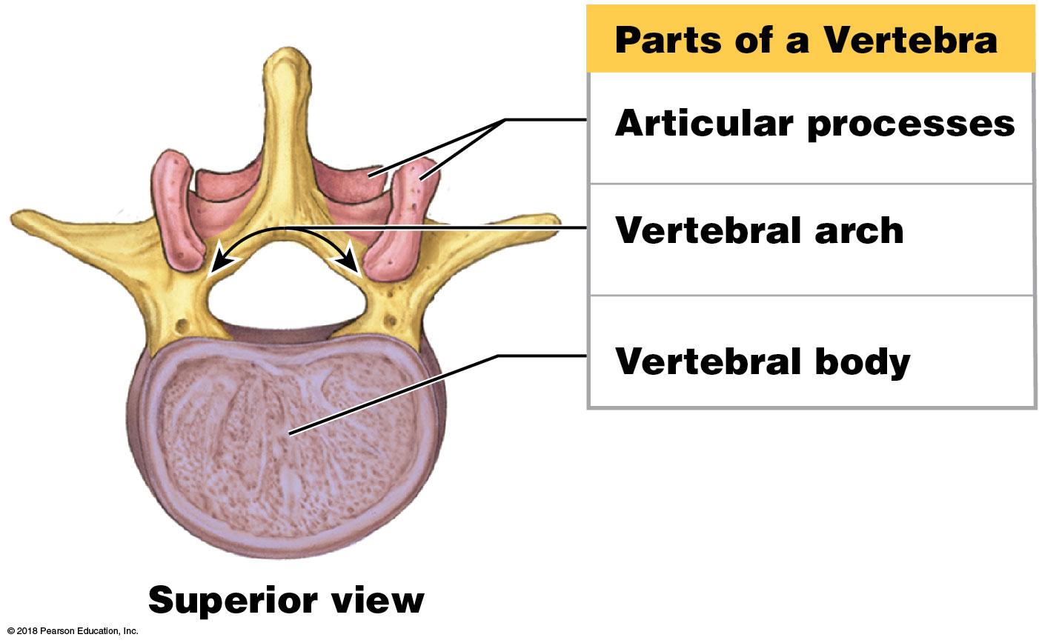
The vertebral column and vertebrae

Slide 86
Video: Typical Vertebra

Slide 87
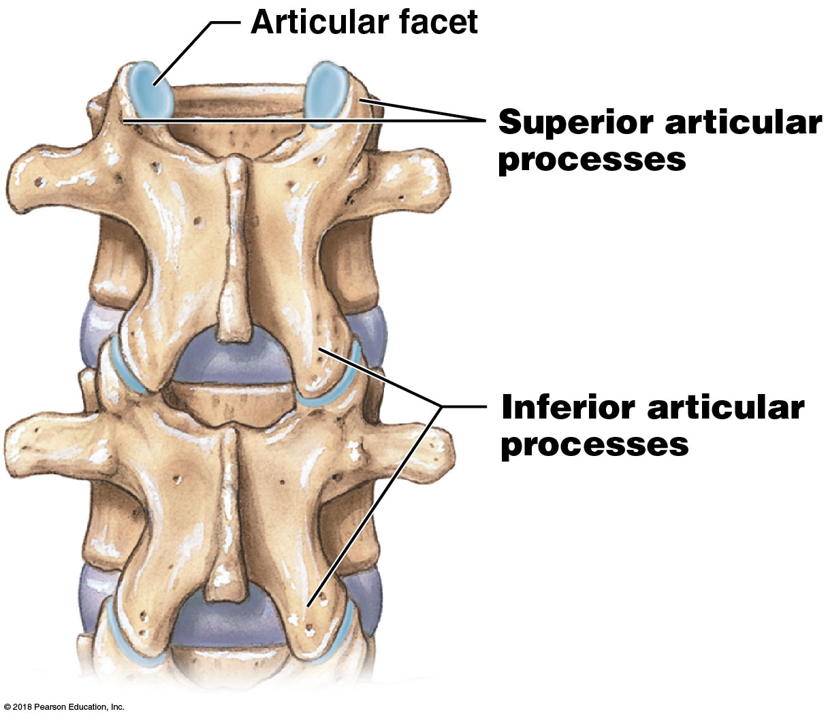
Module 7.10: The vertebral column and vertebrae
Articulations between vertebrae
Articular facet
Forms the joint with the adjacent vertebra
Superior articular processes
Articulate with the inferior articular processes of a superior vertebra
Inferior articular processes
Articulate with the superior articular processes of an inferior vertebra
Notes:
Point out that where two vertebrae articulate, the inferior articulating process from the superior vertebrae articulates inferiorly with the superior articulating process of the inferior vertebrae. This seems backwards to many students, who make a superficial assumption that the one on top is the superior articulating process. Have them look at the two vertebrae to see that these processes are named according to the vertebra where they originate, not for their position within the articulation.

Slide 88
Module 7.10: The vertebral column and vertebrae
Vertebral arch components
Laminae
Form the “roof” of the vertebral foramen
Pedicles
Form the sides of the vertebral arch
Spinous process
Projects posteriorly from point of fusion of the laminae
Transverse processes
Project laterally from where pedicles join the laminae
Sites of muscle attachment
May articulate with the ribs

Slide 89
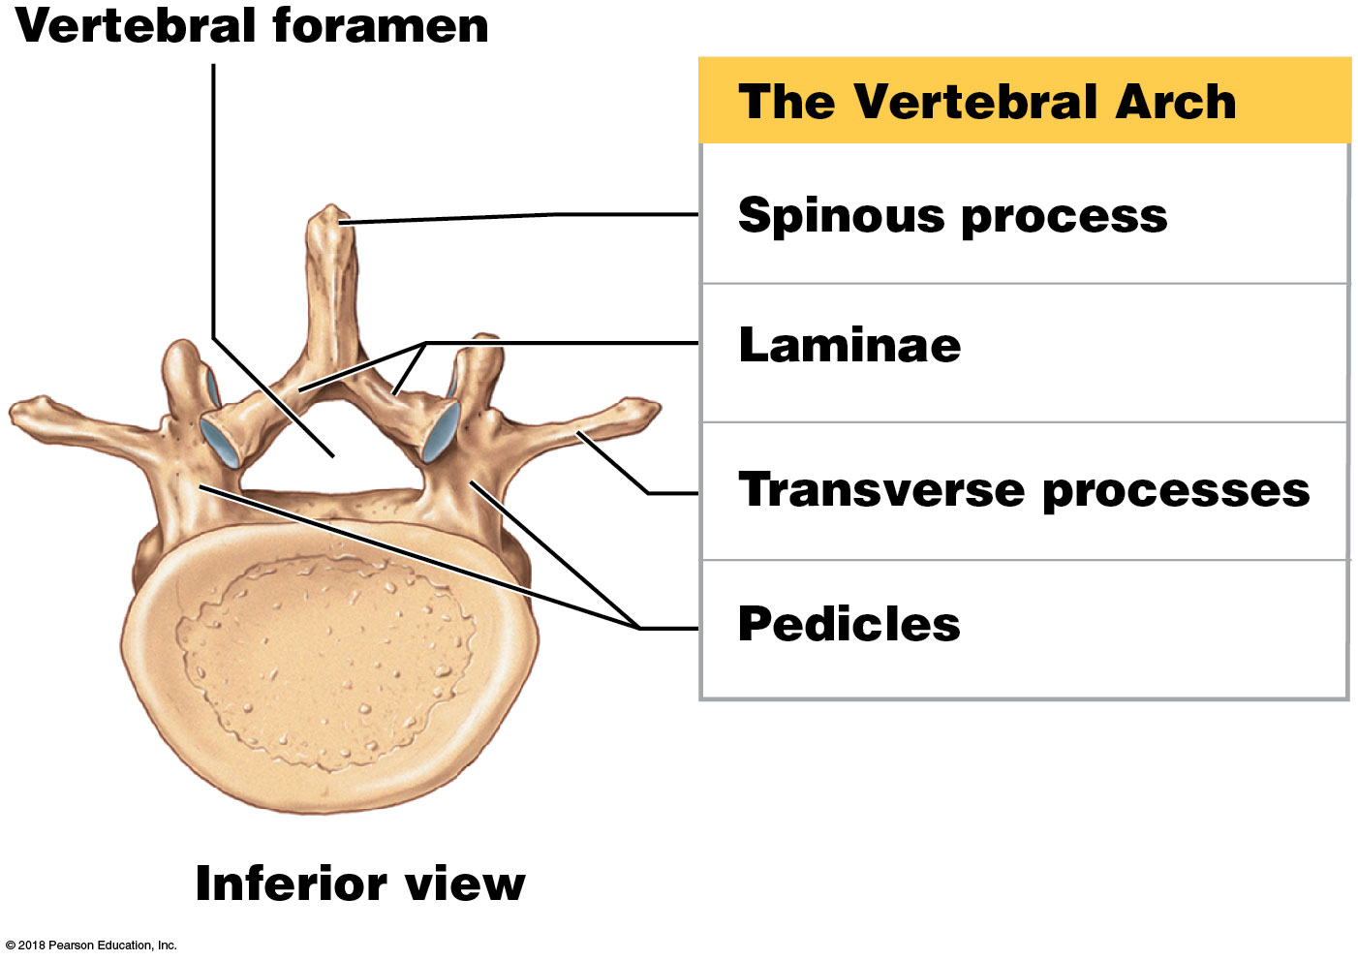
Parts of a vertebra

Slide 90
Module 7.10: The vertebral column and vertebrae
The vertebral canal
Formed by the vertebral foramina of successive vertebrae
Encloses the spinal cord
Intervertebral discs
Pads of fibrocartilage separating the bodies of adjacent vertebrae
Intervertebral foramina
Spaces formed between successive pedicles
Allow passage of nerves and blood vessels

Slide 91
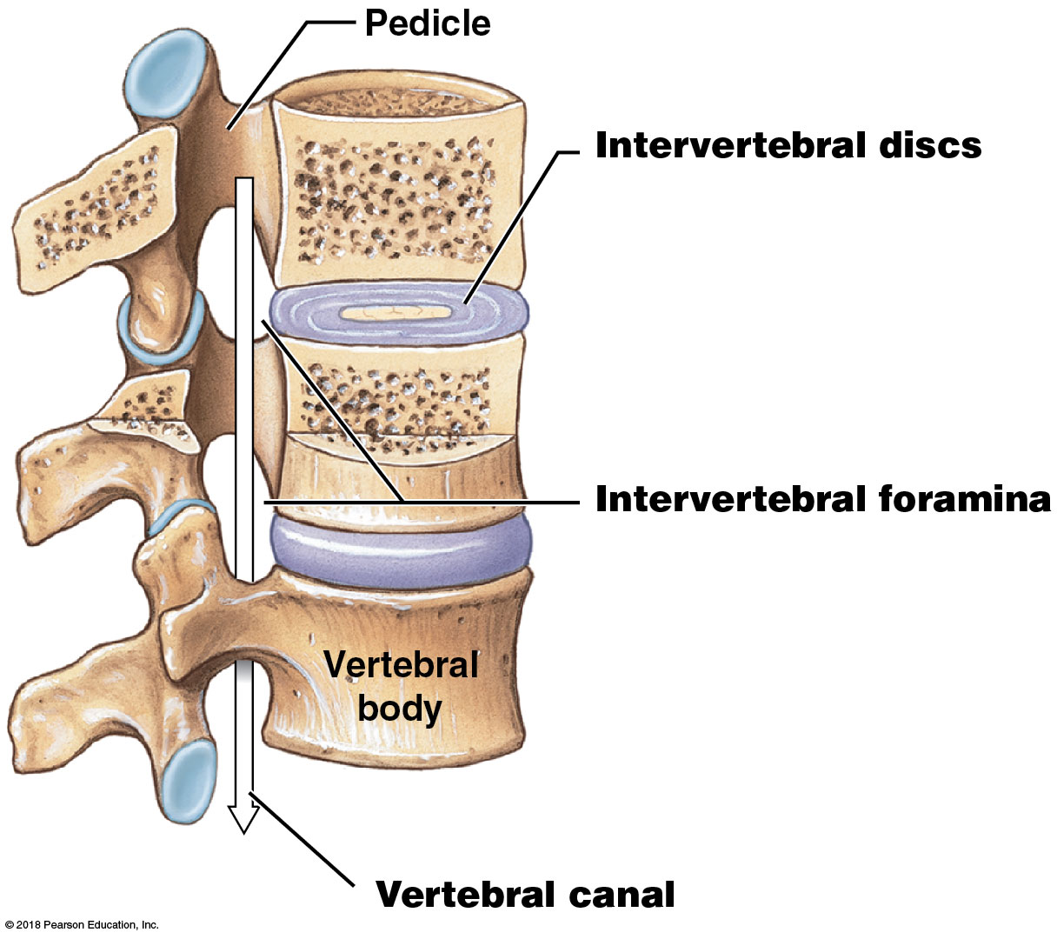
Vertebral column

Slide 92
Module 7.10: The vertebral column and vertebrae
Vertebrae naming conventions
In reference to a specific vertebra, capital letters designate the region (cervical, thoracic, lumbar, sacral, coccygeal)
Examples: C, T, L, S, Co
The relative position of the vertebra within the region is indicated by a subscript number
1 designates the vertebra closest to the skull
Example: C₃ = third cervical vertebra

Slide 93
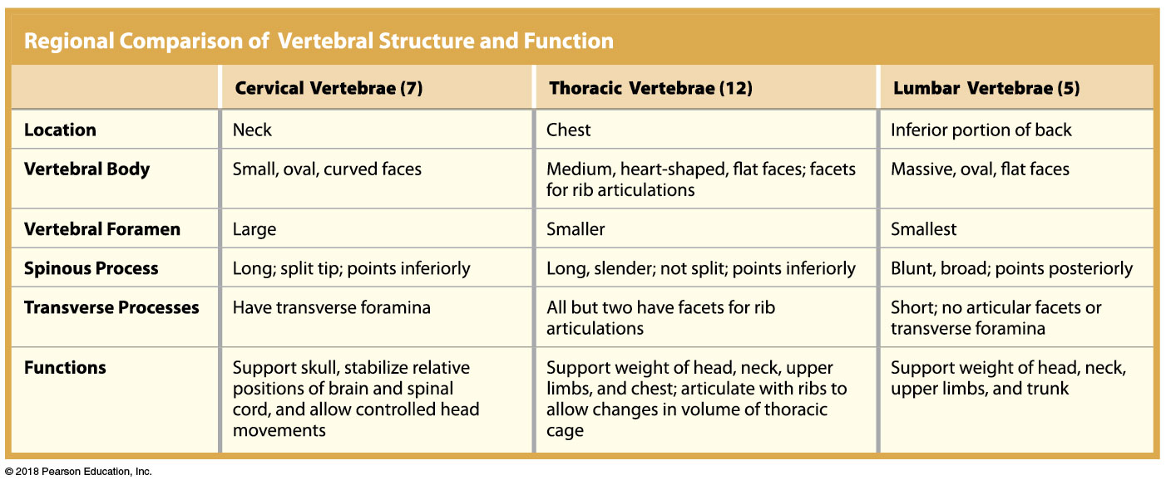
Regional comparison of vertebral structure and function

Slide 94
Module 7.10: Review
What is the importance of the secondary curves of the spine?
Name the major components of a typical vertebra.
To which part of the vertebra do the intervertebral discs attach?
Learning Outcome: Identify and describe the curves of the spinal column and their functions, and identify the vertebral regions.

Slide 95
Module 7.11: There are seven cervical vertebrae …
Seven smallest vertebrae in the vertebral column
Extend from occipital bone to thorax
Large vertebral foramen
Spinal cord here has many axons connecting to brain
Vertebral body is small and light
Supports only weight of head

Slide 96
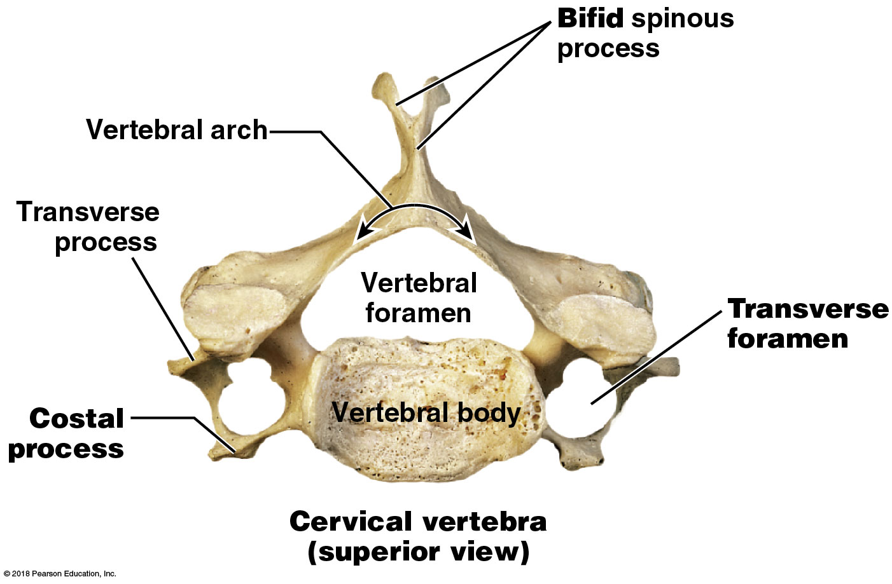
Module 7.11: Cervical vertebrae
Bifid spinous process (notch in the tip)
Transverse processes are short and stumpy
Transverse foramen
Protects vertebral arteries and veins serving the brain
Costal processes
Extend anterolaterally from either side of the body
Notes:
Note that the image shows C7, and it is the only cervical vertebra that has a costal process. Similarly, not all cervical vertebrae have distinct bifid spinous processes. The definitive characteristic of cervical vertebrae is that they all have transverse foramina.

Slide 97
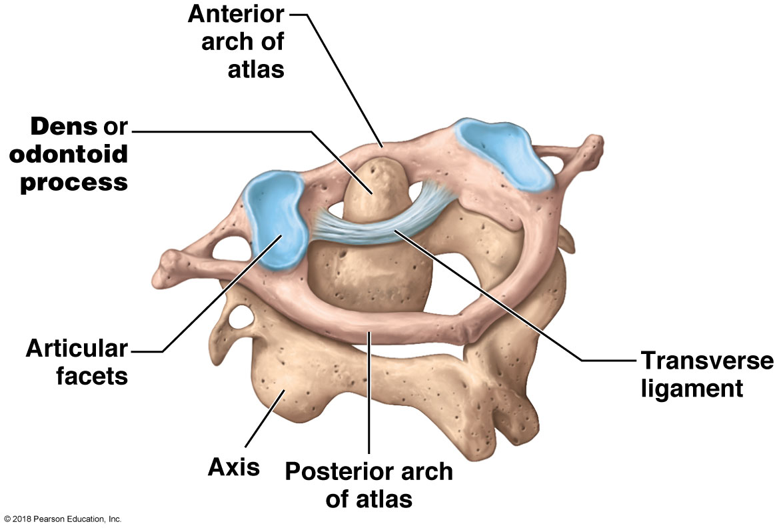
Module 7.11: Cervical vertebrae
First two cervical vertebrae are specialized to support and stabilize the cranium and allow head movement
​Atlas (C₁) (named after Greek mythical figure holding the world on his shoulders)
No spinous process or vertebral body
Large round vertebral foramen
Articulates with the occipital condyles
Permits nodding “yes”

Slide 98
Module 7.11: Cervical vertebrae
​Axis (C₂)
Prominent dens, or odontoid (odontos, tooth) process, on superior surface
Dens bound to atlas by transverse ligament
Permits rotation, as in shaking head “no”

Slide 99
Video: Atlas and Axis

Slide 100
Module 7.11: Cervical vertebrae
Last cervical vertebra (C₇)
Also known as the vertebra prominens, or prominent vertebra
Has large spinous process ending in a tubercle
Can be felt through the skin
Ligamentum nuchae (nucha, nape)
Elastic ligament that connects the vertebra prominens to the external occipital crest
Acts like a bow string to maintain the cervical curvature without muscular effort

Slide 101
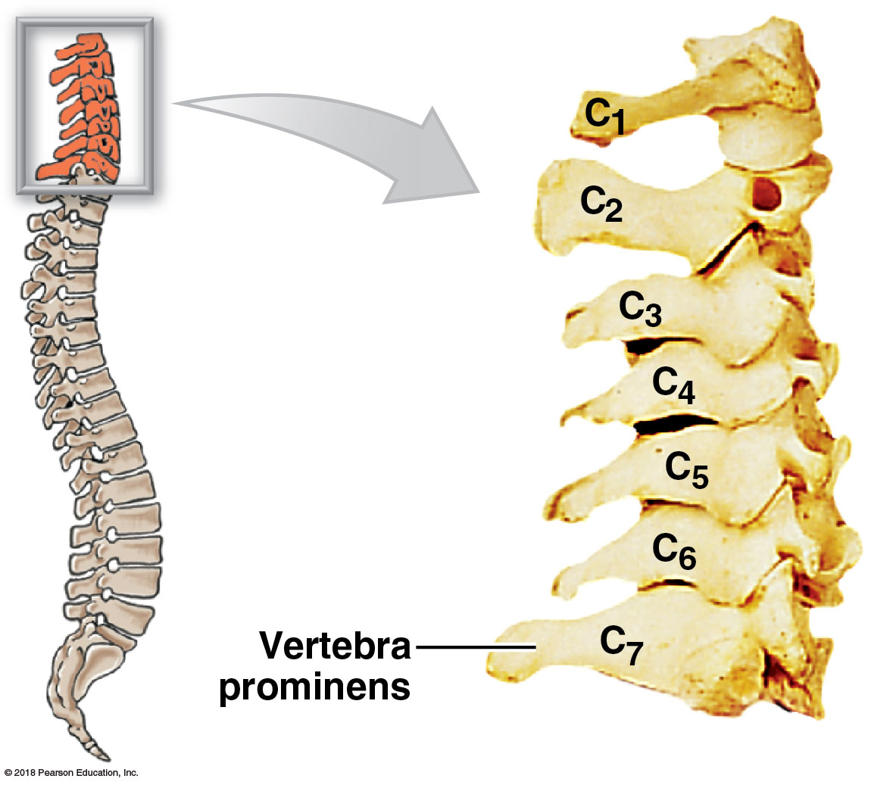
Cervical vertebrae

Slide 102
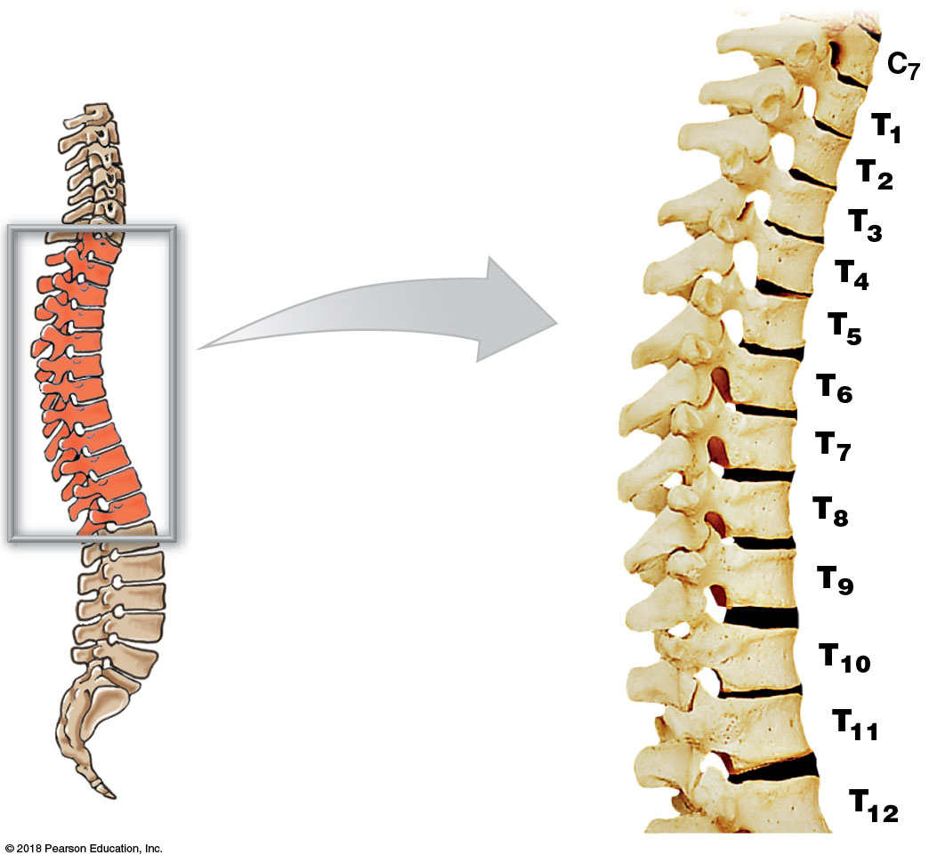
Module 7.11: … and twelve thoracic vertebrae
Thoracic vertebrae
12 thoracic vertebrae
Body of each one slightly larger as they move inferiorly
Able to bear increasing weight

Slide 103
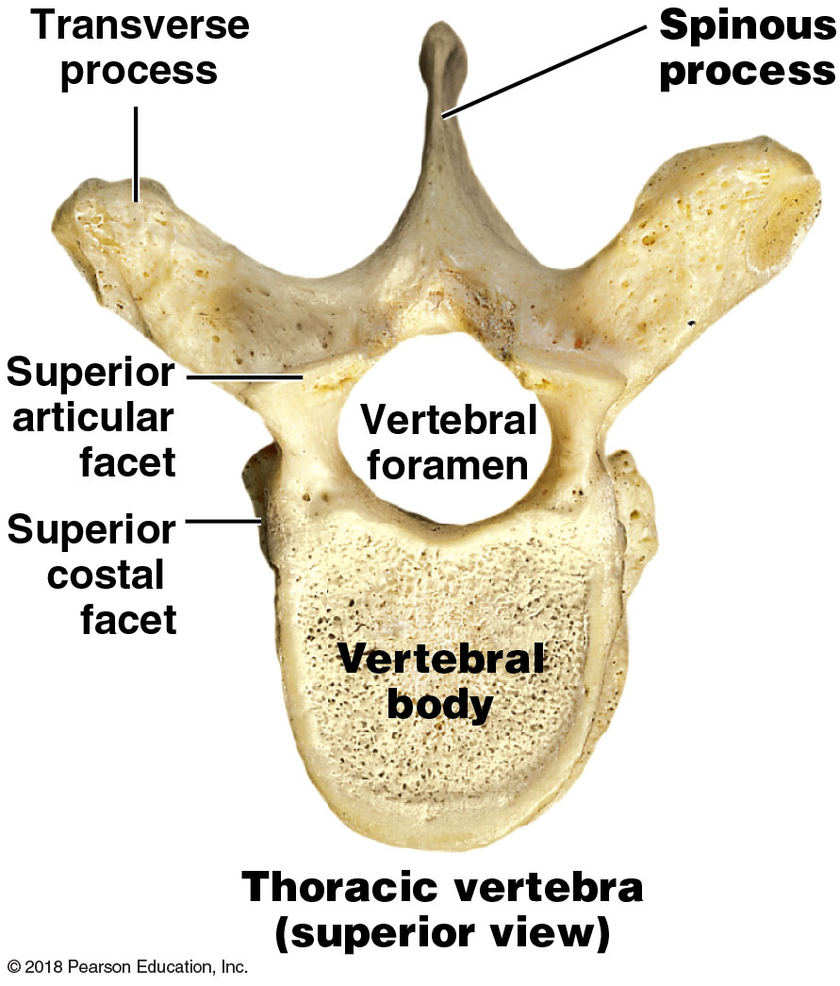
Module 7.11: Thoracic vertebrae
Thoracic vertebrae (continued)
Long, slender spinous process that projects posteriorly and inferiorly
Smaller vertebral foramen than cervical vertebrae

Slide 104
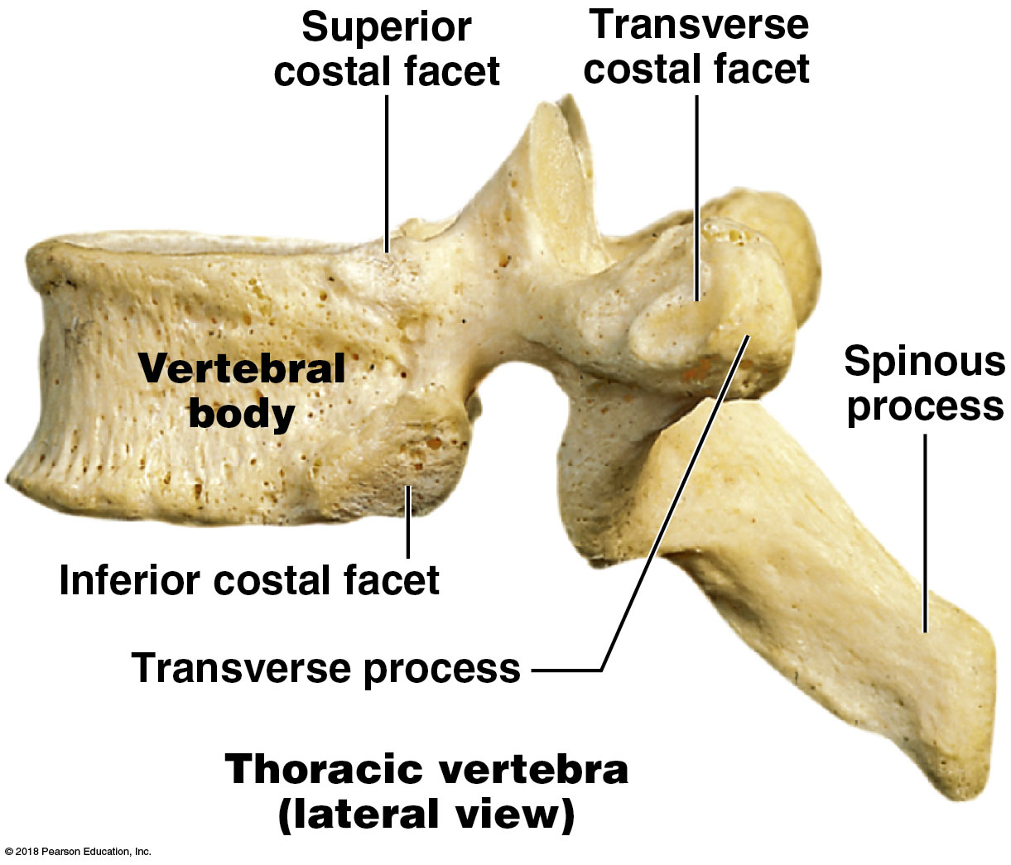
Module 7.11: Thoracic vertebrae
Thoracic vertebrae (continued)
Costal facets on dorsolateral surface of vertebral body for rib articulation
T₁–T₁₀ also have costal facets on the transverse processes

Slide 105
Video: Thoracic Vertebra

Slide 106
Module 7.11: Review
Joe suffered a hairline fracture at the base of the dens. Identify the bone and fracture site.
In which region of the vertebral column would you find a vertebra with a large foramen and two smaller foramina within the transverse process?
When you run your finger down the middle of a person’s spine, what part of each vertebra are you feeling just beneath the skin?
Learning Outcome: Describe the distinctive structural and functional characteristics of the cervical and thoracic vertebrae.

Slide 107
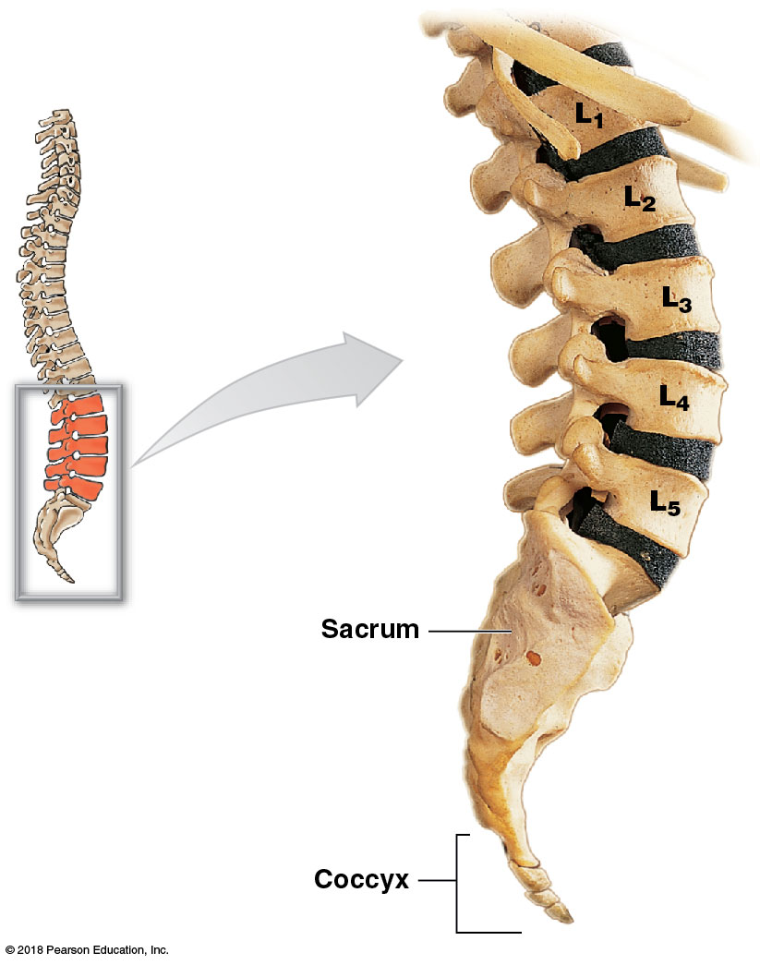
Module 7.12: There are five lumbar vertebrae
Five lumbar vertebrae
Largest vertebrae (transmit the most weight)
Thicker body than that of a thoracic vertebra
Superior and inferior surfaces are oval (not heart shaped)

Slide 108
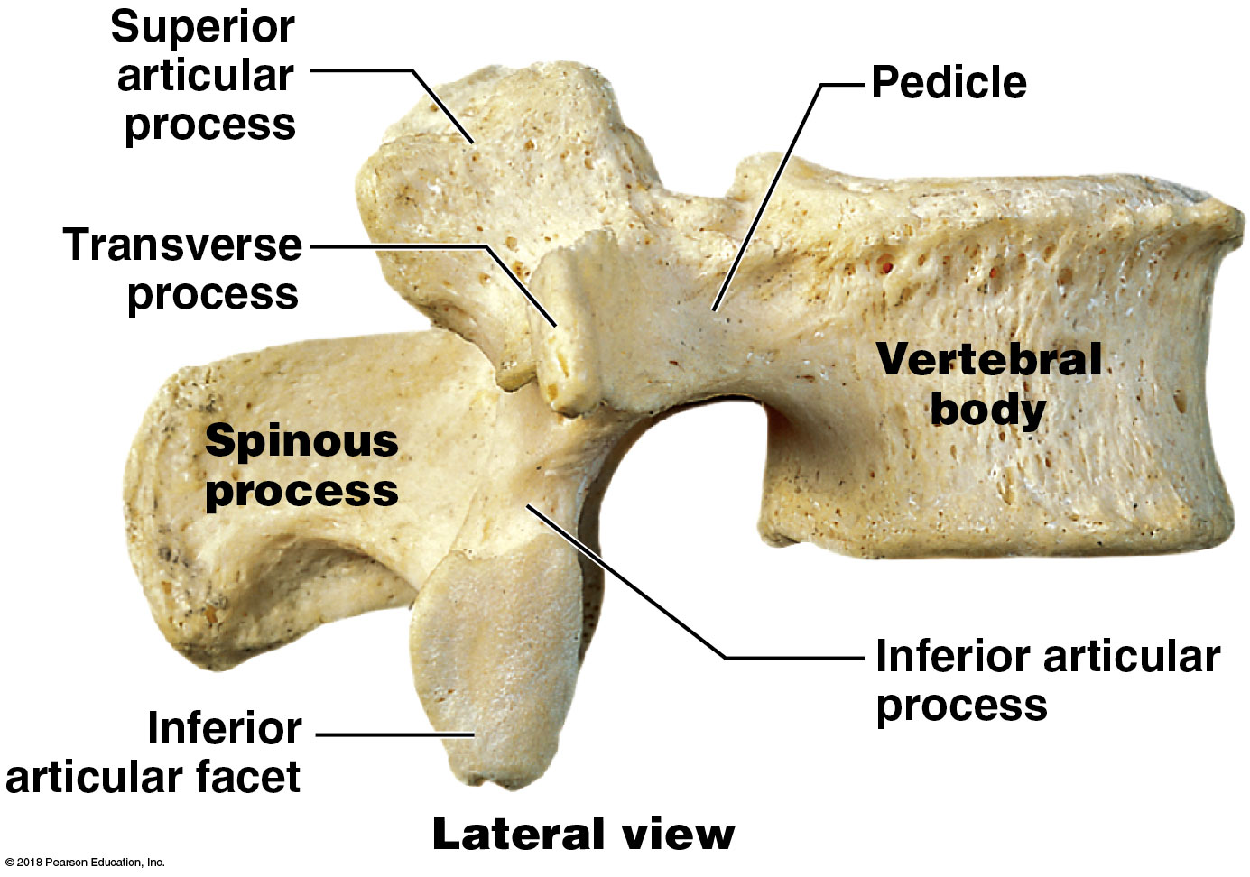
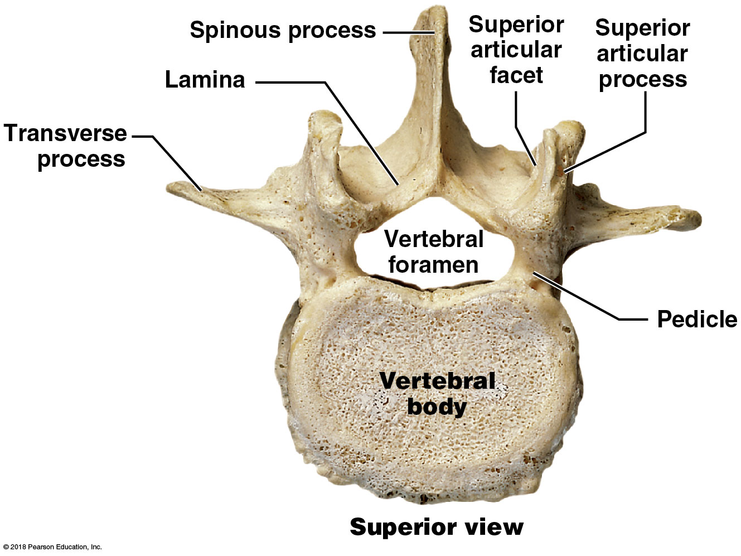
Module 7.12: Lumbar vertebrae
Lumbar vertebrae features
No costal facets
Slender transverse processes
Triangular vertebral foramen
Stumpy spinous process
Superior articular processes face medially
Inferior articular processes face laterally

Slide 109
Video: Lumbar Vertebra

Slide 110
Module 7.12: Review
How many vertebrae are in the lumbar region of the vertebral column?
Why are the bodies of lumbar vertebrae so large?
Learning Outcome: Describe the distinctive structural and functional characteristics of the lumbar vertebrae.

Slide 111
Module 7.13: The sacrum and coccyx consist of fused vertebrae
Sacrum
Five fused vertebrae
Begin fusing after puberty
Completely fused by age 25–30
Transverse lines mark former boundaries of individual vertebrae
Protects reproductive, digestive, and urinary organs
Attaches the axial skeleton to the appendicular skeleton
Anterior surface concave; posterior surface convex
Curvature more pronounced in males than females

Slide 112
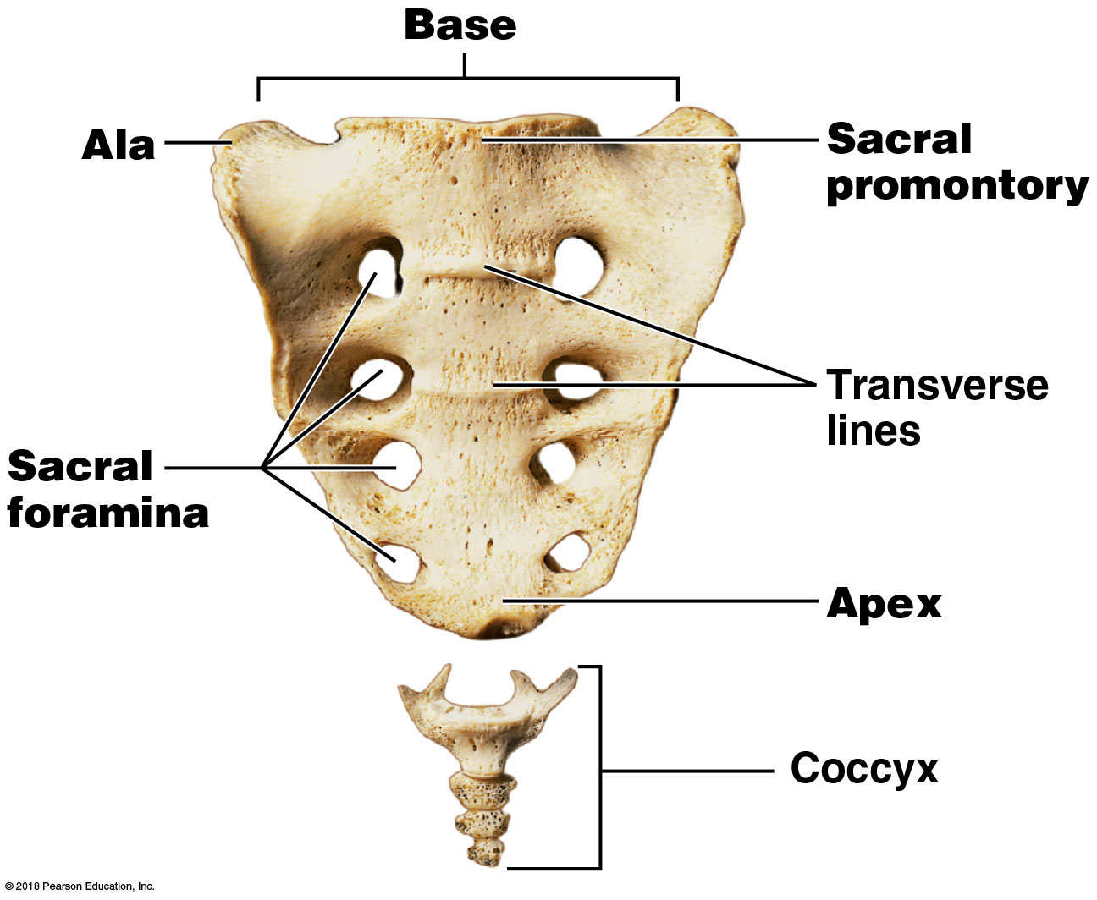
Module 7.13: The sacrum and the coccyx
Sacrum features
Base
Broad, superior surface
Ala, or wing
Extends to each side from the base
Sacral promontory
Important landmark in female pelvic exams and in labor and delivery
Notes:
This is an anterior view.

Slide 113
Module 7.13: The sacrum and the coccyx
Sacrum features (continued)
Sacral foramina
Intervertebral foramina of fused vertebrae
Apex
Narrow, inferior portion

Slide 114
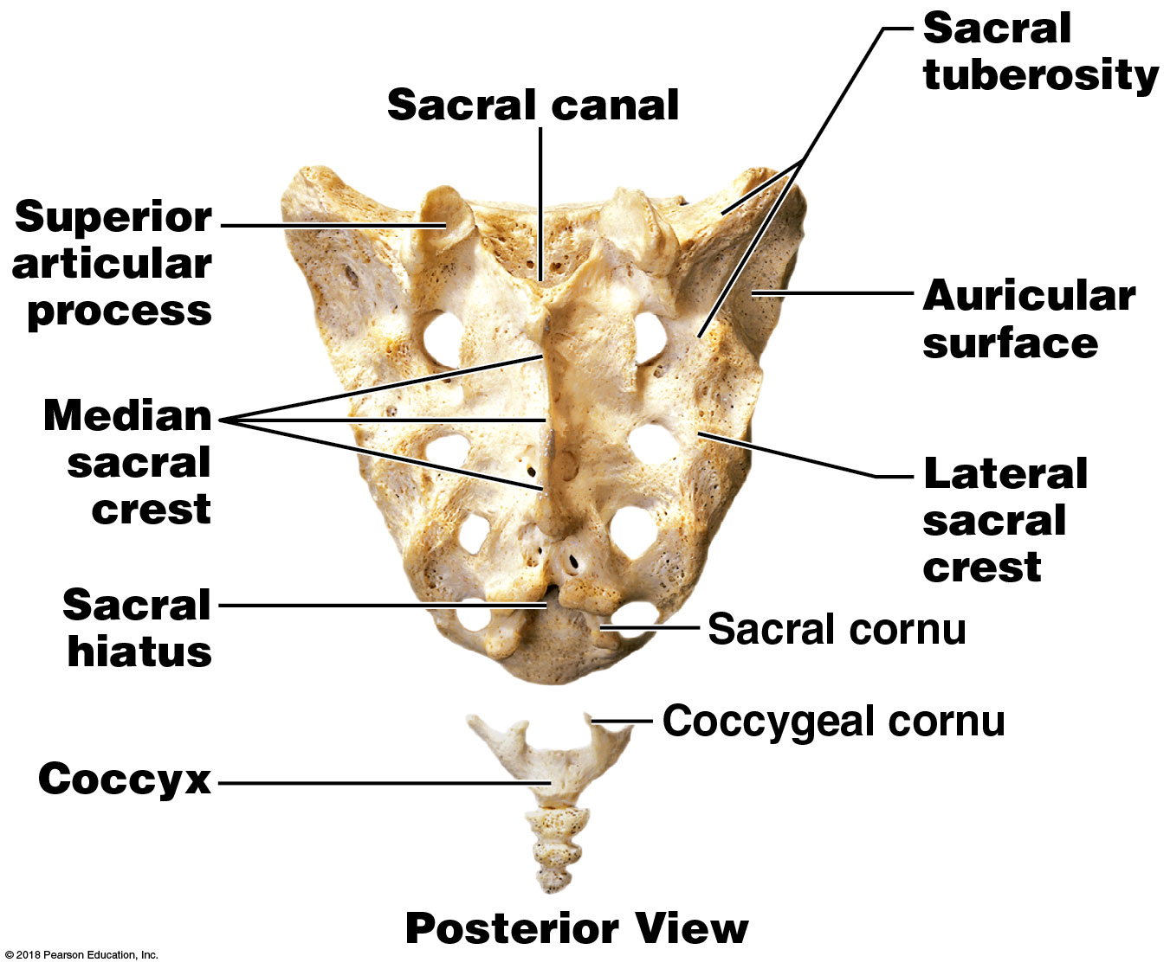
Module 7.13: The sacrum and the coccyx
Sacrum features (continued)
Sacral canal
Passageway extending the length of the sacrum
Contains nerves and membranes of the spinal cord
Auricular surface
Thickened, flattened lateral surfaces
Site of articulation with pelvic bones (sacro-iliac joint)
Notes:
Show students how they can tell anterior and posterior surfaces of the sacrum. The median sacral crest represents the remnants of the spinous processes, and the sacral promontory represents the fused bodies of the individual sacral vertebrae that fuse.

Slide 115
Module 7.13: The sacrum and the coccyx
Sacrum features (continued)
Sacral tuberosity
Roughened area posterior to auricular surface
Attachment site of sacro-iliac joint ligaments
Superior articular process
Articulates with last lumbar vertebra

Slide 116
Module 7.13: The sacrum and the coccyx
Sacrum features (continued)
Median sacral crest
Ridge formed by fused spinous processes of sacral vertebrae
Lateral sacral crest
Ridge from fused transverse processes of sacral vertebrae
Sacral hiatus
Opening at inferior end of sacral canal

Slide 117
Module 7.13: The sacrum and the coccyx
Coccyx
Three to five fused vertebrae
Begin fusing about age 26
Coccygeal cornu
Curves to met sacral cornu superior to it

Slide 118
Video: Sacrum and Coccyx

Slide 119
Module 7.13: Review
Which bone of the axial skeleton joins with the hip bones of the appendicular skeleton?
Which regions of the vertebral column do not consist of individual vertebrae?
Learning Outcome: Describe the distinctive structural and functional characteristics of the sacrum and coccyx.

Slide 120
Module 7.14: The thoracic cage protects organs in the chest and provides sites for muscle attachment
Thoracic cage overview
Provides bony support to thoracic cavity walls
Protects heart, lungs, thymus, and other thoracic cavity organs
Composed of thoracic vertebrae, ribs, and sternum
Ribs and sternum form the rib cage
Attachment for muscles involved in:
Breathing
Maintaining position of the vertebral column
Moving the pectoral girdles and upper limbs

Slide 121
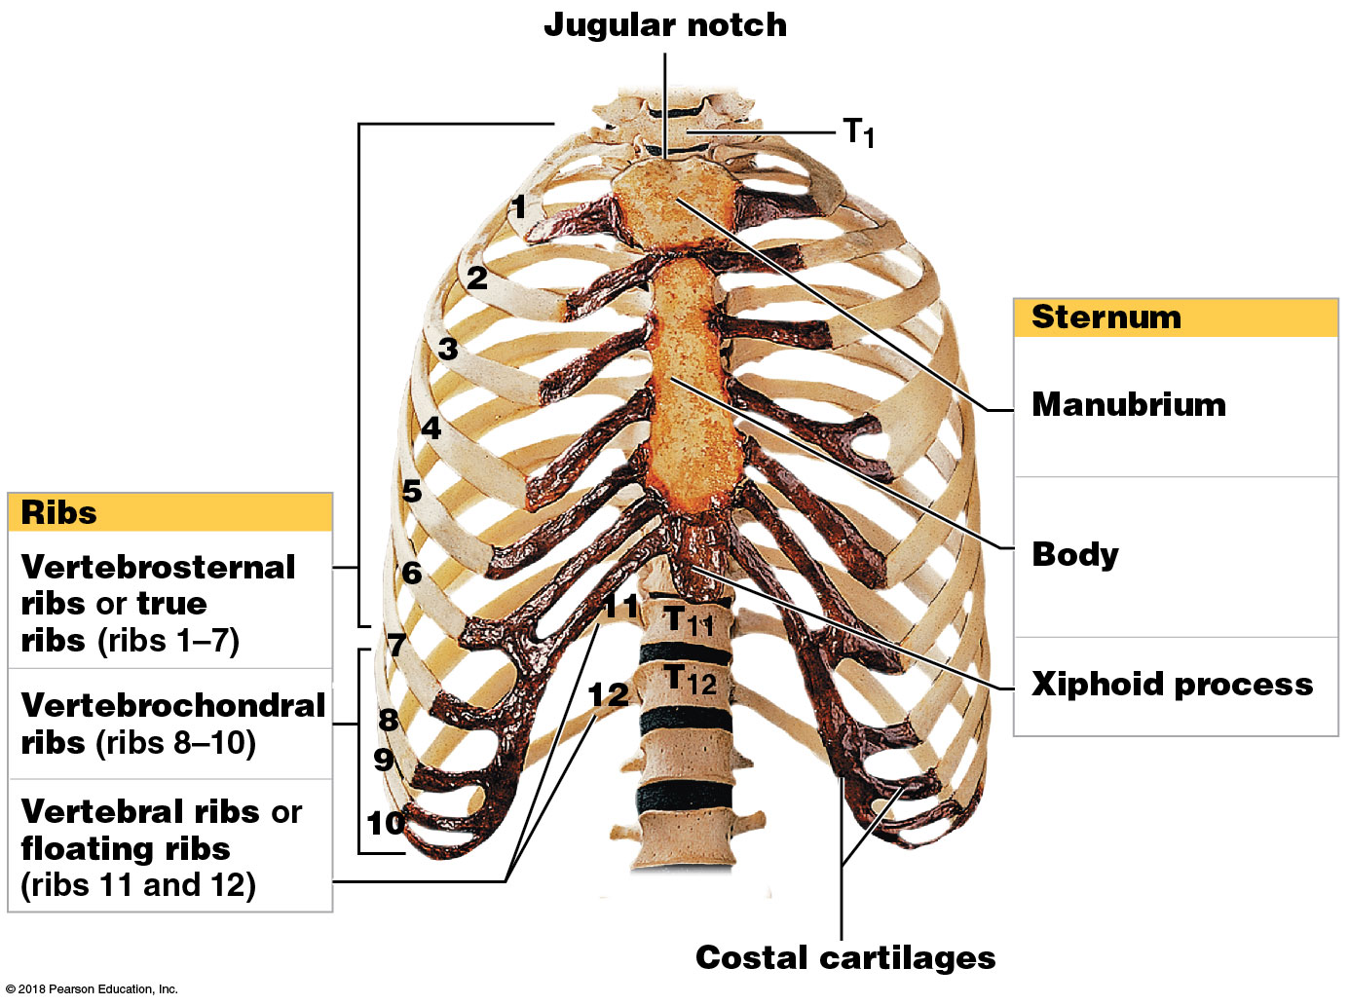
Module 7.14: The thoracic cage
Sternum
​Manubrium
Trapezoid-shaped superior portion
​Body
Attaches to inferior surface of the manubrium
​Xiphoid process
Attached to inferior portion of body

Slide 122
Module 7.14: The thoracic cage
Ribs
Vertebrosternal ribs (ribs 1–7)
Connect to sternum by individual costal cartilages
Also called true ribs
Vertebrochondral ribs (ribs 8–10)
Connect to sternum by shared costal cartilages

Slide 123
Module 7.14: The thoracic cage
Ribs (continued)
Vertebral ribs (ribs 11 and 12)
No connection to sternum
Also known as floating ribs
Ribs 8–12 also called false ribs

Slide 124
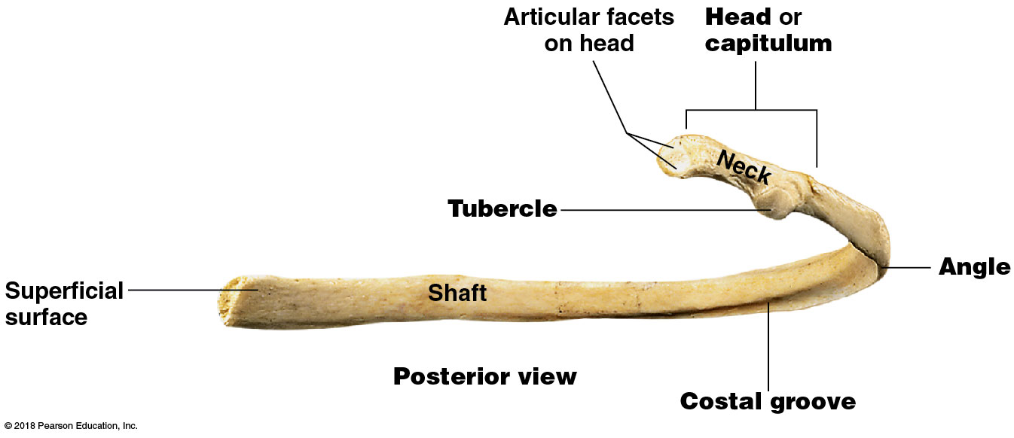
Module 7.14: The thoracic cage
Ribs (continued)
Costal groove on the inferior border
Marks path of nerves and blood vessels
Shaft
Tubular body of the rib
Angle
Where shaft begins curving toward sternum

Slide 125
Module 7.14: The thoracic cage
Ribs (continued)
Head or capitulum
Vertebral end of the rib where rib articulates with vertebral column at specific points (articular facets)
Tubercle
Contains articular facet that contacts the transverse process of a thoracic vertebra

Slide 126
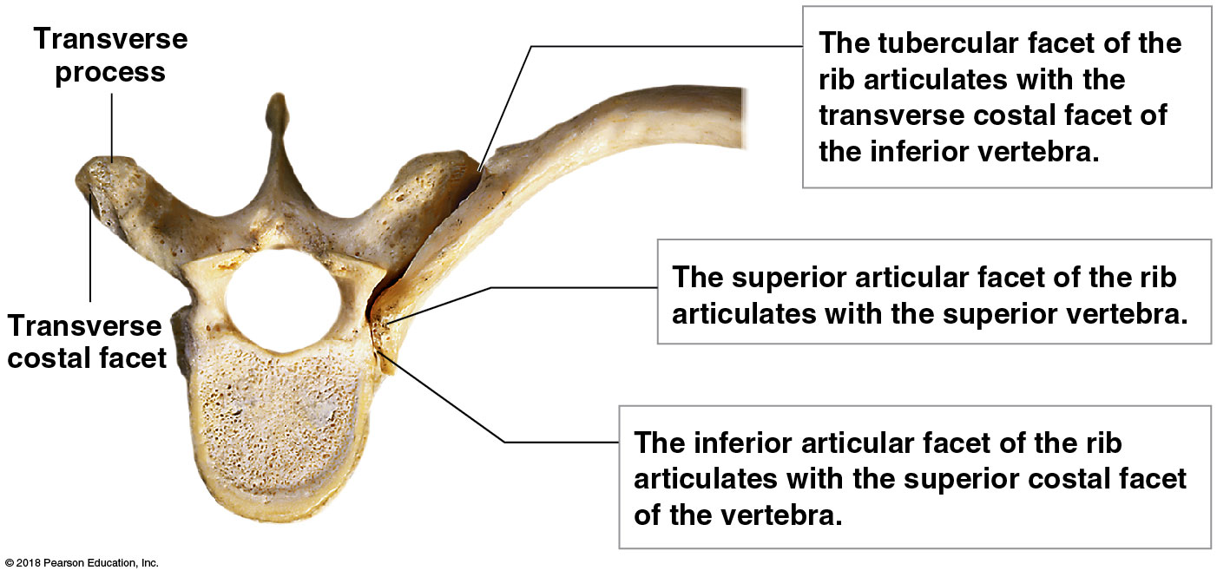
Module 7.14: The thoracic cage
Rib articulations with a thoracic vertebra
Ribs 2–9
Heads articulate with costal facets of two adjacent vertebrae

Slide 127
Module 7.14: The thoracic cage
Rib articulations with a thoracic vertebra (continued)
Ribs 1, 10, 11, and 12
Heads articulate with single costal facet of individual vertebrae
Tubercular facets of ribs 1 and 10 attach to transverse costal facets
No tubercular facets on ribs 11 and 12

Slide 128
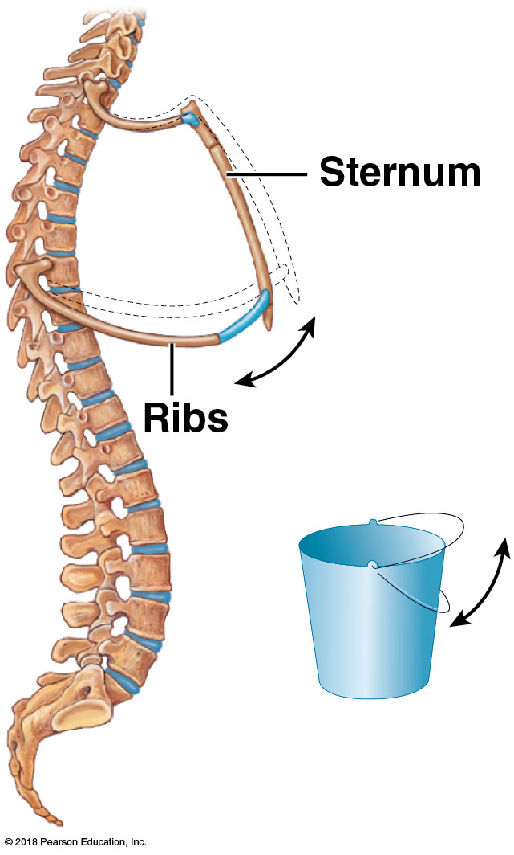
Module 7.14: The thoracic cage
Movement of ribs
Typical rib acts like a bucket handle held out to the side horizontally
Pushing down moves rib inward
Pulling up moves rib outward
Movements affect width and depth of thoracic cage
Increases or decreases volume

Slide 129
Module 7.14: Review
How are vertebrosternal ribs distinguished from vertebrochondral ribs?
Why are ribs 11 and 12 called floating ribs?
Along with the ribs and sternum, what other bones make up the thoracic cage?
Learning Outcome: Explain the significance of the articulations between the thoracic vertebrae and the ribs, and between the ribs and sternum.

Slide 130
Section 2: Appendicular Skeleton
Learning Outcomes
7.15 List the four major components of the appendicular skeleton.
7.16 Identify the bones that form the pectoral girdles, their functions, and their superficial features.
7.17 Identify the bones of the arm and forearm, their functions, and their bone markings.
7.18 Identify the bones of the wrist and hand, and describe their locations using anatomical terminology.

Slide 131
Section 2: Appendicular Skeleton
Learning Outcomes (continued)
7.19 Describe the hip bones that form the pelvic girdle, their functions, and their bone markings.
7.20 Identify the bones of the pelvis.
7.21 Discuss the differences between the male and female skeletons.
7.22 Identify the bones of the thigh and leg, their functions, and their bone markings.
7.23 Identify the bones of the ankle and foot, and describe their locations using anatomical terminology.

Slide 132
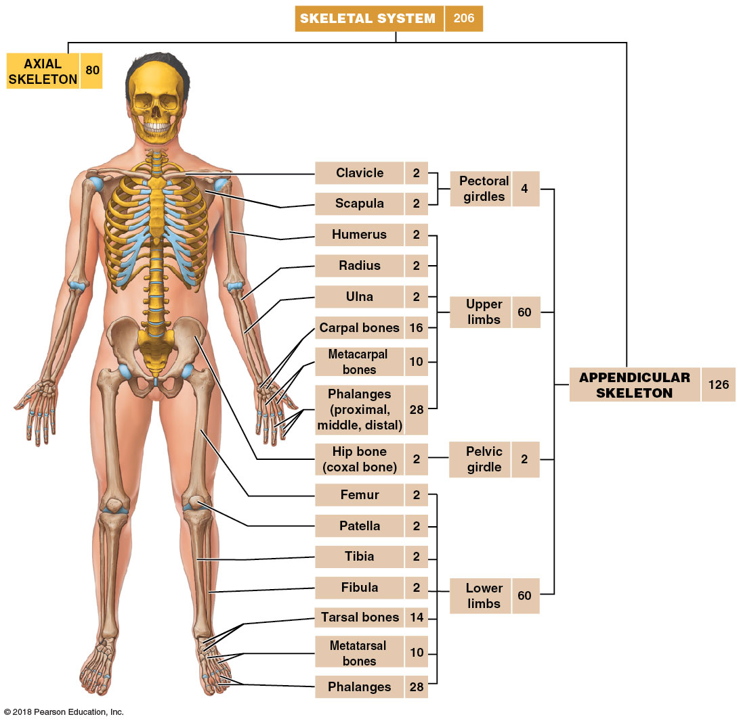
Module 7.15: The appendicular skeleton includes the limb bones and the pectoral and pelvic girdles
Appendicular skeleton
Includes bones of the limbs and supporting bone girdles that connect the limbs to the trunk
Notes:
Additional resource: PAL 3.0—Anatomical Models—Appendicular Skeleton.

Slide 133
Module 7.15: Review
How many bones are in the appendicular skeleton?
What is the function of the pectoral and pelvic girdles?
Learning Outcome: List the four major components of the appendicular skeleton.

Slide 134
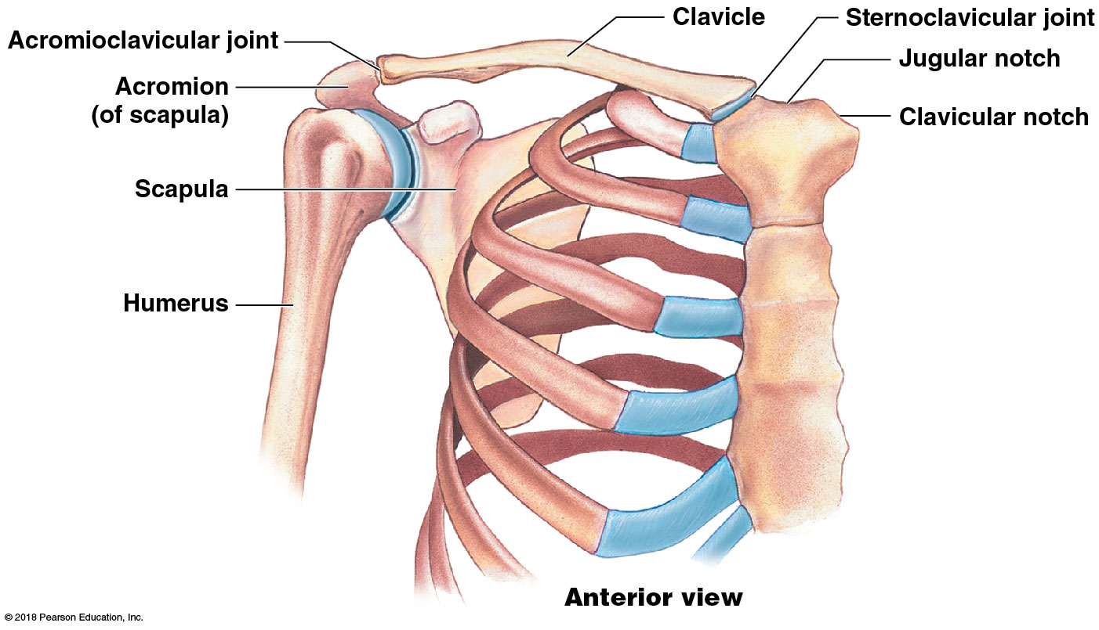
Module 7.16: The pectoral girdles—the clavicles and scapulae—connect the upper limbs to the axial skeleton
Pectoral girdle, or shoulder girdle
Joins the arms to the trunk
Each consists of:
An S-shaped clavicle
A broad, flat scapula

Slide 135
Module 7.16: The pectoral girdles
Clavicle
Originates at articulation with the superior, lateral border of the manubrium of the sternum (lateral to jugular notch)
Forms the sternoclavicular joint
Only articulation between pectoral girdle and the axial skeleton
Sternal end of the clavicle
Pyramid shaped
Curves laterally and posteriorly then forms a posterior curve to the scapula

Slide 136
Module 7.16: The pectoral girdles
Clavicle (continued)
Articulates with acromion of scapula at the clavicular notch
Forms the acromioclavicular joint
Stabilizing ligaments attach to conoid tubercle and costal tuberosity
Acromial end of the clavicle
Flatter, broader than sternal end
Rough inferior surface bearing lines and tubercles

Slide 137
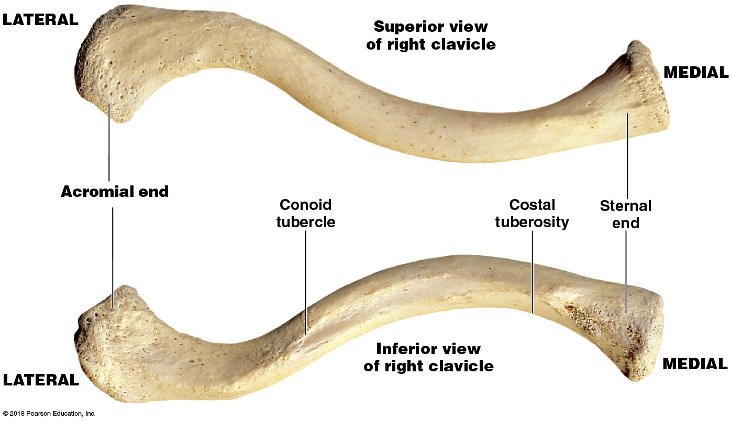
The clavicle

Slide 138
Module 7.16: The pectoral girdles
Scapula
Anterior surface forms smooth, broad triangle
Three sides (muscle attachment sites)
Superior border
Medial (vertebral) border
Lateral (axillary) border
Notes:
Students struggle with differentiating between the anterior and posterior surfaces of the scapula. Remind them that the spinous processes of the vertebrae are posterior, and so is the spine of the scapula.

Slide 139
Module 7.16: The pectoral girdles
Scapula (continued)
Corners of the triangle
Superior angle
Inferior angle
Lateral angle (location of the glenoid cavity)
Subscapular fossa
Depression on the anterior scapular surface

Slide 140
Module 7.16: The pectoral girdles
Scapula (continued)
Glenoid cavity
Cup-shaped depression
Where scapula articulates with the humerus, forming the glenohumoral joint

Slide 141
Module 7.16: The pectoral girdles
Scapula (continued)
Acromion
Large process that extends laterally
Projects posterior and superior to the glenoid cavity
Continuous with the scapular spine
Coracoid process
Projects anterior and superior to glenoid cavity

Slide 142
Module 7.16: The pectoral girdles
Scapula (continued)
Posterior surface is convex with prominent ridges and processes for muscle attachment
Scapular spine
Ridge crossing the posterior surface of the scapular body
Continuous with the acromion
Ends at the medial border of the body

Slide 143
Module 7.16: The pectoral girdles
Scapula (continued)
Supraspinous fossa (supra, above)
Depression superior to the scapular spine
Infraspinous fossa (infra, below)
Region inferior to scapular spine

Slide 144
Module 7.16: Review
Name the bones of the pectoral girdles.
How would a broken clavicle affect the mobility and stability of the scapula?
Which bone articulates with the scapula at the glenoid cavity?
How are the pectoral girdles of the appendicular skeleton attached to the axial skeleton?
Learning Outcome: Identify the bones that form the pectoral girdles, their functions, and their superficial features.

Slide 145
Module 7.17: The humerus of the arm articulates with the radius and ulna of the forearm
Upper limb
Consists of bones of the:
Arm (shoulder to elbow)
Humerus
Forearm (elbow to wrist)
Ulna
Radius
Wrist
Carpals
Hands
Metacarpals and phalanges

Slide 146
Module 7.17: Bones of the arm and forearm
Humerus
Only bone in the arm (brachium)
Shaft expands at distal end to form epicondyles
Provide additional surface area for muscle attachment
Medial epicondyle
Lateral epicondyle

Slide 147
Module 7.17: Bones of the arm and forearm
Humerus (continued)
Head
Proximal end that articulates with the glenoid cavity
Anatomical neck
Marks the extent of the joint capsule
Surgical neck
Corresponds to the metaphysis of growing bone
Typical site for fractures

Slide 148
Module 7.17: Bones of the arm and forearm
Humerus (continued)
Greater tubercle
Rounded projection on lateral epiphyseal surface
Establishes lateral contour of the shoulder
Lesser tubercle
Smaller projection on anterior medial surface of the epiphysis

Slide 149
Module 7.17: Bones of the arm and forearm
Humerus (continued)
Intertubercular sulcus (intertubercular groove, or bicipital groove)
Between the greater and lesser tubercles (both important muscle attachment sites)
Large tendon runs through the groove

Slide 150
Module 7.17: Bones of the arm and forearm
Humerus (continued)
Deltoid tuberosity
Large, rough elevation on the lateral humeral shaft
Attachment site for deltoid muscle

Slide 151
Module 7.17: Bones of the arm and forearm
Humerus (continued)
Radial groove
Crosses inferior end of deltoid tuberosity
Marks path of radial nerve
Radial fossa
Shallow depression on anterior humeral surface

Slide 152
Module 7.17: Bones of the arm and forearm
Humerus (continued)
Condyle
Site where humerus articulates with both radius (radiohumeral joint) and ulna (humero-ulnar joint)
Divided into two regions:
​Capitulum
Rounded portion forming lateral surface
Articulates with the radius

Slide 153
Module 7.17: Bones of the arm and forearm
Humerus (continued)
Condyle (continued)
​Trochlea (trochlea, a pulley)
Forms medial surface
Extends from olecranon fossa (posterior) to coronoid fossa (anterior)
These depressions accept projections of ulna

Slide 154
Module 7.17: Bones of the arm and forearm
Ulna and radius
Parallel bones that support the forearm (antebrachium)
Shafts are connected by the interosseous membrane of the forearm

Slide 155
Module 7.17: Bones of the arm and forearm
Ulna and radius (continued)
Proximal radio-ulnar joint
Radial notch on ulna articulates with radial head
Distal radio-ulnar joint
Lateral surface of head of ulna articulates with ulnar notch on distal end of radius

Slide 156
Module 7.17: Bones of the arm and forearm
Features of the ulna
Olecranon
Proximal end of ulna forming the point of the elbow
Trochlear notch
Articulates with the trochlea of the humerus
Coronoid process
Forms inferior lip of trochlear notch
Fits into coronoid fossa of humerus during flexion
Notes:
Have students palpate the bump that we commonly refer to as the elbow and ask them what part that is (the olecranon). Then show them, using bones, how the trochlear notch pivots against the trochlea of the humerus.

Slide 157
Module 7.17: Bones of the arm and forearm
Features of the ulna (continued)
Head of ulna (ulnar head)
Slender, rounded distal end of the ulna
Ulnar styloid process
Pointed projection on lateral surface of ulnar head

Slide 158
Module 7.17: Bones of the arm and forearm
Features of the radius
Radial head
Disc-shaped proximal end of the radius
Articulates with the capitulum of humerus
Neck of the radius
Extends from the radial head to radial tuberosity
Radial tuberosity
Attachment site for the biceps brachii muscle

Slide 159
Module 7.17: Bones of the arm and forearm
Features of the radius (continued)
Ulnar notch of the radius
Site of articulation with the head of the ulna
Radial styloid process
Pointed projection on the distal end of the radius
Helps stabilize the wrist joint

Slide 160
Module 7.17: Review
Identify the two rounded projections on either side of the elbow, and state to which bone they belong.
Which bone of the forearm is positioned laterally while in anatomical position?
Name four different bone markings associated with the proximal portion of the ulna.
Learning Outcome: Identify the bones of the arm and forearm, their functions, and their bone markings.

Slide 161
Module 7.18: The wrist consists of carpal bones …
Carpus, or wrist
Eight carpal bones arranged in two rows
Proximal carpal bones
​Scaphoid (skaphe, boat)
Closest to styloid process of radius
​Lunate (luna, moon)
Articulates with the radius

Slide 162
Module 7.18: Bones of the wrist
Carpus, or wrist (continued)
Proximal carpal bones (continued)
​Triquetrum (triquetrus, three-cornered)
Articulates with articular disc separating the ulna from the wrist
​Pisiform (pisum, pea)
Pea-shaped
Anterior to the triquetrum

Slide 163
Module 7.18: Bones of the wrist
Distal carpal bones
​Trapezium (trapezion, table)
Proximal surface articulates with scaphoid
​Trapezoid
Wedge-shaped bone medial to trapezium
Also articulates with the scaphoid

Slide 164
Module 7.18: Bones of the wrist
Distal carpal bones (continued)
​Capitate (caput, head)
Largest carpal bone
Between the trapezoid and hamate
​Hamate (hamatum, hooked)
Medial distal carpal bone
Prominent hook projects anteriorly

Slide 165
Module 7.18: … and the hand consists of metacarpal bones and phalanges
Bones of the hand
Metacarpal bones
Identified by Roman numerals I–V starting on the lateral side
Metacarpal I articulates with trapezium and the thumb
Notes:
Students sometimes mix up metacarpals and phalanges because they look so similar. Have them palpate the long bones within the palm of their hands. These are the metacarpals.

Slide 166
Module 7.18: Bones of the hand
Bones of the hand (continued)
Phalanges, or finger bones
Articulate with the metacarpals
14 phalanges per hand
Pollex (thumb) has two phalanges (proximal and distal)
All other fingers have three phalanges (proximal, middle, and distal)

Slide 167
Video: The Hand

Slide 168
Module 7.18: Review
Name the carpal bones.
Define phalanges.
Bill accidentally fractures his first distal phalanx with a hammer. Which finger is broken?
Learning Outcome: Identify the bones of the wrist and hand, and describe their locations using anatomical terminology.

Slide 169
Module 7.19: The hip bone forms by the fusion of the ilium, ischium, and pubis
Pelvic girdle
Composed of two hip bones, also called coxal bones or innominate (“no-name”) bones
Each hip bone is formed by the fusion of three bones
​Ilium
​Ischium
​Pubis

Slide 170
Module 7.19: The hip bone
Pelvic girdle (continued)
Pubic symphysis
Fibrocartilage pad connecting the right and left pubic bones

Slide 171
Module 7.19: The hip bone
Features seen in a lateral view
Iliac spines (posterior superior, posterior inferior, anterior superior, and anterior inferior)
Attachment sites for important muscles and ligaments
Gluteal lines (anterior and posterior)
Attachment site for large hip muscles

Slide 172
Module 7.19: The hip bone
Features seen in a lateral view (continued)
Greater sciatic notch
Passage of sciatic nerve to lower limb
Iliac crest
Important ridge for muscle attachment

Slide 173
Module 7.19: The hip bone
Features seen in a lateral view (continued)
Ischial spine
Projects superior to lesser sciatic notch
Marks passage of blood vessels, nerves, and small muscle
Ischial tuberosity
Roughened projection
Bears body weight when seated

Slide 174
Module 7.19: The hip bone
Features seen in a lateral view (continued)
Acetabulum (acetabulum, vinegar cup)
Concave socket formed by all three fused bones
Articulates with head of femur
Smooth, cup-shaped surface (lunate surface)
Gap in inferior portion of bony rim (acetabular notch)

Slide 175
Module 7.19: The hip bone
Features seen in a medial view
Iliac fossa
Shallow depression
Helps support abdominal organs
Provides area for muscle attachment
Pectineal line
Ridge that ends in pubic tubercle (small, elevated area anterior and lateral to the pubic symphysis)

Slide 176
Module 7.19: The hip bone
Features seen in a medial view (continued)
Arcuate line of the ilium
Continuous with the pectineal line of the pubis
Auricular surface of the ilium
Articulates with auricular surface of the sacrum at the sacro-iliac joint

Slide 177
Module 7.19: The hip bone
Features seen in a medial view (continued)
Iliac tuberosity
Roughened area superior to the auricular surface
Ligaments from here stabilize sacro-iliac joint

Slide 178
Module 7.19: The hip bone
Features seen in a medial view (continued)
Obturator foramen
Space that is closed by sheet of collagen fibers
Inner and outer surfaces provide base for muscle attachment
Bounded by the ischial ramus, inferior pubic ramus, and superior pubic ramus

Slide 179
Video: Hip Bone

Slide 180
Module 7.19: Review
Which three bones fuse to make up a hip bone?
Describe the acetabulum.
When you are seated, which part of the hip bone bears your body’s weight?
Which bones articulate at the sacro-iliac joint?
Learning Outcome: Describe the hip bones that form the pelvic girdle, their functions, and their bone markings.

Slide 181
Module 7.20: The pelvis consists of the two hip bones, the sacrum, and the coccyx
Pelvis
Contains bones of the:
Axial skeleton (sacrum and coccyx)
Appendicular skeleton (hip bones)
Extensive network of ligaments connect sacrum with:
Iliac crest
Ischial tuberosity
Ischial spine
Arcuate line

Slide 182
Module 7.20: The pelvis consists of the two hip bones, the sacrum, and the coccyx
Pelvis (continued)
Other ligaments connect the ilia to the lumbar vertebrae
Sacro-iliac joint
Articulation between sacrum and adjacent ilium

Slide 183
The pelvis

Slide 184
Module 7.20: The pelvis
Divisions of the pelvis
​True (lesser) pelvis
Encloses the pelvic cavity
Superior limit is called pelvic brim
Encloses an opening called the pelvic inlet
Pelvic outlet
Opening bounded by coccyx, ischial tuberosities, ischial spines, and inferior pubic symphysis

Slide 185
Module 7.20: The pelvis
Divisions of the pelvis (continued)
​False (greater) pelvis
Consists of area enclosed by bladelike portions of ilia superior to pelvic brim

Slide 186
Module 7.20: Review
Name the bones of the pelvis.
The pubic bones are joined anteriorly by what structure?
Learning Outcome: Identify the bones of the pelvis.

Slide 187
Module 7.21: The adult male and female skeletons have significant differences
Female skull compared to male skull
Female skull 10% smaller; lighter and smoother
Female forehead more vertical
Female sinuses, teeth, and mandible smaller

Slide 188
Module 7.21: The male and female skeletons
Female pelvis compared to male pelvis
Differences due to variations in body size and muscle mass
Female pelvis is smaller, lighter, and with less prominent markings
Adaptations for childbearing
Enlarged pelvic outlet
Broader pubic angle (greater than 100º)
Less curvature on sacrum and coccyx
Wider, more circular pelvic inlet
Broad, shallow pelvis
Ilia project farther laterally but not as far superiorly
Notes:
Most of the sex differences in the bony pelves are adaptations for childbearing. However, it is not uncommon for any single pelvis to have a blend of traits—some slightly more masculine, some more feminine.

Slide 189
Module 7.21: The male and female skeletons

Slide 190
Module 7.21: Review
How does the female skull differ from the male skull?
Learning Outcome: Discuss the differences between the male and female skeletons.

Slide 191
Module 7.22: The femur, tibia, and patella meet at the knee
Lower limb
Transfers the body weight to the ground
Consists of bones of the:
Thigh (proximal portion of the limb)
Femur
Leg (distal portion of the limb)
Tibia and fibula
Connected by the interosseous membrane
Kneecap–patella
Ankle–tarsals
Foot–metatarsals and phalanges

Slide 192
Module 7.22: Bones of the lower limb
Femur
Longest and heaviest bone in the body
Femoral head
Articulates with the pelvis at the acetabulum
Fovea capitis
Small pit in the center of the femoral head
Attaches the acetabulum to the femur

Slide 193
Module 7.22: Bones of the lower limb
Femur (continued)
Neck of the femur
Joins head to the shaft at about 125º
Greater trochanter
Large, rough projection extending laterally from head and shaft junction
Attachment site for large tendons

Slide 194
Module 7.22: Bones of the lower limb
Femur (continued)
Lesser trochanter
Smaller projection extending posteriorly and medially
Intertrochanteric line
Marks the edge of the articular capsule on the anterior surface

Slide 195
Module 7.22: Bones of the lower limb
Femur (continued)
Gluteal tuberosity
Attachment site for gluteus maximus muscle
Linea aspera
Attachment site for powerful hip muscles

Slide 196
Module 7.22: Bones of the lower limb
Femur (continued)
Popliteal surface (poples, hollow of knee)
Flattened triangular area on posterior surface

Slide 197
Module 7.22: Bones of the lower limb
Femur (continued)
Medial and lateral condyles
Part of the knee joint at distal end of femur
Separated by:
Patellar surface (anterior)
Smooth surface on which patella glides
Intercondylar fossa (posterior)

Slide 198
Module 7.22: Bones of the lower limb
Patella
Large sesamoid bone that forms in the quadriceps tendon
Base
Attachment area for quadriceps tendon
Apex
Attachment area for patellar ligament (connects patella to tibia)

Slide 199
Module 7.22: Bones of the lower limb
Patella (continued)
Lateral facet
For lateral condyle of femur
Medial facet
For medial condyle of femur

Slide 200
Module 7.22: Bones of the lower limb
Tibia (shinbone)
Large medial bone of leg
Intercondylar eminence
Ridge separating the medial and lateral tibial condyles
Tibial tuberosity
Attachment site of the patellar ligament
Anterior margin
Ridge beginning at tibial tuberosity, extending along anterior surface
Notes:
Have students palpate their own tibial tuberosities.

Slide 201
Module 7.22: Bones of the lower limb
Tibia (shinbone) (continued)
Medial malleolus (malleolus, hammer)
Medial projection of ankle that provides medial support for the ankle joint

Slide 202
Module 7.22: Bones of the lower limb
Fibula
Small, slender bone
Does not participate in knee joint; does not bear weight
Site of attachment for muscles of foot and toes
Head of the fibula
Articulates with the tibia
Lateral malleolus
Distal tip that extends lateral to the ankle
Provides lateral stability to the ankle

Slide 203
Module 7.22: Review
Identify the bones of the lower limb.
Which structure articulates with the acetabulum?
Identify the sesamoid bone of the lower limb.
The fibula neither participates in the knee joint nor bears weight. Yet when it is fractured, walking becomes difficult. Why?
Learning Outcome: Identify the bones of the thigh and leg, their functions, and their bone markings.

Slide 204
Module 7.23: The ankle and foot consist of tarsal bones, metatarsal bones, and phalanges
Functions of the ankle and foot bones
Ankle bones accept the body weight from the leg
Transfer that weight to the ground
Distribute the weight through the foot bones
Ankle and foot bones together:
Must be both strong and flexible to carry weight and deal with changes in distribution of that weight with various motions (walking, running, jumping)

Slide 205
Module 7.23: Bones of the ankle and foot
The ankle (tarsus)
Consists of seven tarsal bones
​Calcaneus (heel bone)
Body weight is transmitted from the talus to the calcaneus to the ground
Rough, knob-shaped projection on posterior portion for attachment of the calcaneal tendon (Achilles tendon)
Notes:
Remind students about the structure of the hand and have them compare that to the structure of the foot.

Slide 206
Module 7.23: Bones of the ankle and foot
The ankle (tarsus) (continued)
​Talus
Transmits body weight from tibia toward the toes
Trochlea
Spool- or pulley- shaped articular process between tibia and talus

Slide 207
Module 7.23: Bones of the ankle and foot
The ankle (continued)
​Navicular
Articulates with the talus and cuneiform bones
On medial side of the ankle
​Cuboid
Articulates with the anterior surface of the calcaneus

Slide 208
Module 7.23: Bones of the ankle and foot
The ankle (continued)
5–7. Cuneiform bones
Arranged in a row
Named according to their relative position (medial, intermediate, and lateral)

Slide 209
Module 7.23: Bones of the ankle and foot
Metatarsals
Identified by Roman numerals I–V from medial to lateral (metatarsal I articulates with hallux, or great toe)
I–III articulate with the cuneiform bones
IV and V articulate with the cuboid

Slide 210
Module 7.23: Bones of the ankle and foot
Phalanges (toe bones)
Same anatomical organization as fingers (14 bones)
Hallux (great toe) has two bones (proximal and distal)
All other toes have three bones (proximal, middle, distal)

Slide 211
Video: Foot

Slide 212
Module 7.23: Bones of the ankle and foot
Arches of the foot
Longitudinal arch
Formed from the ligaments and tendons connecting calcaneus to distal part of metatarsal bones
Allows for weight transfer (amount depends on position of foot and placement of weight)

Slide 213
Module 7.23: Bones of the ankle and foot
Arches of the foot (continued)
Longitudinal arch (continued)
Lateral (calcaneal) portion less elastic, so has much less curvature than medial (talar) portion
Result of difference is an elevated medial plantar surface
Allows room for inferior surface muscles, blood vessels, and nerves

Slide 214
Module 7.23: Bones of the ankle and foot
Arches of the foot (continued)
Transverse arch
Formed from the change in the degree of longitudinal curvature from medial to lateral border

Slide 215
Module 7.23: Bones of the ankle and foot
Dancer’s fracture
Fracture of the fifth metatarsal
Usually occurs while body weight is supported by the longitudinal arch (as in ballet dancing)

Slide 216
Module 7.23: Review
Identify the tarsal bones.
Which foot bone transmits the weight of the body from the tibia toward the toes?
Ten-year-old Joey jumps off the back porch, lands on his right heel, and breaks his foot. Which foot bone is likely broken?
Learning Outcome: Identify the bones of the ankle and foot, and describe their locations using anatomical terminology.

