Slide 2
Section 1: Functional Organization of the Muscular System
Learning Outcomes
10.1 ​Describe the general function of the body’s axial and appendicular muscles.
10.2 Describe fascicle organization, and explain how levers affect muscle efficiency.
10.3 Explain how the name of a muscle can help identify its location, appearance, or function.
10.4 Describe the separation of muscles into axial and appendicular divisions.

Slide 3
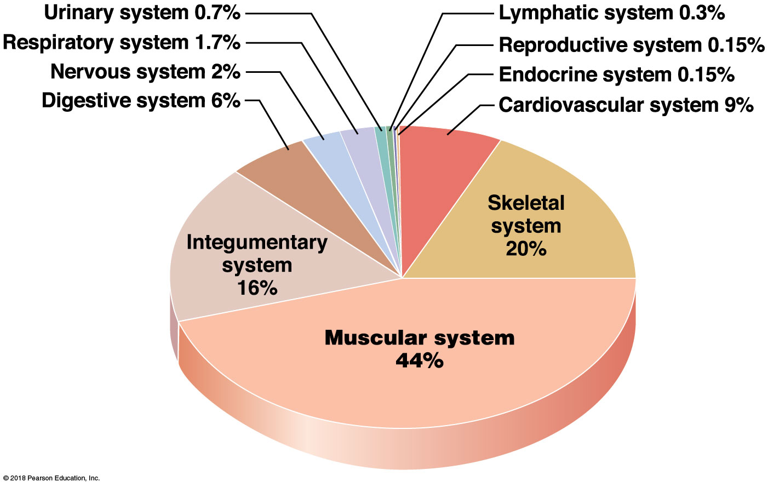
Module 10.1: The axial and appendicular muscles have different functions
Muscular system
~Half body weight, more than any other organ system
Contains ~700 muscles—vary widely (size, shape, function)
Performance varies by fiber organization and skeletal attachments

Slide 4
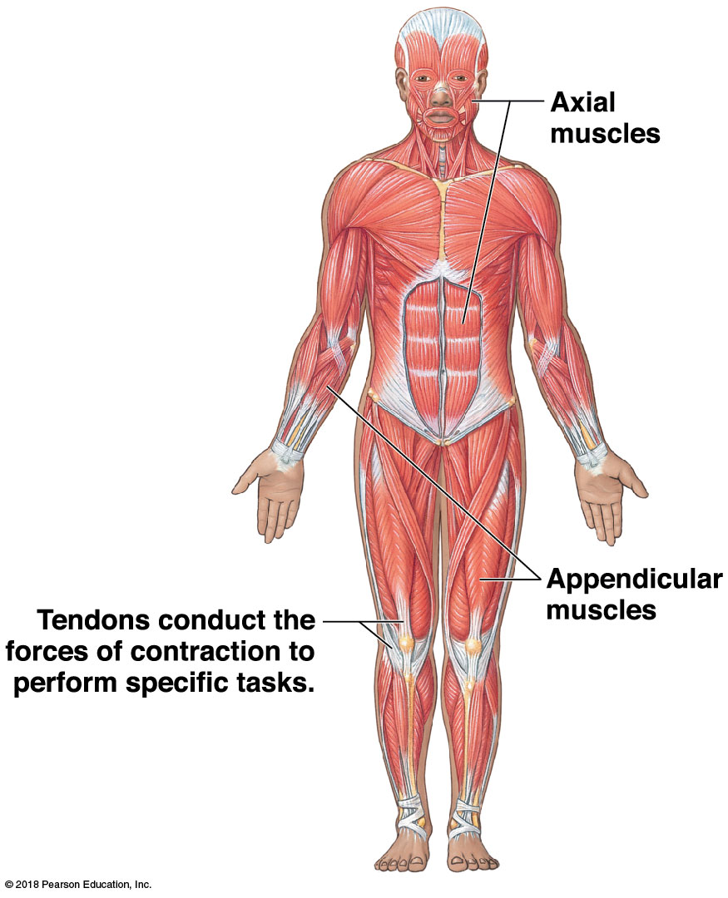
Module 10.1: Divisions of the muscular system
2 Divisions
Axial division
Axial muscles support and position axial skeleton
Appendicular division
Appendicular muscles support, move, and brace the limbs
Notes:
Additional resources: A&P Flix—origins, insertions, and innervations; and group muscle actions and joints.

Slide 5
Module 10.1: Review
What are the divisions and functions of the muscular system?
How many skeletal muscles are there in the body?
What factors influence the performance of a skeletal muscle?
Learning Outcome: Describe the general function of the body’s axial and appendicular muscles.

Slide 6
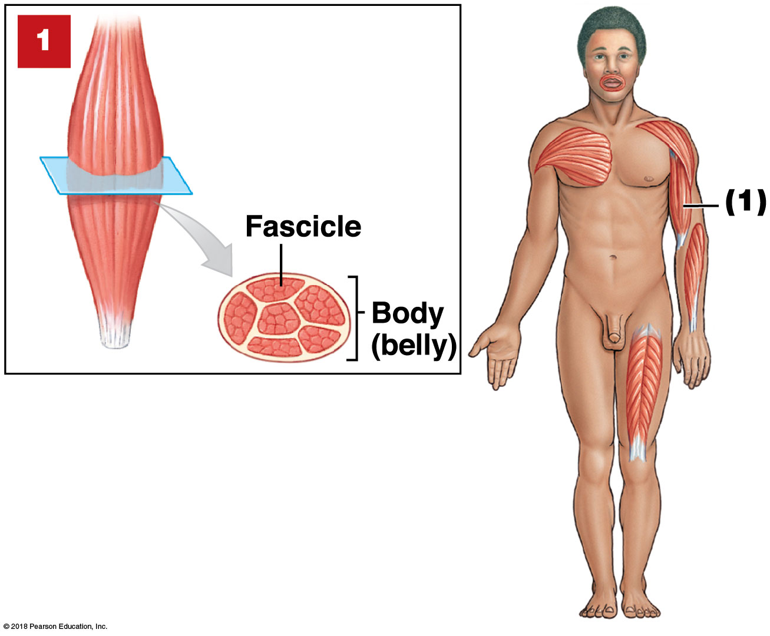
Module 10.2: Muscular power and range of motion are influenced by fascicle organization and leverage
Fascicle = bundle of muscle fibers within a skeletal muscle
Parallel muscle—fascicles parallel to long axis
Has central body (belly)
Muscle shortens ~30%
Examples:
Biceps brachii
Most skeletal muscles

Slide 7
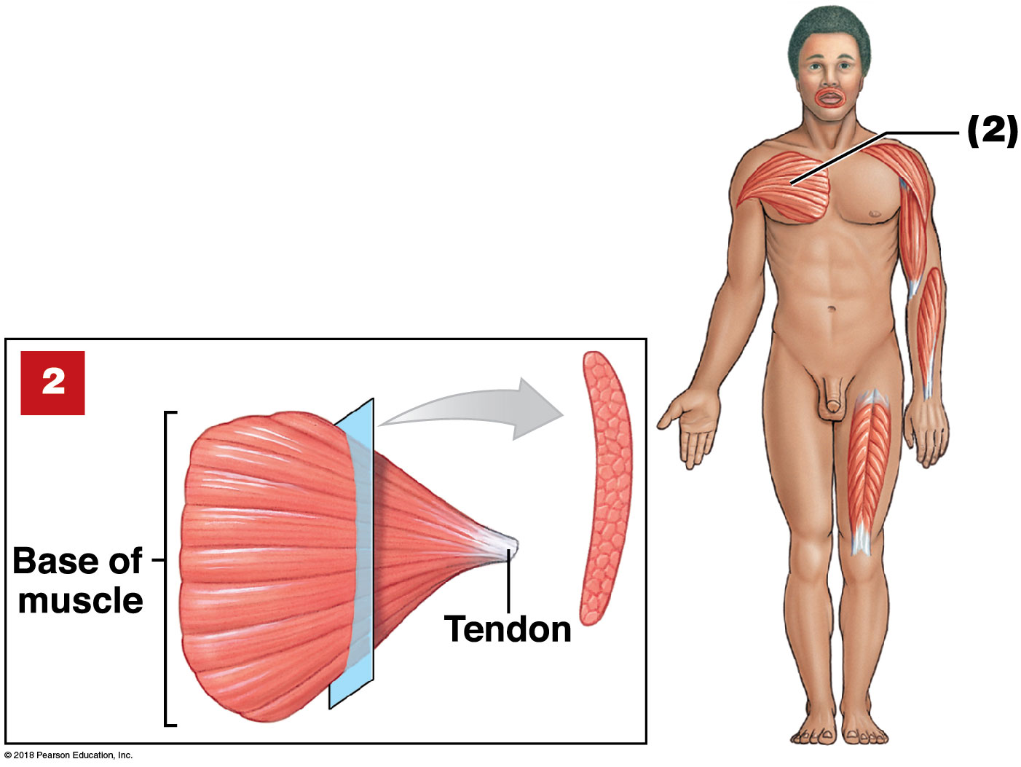
Module 10.2: Fascicle organization
Convergent muscle—fascicles extending over broad area converge on common attachment site
Versatile—different parts can pull different directions
Does not pull as hard on attachment as parallel muscles
Example:
Pectoralis major

Slide 8
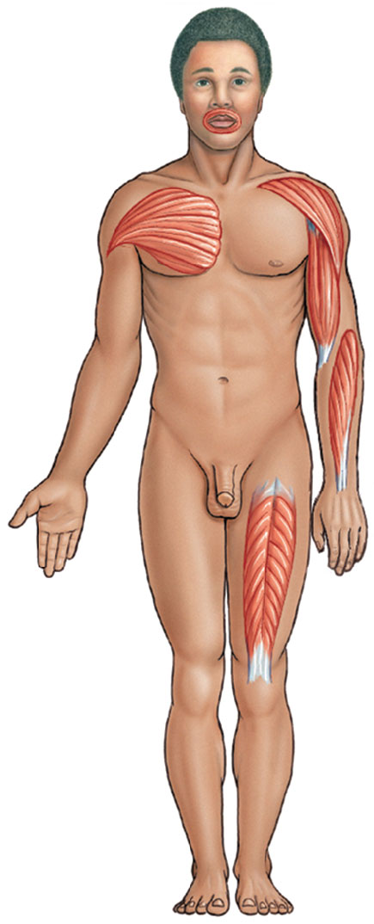
Module 10.2: Fascicle organization
Pennate muscle (penna, feather)— fascicles form angle with tendon
Fibers pull at angle
Tendon moves less than in parallel muscle
More fibers/myofibrils than same-sized parallel muscle
Produces more tension

Slide 9
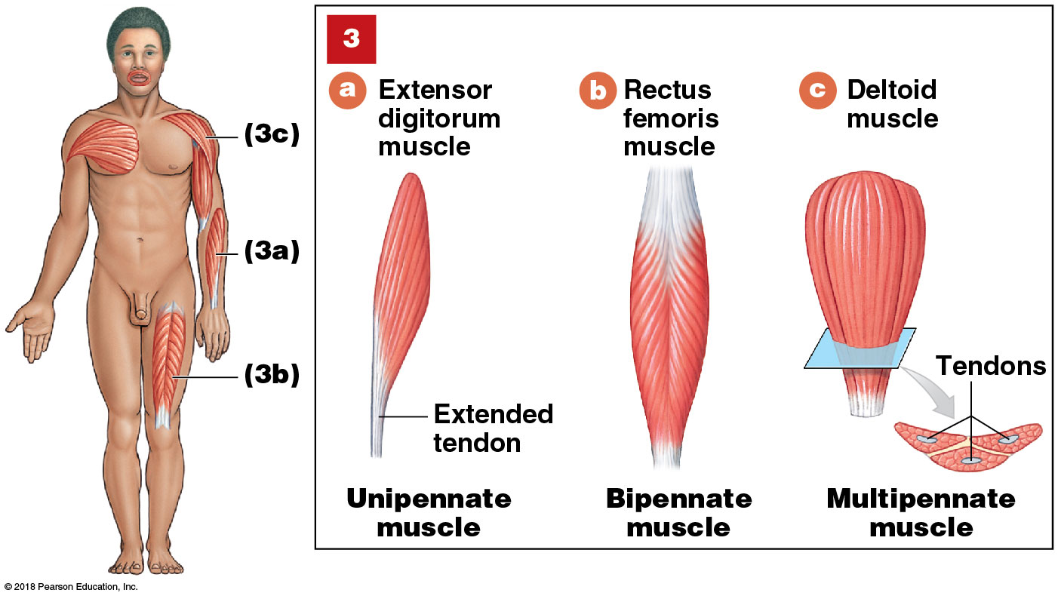
Module 10.2: Fascicle organization
3 Types of pennate muscles:
​Unipennate—all fibers are on one side of tendon (extensor digitorum)
​Bipennate—fibers insert on both sides of tendon (rectus femoris)
​Multipennate—tendon branches within pennate muscle (deltoid)
Notes:
Be sure students see the differences in the fascicle directions and relationship to the tendons in each image.

Slide 10
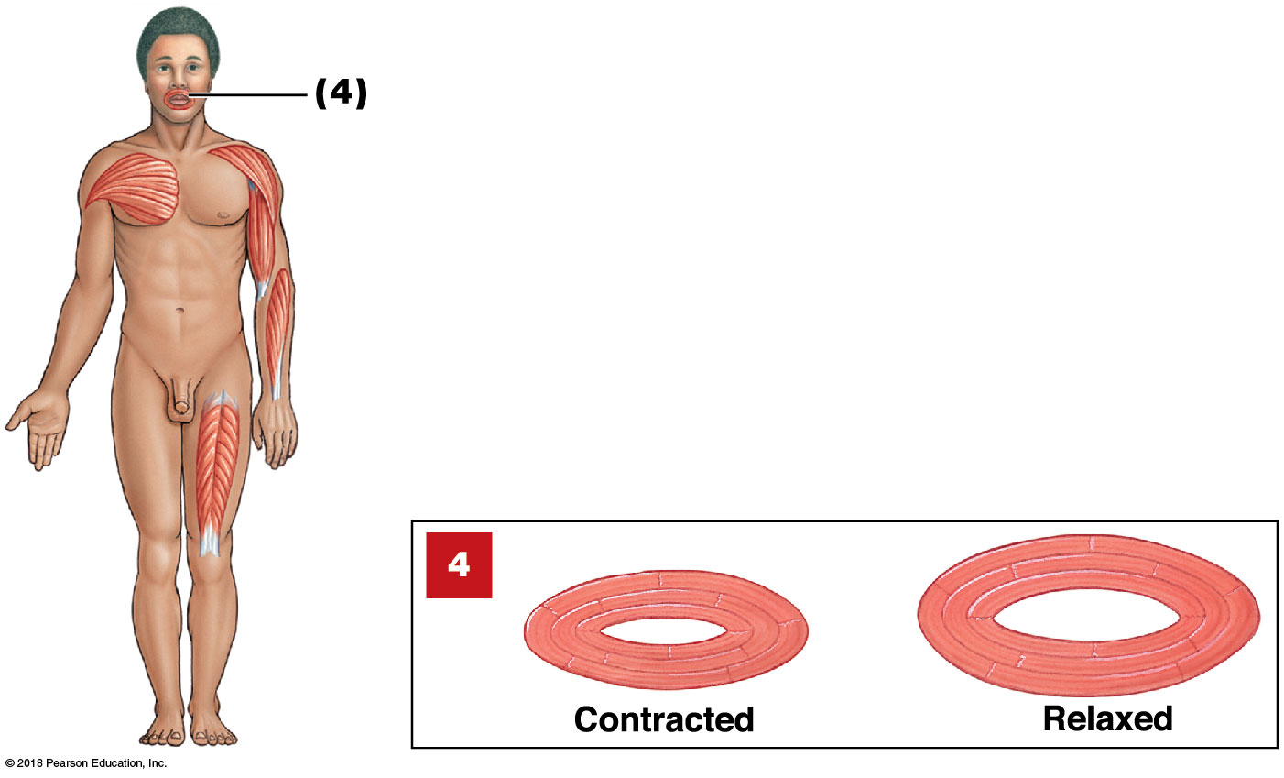
Module 10.2: Fascicle organization
Circular muscle or sphincter—fascicles in concentric circles
Encircle a duct, tube, or opening
Contraction decreases diameter of opening (constricts)
Example: orbicularis oris

Slide 11
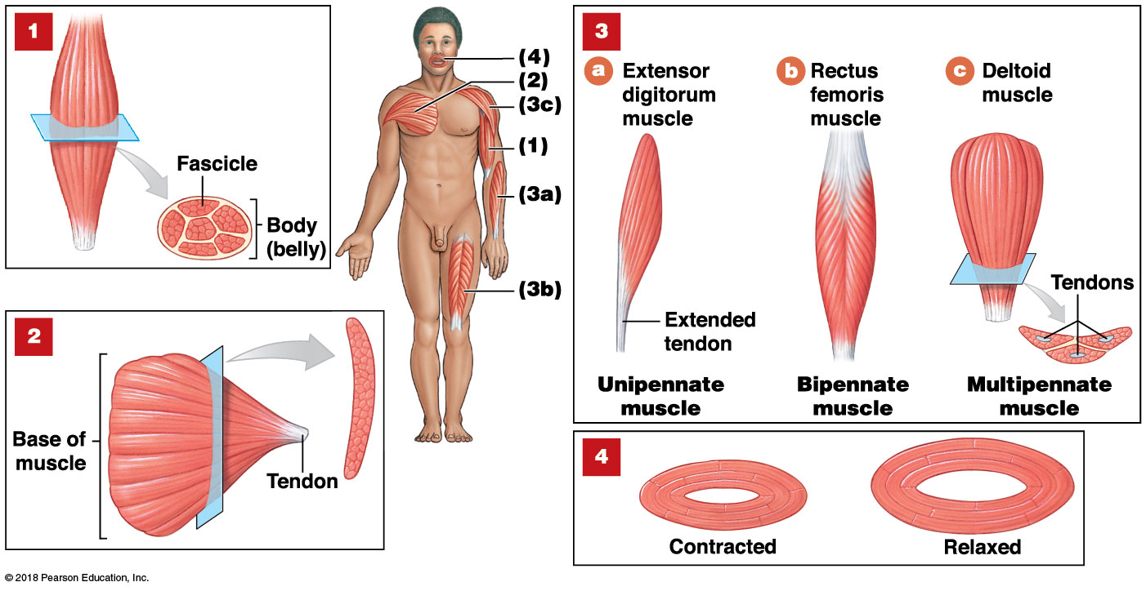
Skeletal muscles can be categorized based on the organization of their fascicles, as follows: (1) parallel muscles, (2) convergent muscles, (3) pennate muscles, and (4) circular muscles

Slide 12
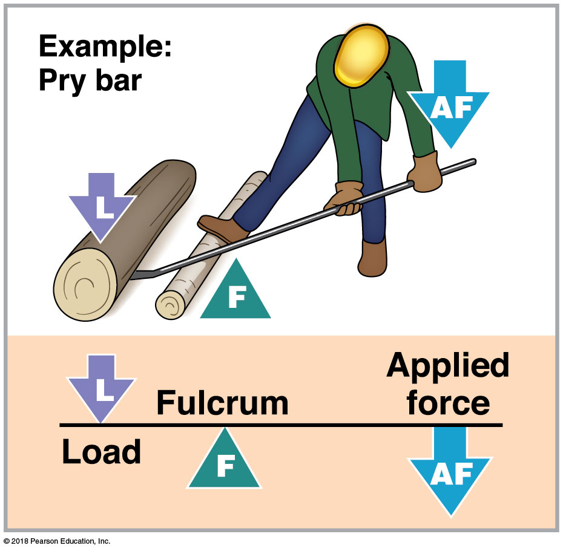
Module 10.2: Fascicle organization
Levers and leverage
Force, speed, direction of movement from skeletal muscle contraction modified by muscle attachment to a lever
Lever = a rigid structure that moves when force applied overcomes the load (a bone)
Fulcrum = a fixed point on which lever pivots (a joint)
Notes:
Discussions of levers and leverage are often confusing to students. Consider acting out some of the examples so students see the actual movement, and have them tell you where the load is, what is acting as the lever and as the fulcrum, and where/in what direction is the applied force. Thinking it through like this will help them learn the concepts better.

Slide 13
Module 10.2: Fascicle organization
3 classes of levers—first, second, and third class
​First-class lever—fulcrum (F) is between the applied force (AF) and the load (L)
Acts like pry bar
Distance moved depends on:
Size of force and load
How far each is from fulcrum

Slide 14
Module 10.2: Fascicle organization
​Second-class lever—load is between applied force and fulcrum
Acts like wheelbarrow
Force farther from fulcrum than the load
Small force moves large load
Increased effective force, but at expense of speed (moves load slowly) and distance (moves load only short distance)

Slide 15
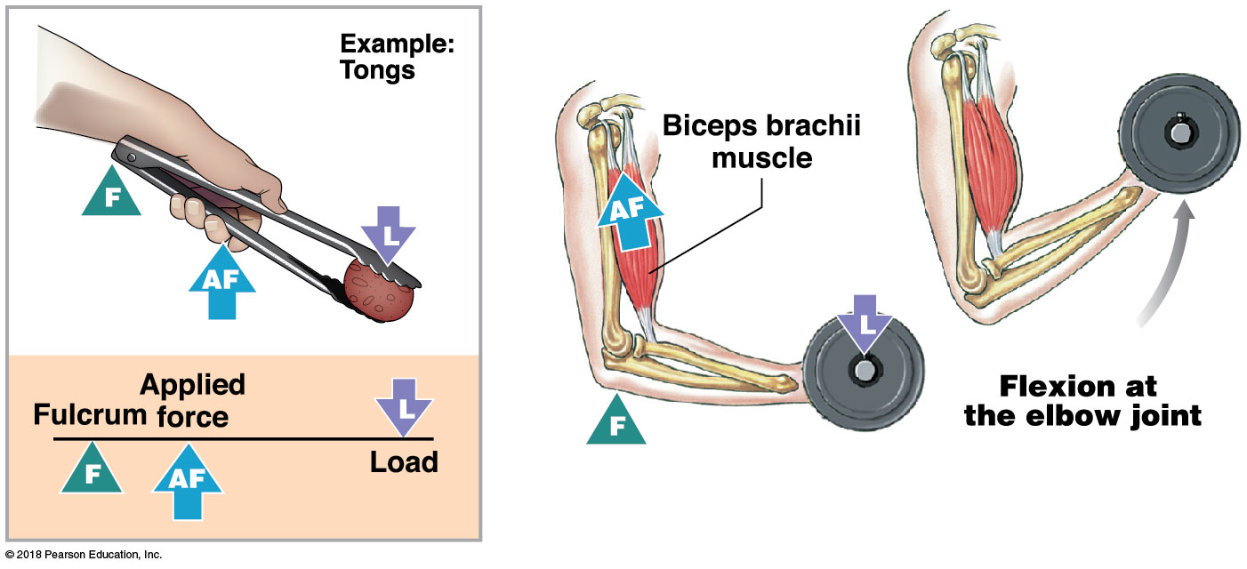
Module 10.2: Fascicle organization
​Third-class lever—force is applied between load and fulcrum
Most common lever in body
Using barbecue tongs is an example
Speed/distance traveled are increased at expense of force

Slide 16
Module 10.2: Review
Why does a pennate muscle generate more tension than does a parallel muscle of the same size?
Define lever, and describe the three classes of levers.
The joint between the occipital bone of the skull and the first cervical vertebra (atlas) is which part of which class of lever system?
Learning Outcome: Describe fascicle organization, and explain how levers affect muscle efficiency.

Slide 17
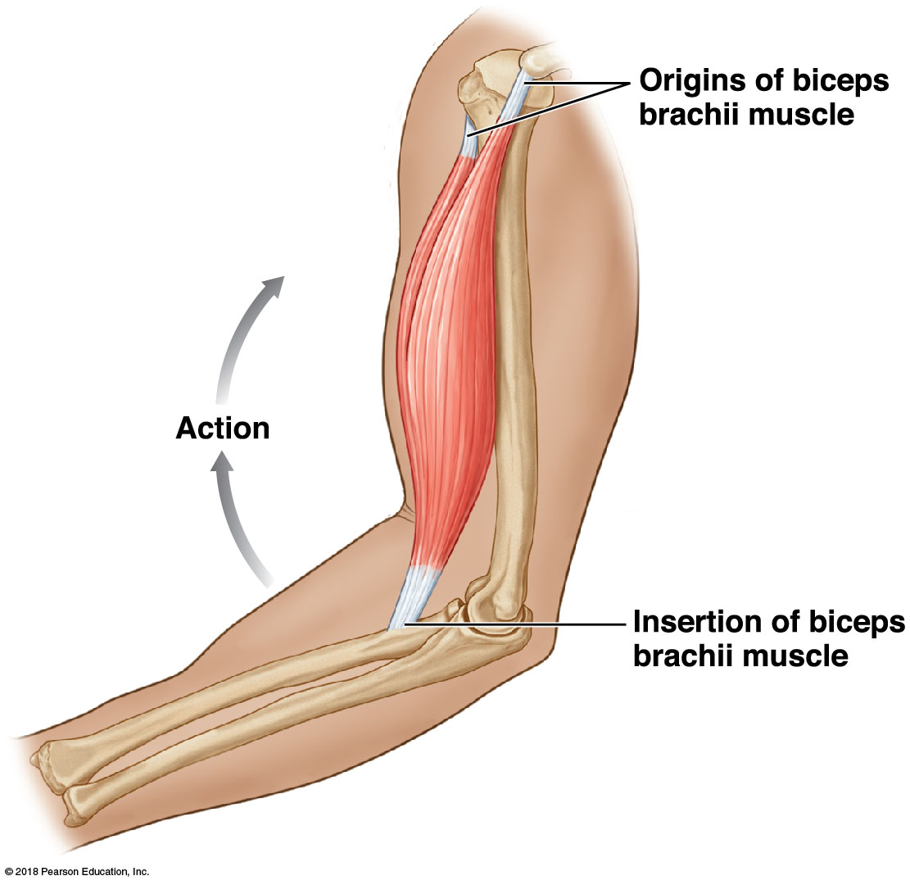
Module 10.3: The origins and insertions of muscles determine their actions
Origin = where fixed end of a skeletal muscle attaches
Most are bones
Some are connective tissue sheaths or bands
Typically proximal to insertion in anatomical position
Insertion = where the movable end of a skeletal muscle attaches
Action = specific movement produced by a skeletal muscle
Notes:
Point out that for more complex muscles, the origin and insertion may be reversed for some movements. It is generally more important to know the attachments.

Slide 18
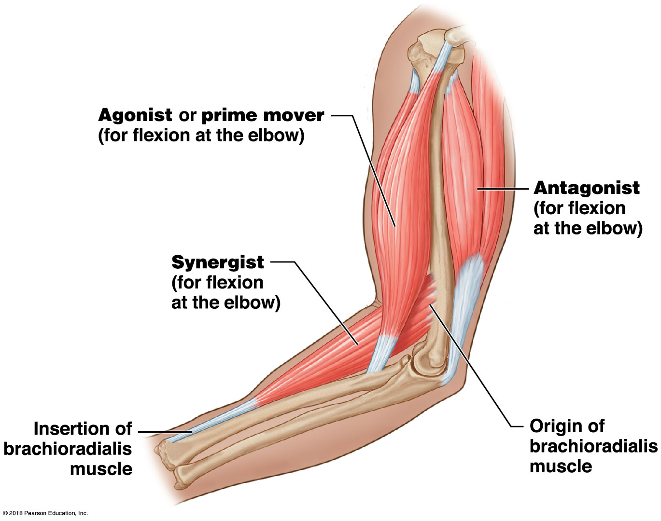
Module 10.3: Origin, insertion, and action
Muscles usually work together in groups—agonist, synergist, and antagonist
Agonist or prime mover = muscle whose contraction is mostly responsible for producing the movement
Example: biceps brachii—elbow flexion

Slide 19
Module 10.3: Origin, insertion, and action
Synergist = muscle that helps larger agonist work efficiently
May provide additional pull or stabilize origin
Example: brachioradialis for elbow flexion
Fixators = synergists that assist by preventing movement at another joint

Slide 20
Module 10.3: Origin, insertion, and action
Antagonist = muscle whose action opposes a particular agonist
Example: triceps brachii for elbow flexion
Antagonist to biceps brachii
Agonist for elbow extension

Slide 21
Module 10.3: Origin, insertion, and action
Muscle terminology
May provide information about a muscle’s:
Location in specific regions
Position, direction, or fascicle organization
Structural characteristics
Actions
Familiarity with the terms helps identify and remember specific muscles

Slide 22
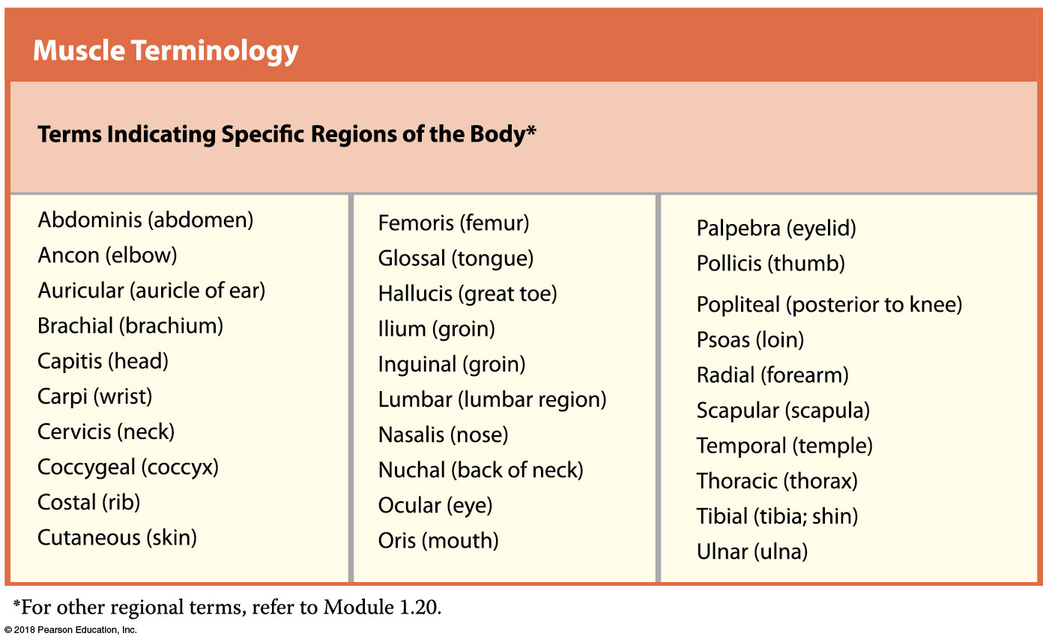
Notes:
This table is large and overwhelming. Be sure students know to read each column as a unit. Consider providing a list of muscles and have students use this table to make sense of the names and write their interpretations—rectus femoris, external oblique, orbicularis oculi, extensor hallucis brevis, for example.

Slide 23
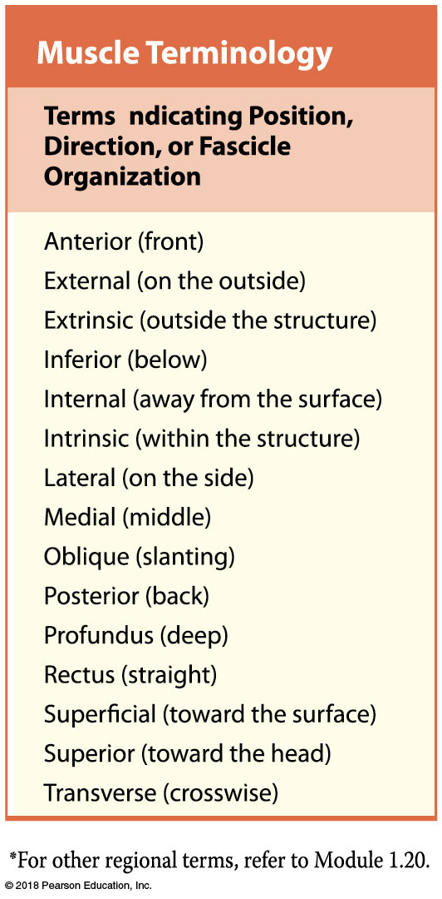

Slide 24
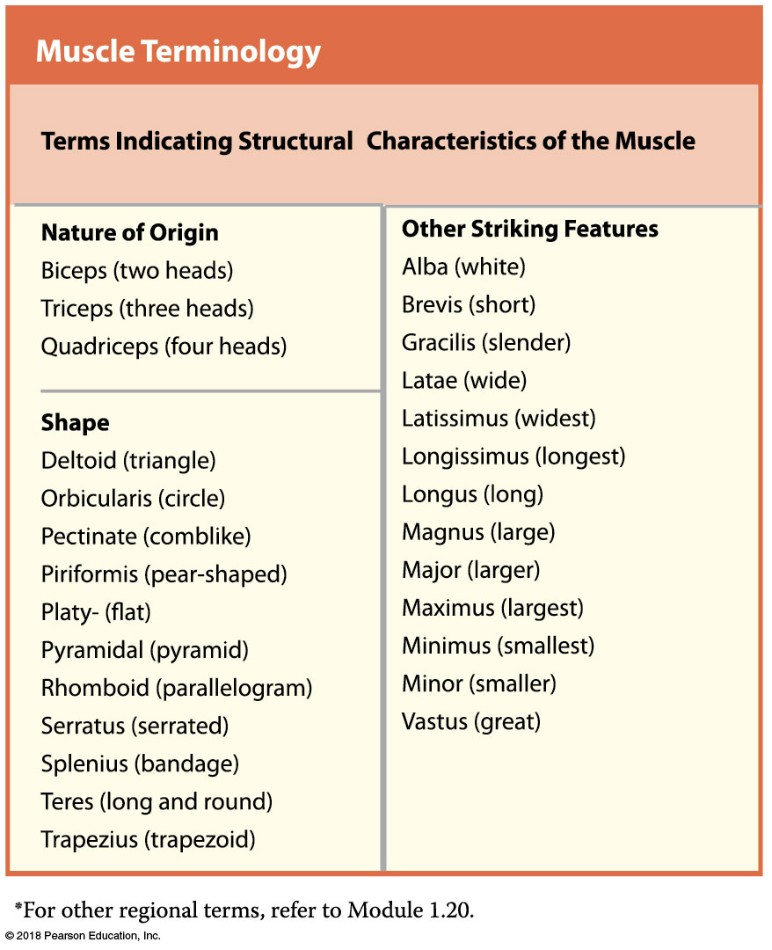

Slide 25
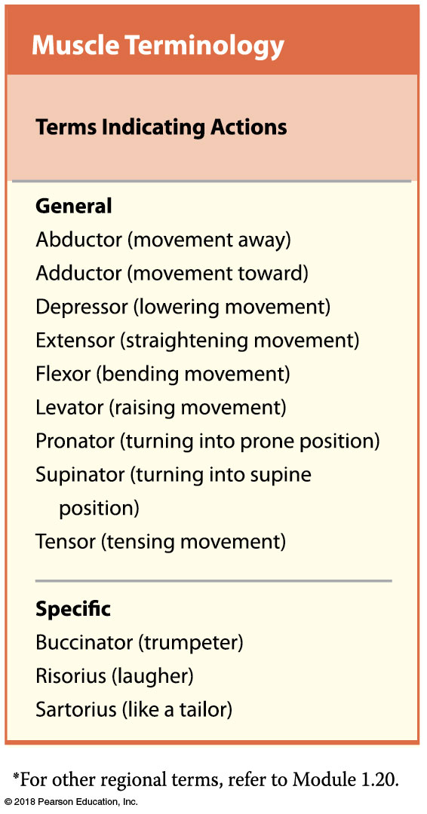

Slide 26
Module 10.3: Review
Define the term synergist as it relates to muscle action.
Muscle A abducts the humerus, and muscle B adducts the humerus. What is the relationship between these two muscles?
What does the name flexor carpi radialis longus tell you about this muscle?
Learning Outcome: Explain how the name of a muscle can help identify its location, appearance, or function.

Slide 27
Module 10.4: The skeletal muscles can be assigned to the axial division or the appendicular division based on origins and functions
Axial muscles
Arise on axial skeleton
~60% of skeletal muscles in body
Position head and spinal column
Move rib cage, assist in breathing
Appendicular muscles
Remaining 40% of all skeletal muscles
Stabilize or move appendicular skeleton

Slide 28
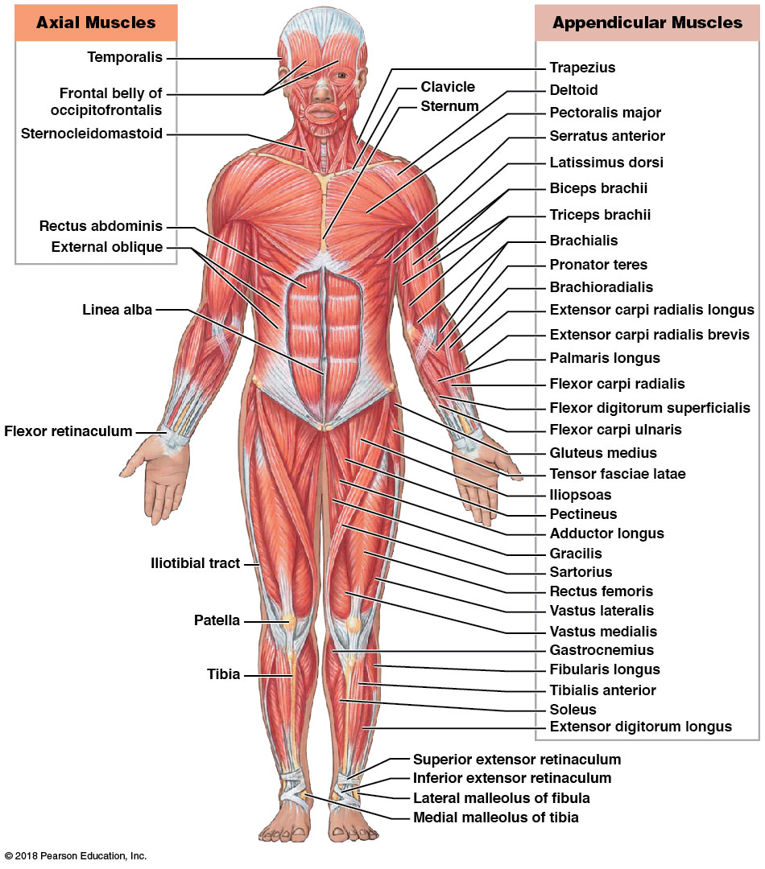
Skeletal muscles, anterior view
Notes:
This is overwhelming at first. These illustrations can be paired with the previous table of muscle name terminology to help students make sense of the muscles listed. Have them use both resources and write out as many descriptions of these muscles as they can based on information in the table.

Slide 29
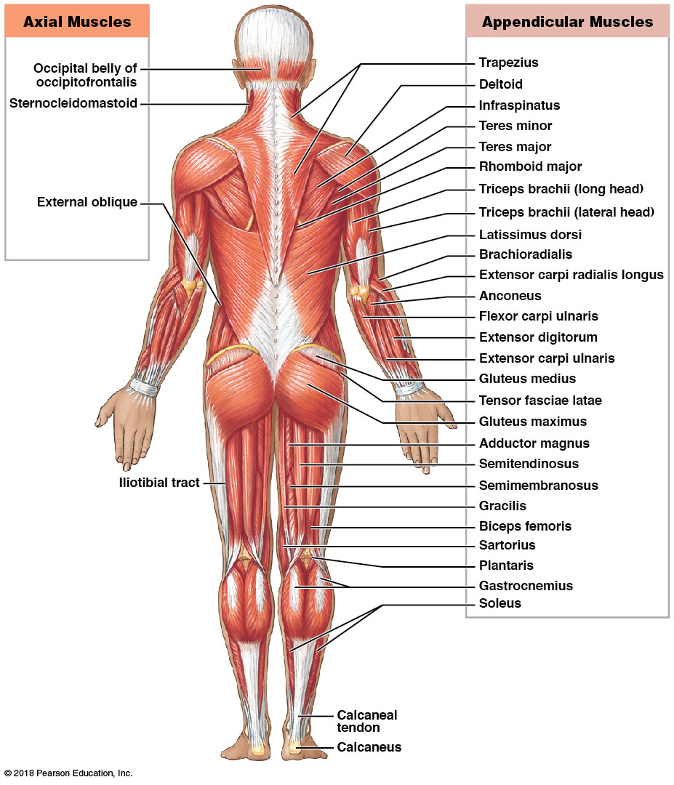
Skeletal muscles, posterior view

Slide 30
Module 10.4: Review
What is the function of the axial muscles?
Which structures labeled in the figures in this module are not muscles?
Identify the division (axial or appendicular) to which each of the following muscles belongs: biceps brachii, external oblique, temporalis, and vastus medialis.
Learning Outcome: Describe the separation of muscles into axial and appendicular divisions.

Slide 31
Section 2: Axial Muscles
Learning Outcomes
10.5 Describe the four groups of axial muscles and their general functions.
10.6 Identify the facial expression muscles, and cite their origins, insertions, and actions.
10.7 Identify the eye and jaw muscles, and cite their origins, insertions, and actions.
10.8 Identify the tongue, pharynx, and neck muscles, and cite their origins, insertions, and actions.

Slide 32
Section 2: Axial Muscles
Learning Outcomes (continued)
10.9 Identify the vertebral column muscles, and cite their origins, insertions, and actions.
10.10 Identify the trunk muscles, and cite their origins, insertions, and actions.
10.11 Identify the pelvic floor muscles, and cite their origins, insertions, and actions.

Slide 33
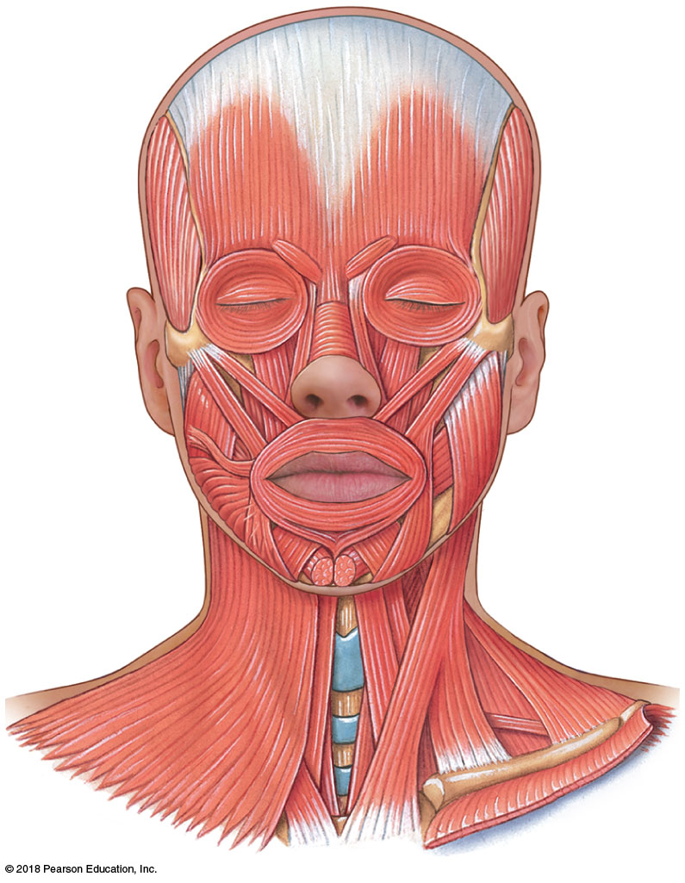
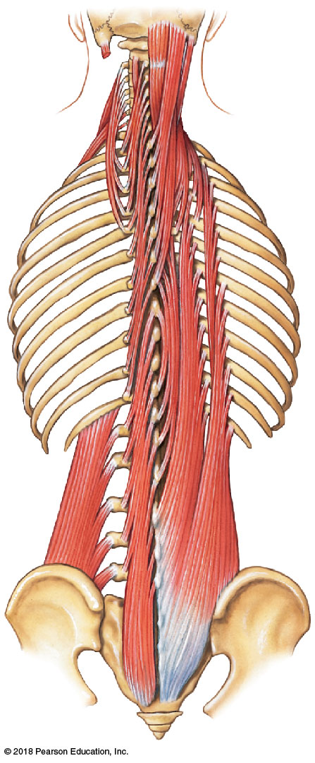
Module 10.5: There are four groups of axial muscles
4 axial muscle groups stabilize/ position head, neck, and trunk:
Muscles of the head and neck
Muscles of facial expression, extrinsic eye muscles, tongue, pharynx, neck
Muscles of the vertebral column
Muscles that stabilize, flex, extend, rotate vertebral column

Slide 34
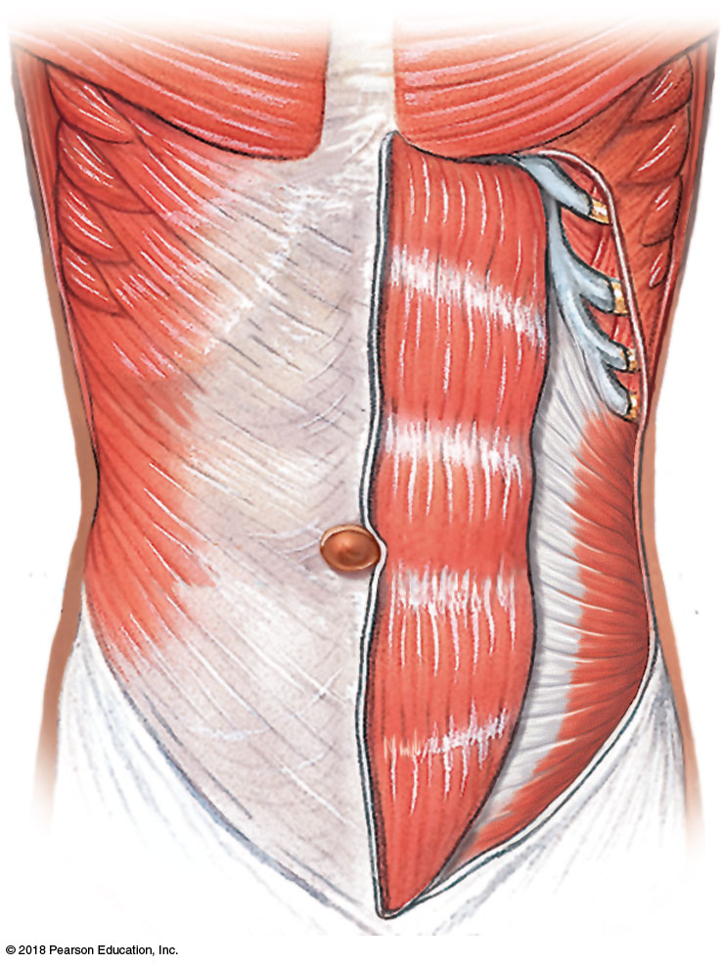
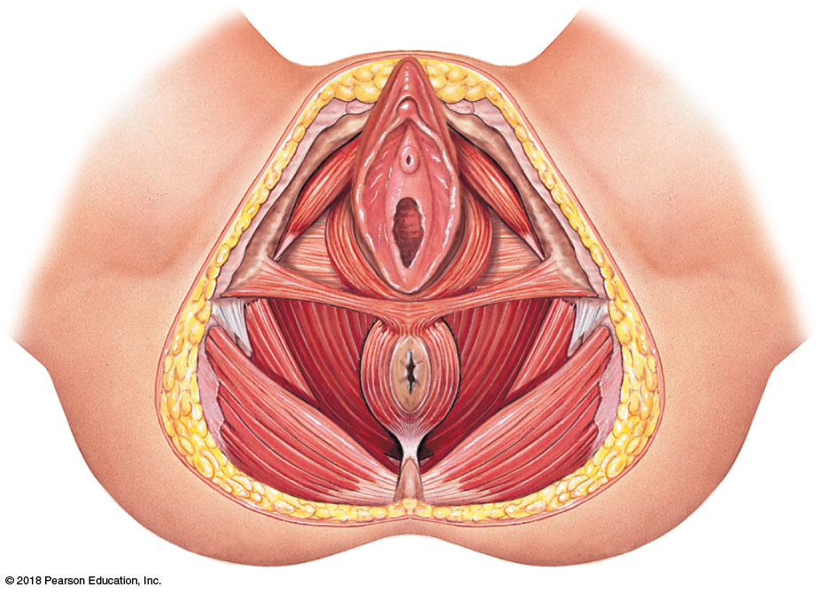
Module 10.5: There are four groups of axial muscles
4 axial muscle groups stabilize/ position head, neck, and trunk:
Oblique and rectus muscles of trunk
Broad sheets/bands forming muscular walls of thoracic and abdominopelvic cavities
Muscles of the pelvic floor
Span the pelvic outlet and support organs of the pelvis

Slide 35
Module 10.5: Review
The axial muscles stabilize and position which regions of the body?
Learning Outcome: Describe the four groups of axial muscles and their general functions.

Slide 36
Module 10.6: The muscles of facial expression are important in eating and useful for communication
Muscles of facial expression
Origins—surface of skull (except for platysma in neck)
Insertions—superficial fascia and dermis of skin
Actions—move skin, allowing facial expression

Slide 37
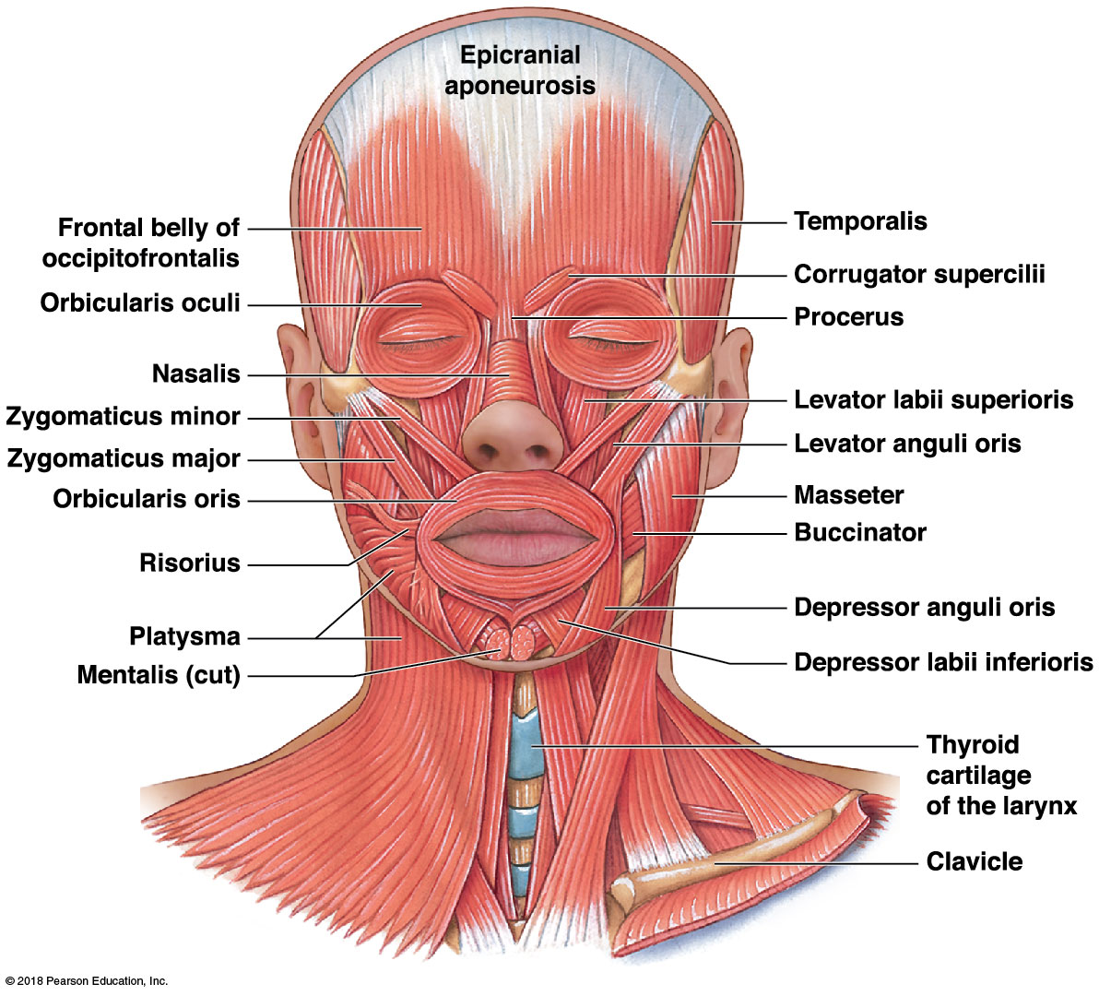
Muscles of facial expression, anterior view
Notes:
The previous chapter discussed botulinum toxin and how it paralyzes muscles. Most students have heard of Botox injections for cosmetic purposes. Ask them which muscles of facial expression are usually affected by these injections.

Slide 38
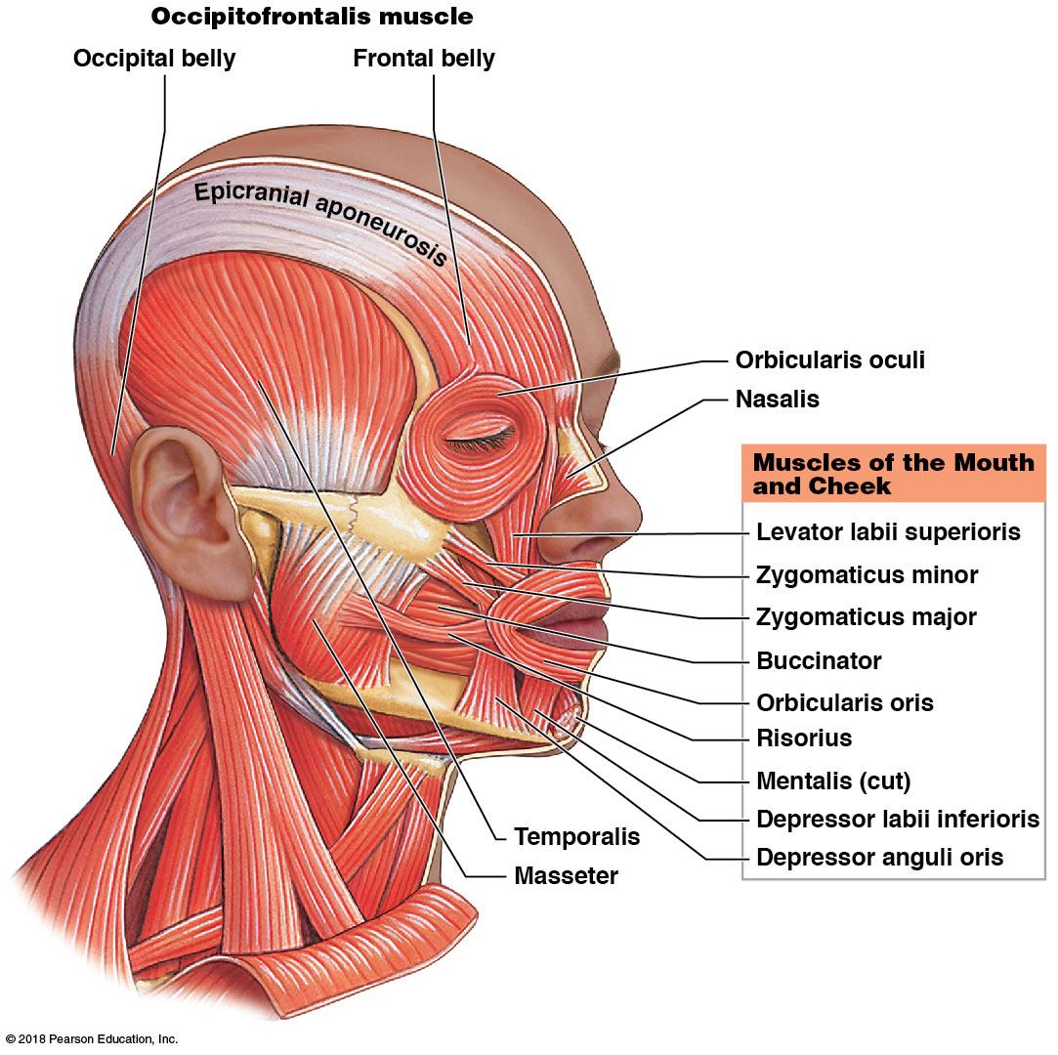
Muscles of facial expression, lateral view

Slide 39
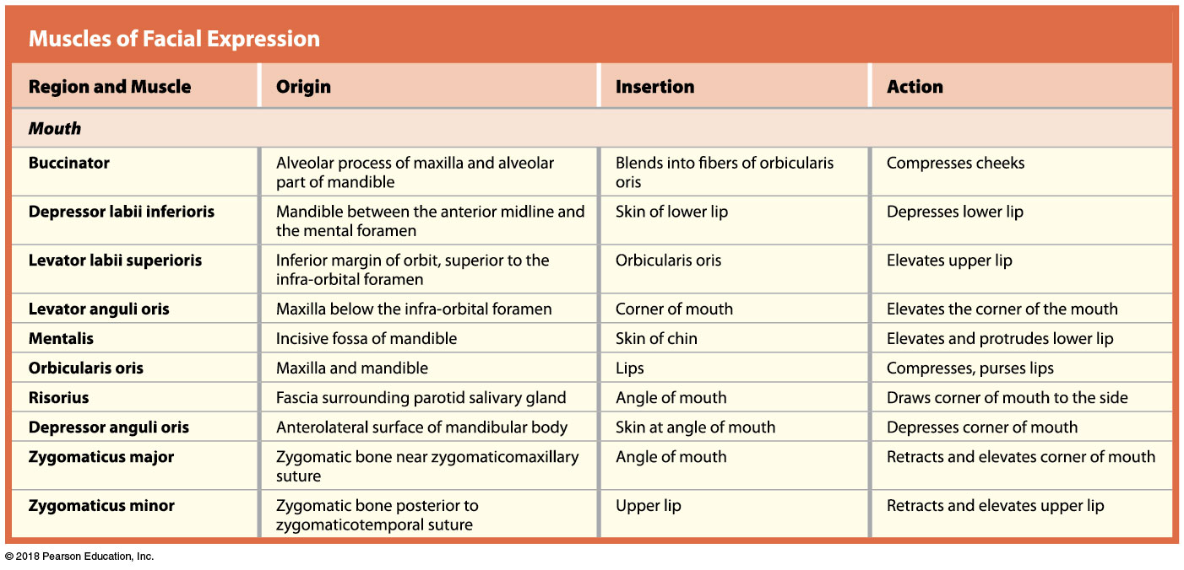
Muscles of facial expression

Slide 40
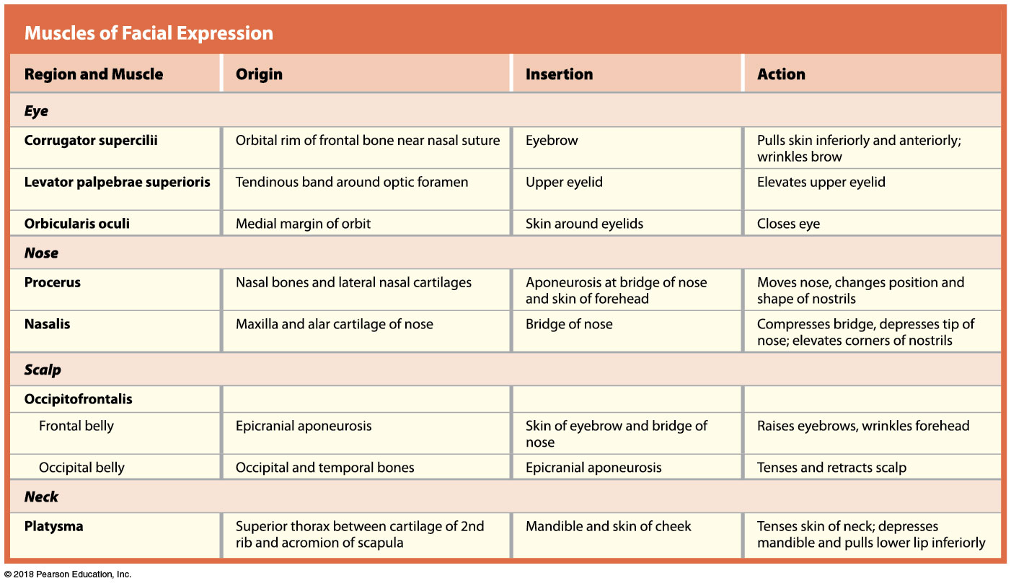
Muscles of facial expression

Slide 41
Module 10.6: Review
Name the muscles associated with the mouth, and identify the one involved in whistling.
State whether the following muscles involve the mouth, eye, nose, ear, scalp, or neck: buccinator, corrugator supercilii, mentalis, nasalis, platysma, procerus, and risorius.
Explain how a person is able to consciously move the skin on the scalp but is not able to consciously move the skin of the thigh.
Learning Outcome: Identify the facial expression muscles, and cite their origins, insertions, and actions.

Slide 42
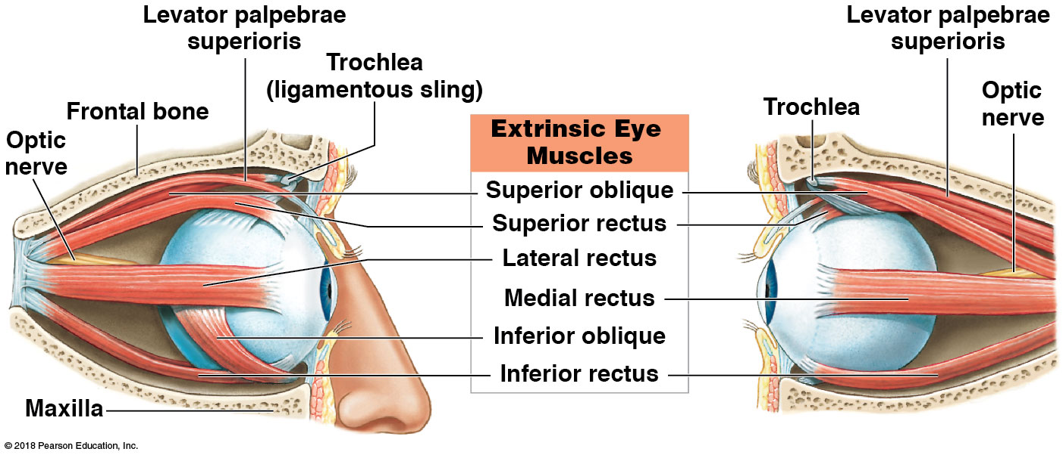
Module 10.7: The extrinsic eye muscles position the eye . . .
Extrinsic eye muscles—there are 6 which share:
Origins—sphenoid and maxillary bone around optic canal
Insertions—surface of the eyeball
Actions—positioning the eye

Slide 43
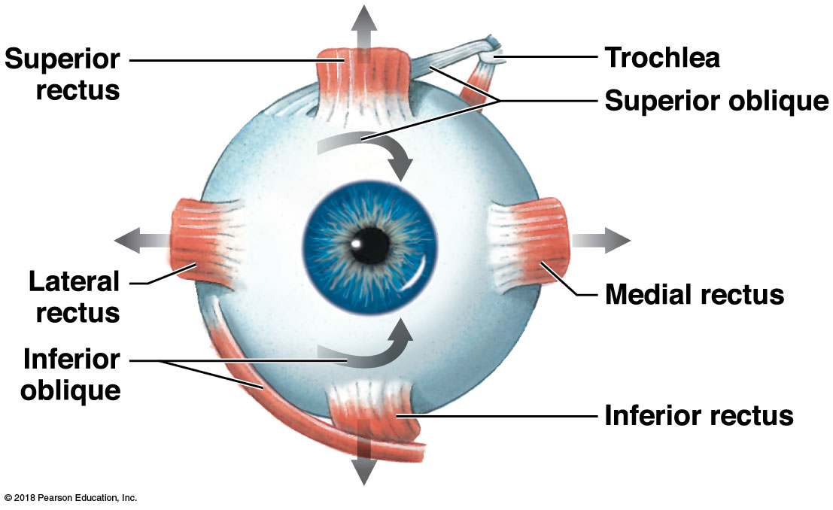
Extrinsic eye muscles, anterior view

Slide 44
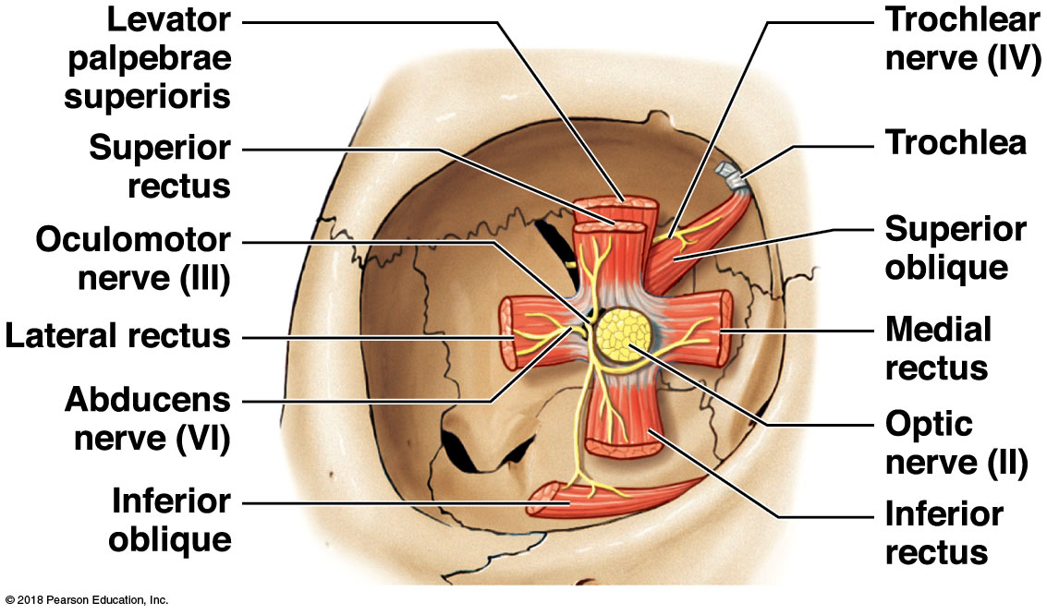
Origins of the extrinsic eye muscles within the right orbit

Slide 45
Extrinsic eye muscles
Notes:
For extrinsic eye muscles, students often get mixed up on the actions of the oblique muscles. Tell them to remember the Obliques move the eye “Opposite and Out”—opposite direction from their name (superior oblique moves the eye inferior, and vice versa) and out meaning slightly lateral—out to the side.

Slide 46
Module 10.7: … and the muscles of mastication move the lower jaw
Muscles of mastication
Origins—zygomatic arch, temporal lines, lateral pterygoid plate
Insertion—mandibular ramus and coronoid process
Actions—elevating mandible, sliding mandible side to side, protruding mandible, opening jaw (lateral pterygoid)
Notes:
Demonstrate mastication with a skull so students realize it is all about moving the mandible up and down.

Slide 47
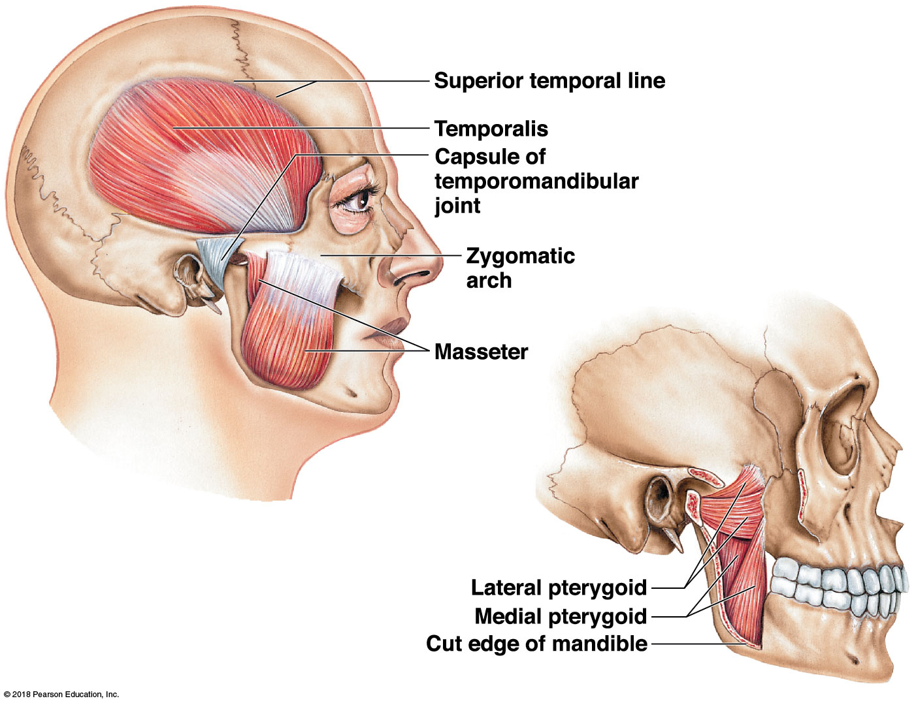
Muscles of mastication

Slide 48
A&P Flix: Masseter

Slide 49
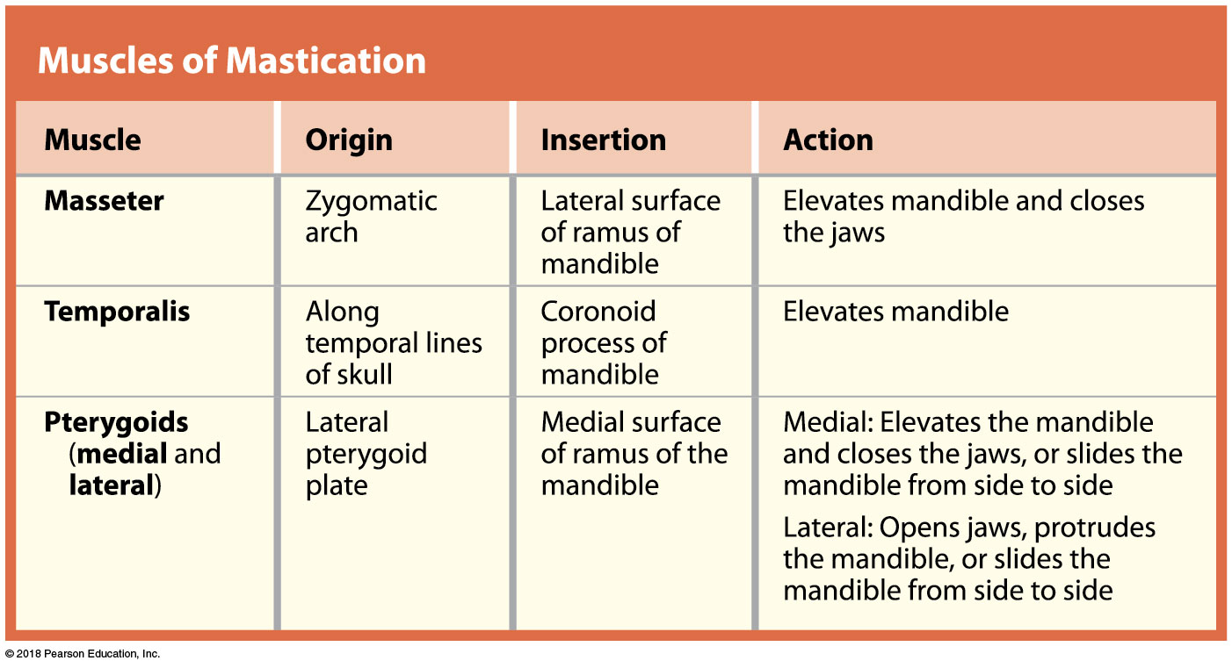
Muscles of mastication

Slide 50
Module 10.7: Review
Name the extrinsic eye muscles.
Which muscles have their origin on the lateral pterygoid plates and their insertion on the medial surface of the ramus of the mandible?
If you were contracting and relaxing your masseter, what would you probably be doing?
Learning Outcome: Identify the eye and jaw muscles, and cite their origins, insertions, and actions.

Slide 51
Module 10.8: The muscles of the tongue are closely associated with the muscles of the pharynx and neck
Closely associated muscles
Muscles of the tongue—involved in speaking and chewing
Muscles of the pharynx—role in swallowing
Muscles of the neck—involved in positioning mandible, hyoid, and larynx

Slide 52
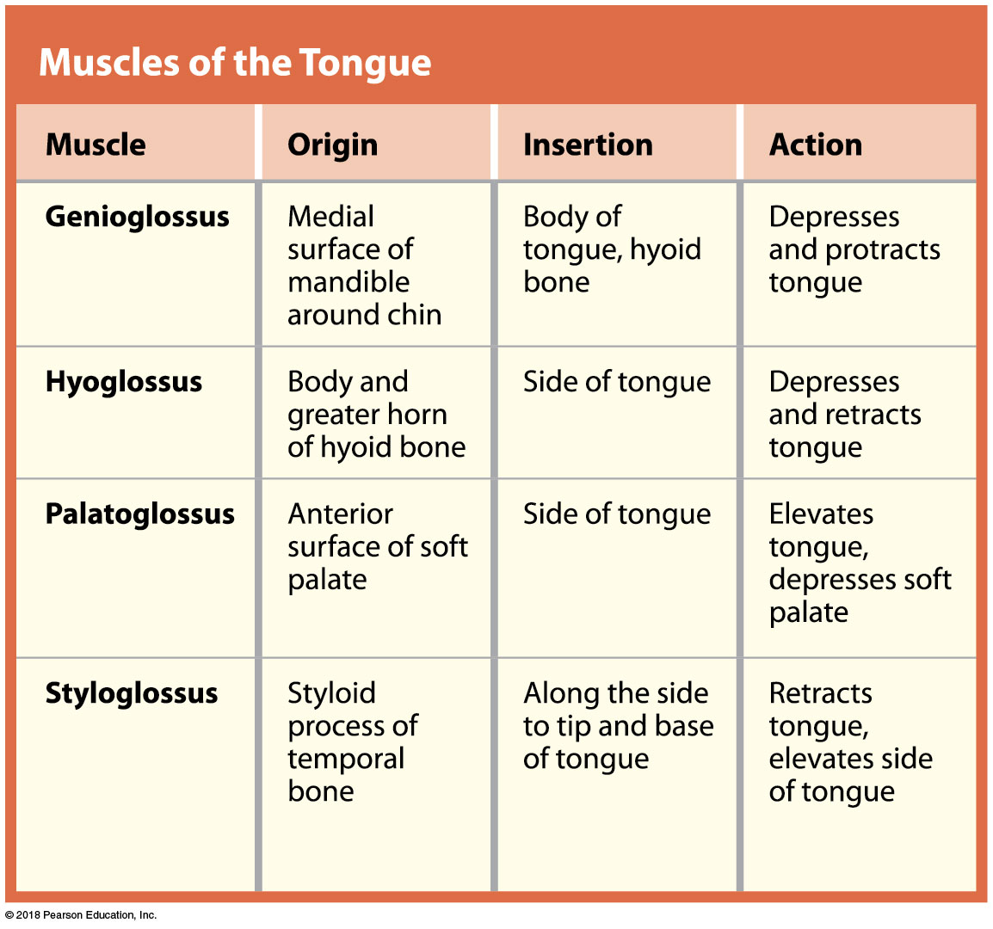
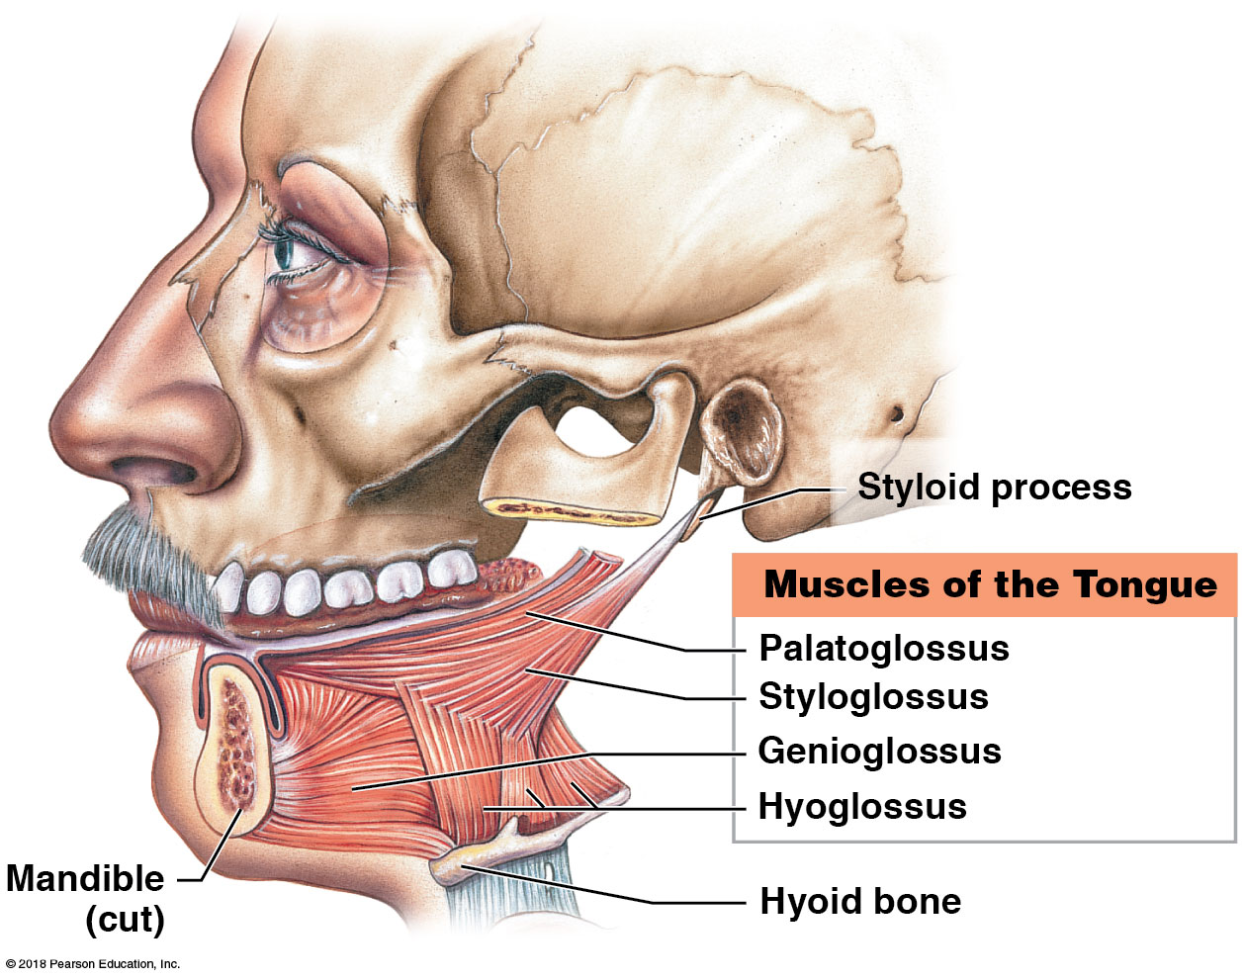
Muscles of the tongue
Notes:
Have students contemplate what speech would be like if the muscles of the tongue were paralyzed on one side, say from a stroke.

Slide 53
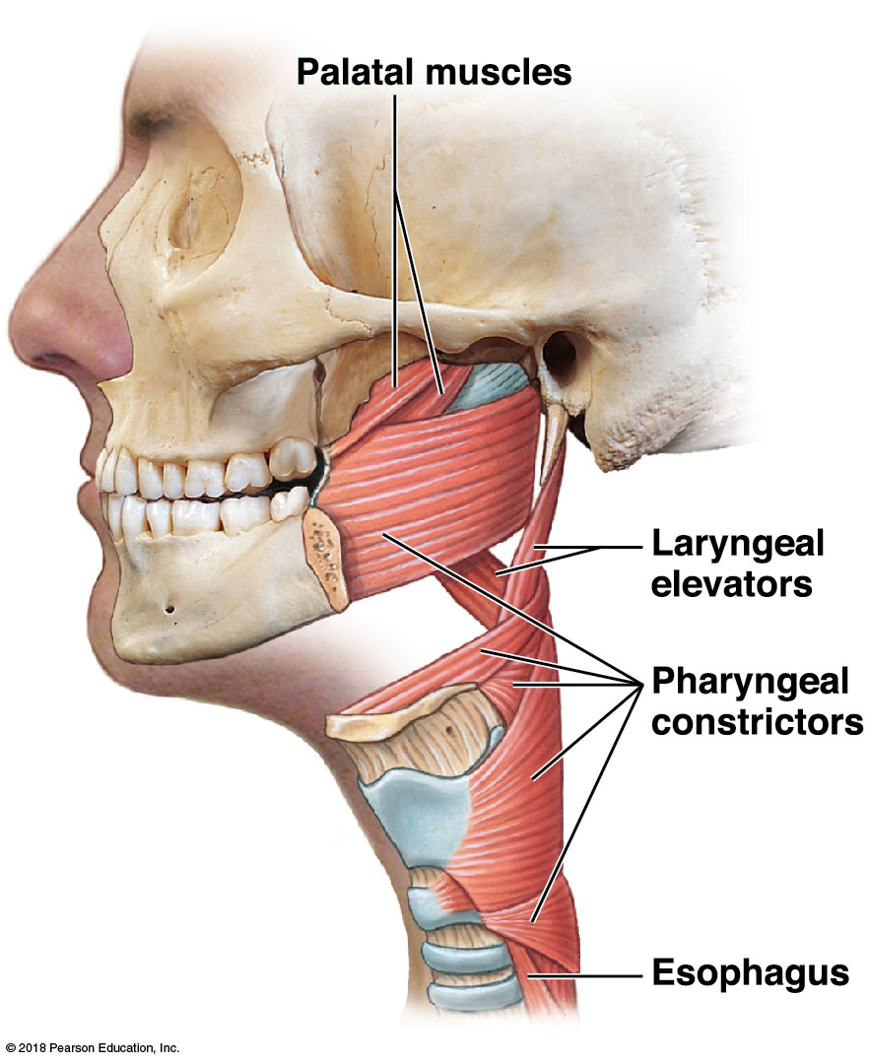
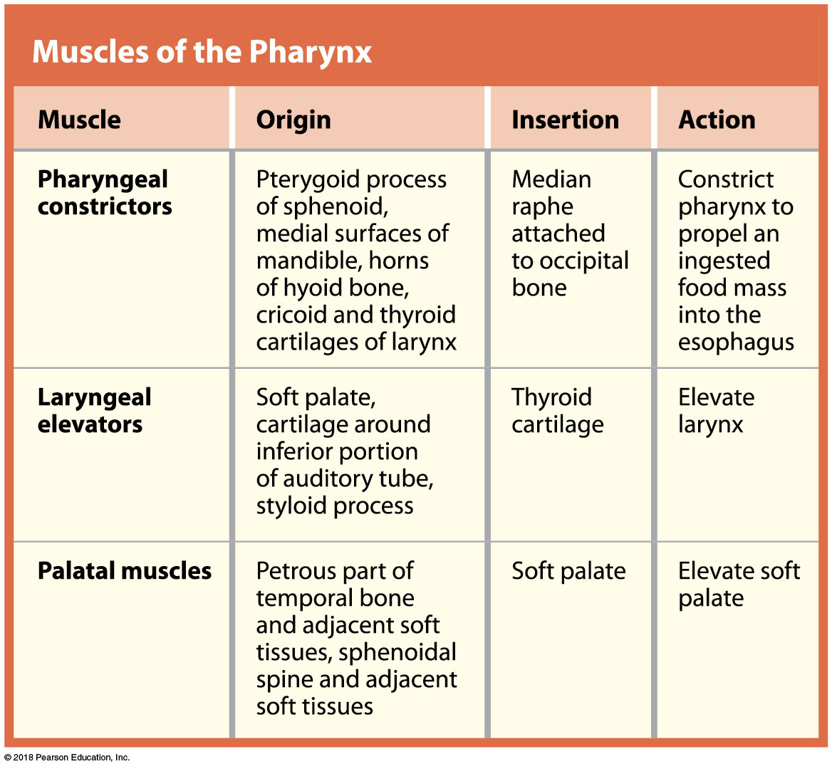
Muscles of the pharynx

Slide 54
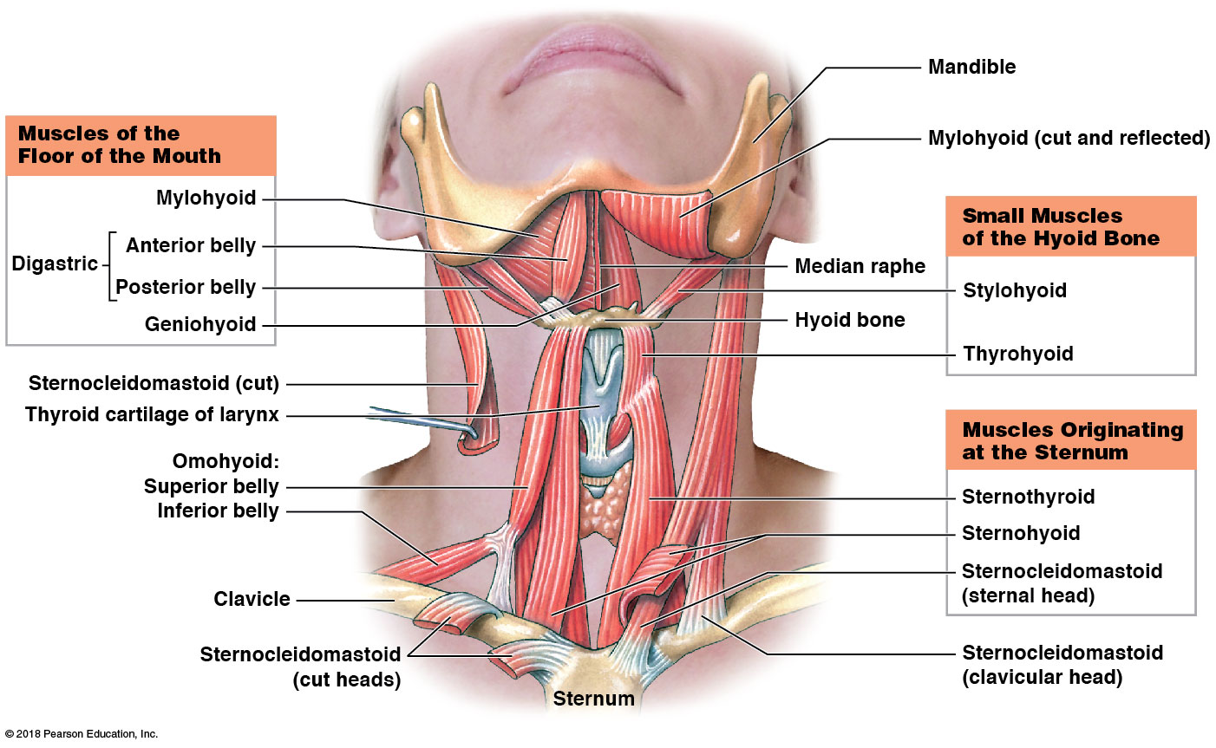
Anterior muscles of the neck

Slide 55
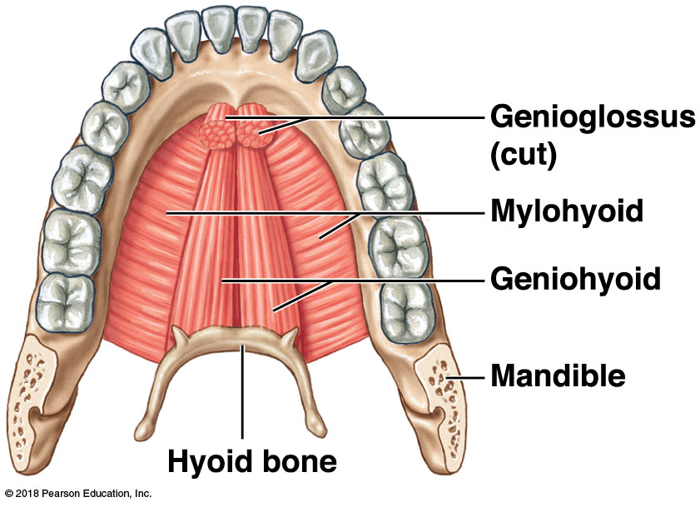
Muscles from the hyoid bone that form the floor of the mouth, superior view

Slide 56
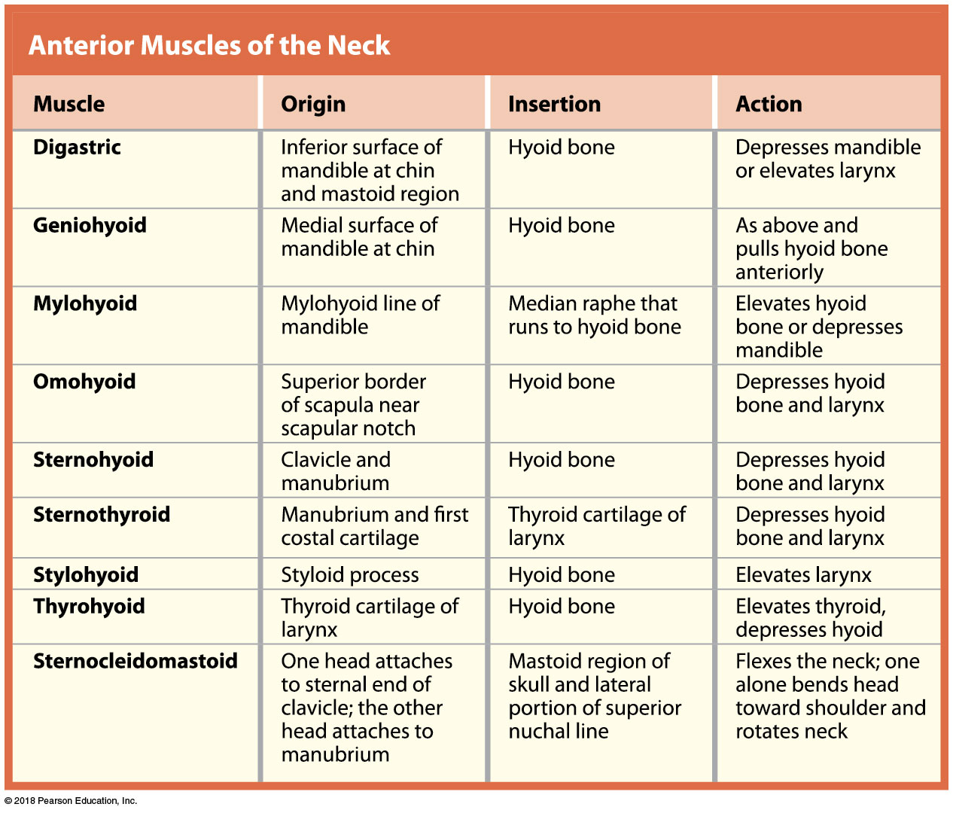
Anterior muscles of the neck

Slide 57
Module 10.8: Review
List the muscles of the tongue.
Which muscles elevate the soft palate?
Which muscles associated with the hyoid form the floor of the mouth?
Learning Outcome: Identify the tongue, pharynx, and neck muscles, and cite their origins, insertions, and actions.

Slide 58
Module 10.9: The muscles of the vertebral column support and align the axial skeleton
Muscles of the vertebral column
Several layers
Includes muscles originating or inserting on the ribs and vertebral processes
Entire muscle mass extends from sacrum to skull, but each muscle group has numerous separate muscles of various lengths
Few flexors because:
Many large trunk muscles flex vertebral column
Most body weight is anterior to vertebral column, so gravity tends to flex the spine

Slide 59
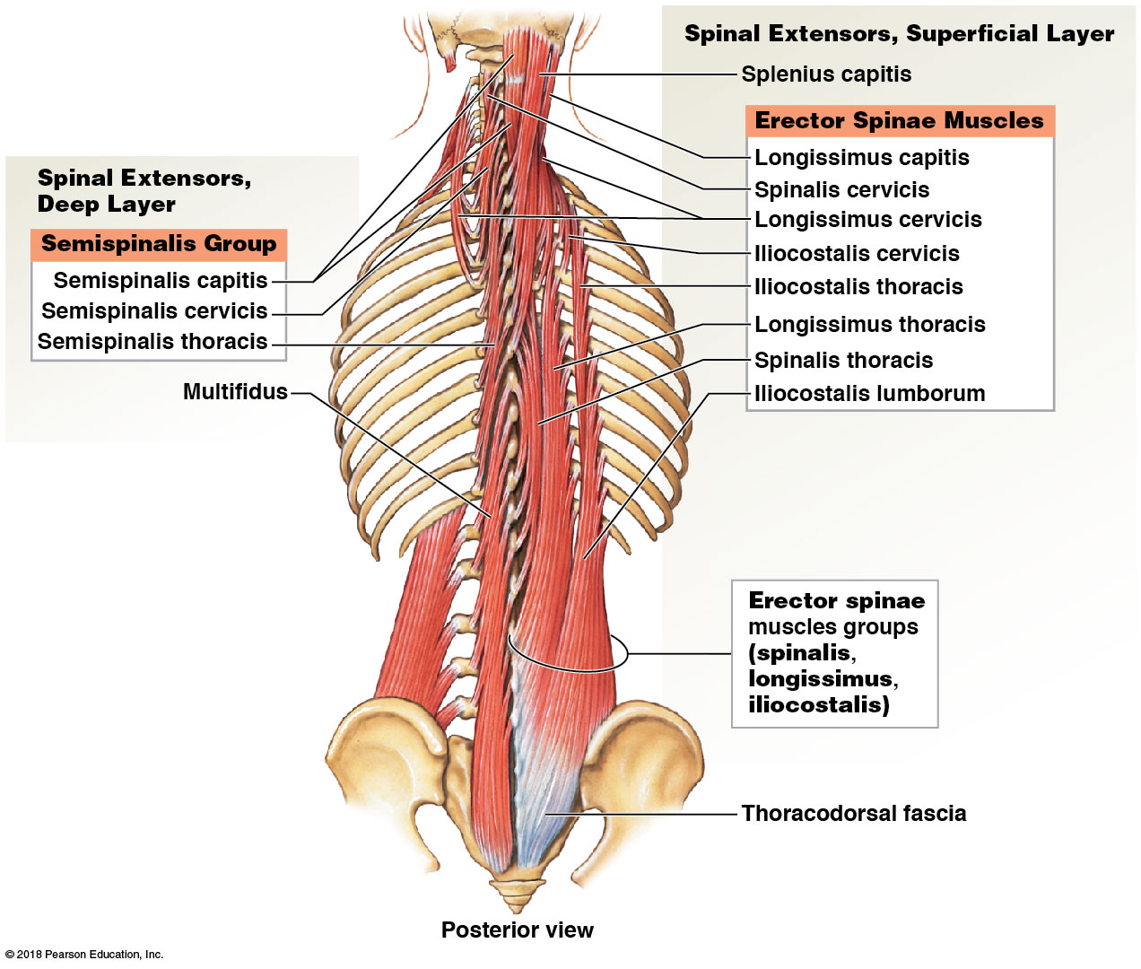
Muscles that extend the spine, superficial and deep groups

Slide 60
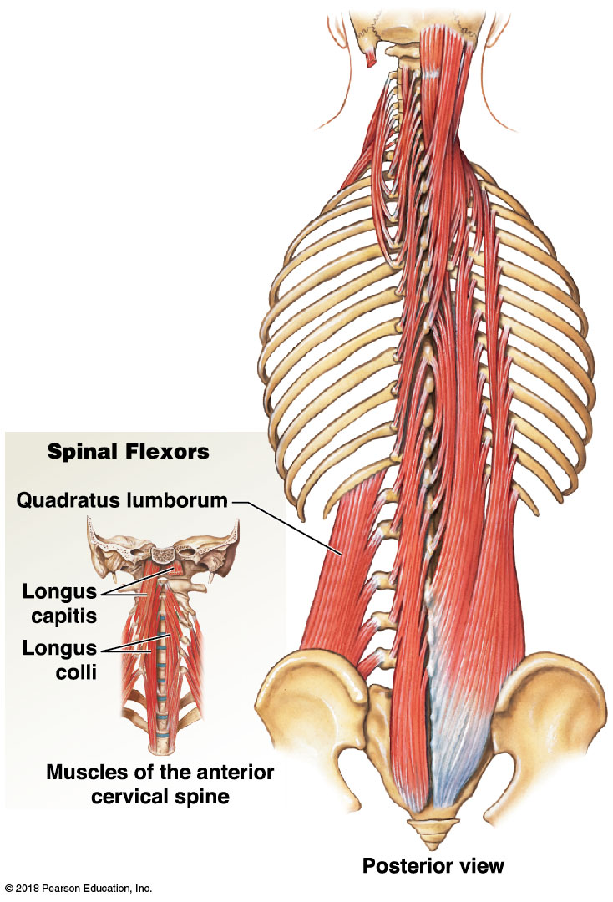
Muscles that flex the spine

Slide 61
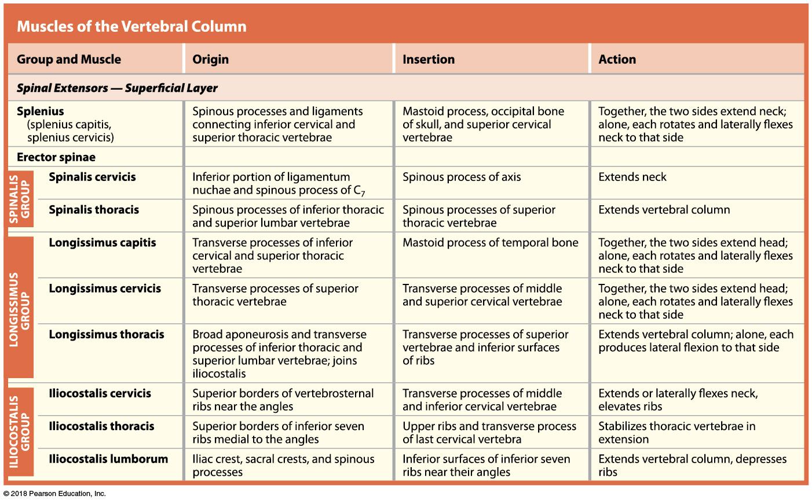
Muscles that extend the spine, superficial layer
Notes:
Using the figure showing spinal extensors, explain to students how the different parts of erector spinae are named.

Slide 62
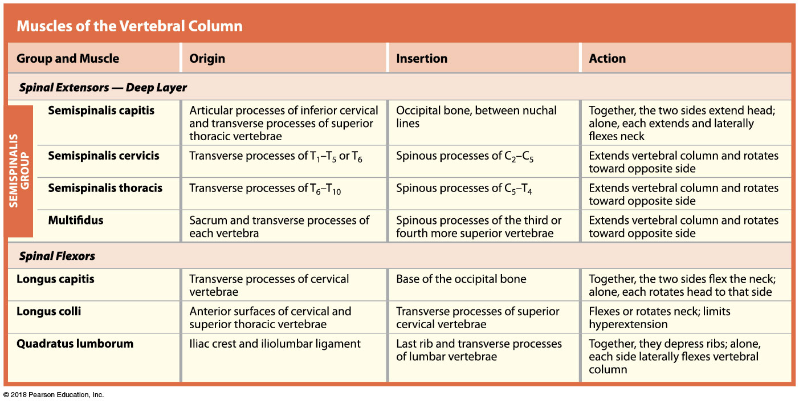
Muscles that extend the spine (deep layer), and muscles that flex the spine

Slide 63
Module 10.9: Review
List the spinal flexor muscles.
Which muscles enable you to extend your neck?
What might account for a lack of massive flexor muscles?
Learning Outcome: Identify the vertebral column muscles, and cite their origins, insertions, and actions.

Slide 64
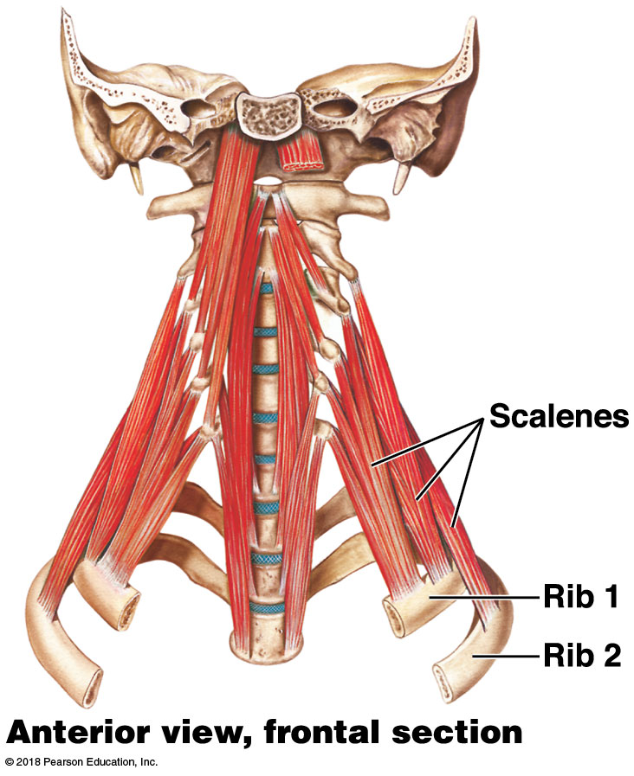
Module 10.10: The oblique and rectus muscles form the muscular walls of the trunk
Muscles of the trunk wall
Share embryological origins
The scalene muscles extend from the cervical vertebrae to the first two ribs

Slide 65
A&P Flix: External Intercostals

Slide 66
A&P Flix: Internal Intercostals

Slide 67
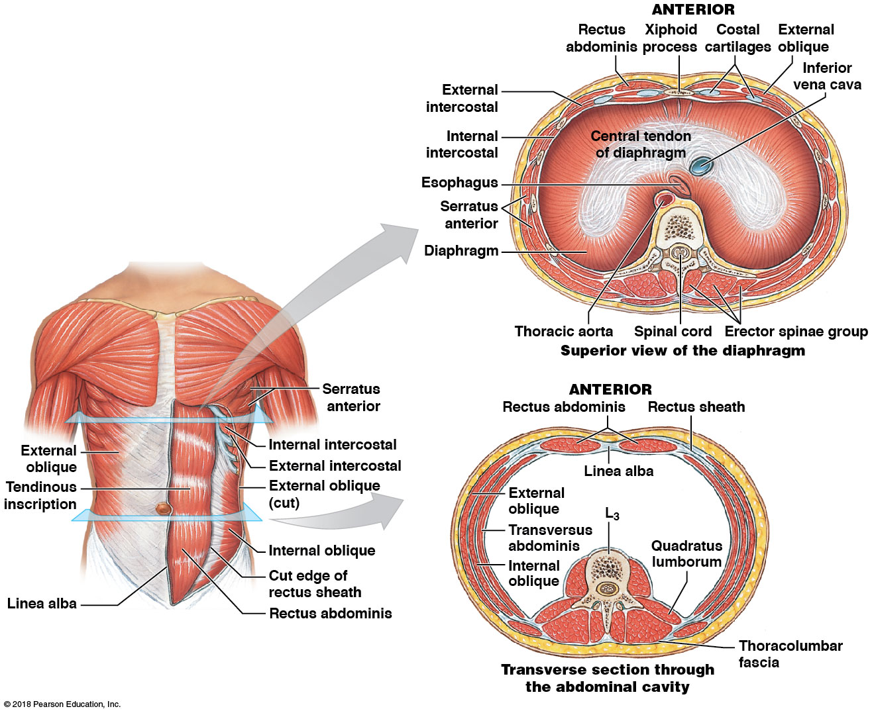
Muscles of the oblique and rectus groups form the muscular walls of the thorax and abdomen
Notes:
Students often struggle with orientation. Be sure they understand what the two transverse sections represent. You can do this easily if you have a torso model available—show the level of each section on an open torso model.

Slide 68
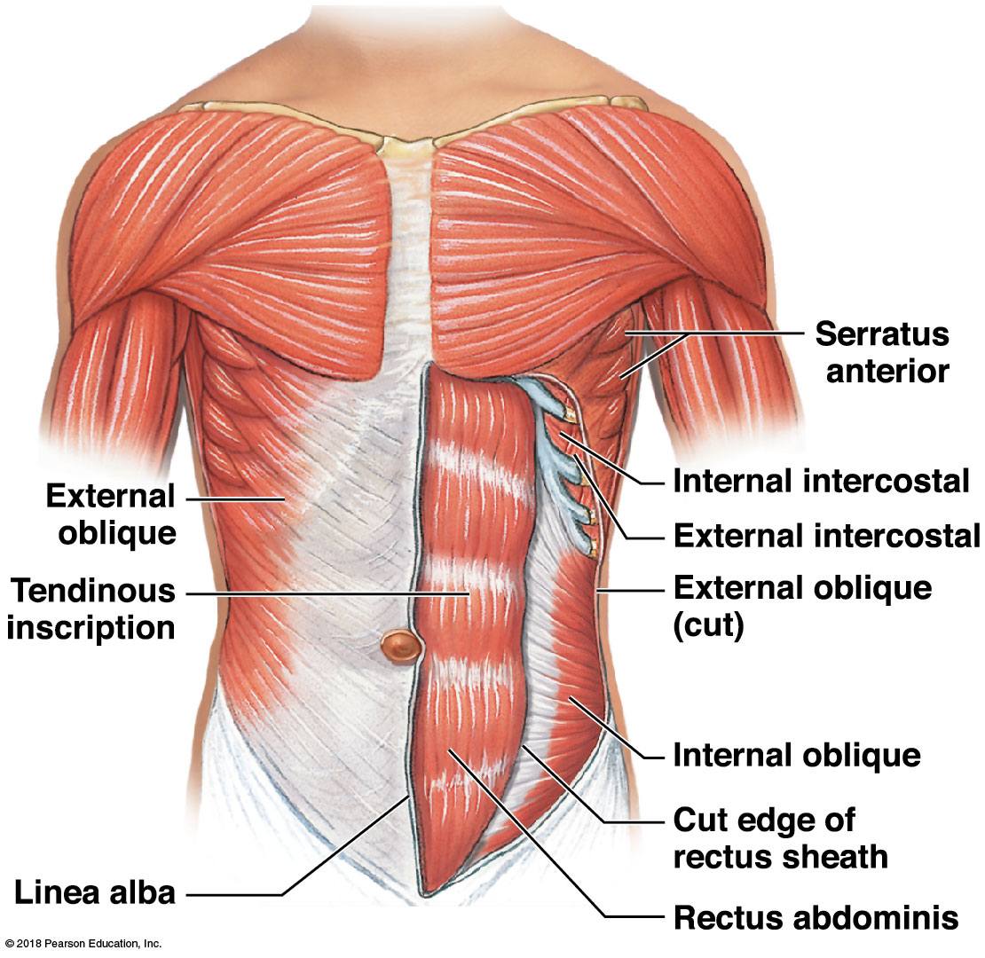
Superficial trunk wall muscles are shown on the right side of the body, and the deeper muscles are shown on the left side of the body

Slide 69
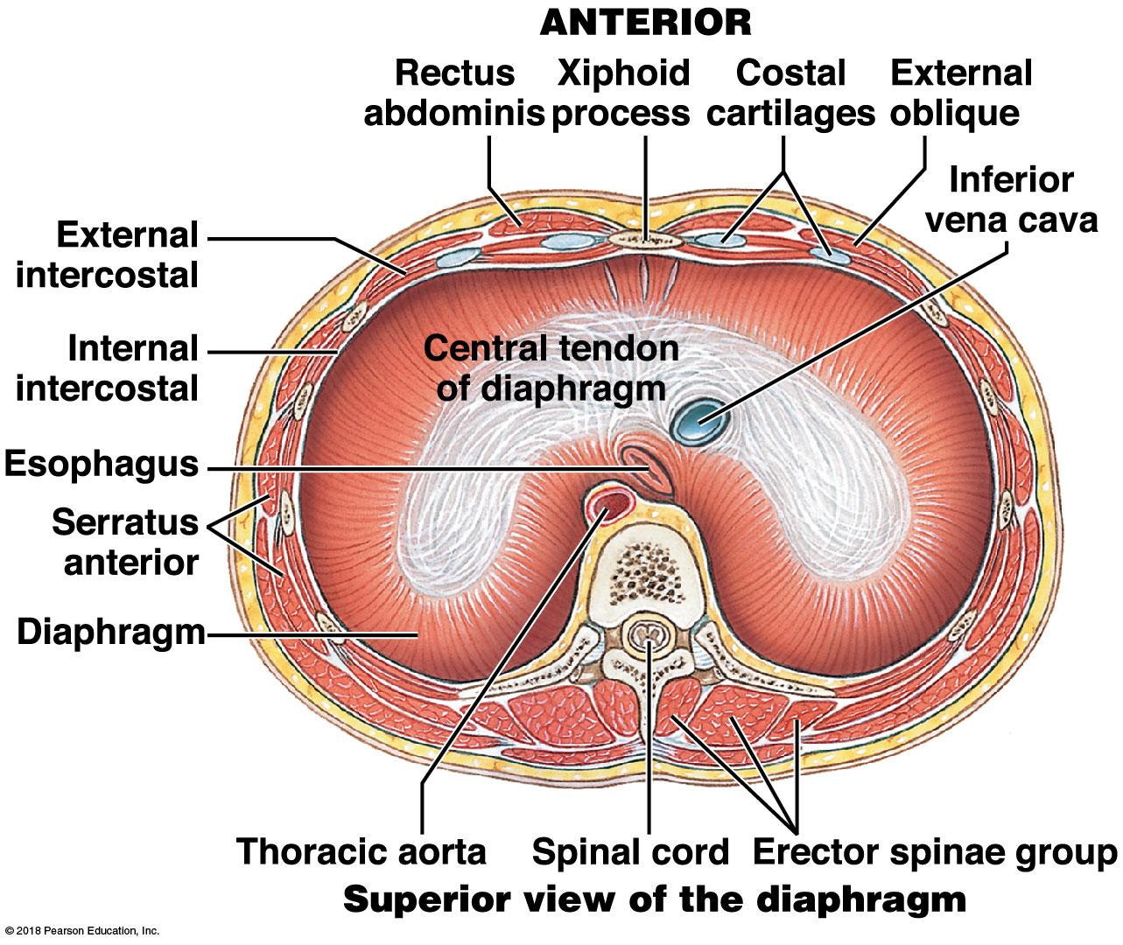
Transverse section showing the muscles of the thoracic wall, superior view of the diaphragm
Notes:
If you have a torso model, show where this section is located and demonstrate how this is a superior view. Also point out how students could tell anterior from posterior if it was not labeled—vertebral bodies are posterior, costal cartilages and xiphoid are anterior.

Slide 70
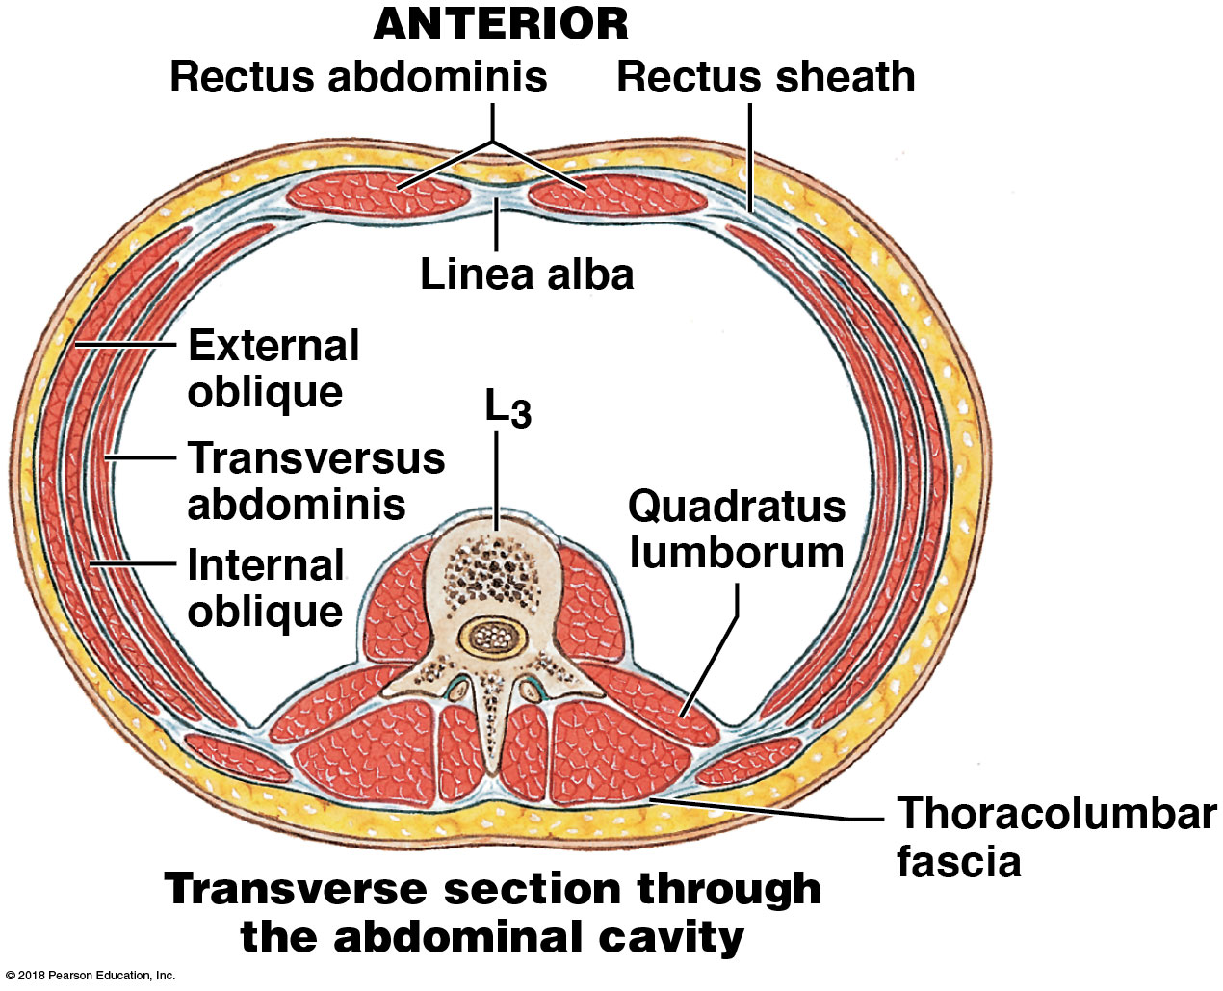
Transverse section showing the muscles of the abdominal wall
Notes:
Point out the similar arrangement of muscles on the lateral abdominal wall and those of the thoracic wall.

Slide 71
A&P Flix: External Obliques

Slide 72
A&P Flix: Internal Obliques

Slide 73
A&P Flix: Transversus Abdominis

Slide 74
A&P Flix: Rectus Abdominis

Slide 75
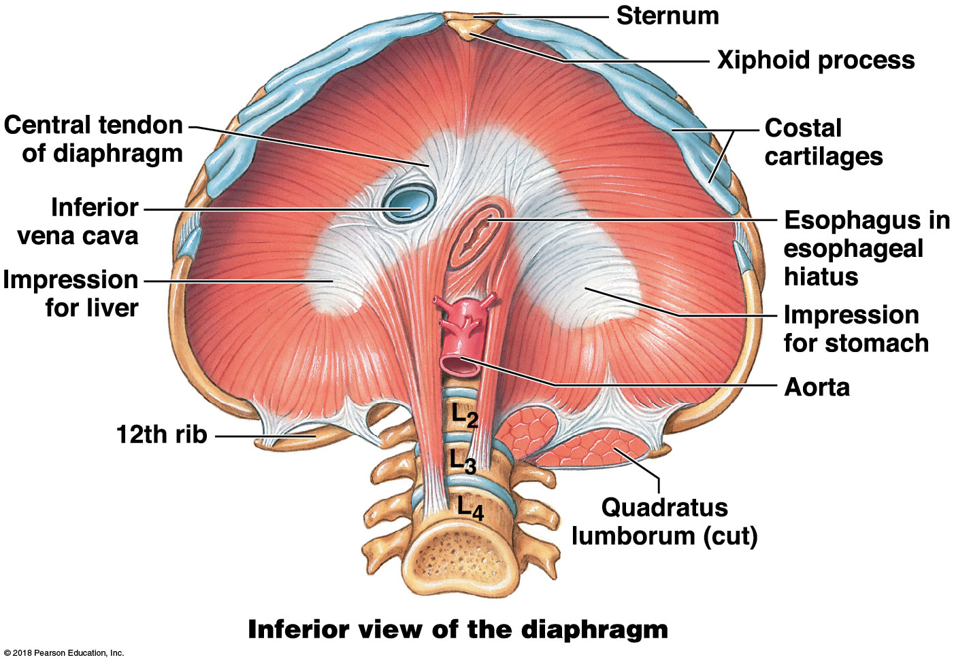
Major landmarks of the inferior surface of the diaphragm
Notes:
Be sure students realize this view is looking up from inside the abdomen.

Slide 76
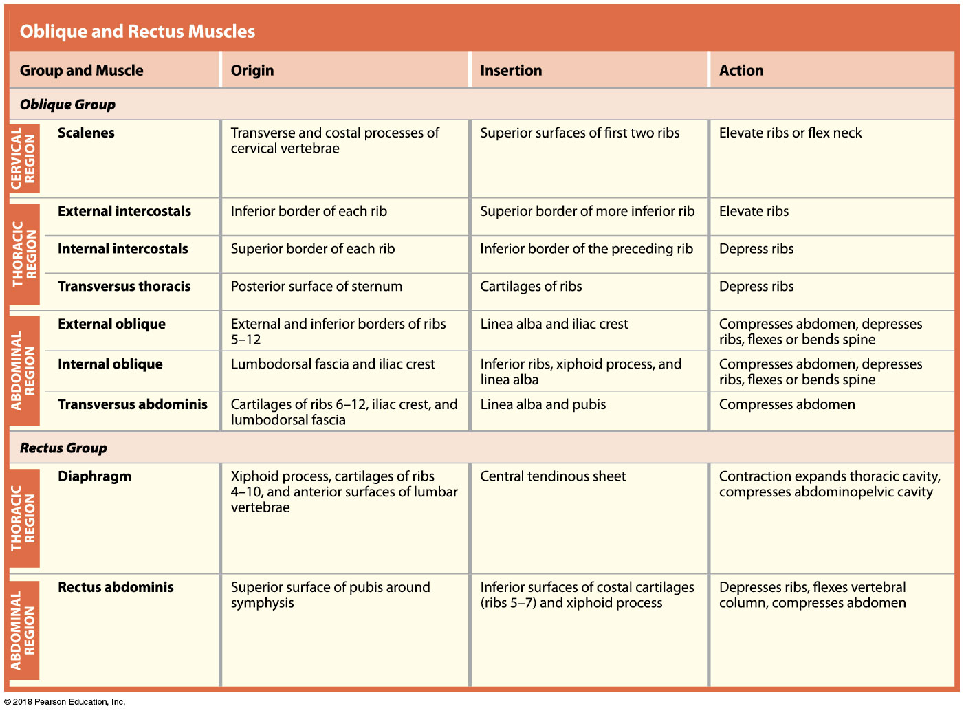
Oblique and rectus muscles

Slide 77
Module 10.10: Review
Which muscle forms the deepest layer of the abdominal wall muscles?
Which muscle connects the ribs and sternum to the pubic bones?
Describe the action of the external oblique.
Learning Outcome: Identify the trunk muscles, and cite their origins, insertions, and actions.

Slide 78
Module 10.11: The muscles of the pelvic floor support the organs of the abdominopelvic cavity
Muscles of the pelvic floor
Muscles of pelvic floor form the perineal region = area divided into the anal triangle (posterior) and urogenital triangle (anterior)
No differences in the ♀ and ♂ deep perineal musculature
Pelvic diaphragm supports pelvic organs but does not completely close pelvic outlet
Urethra, anus, vagina, vessels/nerves to lower limb exit

Slide 79
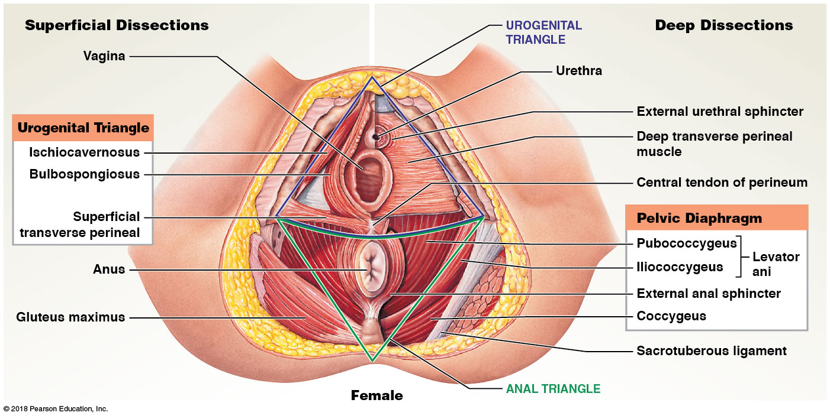
Female pelvic floor, inferior view
Notes:
Prolapsed pelvic organs occurs far more often in women than in men. Consider discussing reasons women sometimes have prolapsed bladders or uteruses—more organs on top of pelvic diaphragm, less muscle mass, childbirth stretching the muscles.

Slide 80
Male pelvic floor, inferior view

Slide 81
Muscles of the pelvic floor—urogenital triangle

Slide 82
Muscles of the pelvic floor—anal triangle

Slide 83
Module 10.11: Review
Which muscles make up the pelvic diaphragm?
In females, what is the action of the bulbospongiosus?
The coccygeus extends from the sacrum and coccyx to which structure?
Learning Outcome: Identify the pelvic floor muscles, and cite their origins, insertions, and actions.

