Slide 2
Note to the Instructor:
For the third edition of Visual Anatomy & Physiology, we have updated our PowerPoints to fully integrate text and art. The pedagogy now more closely matches that of the textbook. The goal of this revised formatting is to help your students learn from the art more effectively. However, you will notice that the labels on the embedded PowerPoint art are not editable. You can easily import editable art by doing the following:
Copying slides from one slide set into another
You can easily copy the Label Edit art into the Lecture Presentations by using either the PowerPoint Slide Finder dialog box or Slide Sorter view. Using the Slide Finder dialog box allows you to explicitly retain the source formatting of the slides you insert.
Using the Slide Finder dialog box in PowerPoint:
Open the original slide set in PowerPoint.
On the Slides tab in Normal view, click the slide thumbnail that you want the copied slides to follow.
On the toolbar at the top of the window, click the drop down arrow on the New Slide tab. Select Reuse Slides.
Click Browse to look for the file; in the Browse dialog box, select the file, and then click Open.
If you want the new slides to keep their current formatting, in the Slide Finder dialog box, select the Keep source formatting checkbox. When this checkbox is cleared, the copied slides assume the formatting of the slide they are inserted after.
To insert selected slides: Click the slides you want to insert. Slides will place immediately after the slide you have selected in the Slides tab in Normal view.

Slide 3
Section 1: Overview of Development
Learning Outcomes
27.1 Describe the various stages of gestation and development.
27.2 Describe the process of fertilization, and explain the significance of multiple sperm to ensuring its success.
27.3 Explain the processes of cleavage, blastocyst formation, and blastocyst implantation in the uterine wall.
27.4 Describe gastrulation and the formation of the three germ layers.

Slide 4
Section 1: Overview of Development
Learning Outcomes (continued)
27.5 Identify and describe the formation, location, and functions of the extra-embryonic membranes.
27.6 Discuss the roles of the extra-embryonic membranes in embryonic development and placenta formation.
27.7 Discuss the importance of the placenta to the fetus and as an endocrine organ.
27.8 Describe organogenesis and its role in the developing fetus.

Slide 5
Section 1: Overview of Development
Learning Outcomes (continued)
27.9 Describe the interplay between maternal organ systems and the developing fetus.
27.10 List and discuss the events that occur during labor and delivery.
27.11 Describe the neonatal period and the milk ejection reflex.
27.12 Identify the features of and the functions associated with the various life stages.
27.13 Explain the roles of hormones in males and females at puberty.

Slide 6
Module 27.1: Gestation and development are marked by various stages
Gestation
Time a developing embryo and fetus spends in uterus
Pregnancy—state of female during this time
Development
Process with gradual anatomical and physiological changes

Slide 7
Module 27.1: Overview of development
Prenatal development (natus, birth)
Embryonic development
Events occurring in the first 2 months after fertilization
Study of these events is called embryology
Fetal development
Begins at the start of the 9th week
Continues until birth

Slide 8
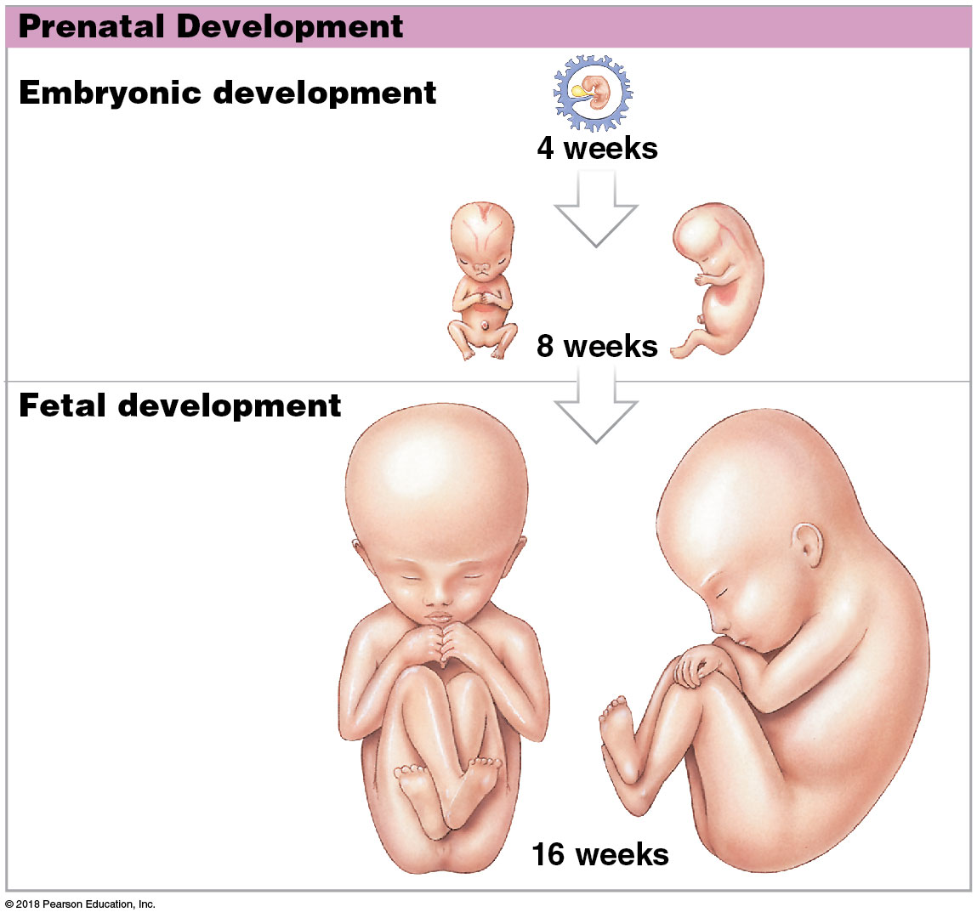
Prenatal development

Slide 9
Module 27.1: Overview of development
Usually divided into three trimesters (each 3 months long)

Slide 10
Module 27.1: Review
Define gestation.
Distinguish among embryonic, fetal, and prenatal development.
What is postnatal development?
Learning Outcome: Describe the various stages of gestation and development.

Slide 11
Module 27.2: At fertilization, an ovum and a sperm form a zygote that prepares for cell division
Fertilization (conception)
Fusion of two haploid (23 chromosomes) gametes
Produces zygote with 46 chromosomes
Typically occurs in the uterine tube, near the junction between the ampulla and isthmus
Usually within a day after ovulation

Slide 12
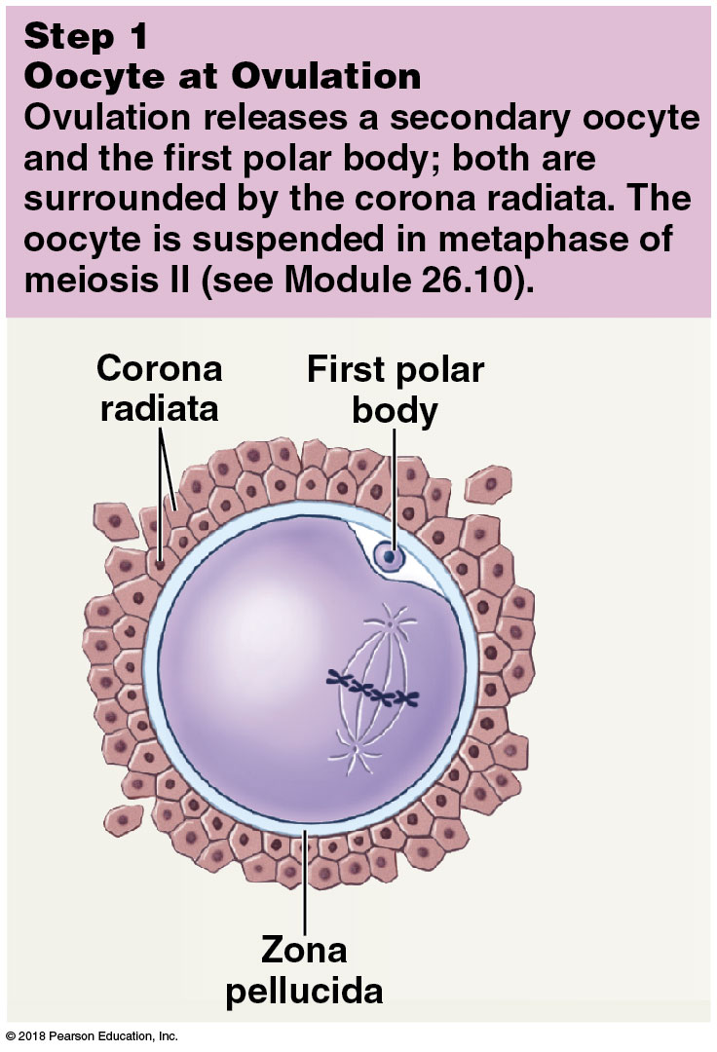
Steps in fertilization
Notes:
This is an opportunity to again review meiosis.

Slide 13
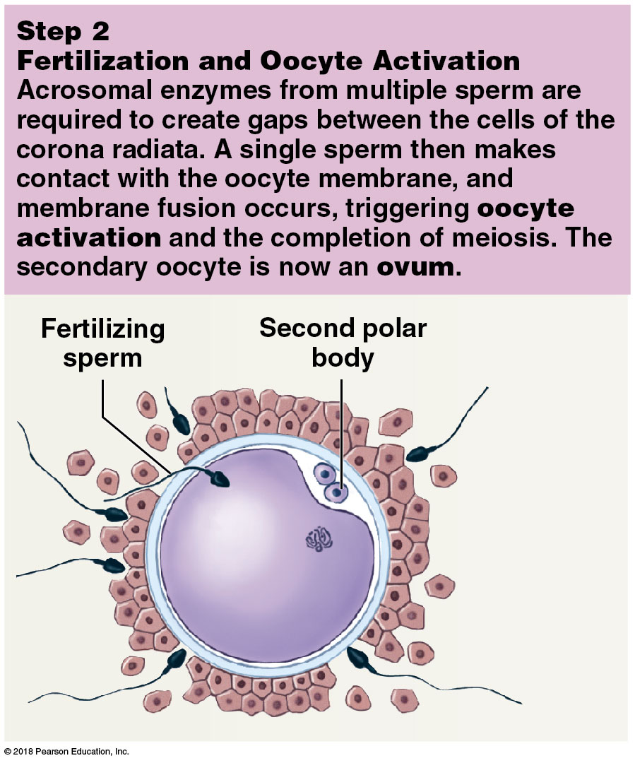
Steps in fertilization

Slide 14
Module 27.2: Fertilization
Oocyte activation
Changes in metabolic activity of oocyte leading to Ca⁺² release from smooth ER
Rise in Ca⁺² has three effects:
Release enzymes to harden zonal pellucida to prevent fertilization by more than one sperm
Completion of meiosis II and formation of second polar body
Activation of enzymes that cause rapid increase in ovum’s metabolic rate

Slide 15
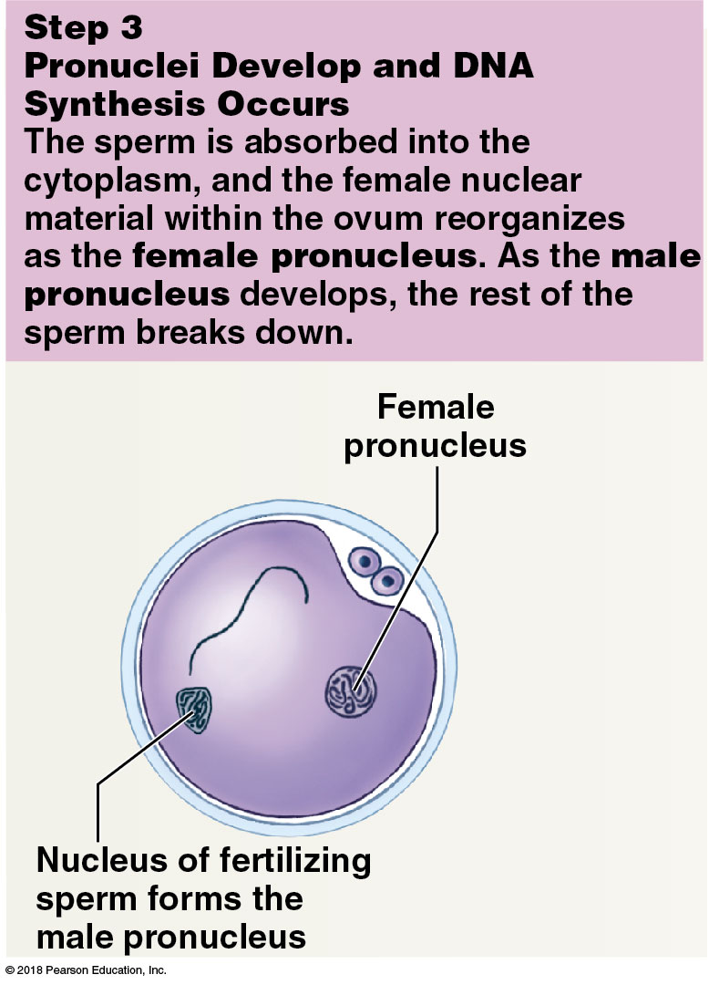
Steps in fertilization

Slide 16
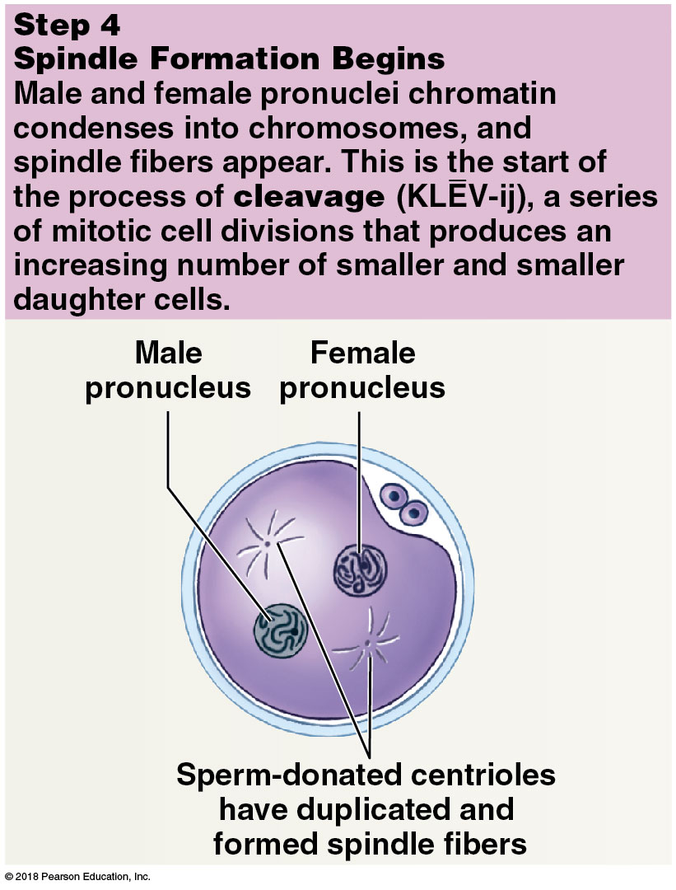
Steps in fertilization

Slide 17
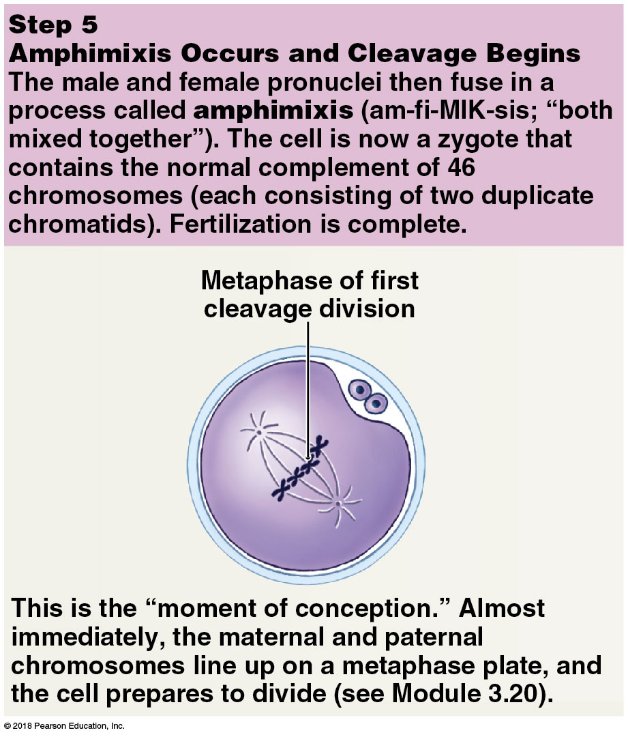
Steps in fertilization
Notes:
Amphimixis results in a diploid zygote.

Slide 18
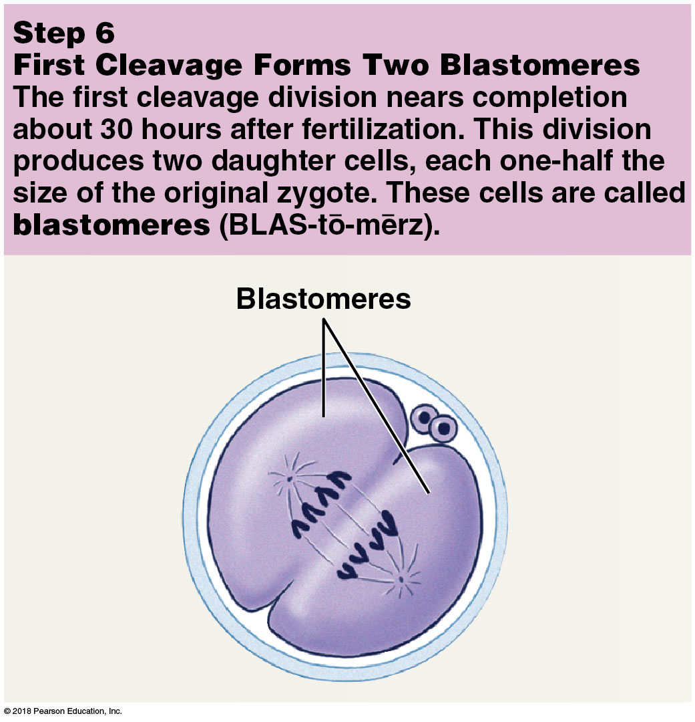
Steps in fertilization

Slide 19
Module 27.2: Fertilization
Sperm delivers paternal chromosomes to secondary oocyte
Secondary oocyte provides all organelles and inclusions, nourishment, and genetic programming to support embryo for 1 week after conception
Of 200 million sperm introduced into vagina, 10,000 enter uterine tube, and fewer than 100 reach isthmus.
Males with below 20 million sperm/milliliter are functionally sterile
Although only one sperm is needed for fertilization, multiple sperm are needed to supply enough acrosomal enzymes to penetrate corona radiata

Slide 20
Module 27.2: Review
Define fertilization.
How many chromosomes are contained within a human zygote?
Why are numerous sperm required to fertilize a secondary oocyte?
Learning Outcome: Describe the process of fertilization, and explain the significance of multiple sperm to ensuring its success.

Slide 21
Module 27.3: Cleavage continues until the blastocyst implants in the uterine wall
Cleavage
Subdivision of the zygote cytoplasm into numerous, progressively smaller blastomeres
Group of blastomeres created by cleavage divisions is called a pre-embryo
Lasts about 7 days
Pre-embryo travels the length of the uterine tube in that time

Slide 22
Module 27.3: Cleavage and implantation
Cleavage (continued)
After 3 days, pre-embryo is solid ball of cells (morula)
Morula reaches the uterus on day 4
In subsequent stages, the blastomeres are no longer identical in size and shape
Over next 2 days, blastomeres form a hollow ball of cells (blastocyst) with interior cavity (blastocoele)

Slide 23
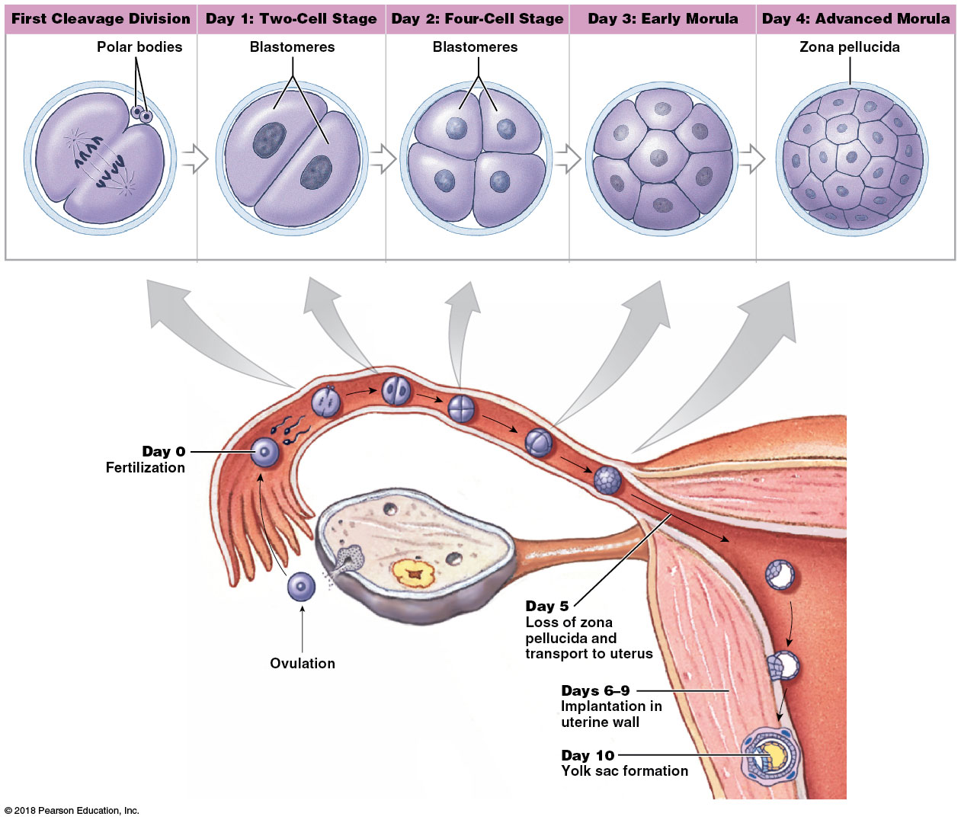
Cleavage
Notes:
Point out that day 0 is the day of fertilization.

Slide 24
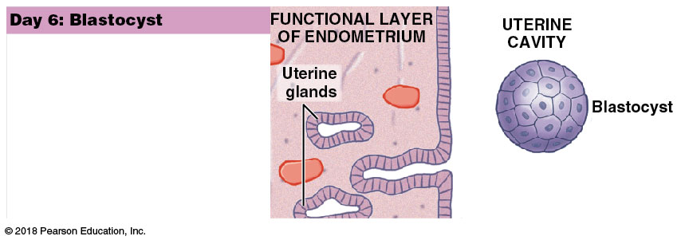
Module 27.3: Cleavage and implantation
Implantation
Day 6: Blastocyst growth
Glycogen-rich secretions of the uterine glands nourish the blastocyst
Cell division rate increased, enlarging blastocyst rapidly

Slide 25
Module 27.3: Cleavage and implantation
Implantation (continued)
Day 7: Implantation
Begins with the attachment of the blastocyst to the uterine endometrium
Blastocyst erodes endometrial lining and becomes enclosed within the endometrium by day 10

Slide 26
Module 27.3: Cleavage and implantation
Implantation (continued)
Day 7: Implantation (continued)
Blastocyst cell layers
Trophoblast (trophos, food + blast, precursor)
Outer layer of cells surrounding the blastocyst
Provides nutrients to the developing embryo
Will later form part of the placenta
Inner cell mass
Insulated from contact with the intrauterine environment
Will form the embryo

Slide 27
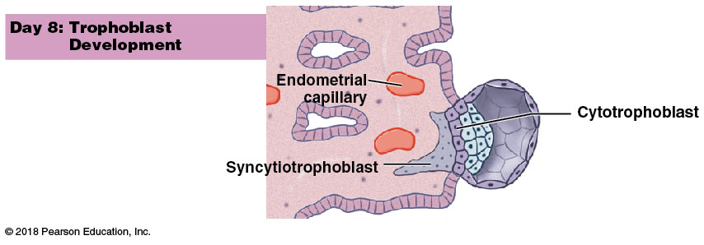
Module 27.3: Cleavage and implantation
Implantation (continued)
Day 8: Trophoblast development
Trophoblast cells divide rapidly
Cells closest to the blastocoele form a layer of cytotrophoblast
Syncytiotrophoblast
Layer of cytoplasm with multiple nuclei
Formed by disappearance of the plasma membranes between cells near the endometrial wall

Slide 28
Module 27.3: Cleavage and implantation
Implantation (continued)
Day 9: Formation of amniotic cavity
Fingerlike villi extend away from the trophoblast into the endometrium around endometrial capillaries
Creates channels called lacunae that fill with maternal blood
Syncytiotrophoblast absorbs and distributes nutrients to the inner cell mass
Fluid-filled amniotic cavity develops as inner cell mass separates from trophoblast

Slide 29
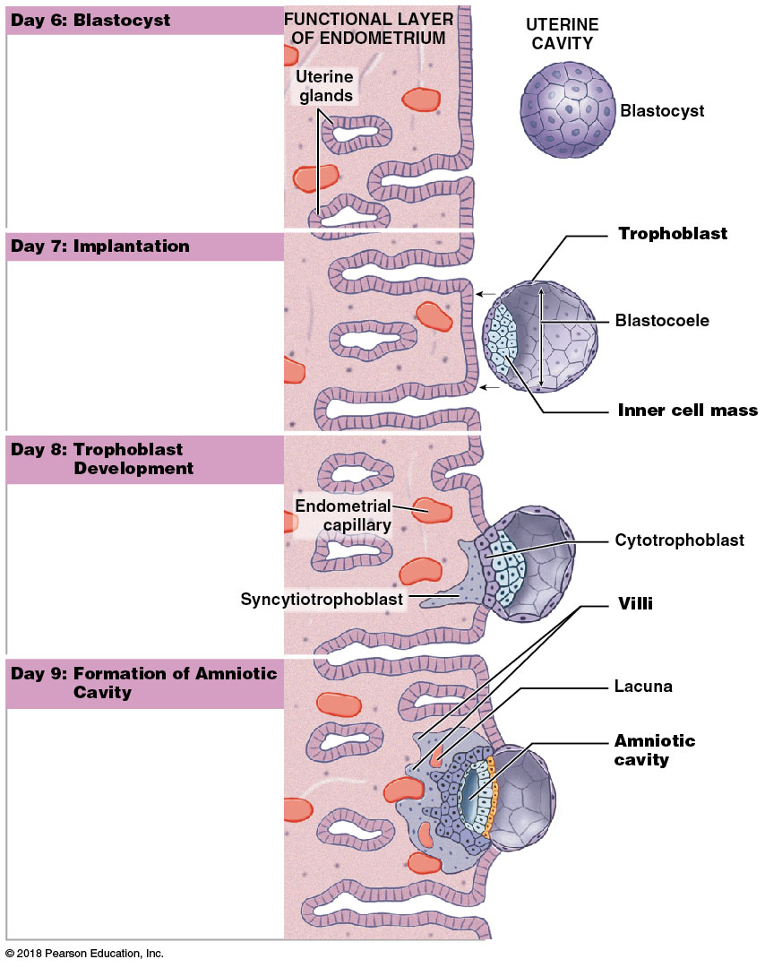
Implantation
Notes:
Use this image to review the stages, and ask students to look at each row and compare it to the next to tell you what changes they see occurring.

Slide 30
Module 27.3: Review
A pre-embryo that consists of a solid ball of cells is known as what type of structure?
Describe the trophoblast.
Describe the blastocyst and its role in implantation.
Learning Outcome: Explain the processes of cleavage, blastocyst formation, and blastocyst implantation in the uterine wall.

Slide 31
Module 27.4: Gastrulation produces three germ layers: ectoderm, endoderm, and mesoderm
Day 9: Continued formation of amniotic cavity
Cells of the inner cell mass organized into an oval sheet (blastodisc) with two layers
Cells of superficial layer (facing amniotic cavity) migrate along the walls of the amniotic cavity
Separate the amniotic cavity from trophoblast
First step in formation of amnion (an extra-embryonic membrane)
At this stage, nutrients are absorbed directly by blastodisc cells

Slide 32
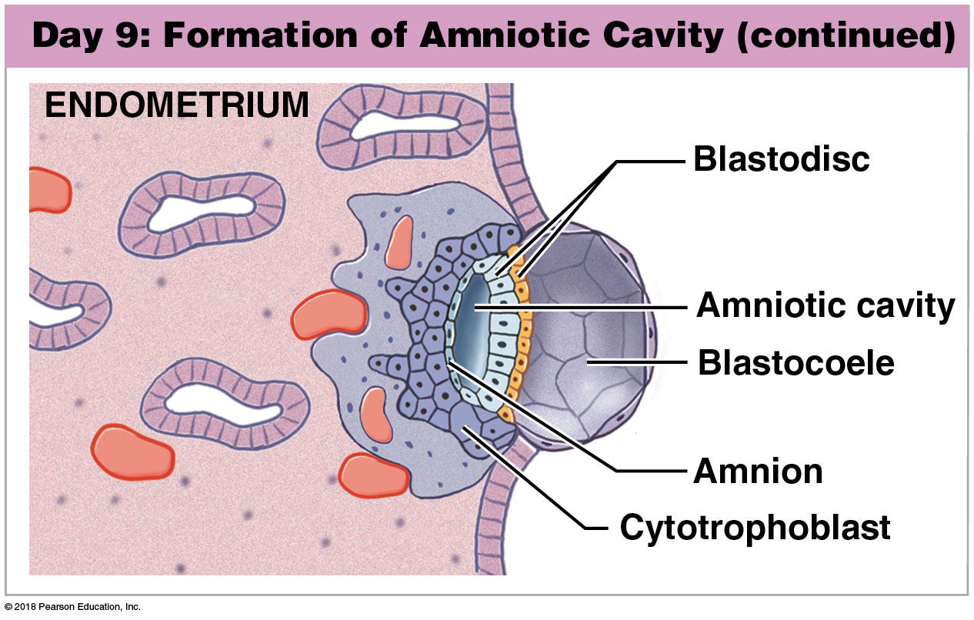
Formation of the amniotic cavity

Slide 33
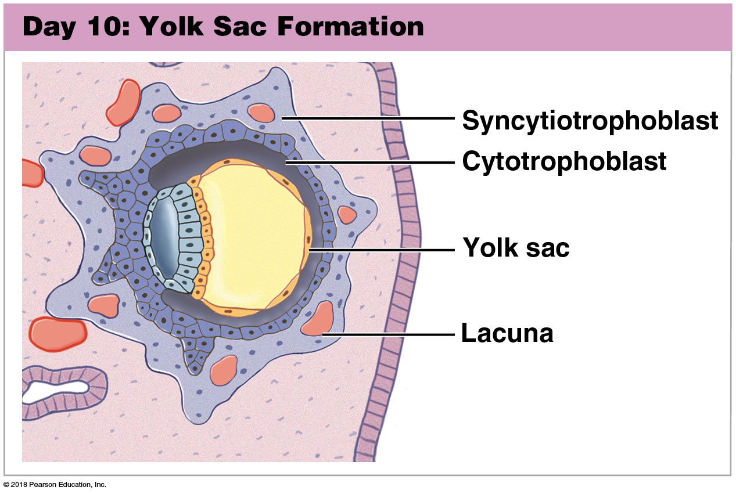
Module 27.4: Gastrulation and germ layers
Day 10: Yolk sac formation
Cells from the deep layer of the blastodisc migrate around the outer edge of the blastocoele
First step in formation of the yolk sac (another extra-embryonic membrane)
Yolk sac is the primary nutrient source for the inner cell mass for the next 2 weeks

Slide 34
Module 27.4: Gastrulation and germ layers
Day 15: Gastrulation
Superficial cells of the blastodisc migrate toward a central line (primitive streak)
Migrating cells leave the surface and move between the two existing layers
Migration process is called gastrulation
Creates three embryonic layers called germ layers
End result is an oval, three-layered sheet called the embryonic disc
Embryonic disc forms the body of the embryo
Other cells of the blastocyst form the extra-embryonic membranes

Slide 35
Module 27.4: Gastrulation and germ layers
Day 15: Gastrulation (continued)
Three germ layers
Ectoderm
Superficial blastodisc cells that did not migrate
Endoderm
Cells facing the yolk sac
Mesoderm
Poorly organized layer of migrating cells between other two germ layers

Slide 36
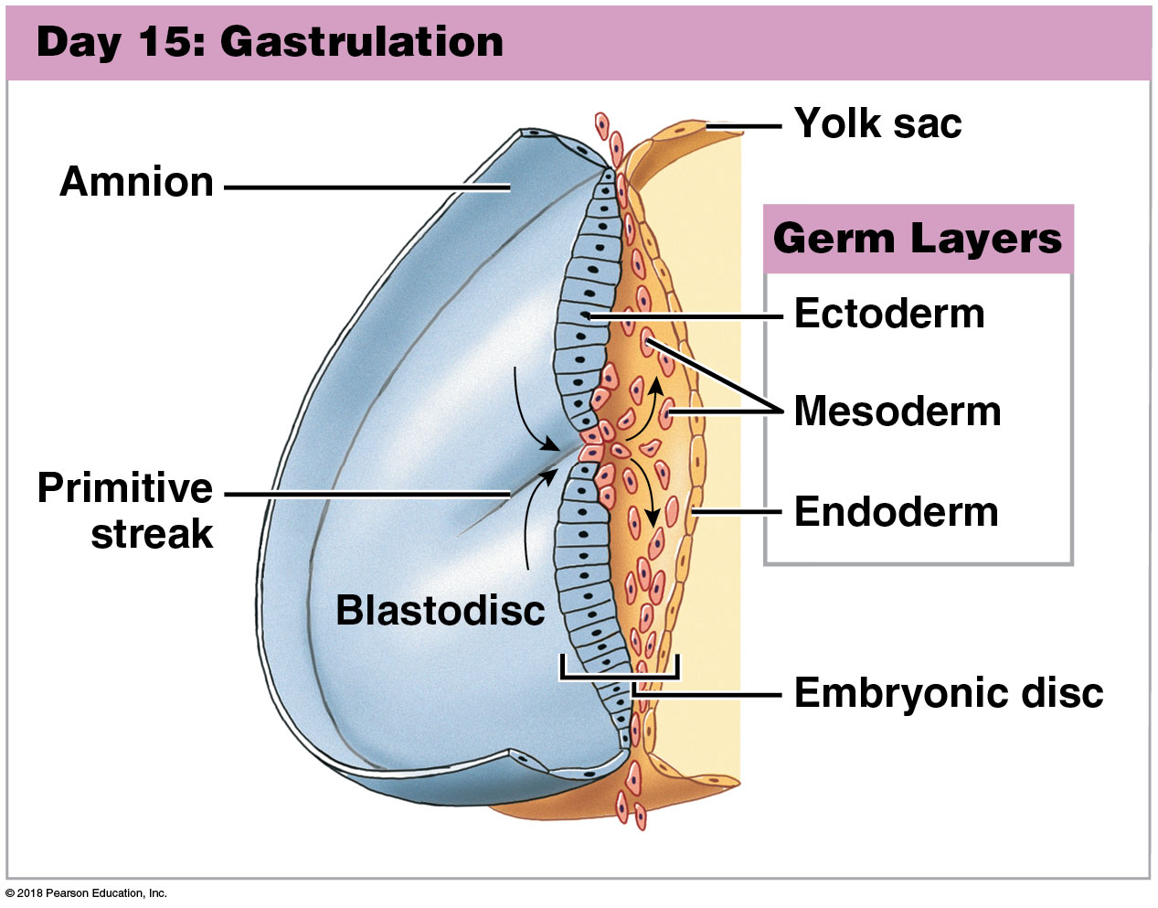
Gastrulation

Slide 37
Notes:
Use this image to help students differentiate between the positioning of the three germ, layers.

Slide 38
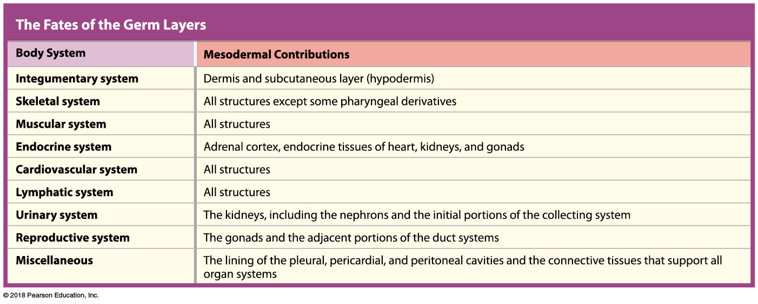
Notes:
There is a tremendous amount of information conveyed here. Be specific in your expectations so students know how in depth they should know the derivatives from each germ layer.

Slide 40
Module 27.4: Gastrulation and germ layers
Gestational trophoblastic neoplasia
Many aspects of the trophoblast are similar to cancerous cells
Repeated nuclear divisions
Extensive and rapid growth
Invades and spreads into tissues
In 0.1 percent of pregnancies, syncytiotrophoblast behaves like a tumor (gestational trophoblastic neoplasia)

Slide 41
Module 27.4: Review
Describe the process that forms the primary germ layers and cite the layer that contributes to nearly all body systems.
Learning Outcome: Describe gastrulation and the formation of the three germ layers.

Slide 42
Module 27.5: The extra-embryonic membranes form the placenta that supports fetal growth and development
Extra-embryonic membranes
Formed by the germ layers
Yolk sac (endoderm + mesoderm)
Amnion (ectoderm + mesoderm)
Allantois (endoderm + mesoderm)
Chorion (mesoderm + trophoblast)
Support embryonic and fetal development

Slide 43
Module 27.5: Extra-embryonic membranes
Yolk sac
Begins as a layer of cells around the outer edges of the blastocoele
Visible 10 days after fertilization
Vascular network collects and distributes nutrients absorbed from the blastocoele
Also important site of blood cell formation

Slide 44
Module 27.5: Extra-embryonic membranes
Amnion
Begins as blastodisc cells migrate around cavity separating inner cell mass and trophoblast
Combination of mesodermal and ectodermal cells
Amniotic cavity contains amniotic fluid
Cushions developing embryo or fetus

Slide 45
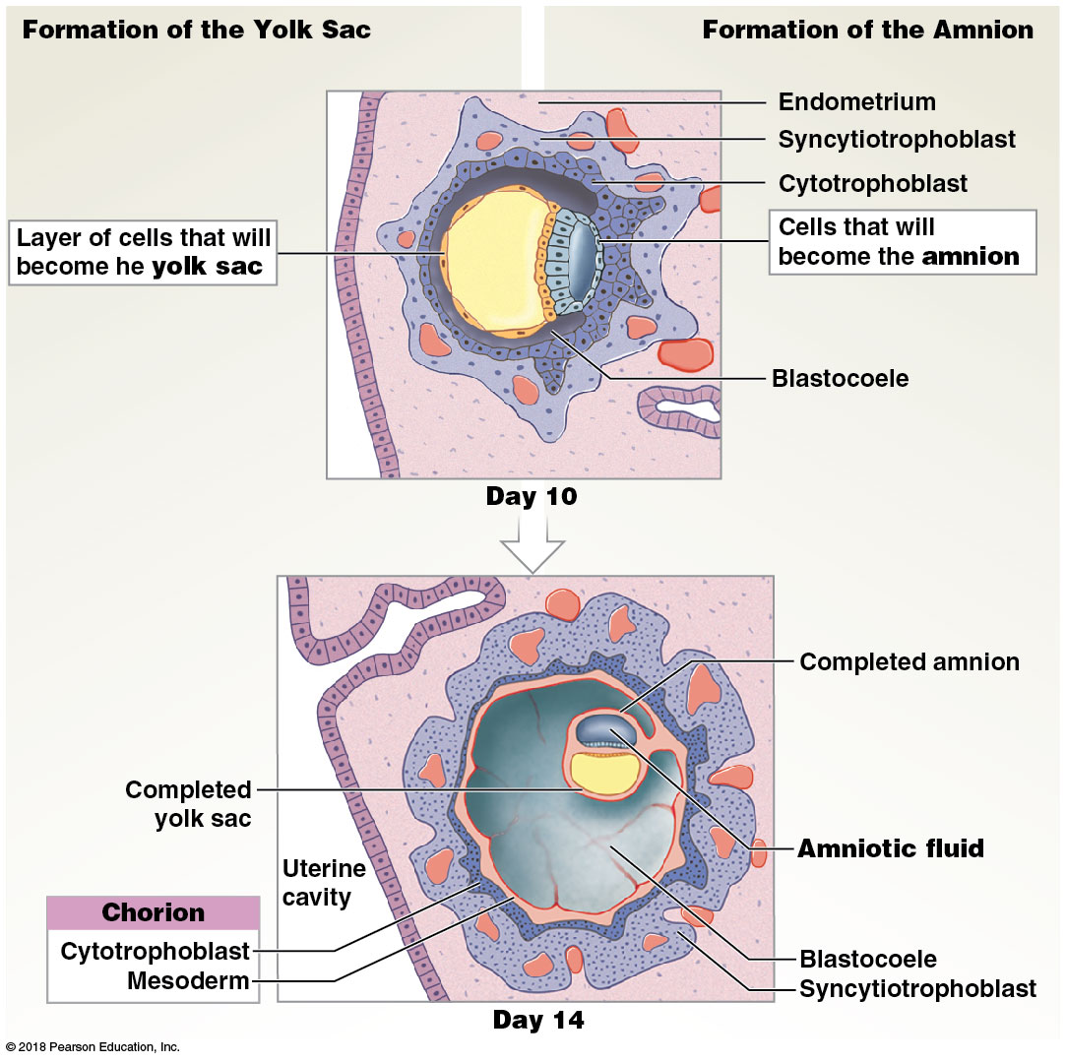
Yolk sac and amnion formation

Slide 46
Module 27.5: Extra-embryonic membranes
Allantois
Begins as an outpocket of endoderm near the base of the yolk sac
Free endodermal tip grows toward the wall of the blastocyst, surrounded by mesodermal cells
Allantois extends partway into the umbilical stalk
Base of the allantois will form the urinary bladder

Slide 47
Module 27.5: Extra-embryonic membranes
Chorion
Mesoderm associated with the allantois spreads around the blastocyst
Separates mesoderm and trophoblast near allantois
Chorionic villi invade endometrium and receive nutrients
Placenta develops and becomes primary embryo support
Oxygen and nutrients exchanged for carbon dioxide and wastes

Slide 48
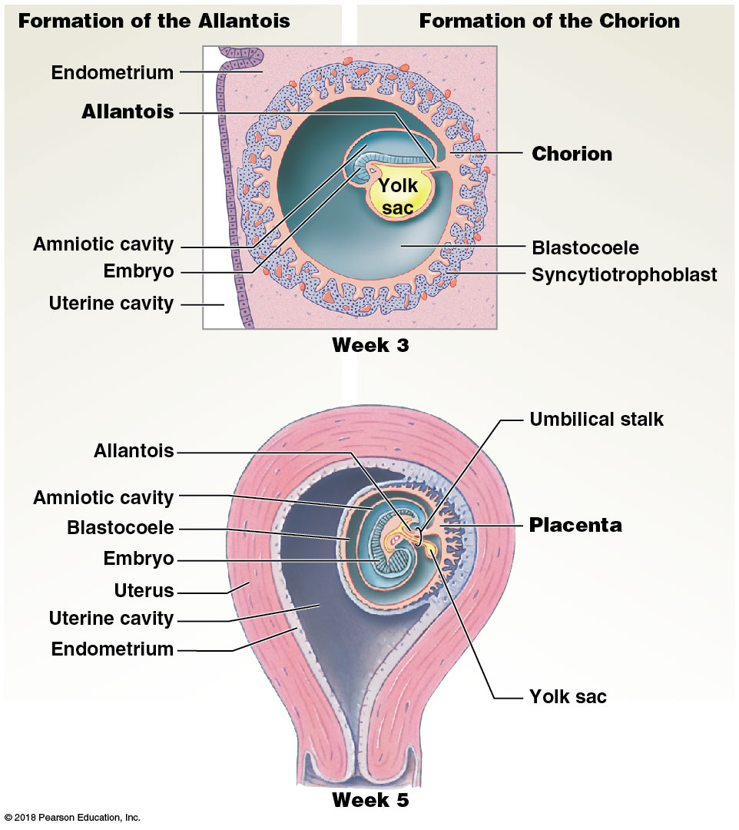
Formation of the allantois and chorion

Slide 49
Module 27.5: Review
Name the four extra-embryonic membranes.
From which germ layers do the extra-embryonic membranes form, and what are each membrane’s functions?
Describe the placenta.
Learning Outcome: Identify and describe the formation, location, and functions of the extra-embryonic membranes.

Slide 50
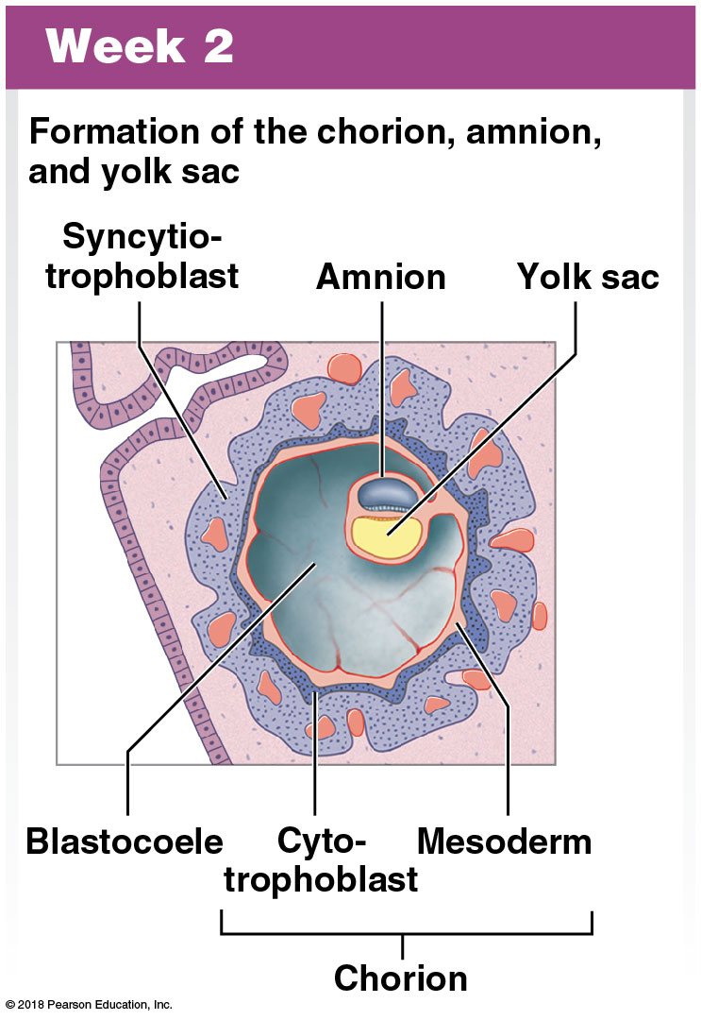
Module 27.6: The formation of extra-embryonic membranes is associated with major changes in the shape and complexity of the embryo
Weeks 2–3
Week 2
Formation of the chorion, amnion, and yolk sac

Slide 51
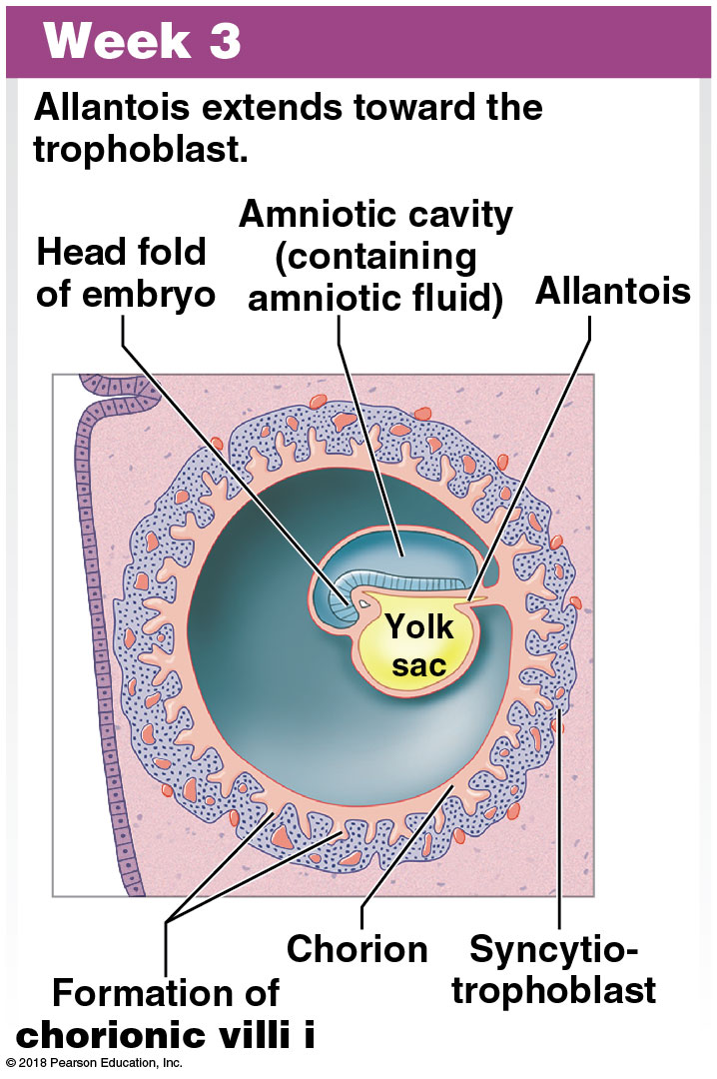
Module 27.6: Early embryonic development
Weeks 2–3 (continued)
Week 3
Embryonic disc bulges into the amniotic cavity at the head fold
Allantois extends toward the trophoblast
Embryonic heart starts beating
Mesoderm extensions along the core of trophoblastic villi form the chorionic villi
Villi are in contact with maternal tissues
Embryonic blood vessels develop within each villus

Slide 52
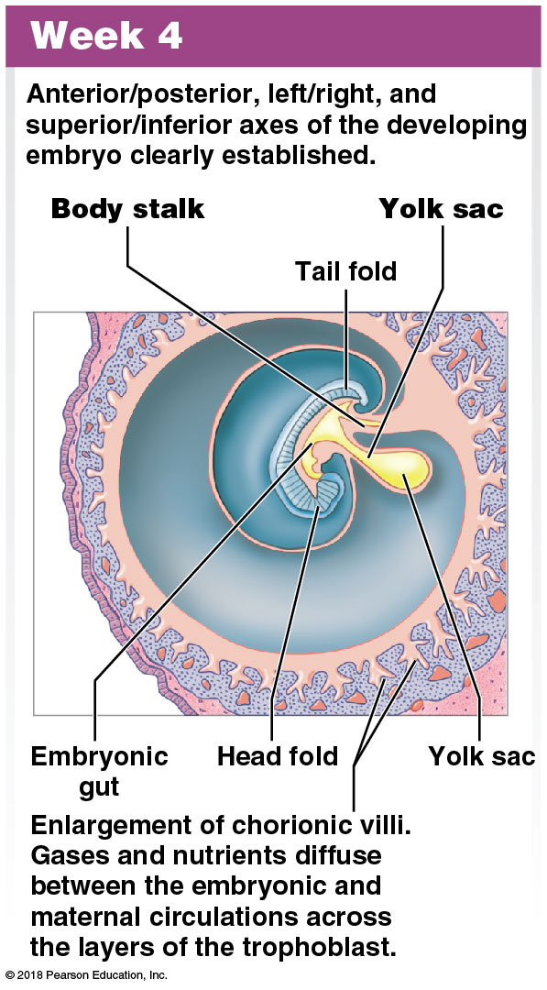
Module 27.6: Early embryonic development
Week 4
Tail fold forms
Anterior/posterior, left/right, superior/inferior axes of embryo established
Body stalk (between embryo and chorion) forms, carrying blood to and from placenta
Yolk stalk (narrow connection between endoderm and yolk sac) forms

Slide 53
Module 27.6: Early embryonic development
Week 4 (continued)
Chorionic villi enlarge
Maternal blood flows through lacunae around the villi
Gases and nutrients diffuse between embryonic and maternal circulation across the trophoblast layers

Slide 54
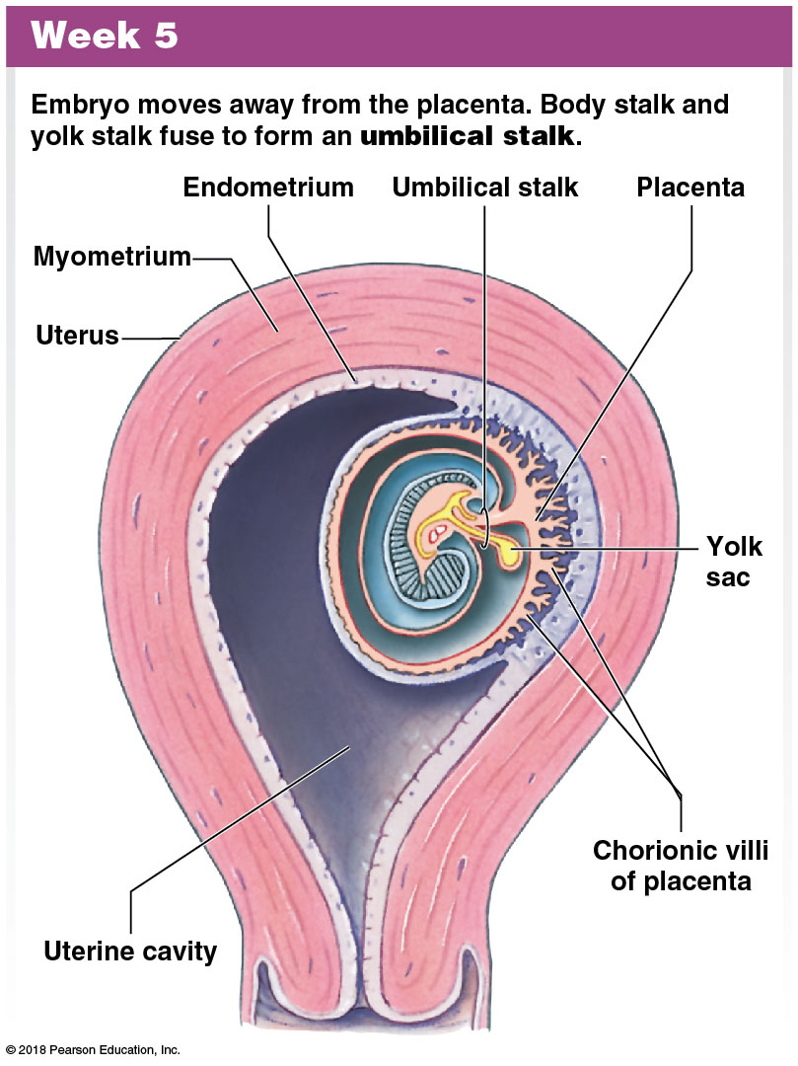
Module 27.6: Early embryonic development
Week 5 and week 10
Week 5
Umbilical stalk formed from body and yolk stalks
Embryo and membranes bulge into uterine cavity
Notes:
Stress that materials diffuse back and forth between embryonic and maternal circulation, but the blood does not actually come in contact. Revisit what they learned in the circulatory system about hemolytic disease of the newborn (erythroblastosis fetalis). The lack of contact between the two sources of blood explains why the first pregnancy is usually not problematic.

Slide 55
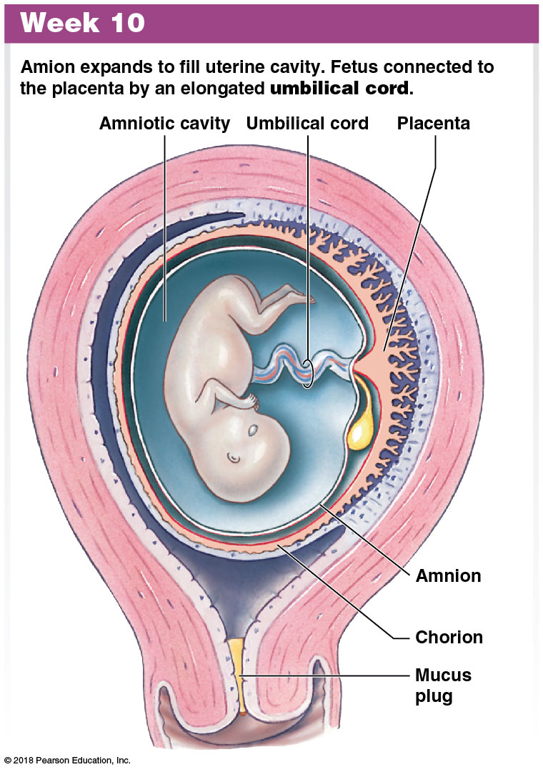
Module 27.6: Early embryonic development
Week 5 and week 10 (continued)
Week 10
Embryo has now become a fetus
Fetus is connected to placenta by the umbilical cord
Cord contains portions of the allantois, blood vessels, and remnants of the yolk stalk
Amniotic cavity fills uterine cavity

Slide 56
Module 27.6: Review
Describe the chorionic villi.
Compare the body stalk with the yolk stalk.
Identify the structure connecting the fetus to the placenta, and name the extra-embryonic membrane from which it is derived.
Learning Outcome: Describe the roles of the extra-embryonic membranes in embryonic development and placenta formation.

Slide 57
Module 27.7: The placenta performs many vital functions during prenatal development
Blood supply
Umbilical arteries
Carry blood from the developing fetus to the placenta
Blood is deoxygenated and full of waste products
Chorionic villi
Provide surface area for exchange of gases, nutrients, and wastes between fetal and maternal bloodstreams
Umbilical vein
Carries blood from the placenta to the fetus
Blood contains nutrients and oxygen

Slide 58
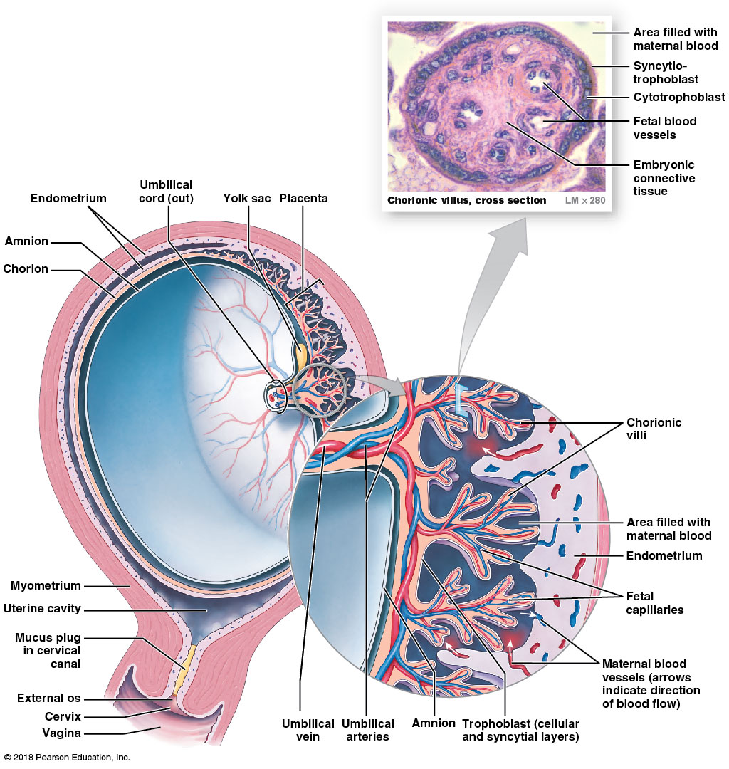
The placenta
Notes:
Remind students that artery and vein are directional terms. The umbilical vessels are named for the fetus. Thus, the umbilical artery carries blood away from the fetal heart to the placenta. This is deoxygenated blood. Students often assume the umbilical artery carries oxygenated blood.

Slide 59
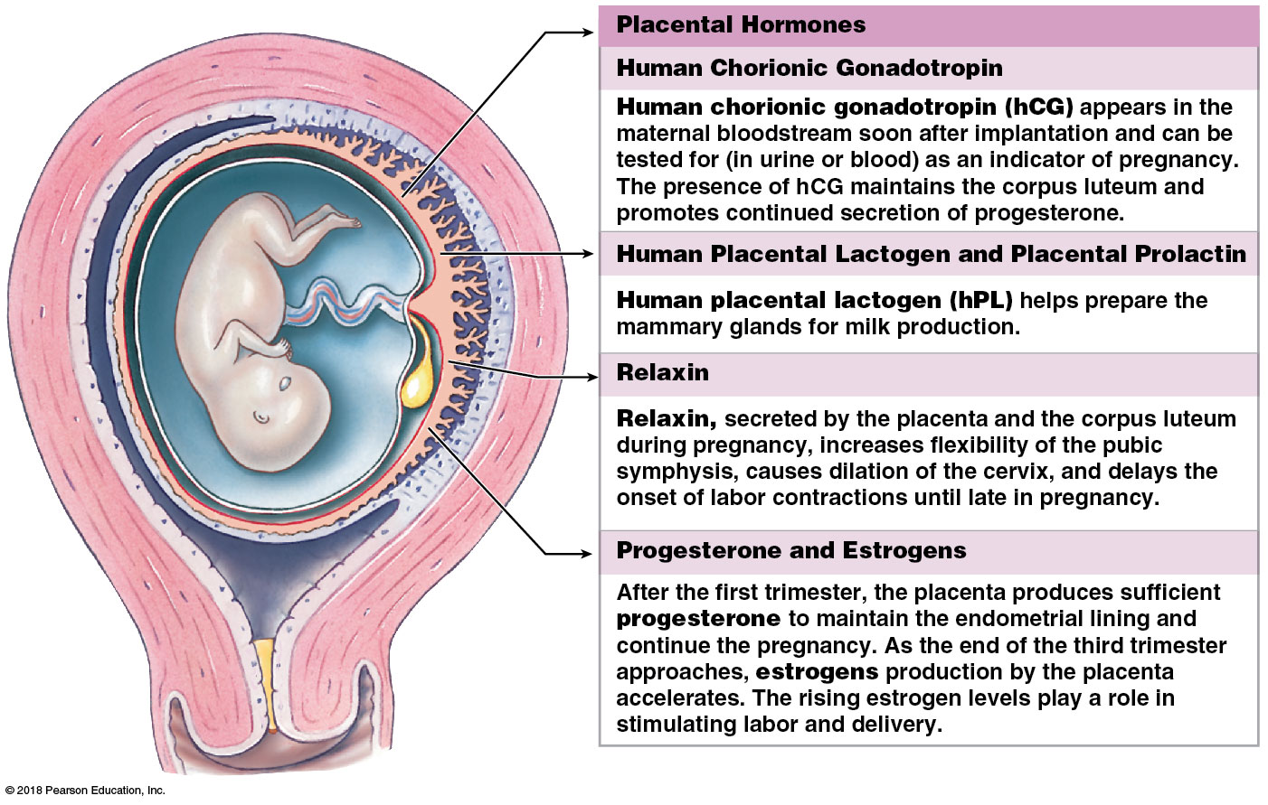
Module 27.7: The placenta
Placental hormones
Synthesized by the syncytiotrophoblast

Slide 60
Module 27.7: Review
Name the hormones synthesized by the syncytiotrophoblast.
The presence of which hormone in the urine provides a reliable indicator of pregnancy, as detected by home pregnancy tests?
When does the placenta become sufficiently functional to continue the pregnancy?
Learning Outcome: Discuss the importance of the placenta to the fetus and as an endocrine organ.
Notes:
Note that the slide says that hCG maintains the corpus luteum. Ask students to recall how the corpus luteum forms and what it does. Point out that absence of hCG is the signal that causes degeneration of the corpus luteum, which withdraws its hormonal support of the built-up endometrium, triggering menstruation and the start of a new cycle.

Slide 61
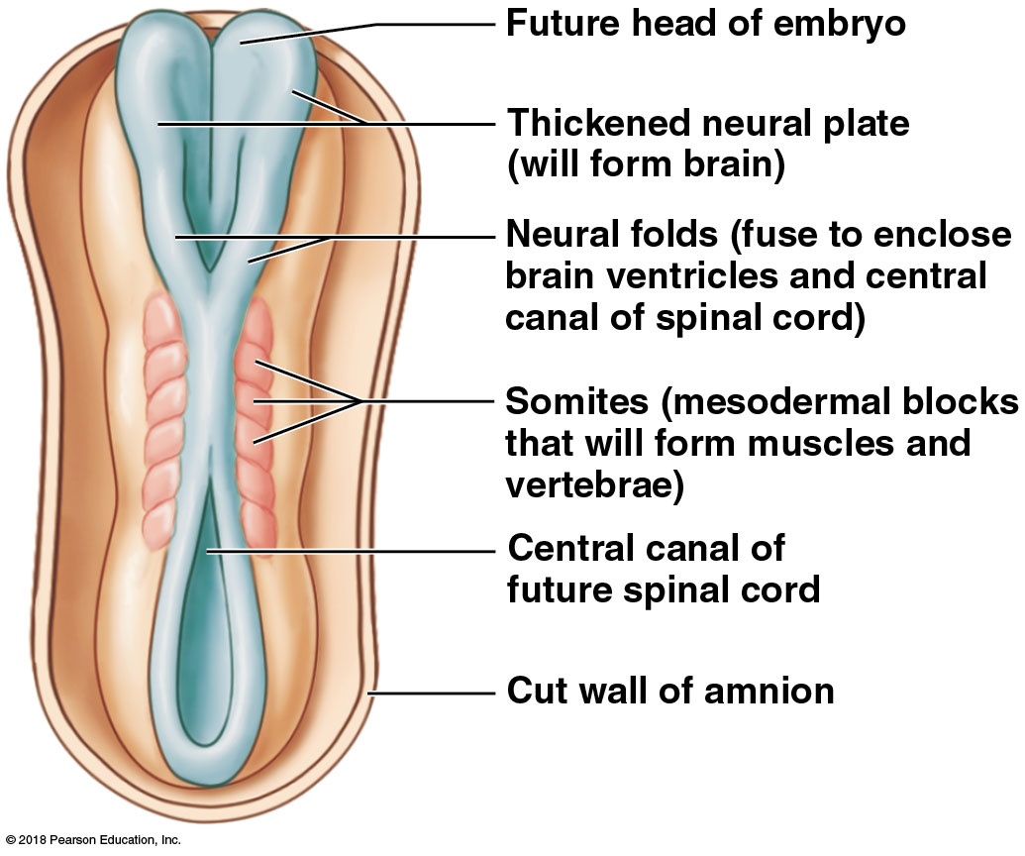
Module 27.8: Organ systems form in the first trimester and become functional in the second and third trimesters
Organogenesis
The process of organ formation
Week 3
Central nervous system is forming as deep groove develops in ectodermal band along the posterior midline of the embryo
Neural plate (which will form the brain) and neural folds are located adjacent to the central groove

Slide 62
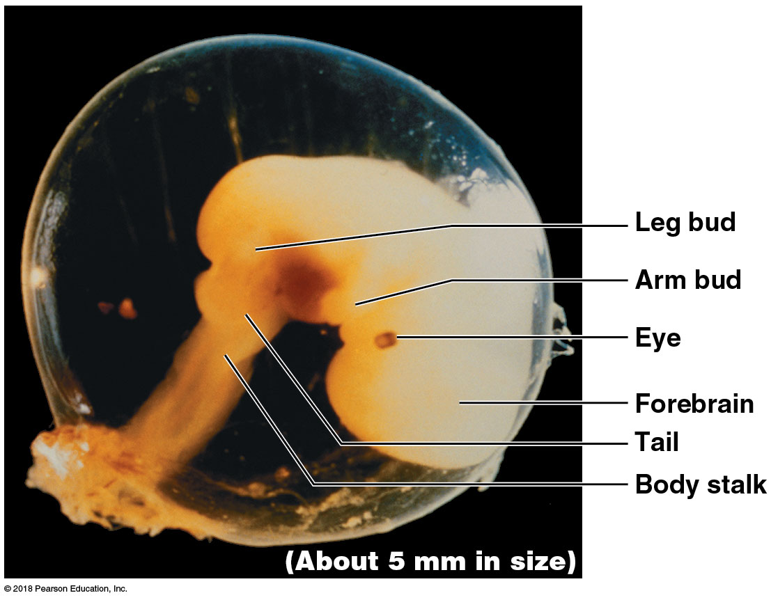
Module 27.8: Organ system development
Organogenesis (continued)
Week 4
The heart is beating
Providing nutrients for additional growth and development

Slide 63
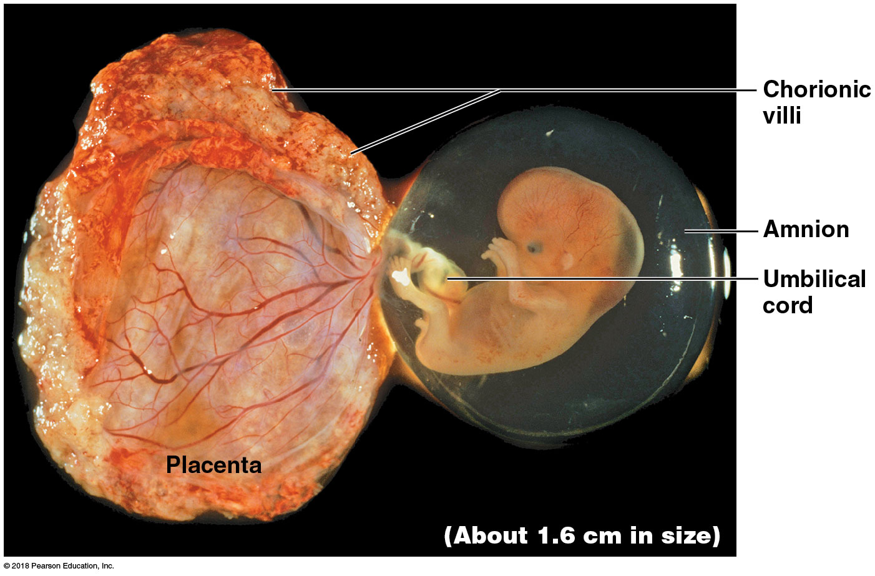
Module 27.8: Organ system development
Organogenesis (continued)
Week 6
The placenta has formed
Embryo is floating in the amniotic cavity
Limbs grow longer
Skull bones are forming around the brain

Slide 64
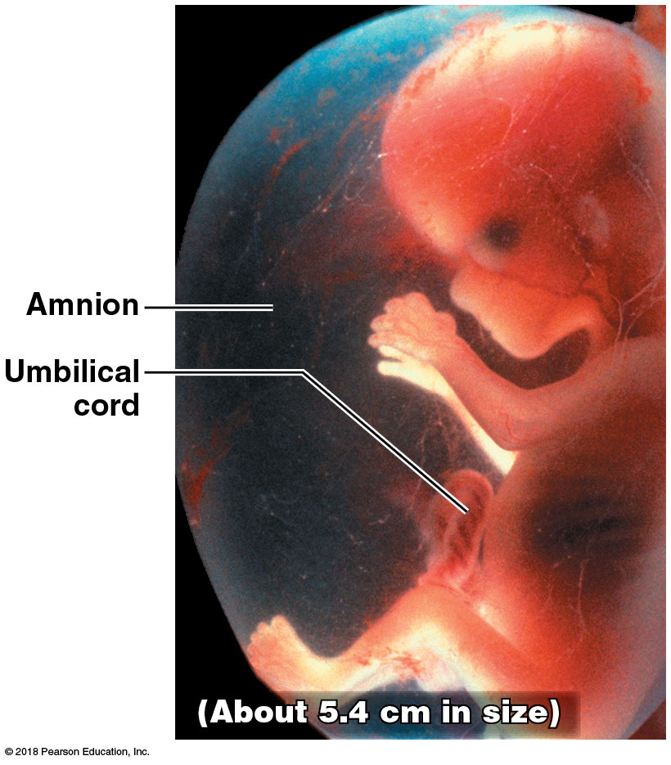
Module 27.8: Organ system development
End of first trimester
Human features are better defined
Axial and appendicular muscles are forming
Fetal movements will begin soon

Slide 65
Module 27.8: Organ system development
The second trimester
By the end of 4 months:
Face and palate have formed
Cerebral hemispheres are enlarging
Hair follicles are present, and hair is growing
Peripheral nerves are formed
The first 8 weeks of fetal growth are the most rapid
Fetus increasing in weight about 25-fold
By the end of the second trimester, fetus weighs about 0.64 kg (1.4 lb)

Slide 66
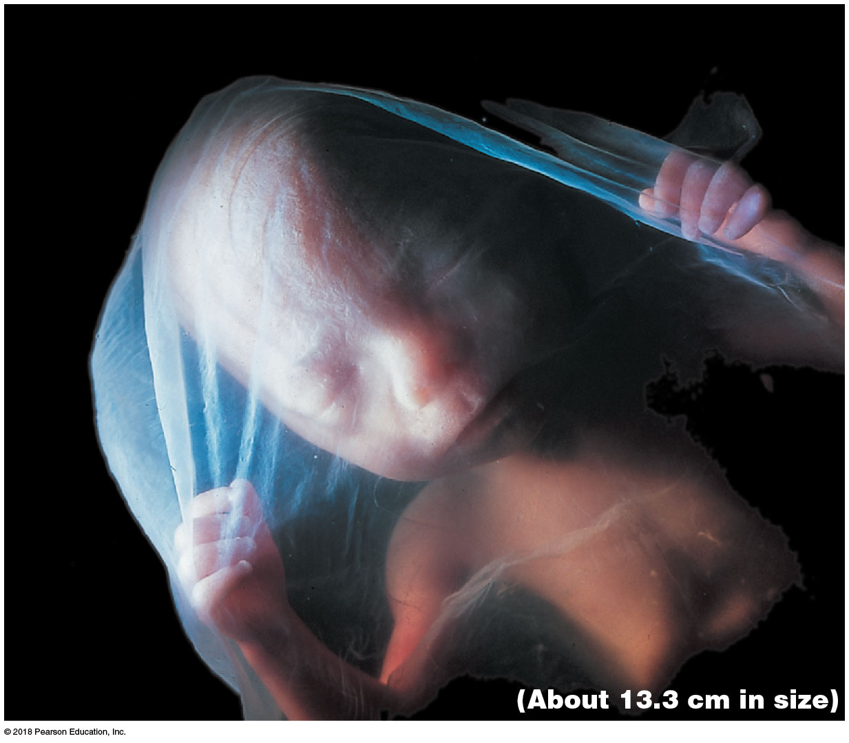
Four months’ gestation

Slide 67
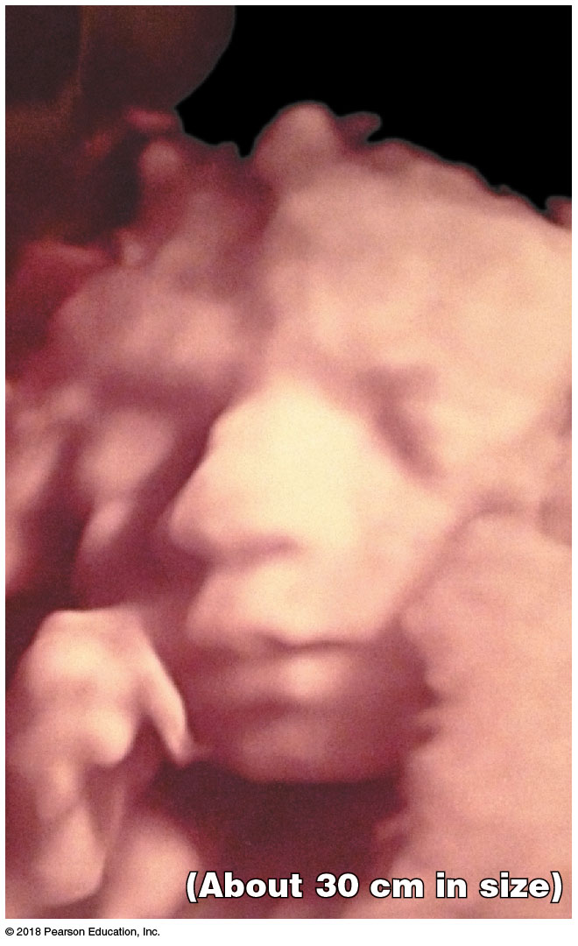
Module 27.8: Organ system development
Third trimester
Organ systems become ready for normal function
Rate of growth slows a little
In absolute terms, the largest weight gain occurs in the third trimester
Fetus gains ~2.6 kg (5.7 lb) to reach full-term weight of ~3.2 kg (7 lb)

Slide 68
Module 27.8: Organ system development
Multiple births
Dizygotic (“fraternal”) twins
Develop when two separate oocytes are ovulated and fertilized
70 percent of twins are dizygotic
Monozygotic (“identical”) twins
Result from separation of blastomeres early in cleavage
Can also result when inner cell mass splits before gastrulation
Genetic makeup of twins is identical (both formed from the same set of gametes)

Slide 69
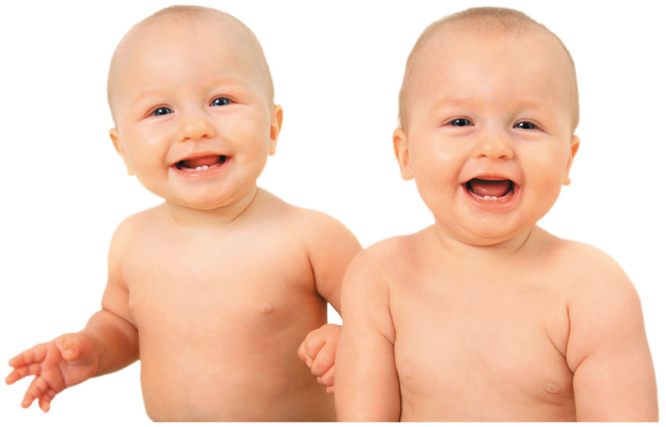
Multiple births
Notes:
Ask students to consider the meaning of the terms dizygotic and monozygotic. This will help them think about the division processes that lead to each type of twins.

Slide 70
Module 27.8: Review
Define organogenesis.
Identify the general events of fetal development during the second and third trimesters.
A fetus undergoes its largest absolute weight gain during which trimester?
Learning Outcome: Describe organogenesis and its role in the developing fetus.

Slide 71
Module 27.9: Pregnancy places anatomical and physiological stresses on maternal systems
Strains on maternal systems
Mother has to absorb enough oxygen, nutrients, and vitamins for herself and the fetus
She must also eliminate all wastes generated
Physical strains include:
Weight gain of 11–16 kg (25–35 lb)
Changes balance because the additional weight is not evenly distributed
Requires more energy to maintain balance
Increasing size of the uterus and fetus pushes maternal abdominal organs out of normal position

Slide 72
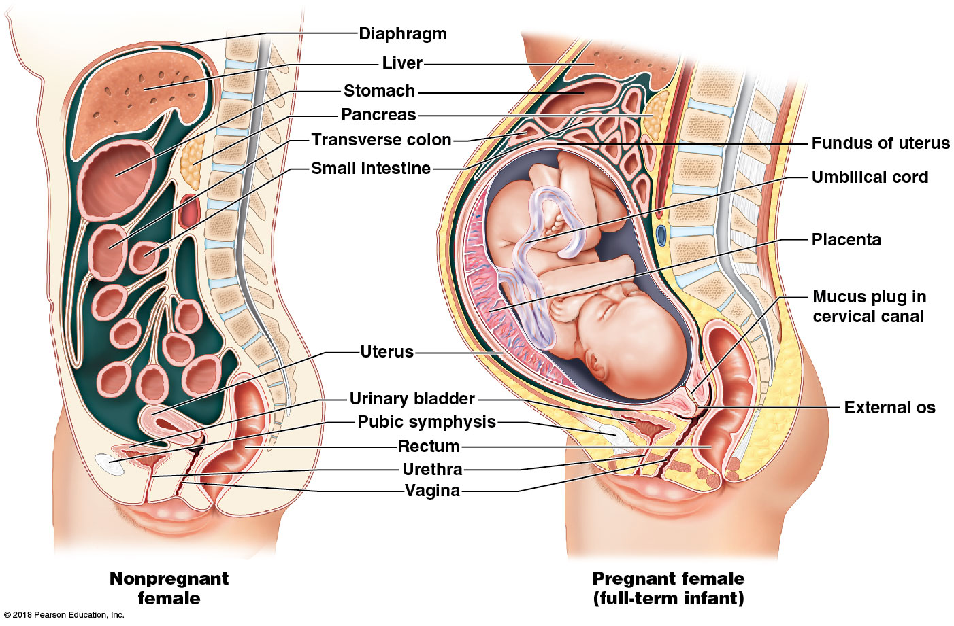
Anatomical changes in a pregnant female

Slide 73
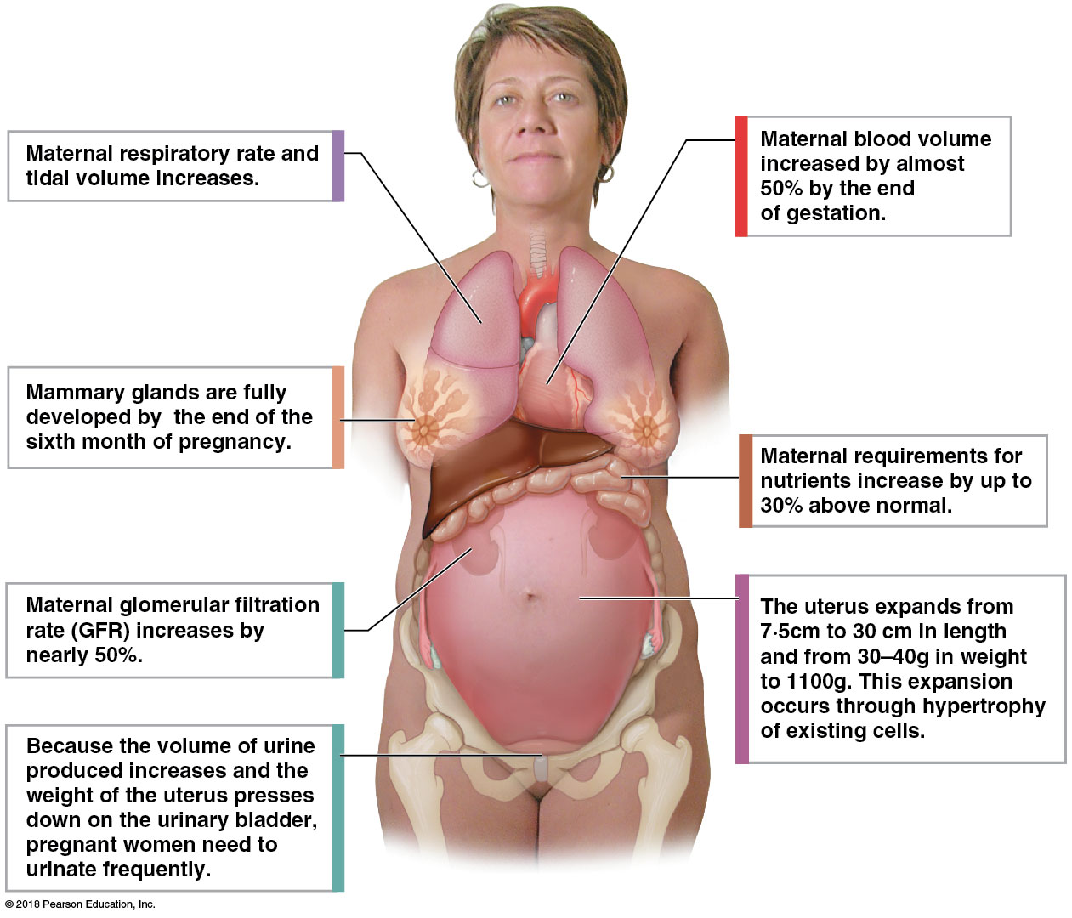
Physiological adjustments to pregnancy
Notes:
Using this image, ask students to suggest some of the problems an expectant mom might experience, and what causes them. For example, pregnant women often have polyuria. Why?

Slide 74
Module 27.9: Maternal changes with pregnancy
Pregnancy risks increase with age
Pregnancy is a natural phenomenon, yet not without health risks
Physical and physiological demands on maternal systems are potentially dangerous
Risks associated with pregnancy significantly greater than with the use of oral contraceptives
Pregnant women over age 35 are twice as likely to die from pregnancy-related complications as from an automobile accident

Slide 75
Module 27.9: Review
List the major changes that occur in maternal systems during pregnancy.
Why does a mother’s blood volume increase during pregnancy?
Based on the illustrations showing the locations of the internal organs in nonpregnant and pregnant women, explain why some pregnant women experience difficulty breathing.
Learning Outcome: Describe the interplay between maternal organ systems and the developing fetus.

Slide 76
Module 27.10: Multiple factors initiate and accelerate labor and delivery
Labor
Spontaneous contractions of the smooth muscle in the uterine myometrium
Stretching of the uterus causes a gradual increase in the rate of those contractions
During early pregnancy, progesterone from placenta inhibits contractions
Braxton Hicks contractions (false labor)
Spasms in the uterine muscles that are neither regular nor persistent
True labor
Involves placental and fetal factors for initiation

Slide 77
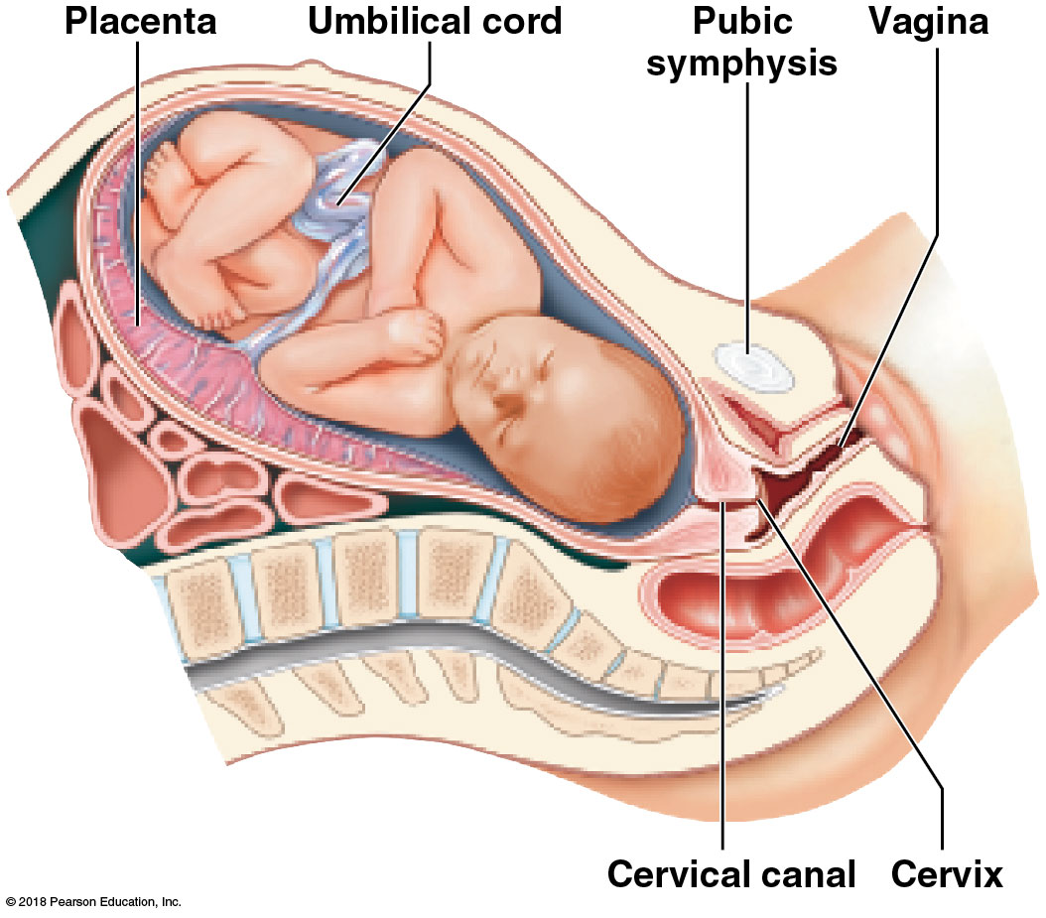
Fetal position at onset of true labor

Slide 78
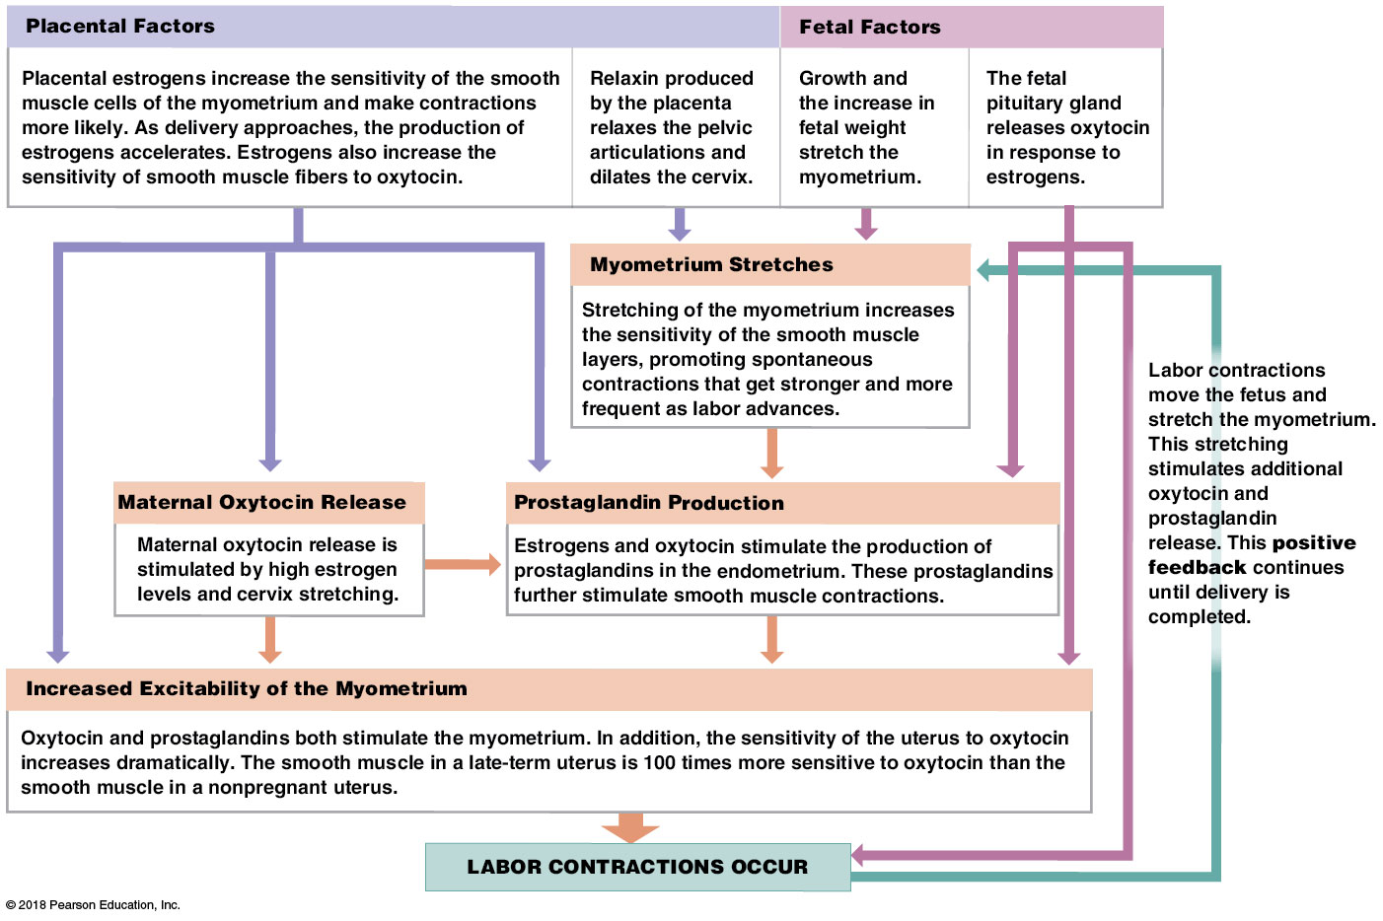
Factors affecting labor
Notes:
This is a complex figure and some students will need guidance to follow it.

Slide 79
Module 27.10: Labor and delivery
Three stages of labor
The goal of labor is parturition (childbirth)
The forcible expulsion of the fetus and placenta
Labor is divided into three stages
​Dilation stage
​Expulsion stage
​Placental stage

Slide 80
Module 27.10: Labor and delivery
Three stages of labor (continued)
​Dilation stage
Begins with the onset of true labor
Cervix dilates, and fetus shifts toward the cervical canal, moved by gravity and uterine contractions
Typically lasts 8 or more hours
Contractions at the beginning last up to 30 seconds and occur once every 10–30 minutes
Frequency and duration of contractions increase
Amnion ruptures late in the stage
Referred to as “having one’s water break”

Slide 81
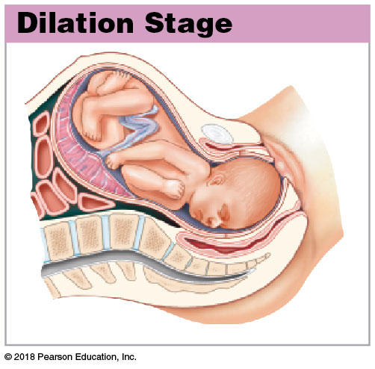
Dilation stage

Slide 82
Module 27.10: Labor and delivery
Three stages of labor (continued)
​Expulsion stage
Begins as the cervix completes dilation and is pushed open by the fetus
Contractions reach maximum intensity
Can last up to a full minute and occur 2–3 minutes apart
Stage continues until the fetus has emerged from the vagina
Usually lasts less than 2 hours
Arrival of the newborn outside the mother’s body is called delivery

Slide 83
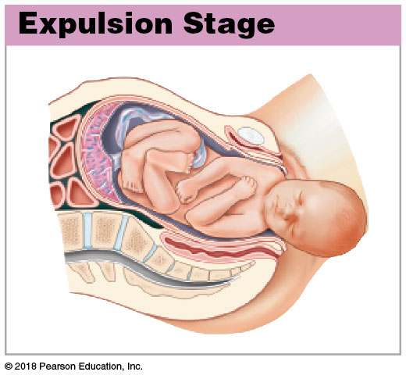
Expulsion stage

Slide 84
Module 27.10: Labor and delivery
Three stages of labor (continued)
​Placental stage
Uterine contractions continue
Size of the uterus gradually decreases
Contractions tear the connections between the endometrium and the placenta
Placenta, or afterbirth, is ejected
Continued contractions compress uterine blood vessels to restrict blood loss

Slide 85
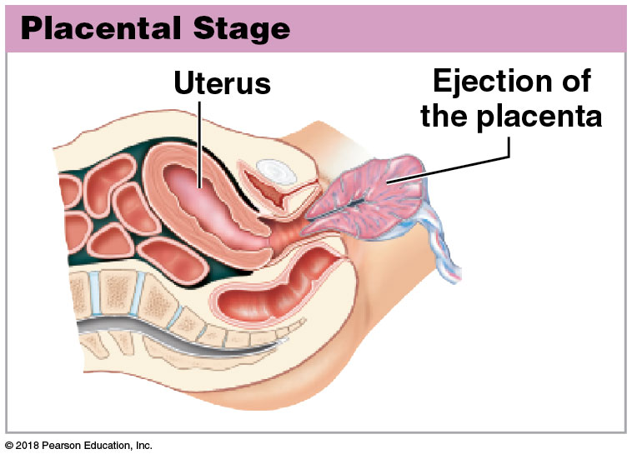
Placental stage

Slide 86
Module 27.10: Labor and delivery
Premature labor
Occurs when true labor begins before normal fetal development is completed
Survival chances are directly related to body weight at birth
<400 g (14 oz): will not survive
Respiratory, cardiovascular, urinary systems are unable to support life
<600 g (22.1 oz): not likely to survive

Slide 87
Module 27.10: Labor and delivery
Premature labor (continued)
Premature delivery
Birth at 28–36 weeks (birth weight over 1 kg, or 2.2 lb)
With care, newborn has a good change of surviving and developing normally

Slide 88
Module 27.10: Review
List and describe the factors involved in initiating labor contractions.
Which chemicals are primarily responsible for initiating contractions of true labor?
Name the three stages of labor, and describe the events that characterize each stage.
Learning Outcome: List and discuss the events that occur during labor and delivery.

Slide 89
Module 27.11: After delivery, development initially requires nourishment by maternal systems
Neonatal period
First 28 days of life
Developmental processes continue
Dependent on mother for nourishment, transportation, and protection

Slide 90
Module 27.11: Postnatal development
Milk production
By the end of the 6th month of pregnancy, mammary glands are fully developed and secreting colostrum
Colostrum contains antibodies to help fight infection until newborn’s immune system develops
A few days into nursing, mammary glands produce breast milk
Much higher in fat content than colostrum
Also contains antibodies and lysozyme (antibiotic enzyme)

Slide 91
Module 27.11: Postnatal development
Milk ejection reflex (milk let-down reflex)
Stimulation of tactile receptors (by infant suckling)
Neural impulse transmission (to the spinal cord and brain)
Oxytocin secretion
By secretory neurons in the paraventricular nucleus of the maternal hypothalamus

Slide 92
Module 27.11: Postnatal development
Milk ejection reflex (continued)
Oxytocin release
By the posterior lobe of the pituitary gland
Oxytocin is distributed throughout the body by the bloodstream
Milk ejected
Oxytocin causes contraction of myoepithelial cells in the walls of the lactiferous ducts and sinuses

Slide 93
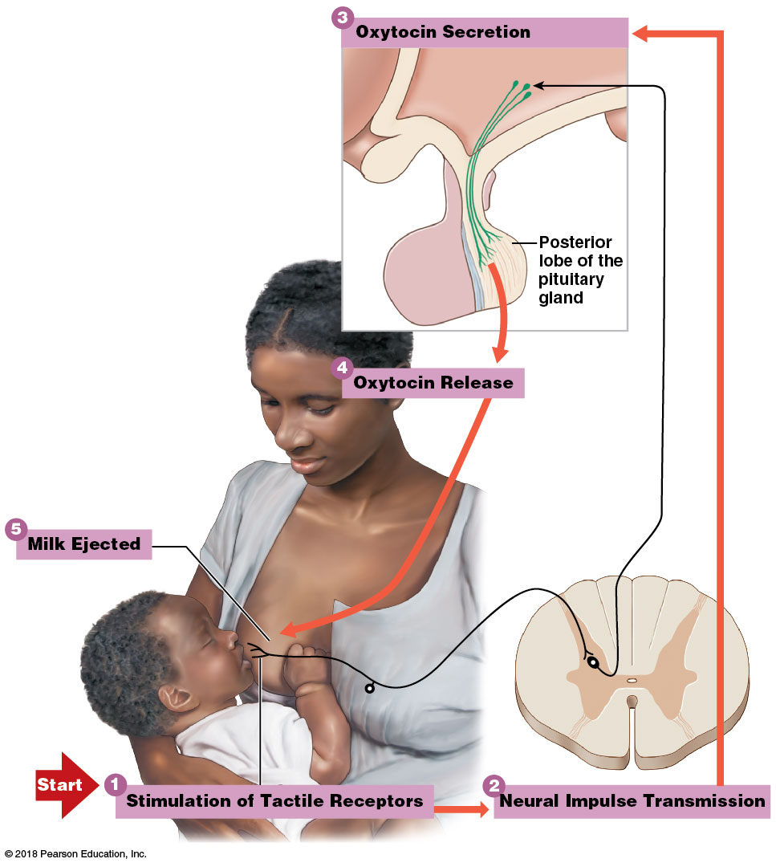
Milk ejection reflex
Notes:
This figure shows the positive feedback loop that arises. Be sure students see why it is positive feedback.

Slide 94
Module 27.11: Review
Explain the difference between colostrum and breast milk.
What hormone causes the milk ejection (milk let-down) reflex?
Learning Outcome: Describe the neonatal period and the milk ejection reflex.

Slide 95
Module 27.12: Postnatal development includes five life stages
Five life stages in postnatal development
Growth during early stages coordinated by hormones such as growth hormone, steroids, and thyroid hormones
​Neonatal period (first 28 days)
​Infancy (first year)
Still dependent on the mother
​Childhood
Weaned from breast milk in early childhood
Body proportions gradually change

Slide 96
Module 27.12: Five life stages of postnatal development
Five life stages in postnatal development (continued)
​Adolescence
Begins at puberty (period of sexual maturation)
Ends when growth is complete
​Maturity
After maturity, gradual changes continue in the process of senescence (senesco, to grow old), or aging

Slide 97
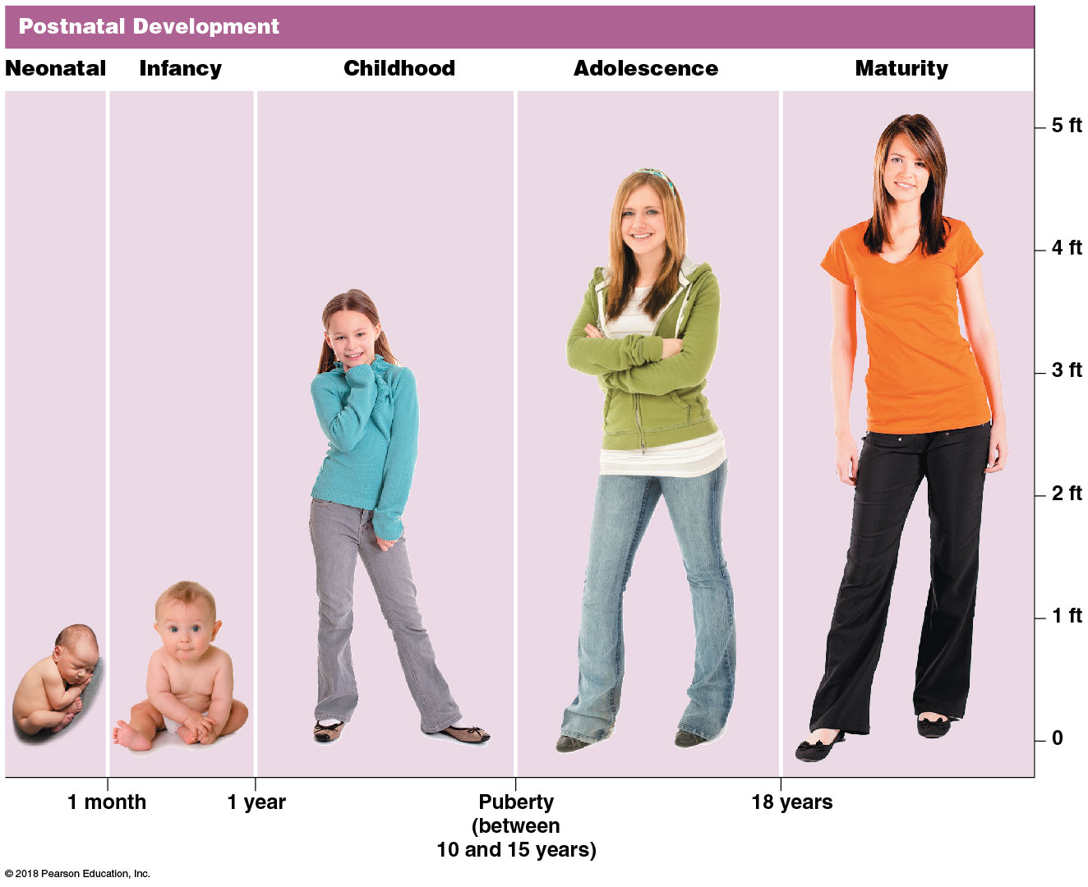
5 life stages of postnatal development

Slide 98
Module 27.12: Review
Name the stages of postnatal development, and describe the time frame involved for each stage.
Learning Outcome: Identify the features of and the functions associated with the various life stages.

Slide 99
Module 27.13: At puberty, male and female sex hormones have differing effects on most body systems
Hormonal changes at puberty
Many body systems alter their activities in response to changes in levels of sex hormones at puberty
Effects of testosterone and estrogens are enhanced by other hormones
Growth hormone
Thyroid hormones
Prolactin
Adrenocortical hormones

Slide 100
Module 27.13: Puberty
Release of GnRH
Hypothalamus increases release of gonadotropin-releasing hormone (GnRH)
In response, anterior pituitary releases more LH and FSH
In response, testicular and ovarian cells initiate:
Gamete production
Secretion of sex hormones, which stimulate secondary sex characteristics and behaviors
Sudden acceleration in growth rate, ending with closure of the epiphyseal cartilages

Slide 101
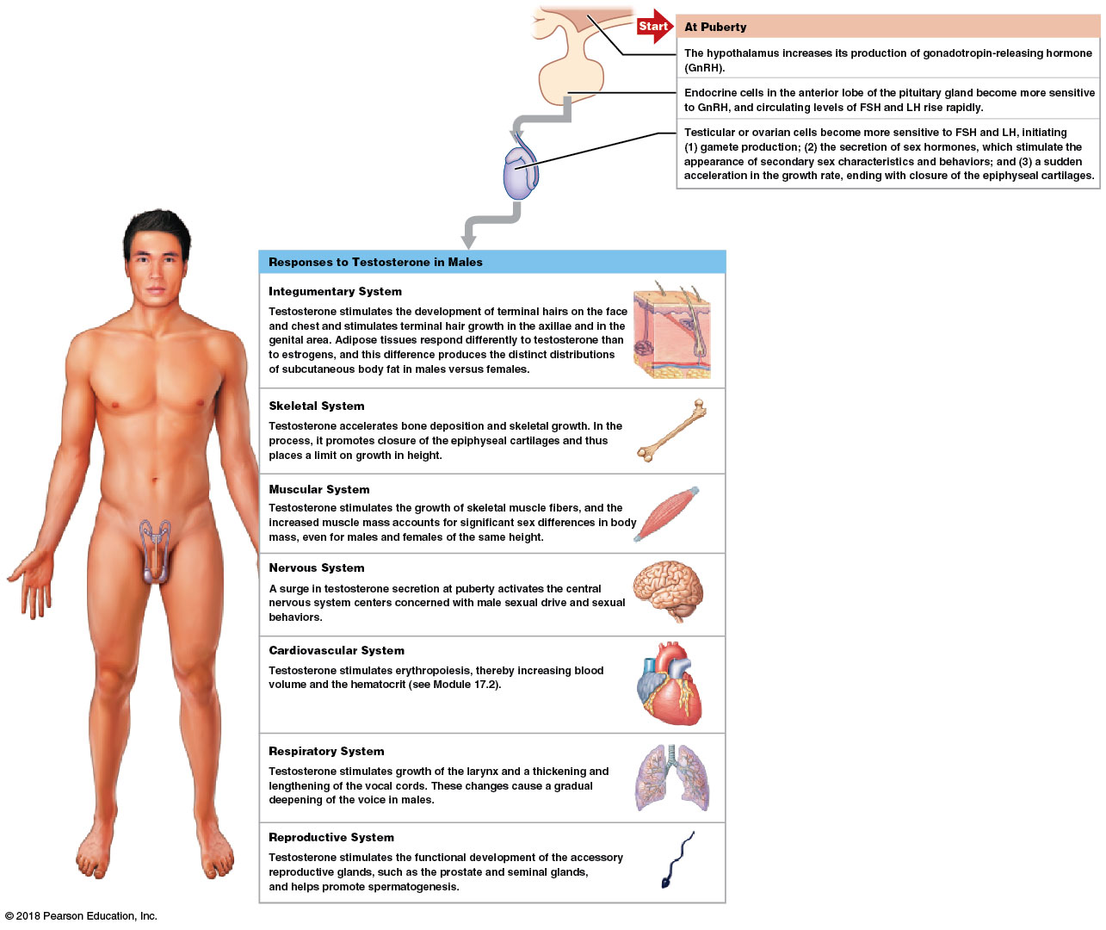
Responses to testosterone in males
Notes:
Be sure students see the START arrow at the top, showing where the GnRH originates.

Slide 102
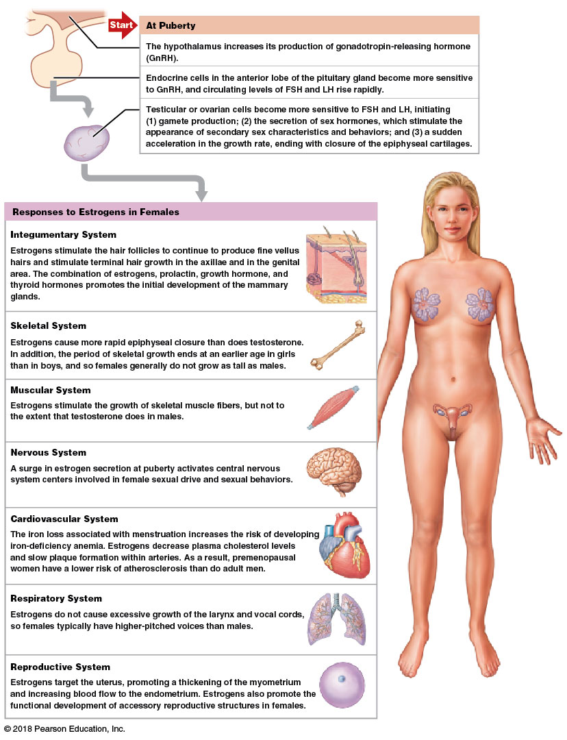
Responses to estrogens in females
Notes:
To get students really examining this image, ask if the karyotype is from a male or female?

Slide 103
Module 27.13: Review
Name the three major interacting hormonal events associated with the onset of puberty.
Why does a man have a deeper voice and a larger larynx than a woman?
Why are premenopausal women at lesser risk of atherosclerosis than men?
Learning Outcome: Explain the roles of hormones in males and females at puberty.

Slide 104
Section 2: Genetics and Inheritance
Learning Outcomes
27.14 Describe genetics and inheritance and the relationship between genotype and phenotype.
27.15 Relate the basic principles of genetics to the inheritance of human traits.
27.16 Describe the relationships among the various forms of inheritance, and give examples of representative phenotypic characters, both normal and abnormal.
27.17 Clinical Module: Identify several chromosomal disorders, and describe the human genome.

Slide 105
Module 27.14: A person may be described in terms of genotype and phenotype
Inheritance and genetics
Inheritance (heridity)
Transfer of genetically determined characteristics from generation to generation
Genetics
Study of mechanisms responsible for inheritance

Slide 106
Module 27.14: Genotype and phenotype
Genotype and phenotype
Genotype (geno, gene)
Chromosomes and their component genes
Analogous to house architectural plan or blueprint
Phenotype (phaino, to display)
Anatomical and physiological characteristics displayed by the collective expression of your genes
Analogous to the physical appearance of a house
Epigenetics
Study of gene expression due to alterations in the reading of the DNA sequences

Slide 107
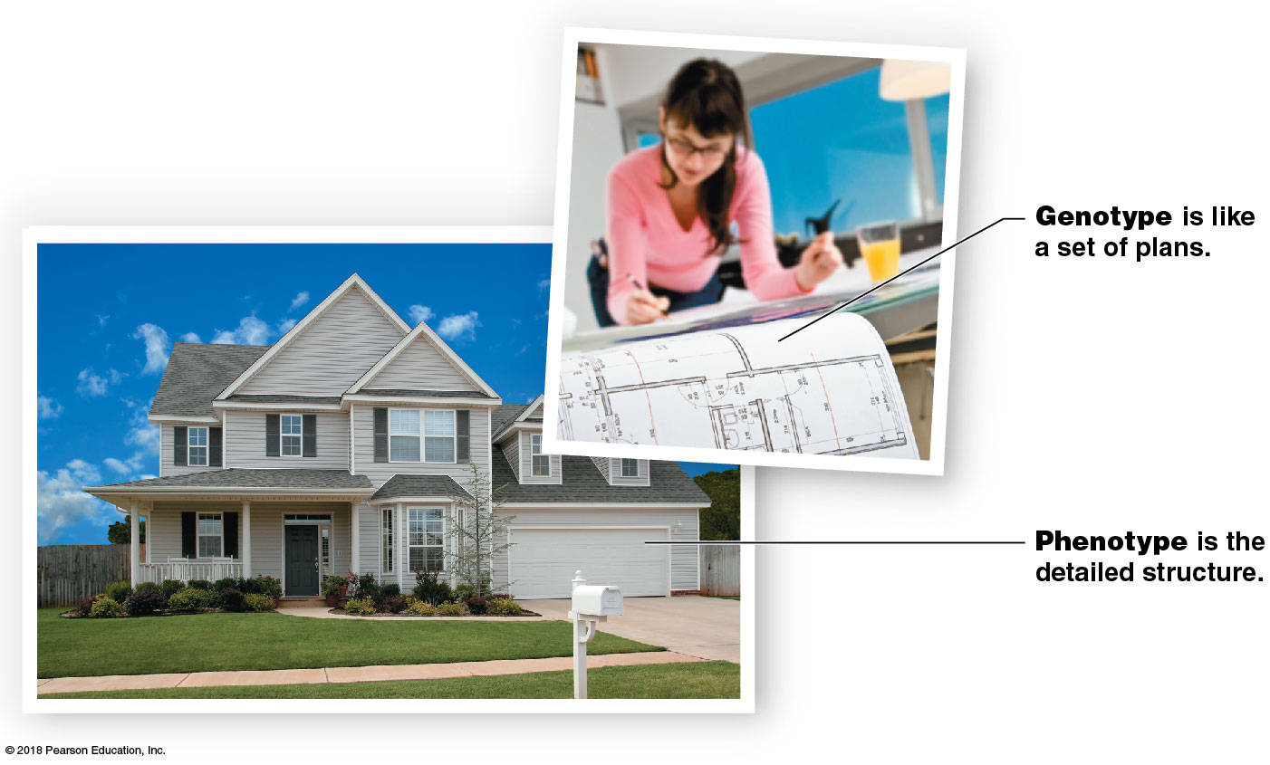
Genotype and phenotype

Slide 108
Module 27.14: Genotype and phenotype
Karyotype (karyon, nucleus + typos, mark)
Entire set of chromosomes
Normal human: 23 pairs of chromosomes
One member of the pair came from sperm
One member came from oocyte
Two together are called homologous chromosomes
22 pairs are autosomal chromosomes
Affect somatic characteristics, such as eye color
1 pair of sex chromosomes
Determine whether individual is genetically male or female
Male: one X chromosome and one Y chromosome
Female: two X chromosomes

Slide 109
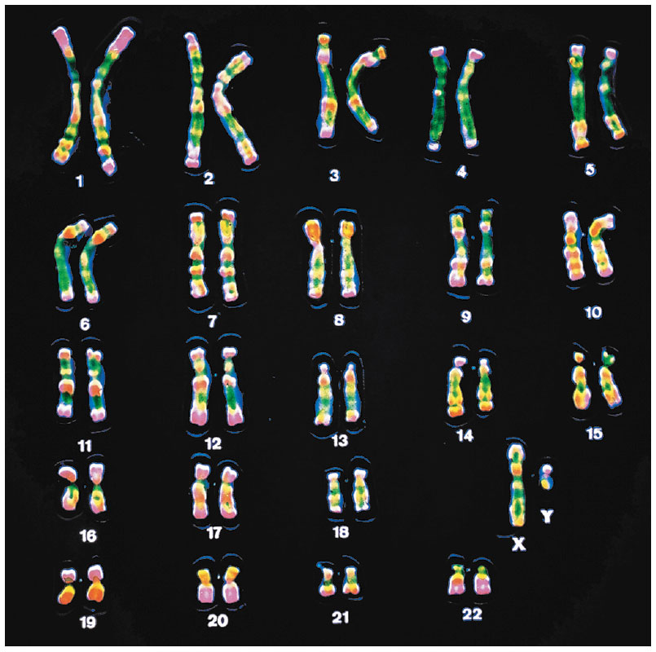
Karyotype of a male

Slide 110
Module 27.14: Review
Distinguish between genotype and phenotype.
How do autosomes and sex chromosomes differ?
How can you tell that the karyotype shown in the figure on the previous slide is male?
Learning Outcome: Describe genetics and inheritance and the relationship between genotype and phenotype.

Slide 111
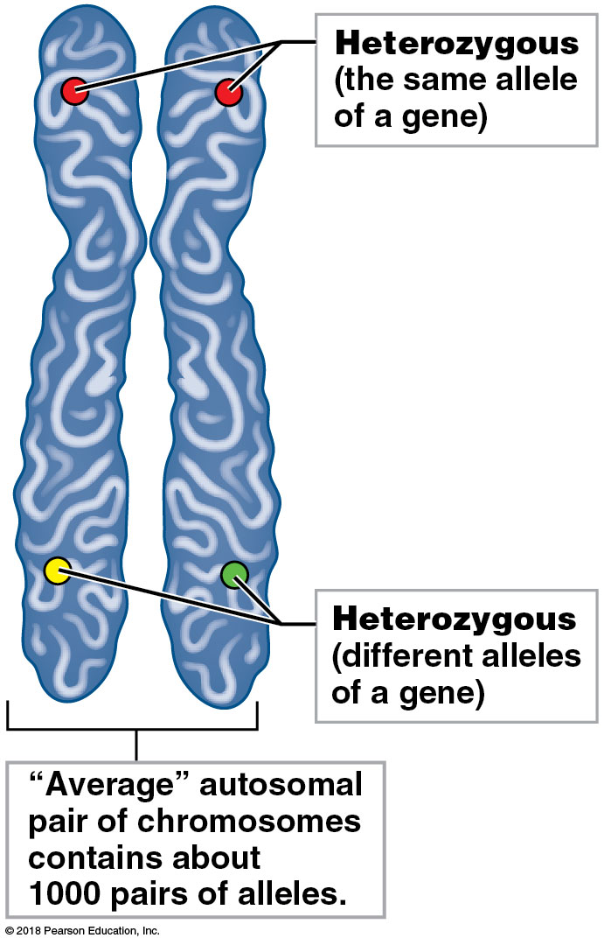
Module 27.15: Genes and chromosomes determine patterns of inheritance
Homologous chromosomes
Chromosomes in a homologous pair have the same structure and carry genes affecting the same traits
Genes are located at equivalent position (locus) on chromosome
Two chromosomes may carry the same or different form (allele) of the gene

Slide 112
Module 27.15: Genes and chromosomes
Interactions of alleles
Phenotype from a heterozygous genotype depends on how the corresponding alleles interact
Most common form of interaction is simple inheritance
Strict dominance
Any dominant allele present is expressed in the phenotype regardless of any other allele
For example, even if you have only one allele for freckles, you will show freckles
“Freckle” allele is dominant over “nonfreckle” allele
A recessive allele is expressed only if it is present on both chromosomes of the homologous pair

Slide 113
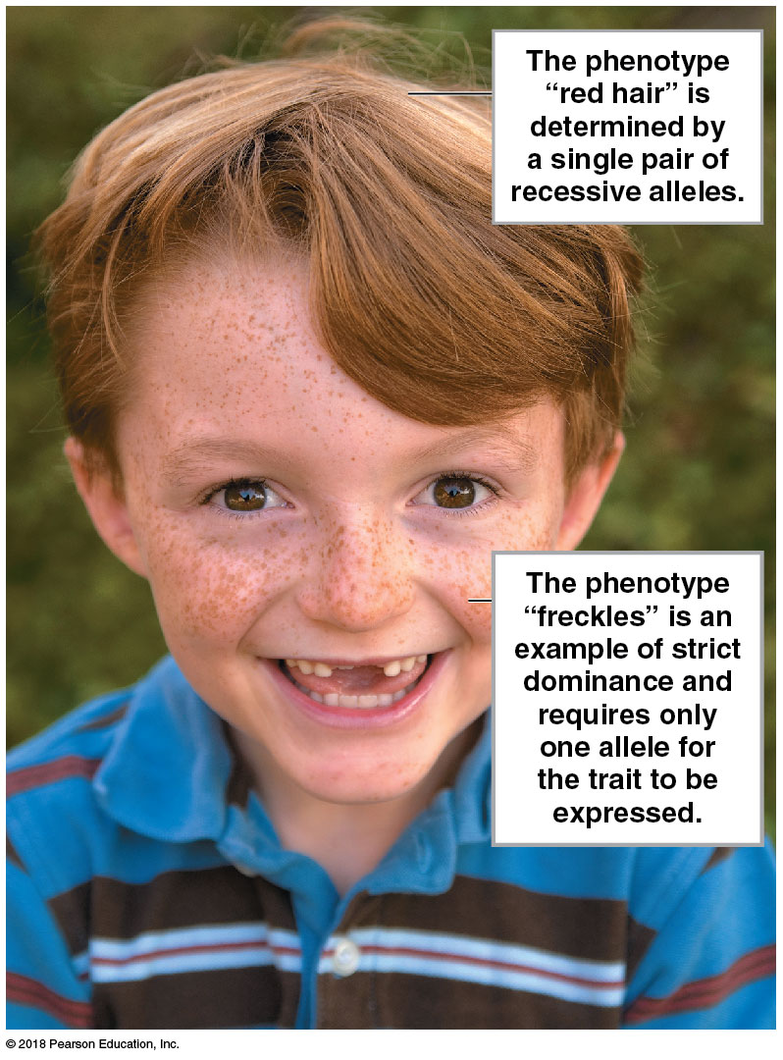
Dominant and recessive alleles

Slide 114
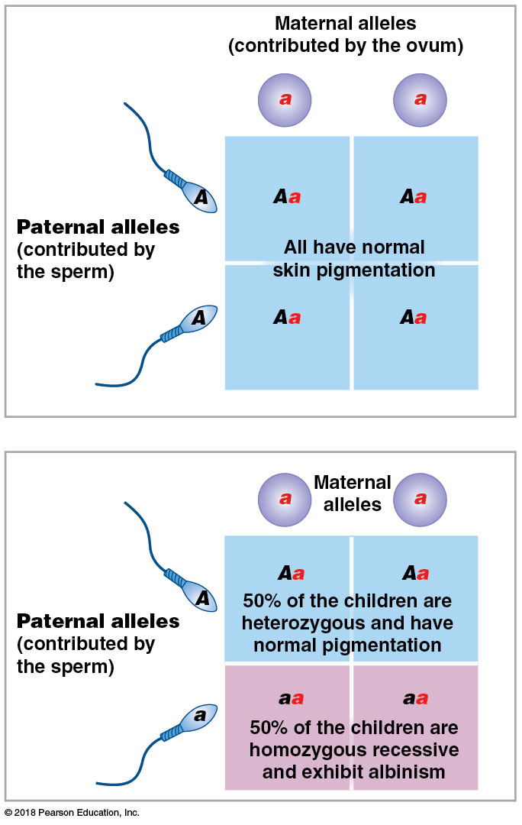
Module 27.15: Genes and chromosomes
Punnett squares
Grid used to predict genetic probabilities
Dominant alleles indicated by capital letters
Recessive alleles indicated by lowercase letters
TT (homozygous dominant)
Tt (heterozygous)
tt (homozygous recessive)

Slide 115
Module 27.15: Genes and chromosomes
Polygenic inheritance
Interactions among several genes determine phenotypic characteristics
Cannot use simple Punnett square to predict phenotype
Example: brown or black hair color
Notes:
It's important to point out to students that a Punnett square shows probabilities for each pregnancy. The results do not get “used up.” For example, the bottom image says that 50% of the children will have normal pigmentation and 50% will exhibit albinism. That means that there is a 50% likelihood of albinism with each pregnancy. If the couple has four children, there is a 50% chance with each child. If their first child has normal pigmentation, so might the next and the next. Each pregnancy has the same probability.

Slide 116
Module 27.15: Review
Describe homozygous and heterozygous.
Differentiate between simple inheritance and polygenic inheritance.
The trait “freckles” operates through strict dominance. What would be the phenotype of a person who is heterozygous for this trait?
Learning Outcome: Relate the basic principles of genetics to the inheritance of human traits.
Notes:
Most human traits are polygenic.

Slide 117
Module 27.16: There are several different patterns of inheritance
Two major patterns of inheritance
Inheritance involving autosomal chromosomes
Simple inheritance (~80 percent of your genotype)
Strict dominance
Incomplete dominance
Heterozygous alleles produce phenotype as intermediate to homozygous individuals
Codominance
Heterozygous individuals (for given trait) exhibit both phenotypes for trait
Example: Type AB blood
Polygenic inheritance

Slide 118
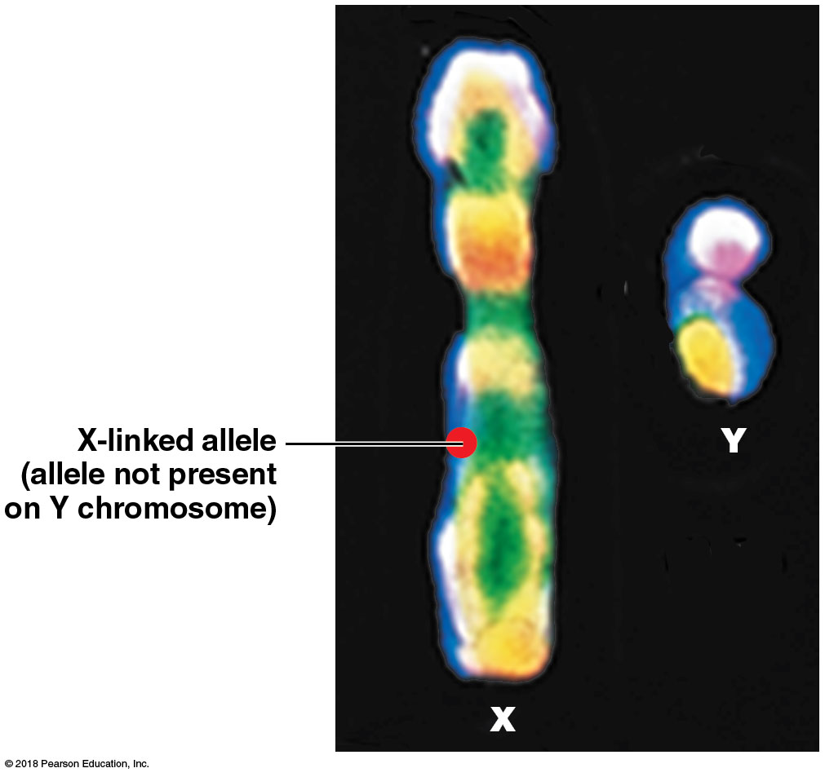
Module 27.16: Patterns of inheritance
Two major patterns of inheritance (continued)
Inheritance involving sex chromosomes
Sex-linked inheritance involves genes on the sex chromosomes
Most examples involve the X chromosome
X-linked allele determines the phenotype in males
No corresponding allele on the Y chromosome

Slide 119
Patterns of inheritance

Slide 120
Module 27.16: Patterns of inheritance
Sex-linked genes
Carried by either sex chromosome
X chromosome is larger and so carries many more genes
X-linked
Genes found on the X chromosome but not the Y chromosome
Example: gene for red–green color blindness
Y-linked
Genes found on the Y chromosome but not the X chromosome
Example: SRY gene for “maleness”

Slide 121
Module 27.16: Patterns of inheritance
Inheritance of color blindness
Gene for distinguishing colors is carried on the X chromosome
Males with a dominant allele (X^{C}) have normal color vision
Males with a recessive allele (X^{c}) have red–green color blindness
Females can have one dominant and one recessive allele and still have normal color vision (X^{C}X^{c})
Females must have two recessive alleles to have red–green color blindness (X^{c}X^{c})

Slide 122
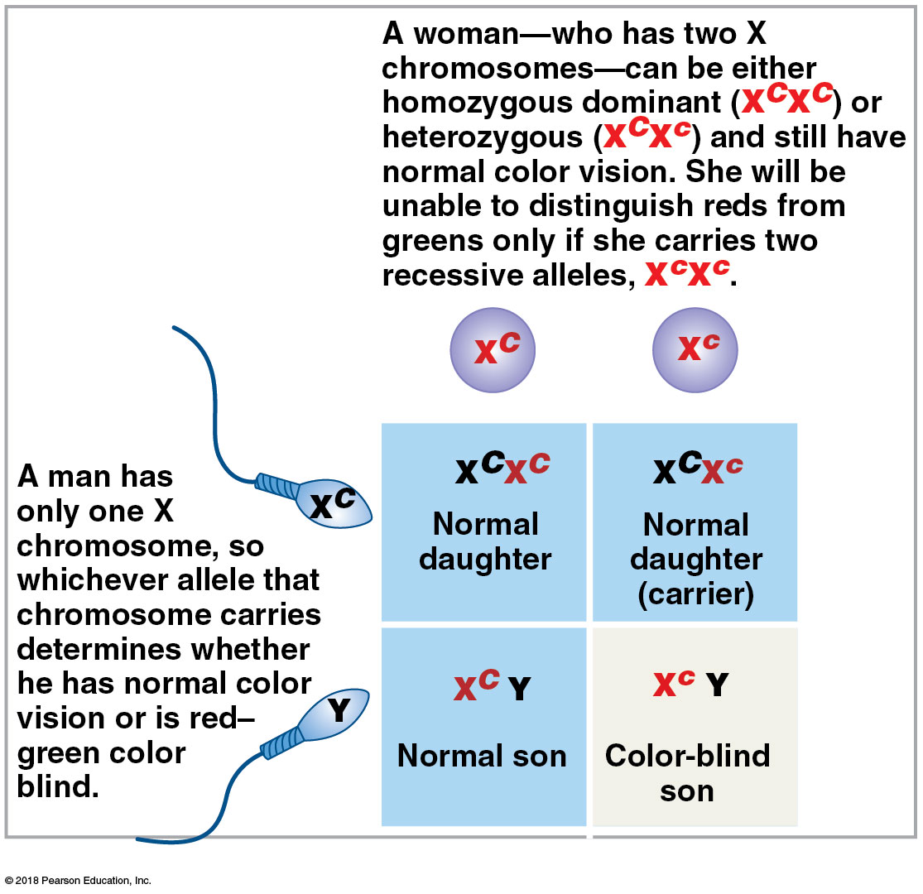
Inheritance of colorblindness
Notes:
Again, the Punnett Square shows probability with each pregnancy. If a couple has one child who is color blind, it in no way impacts how many other children from the same parents may have color blindness.

Slide 123
Module 27.16: Review
Compare strict dominance with codominance.
Why are sex-linked traits expressed more frequently in males than in females?
Indicate the type of inheritance involved in each of the following situations: (1) children who exhibit the trait have at least one parent who also exhibits it; (2) children exhibit the trait even though neither parent exhibits it; and (3) the trait is expressed equally in daughters and sons.
Learning Outcome: Describe the relationship among the various forms of inheritance, and give examples of representative phenotypic characters, both normal and abnormal.

Slide 124
Module 27.17: Clinical Module: Many clinical disorders are linked to individual chromosomes or their genes
Genetic abnormalities
Chromosomal abnormalities
Can involve thousands of genes, so are usually lethal
Only a few autosomal chromosome abnormalities do not result in prenatal death

Slide 125
Module 27.17: Chromosomal abnormalities
Genetic abnormalities (continued)
Variations in individual gene structure
Relatively common
More than 99 percent of human nucleotide bases are the same in all people
There are about 1.4 million single-base-pair differences, or single nucleotide polymorphisms (SNPs)
Some are inconsequential, but others are associated with specific diseases

Slide 126
Module 27.17: Chromosomal abnormalities
Trisomy 21 (Down syndrome)
Three copies of chromosome 21
Most common viable chromosome abnormality
Causes intellectual disability and physical malformation
Degree of intellectual disability ranges from moderate to severe
Anatomical problems affecting the cardiovascular system are often fatal

Slide 127
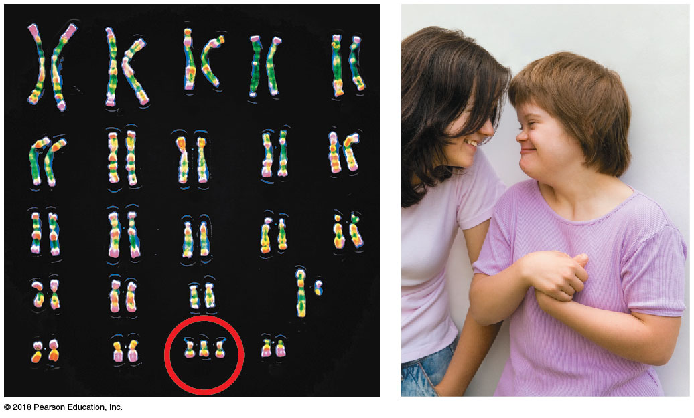
Module 27.17: Chromosomal abnormalities
Trisomy 21 (Down syndrome) (continued)
In adulthood, many develop Alzheimer’s before age 40
Direct correlation between maternal age and risk of having a child with trisomy 21
Risk increases from 1 in 2000 (before age 25) to 1 in 900 (ages 30–34) to 1 in 46 (ages 35–44)

Slide 128
Module 27.17: Chromosomal abnormalities
Klinefelter syndrome
Individual has sex chromosome pattern XXY
Male phenotype but reduced androgen production
Testes fail to mature (causing sterility)
Breasts slightly enlarged
Incidence averages 1 in 750 male births

Slide 129
Module 27.17: Chromosomal abnormalities
Turner syndrome
Individual has only a single female sex chromosome (XO)
Type of chromosomal deletion called monosomy
Incidence estimated at 1 in 10,000 live births
May not be recognized at birth
Phenotype is normal female
Maturational changes do not appear at puberty
Ovaries are nonfunctional, with negligible estrogen production

Slide 130
Turner syndrome

Slide 131
Module 27.17: Chromosomal abnormalities
Human genome
The full set of genetic material (DNA) in our chromosomes
Contains estimated 20,000–25,000 genes
About 10,000 different single-gene disorders have been described
Most are rare
Collectively, may affect 1 in 200 births
Over 900 have been mapped on the genome
Epigenome
All the chemicals that mark our genome and affect its activities

Slide 132
Human genome

Slide 133
Module 27.17: Review
Define single nucleotide polymorphism.
Name the disorder characterized by each of the following chromosome patterns: (1) XO and (2) XXY.
Identify the chromosome pair involved in each of the following disorders: (1) ovarian cancer, (2) Tay–Sachs disease, and (3) spinocerebellar ataxia.
Learning Outcome: Identify several chromosomal disorders, and describe the human genome.

