Slide 2
Module 14.2: The ANS consists of sympathetic and parasympathetic divisions
Autonomic nervous system
Two major divisions
Sympathetic division
Parasympathetic division
Usually have opposing effects
May also work independently
Some structures innervated by only one division
Sometimes work together in complex processes
Both divisions influence third autonomic division, called the enteric nervous system (ENS)
Notes:
Additional resource: MP3 Tutor Session—Sympathetic vs. Parasympathetic.

Slide 3
Module 14.2: ANS divisions
Sympathetic division
In general, active during exertion, stress, or emergency
Also called thoracolumbar division
Axons emerge from cell bodies in lateral gray horns of thoracic and superior lumbar segments of spinal cord (T₁–L₂)
Axons innervate ganglia close to spinal cord (sympathetic chain ganglia)
Notes:
Consider showing a cross section of the thoracic spinal cord so students see the lateral gray horn, where sympathetic neurons originate.
Consider showing a separate cadaver image or drawing of the sympathetic chain ganglia. You might explain its nature—sympathetic fibers originating in the thoracic and upper lumbar levels of the spinal cord can travel up or down in the chain ganglia to reach areas where sympathetic fibers do not originate—such as cervical structures or lower lumbar and sacral structures—and distribute through spinal nerves in those areas.

Slide 4
Module 14.2: ANS divisions
Parasympathetic division
Predominates under resting conditions
Also called craniosacral division
Axons emerge from brainstem nuclei and lateral gray horns of sacral segments of spinal cord
Axons innervate ganglia close to or within target organs
Parasympathetic fibers carried in cranial nerves III, VII, IX, and X and sacral nerves S₂, S₃, and S₄

Slide 5
Module 14.2: ANS divisions
Notes:
Make sure students understand that there is symmetry in the ANS—this illustration just separates the two divisions for easy comparison.

Slide 6
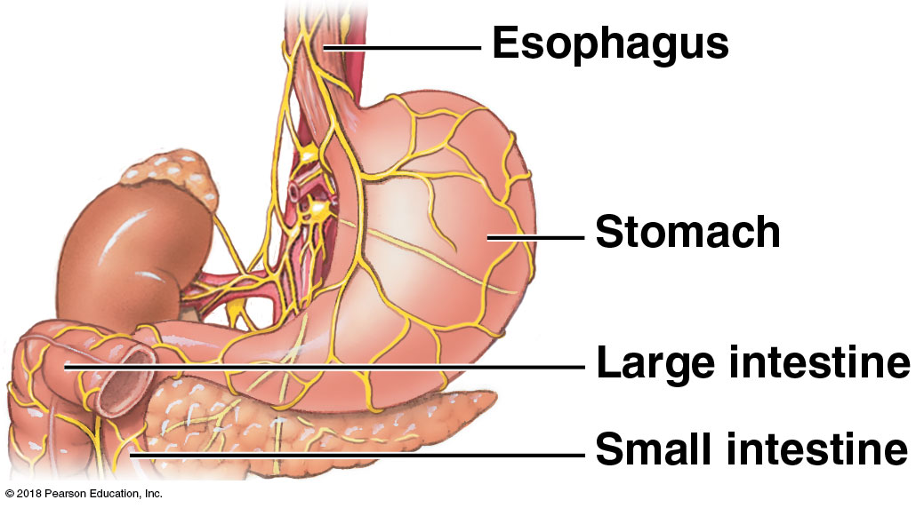
Module 14.2: ANS divisions
Enteric nervous system (ENS)
Extensive network of neurons and nerve networks in walls of digestive tract
Initiates/coordinates many complex local visceral reflexes with no CNS input
Influenced by sympathetic and parasympathetic divisions
~100 million neurons—at least as many as spinal cord
Same neurotransmitters as brain
See Chapter 22

Slide 7
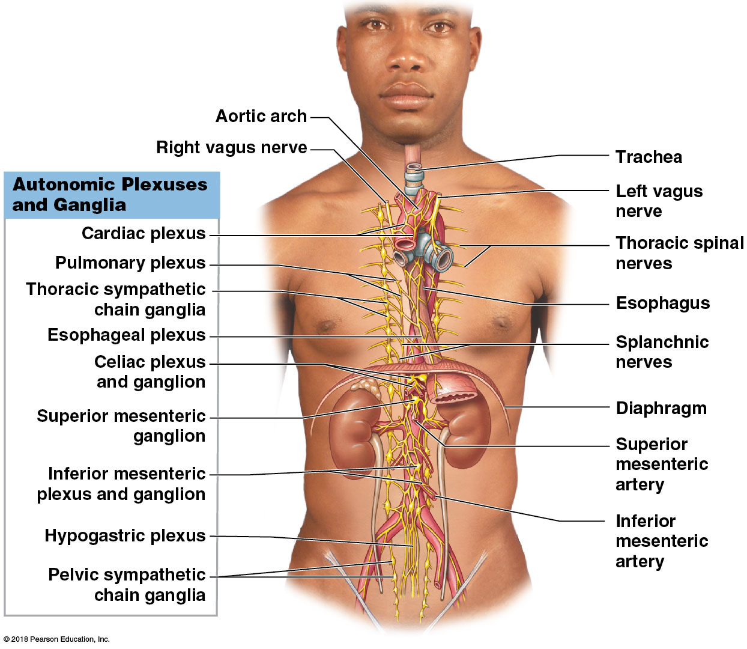
Module 14.2: ANS divisions

Slide 8
Module 14.3: Sympathetic and parasympathetic divisions
Responses to increased sympathetic activity
“Fight or flight” responses, which include:
Heightened mental alertness
Increased metabolic rate
Decreased digestive and urinary functions
Activation of energy reserves
Dilation of respiratory passageways; increased respiratory rate
Increased heart rate and blood pressure
Activation of sweat glands
Notes:
Have students think about what they experience when they feel an “adrenaline rush.” That will help them understand the “fight or flight” response.

Slide 9
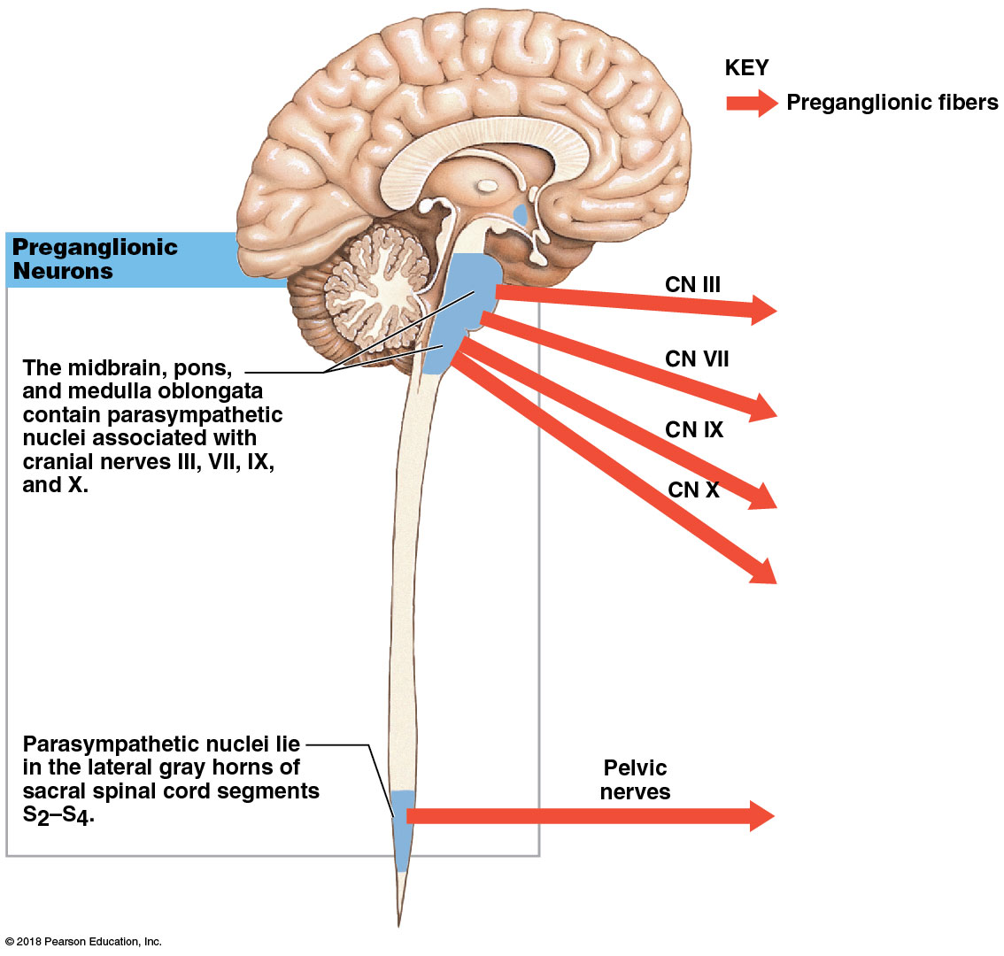
The parasympathetic nervous system

Slide 10
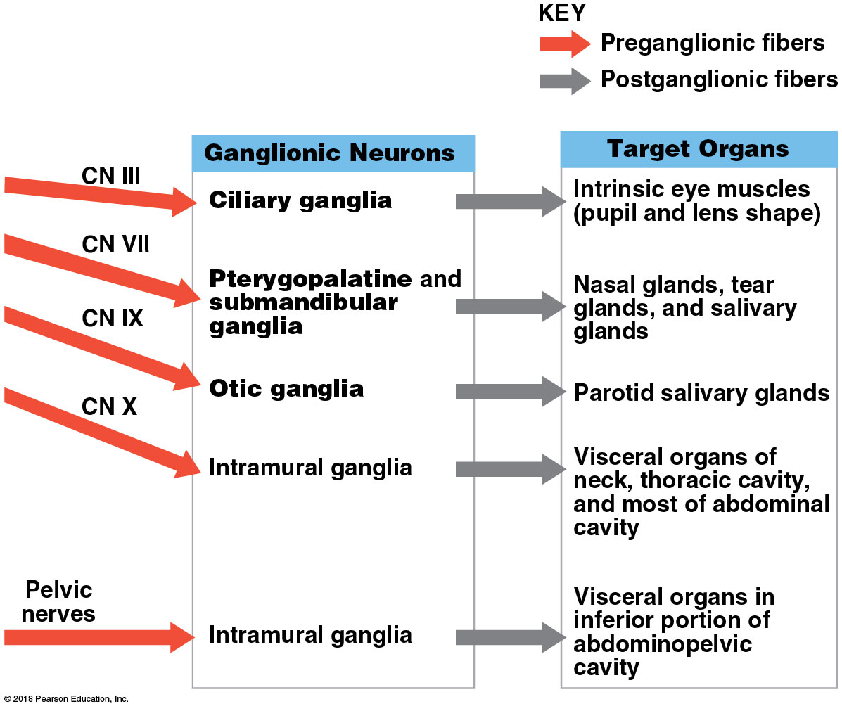
The parasympathetic nervous system

Slide 11
Module 14.3: Sympathetic and parasympathetic divisions
Responses to increased parasympathetic activity
“Rest and digest” responses, which include:
Decreased metabolic rate
Decreased heart rate and blood pressure
Increased secretion by salivary and digestive glands
Increased motility and blood flow to the digestive tract
Stimulation of urination and defecation
Notes:
Have students describe how they feel when they are calm and resting, to help them understand parasympathetic effects. Ask why the body would take these steps (conserves energy, replenishes energy stores).

Slide 12
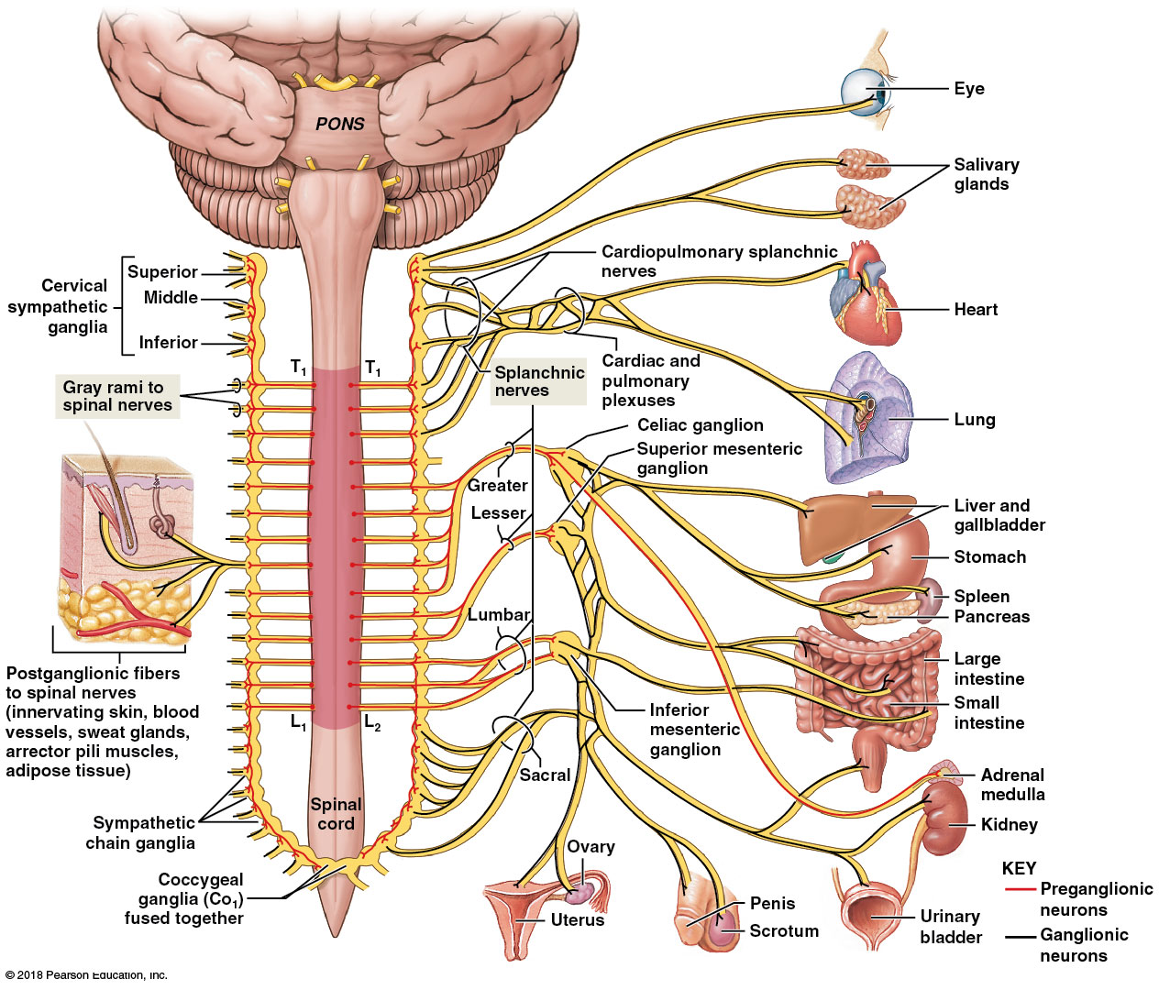
Sympathetic nervous system distribution
Notes:
Point out that sympathetic distribution is the same on both sides of the body, but this illustration separates the distribution, for simplicity, showing distribution to skin and body wall structures on the left, and visceral distribution on the right.
Walk students through a few pathways to reinforce the concept of short preganglionic and long postganglionic fibers characteristic of the sympathetic nervous system.

Slide 13
Module 14.4: Innervation patterns of the sympathetic and parasympathetic divisions
Innervation in the parasympathetic division
Vagus nerve (cranial nerve X) provides ~75 percent of all parasympathetic outflow
Vagal branches intermingle sympathetic fibers, forming nerve plexuses
Sacral preganglionic fibers carry sacral parasympathetic output directly—do not join spinal nerves
Form distinct pelvic nerves
Innervate intramural ganglia in kidneys, bladder, distal large intestine, and sex organs

Slide 14
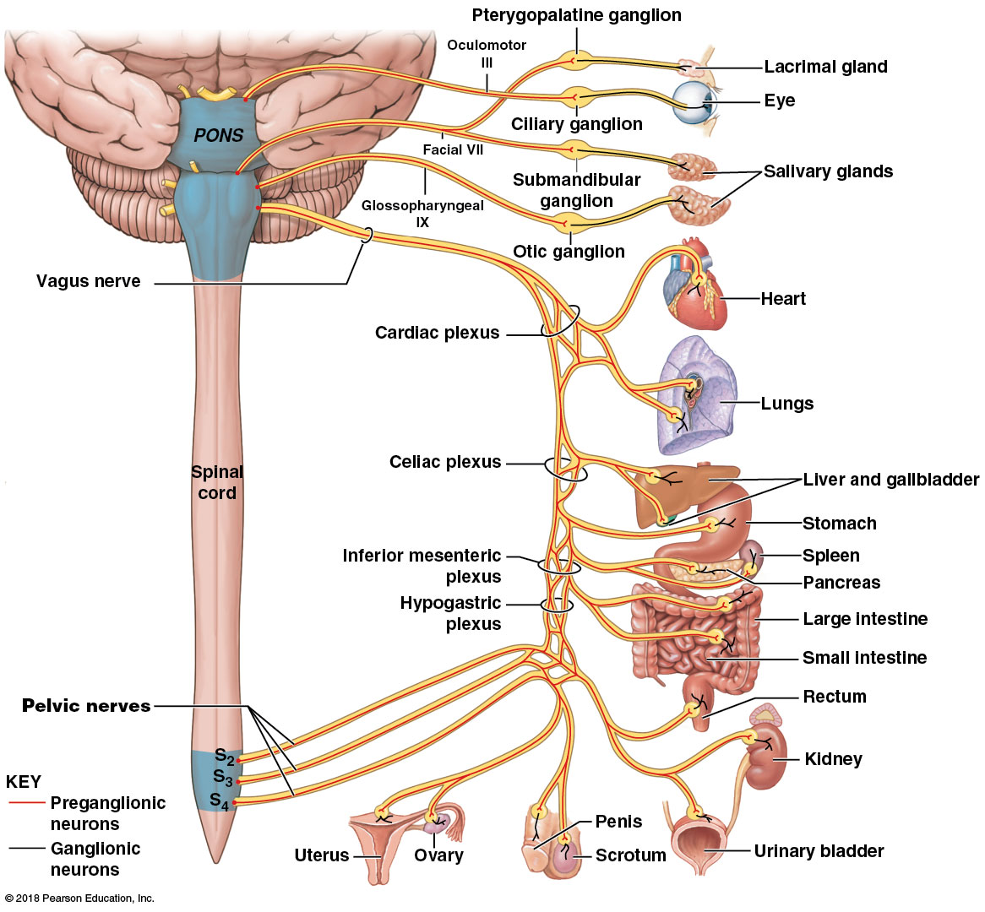
Parasympathetic nervous system distribution
Notes:
This image clearly shows that the parasympathetic pathway involves fairly long preganglionic and short postganglionic fibers.

Slide 15
Module 14.5: The functional differences between the two ANS divisions reflect their divergent anatomical and physiological characteristics
Sympathetic division
Can trigger local reflexes with specific effectors
Can be activated in its entirety (sympathetic activation) by:
Releasing norepinephrine (NE) at peripheral synapses
Distributing NE and epinephrine (E) throughout body

Slide 16
Module 14.5: Functional differences in ANS divisions
Sympathetic activation controlled by centers in hypothalamus
Occurs during crisis
Effects not limited to peripheral tissues
Also alters CNS activity

Slide 17
Module 14.5: Functional differences in ANS divisions
Notes:
Consider a discussion of each bullet point with your students—how does each of these help a person deal with a crisis situation?

Slide 18
Module 14.5: Functional differences in ANS divisions
Parasympathetic division
Does not release neurotransmitters into bloodstream, so does not do division-wide system activation.
Parts are active continuously
Activities are reflex responses to conditions within specific structures or regions
Effects center on relaxation, food processing, and energy absorption

Slide 19
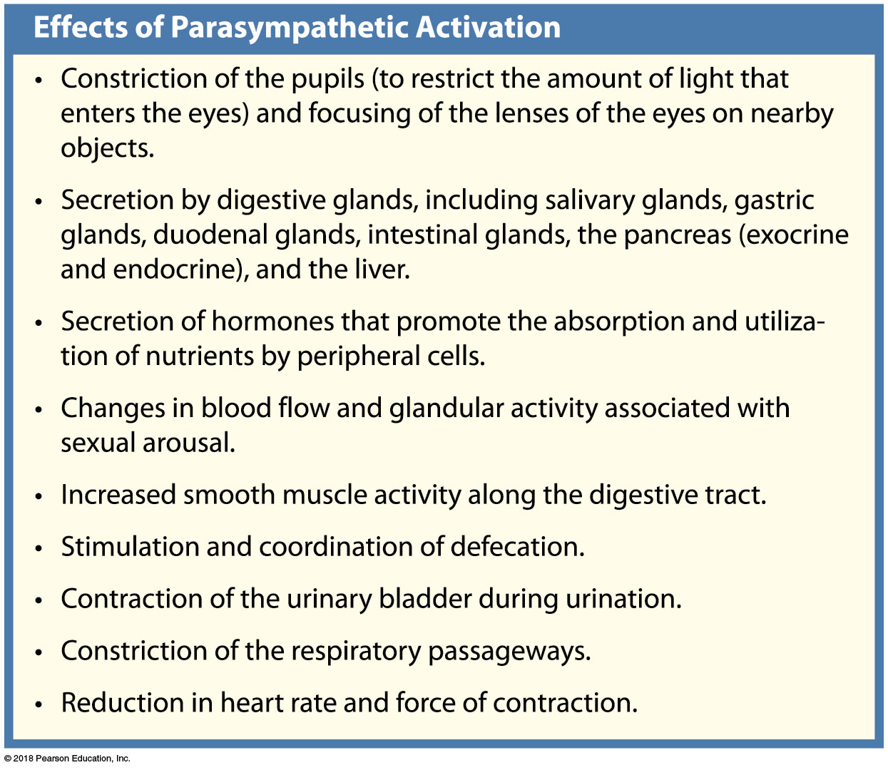
Module 14.5: Functional differences in ANS divisions

Slide 20
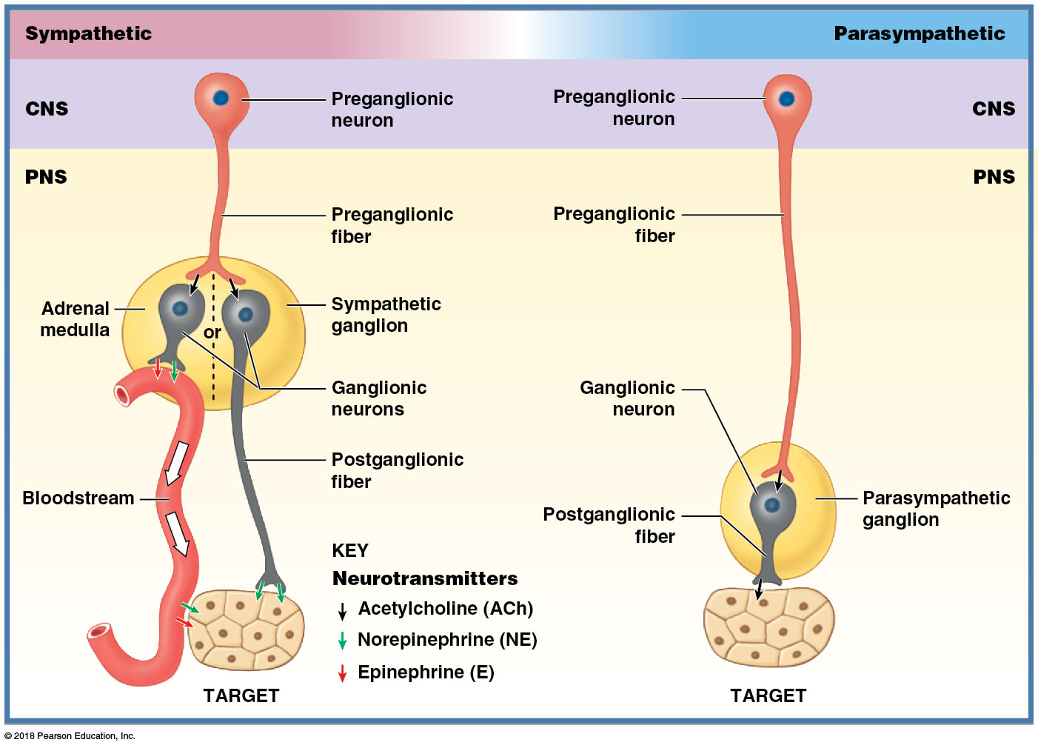
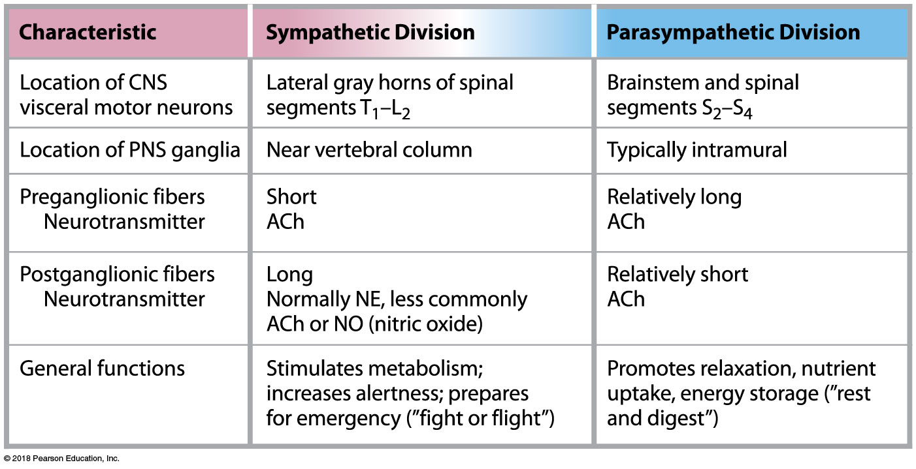
Summary comparison of sympathetic and parasympathetic divisions

Slide 21
Module 14.6: Membrane receptors at target organs mediate the effects of sympathetic and parasympathetic stimulation
Neurotransmitter release in sympathetic division
Effects result from norepinephrine (NE) and epinephrine (E) binding to adrenergic receptors in target cell plasma membrane
Two types of adrenergic receptors: alpha receptors and beta receptors
NE stimulates alpha receptors more than beta receptors
E stimulates both types

Slide 22
Module 14.6: Membrane receptors at target organs mediate the effects of sympathetic and parasympathetic stimulation
Generalized sympathetic activation and release of NE/E from adrenal medulla stimulates both types of receptors; effect lasts longer.
Adrenals release three times more E than NE, so during sympathetic activation, beta receptor effects predominate

Slide 23
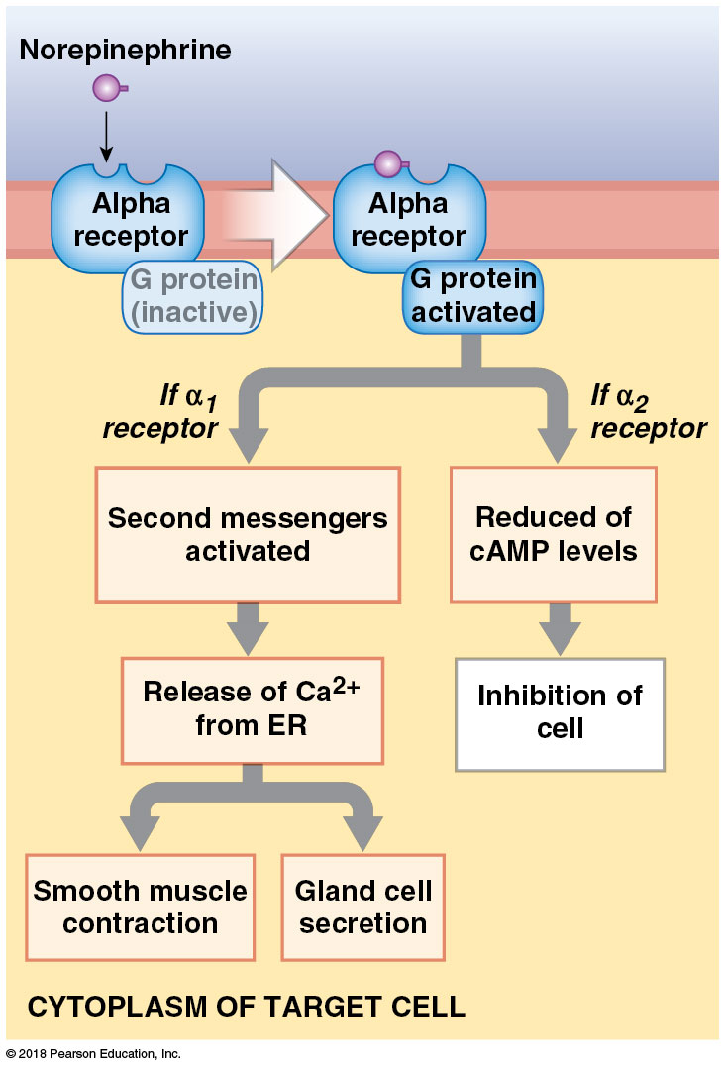
Module 14.6: Neurotransmitter release in ANS divisions
Alpha (α) receptors
Generally stimulated by NE and E
Activates G proteins of plasma membrane
Activation triggers different activities in cell
Alpha-1 receptors—excitatory
Alpha-2 receptors—inhibitory

Slide 24
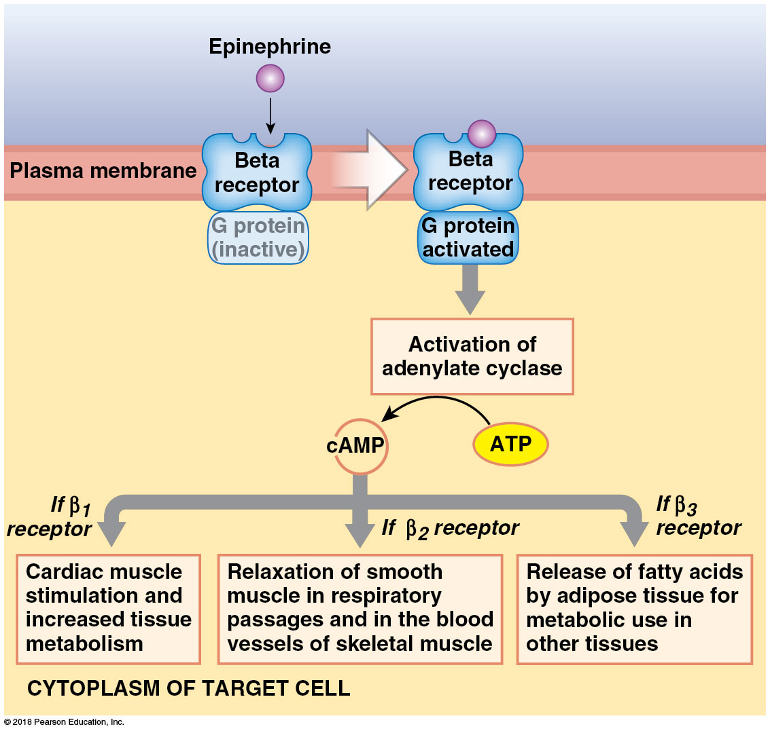
Module 14.6: Neurotransmitter release in ANS divisions
Beta (β) receptors
Generally stimulated by E
In many organs (skeletal muscles, lungs, heart, liver)
Stimulation of beta receptors and G protein activation change target cell’s metabolic activity
Three types: beta-1 (β₁), beta-2 (β₂), beta-3 (β₃)

Slide 25
Module 14.6: Neurotransmitter release in ANS divisions
Neurotransmitter release in the parasympathetic division
All parasympathetic fibers release acetylcholine (ACh)
Two types of cholinergic receptors—nicotinic and muscarinic

Slide 26
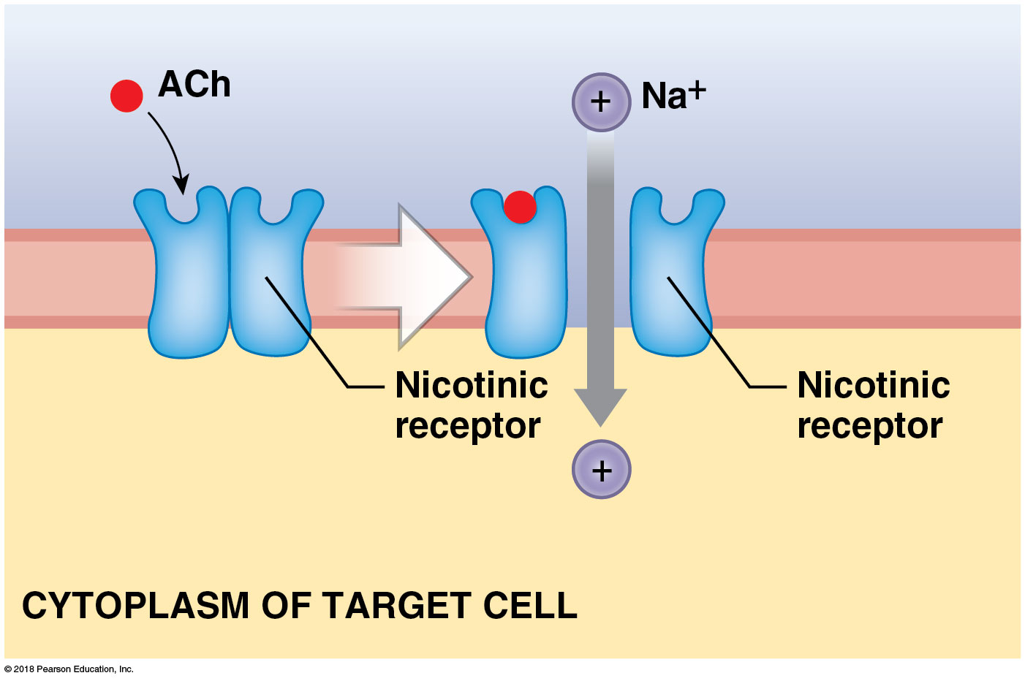
Module 14.6: Neurotransmitter release in ANS divisions
​Nicotinic receptors
On all postganglionic neurons, on adrenal medullae cells, and at neuromuscular junctions of skeletal muscle fibers
Excitatory
Stimulated by nicotine

Slide 27
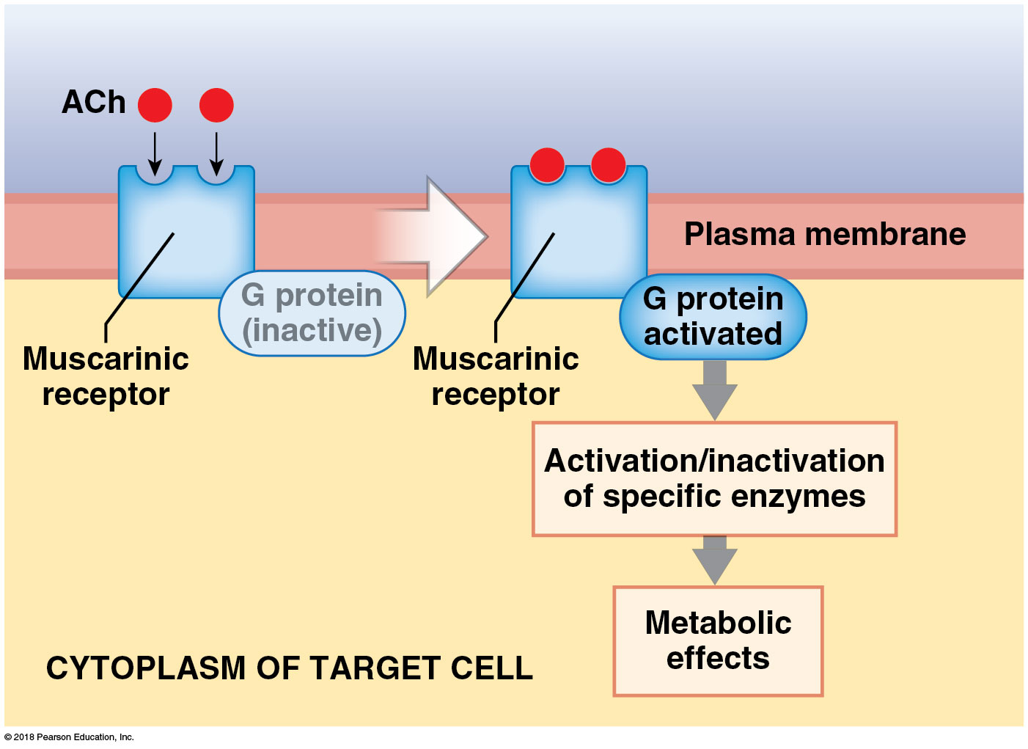
Module 14.6: Neurotransmitter release in ANS divisions
​Muscarinic receptors
G protein–coupled receptors
At cholinergic neuromuscular or neuroglandular junctions in parasympathetic division and few cholinergic junctions in sympathetic division
Longer-lasting effects than nicotinic receptors
Excitatory or inhibitory
Stimulated by muscarine (toxin produced by poisonous mushrooms)

Slide 28
Module 14.7: The ANS adjusts visceral motor responses to maintain homeostasis
Maintaining homeostasis
Vital physiological processes continue even if person is unconscious
Person can survive in a coma for decades
ANS adjusts activities of digestive, cardiovascular, respiratory, and reproductive systems without input from conscious mind
ANS output impacts virtually every body system

Slide 29
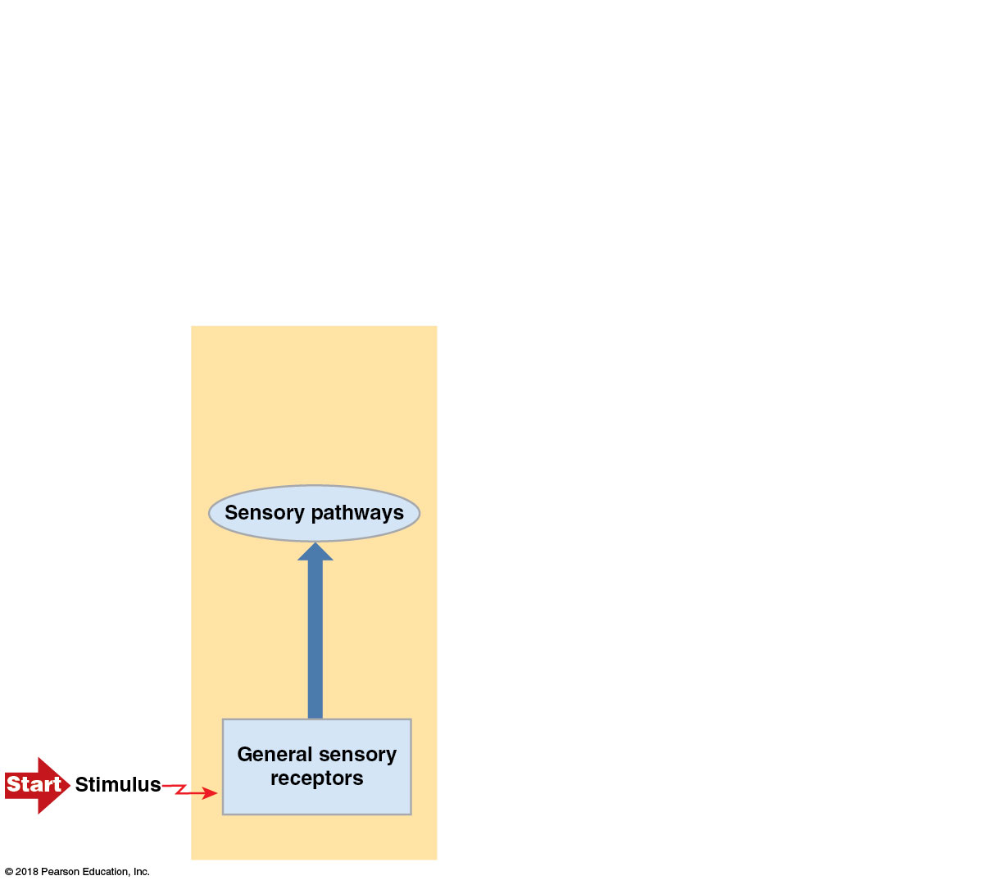
CNS processing

Slide 30
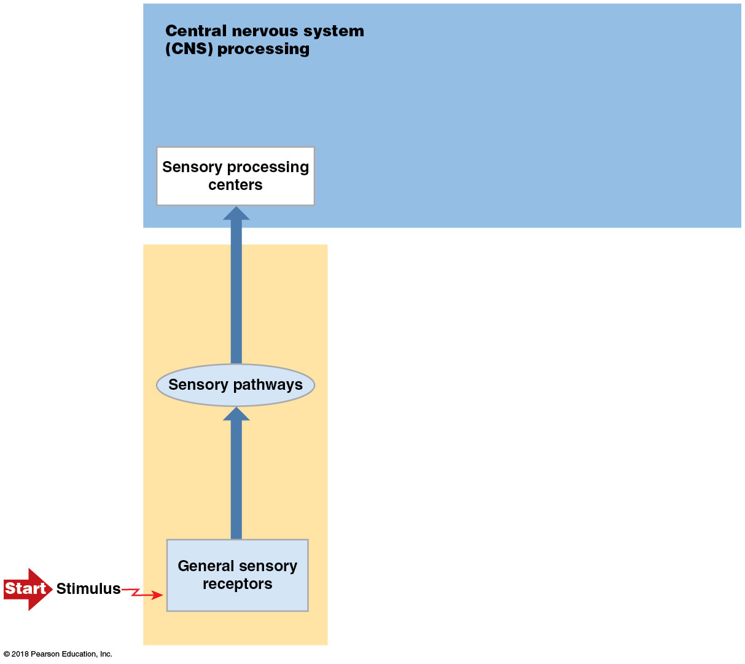
CNS processing

Slide 31
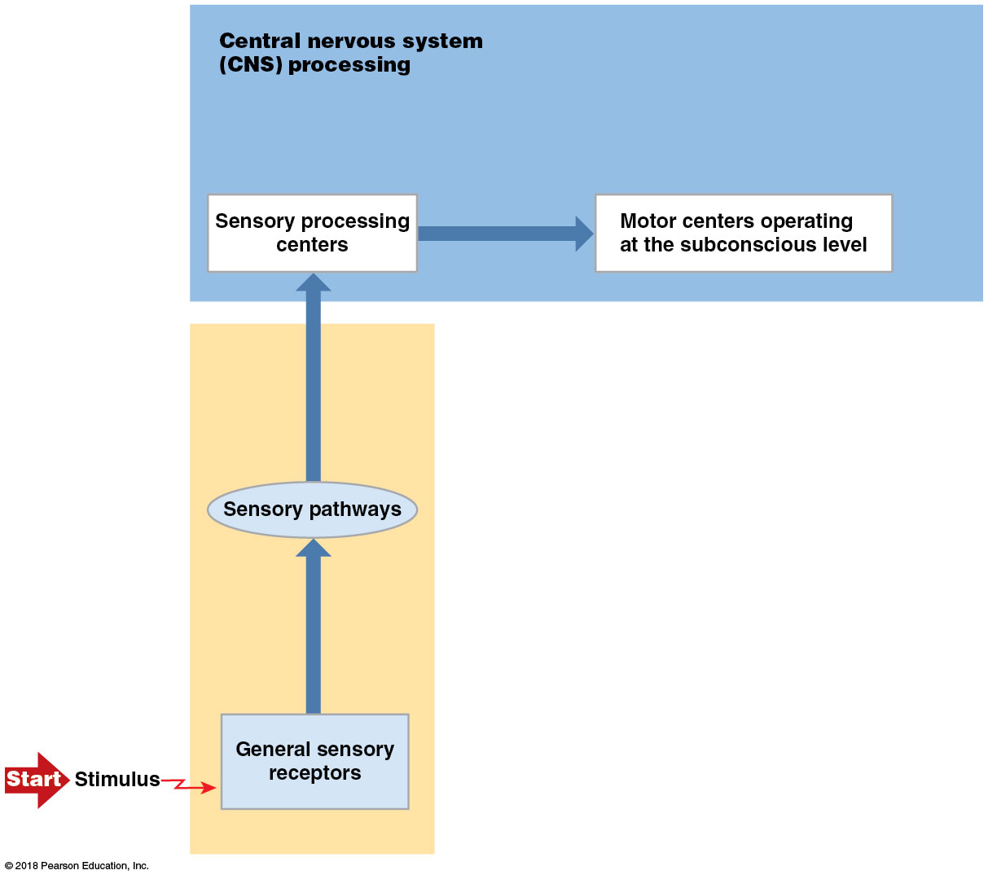
CNS processing

Slide 32
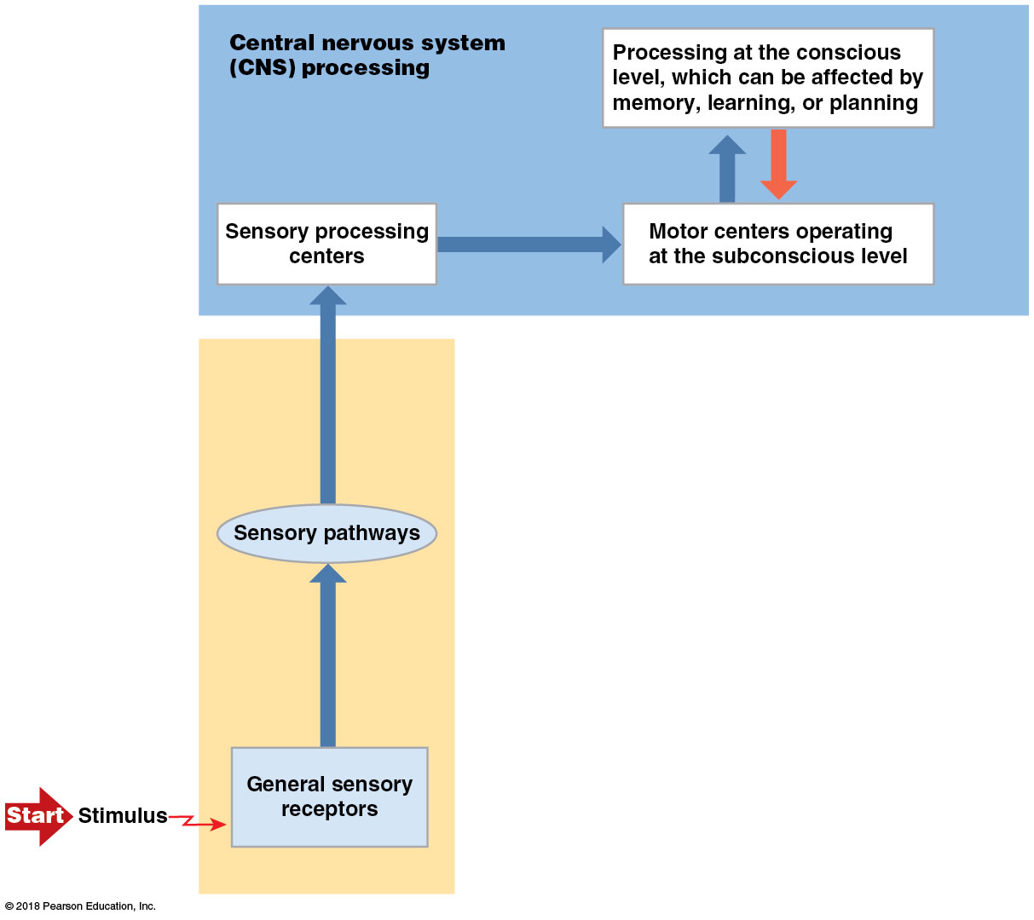
CNS processing

Slide 33
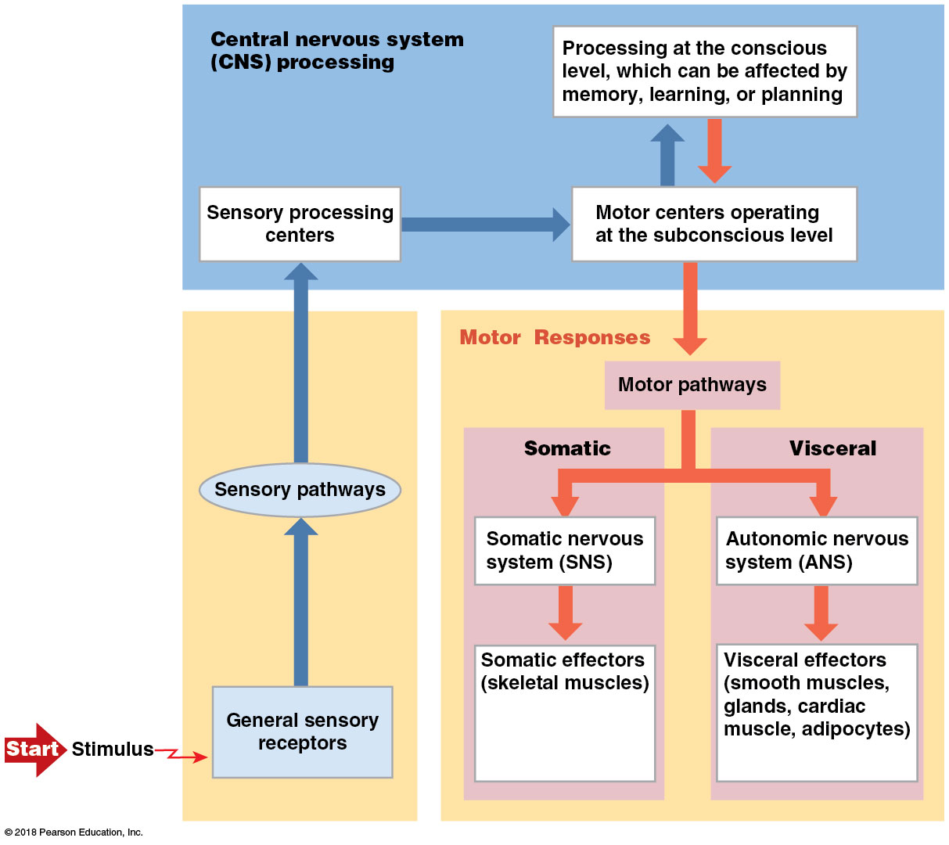
CNS processing

Slide 34
Module 14.8: The ANS provides precise control over visceral functions
ANS control over visceral functions
Autonomic tone
Continuous level of spontaneous ANS activity; maintained even without stimuli
Dual innervation
Receiving instructions from both ANS divisions
Effects may be complementary or opposite
In organs with only sympathetic innervation, responses vary depending on receptor type stimulated

Slide 35
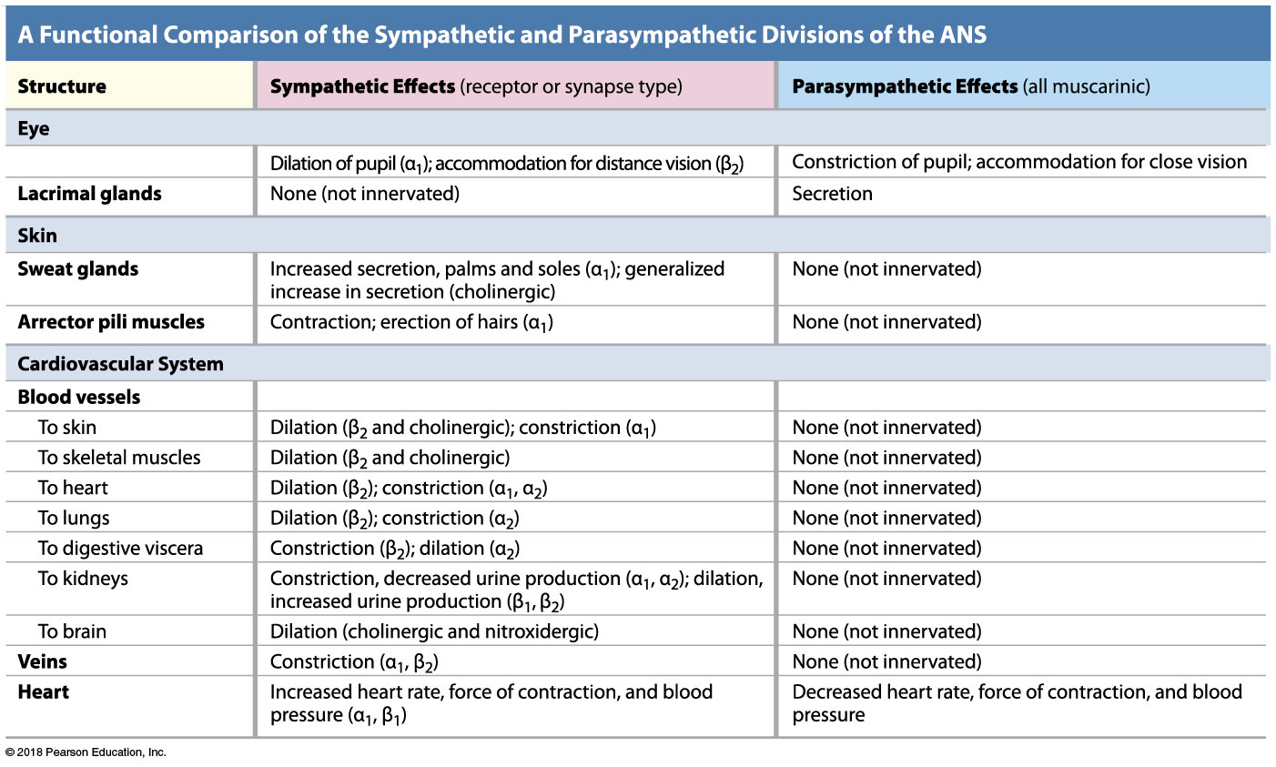
Dual innervation
Notes:
Ask students to consider how each of these effects serves the overall purpose of the ANS division that triggers the response.

Slide 36
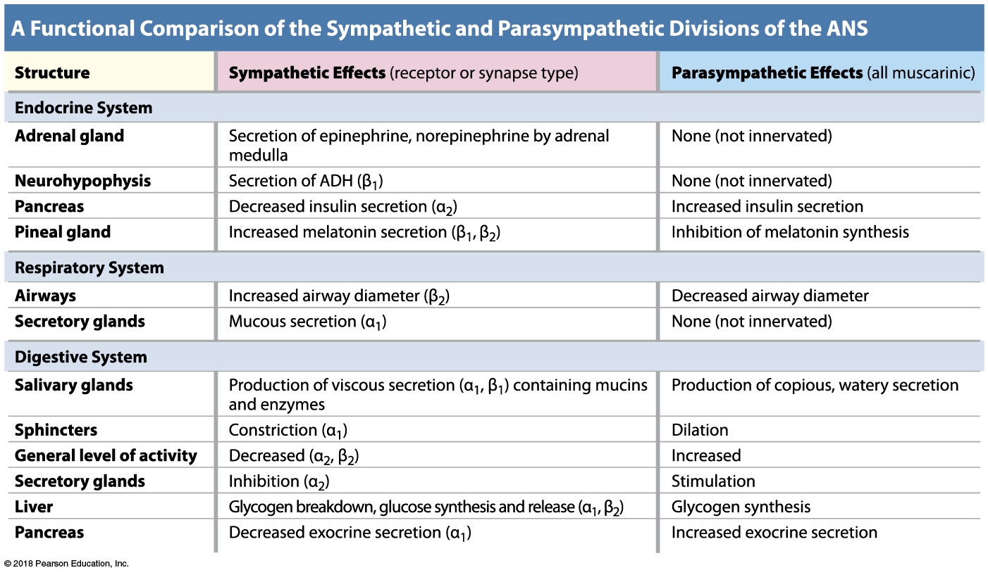
Dual innervation

Slide 37
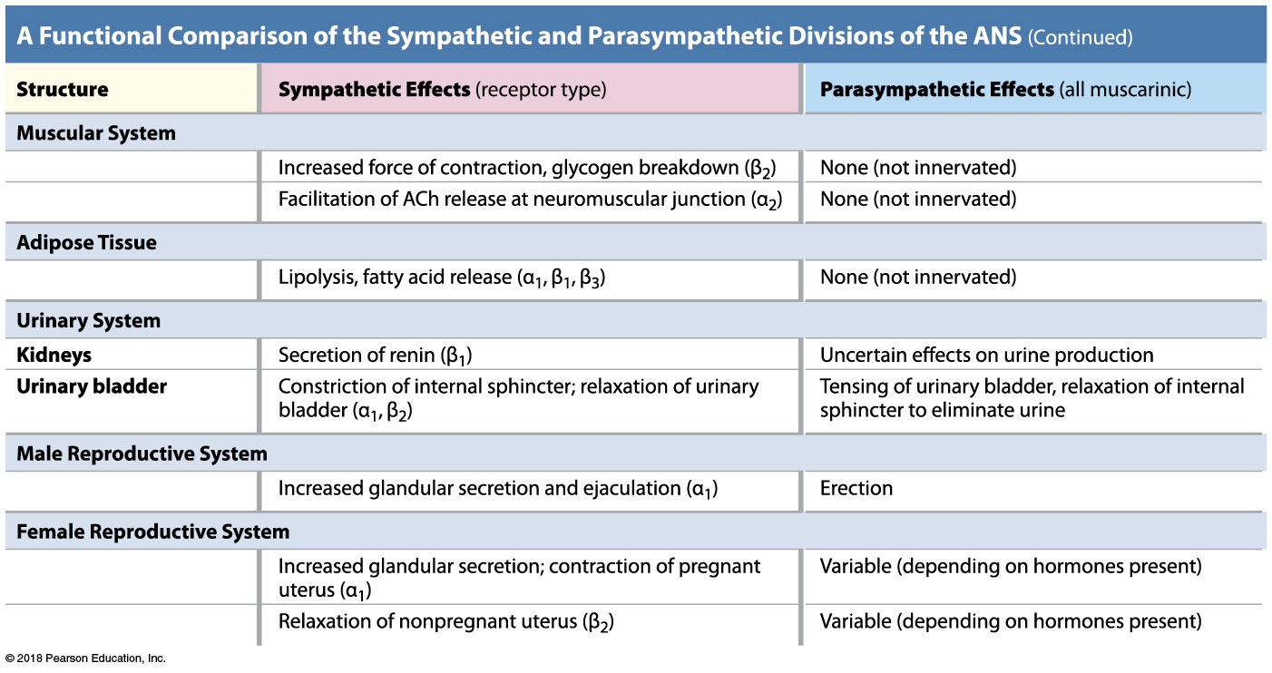
Dual innervation

Slide 38
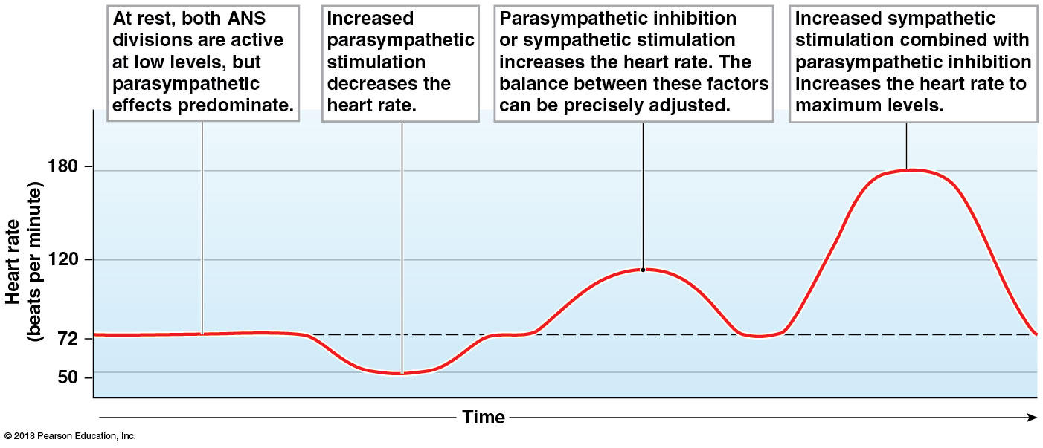
Module 14.8: Dual innervation
Dual innervation of the heart
Cardiac muscle tissue—contractions triggered by pacemaker cells
ANS divisions—opposing effects on pacemaker function
ACh (parasympathetic) reduces heart rate
NE (sympathetic) accelerates heart rate
Small amounts of both released continuously
At rest, parasympathetic effects dominate

Slide 39
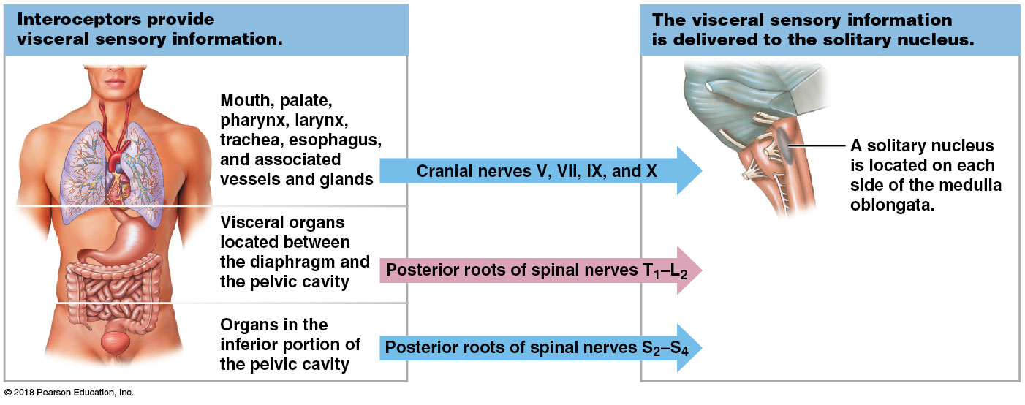
Module 14.9: Visceral reflexes
Interoceptors monitor visceral tissues and organs
Include nociceptors, thermoreceptors, tactile receptors, baroreceptors, chemoreceptors
Most processing is subconscious—occurs in nuclei of spinal nerves and solitary nuclei in brainstem

Slide 40
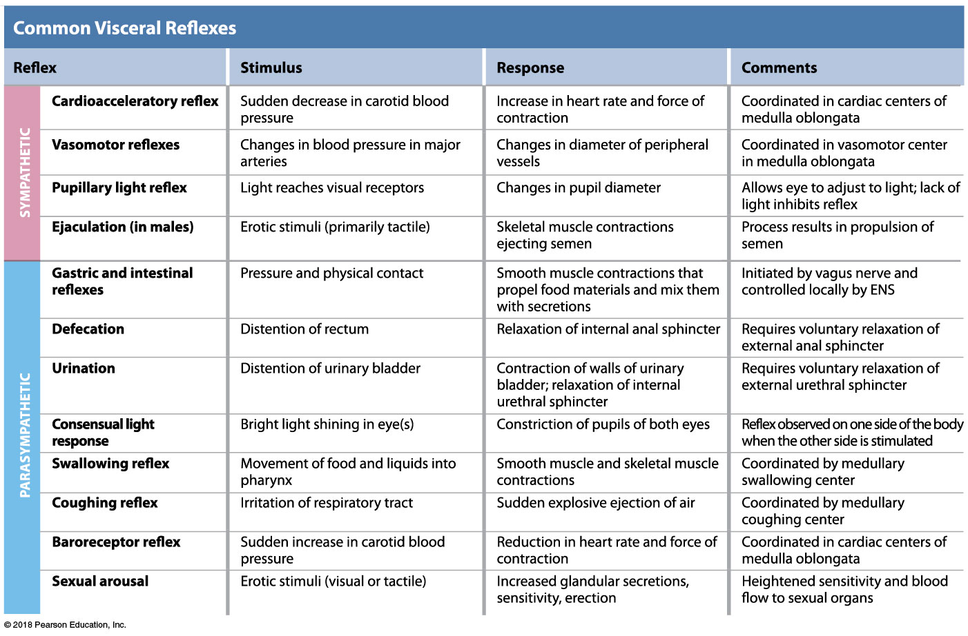
Module 14.9: Visceral reflexes

Slide 41
Module 14.10: Baroreceptors and chemoreceptors initiate important autonomic reflexes involving visceral sensory pathways
Baroreceptors
Stretch receptors that monitor pressure changes
Free nerve endings branching into elastic tissues in:
Hollow organs
Blood vessels
Tubes of respiratory, digestive, urinary tracts
Changes in pressure distort dendritic branches; alter rate of action potential generation

Slide 42
Module 14.10: Roles of baroreceptors and chemoreceptors
Baroreceptors (continued)
Monitor blood pressure in walls of major vessels
Carotid artery (at the carotid sinus)
Aorta (at the aortic sinus)
Regulates cardiac function; adjusts blood flow to vital tissues
Monitor degree of lung expansion
Relayed to respiratory rhythmicity centers in medulla oblongata (sets the pace of respiration)
Trigger visceral reflexes in digestive and urinary tracts
Example: urination/defecation

Slide 43
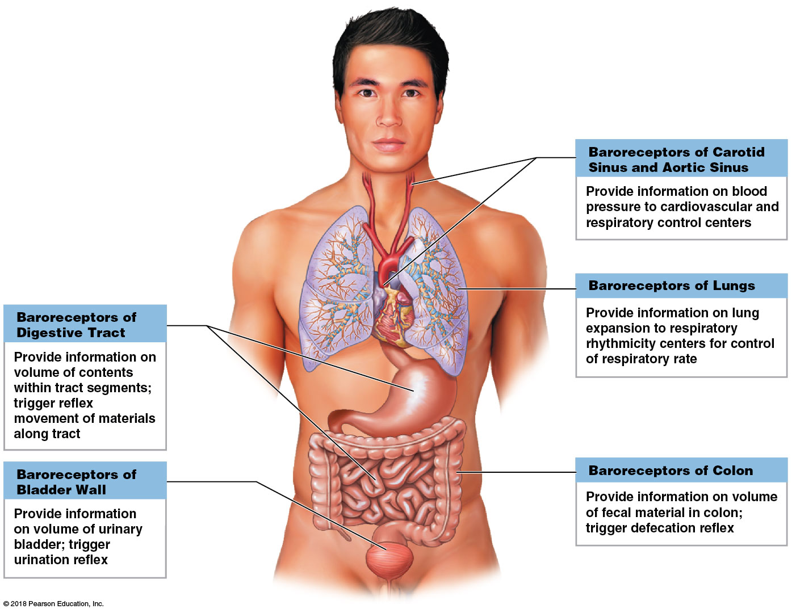
Baroreceptors

Slide 44
Module 14.10: Roles of baroreceptors and chemoreceptors
Chemoreceptors
Specialized neurons that detect changes in concentrations of specific chemicals or compounds
Role in reflexive control of respiration/cardiovascular function

Slide 45
Module 14.10: Roles of baroreceptors and chemoreceptors
Locations of chemoreceptors
Medulla oblongata and elsewhere in the brain
Monitor pH and P_{CO2} in CSF
​Carotid bodies
Near the origin of internal carotid arteries
Monitor pH, P_{CO2}, and P_{O2} in arterial blood
​Aortic bodies
Between branches of the aortic arch
Monitor pH, P_{CO2}, and P_{O2} in arterial blood

Slide 46
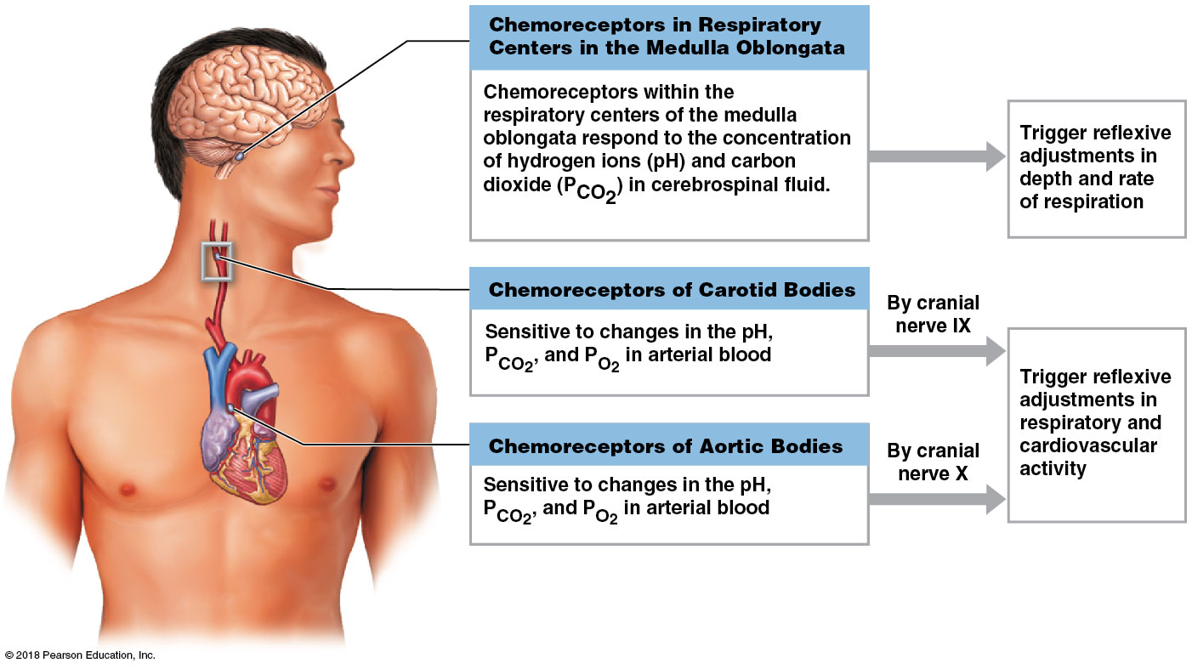
Chemoreceptors

Slide 47
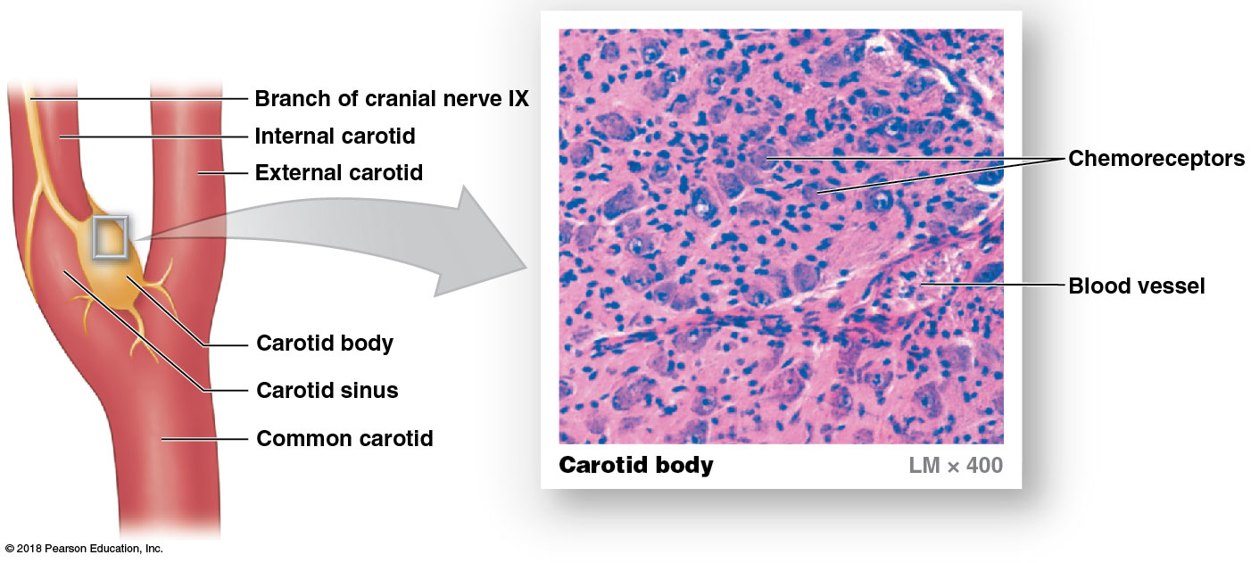
The carotid sinus and carotid body
Notes:
Point out that the internal carotid artery, shown here, is the major blood supply to the brain. Ask students why it is important that the carotid body is located where it is.

