Slide 1
Anatomy & physiology ii lab BSC 2094L Introduction and white blood cells
INDIAN RIVER STATE COLLEGE
WEEK 1

Slide 2
Paperwork for class
Syllabus/Tentative Schedule
General Laboratory Rules

Slide 3
Blood
Functions of the Circulatory System
Transport
Protection
Regulation

Slide 4
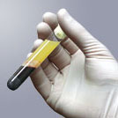
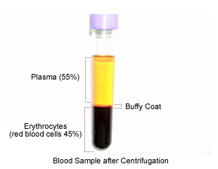
Properties
4 to 6 liters
Plasma
55%
Formed elements
Buffy Coat
1%
Leukocytes and platelets
Erythrocytes
45%

Slide 5
Plasma
Water (92%)
Proteins
Albumin, Globulins, Fibrinogen
Nutrients
Glucose, A.A.’s, Lactic Acid, Lipids, Iron, Trace elements, Vitamins
Electrolytes
Na⁺, Ca⁺⁺, K⁺, Mg⁺⁺, Cl⁻, HCO₃⁻,HPO₄⁻⁻,SO₄⁻⁻
Nitrogenous Wastes
Urea, Uric acid, Creatinine, Creatine, Ammonia, Bilirubin
Others
Dissolved CO2, O2, N2
Enzymes
Hormones

Slide 6
Formed Elements
Erythrocytes
Platelets
Leukocytes (Percentage of total WBC’s)
Granulocytes
Neutrophils (60 to 70%)
Eosinophils (2 to 4%)
Basophils (< 0.5%)
Agranulocytes
Lymphocytes (25 to 33%)
Monocytes (3 to 8%)
“Never Let Monkeys Eat Bananas”

Slide 7
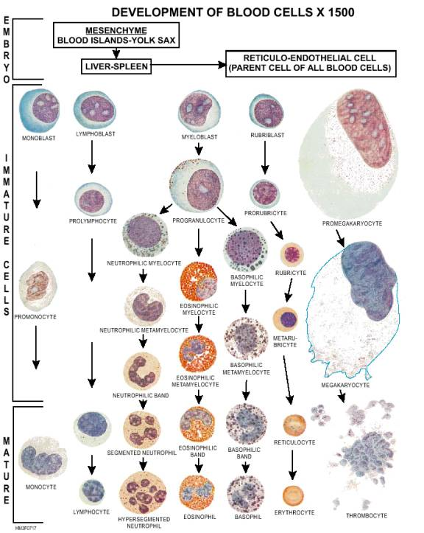
Blood Components

Slide 8
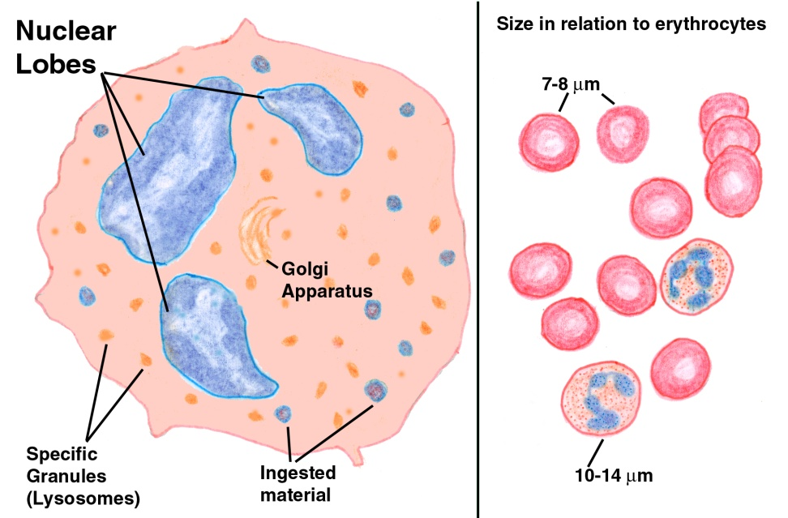
Neutrophils
Nucleus: Multilobed
Granules: inconspicuous
Size: 10 to 12 micrometers
Number: 3000 to 7000/mm³
Development: 14 Days
Life Span: 6 hours to a few days
Function: Phagocytize bacteria

Slide 9
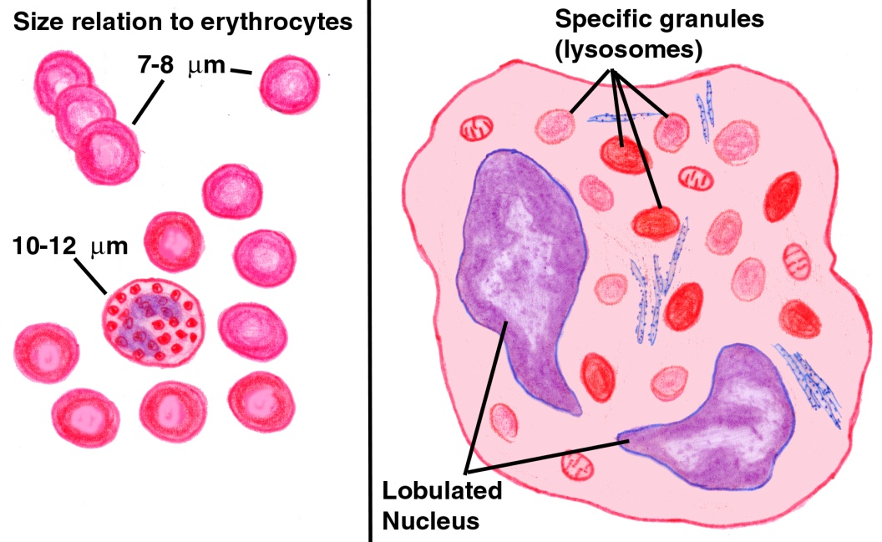
Eosinophils
Nucleus: Bi-lobed
Granules: Red Cytoplasmic
Size: 10 to 14 micrometers
Number: 100 to 400/mm³
Development: 14 Days
Life Span: 8 to 12 days
Function:
Worms (parasites)
Antigen-antibody complexes
inflammatory and allergies

Slide 10
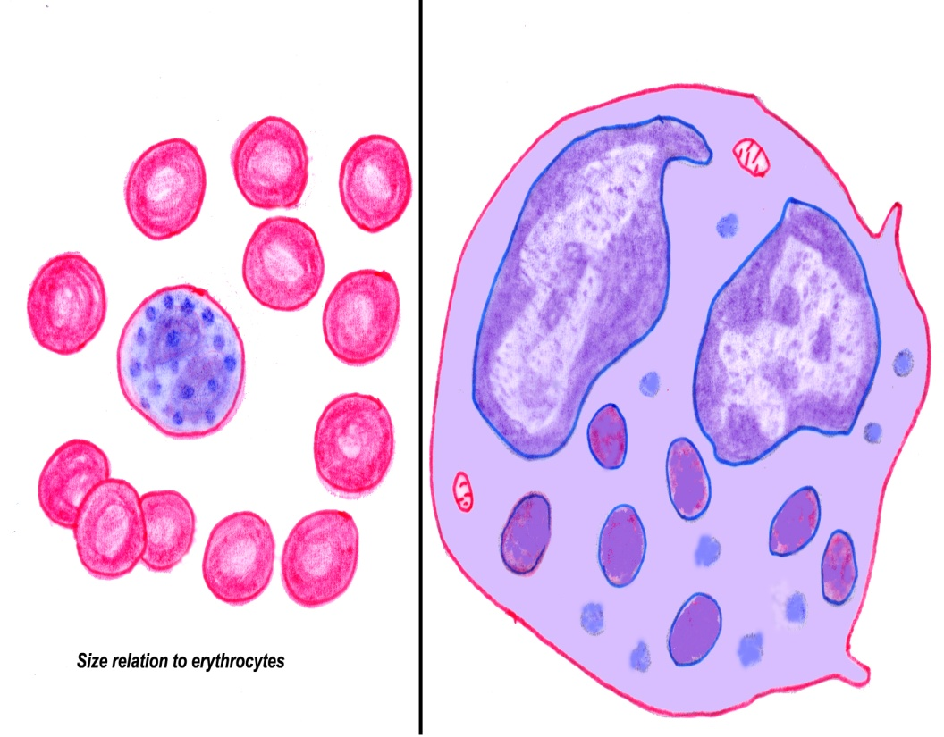
Basophils
Nucleus: Lobed
Granules: Large blue-purple Cytoplasmic
Size: 10 to 14 micrometers
Number: 20 to 50/mm³
Development: 1 to 7 Days
Life Span: A few hours to a few days
Function:
Release Histamine
Contain Heparin

Slide 11
Lymphocytes
Nucleus: Spherical or indented
Granules: None
Size: 5 to 17 micrometers
Number: 1500 to 3000/mm³
Development: Days to Weeks
Life Span: Hours to Years
Function: Mount immune response by direct cell attack or by antibodies

Slide 12
Monocyte
Nucleus: U or Kidney Shaped
Granules: None
Size: 14 to 24 micrometers
Number: 100 to 700/mm³
Development: 2 to 3 Days
Life Span: Months
Function: Phagocytosis (Develop into macrophages in tissue)

Slide 13
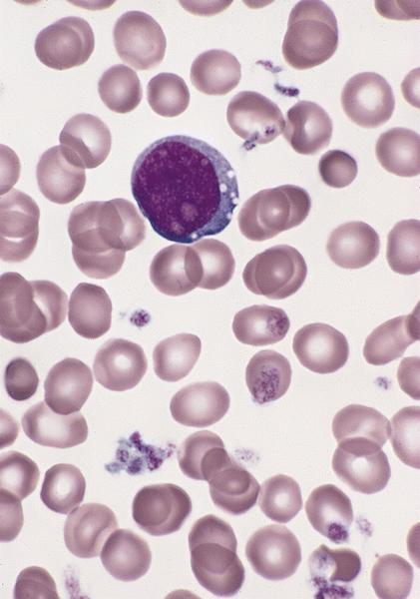
Platelets
Nucleus: None
Granules
Stain Deep Purple
Size: 2 to 4 micrometers
Number: 150,000 to 400,000/mm³
Development: 4 to 5 Days
Life Span: 5 to 10 Days
Function:
Seal small tears in blood vessels
Blood clotting

Slide 14
Practice
Practice Slides about 15
Practice Slides 144

Slide 15
References
Cell Pictures and Other Information
http://education.vetmed.vt.edu/Curriculum/VM8054/Labs/Lab6/Lab6.htm
http://www.pathologyoutlines.com/myeloproliferative.html
http://www.histology-world.com/contents/contents.htm
http://www.lab.anhb.uwa.edu.au/mb140/CorePages/Blood/blood.htm
http://www.siumed.edu/~dking2/intro/bldcells.htm
http://en.wikipedia.org/wiki/White_blood_cells

