Slide 1
Anatomy & Physiology I Lab
BSC 2093 LAB
Introduction

Slide 2
Histology
Epithelial Tissues
Connective Tissues
Muscle Tissues
Nervous Tissues

Slide 3
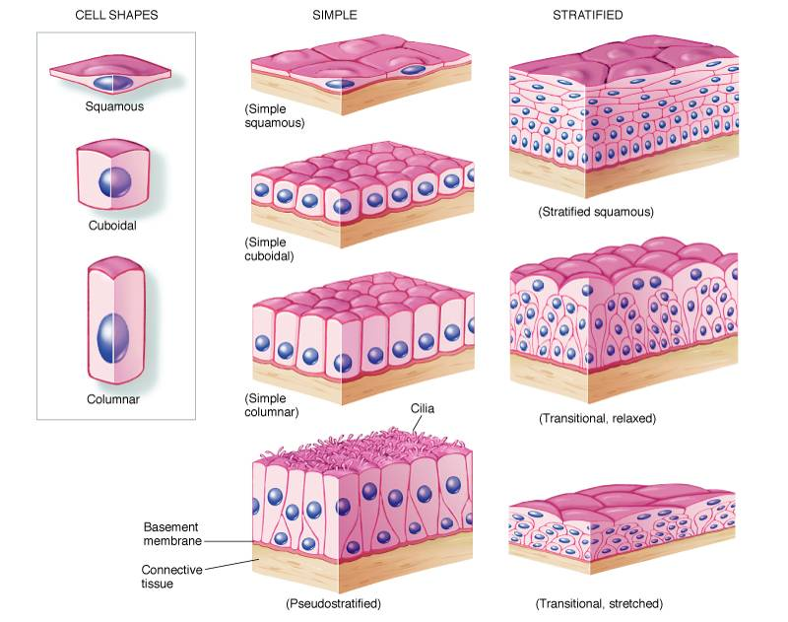
Epithelium Types

Slide 4
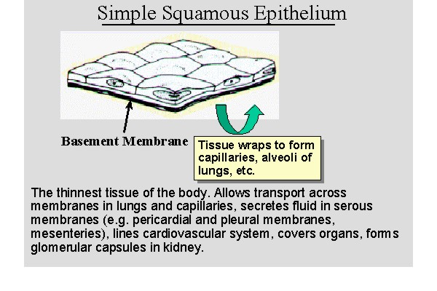
Epithelial: Simple Squamous Epithelium
Simple squamous epithelium is a single layer of flat cells.
Simple squamous epithelium is "simple" because it is one cell thick. "Squamous" refers to the fact that the cells are flat.
Endothelium is a type of simple squamous epithelium which lines blood vessels.

Slide 5
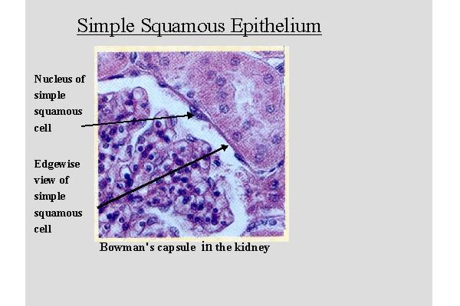
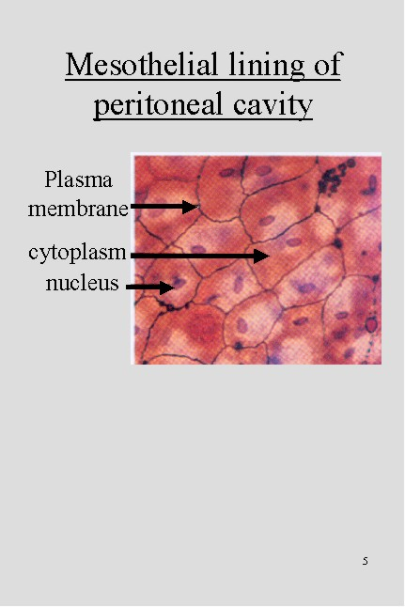
Epithelial: Simple Squamous Epithelium

Slide 6
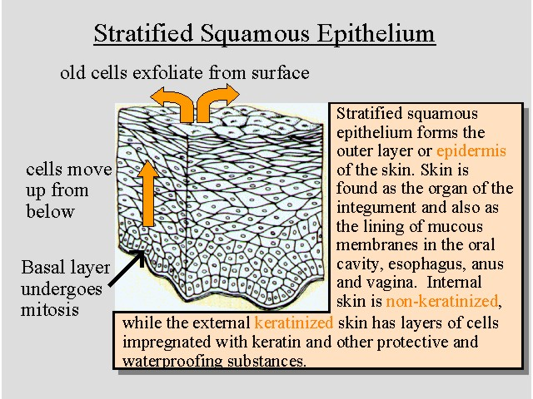
Epithelial: Stratified Squamous Epithelium
Stratified squamous epithelium is "stratified" because it is more than one cell layer thick. "Squamous" refers to the fact that the surface cells of the stratified squamous layer are flat.
Histology hint from Sarah Bellham: In stratified squamous epithelium, the cells at the basal layer are cuboidal or even columnar. However, the epithelium is still classified as "squamous" based on the cells of the surface layer.
The epidermis of the skin is stratified squamous epithelium. The lining of the esophagus is stratified squamous epithelium. The cornea is covered by a non-keratinized stratified squamous epithelium.

Slide 7
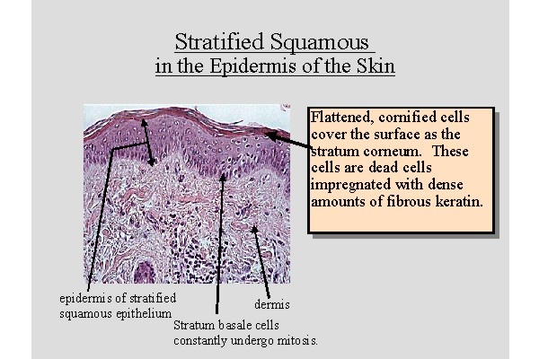
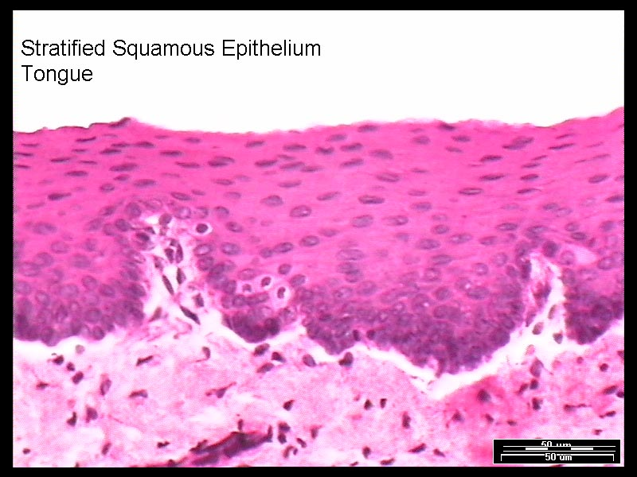
Epithelial: Stratified Squamous Epithelium

Slide 8
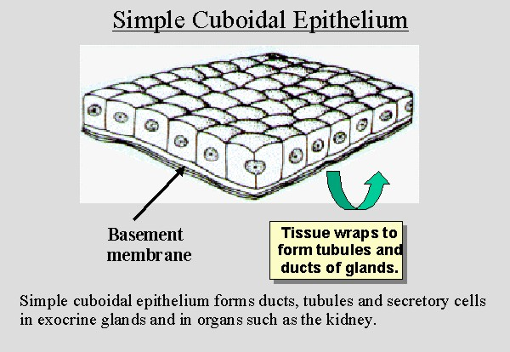
Epithelial: Simple cuboidal epithelium
Simple cuboidal epithelium has cells which are as tall as they are deep and wide. Simple cuboidal epithelium is "simple" because it is one cell thick. "Cuboidal" refers to the shape of the cells.
The lining of most ducts is simple cuboidal epithelium. The kidney tubules are simple cuboidal epithelium.

Slide 9
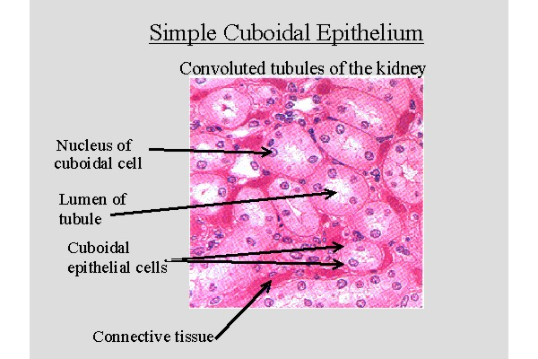
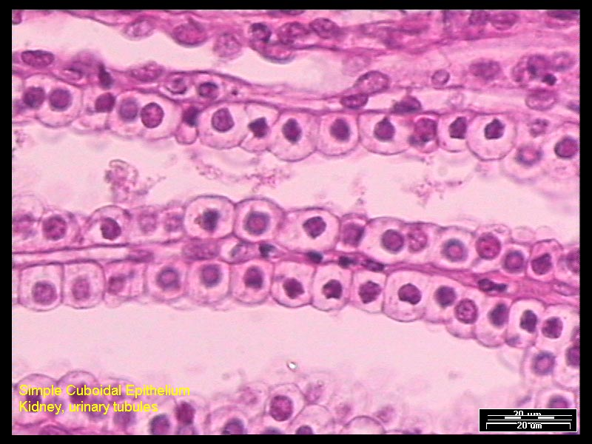
Epithelial: Simple cuboidal epithelium
http://www.technion.ac.il/~mdcourse/274203/slides/Epithelium/2-Simple%20Cuboidal%20Epithelium%20A.jpg

Slide 10
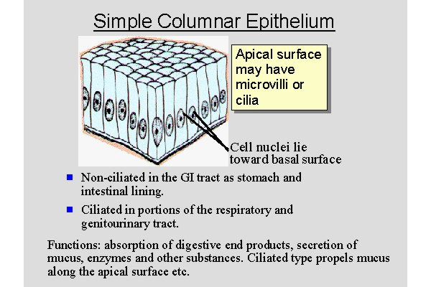
Epithelial: Simple Columnar Epithelium
In simple columnar epithelium, the height of the cell is greater than the width and depth of the cell. Simple columnar epithelium is "simple" because it is one cell thick. "Columnar" cells are taller than they are wide and have an oval nucleus.
The lining of the gastrointestinal tract is simple columnar epithelium. Goblet cells are associated with simple columnar epithelium of the gastrointestinal tract.
The mucosa of the gallbladder is made of simple columnar epithelium.
Histology hint from Sarah Bellham: the simple columnar epithelium of the gallbladder is very tall!

Slide 11
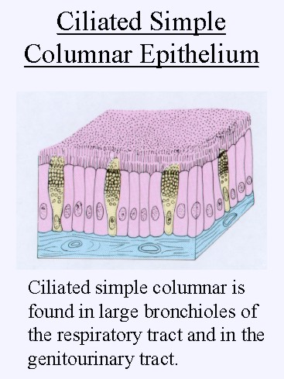
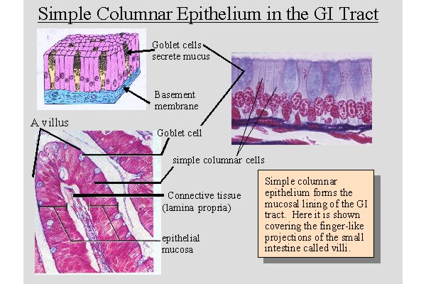
Epithelial: Simple Columnar Epithelium

Slide 12
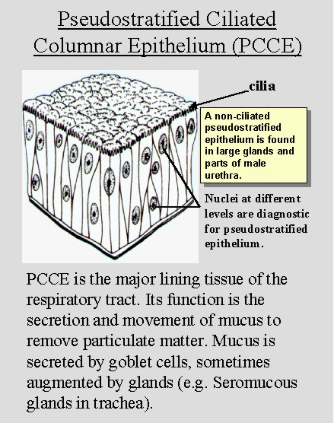
Epithelial: Pseudostratified Columnar Epithelium
Pseudostratified columnar epithelium is a single layer of cells which looks like it is stratified. Pseudostratified squamous epithelium is "pseudostratified" because it is only one cell layer thick, yet it appears to be stratified. In reality, every cell touches the basement membrane.
Histology hint from Sarah Bellham: The prefix "pseudo" is of Greek origin and it means false or counterfeit. For example: pseudonym, pseudo-science or pseudostratified.
Pseudostratified columnar epithelium lines the trachea and respiratory tract as well as some of the male reproductive tract.

Slide 13
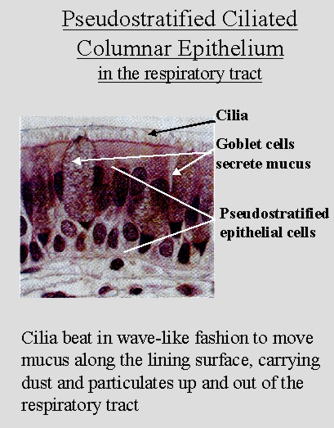
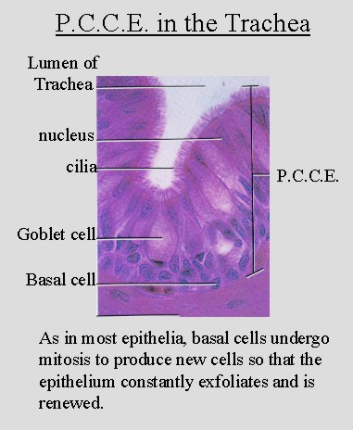
Epithelial: Pseudostratified Columnar Epithelium

Slide 14
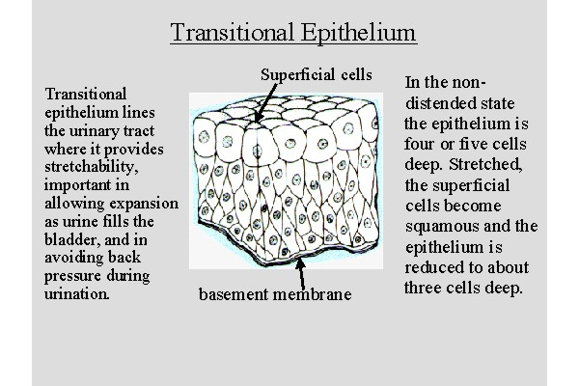
Epithelial: Transitional Epithelium
Transitional epithelium has domed shape cells on the apical surface. It can be distended or stretched.
Transitional epithelium is found in the bladder and urinary tract.

Slide 15
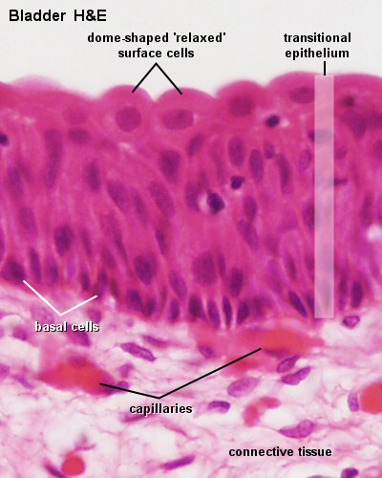
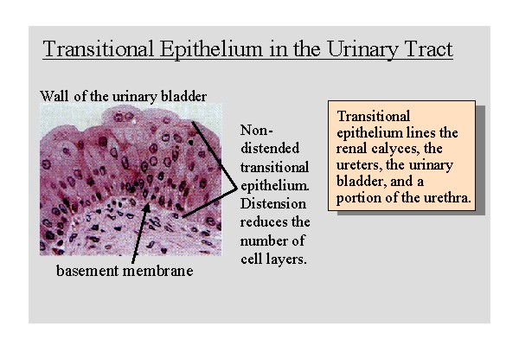
Epithelial: Transitional Epithelium
http://webanatomy.net/histology/epithelium/epithelial_index.htm
http://www.lab.anhb.uwa.edu.au/mb140/CorePages/Epithelia/Images/blad042he.jpg

Slide 16
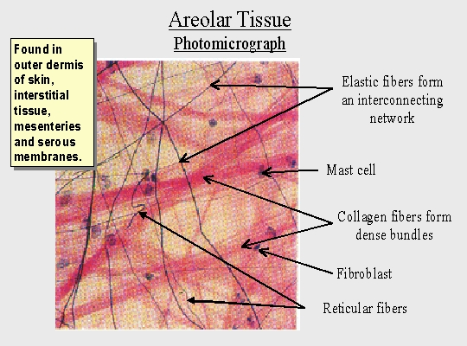
Connective Tissues: Areolar
http://webanatomy.net/histology/connective_histology.htm

Slide 17
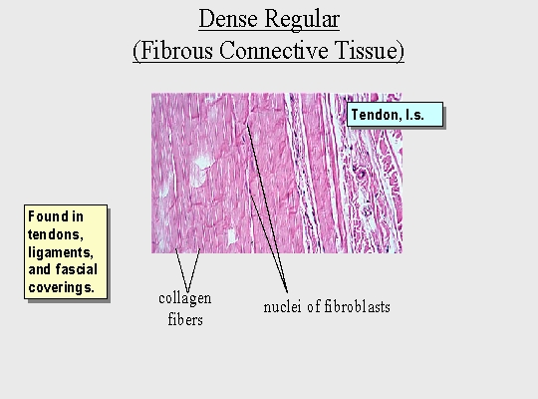
Connective Tissues: Dense Regular Connective Tissue

Slide 18
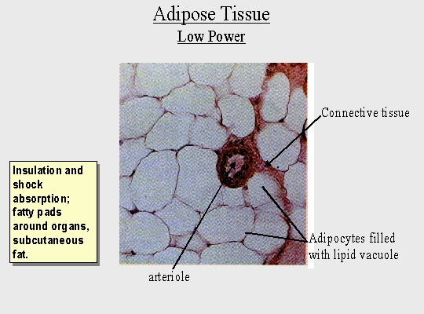
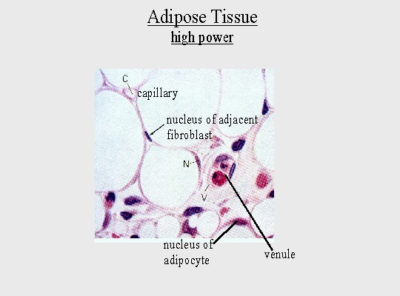
Connective Tissue: Adipose Tissue

Slide 19
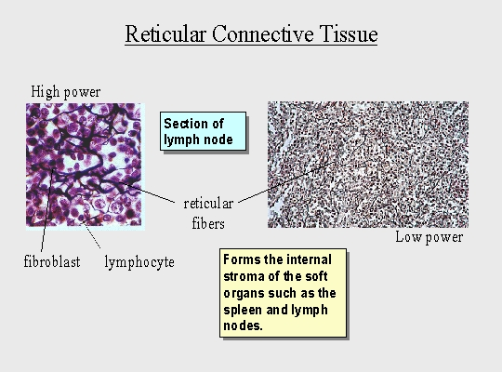
Connective Tissue: Reticular Connective

Slide 20
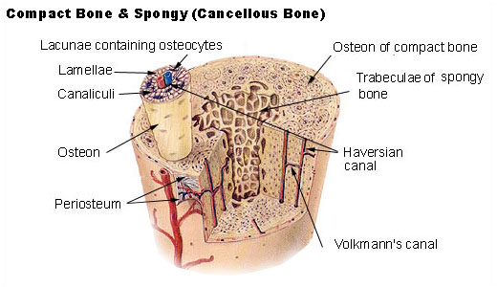
Connective Tissue: Compact Bone
Haversian Canal
  a series of tubes around narrow channels formed by lamellae
Osteoblast
  Bone forming Cells
Osteocyte
    an osteoblast that has become embedded within the bone matrix, occupying a bone lacuna and sending, through the canaliculi, slender cytoplasmic processes that make contact with processes of other osteocytes.
Lamella
  Osteoblasts deposit the matrix in the form of thin sheets which are called lamellae.
Canaliculi
  Canaliculi provide the means for the osteocytes to communicate with each other and to exchange substances by diffusion.
Lacuna
  In the process of the deposition of the matrix, osteoblasts become encased in small hollows within the matrix
Volkmann’s Canal
  These canals establish connections of the Haversian canals with the inner and outer surfaces of the bone

Slide 21
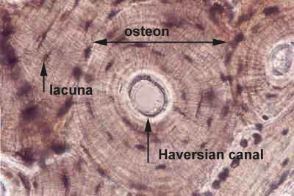
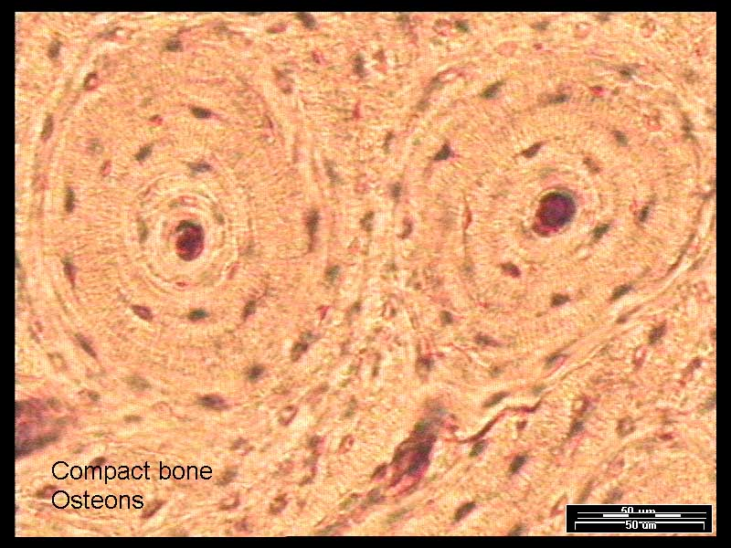
Connective Tissue: Compact Bone

Slide 22
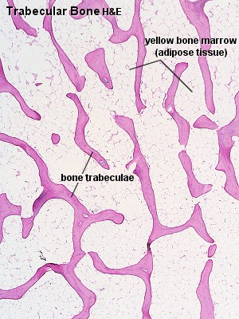
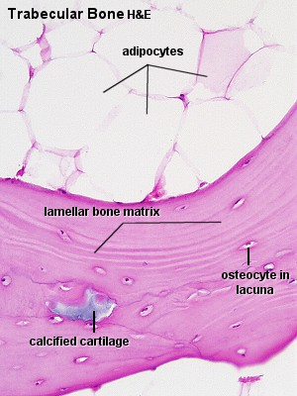
Connective Tissue: Spongy Bone

Slide 23
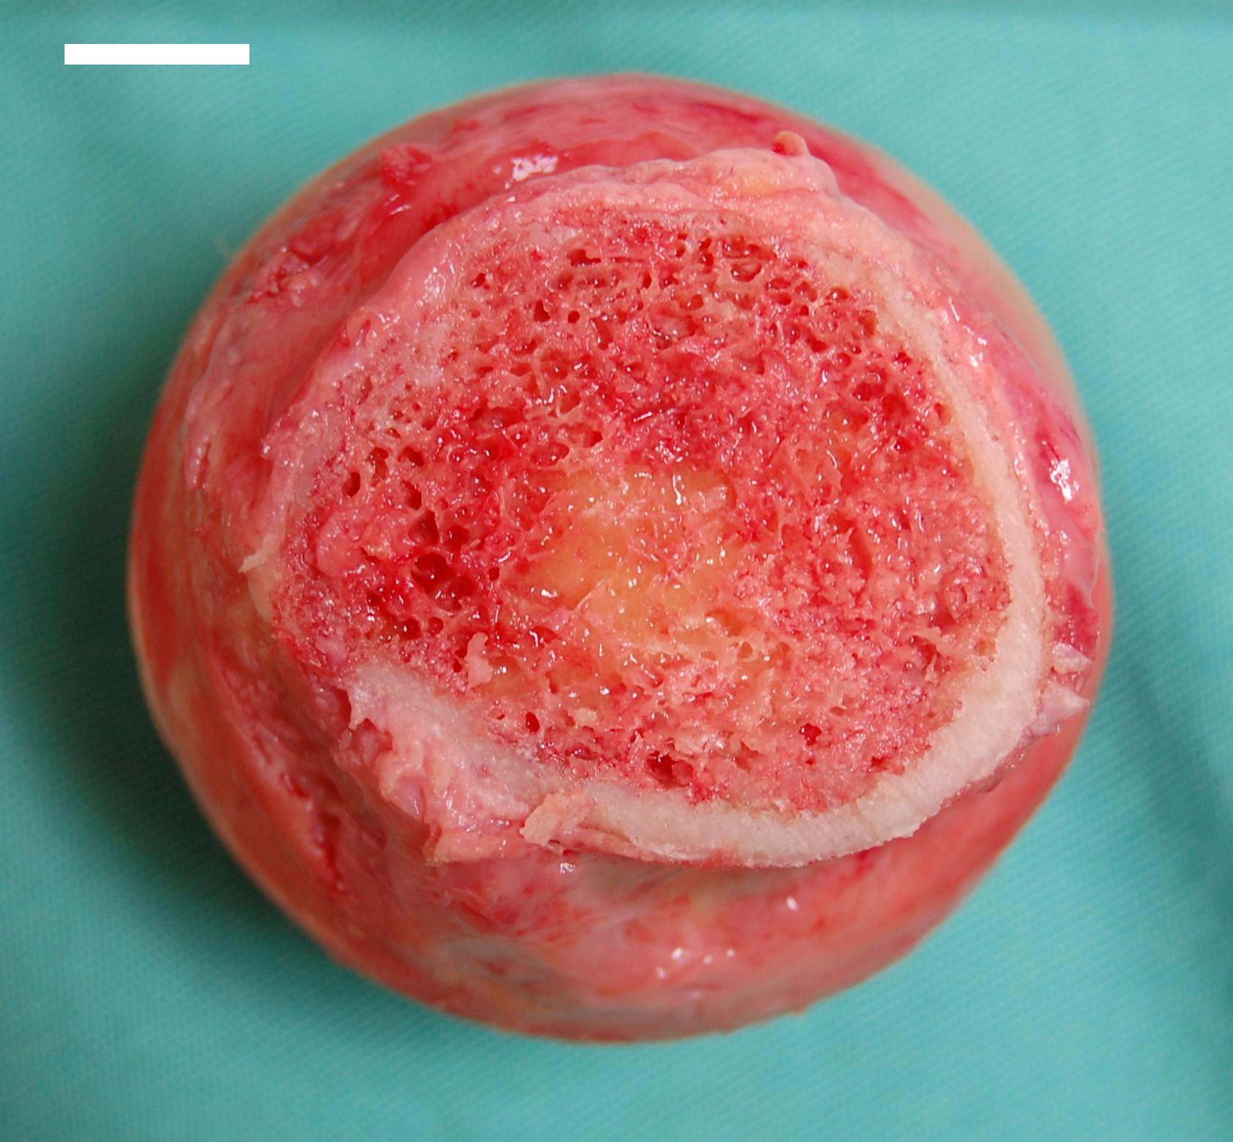
Connective Tissue: Spongy Bone
Red marrow (consisting mainly of hematopoietic) tissue and Red blood cells, platelets and most white blood cells arise in red marrow, found mainly in the flat bones.
Yellow marrow (consisting mainly of fat cells). Yellow marrow is found in the hollow interior of the middle portion of long bones.
http://en.wikipedia.org/wiki/Bone_marrow

Slide 24
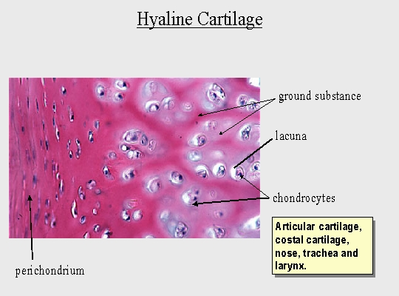
Connective Tissue: Hyaline cartilage

Slide 25
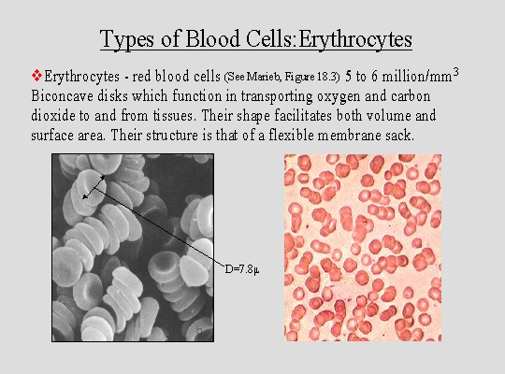
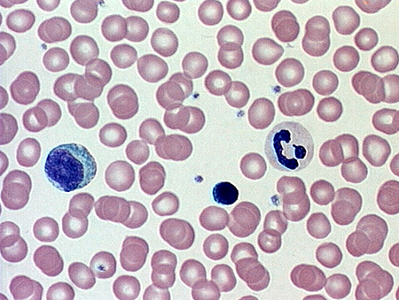
Connective Tissue: Blood

Slide 26
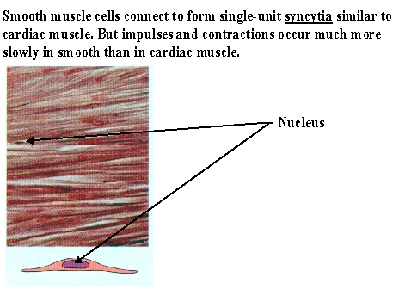
Muscle Tissue: Smooth

Slide 27
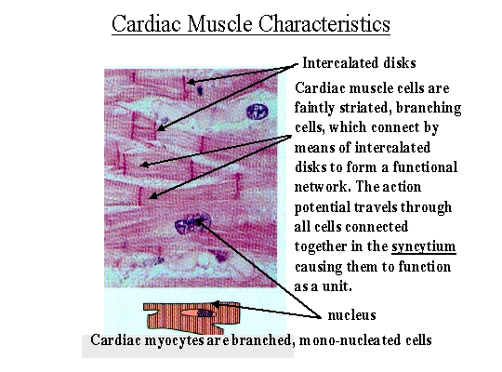
Muscle Tissue: Cardiac

Slide 28
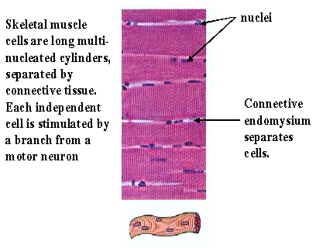
Muscle Tissue: Skeletal

Slide 29
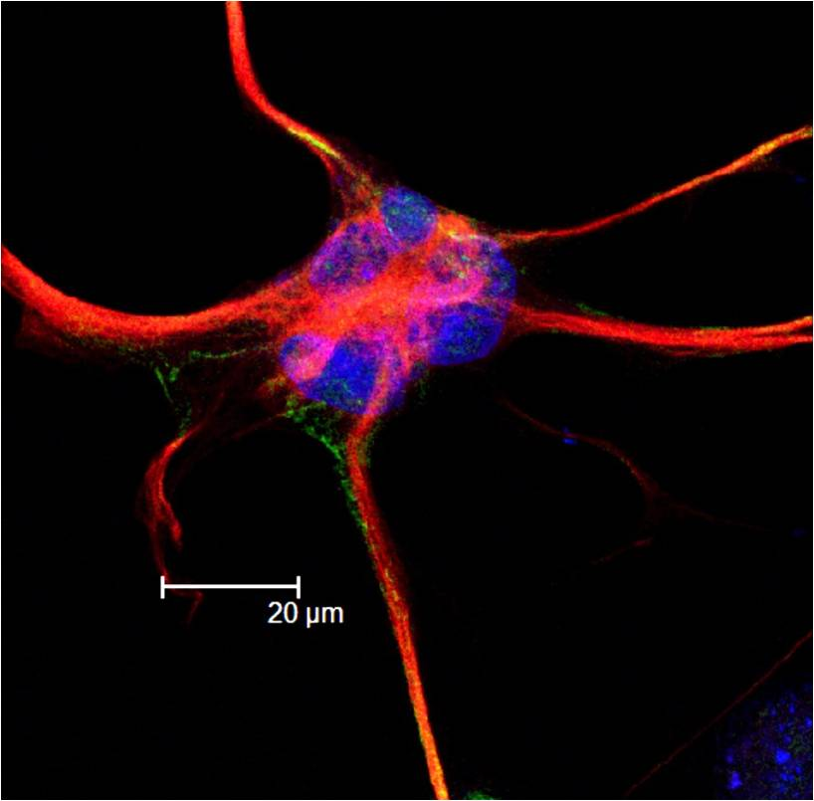
Nervous Tissue: Neuroglia
Glial cells, commonly called neuroglia or simply glia (Greek for "glue"), are non-neuronal cells that maintain homeostasis, form myelin, and provide support and protection for the brain's neurons. In the human brain, there is roughly one glia for every neuron with a ratio of about two neurons for every three glia in the cerebral gray matter.^{[1]}
The four main functions of glial cells are to:
  surround neurons and hold them in place
  to supply nutrients and oxygen to neurons
  to insulate one neuron from another
  destroy pathogens and remove dead neurons

Slide 30
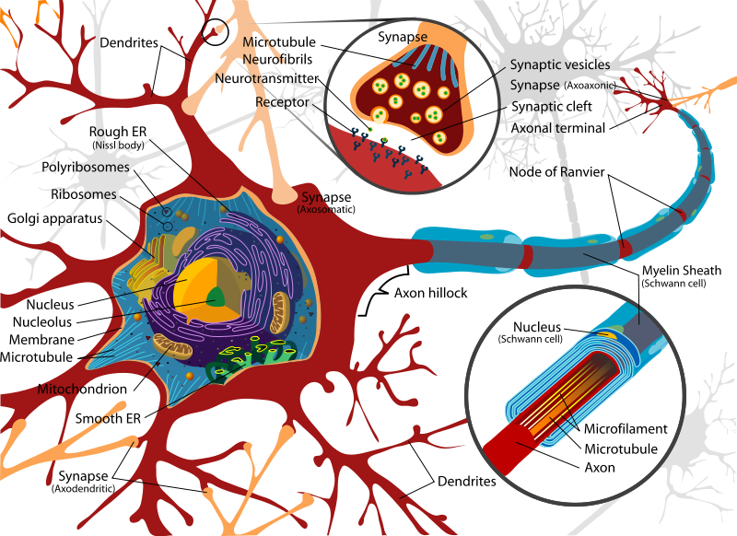
Nervous Tissue: Neuron

Slide 31
Web Sites to Study from
http://www.histology-world.com/
http://www.unm.edu/~vscience/microscopy.htm
http://www.technion.ac.il/~mdcourse/274203/lect5.html
References and images
  http://webanatomy.net/histology/epithelium/epithelial_index.htm
  http://www.histology-world.com/
  http://webanatomy.net/histology/epithelium/epithelial_index.htm
  www.google.com images for each type of tissue

