Slide 1
Anatomy and physiology of Pulses and blood pressure
INDIAN RIVER STATE COLLEGE
WEEK 4

Slide 2
PULSES
What are they?
Something you must feel or use a device to detect
Looking at a patient does not ensure they have a pulse!
As you press on the artery you feel the force of the blood being pushed through the vessel you are compressing with you finger, this is a pulse.
Where are they?
Not found everywhere!
Need an artery that is close to surface and in a location that is appropriate that you can trap the artery against a structure to allow you to press on it. This is not always the case but the typical location.

Slide 3
Locations
Carotid arteries
Brachial, Radial, Ulnar

Slide 4
Locations
Femoral
Popliteal

Slide 5
Locations
Posterior Tibial
Dorsalis Pedis

Slide 6
Blood Pressure
What?
Pressure of blood in the aorta at any given time
Systolic: Maximum pressure in Aorta
Diastolic: Minimum pressure in Aorta
Where?
Most places you can take a pulse (except the neck!)
Why?
Direct indications of how the heart is functioning
Blood flow to tissue (perfusion), a certain pressure is needed to ensure organs receive proper blood flow!

Slide 7
Blood Pressure
Location
Upper Arm
Wrist
Thigh
Lower Leg
Cuff Placement/Size
Cuff size is indicated on cuff.
Bladder over artery
Inflation
Feel Pulse until it disappears.
Listen until sounds disappear.
Sounds
Above Systolic no sound
Below Diastolic no sound
Exceptions (hardened arteries, elderly)
Positions
Left verses Right
Above heart/Below Heart
Lying, Sitting, Standing

Slide 8
Key Points to Taking BP
Proper Position of cuff, must be level with heart. Remember you are concerned with pressure being created by the left ventricle, not the pressure in the artery you are measuring.
Proper Cuff Size!
Consistency: Measure same way each time. Time of day also effects pressure.
Remember the numbers you get are what the doctor is using to treat or diagnose the patient. If you did not hear, do it again or have someone else do it. Very rarely is the patients pressure 120/80, this is the most common number recorded if the person taking the pressure didn’t hear it!

Slide 9
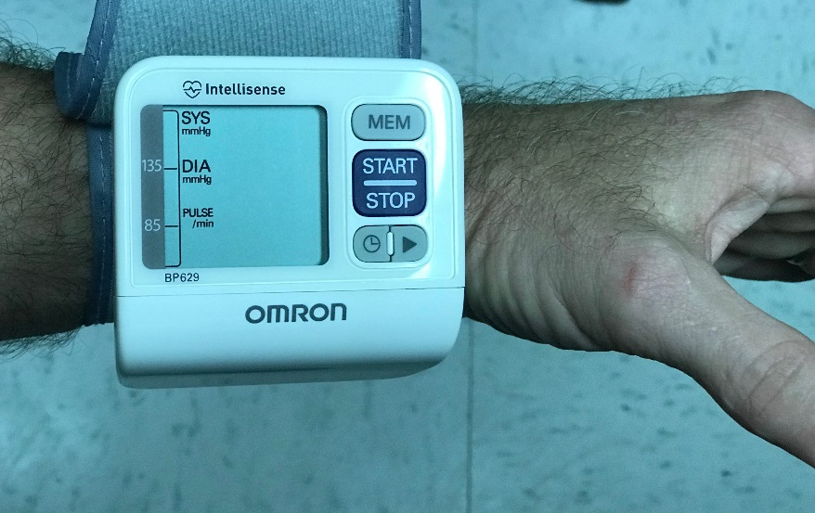
Wrist Blood Pressure
Keys to Wrist Pressures
Two Different Positions for Two Different Cuffs
Accurate if performed properly!
Cuff must be placed on wrist correctly!
Arm/Wrist (artery being compressed must be level with heart in line of gravity!)
Use same cuff each time
If reading seems unusual be educated enough to know something may not be correct and take pressure manually with upper arm cuff. This goes with all automatic cuff systems. You must be smarting than the cuff!!!

Slide 10
Lab Exercises
Page 43-46
HR/Pulse: same thing, this is what you count for number of beats of the heart.
Systolic: Maximum pressure in artery measured.
Diastolic: Minimum pressure in artery measured.
Pulse Pressure: Systolic- Diastolic Pressure
Arm up/ Arm Down: Pressure changes approximately 2 mmHg / 1 inch above or below the heart.
How could this effect high blood pressure diagnosis?
Orthostatic Test: This test gives you an indication of how the patient responds to change in body position. Commonly used in patients who get dizzy or low pressure upon standing. Test must be competed in this order (lying, sitting, standing).
A patient is considered to have orthostatic hypotension when the systolic blood pressure falls by more than 20 mm Hg, the diastolic blood pressure falls by more than 10 mm Hg, or the pulse rises by more than 20 beats per minute within 3 minutes of standing

