Slide 2
Note to the Instructor:
For the third edition of Visual Anatomy & Physiology, we have updated our PowerPoints to fully integrate text and art. The pedagogy now more closely matches that of the textbook. The goal of this revised formatting is to help your students learn from the art more effectively. However, you will notice that the labels on the embedded PowerPoint art are not editable. You can easily import editable art by doing the following:
Copying slides from one slide set into another
You can easily copy the Label Edit art into the Lecture Presentations by using either the PowerPoint Slide Finder dialog box or Slide Sorter view. Using the Slide Finder dialog box allows you to explicitly retain the source formatting of the slides you insert.
Using the Slide Finder dialog box in PowerPoint:
Open the original slide set in PowerPoint.
On the Slides tab in Normal view, click the slide thumbnail that you want the copied slides to follow.
On the toolbar at the top of the window, click the drop down arrow on the New Slide tab. Select Reuse Slides.
Click Browse to look for the file; in the Browse dialog box, select the file, and then click Open.
If you want the new slides to keep their current formatting, in the Slide Finder dialog box, select the Keep source formatting checkbox. When this checkbox is cleared, the copied slides assume the formatting of the slide they are inserted after.
To insert selected slides: Click the slides you want to insert. Slides will place immediately after the slide you have selected in the Slides tab in Normal view.

Slide 3
Section 1: Plasma and Formed Elements
Learning Outcomes
17.1 List the components of the cardiovascular system, and describe several important functions of blood.
17.2 Describe the important components and major properties of blood.
17.3 Explain the origins and differentiation of the formed elements.

Slide 4
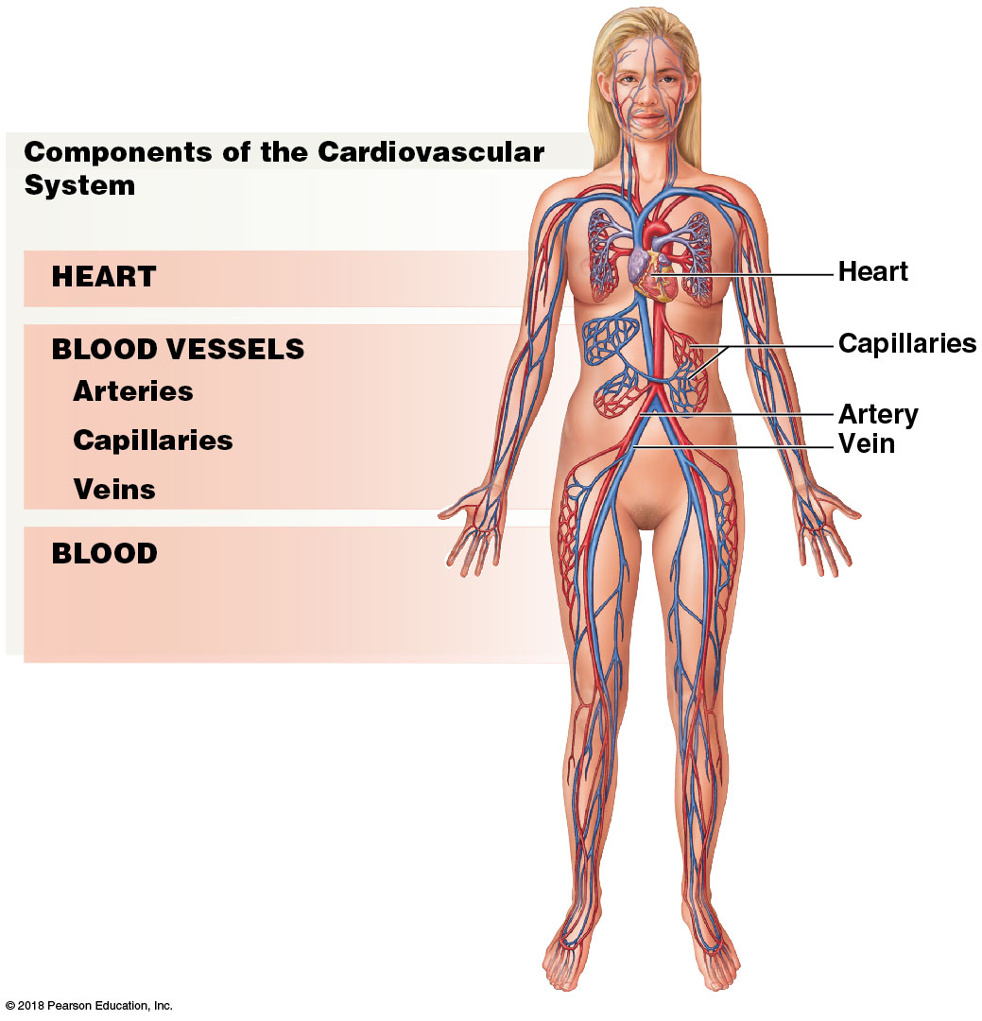
Module 17.1: Blood is the fluid portion of the cardiovascular system
Cardiovascular system consists of heart, blood vessels, blood
​Heart—pumps blood; maintains blood pressure
​Blood vessels
Arteries carry blood away from heart
Capillaries permit exchange between blood and interstitial fluids
Veins return blood to heart
Notes:
This is a good opportunity to stress that artery and vein are directional terms. Many students arrive in class believing all arteries contain oxygenated blood and veins contain deoxygenated blood. The pulmonary vessels, as an example, do not adhere to that rule.

Slide 5
Module 17.1: Blood functions
Functions of blood
Transport dissolved gases, nutrients, hormones, and metabolic wastes
Oxygen—lungs to peripheral tissues
Carbon dioxide—tissues to lungs
Nutrients—from digestive tract or storage in adipose or liver
Hormones—gland to target
Wastes—to kidneys (excretion)

Slide 6
Module 17.1: Blood functions
Functions of blood (continued)
Regulate pH and ion composition of interstitial fluids (IF)
Absorbs/neutralizes acids
Diffusion between blood and IF balances ion concentrations
Restrict fluid loss at injury sites
Enzymes/other substances initiate clotting when vessel wall is broken; clot = temporary patch
Defend against toxins and pathogens
Transports white blood cells and antibodies to fight infection

Slide 7
Module 17.1: Blood functions
Functions of blood (continued)
Stabilize body temperature
Absorbs heat generated in one area; distributes to other tissues
High body temperature—blood directed closer to skin
Low body temperature—blood directed to brain, internal organs

Slide 9
Module 17.1: Review
Identify the components of the cardiovascular system.
What are the functions of blood?
Learning Outcome: List the components of the cardiovascular system, and describe several important functions of blood.

Slide 10
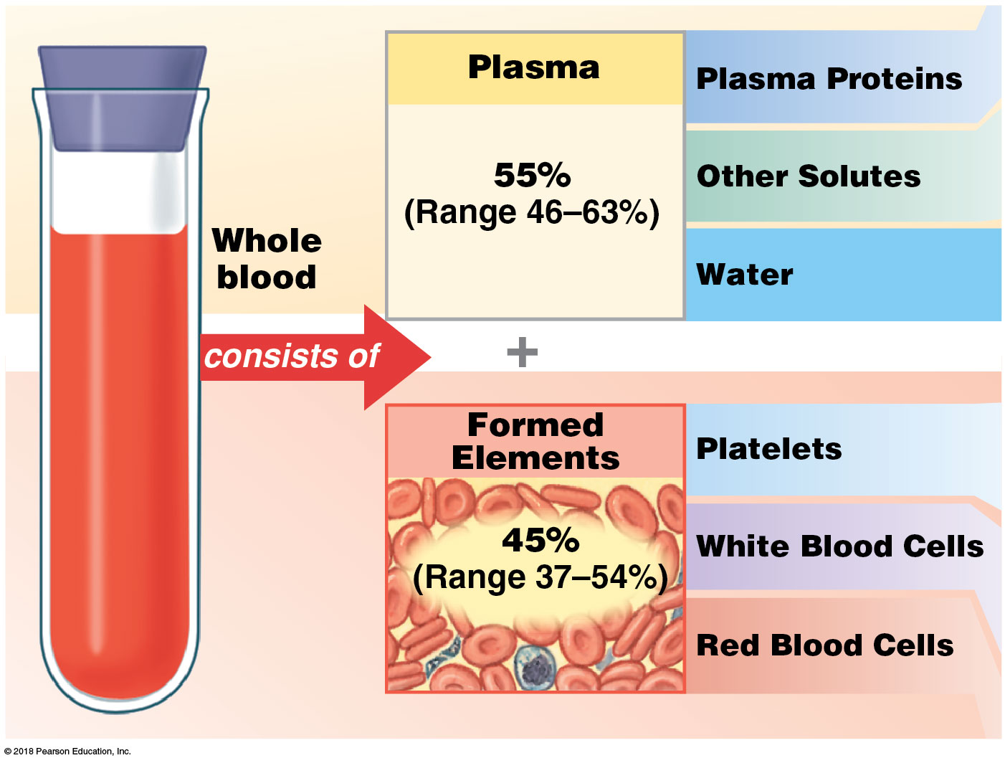
Module 17.2: Blood is a fluid connective tissue containing plasma and formed elements
Blood = fluid connective tissue
Whole blood = blood with all components
Plasma = liquid matrix
Formed elements = cells and cell fragments
5–6 liters (5.3–6.4 quarts) blood in males
4–5 liters (4.2–5.3 quarts) blood in females

Slide 11
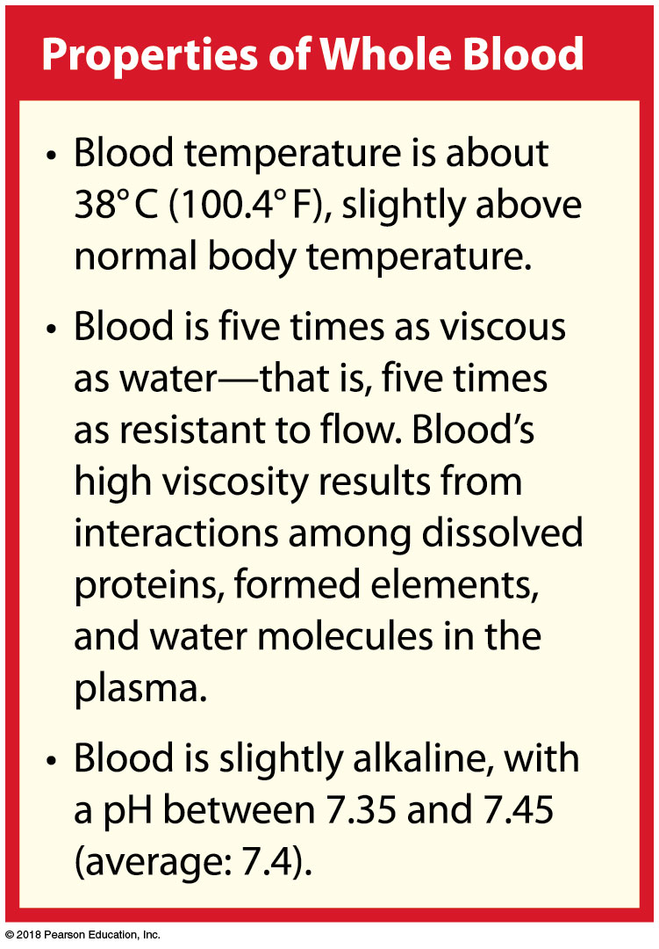

Slide 12
Module 17.2: Blood composition
Plasma = 55 percent of the volume of whole blood
Similar to interstitial fluid (IF)—constant exchange of water, ions, small solutes across capillary walls
Primary differences
Respiratory gases (oxygen, carbon dioxide)
Dissolved proteins (plasma proteins cannot cross capillary walls)

Slide 13
Module 17.2: Blood composition
Formed elements = blood cells/fragments; ~45 percent of whole blood
99 percent of formed elements are red blood cells
Hematocrit (packed cell volume, PCV)
Percentage of whole blood from formed elements
Overall average 45 percent (range 37–54 percent)
Males average 47 percent; females average 42 percent (androgens stimulate RBC production)
Notes:
Additional Resource: PhysioEx 9.1—Ex: 11—Blood Analysis I Hematocrit.

Slide 14
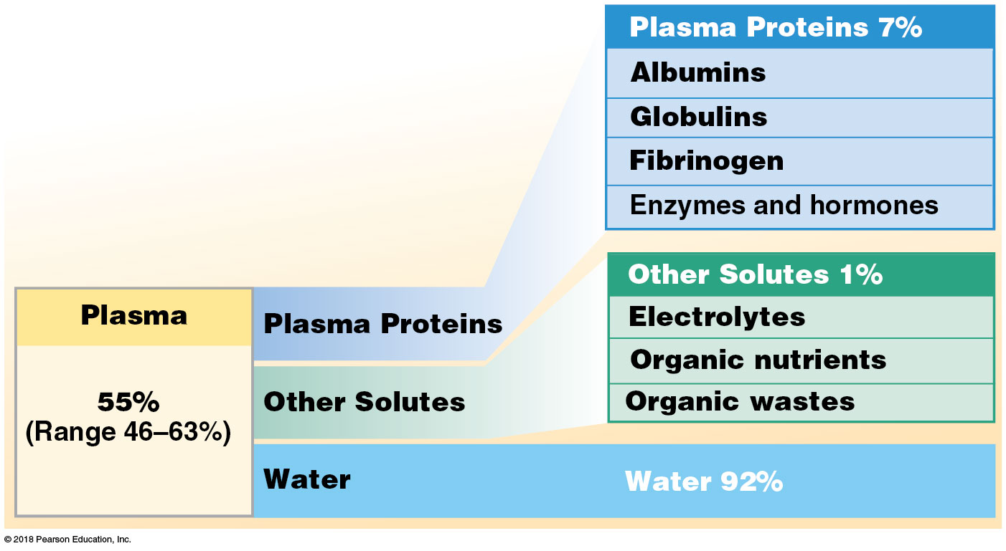
Module 17.2: Blood composition
Plasma proteins
In solution
Each 100 mL has ~7.6 g of protein (~5× more than IF)
Large, globular shapes prevent leaving bloodstream
Liver synthesizes >90 percent of plasma proteins

Slide 15
Module 17.2: Blood composition
Albumins ~60 percent of plasma proteins; for osmotic pressure
Globulins ~35 percent of plasma proteins
Antibodies (immunoglobulins) attack foreign proteins, pathogens
Transport globulins bind ions, hormones, lipids, other compounds

Slide 16
Module 17.2: Blood composition
Fibrinogen ~4 percent of plasma proteins
Blood clotting—form large insoluble fibrin strands
Plasma also contains active and inactive enzymes and hormones

Slide 17
Module 17.2: Blood composition
Plasma solutes (water = 92 percent of plasma)
Electrolytes—essential for vital cellular activities
Major ions: Na⁺, K⁺, Ca²⁺, Mg²⁺, Cl–, HCO₃–, HPO₄–, SO₄^{2–}
Organic nutrients include lipids, carbohydrates, and amino acids
Used for cell ATP production, growth, and maintenance

Slide 18
Module 17.2: Blood composition
Plasma solutes (continued)
Organic wastes carried to sites of breakdown or excretion
Examples: urea, uric acid, creatinine, bilirubin, NH₄⁺

Slide 19
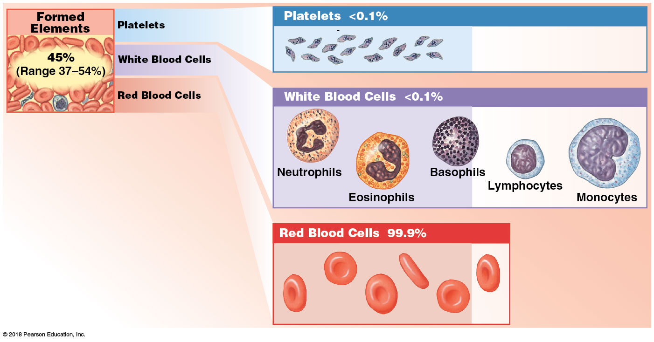
Module 17.2: Blood composition
Formed elements
Platelets < 0.1 percent of formed elements
Small membrane-bound cell fragments involved in clotting
White blood cells (WBCs, leukocytes) < 0.1 percent of formed elements
Body defense; five classes, each with different functions
Notes:
This is a good time to point out that leukocyte is the name for all WBCs, which includes lymphocytes. Students often mix up the two names because they both begin with “l”.

Slide 20
Module 17.2: Blood composition
Formed elements (continued)
Red blood cells (RBCs, erythrocytes) = 99.9 percent of formed elements
Oxygen transport
Notes:
This is a good time to point out that leukocyte is the name for all WBCs, which includes lymphocytes. Students often mix up the two names because they both begin with “l”.

Slide 21
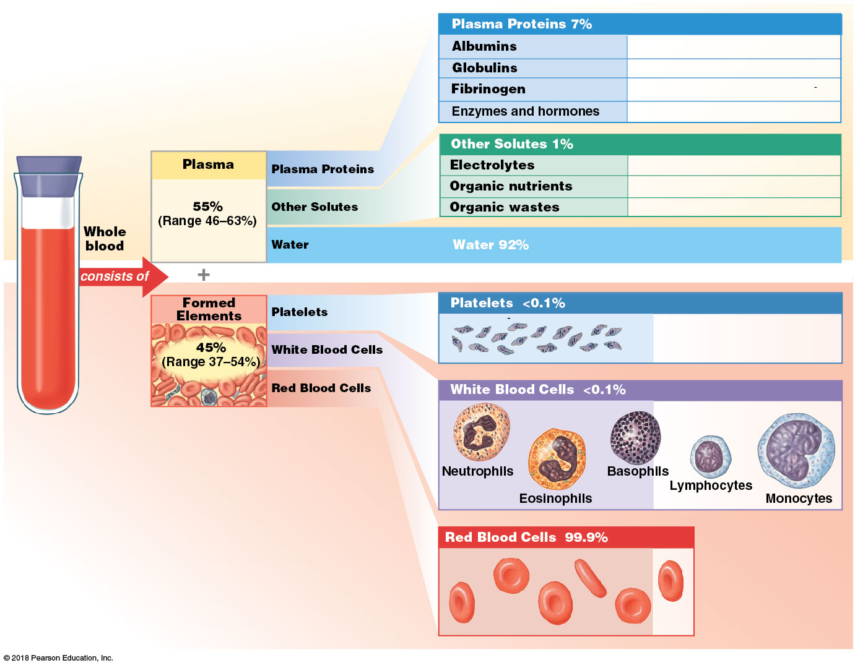
Summary of the composition of whole blood
Notes:
The numbers might confuse some students when they look at this whole image. Be sure they know to read it from the left. For example, 45% of whole blood is formed elements, and of that part, 99.9% is RBCs. Some students jump to the right side of the image and assume it means 99.9% of the blood is RBCs, or get confused when it says water is 92% and RBCs are 99.9%.

Slide 22
Module 17.2: Review
Identify the two components making up whole blood, and list the composition of each.
Define hematocrit.
Which specific plasma proteins would you expect to be elevated during an infection?
Learning Outcome: Describe the important components and major properties of blood.

Slide 23
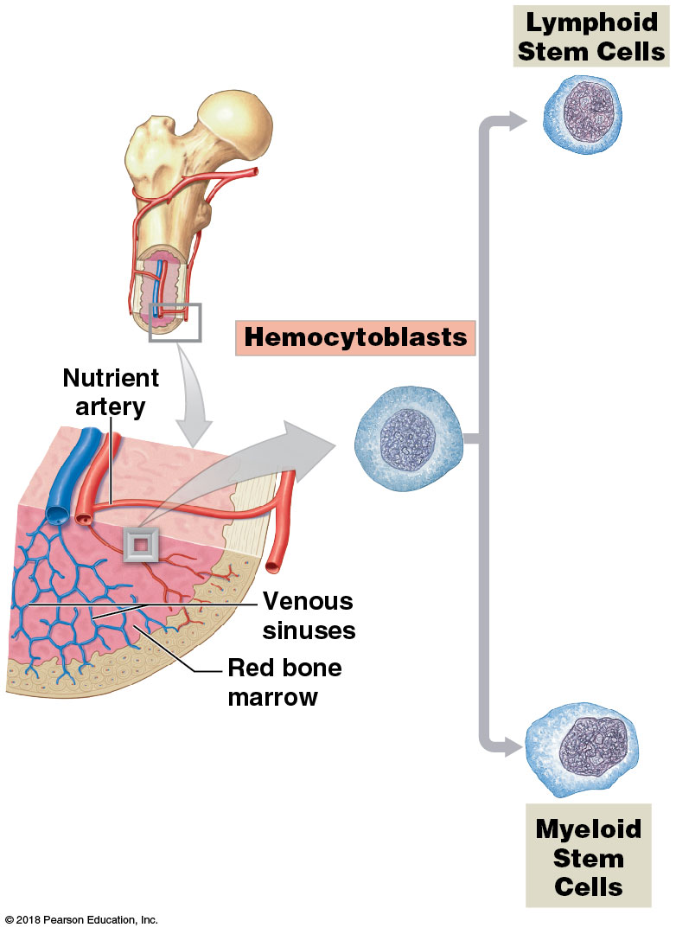
Module 17.3: Formed elements are produced by stem cells in red bone marrow
Development of formed elements = hemopoiesis/hematopoiesis
Occurs in red bone marrow
Hemocytoblasts from hematopoietic stem cells (HSCs)
Produce two types of stem cells
​Lymphoid stem cells produce lymphocytes (type of WBC)
​Myeloid stem cells produce RBCs, other WBCs

Slide 24
Module 17.3: Hemopoiesis
Two types of stem cells produced by hemocytoblasts
​Lymphoid stem cells produce lymphocytes (immune response)
Originate in red bone marrow; some stay
Others migrate to lymphoid tissues (thymus, spleen, lymph nodes)
​Myeloid stem cells give rise to all other formed elements

Slide 25
Module 17.3: Hemopoiesis
Lymphoid stem cells to lymphocytes
Lymphoid stem cells → lymphoblasts → prolymphocytes → lymphocytes
Colony-stimulating factors = hormones released by activated lymphocytes and other cells during immune response to stimulate blood cell formation

Slide 26
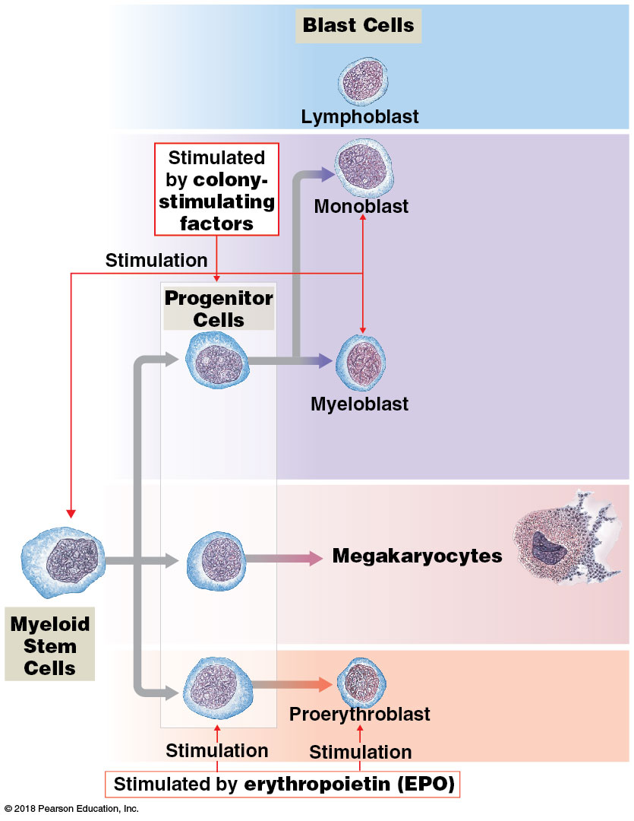
Module 17.3: Hemopoiesis
Myeloid stem cells to immature blast cells
Myeloid stem cells differentiate into three types of progenitor cells that, in turn, differentiate into:
Monoblasts and myeloblasts
​Megakaryocytes
Proerythroblasts
Notes:
This is a complex image. Walk students through it so they know how to read it. Be sure to explain the different uses of arrow symbols, which are often misinterpreted by students.

Slide 27
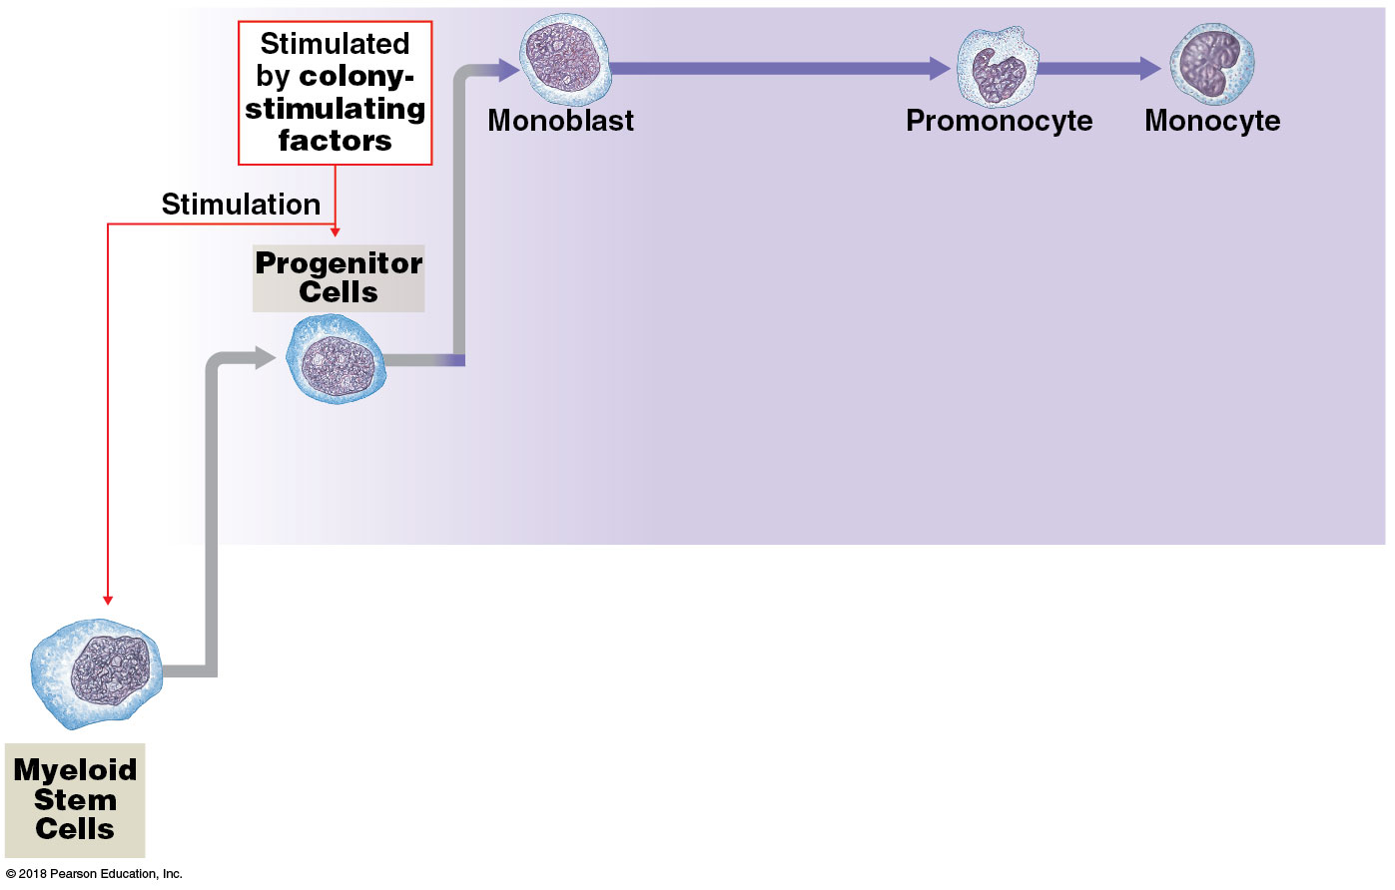
Module 17.3: Hemopoiesis
Myeloid stem cells to monoblasts to monocytes
Monoblasts differentiate into promonocytes
Promonocytes differentiate into monocytes

Slide 28
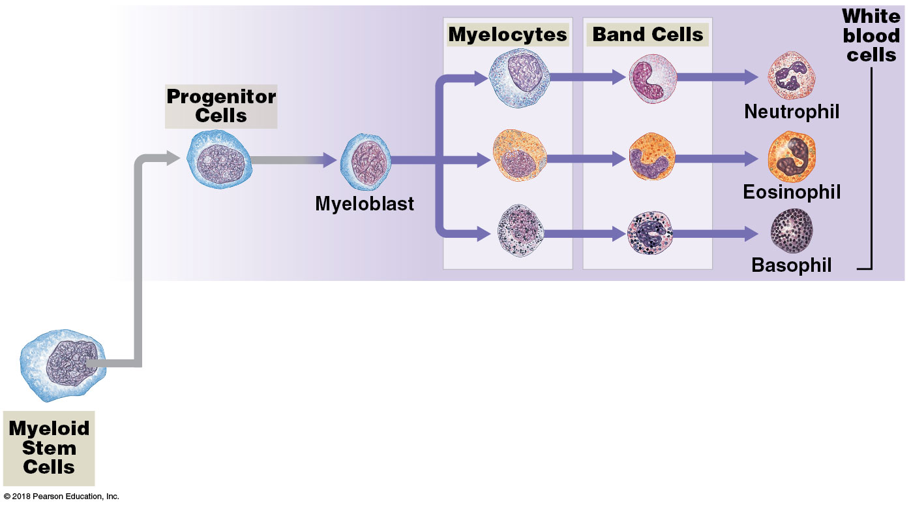
Module 17.3: Hemopoiesis
Myeloid stem cells to myeloblasts to WBCs
Myeloblasts differentiate into three types of myelocytes
Myelocytes differentiate into band cells
Band cells differentiate into neutrophils, eosinophils, basophils

Slide 29
Module 17.3: Hemopoiesis
Myeloid stem cells to megakaryocytes to platelets
Myeloid stem cells differentiate into megakaryocytes
Megakaryocytes are enormous cells with large nuclei
Eventually shed cytoplasm in small, membrane-enclosed packets = platelets

Slide 30
Module 17.3: Hemopoiesis
Myeloid stem cells to proerythroblasts to RBCs
Myeloid stem cells differentiate into proerythroblasts
Proerythroblasts differentiate to erythroblasts, which shed their nuclei, and then on to anucleate reticulocytes
Reticulocytes differentiate to erythrocytes (red blood cells/RBCs)

Slide 31
Module 17.3: Hemopoiesis
Erythropoietin (EPO)
Released into plasma in response to low tissue oxygen levels = hypoxia (hypo, below + oxy, presence of oxygen)

Slide 32
Module 17.3: Hemopoiesis
Erythropoietin (EPO) (continued)
Stimulus for EPO release:
Anemia
Reduced blood flow to kidneys
O₂ content in lungs decreased from disease or high altitude
Lung damage
Stimulates stem cells and developing RBCs in red bone marrow

Slide 33
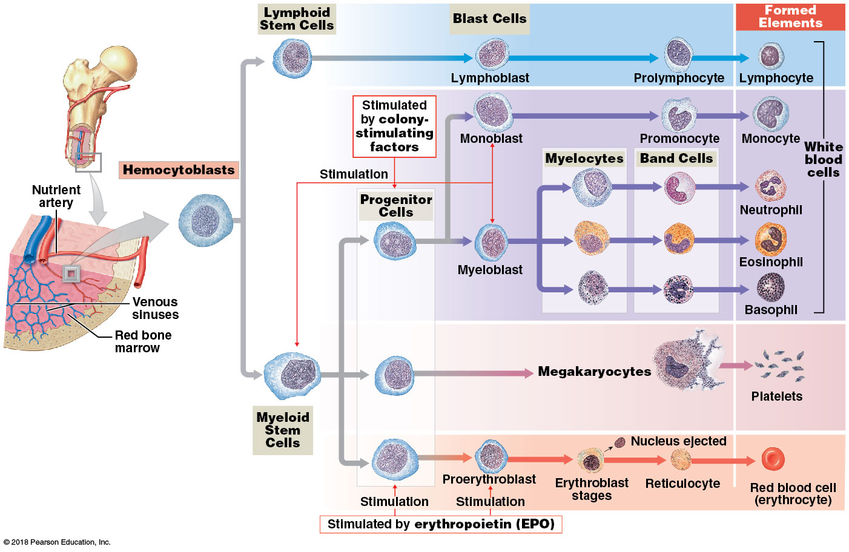
The process of hemopoiesis

Slide 34
Module 17.3: Review
Define hemocytoblasts.
Describe platelets and their origin.
Compare the types of cells that lymphoid stem cells and myeloid stem cells produce.
Learning Outcome: Explain the origins and differentiation of the formed elements.

Slide 35
Section 2: Structure and Function of Formed Elements
Learning Outcomes
17.4 Define hematology, describe the elements of a complete blood count (CBC), and give examples of red blood cell lab tests.
17.5 List the characteristics and functions of red blood cells, and describe the structure and functions of hemoglobin.
17.6 Describe how the components of aged or damaged red blood cells are recycled.

Slide 36
Section 2: Structure and Function of Formed Elements
Learning Outcomes (continued)
17.7 Explain the importance of blood typing and the basis for ABO and Rh incompatibilities.
17.8 Clinical Module: Describe hemolytic disease of the newborn, explain the clinical significance of the cross-reaction between fetal and maternal blood types, and cite preventive measures.

Slide 37
Section 2: Structure and Function of Formed Elements
Learning Outcomes (continued)
17.9 Categorize the various types of white blood cells on the basis of their structures and functions.
17.10 Discuss the mechanisms that control blood loss after an injury, and describe the reaction sequences responsible for blood clotting.
17.11 Clinical Module: Explain how blood disorders are detected, and describe examples of the various categories of blood disorders.

Slide 38
Module 17.4: Hematology is the study of blood and blood-forming tissues
Hematology
Important information about a person’s health
Can detect disorders (anemia, infection, clotting disorders)
Dyscrasias = blood disorders; can have systemic effects
Reasons for performing blood tests
Determine blood type
Evaluate types/numbers of RBCs, WBCs, and platelets
Abnormal values may indicate underlying medical conditions

Slide 39
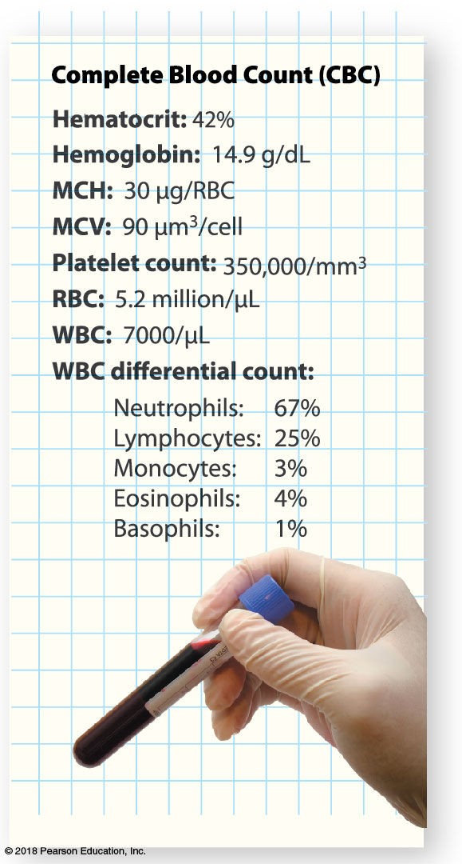
Module 17.4: Hematology
Complete blood count (CBC)
Determines following in 1 cubic millimeter (1 microliter or μL) of blood:
RBC count
WBC count
Erythrocyte indices (hemoglobin)
Hematocrit
Others
WBC differential count
Identifies numbers of each type of white blood cell

Slide 40
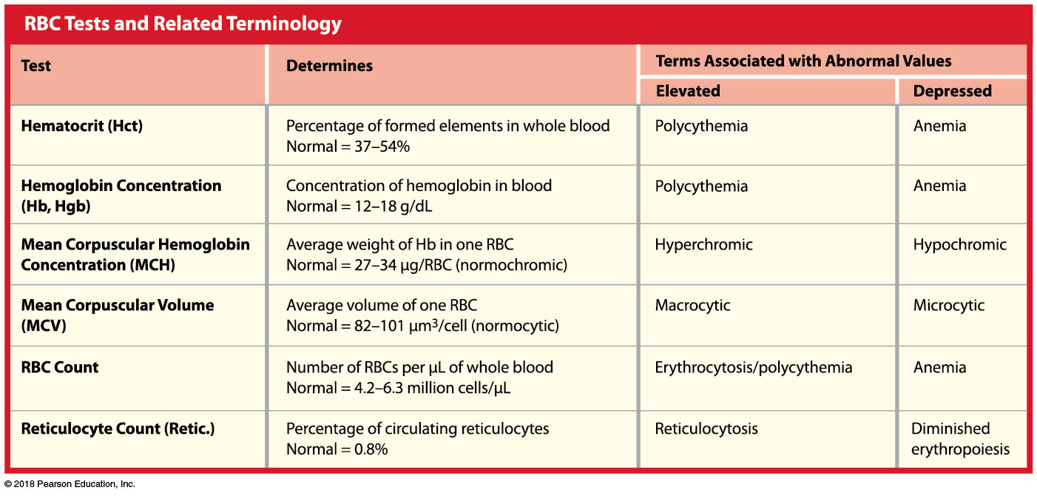
Module 17.4: Hematology
Red blood cell tests
Several common tests
Assess number, size, shape, maturity of circulating RBCs
Can detect problems that lack obvious signs (internal bleeding)

Slide 41
Module 17.4: Review
What is hematology?
Describe a complete blood count (CBC).
Which condition would a patient have if she had a depressed hematocrit level?
Learning Outcome: Define hematology, describe the elements of a complete blood count (CBC), and give examples of red blood cell lab tests.

Slide 42
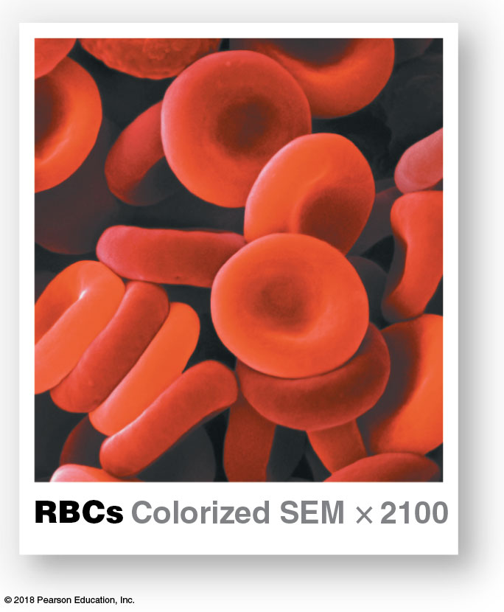
Module 17.5: Red blood cells, the most common formed elements, contain hemoglobin that transports respiratory gases
Red blood cells (RBCs)
Roughly one-third of all cells in the body
Single drop of whole blood contains ~260 million RBCs
Average adult ~25 trillion RBCs = one-third of all cells in body

Slide 43
Module 17.5: Red blood cells
Red blood cell count (standard test)
Number of RBCs per microliter (µL), or cubic millimeter (mm³), of whole blood
Adult males: 4.5–6.3 million RBCs/µL
Adult females: 4.2–5.5 million RBCs/µL

Slide 44
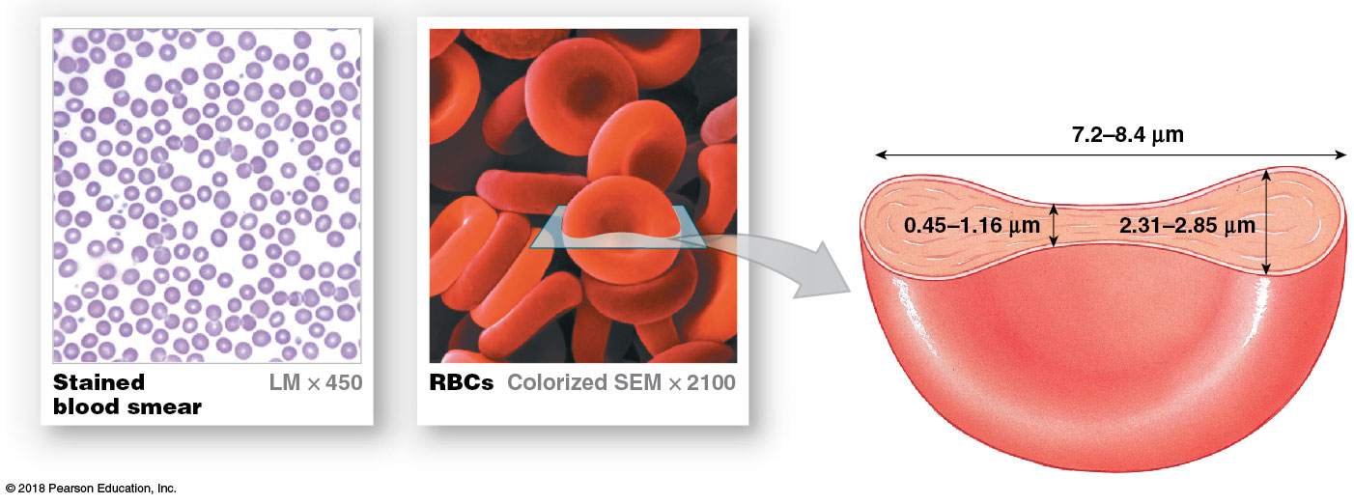
RBCs are biconcave discs—thinner centers, thicker edges
Notes:
To demonstrate how much surface area is increased by the RBCs biconcave disk shape, consider taking a ball of clay to class. Show it as a round ball, then flatten it into a fairly thick disk. Have students look at the surface area. Finally, indent both the top and bottom surfaces to demonstrate biconcavity and the further increase of surface area. Or have students try the demonstration themselves.

Slide 45
Module 17.5: Red blood cells
Functional aspects of red blood cells
Large surface area–to–volume ratio
Packed with hemoglobin (= protein that carries oxygen)
Allows more oxygen exchange
Total RBC surface area (adult) equals ~2000 times total surface area of body
Form stacks (rouleaux)—facilitate transport in small vessels
Flexible—RBCs can move through narrowest capillaries with diameters smaller than RBC

Slide 46
Notes:
This picture will look very abstract to may students. Help them get oriented by pointing our the wall vs. lumen of the blood vessels.

Slide 47
Module 17.5: Red blood cells
Red blood cell characteristics
Lose most organelles during development
Mature RBCs lack nuclei (anucleate) and ribosomes
Cannot divide/repair
Life span <120 days
Primary function—transport respiratory gases
95 percent of RBC intracellular proteins are hemoglobin molecules
Hemoglobin (Hb) content, whole blood:
14–18 g/dL males
12–16 g/dL females

Slide 48
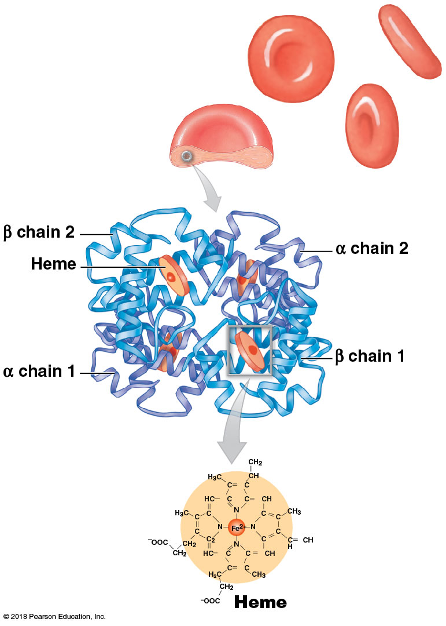
Module 17.5: Red blood cells
Hemoglobin
Complex quaternary structure
Each Hb molecule has:
Two alpha (α) chains
Two beta (β) chains
Similar to myoglobin in muscle cells
Each chain has a single heme molecule
Notes:
Show students the four separate chains and the four heme groups in the center image, then point out that the image at the bottom represents one of the heme groups. Students sometimes don’t know how to interpret pull-out images like this.

Slide 49
Module 17.5: Red blood cells
Hemoglobin (continued)
Each heme contains an iron ion that interacts with oxygen molecule to form oxyhemoglobin (HbO₂)
Makes oxygenated blood bright red
Oxygen binding is reversible
Deoxyhemoglobin = hemoglobin not bound to oxygen; blood is dark red

Slide 50
Module 17.5: Red blood cells
Hemoglobin (continued)
An RBC has ~280 million Hb molecules
Each Hb molecule has four heme units
So, each RBC can carry >1 billion oxygen molecules
~98.5 percent of oxygen in blood is bound to Hb; rest is dissolved in plasma

Slide 51
Module 17.5: Review
Describe the functional aspects of RBCs.
Describe hemoglobin.
Compare oxyhemoglobin with deoxyhemoglobin.
Learning Outcome: List the characteristics and functions of red blood cells, and describe the structure and functions of hemoglobin.

Slide 52
Module 17.6: Red blood cells are continually produced …
~1 percent of circulating RBCs are replaced each day (short lifespan)
~3 million new RBCs enter circulation each second
End of RBC life
Plasma membrane ruptures (hemolysis) or
RBC is engulfed by macrophages in spleen, liver, or bone marrow

Slide 53
Module 17.6: Red blood cells are continually produced …
Erythropoiesis = red blood cell formation
Occurs only in red bone marrow, or myeloid tissue, in vertebrae, ribs, sternum, skull, scapulae, pelvis, and ends of limb bones
Fatty yellow bone marrow can convert to red bone marrow in cases of severe, sustained blood loss and make RBCs

Slide 54
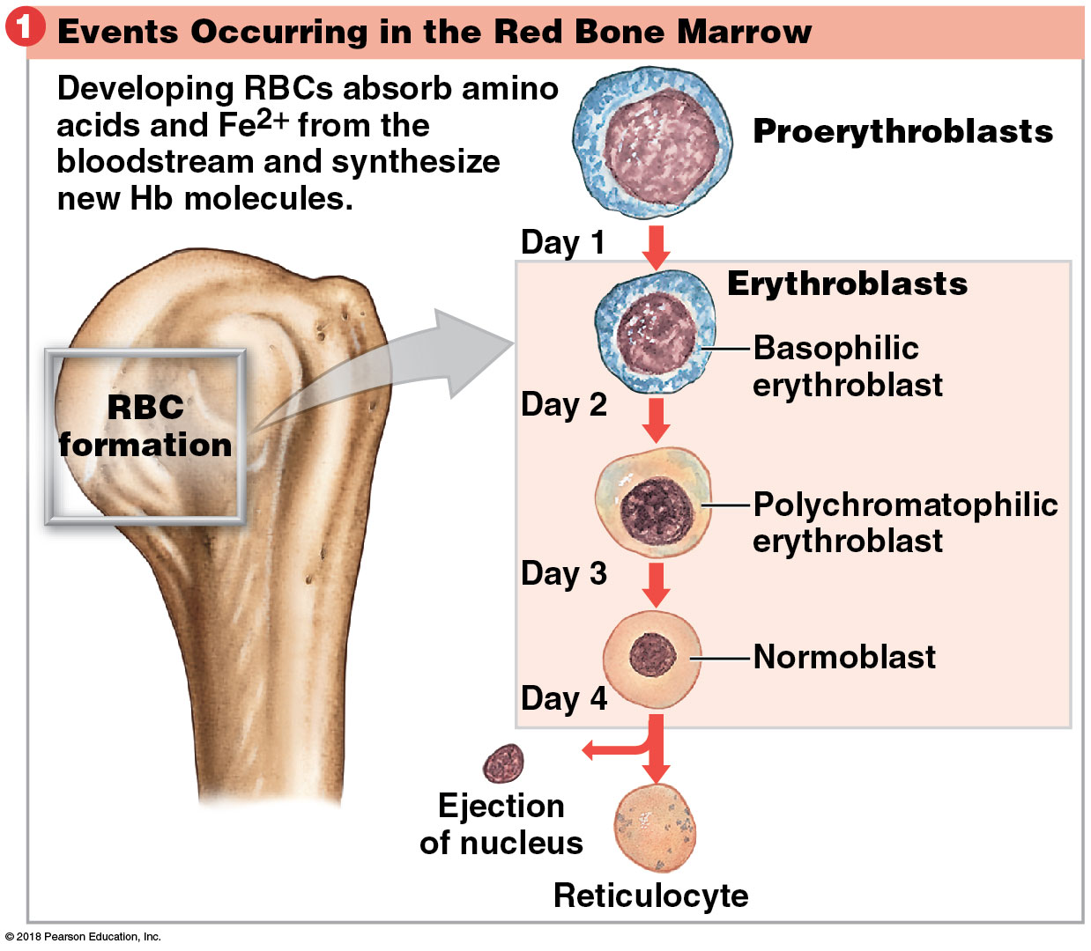
Module 17.6: RBC production and breakdown
Erythroblasts begin producing Hb
Normoblasts lose their nuclei and become reticulocytes
Reticulotyes contain ~80 percent of the Hb of mature RBCs; enter bloodstream after 2 days
Notes:
Be sure students understand that the three cells in the box are all types of erythroblasts.

Slide 55
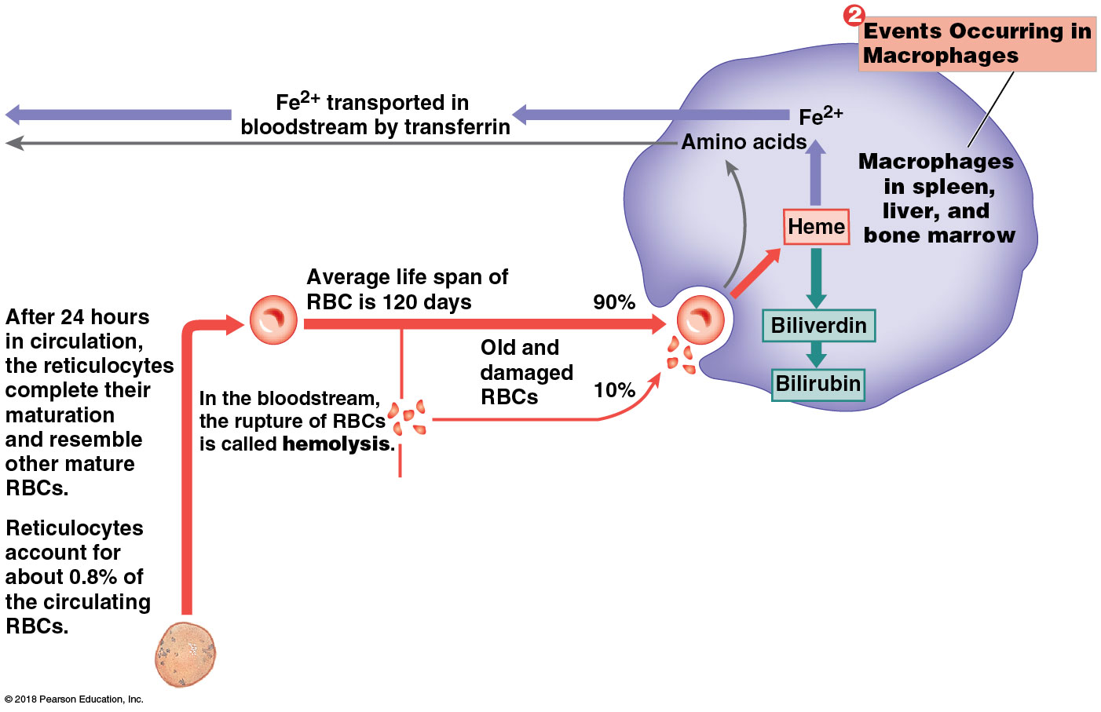
Events occurring in macrophages
Notes:
Walk students through this complex illustration so they know where to begin and how to follow the arrows.

Slide 56
Module 17.6: RBC production and breakdown
Events occurring in macrophages (continued)
Macrophages monitor condition of circulating RBCs
Engulf old RBCs before rupture (hemolyze)
Remove Hb molecules/cell fragments
Heme units stripped of iron
Iron is stored in phagocyte or enters blood and binds to transferrin (plasma protein)
Heme → biliverdin → bilirubin → bloodstream → liver
Globular proteins disassembled and amino acids recycled

Slide 57
Module 17.6: RBC production and breakdown
Events occurring in macrophages (continued)
Hemoglobin that is not phagocytized breaks down into its protein chains and is excreted in urine
Breakdown of an abnormally large number of RBCs results in red or brown urine; condition is hemoglobinuria

Slide 58
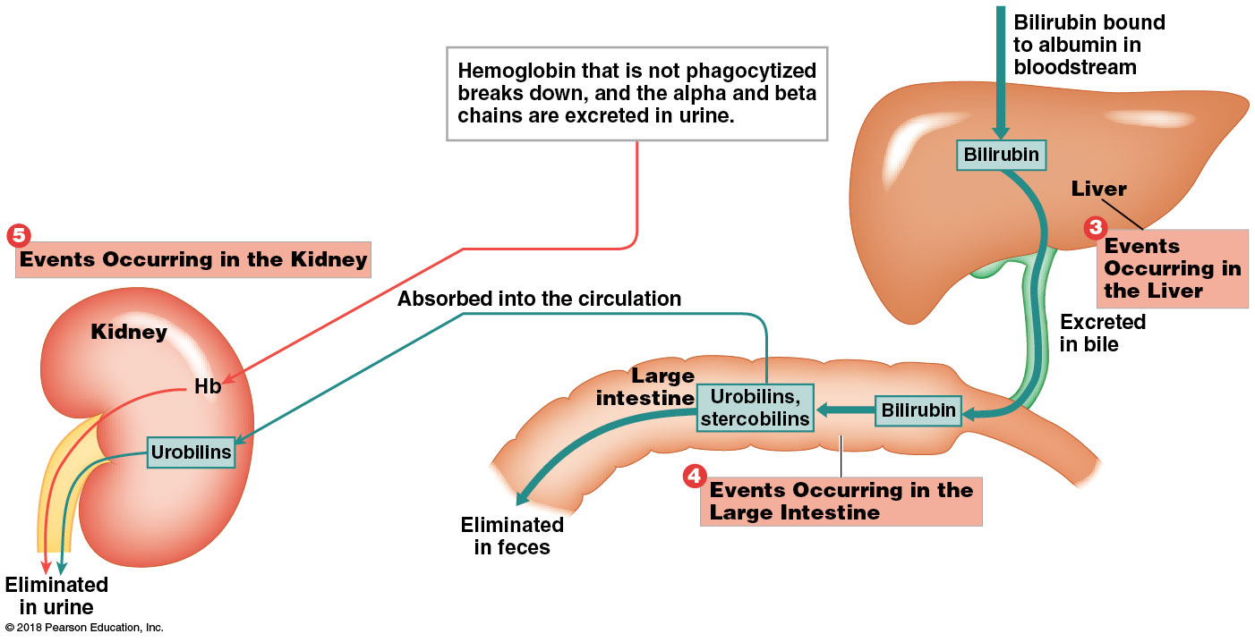
Module 17.6: RBC production and breakdown
Events occurring in the liver
Bilirubin is excreted in bile
Blocked bile ducts or inability to process bilirubin causes bilirubin levels to increase
Bilirubin diffuses into peripheral tissues
Causes yellow color in skin and eyes = jaundice

Slide 59
Module 17.6: RBC production and breakdown
Events occurring in large intestine
Bacteria convert bilirubin to urobilins and stercobilins; they enter feces, giving it yellow-brown or brown color
Notes:
Point out the encircled numbers that students may overlook, so they know how to progress through the image.

Slide 60
Module 17.6: RBC production and breakdown
Events occurring in kidneys
Excrete hemoglobin and urobilins—gives urine yellow color
Hematuria = presence of intact RBCs; occurs only after urinary tract damage
Notes:
Point out the encircled numbers that students may overlook, so they know how to progress through the image.

Slide 61
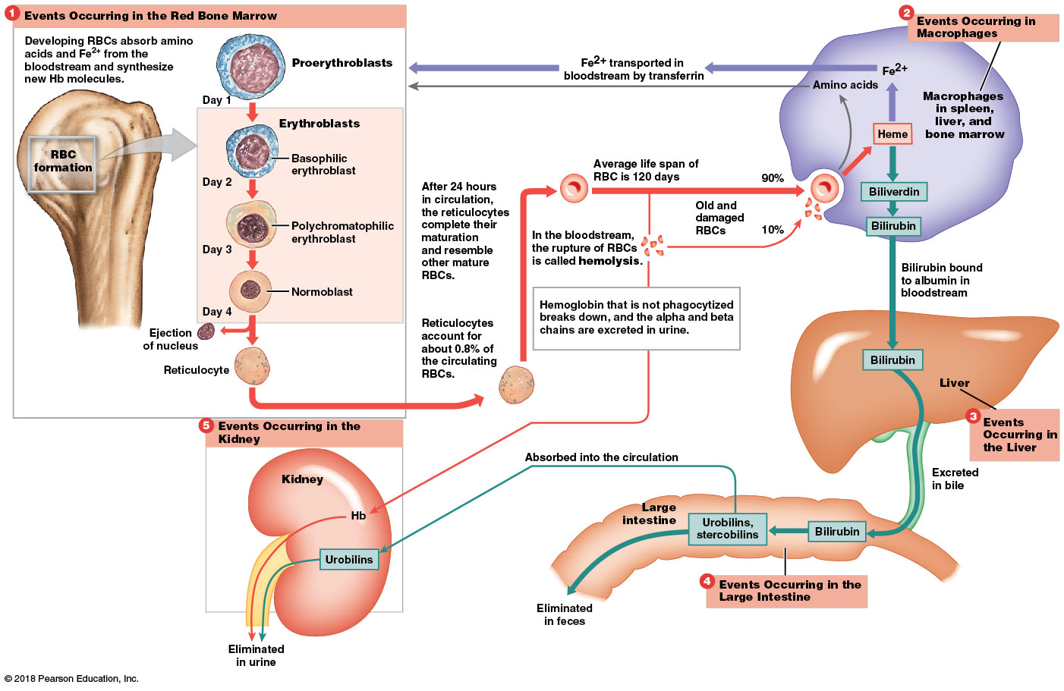
Summary of the production and clearance of RBCs
Notes:
Review the whole sequence of events by showing students where to begin and how to follow the numbers around the image.

Slide 62
Module 17.6: Review
In what way would a liver disease affect the level of bilirubin in the blood?
Learning Outcome: Describe how the components of aged or damaged red blood cells are recycled.

Slide 63
Module 17.7: Blood type is determined by the presence or absence of specific surface antigens on RBCs
Blood types
Antigens = substances that can elicit immune response
Our cells have surface antigens embedded in their plasma membranes; recognized as normal, or self, by immune system
Notes:
Additional Resource: PhysioEx 9.1, Ex. 11—Blood Analysis 4—Blood Typing.

Slide 64
Module 17.7: Blood type
Blood types (continued)
Blood type determined genetically by which surface antigens are present in RBC plasma membranes
>50 blood cell surface antigens
Three most important:
A
B
Rh (or D)
Notes:
Additional Resource: PhysioEx 9.1, Ex. 11—Blood Analysis 4—Blood Typing.

Slide 65
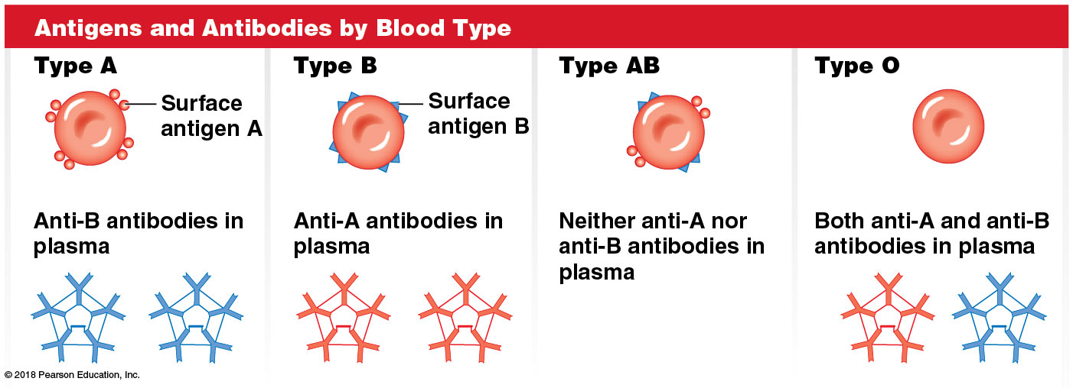
Module 17.7: Blood type
ABO blood group
Based on the presence or absence of A and B surface antigens (or agglutinogens)
Plasma has antibodies that will attack “foreign” surface antigen(s)
Four ABO blood types
Notes:
Students often confuse antigens and antibodies. Stress that antigens are on the cells, but antibodies are carried in the blood plasma.

Slide 66
Module 17.7: Blood type
Agglutination = clumping together of RBCs
Occurs when surface antigens (agglutinogens) are exposed to corresponding antibodies (agglutinins) from another blood type
Example: Giving type A blood to someone who is type B

Slide 67
Module 17.7: Blood type
Agglutination (continued)
Called a cross-reaction
Forms dangerous clumps/fragments of RBCs; can block small blood vessels—cuts blood supply, damages/destroys tissues
Cells may undergo hemolysis

Slide 68
Module 17.7: Blood type
Rh blood group
Based on presence or absence of Rh surface antigen on RBCs
“Rh” comes from original discovery in Rhesus monkeys
Rh positive (Rh⁺) has Rh surface antigen
Indicates presence of Rh surface antigen
Rh negative (Rh–) lacks Rh surface antigen
Included in full blood type as + or –
Examples: O negative (O–), AB positive (AB⁺)

Slide 69
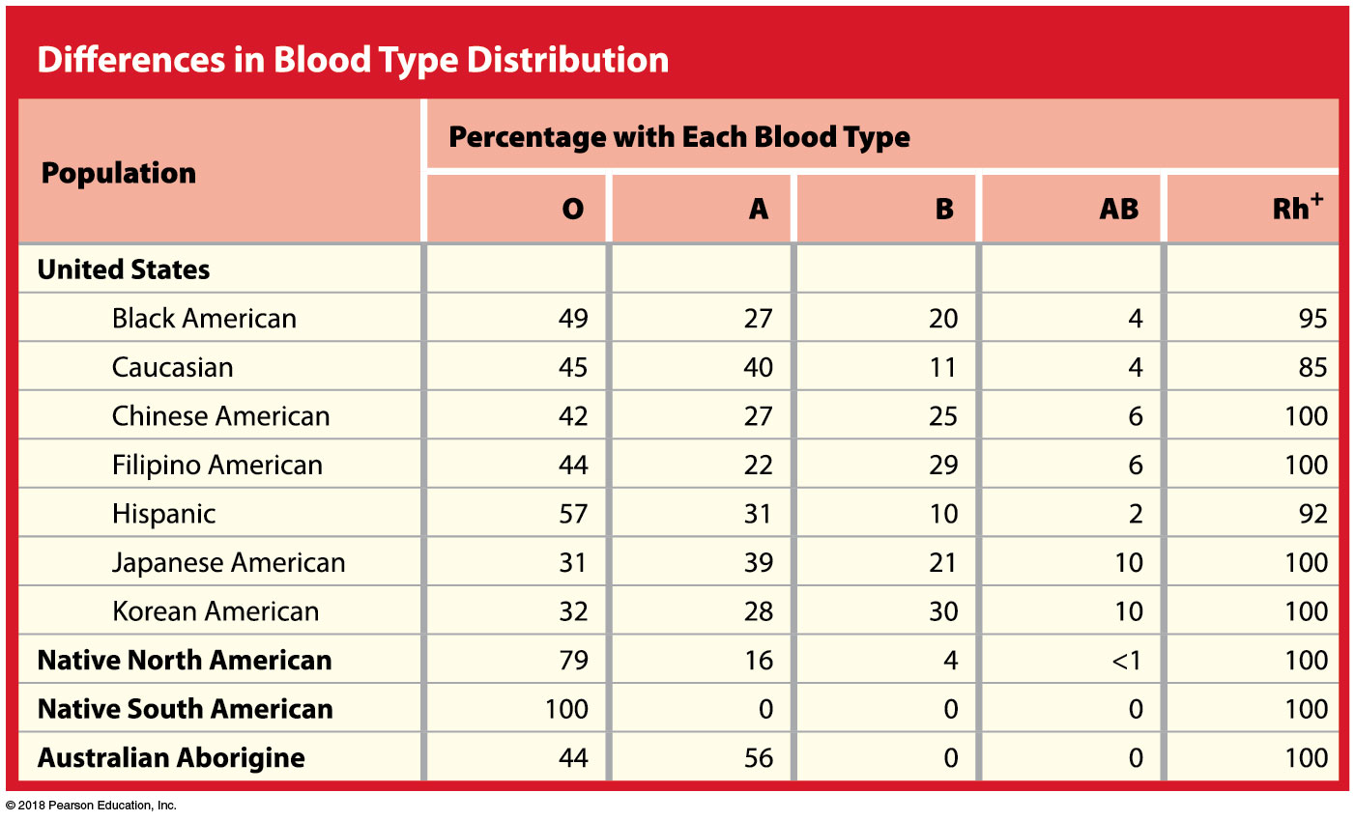

Slide 70
Module 17.7: Blood type
Blood typing tests
Drops of person’s blood are mixed with solutions containing antibodies to surface antigens A, B, and Rh
Clumping (agglutination) occurs where sample contains the corresponding antigen
Example: Type A blood will clump with anti-A antibodies
Typing is necessary to avoid transfusion reactions (cross-reactions occurring from transfusing mismatched blood)
Donor and recipient blood types must be compatible (will not cross-react)
Notes:
Spend some time on this. Students get used to thinking of which blood type contains which antibodies, and then have difficulty letting go of that to understand how reaction of the blood with anti-A antibodies means the person is Type A. They often default to what they memorized—Type B individuals have anti-A—and wrongly conclude that reaction of anti-A antibodies means it is Type B blood.

Slide 71
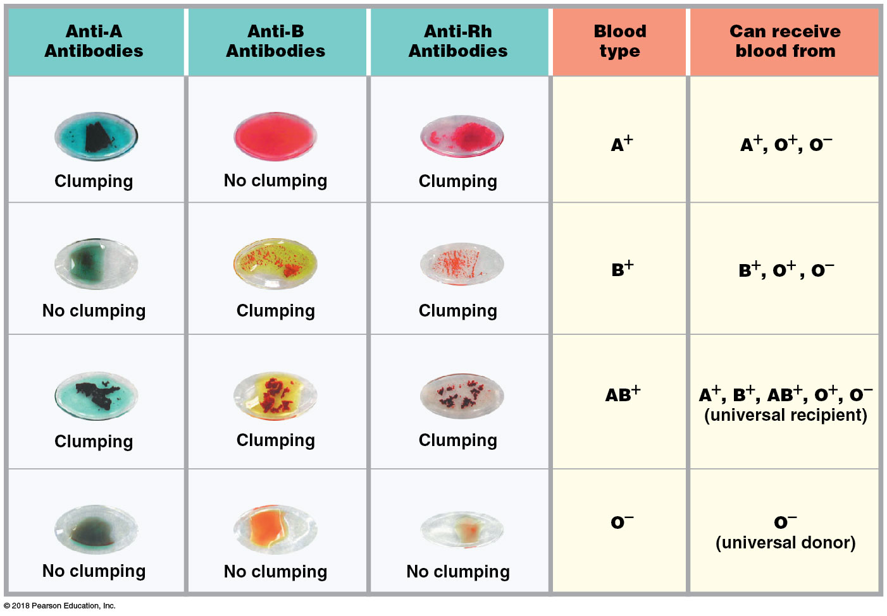
Results of blood typing tests
Notes:
Have students explain what is meant by universal donor and universal recipient and why those terms are used for Type O and Type AB, respectively. Stress that the most critical factor is that the recipient’s antibodies must be compatible with the donor’s antigens.

Slide 72
Module 17.7: Blood type
Genetics of blood type
Presence of anti-A and/or anti-B antibodies is genetically determined
Exposure to foreign RBCs not needed to develop the antibodies
Anti-Rh antibodies are not automatically present
Rh-negative person will not have any anti-Rh antibodies until exposed to Rh-positive RBCs (sensitized); then develops anti-Rh antibodies

Slide 73
Module 17.7: Review
What is determined by the surface antigens on RBCs?
What is the most common blood type in the United States?
Which blood type(s) can be safely transfused into a person with type O⁻ blood?
Why can’t a person with type A blood safely receive blood from a person with type B blood?
Learning Outcome: Explain the importance of blood typing and the basis for ABO and Rh incompatibilities.

Slide 74
Module 17.8: Clinical Module: Hemolytic disease of the newborn is an RBC-related disorder caused by a cross-reaction between fetal and maternal blood types
Background
Blood type is determined by combining genes from both parents
Child can have blood type different from either parent
During pregnancy, mother’s antibodies may cross the placenta and attack/destroy fetal RBCs.
Condition is hemolytic diseases of the newborn (HDN)
Many forms—some very dangerous, others undetectable

Slide 75
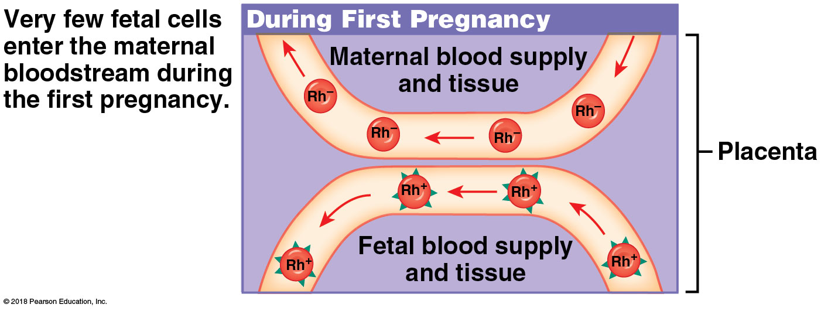
Module 17.8: Hemolytic disease of the newborn
Most common involves Rh– mother who has carried Rh⁺ fetus
First pregnancy—rarely poses a problem because fetal cells are mostly isolated from maternal blood—mom’s immune system is not stimulated to produce anti-Rh antibodies

Slide 76
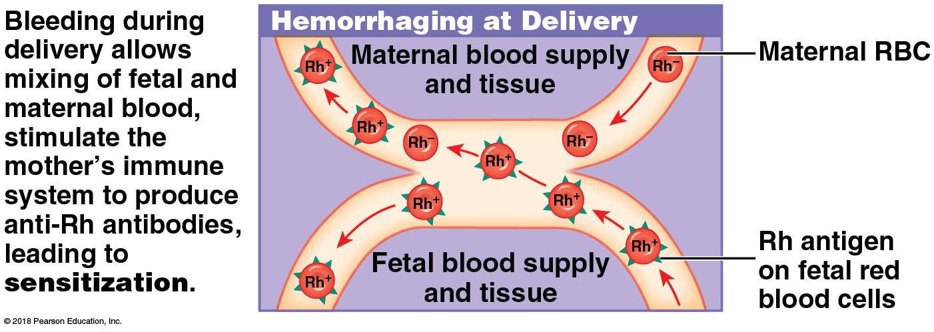
Module 17.8: Hemolytic disease of the newborn
Birth: bleeding at placenta/uterus mixes fetal and maternal blood
Mother exposed to Rh antigens; stimulates her immune system to produce anti-Rh antibodies (= sensitization)
~20 percent of Rh– mothers who carried Rh⁺ children are sensitized within 6 months of delivery, but first child usually not affected (antibodies develop after delivery)

Slide 77
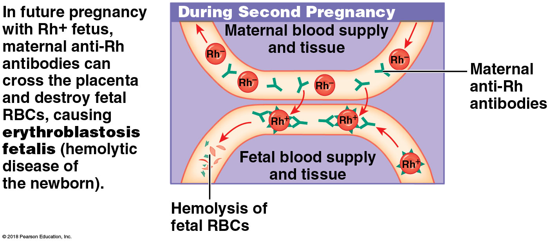
Module 17.8: Hemolytic disease of the newborn
Subsequent pregnancy with Rh⁺ fetus:
Maternal anti-Rh antibodies can cross placenta; destroy fetal RBCs, causing severe anemia
Fetal demand for RBCs increases; erythroblasts enter bloodstream before maturity—leads to alternative name, erythroblastosis fetalis
High fatality rate without treatment
Newborn with severe HDN is anemic/jaundiced (from high bilirubin concentrations)

Slide 78
Module 17.8: Hemolytic disease of the newborn
Maternal antibodies remain active 1–2 months after delivery
May require replacement of infant’s entire blood volume
HDN can be prevented by giving mother anti-Rh antibodies (RhoGAM) at weeks 26–28 of pregnancy and during/after delivery
The antibodies destroy fetal RBCs that crossed placenta before RBCs stimulate maternal immune response (= no sensitization)

Slide 79
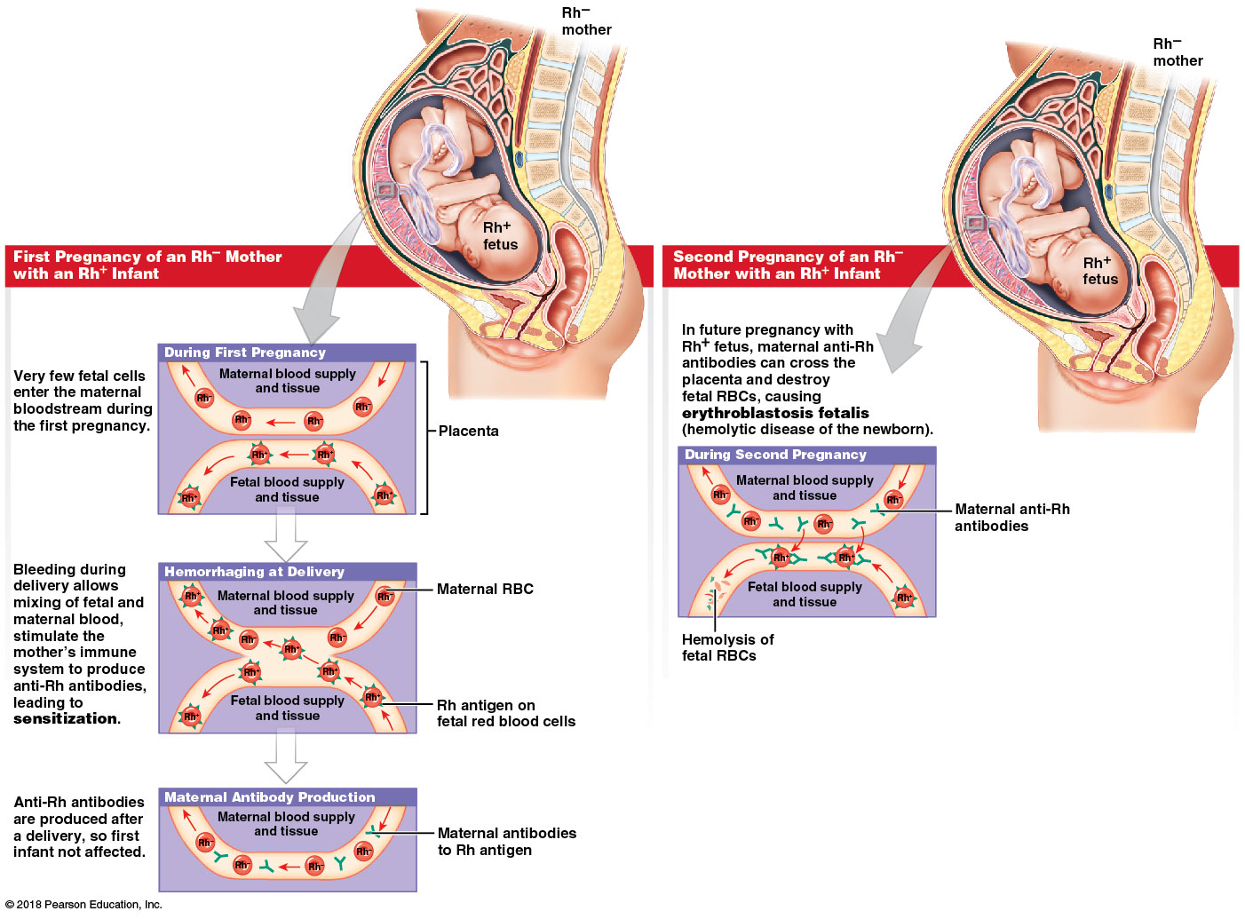
Overview of hemolytic disease of the newborn

Slide 80
Module 17.8: Review
Define hemolytic disease of the newborn (HDN).
Why is RhoGAM administered to pregnant Rh– women?
Does an Rh⁺ mother carrying an Rh– fetus require a RhoGAM injection? Explain your answer.
Learning Outcome: Describe hemolytic disease of the newborn, explain the clinical significance of the cross-reaction between fetal and maternal blood types, and cite preventive measures.

Slide 81
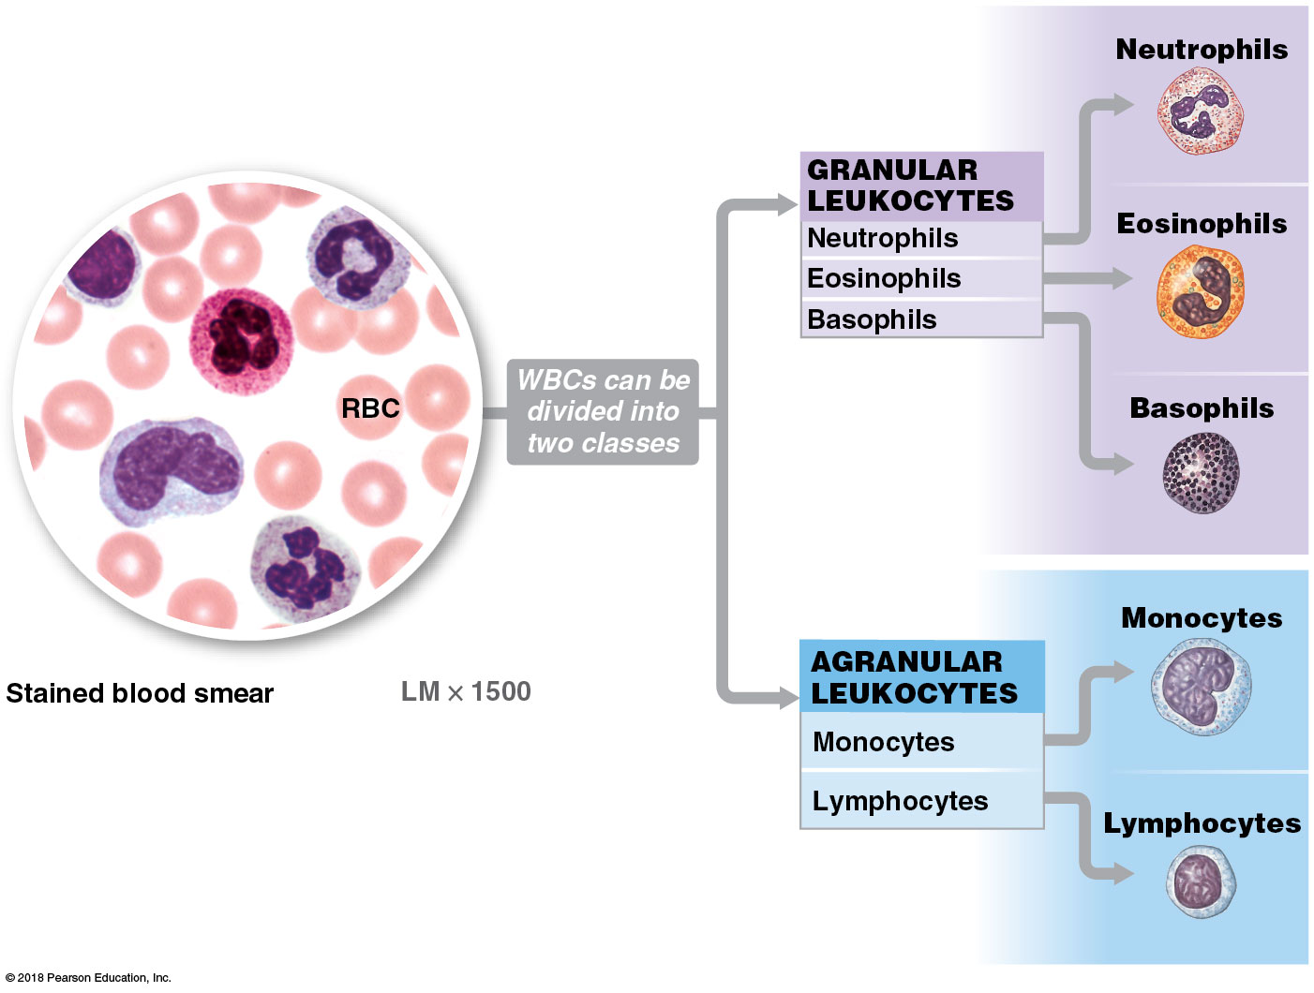
Module 17.9: The various types of white blood cells contribute to the body’s defenses
White blood cells (WBCs), or leukocytes
Have nuclei and other organelles, unlike RBCs, but no hemoglobin
Five types—“Never Let Monkeys Eat Bananas”
​Neutrophils
​Lymphocytes
​Monocytes
​Eosinophils
​Basophils
Notes:
Additional Resource: PAL 3.0—Cardiovascular System.

Slide 83
Module 17.9: White blood cells
White blood cells (continued)
Shared properties
Spend only a short time in circulation
Mostly located in loose and dense connective tissues where infections often occur
Can migrate out of bloodstream
Contact and adhere to vessel walls near infection site
Squeeze between adjacent endothelial cells
Process called emigration or diapedesis (dia, through + pedesis, a leaping)

Slide 84
Module 17.9: White blood cells
White blood cells (continued)
Shared properties (continued)
Are attracted to chemical stimuli
Characteristic called positive chemotaxis
Guides WBCs to pathogens, damaged tissues, or other active WBCs
Neutrophils, eosinophils, and monocytes are capable of phagocytosis
Engulf pathogens, cell debris, or other material
Macrophages are monocytes that have moved out of the bloodstream

Slide 85
Module 17.9: White blood cells
White blood cell counts
On average blood contains 7000 WBCs per µL
Number can be increased in response to infection, inflammation, or allergic responses
Differential count
Indicates number of each type of WBC in a sample
Reported as percentage (per 100 WBCs)

Slide 86
Module 17.9: White blood cells
Two classes of white blood cells
​Granular leukocytes, or granulocytes
Abundant cytoplasmic granules (secretory vesicles and lysosomes) that absorb histological stains
​Agranular leukocytes, or agranulocytes—smaller secretory vesicles/ lysosomes that don’t absorb stains

Slide 87
Module 17.9: White blood cells
Granular leukocytes or granulocytes
Have abundant cytoplasmic granules that absorb histological stains (so are visible under the microscope)
Neutrophils
50–70 percent of leukocytes
Eosinophils
2–4 percent of leukocytes
Basophils
<1 percent of leukocytes

Slide 88
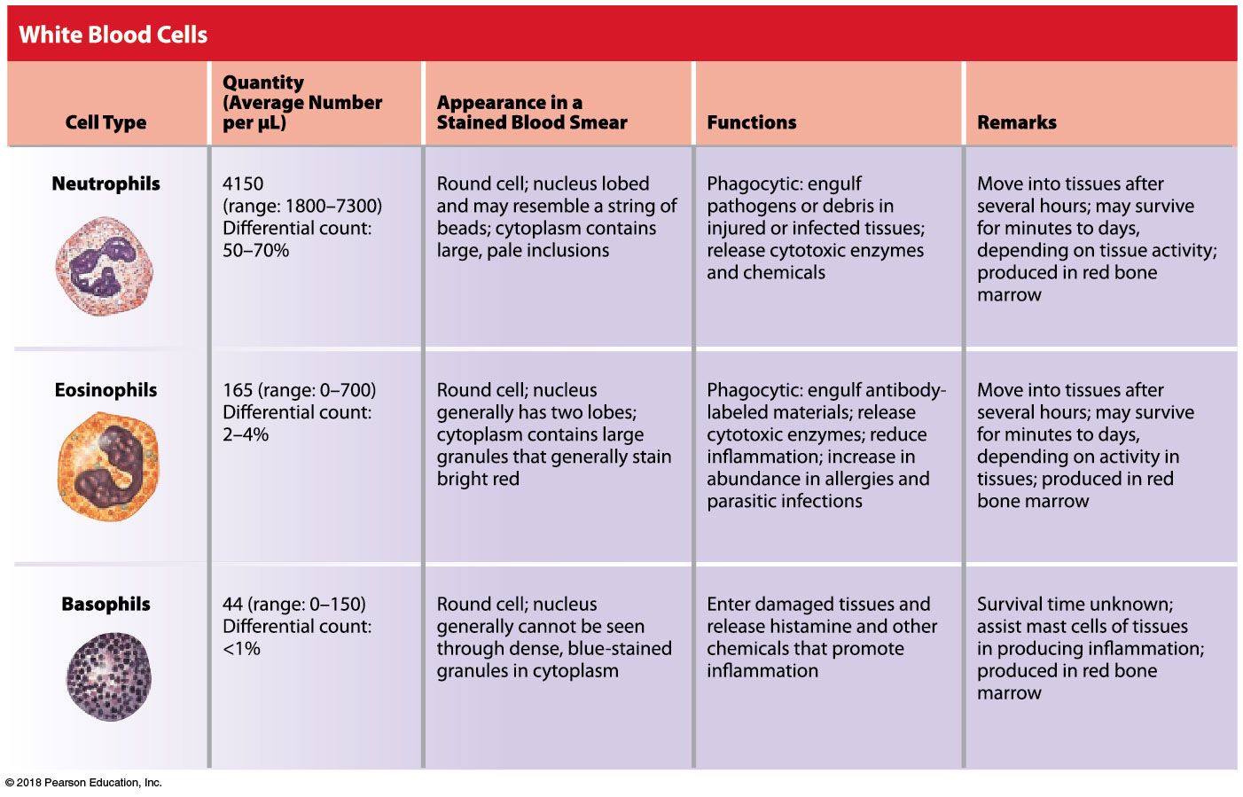
The granular leukocytes are neutrophils, eosinophils, and basophils

Slide 89
Module 17.9: White blood cells
Agranular leukocytes or agranulocytes
Contain few, if any, cytoplasmic granules that absorb histological stain (so are not visible under the microscope)
Monocytes
2–8 percent of leukocytes
Lymphocytes
20–40 percent of leukocytes

Slide 90
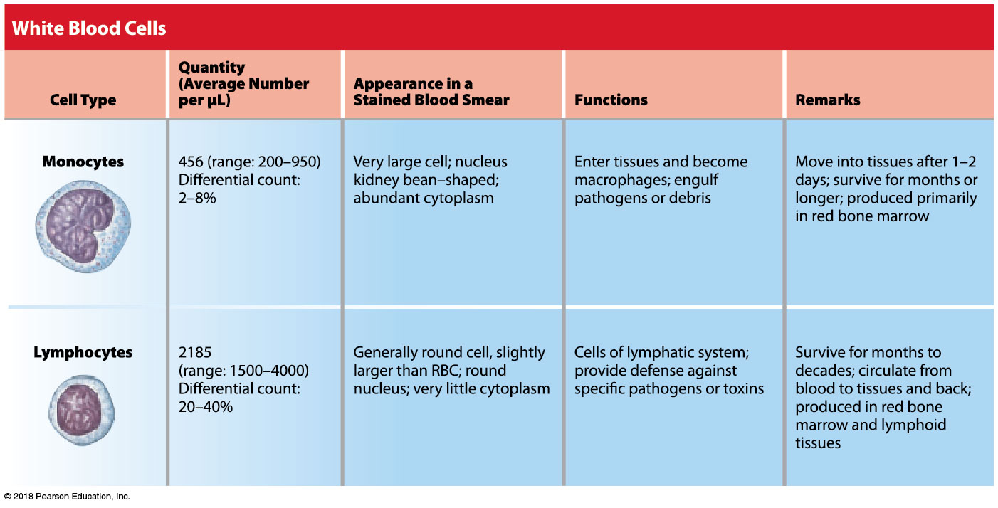
The agranular leukocytes are monocytes and lymphocytes

Slide 91
Module 17.9: Review
Identify the five types of white blood cells.
How do basophils respond to tissue damage?
Which type of white blood cell would you find in the greatest numbers in an infected cut?
Learning Outcome: Categorize the various types of white blood cells on the basis of their structures and functions.

Slide 92
Module 17.10: The clotting response is a complex cascade of events that reduces blood loss
Hemostasis (haima, blood + stasis, halt)
Process responsible for stopping blood loss through walls of damaged blood vessels
Establishes framework for tissue repairs
Three Phases
​Vascular phase
​Platelet phase
​Coagulation phase

Slide 93
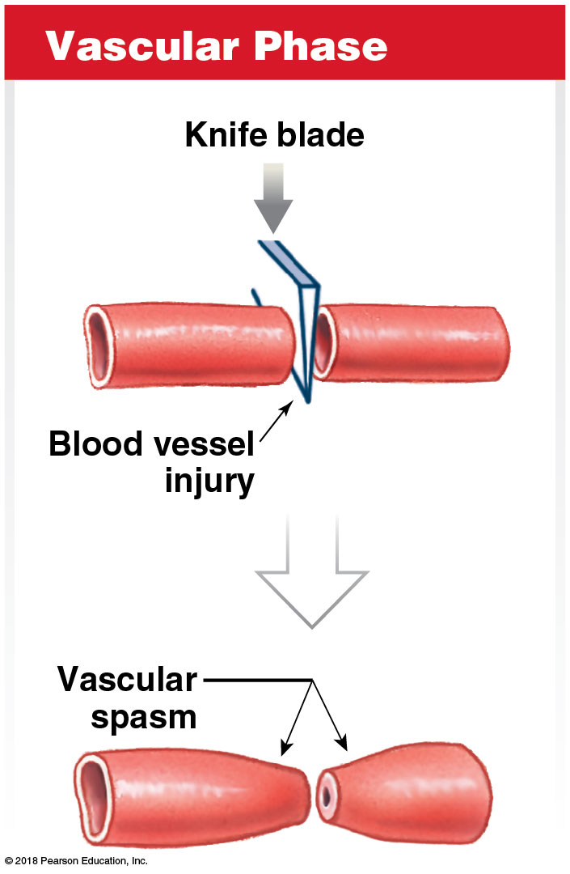
Module 17.10: Hemostasis
Vascular phase of hemostasis
Lasts ~30 minutes after injury
Dominated by endothelial response and vascular spasm (smooth muscle contracts)
Exposed endothelium in contact with blood; releases chemicals/local hormones

Slide 94
Module 17.10: Hemostasis
Vascular phase of hemostasis (continued)
Endothelial cells release chemicals and local hormones, including endothelins:
Cause smooth muscle contraction; promote vascular spasms
Stimulate division of endothelial cells, smooth muscle cells, fibroblasts for repair
Endothelial plasma membranes become “sticky”

Slide 95
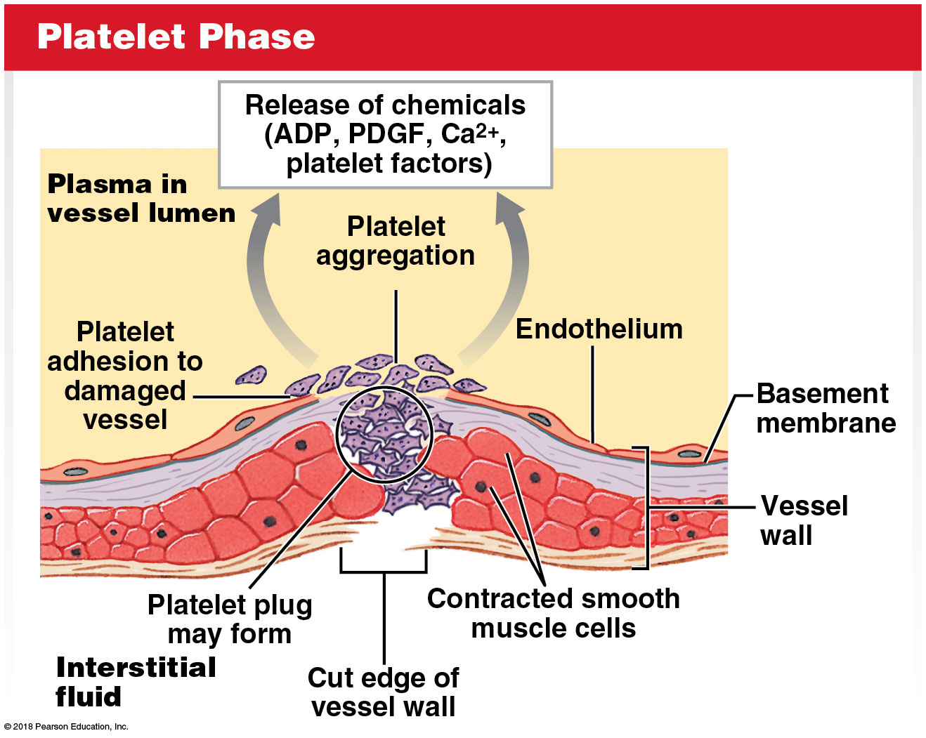
Module 17.10: Hemostasis
Platelet phase of hemostasis
Begins with attachment of platelets to sticky endothelial surfaces, basement membrane, exposed collagen fibers, and other platelets

Slide 96
Module 17.10: Hemostasis
Chemicals released by platelets:
Adenosine diphosphate (ADP) stimulates platelet aggregation and secretion
Chemicals that stimulate vascular spasms (smooth muscle contraction)
Platelet factors—proteins that play role in clotting
Platelet-derived growth factor (PDGF)—promotes vessel repair
Calcium ions—required for platelet aggregation and clotting process

Slide 97
Module 17.10: Hemostasis
Coagulation phase of hemostasis
Starts 30 seconds or more after damage
Coagulation (blood clotting) involves complex sequence of steps leading to conversion of circulating fibrinogen to insoluble fibrin
Blood cells and platelets are trapped in fibrin network (blood clot)
Notes:
Point out the fibrin threads and how they act like a net and catch RBCs.

Slide 98
Module 17.10: Hemostasis
Coagulation phase of hemostasis (continued)
Procoagulants (clotting factors) play a key role
Calcium and 11 different proteins (I–XI)
Many are proenzymes (inactive)
Activated enzymes lead to chain reaction (cascade)
Notes:
Point out the fibrin threads and how they act like a net and catch RBCs.

Slide 99
Module 17.10: Hemostasis
Coagulation phase of hemostasis (continued)
Two pathways lead to common pathway—extrinsic and intrinsic
​Extrinsic pathway
Begins with release of tissue factor (factor III) from damaged endothelial cells or peripheral tissues
Tissue factor combines with Ca²⁺ and another clotting factor to activate factor X (first step in common pathway)

Slide 100
Module 17.10: Hemostasis
Coagulation phase of hemostasis (continued)
Two pathways (continued)
​Intrinsic pathway
Begins with activation of proenzymes exposed to collagen fibers at injury site
Pathway proceeds with assistance of PF-3 (factor released by aggregating platelets)
Sequence of enzyme activations leads to factor X

Slide 101
Module 17.10: Hemostasis
Coagulation phase of hemostasis (continued)
Common pathway
Activated factor X activates prothrombin activator, a complex that converts the prothrombin (a proenzyme) to the enzyme thrombin
Thrombin converts fibrinogen to fibrin
Completes clotting process
Clot retraction
RBCs and platelets stick to the fibrin threads
Platelets contract to form tighter clot and pull edges together
Continues for 30–60 minutes

Slide 102
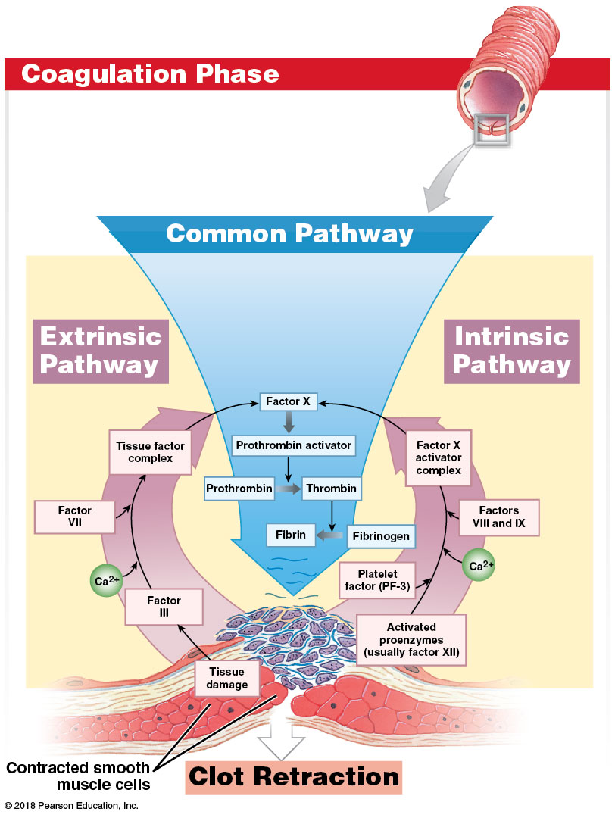
Notes:
This is a complex illustration. Take time to walk students through it so they know how to read it.

Slide 103
Module 17.10: Hemostasis
Fibrinolysis
Process of clot dissolving
Begins with activation of:
Plasminogen by thrombin (from common pathway)
Tissue plasminogen activator, or t-PA, from damaged tissues
Produces plasmin—erodes the clot

Slide 104
Module 17.10: Review
Define hemostasis.
Briefly describe the vascular, platelet, and coagulation phases of hemostasis.
Describe the events that follow the coagulation phase.
Learning Outcome: Discuss the mechanisms that control blood loss after an injury, and describe the reaction sequences responsible for blood clotting.

Slide 105
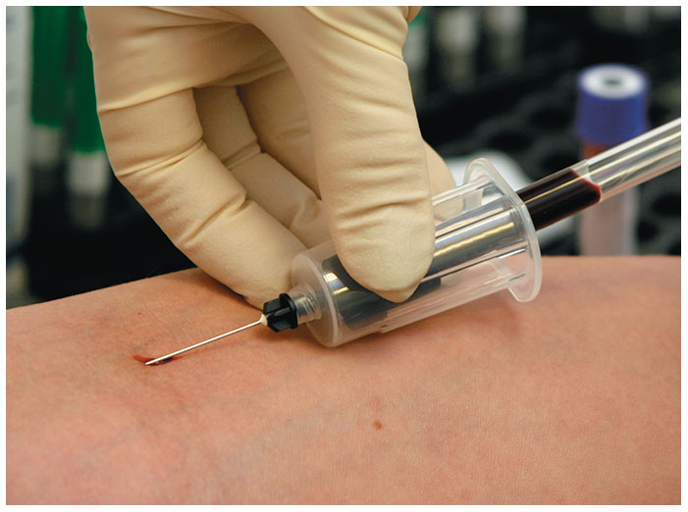
Module 17.11: Blood disorders can be classified by their origins and the changes in blood characteristics
Obtaining blood for diagnosis
Venipuncture (vena, vein + punctura, a piercing)
Withdrawal of whole blood from superficial vein, such as median cubital vein

Slide 106
Module 17.11: Blood disorders
Obtaining blood for diagnosis (continued)
Commonly used because:
Easy to locate superficial veins
Vein walls are thinner than walls of comparable arteries
Venous blood pressure is relatively low, so vein seals quickly

Slide 107
Module 17.11: Blood disorders
Nutritional blood disorders
Iron deficiency anemia
Insufficient iron intake (needed to form functional hemoglobin)
Resulting RBCs are small (microcytic); transport less oxygen
More common in women—iron reserves approximately half the reserves of a typical man

Slide 108
Module 17.11: Blood disorders
Nutritional blood disorders (continued)
Pernicious anemia
Vitamin B₁₂ deficiency prevents normal stem cell divisions
Fewer RBCs produced; often misshaped, large (macrocytic)
Can be from lack of intrinsic factor—secreted in stomach; needed for vitamin B₁₂ absorption
Ca²⁺ and vitamin K deficiencies
Calcium is required for all clotting pathways
Vitamin K is required by liver to synthesize clotting factors

Slide 109
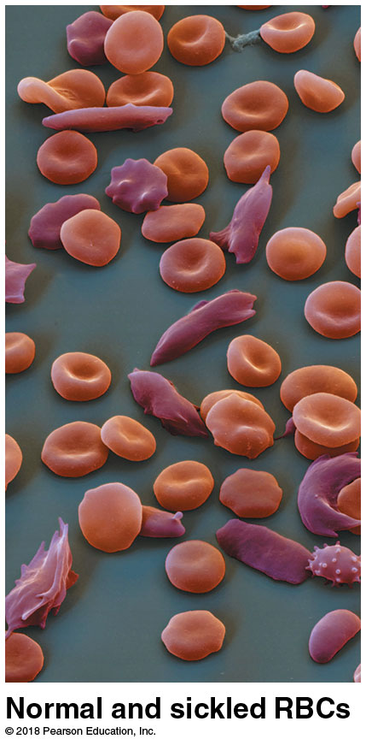
Module 17.11: Blood disorders
Congenital blood disorders
Sickle cell disease (SDC)—group of inherited RBC disorders
Genetic mutation affects amino acid sequence of the beta globin subunit in hemoglobin
RBCs take on sickle shape when they release oxygen
RBCs more fragile, easily damaged
Can get stuck in smaller vessels, block flow

Slide 110
Module 17.11: Blood disorders
Congenital blood disorders (continued)
Sickle cell anemia—most severe type of sickle cell disease
Requires two copies of the sickling gene
People with one copy have the sickling trait, but not disorder
Having the trait increases person’s resistance to malaria
Infected RBCs sickle
Sickled cells are destroyed by macrophages—malarial pathogen destroyed with infected cells

Slide 111
Module 17.11: Blood disorders
Congenital blood disorders (continued)
Hemophilia—Inherited bleeding disorder
Affects 1 person in 10,000; ~80–90 percent are males
Caused by missing or reduced production of a clotting factor
Severity of disorder varies
In severe cases, extensive bleeding occurs with minor contact
Bleeding also occurs at joints and around muscles

Slide 112
Module 17.11: Blood disorders
Congenital blood disorders (continued)
Thalassemias—diverse group of inherited disorders
Unable to adequately produce normal Hb protein subunits
Severity depends on which/how many subunits are abnormal

Slide 113
Module 17.11: Blood disorders
Blood infections
Caused by pathogens entering the blood through wound or infection
Bacteremia—bacteria circulate in blood, do not multiply there
Viremia—viruses circulating in blood, but not multiplying there

Slide 114
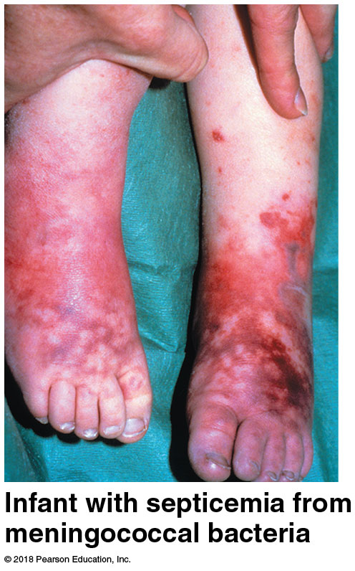
Module 17.11: Blood disorders
Blood infections (continued)
Sepsis
Widespread infection of body tissue
Septicemia
Sepsis of the blood (“blood poisoning”)
Pathogens present, multiplying in blood, and spreading

Slide 115
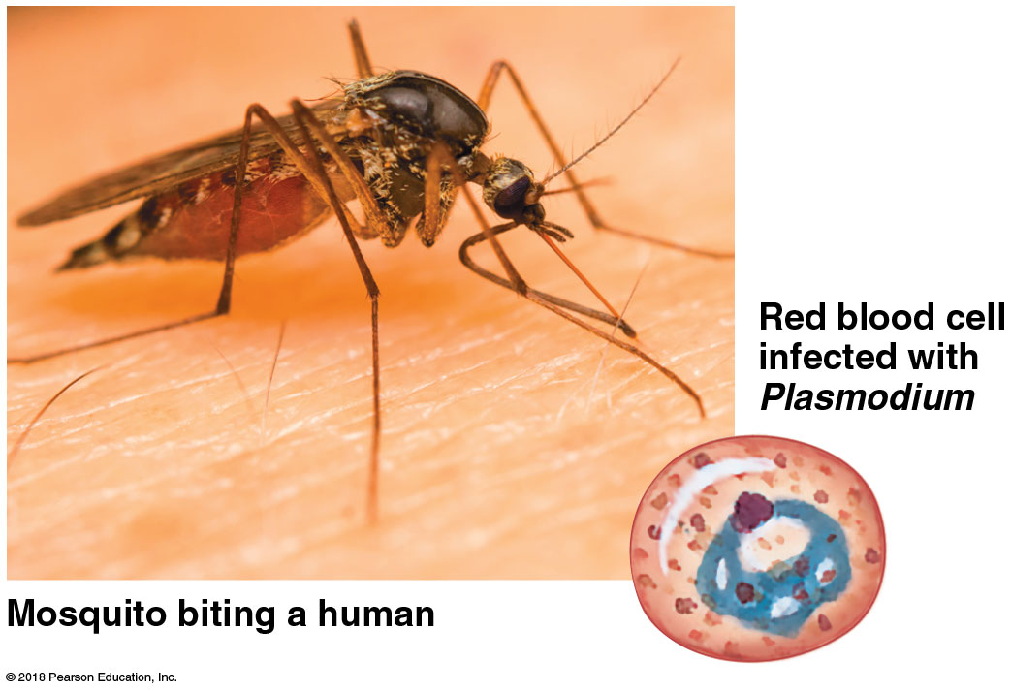
Module 17.11: Blood disorders
Blood infections (continued)
Malaria—parasitic disease caused by several species of Plasmodium
Kills 1.5–3 million people per year (up to half are under age 5)
Transmitted by mosquito
Initially infects liver; later infects RBCs
Every 2–3 days, all infected RBCs rupture, release more parasites
Causes cycles of fever/ chills; dead RBCs block vessels to vital organs

Slide 116
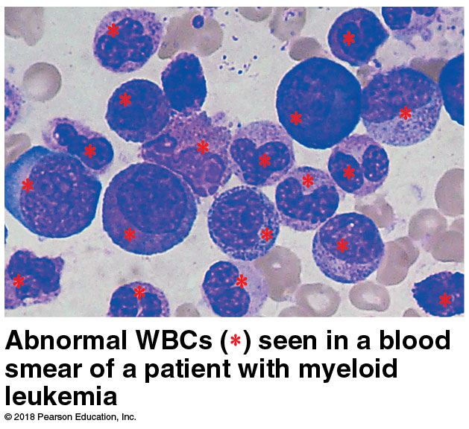
Module 17.11: Blood disorders
Blood cell cancers
Leukemias—cancers of blood-forming tissues
Cancerous cells spread from origin in red bone marrow
First symptoms appear with presence of immature and abnormal WBCs in circulation
Fatal if untreated
Two types
Myeloid leukemia
Lymphoid leukemia
Both have elevated WBCs

Slide 117
Module 17.11: Blood disorders
Degenerative blood disorders
Disseminated intravascular coagulation (DIC)
Bacterial toxins activate steps in coagulation process
Converts too much fibrinogen to fibrin; small clots may block small vessels and damage nearby tissue
Phagocytes and plasmin work to remove fibrin
Liver tries to maintain adequate fibrinogen levels; if cannot keep up, uncontrolled bleeding may occur

Slide 118
Module 17.11: Review
Compare pernicious anemia with iron deficiency anemia.
Identify the two types of leukemia.
Explain why venipuncture is a common clinical procedure for obtaining blood for examination.
Learning Outcome: Explain how blood disorders are detected, and describe examples of the various categories of blood disorders.

