Slide 2
Note to the Instructor:
For the third edition of Visual Anatomy & Physiology, we have updated our PowerPoints to fully integrate text and art. The pedagogy now more closely matches that of the textbook. The goal of this revised formatting is to help your students learn from the art more effectively. However, you will notice that the labels on the embedded PowerPoint art are not editable. You can easily import editable art by doing the following:
Copying slides from one slide set into another
You can easily copy the Label Edit art into the Lecture Presentations by using either the PowerPoint Slide Finder dialog box or Slide Sorter view. Using the Slide Finder dialog box allows you to explicitly retain the source formatting of the slides you insert.
Using the Slide Finder dialog box in PowerPoint:
Open the original slide set in PowerPoint.
On the Slides tab in Normal view, click the slide thumbnail that you want the copied slides to follow.
On the toolbar at the top of the window, click the drop down arrow on the New Slide tab. Select Reuse Slides.
Click Browse to look for the file; in the Browse dialog box, select the file, and then click Open.
If you want the new slides to keep their current formatting, in the Slide Finder dialog box, select the Keep source formatting checkbox. When this checkbox is cleared, the copied slides assume the formatting of the slide they are inserted after.
To insert selected slides: Click the slides you want to insert. Slides will place immediately after the slide you have selected in the Slides tab in Normal view.

Slide 3
Section 1: Structure of the Heart
Learning Outcomes
18.1 Describe the heart’s location, shape, its four chambers, and the pulmonary and systemic circuits.
18.2 Describe the location and general features of the heart.
18.3 Describe the structure of the pericardium and explain its functions, identify the layers of the heart wall, and describe the structures and functions of cardiac muscle.
18.4 Describe the cardiac chambers and the heart’s external anatomy.

Slide 4
Section 1: Structure of the Heart
Learning Outcomes (continued)
18.5 Describe the major vessels supplying the heart, and cite their locations.
18.6 Trace blood flow through the heart, identifying the major blood vessels, chambers, and heart valves.
18.7 Describe the relationship between the AV and semilunar valves during a heartbeat.
18.8 Clinical Module: Define arteriosclerosis, and explain its significance to health.

Slide 5
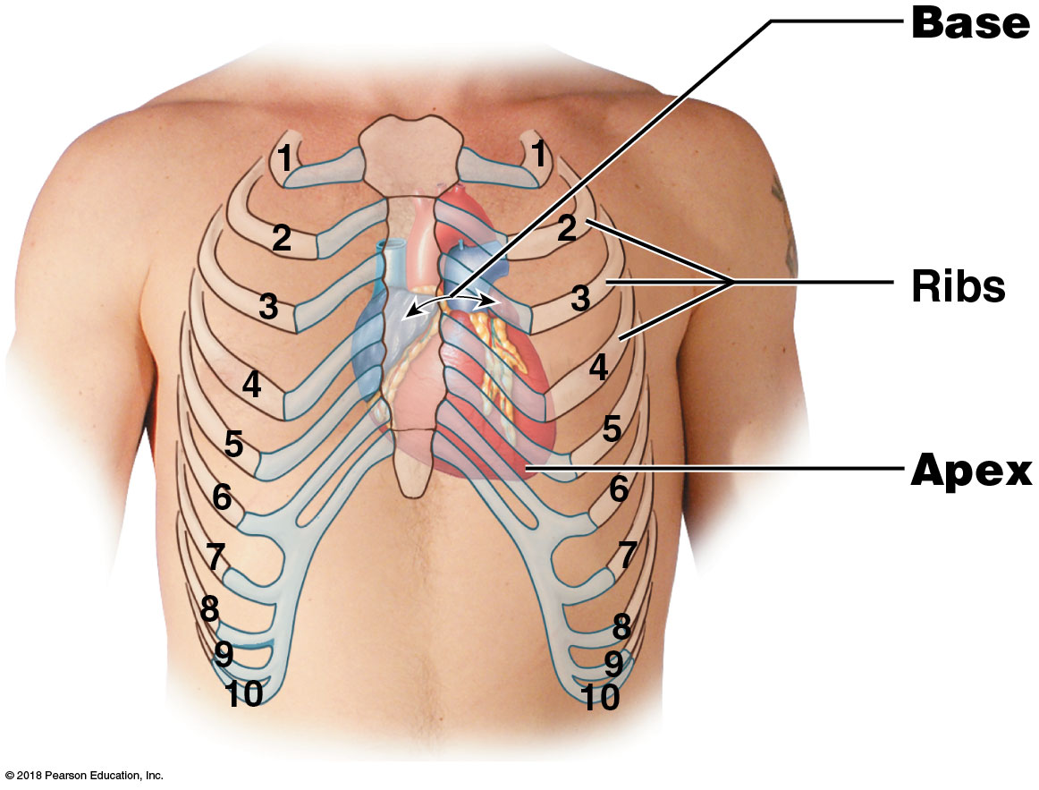
Module 18.1: The heart has four chambers that pump and circulate blood through the pulmonary and systemic circuits
Cardiovascular system = heart and blood vessels transporting blood
Heart—directly behind sternum
Base—superior
where major vessels are
~1.2 cm (0.5 in.) to left
3rd costal cartilage
Apex—inferior, pointed tip
~12.5 cm (5 in.) from base
~7.5 cm (3 in.) to left
5th intercostal space
Notes:
For heart anatomy, direct students to PAL 3.0—Cardiovascular.

Slide 6
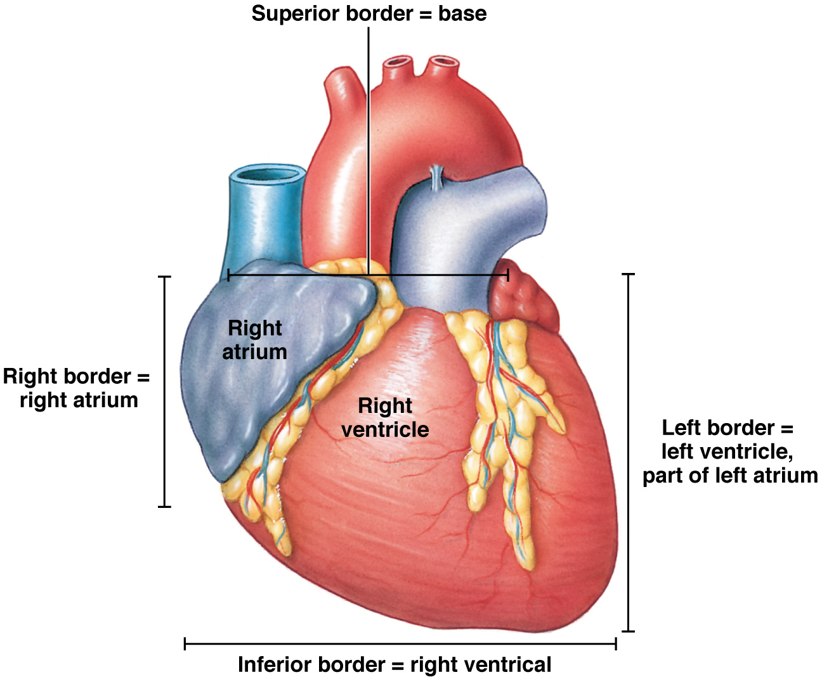
Borders of the heart

Slide 7
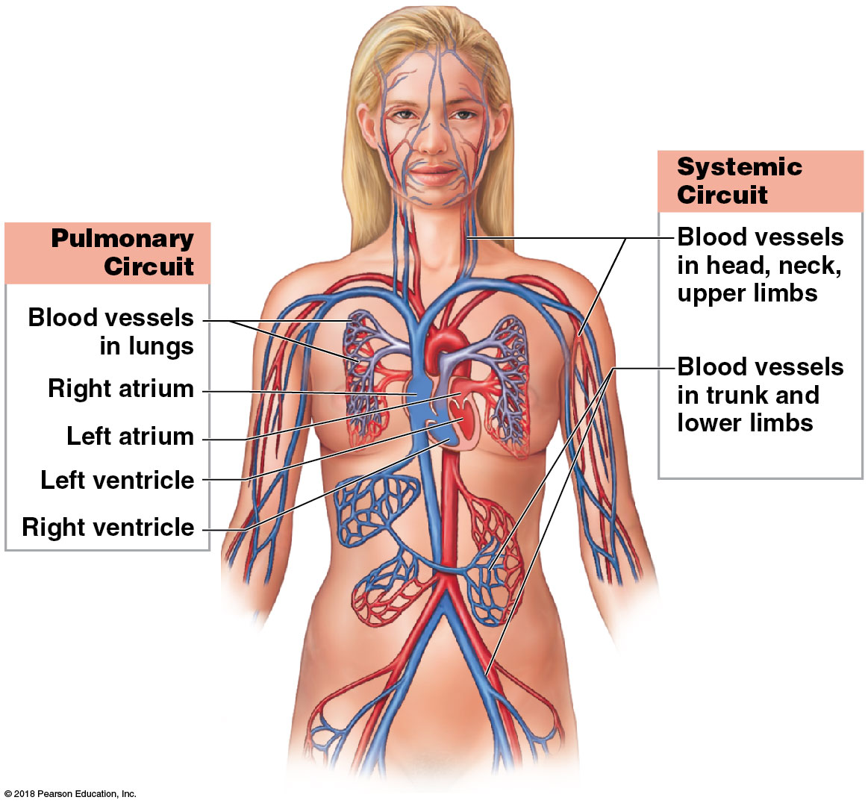
Module 18.1: Heart location and chambers
Heart = 2-sided pump with 4 chambers
Right atrium receives blood from systemic circuit
Right ventricle pumps blood into pulmonary circuit
Left atrium receives blood from pulmonary circuit
Left ventricle pumps blood into systemic circuit
Notes:
This is a good time to point out that the two sides of the heart function at the same time.

Slide 8
Module 18.1: Review
Describe the location and position of the heart.
Compare the base of the heart with the apex.
Name the four chambers of the heart.
Compare the volume of blood each circuit receives from contraction of the ventricles.
Learning Outcome: Describe the heart’s location, shape, its four chambers, and the pulmonary and systemic circuits.

Slide 9
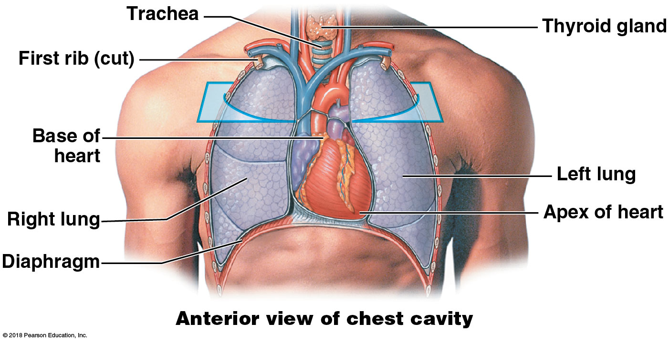
Module 18.2: The heart is located in the mediastinum and is enclosed by the pericardial cavity
Mediastinum = space or region in thorax between the two pleural cavities (between the lungs)
Notes:
The mediastinum is not labeled in the image so be sure to point it out.

Slide 10
Module 18.2: The pericardium
Pericardium = sac-like structure wrapped around heart
Fibrous pericardium: Outermost layer; dense fibrous tissue that extends to sternum and diaphragm
Serous pericardium (2 layers): Outer parietal layer lines fibrous pericardium; inner serous layer covers surface of the heart
Pericardial cavity: Space between serous layers; contains 15–50 mL of pericardial fluid secreted from serous membranes; lubricates movement of heart.
Notes:
Consider using a plastic bag to demonstrate the continuous serous pericardium. Students often think the two layers are separate.

Slide 11
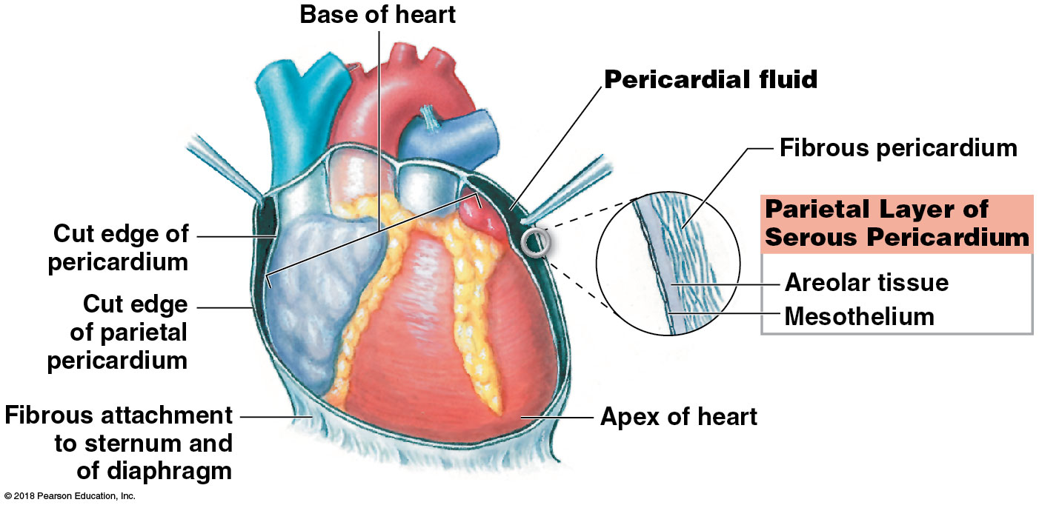
Module 18.2: The pericardium
Pericardium = sac-like structure wrapped around heart (continued)
Pericarditis = inflammation of the pericardium
Cardiac tamponade = excess accumulation of pericardial fluid
Notes:
Consider using a plastic bag to demonstrate the continuous serous pericardium. Students often think the two layers are separate.

Slide 12
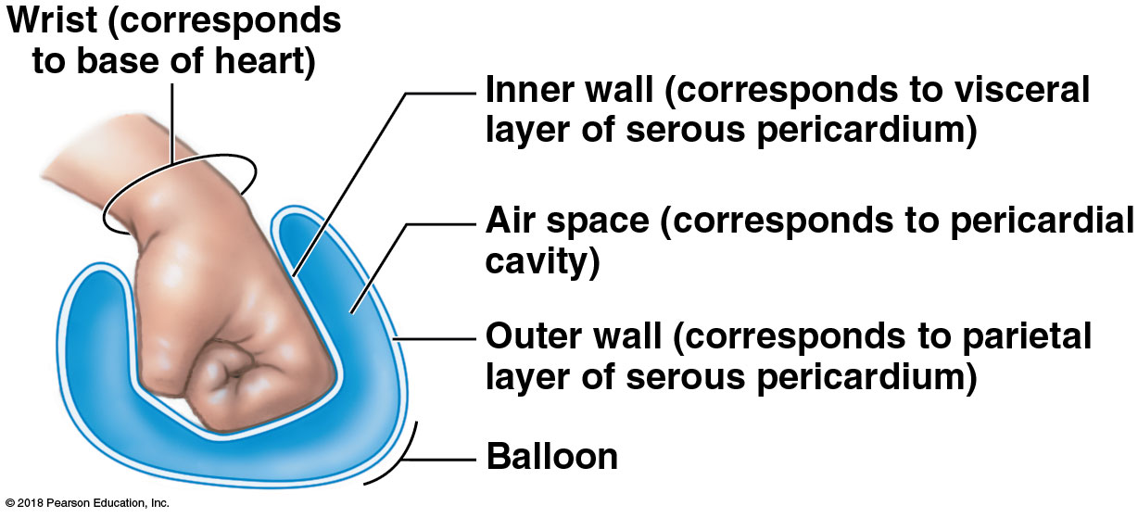
Module 18.2: The pericardium
Relationship between heart and pericardium
Push fist into partly inflated balloon
Fist = heart
Wrist = base of heart, with great vessels
Inside of balloon = pericardial cavity
Notes:
This demonstration shows the continuity of the two layers of the serous pericardium. Consider wrapping a paper towel around the outside of the balloon to represent the fibrous pericardium.

Slide 13
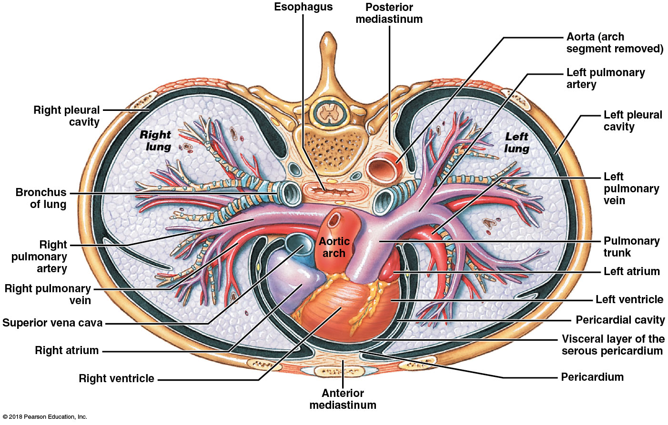
Module 18.2: The pericardium
Superior view of the thorax, showing the positions of the pericardium, pericardial cavity, heart, mediastinum, and three of the great vessels: aorta, superior vena cava, and pulmonary trunk.
Notes:
Be sure students understand the orientation of the image. Trace the layers of the pericardium to demonstrate their continuity.

Slide 14
Module 18.2: Review
Define mediastinum.
Describe the heart’s location in the body.
Why can cardiac tamponade be a life-threatening condition?
Learning Outcome: Describe the location and general features of the heart.

Slide 15
Module 18.3: The heart wall contains concentric layers of cardiac muscle tissue
Heart wall has 3 layers:
​Pericardium—outer fibrous pericardium (dense fibrous tissue) and 2-layered serous pericardium (mesothelium and underlying areolar tissue)
Epicardium = visceral layer of serous pericardium
​Myocardium—middle layer; concentric layers of cardiac muscle; supporting blood vessels, nerves
​Endocardium—(endo = within); innermost layer; simple squamous epithelium (renamed endothelium inside heart and vessels) and areolar tissue; endocardium is continuous with endothelium in vessels and covers heart valves
Notes:
The visceral pericardium (epicardium), unlike the parietal pericardium, is so adhered to the heart that it cannot be dissected away.

Slide 16
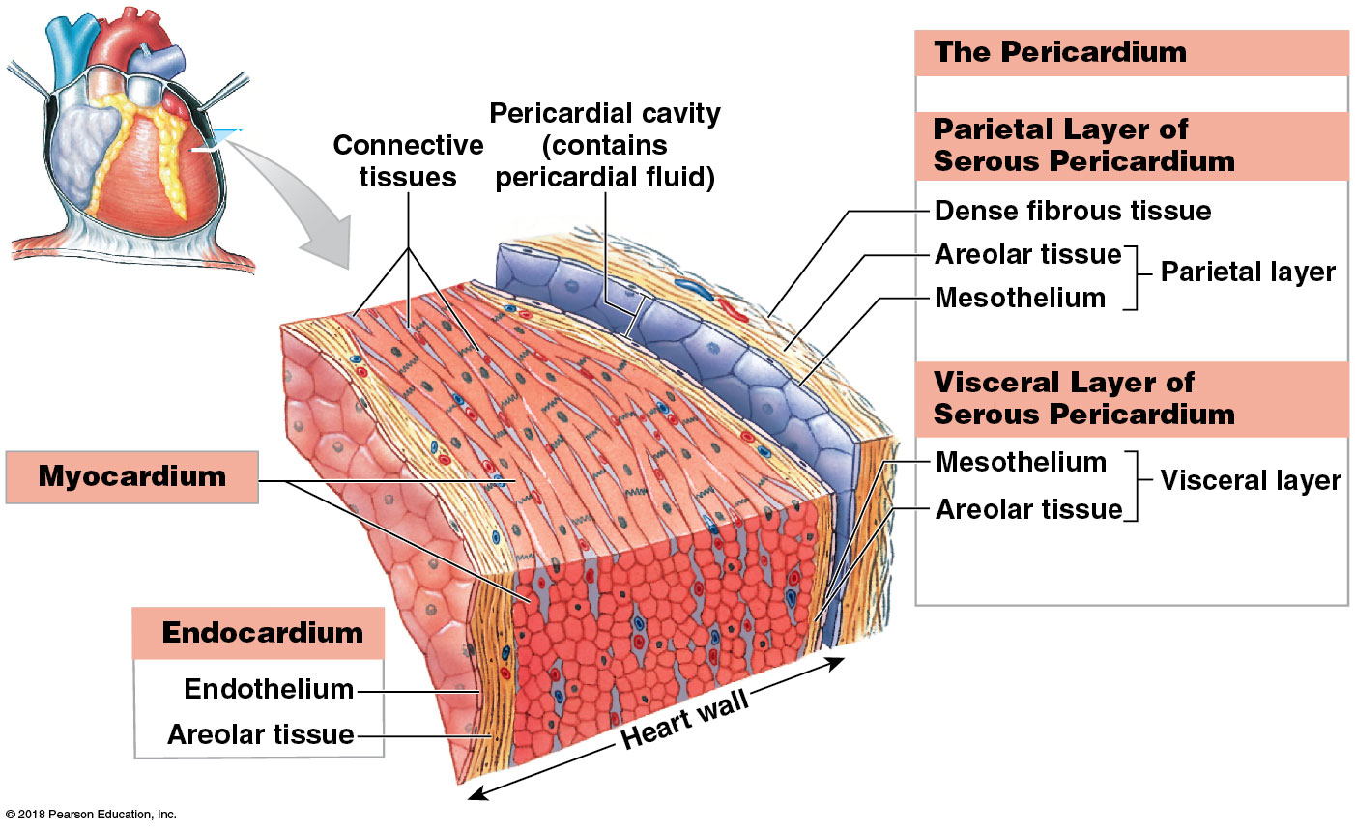
The layers of the heart wall

Slide 17
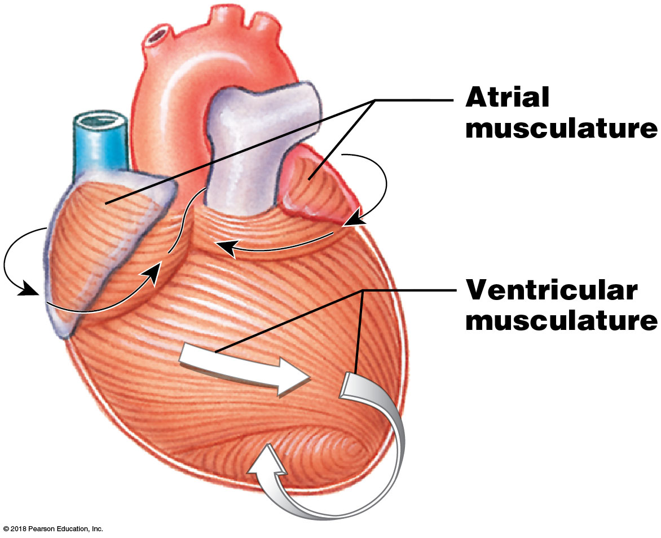
Module 18.3: The heart wall
Myocardium arrangement:
Atrial musculature wraps around atria in figure-8 pattern
Ventricular musculature
Superficial layer surrounds both ventricles
Deeper layers spiral around and between the ventricles

Slide 18
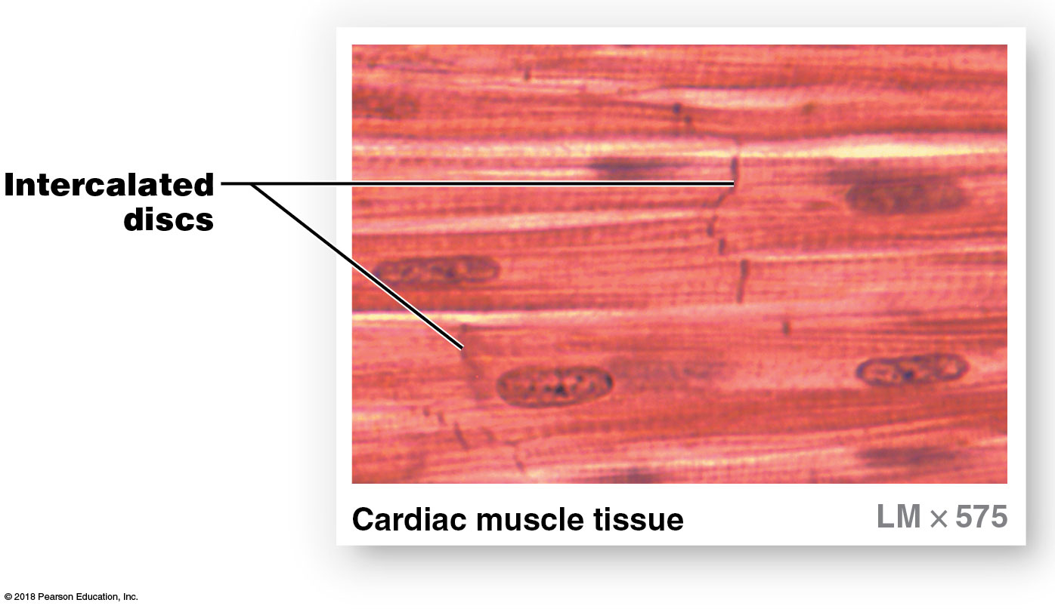
Module 18.3: The heart wall—cardiac muscle
Cardiac muscle vs. skeletal muscle:
Smaller cell size (avg. 10–20 μm diameter; 50–100 μm length)
Single, centrally located nucleus
​Intercalated discs = branching interconnections between cells
Specialized intercellular connections

Slide 19
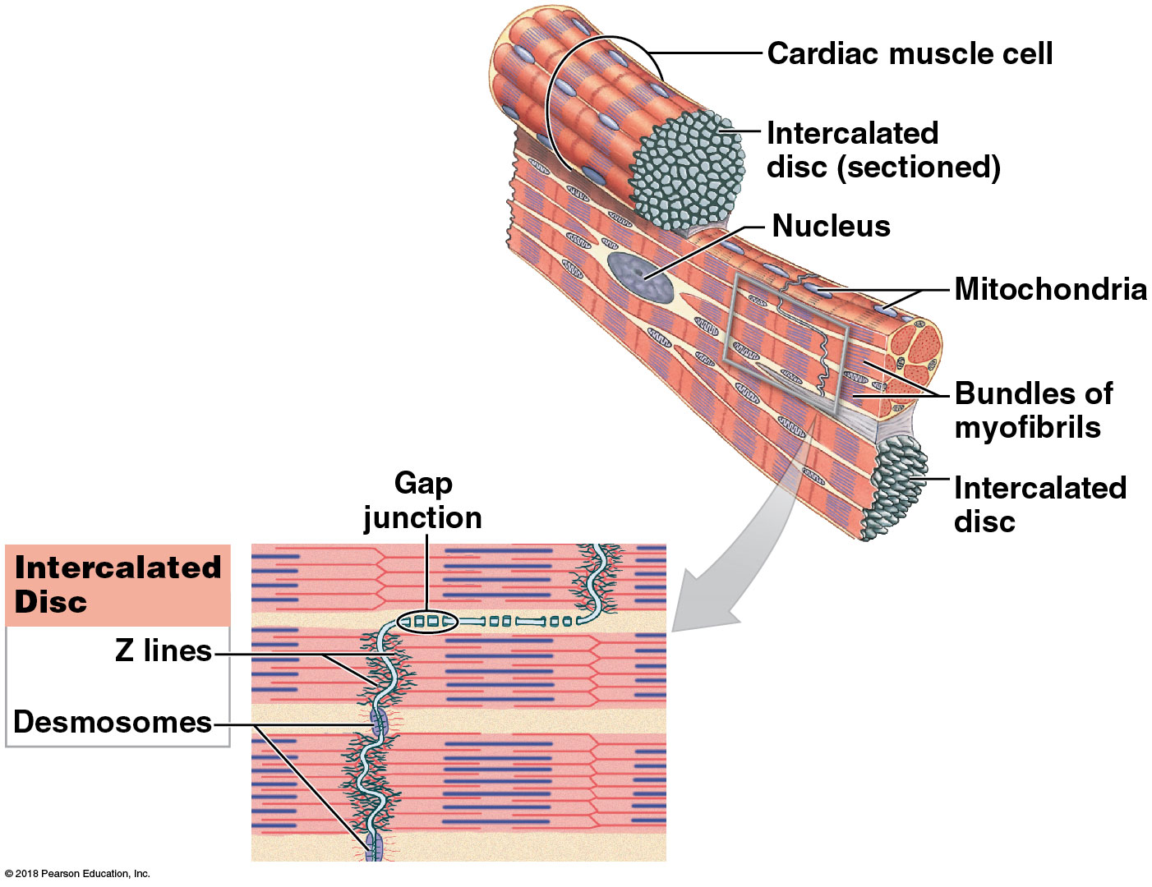
Module 18.3: The heart wall—cardiac muscle
Cardiac muscle tissue
Only in heart
Striated (from organized myofibrils and aligned sarcomeres)
Almost totally dependent on aerobic metabolism (need oxygen) for energy
Abundant mitochondria and myoglobin (stores O₂)
Extensive capillaries

Slide 20
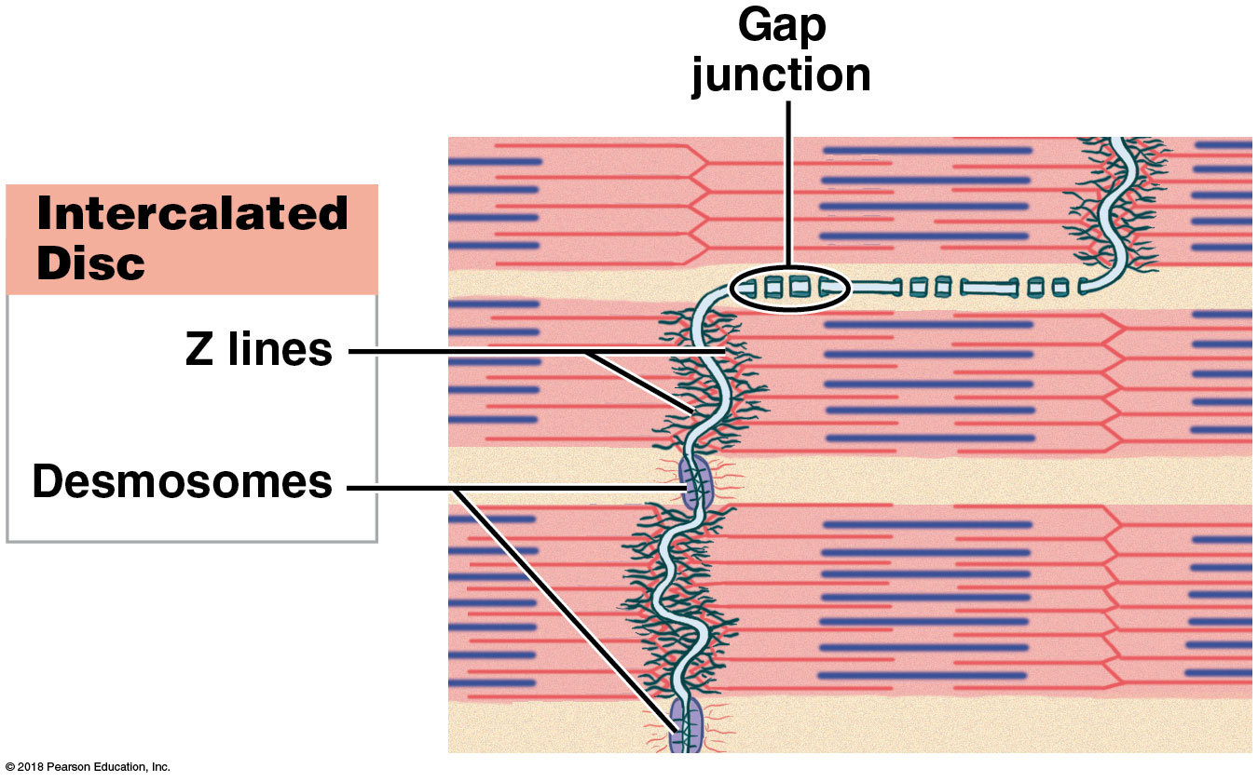
Module 18.3: The heart wall—cardiac muscle
Cardiac muscle tissue (continued)
Intercalated discs
Intertwined plasma membranes of adjacent cardiac muscle cells
Attached by desmosomes and gap junctions
Gap junctions allow action potentials to spread cell to cell; allows all interconnected cells to function together as single unit = a functional syncytium
Notes:
Consider explaining how the heart chambers act as functional syncytiums.

Slide 21
Module 18.3: Review
From superficial to deep, name the layers of the heart wall.
Describe the tissue layers of the pericardium.
Why is it important that cardiac tissue contain many mitochondria and capillaries?
Learning Outcome: Describe the structure of the pericardium and explain its functions, identify the layers of the heart wall, and describe the structures and functions of cardiac muscle.

Slide 22
Module 18.4: The boundaries between the four chambers of the heart can be identified on its external surface
Visible on anterior surface
All four chambers
Auricle of each atrium (expandable pouch)
Coronary sulcus—groove separating atria and ventricles
Anterior interventricular sulcus—groove marking boundary between the two ventricles
Ligamentum arteriosum—fibrous remnant of fetal connection between aorta and pulmonary trunk
Notes:
Remind students that they should remember the term sulcus from when they learned surface anatomy of the brain.

Slide 23
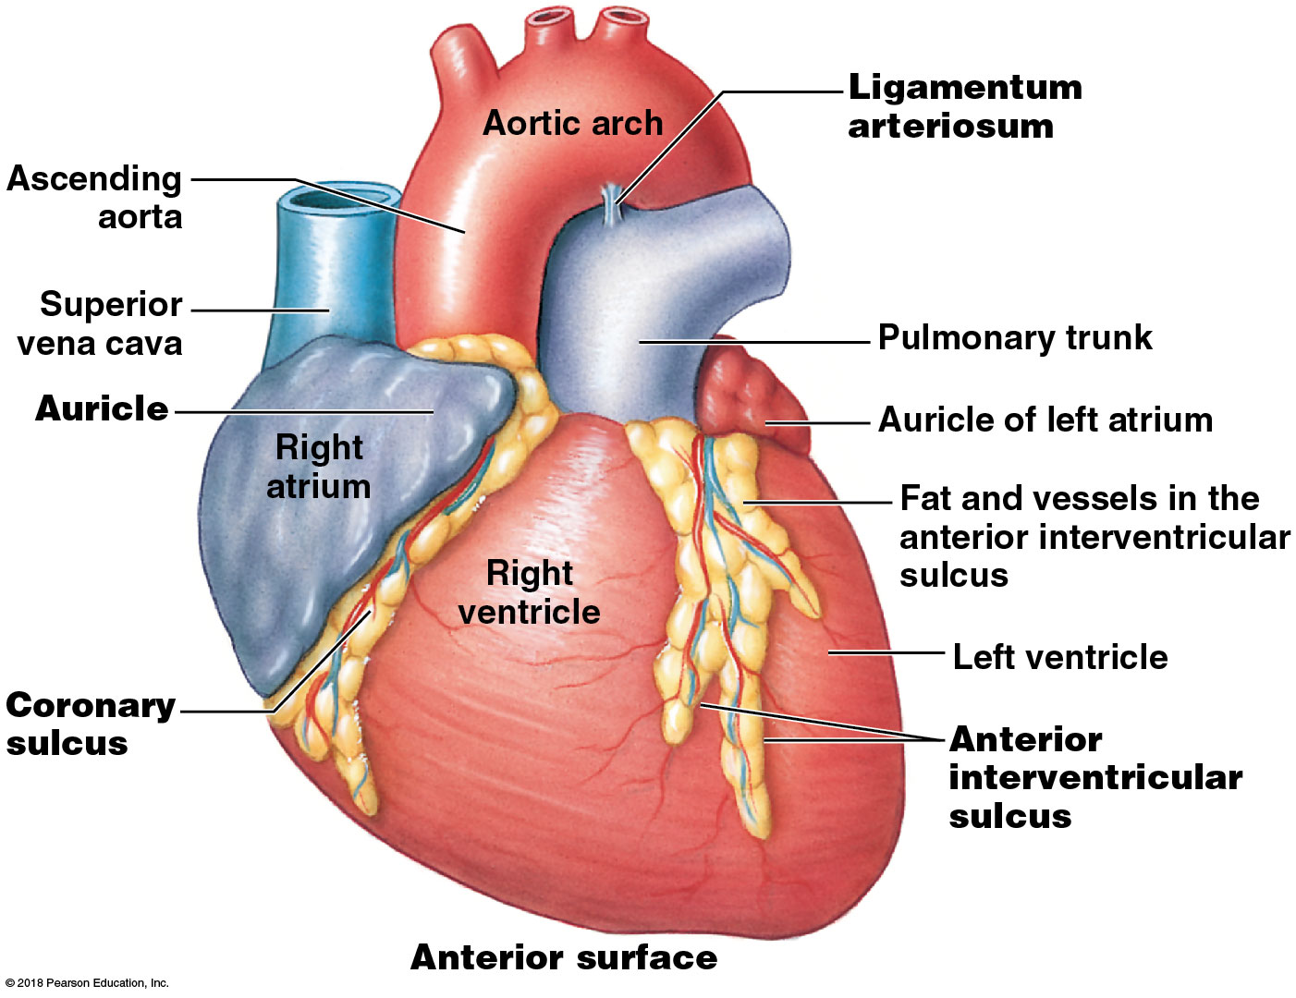
Surface anatomy of the heart (anterior view)

Slide 24
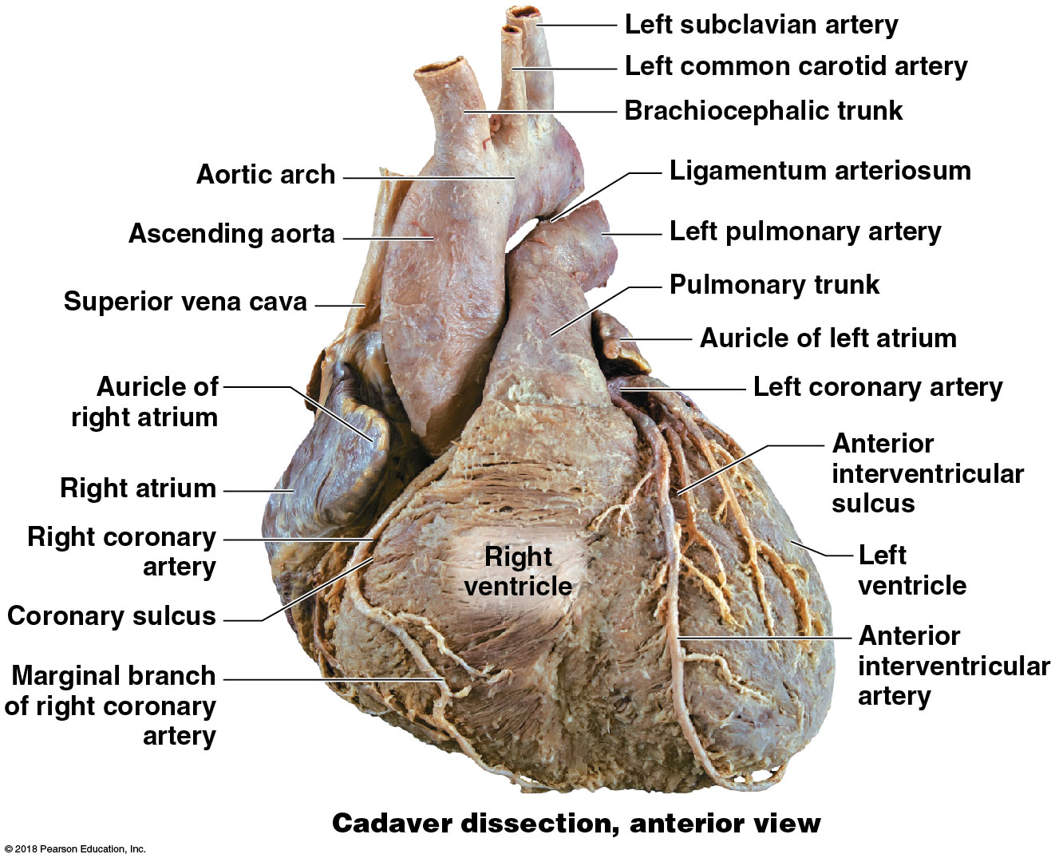
Cadaver heart (anterior view)
Notes:
Coronary blood vessels are easier to see if the fat often found in the epicardium is removed, as it is here.

Slide 25
Module 18.4: Heart surface anatomy
Visible on posterior surface:
All four chambers
Pulmonary veins (4) returning blood to left atrium
Superior and inferior venae cavae returning blood to right atrium
Coronary sinus—returns blood from myocardium to right atrium
Posterior interventricular sulcus—groove marking boundary between the two ventricles

Slide 26
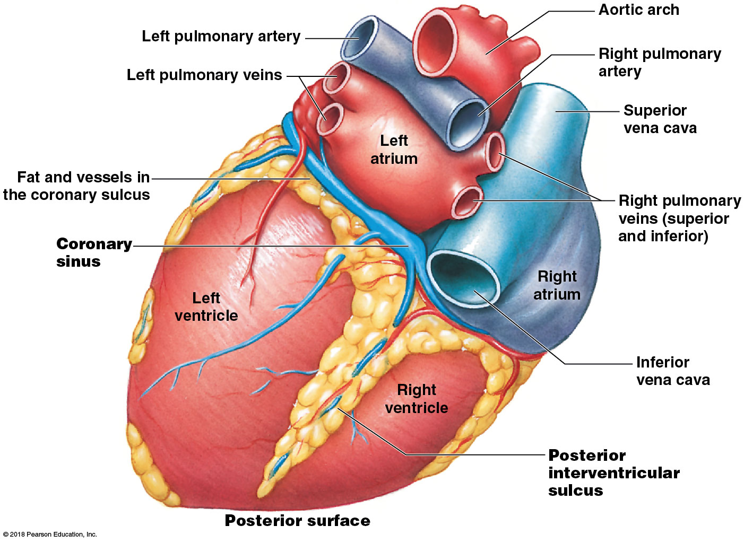
Surface anatomy of the heart (posterior view)

Slide 27
Module 18.4: Review
The anterior view of the heart is dominated by which chambers?
Which structures collect blood from the myocardium, and into which heart chamber does this blood flow?
Name and describe the shallow depressions and grooves found on the heart’s external surface.
Learning Outcome: Describe the cardiac chambers and the heart’s external anatomy.

Slide 28
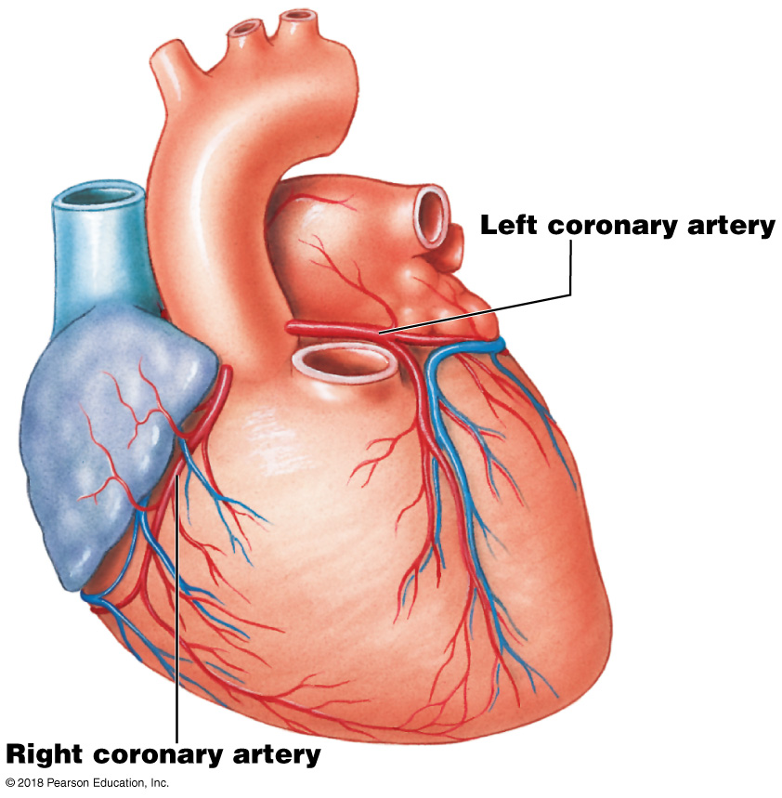
Module 18.5: The heart has an extensive blood supply
Coronary circulation
Continuously supplies cardiac muscle (myocardium) with oxygen/nutrients
Left and right coronary arteries arise from ascending aorta; fill when ventricles are relaxed (diastole)
Myocardial blood flow may increase to 9 times the resting level during maximal exertion

Slide 29
Module 18.5: Coronary circulation
Right coronary artery
Supplies right atrium, parts of both ventricles, and parts of cardiac (electrical) conducting system
Follows coronary sulcus (groove between atria and ventricles)
Main branches:
Marginal arteries—supply right ventricle
Posterior interventricular (posterior descending) artery—runs in posterior interventricular sulcus; supplies interventricular septum and adjacent parts of ventricles

Slide 30
Module 18.5: Coronary circulation
Left coronary artery
Supplies left ventricle, left atrium, interventricular septum
Main Branches:
Anterior interventricular artery (left anterior descending artery)—follows anterior interventricular sulcus; supplies interventricular septum and adjacent parts of ventricles
Circumflex artery—follows coronary sulcus to the left; meets branches of right coronary artery posteriorly; marginal artery off circumflex supplies posterior of left ventricle

Slide 31
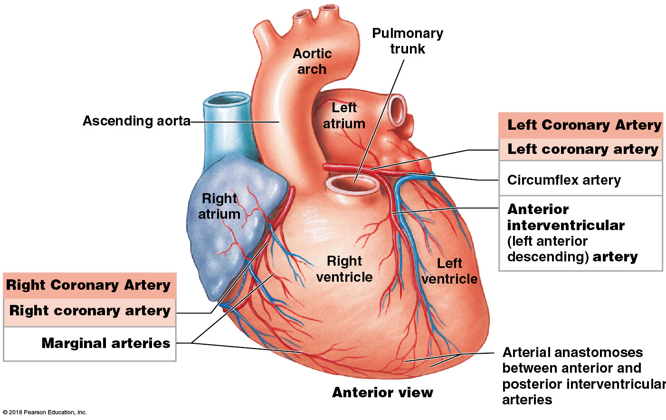
Coronary circulation, main arteries (anterior view)

Slide 32
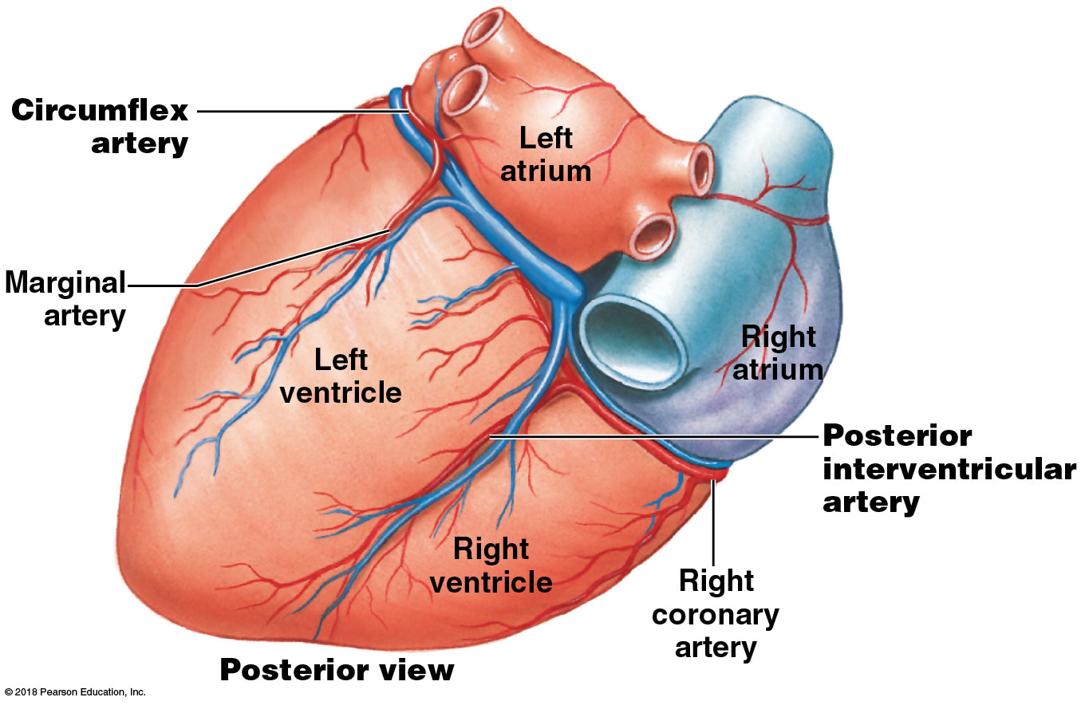
Coronary circulation, main arteries (posterior view)

Slide 33
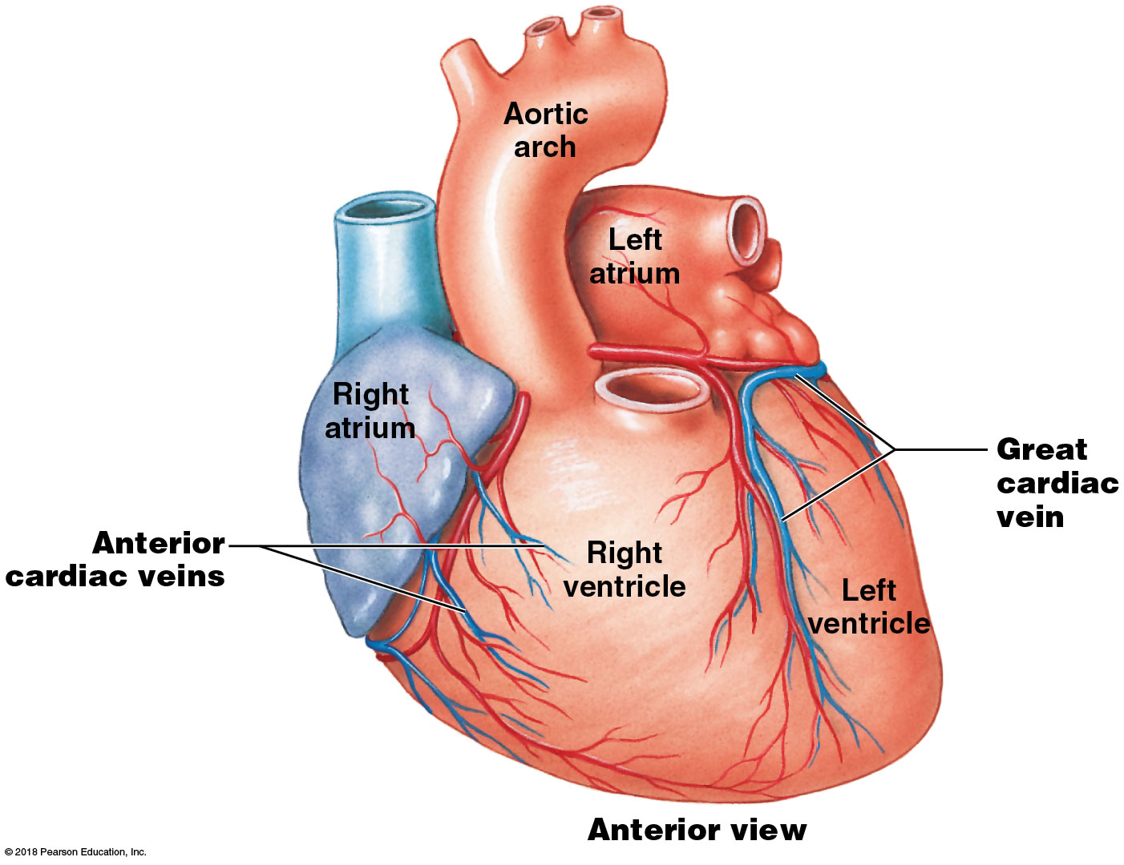
Module 18.5: Coronary circulation
Coronary circulation—veins (anterior)
Great cardiac vein—in anterior interventricular sulcus
Drains area supplied by anterior interventricular artery
Empties into coronary sinus posteriorly
Anterior cardiac veins
Drain anterior surface of right ventricle
Empty directly into the right atrium

Slide 34
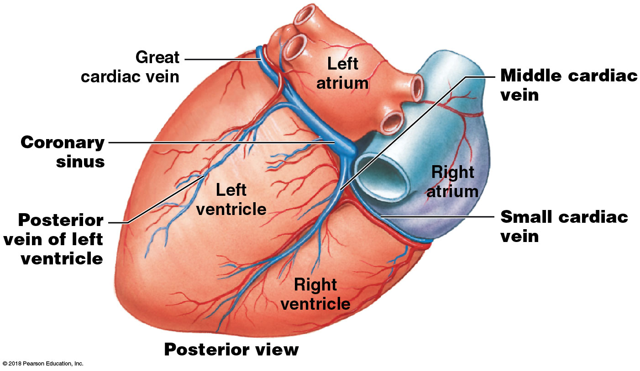
Module 18.5: Coronary circulation
Coronary circulation—veins (posterior)
Coronary sinus—expanded vein that empties into right atrium
Posterior vein of left ventricle—drains area supplied by circumflex artery
Middle cardiac vein—drains area supplied by posterior interventricular artery; empties into coronary sinus
Small cardiac vein— drains posterior of right atrium/ventricle; empties into coronary sinus
Notes:
Most of the veins that drain the heart wall empty into the coronary sinus.

Slide 35
Module 18.5: Coronary circulation
Blood flow through the coronary circuit is maintained by changing blood pressure and elastic rebound
Left ventricular contraction forces blood into aorta, elevating blood pressure there, stretching aortic walls
Left ventricular relaxation—pressure decreases, aortic walls recoil (elastic rebound), pushing blood in both directions
Forward into systemic circuit
Backward into coronary arteries

Slide 36
Module 18.5: Review
Describe the areas of the heart supplied by the right and left coronary arteries.
Compare the anterior cardiac veins to the posterior vein of left ventricle.
List the arteries and veins of the heart.
Describe what happens to blood flow during elastic rebound.
Learning Outcome: Describe the major vessels supplying the heart, and cite their locations.

Slide 37
Module 18.6: Internal valves control the direction of blood flow between the heart chambers and great vessels
Each side of heart has two chambers: an atrium (receives blood) sends blood to a ventricle (pumps blood out of heart)
Right and left atria are separated by the interatrial septum
Right and left ventricles are separated by interventricular septum (much thicker)

Slide 38
Module 18.6: Heart valves
Atrioventricular (AV) valves—between each atrium and ventricle
Allow only one-way blood flow from atrium into ventricle
Semilunar valves—at exit from each ventricle; allow only one-way blood flow from ventricle out into aorta or pulmonary trunk

Slide 39
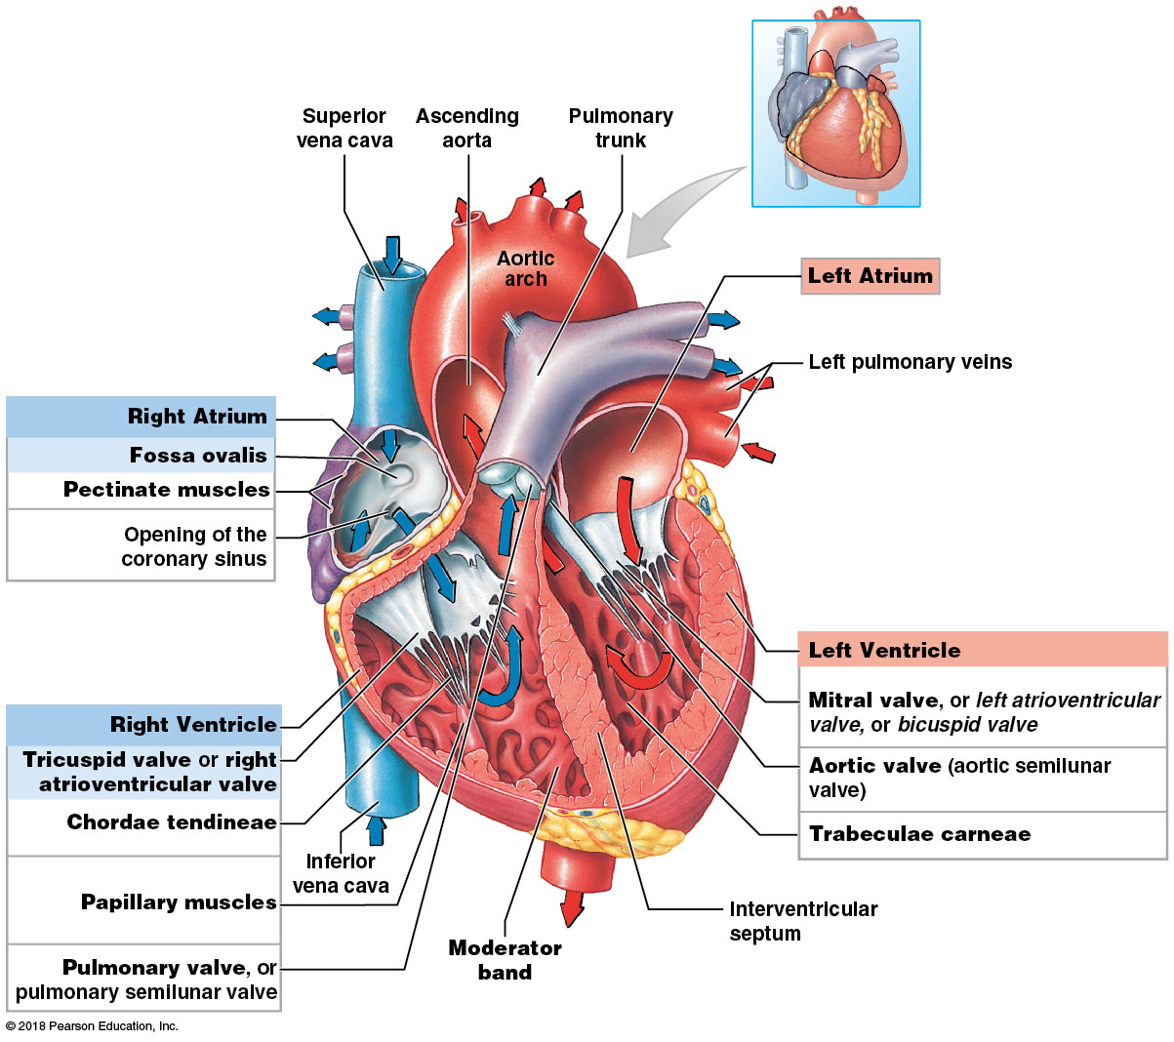
Internal anatomy of the heart, showing chambers and heart valves (coronal section)

Slide 40
Module 18.6: Heart valves
Atria
Right atrium receives deoxygenated blood from superior and inferior venae cavae and coronary sinus
Fossa ovalis—remnant of fetal foramen ovale that allowed fetal blood to pass between atria; closes at birth
Left atrium receives oxygenated blood from pulmonary veins
Pectinate muscles—muscular ridges located inside both atria along the anterior atrial wall and in the auricles

Slide 41
Module 18.6: Heart valves
Ventricles
Right ventricle—receives blood from right atrium through tricuspid valve (has three cusps or flaps), also called the right atrioventricular (AV) valve
With contraction, blood exits through the pulmonary valve (pulmonary semilunar valve) into the pulmonary trunk

Slide 42
Module 18.6: Heart valves
Ventricles (continued)
Left ventricle—much thicker wall than right ventricle
Receives blood from left atrium through mitral valve, also called bicuspid valve (two cusps) or left atrioventricular valve
With contraction, blood exits through the aortic valve (aortic semilunar valve) into the ascending aorta
Trabeculae carneae—muscular ridges inside both ventricles

Slide 43
Module 18.6: Heart valves
AV valve structure (tricuspid and mitral valve)
Each has three (tricuspid) or two (mitral/bicuspid) cusps
Cusps attach to tendon-like connective tissue bands = chordae tendineae
Chordae tendineae anchored to thickened cone-shaped papillary muscles
Moderator band—thickened muscle ridge providing rapid conduction path; tenses papillary muscles just before ventricular contraction; prevents slamming or inversion of AV valve
Notes:
Students look at AV valve structure and may assume chordae tendineae and papillary muscles pull the valves closed, but they do not. They tether the cusps in place so they can move to the closed position but not beyond, preventing them from inverting and allowing backflow into the atria.

Slide 44
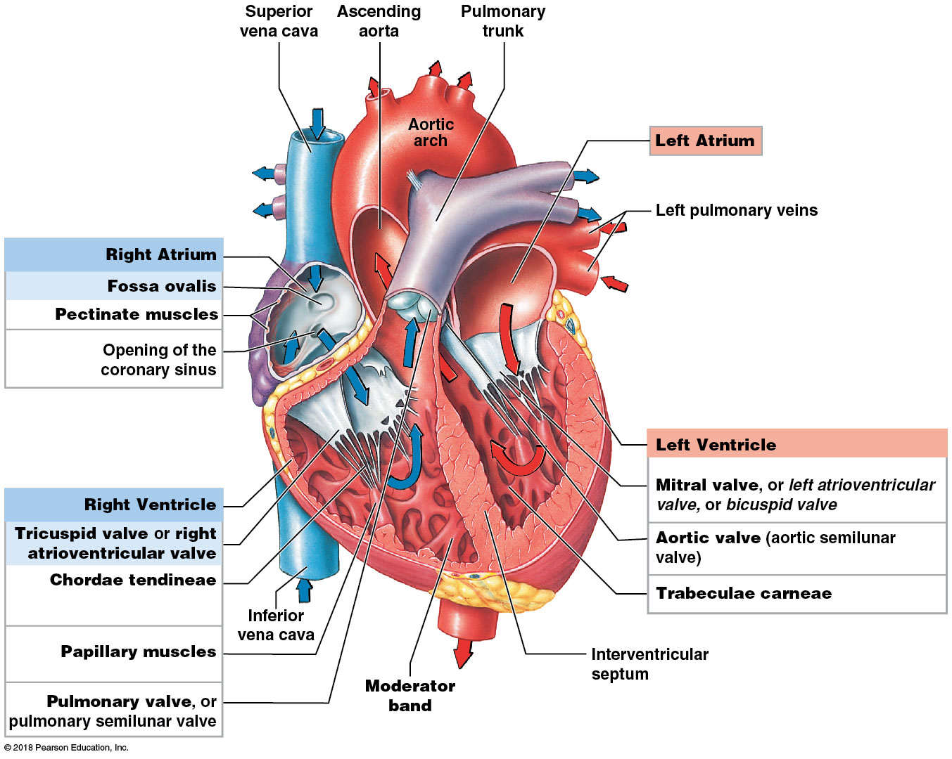
Internal anatomy of the heart (coronal section)

Slide 45
Module 18.6: Heart valves
Comparison between chambers
Atria have similar workloads; walls about same thickness
Ventricles have very different loads
Right ventricle—thinner wall; sends blood to adjacent lungs (pulmonary circuit)
Contraction squeezes against left ventricle, forces blood out pulmonary trunk efficiently; minimal effort, low pressure

Slide 46
Module 18.6: Heart valves
Comparison between chambers (continued)
Ventricles have very different loads (continued)
Left ventricle—very thick wall, rounded chamber
4–6 times the pressure of right; sends blood through entire systemic circuit
Contraction decreases diameter and apex-to-base distance
Reduces right ventricular volume, aiding its emptying

Slide 47
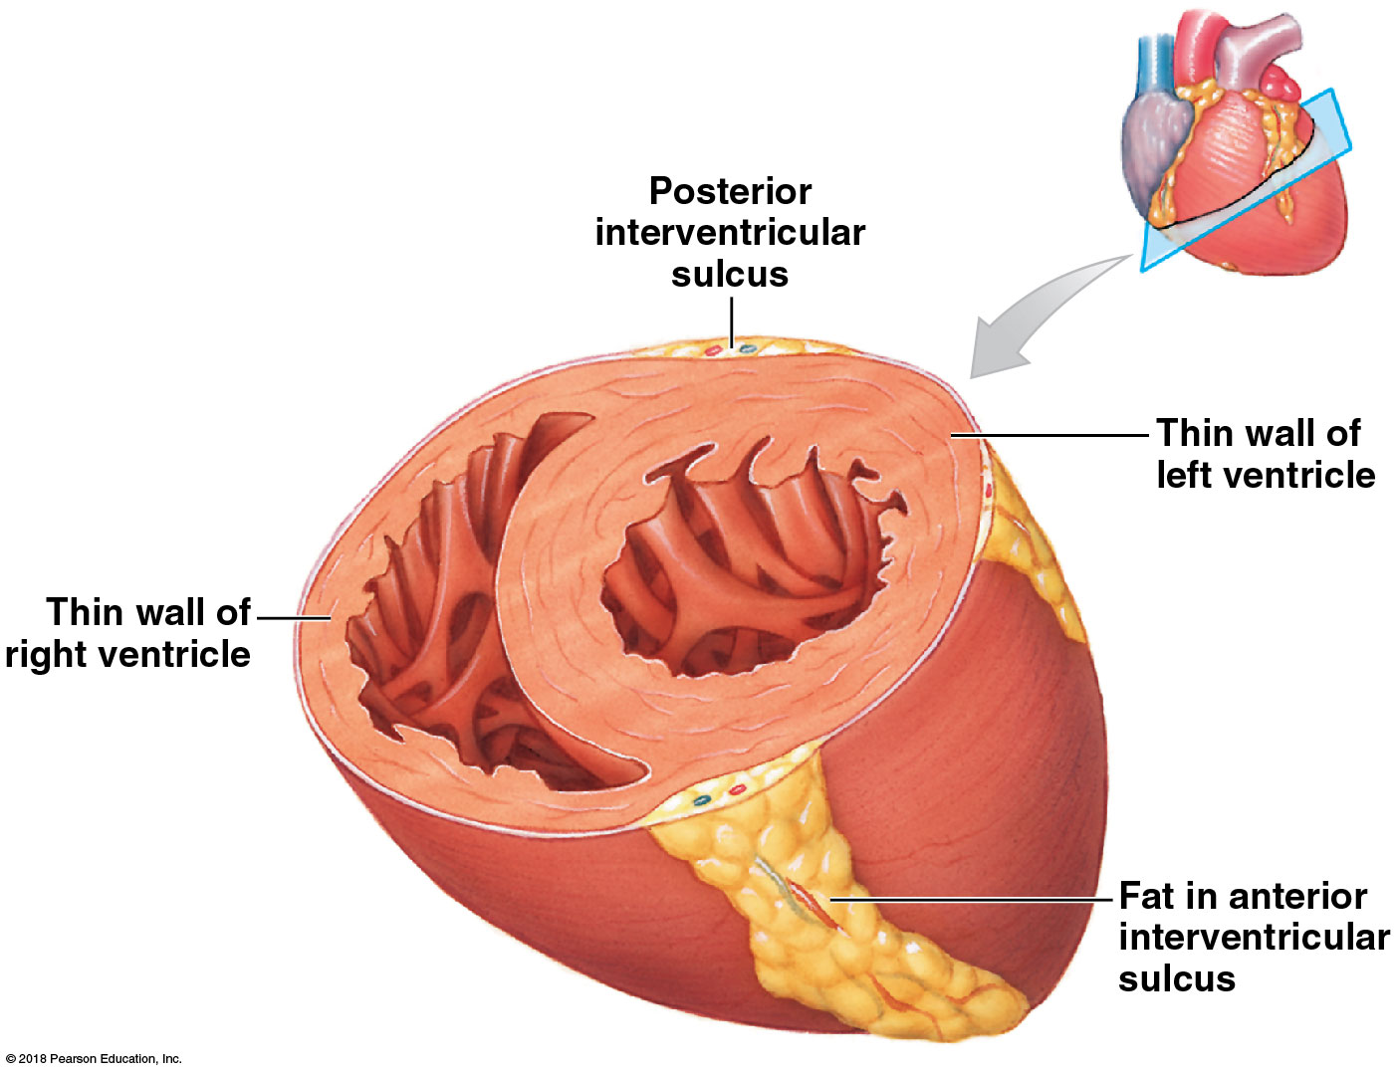
Module 18.6: Heart valves
Notes:
The wall of the left ventricle is much thicker than that of the right ventricle because it must generate tremendous force. Also, notice the shape of the two ventricles—the left is distinctly rounded.

Slide 48
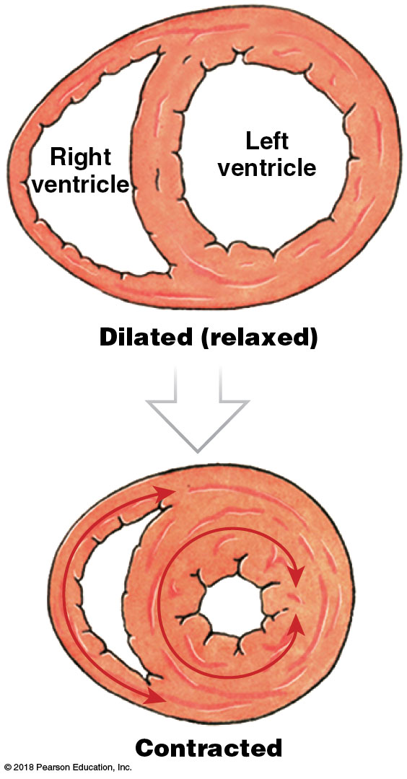
Module 18.6: Heart valves
The wall of the left ventricle is much thicker than that of the right ventricle because it must generate tremendous force.
Note the shape and change in size of both ventricles when they contract.

Slide 49
Module 18.6: Review
Why is the left ventricle more muscular than the right ventricle?
Damage to the semilunar valve on the right side of the heart would affect blood flow to which vessel?
Learning Outcome: Trace blood flow through the heart, identifying the major blood vessels, chambers, and heart valves.

Slide 50
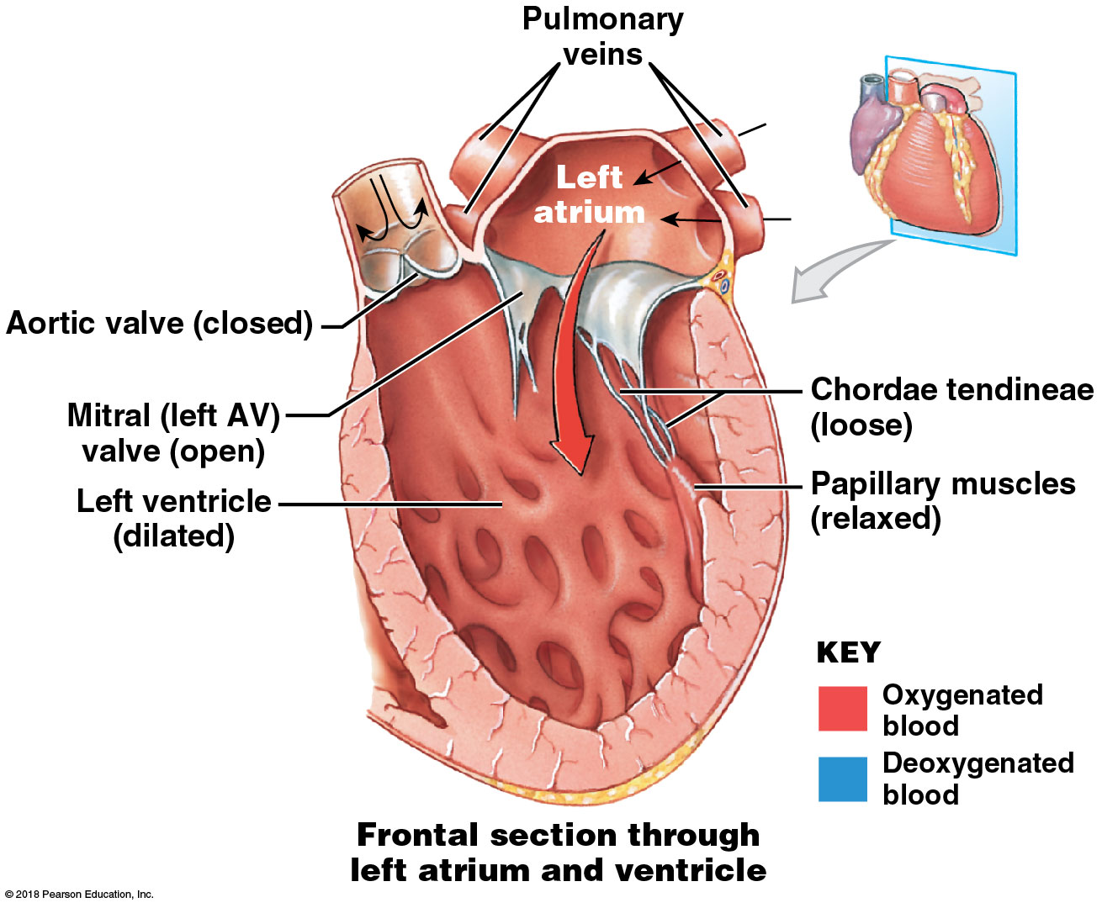
Module 18.7: When the heart beats, the AV valves close before the semilunar valves open, and the semilunar valves close before the AV valves open
When ventricles are relaxed, they fill
AV valves—open
Chordae tendineae are loose
Semilunar valves— closed
Blood pressure from pulmonary and systemic circuits keeps them closed
Notes:
To help students understand blood flow through the heart and the cardiac cycle, they should focus on the valves. Point out that the blood enters the ventricles through the AV valves, then the entrances close before the exit from the ventricles opens (semilunar valves). Go through a door (entrance), shut it behind you, go through next door (exit), shut it behind you.

Slide 51
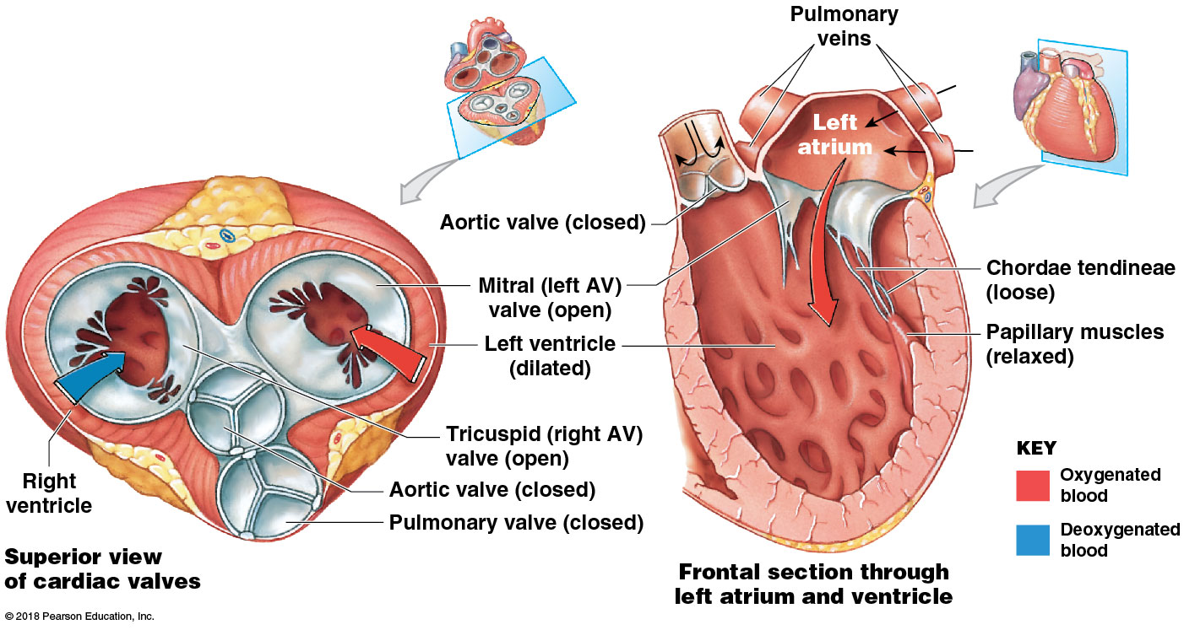
Position of heart valves while ventricles are filling (ventricular relaxation)

Slide 52
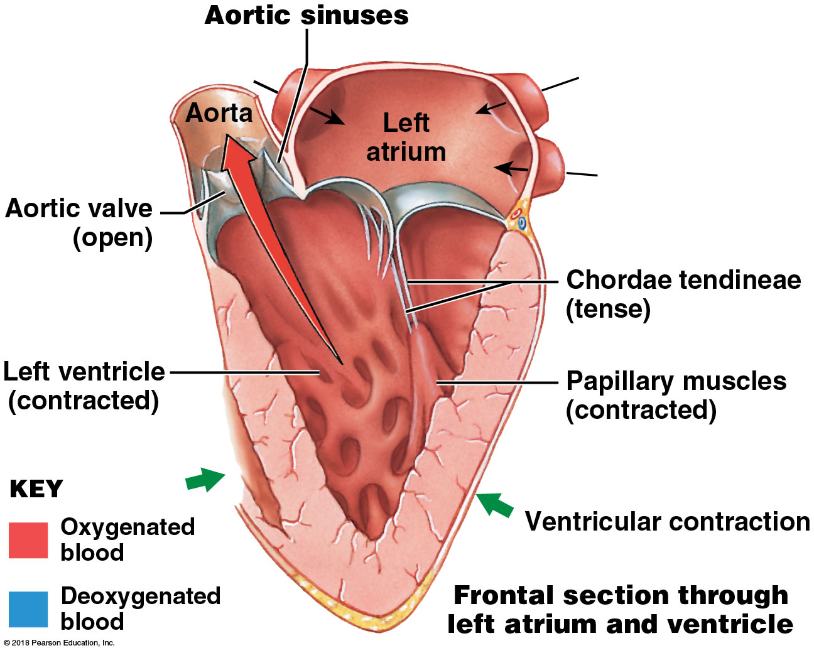
Module 18.7: Valves control direction of flow
When ventricles contract, they empty
AV valves—closed
Pressure from contracting ventricles pushes cusps together
Papillary muscles tighten chordae tendineae so cusps can’t invert into atria; prevents backflow (regurgitation)
Semilunar valves—open
Ventricular pressure overcomes pressure in pulmonary trunk and aorta that held them shut
Notes:
Have students look carefully at a dissected heart or good heart model. The openings into the left and right coronary arteries sit just above the cusps of the aortic semilunar valve. When the valve opens to eject blood from the left ventricle with high pressure, the cusps block entrance into the small coronary arteries, protecting them. As the left ventricle relaxes, the valve shuts, the entrance into the coronary arteries is exposed, and blood trying to backflow, but at much lower pressure, can easily enter the coronary circuit.

Slide 53
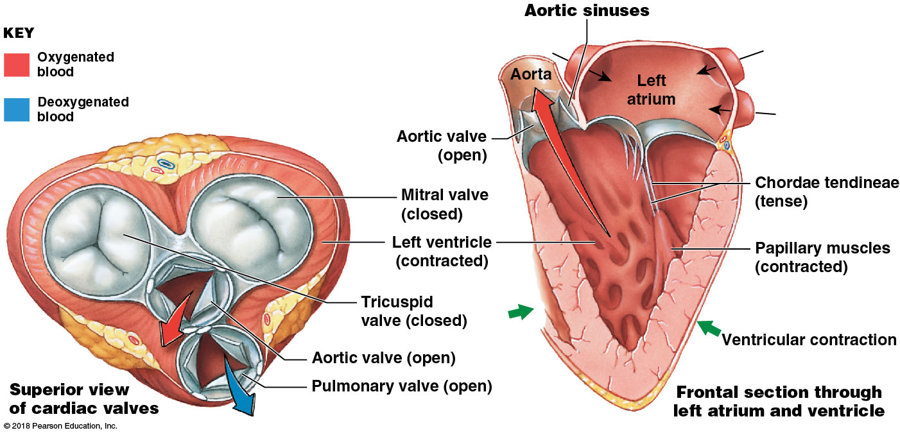
Position of heart valves while ventricles are emptying (ventricular contraction)

Slide 54
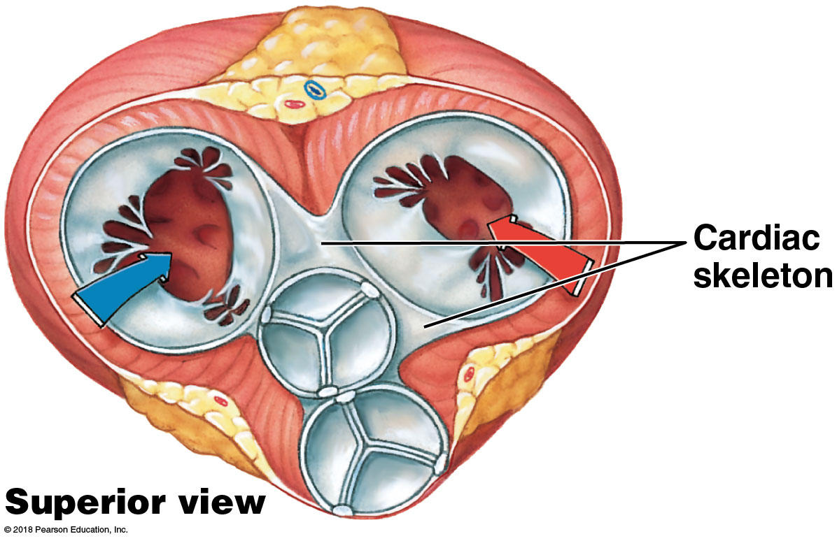
Module 18.6: Valves control direction of flow
Cardiac skeleton (fibrous skeleton)
Flexible connective tissue frame
Interconnected bands of dense connective tissue
Encircle heart valves, stabilize their positions
Also surrounds base of aorta and pulmonary trunk
Electrically isolates atrial from ventricular myocardium

Slide 55
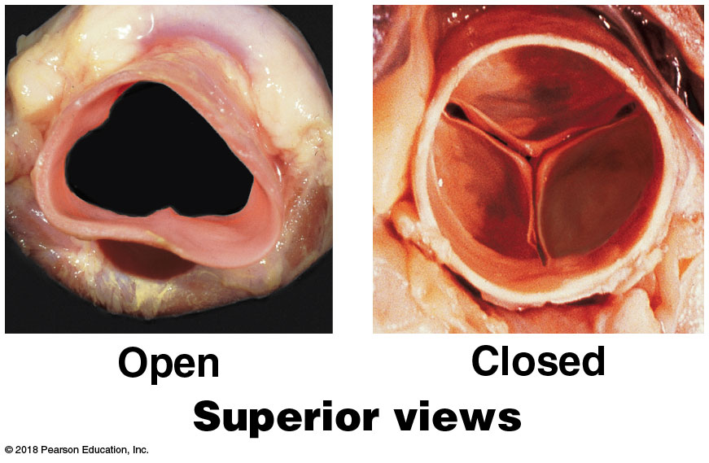
Module 18.7: Valves control direction of flow
Pulmonary and aortic (semilunar) valves
Each has three half-moon shaped cusps
Prevent backflow of blood from aorta and pulmonary trunk back into ventricles
No muscular brace needed—cusps support each other when closed

Slide 56
Module 18.7: Valves control direction of flow
Valvular heart disease (VHD)
Valve function deteriorates until heart cannot maintain adequate blood flow
Congenital malformations or heart inflammation (carditis)
Severe cases may require replacement with prosthetic valve
Bioprosthetic valves come from pigs or cows
Damaged aortic valve with irregular-shaped cusps
Bioprosthetic valve

Slide 57
Module 18.7: Review
Define cardiac regurgitation.
Describe the structural and functional roles of the cardiac skeleton.
What do semilunar valves prevent?
Learning Outcome: Describe the relationship between the AV and semilunar valves during a heartbeat.

Slide 58
Module 18.8: Arteriosclerosis can lead to coronary artery disease
Arteriosclerosis (arterio-, artery + sclerosis, hardness)
Thickening/toughening of arterial walls
Related complications account for about half of U.S. deaths
Coronary artery disease (CAD) = arteriosclerosis of coronary vessels
Arteriosclerosis of brain arteries can lead to strokes

Slide 59
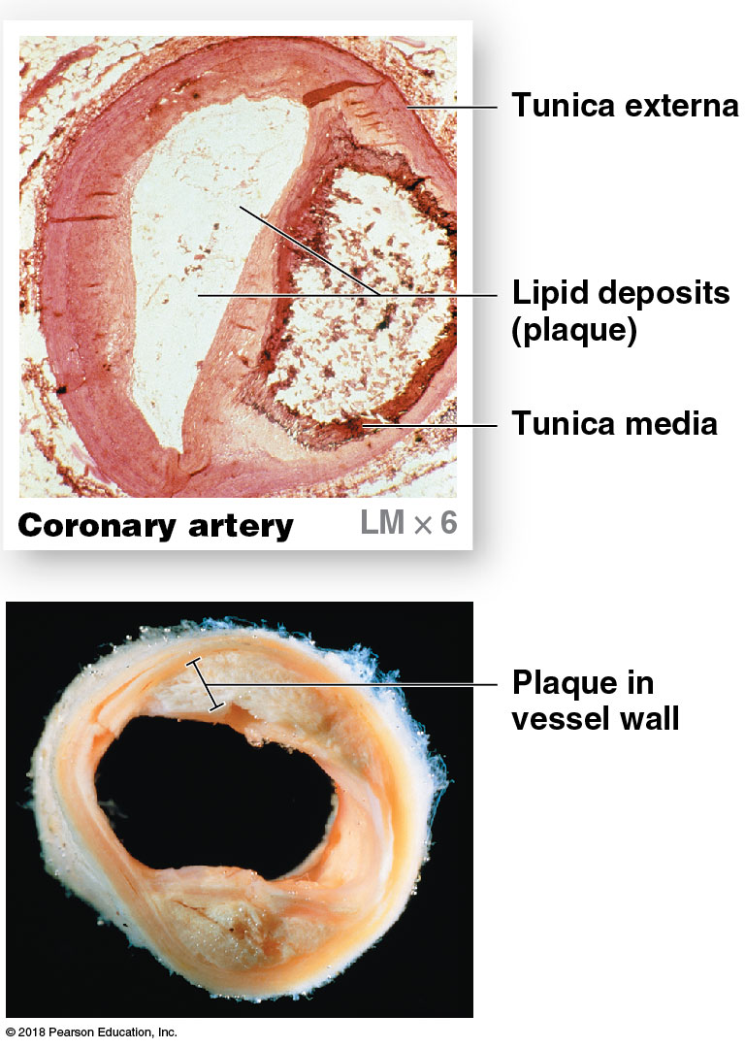
Module 18.8: Arteriosclerosis
Atherosclerosis
= formation of lipid deposits in arterial tunica media and damage to endothelium
Most common form of arteriosclerosis; often associated with elevated blood cholesterol
Fatty tissue mass (plaque) in vessel; restricts blood flow

Slide 60
Module 18.8: Arteriosclerosis
Risk factors
Age (elderly)
Sex (male)
High blood cholesterol levels
High blood pressure
Cigarette smoking

Slide 61
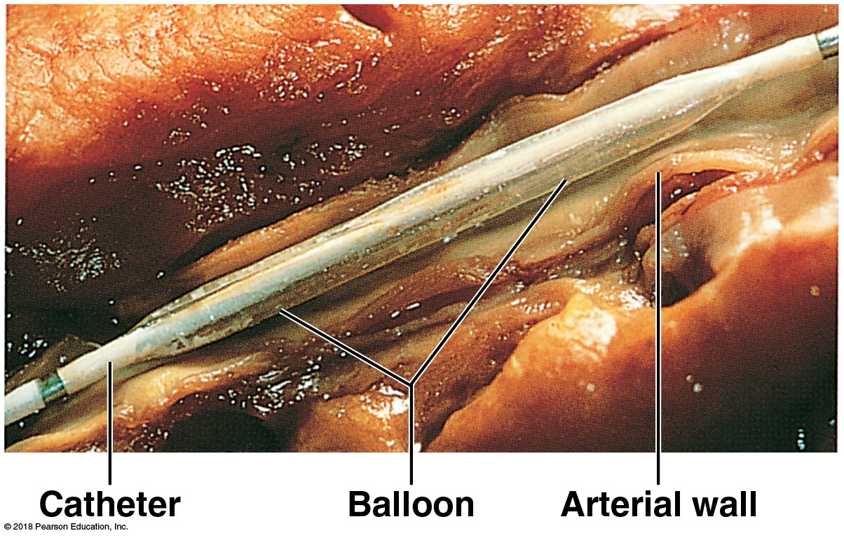
Module 18.8: Arteriosclerosis
Atherosclerosis treatment
Replace damaged segment of the vessel
Compressing plaque with balloon angioplasty
Catheter inserted past blockage; balloon inflated to press plaque against wall and open vessel
Most effective for small, soft plaques
Very low surgical mortality rate (about 1%)
Very high success rate (>90%)
Can be outpatient

Slide 62
Module 18.8: Arteriosclerosis
Coronary artery disease (CAD)
= Areas of partial or complete blockage of coronary circulation
Reduces blood flow to area (coronary ischemia)
Usually from atherosclerosis in a coronary artery or associated blood clot (thrombus)
Seen in digital subtraction angiography (DSA)
May treat with wire-mesh tube (stent) to hold vessel open

Slide 63
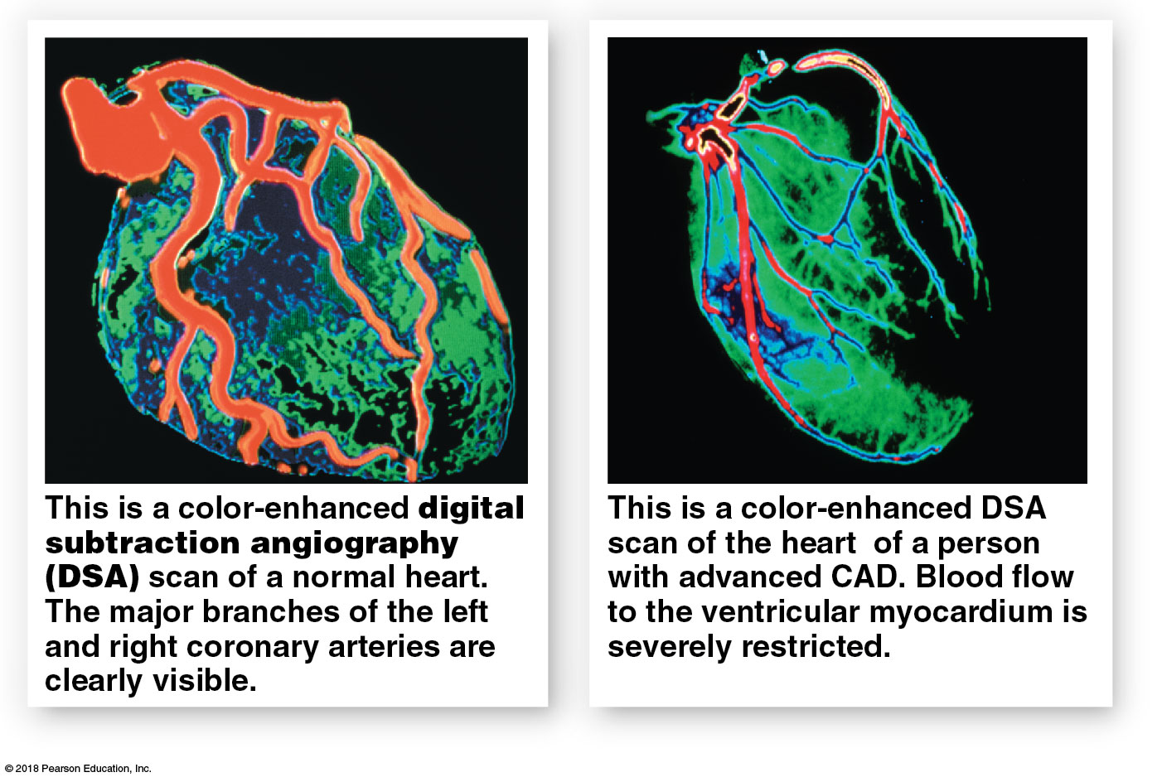
Module 18.8: Arteriosclerosis

Slide 64
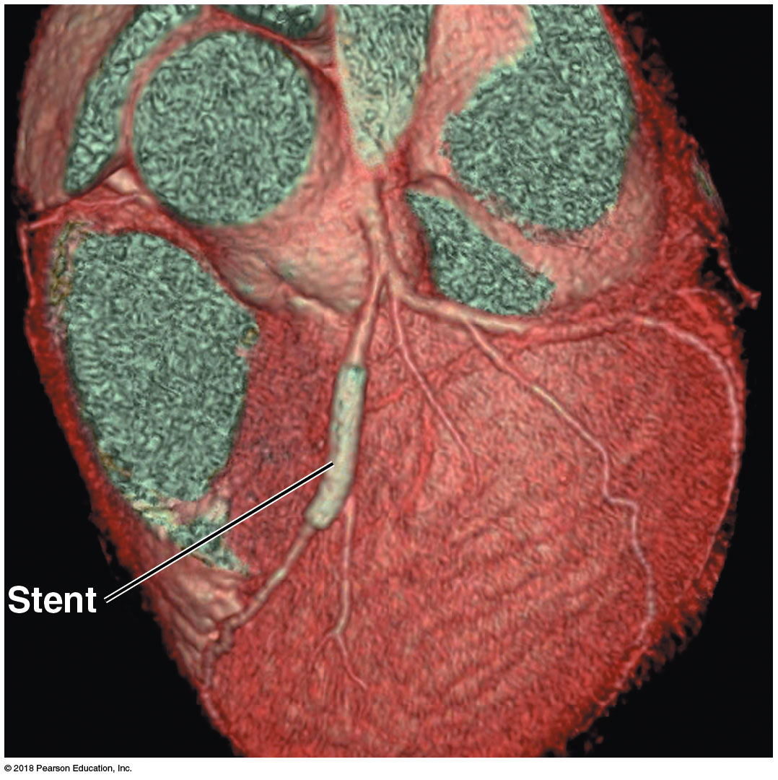
Module 18.8: Arteriosclerosis
Notes:
This is a scan of a stent that has been placed in the anterior interventricular artery. (This imaging technique reveals the lumen of the blood vessels, rather than the vessel, so the stent appears to surround the vessel.)

Slide 65
Module 18.8: Review
Compare arteriosclerosis with atherosclerosis.
What is coronary ischemia?
Describe the purpose of a stent.
Learning Outcome: Define arteriosclerosis, and explain its significance to health.

Slide 66
Section 2: Cardiac Cycle
Learning Outcomes
18.9 Explain the complete round of cardiac systole and diastole.
18.10 Explain the events of the cardiac cycle, and relate the heart sounds to specific events.
18.11 Describe an action potential in cardiac muscle, and explain the role of calcium ions.
18.12 Describe the components and functions of the conducting system of the heart.

Slide 67
Section 2: Cardiac Cycle
Learning Outcomes (continued)
18.13 Clinical Module: Identify the electrical events shown on an electrocardiogram.
18.14 Describe the factors affecting the heart rate.
18.15 Describe the variables that influence stroke volume.
18.16 Explain how stroke volume and cardiac output are coordinated.

Slide 68
Module 18.9: The cardiac cycle is a complete round of systole and diastole
Cardiac cycle = period between start of one heartbeat and the next; heart rate = number of beats per minute
Two atria contract first to fill ventricles; two ventricles then contract to pump blood into pulmonary and systemic circuits
Notes:
Additional resources: Interactive Physiology 2, Cardiac Cycle, accessible through Mastering A&P.

Slide 69
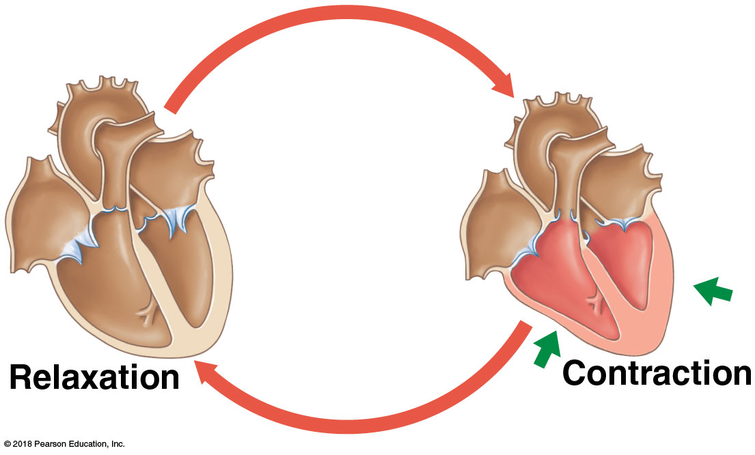
Module 18.9: The cardiac cycle is a complete round of systole and diastole
Cardiac cycle (continued)
Two phases:
Contraction (systole)—blood leaves the chamber
Relaxation (diastole)—chamber refills
Notes:
Additional resources: Interactive Physiology 2, Cardiac Cycle, accessible through Mastering A&P.

Slide 70
Module 18.9: The cardiac cycle
Sequence of contractions
Atria contract together first (atrial systole)
Push blood into the ventricles
Ventricles are relaxed (diastole) and filling
Ventricles contract together next (ventricular systole)
Push blood into the pulmonary and systemic circuits
Atria are relaxed (diastole) and filling
Typical cardiac cycle lasts 800 msec

Slide 71
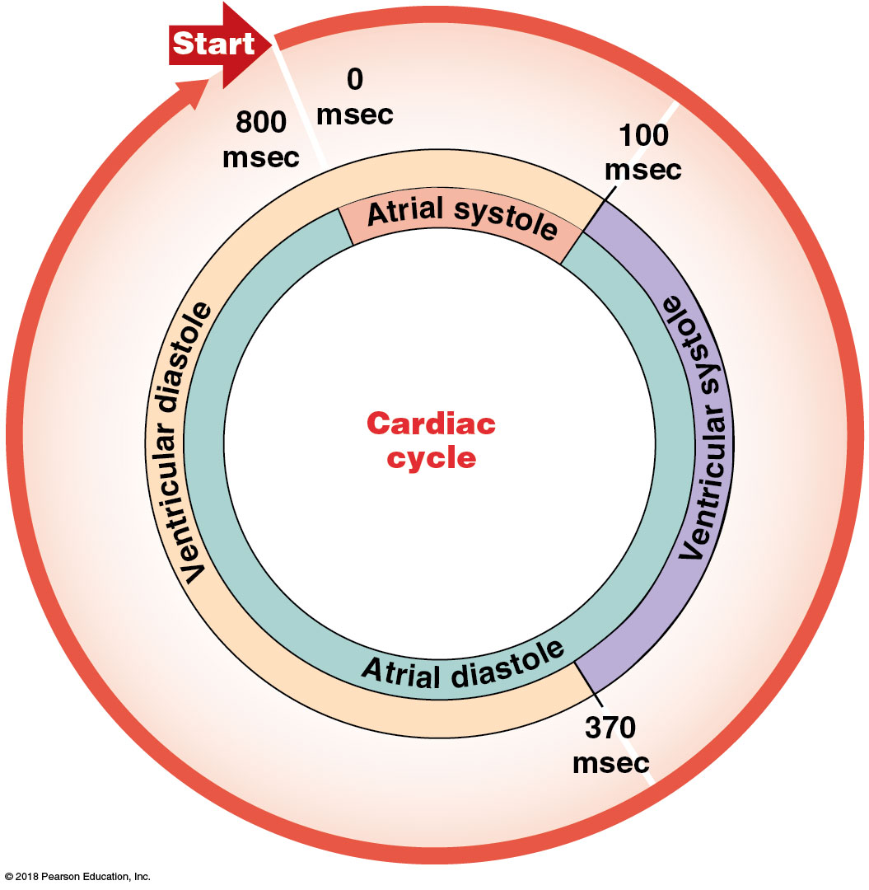
Phases of cardiac cycle for a heart rate of 75 bpm
Notes:
Take time to walk students through this image so they interpret it correctly.

Slide 72
Module 18.9: Review
Define cardiac cycle.
Give the alternate terms for heart contraction and heart relaxation.
Compare the duration of atrial and ventricular systole at a representative heart rate of 75 bpm.
Learning Outcome: Explain the complete round of
cardiac systole and diastole.

Slide 73
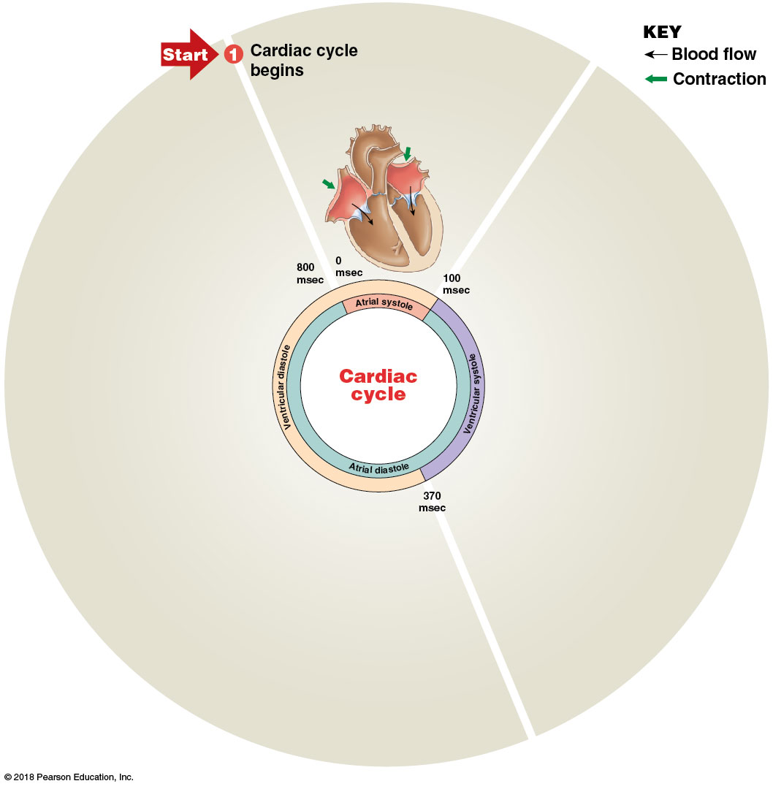
Module 18.10: The cardiac cycle creates pressure gradients that maintain blood flow
Phases of cardiac cycle, diagrammed for heart rate of 75 bpm
Cardiac cycle begins—all four chambers are relaxed (diastole; ventricles are passively refilling)

Slide 74
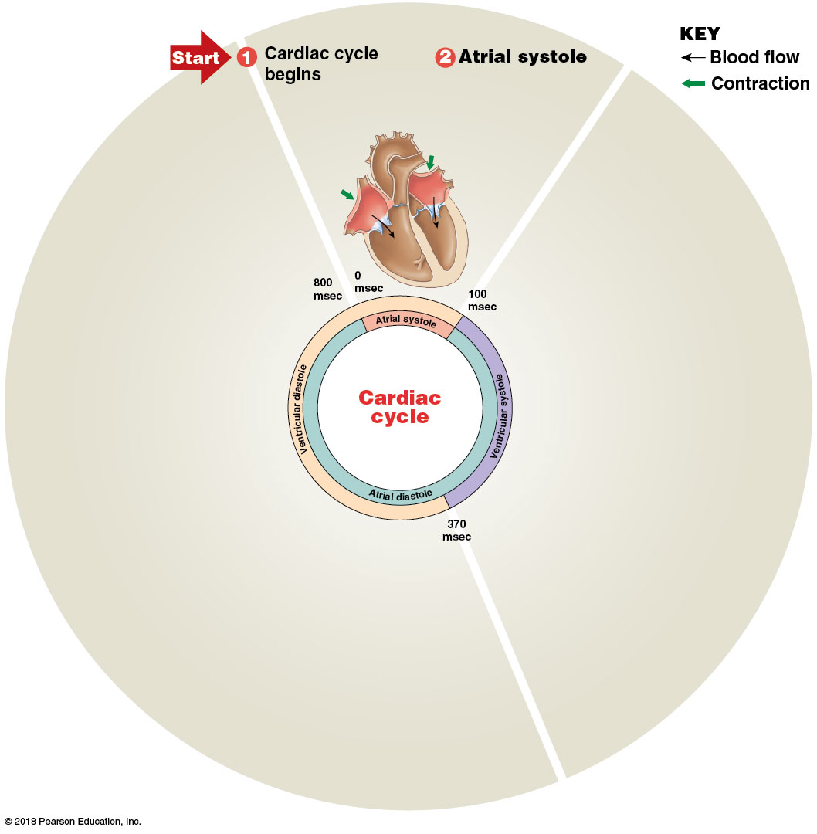
Module 18.10: The cardiac cycle creates pressure gradients that maintain blood flow
Phases of cardiac cycle (continued)
​Atrial systole (100 msec)—atria contract; finish filling ventricles

Slide 75
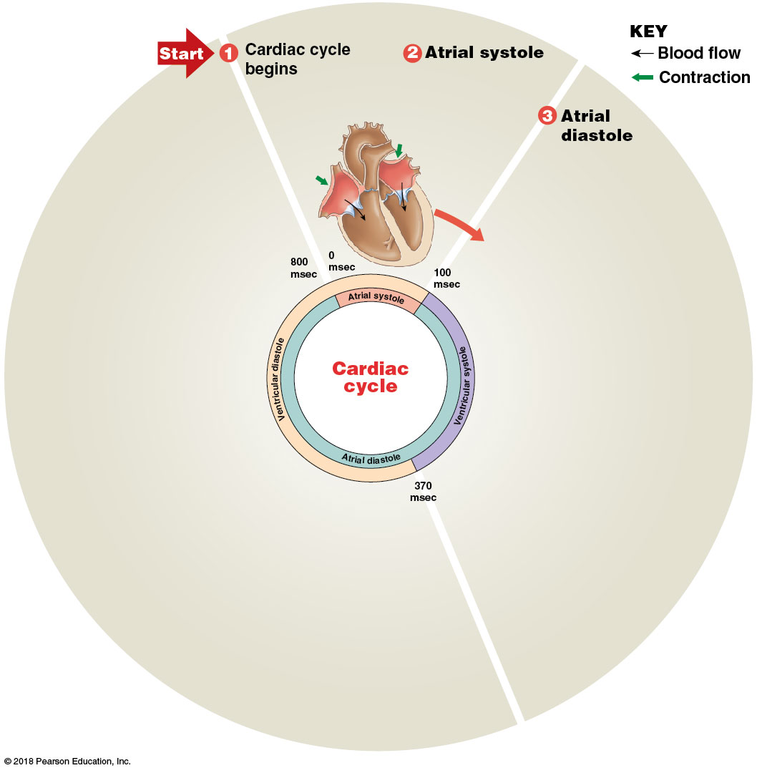
Module 18.10: The cardiac cycle creates pressure gradients that maintain blood flow
Phases of cardiac cycle (continued)
​Atrial diastole (270 msec)—continues until start of next cardiac cycle (through ventricular systole)

Slide 76
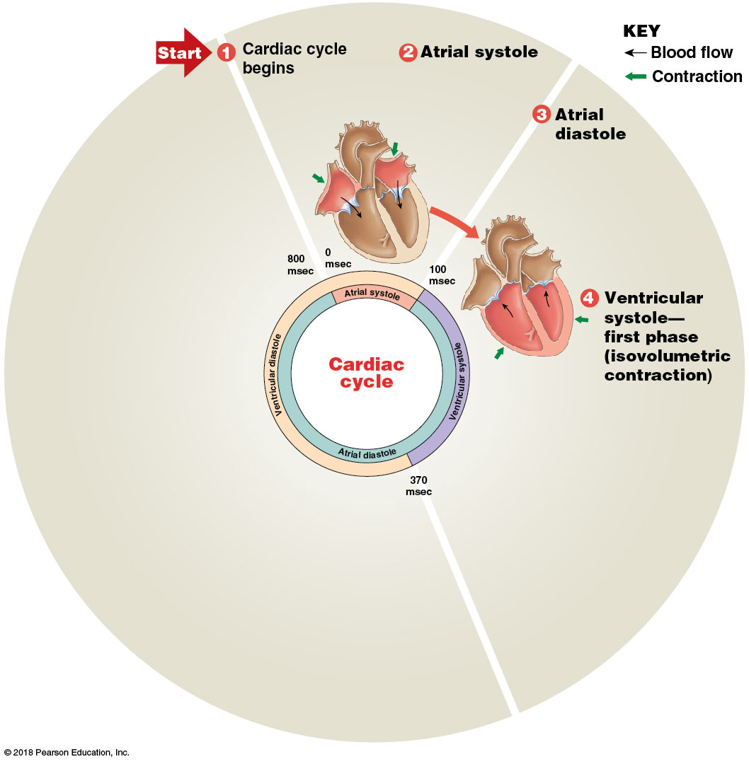
Module 18.10: The cardiac cycle creates pressure gradients that maintain blood flow
Phases of cardiac cycle (continued)
​Ventricular systole—first phase. Contracting ventricles push AV valves closed but not enough pressure to open semilunar valves (= isovolumetric contraction—no volume change)

Slide 77
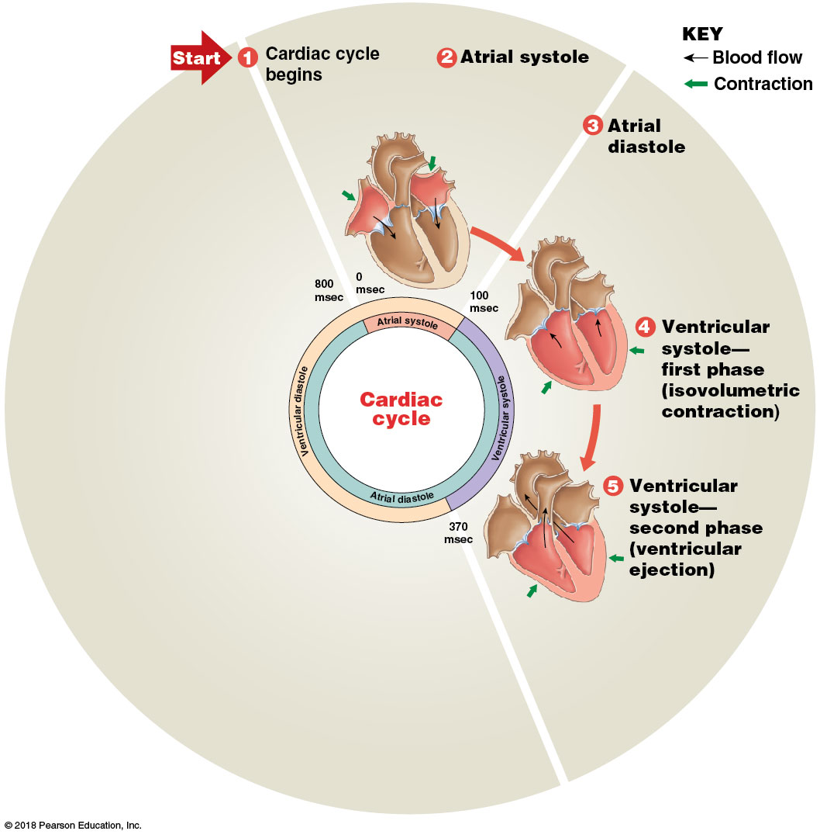
Module 18.10: The cardiac cycle creates pressure gradients that maintain blood flow
Phases of cardiac cycle (continued)
​Ventricular systole—second phase. Increasing pressure opens semilunar valves; blood leaves ventricle (= ventricular ejection)

Slide 78
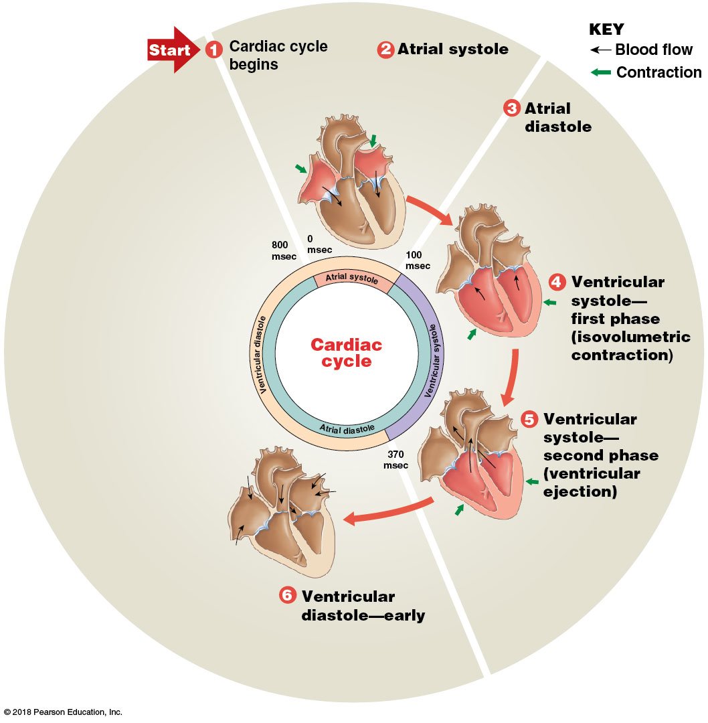
Module 18.10: The cardiac cycle creates pressure gradients that maintain blood flow
Phases of cardiac cycle (continued)
​Ventricular diastole—early. Ventricles relax and their pressure drops; blood in aorta and pulmonary trunk backflows, closes semilunar valves

Slide 79
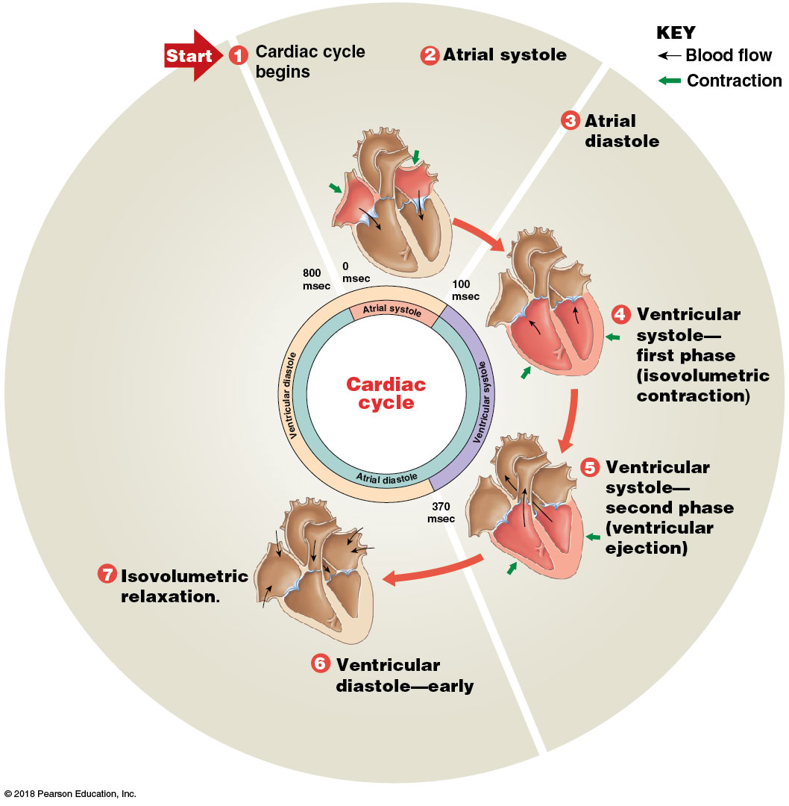
Module 18.10: The cardiac cycle creates pressure gradients that maintain blood flow
Phases of cardiac cycle (continued)
​Isovolumetric relaxation. All valves closed; no volume change; blood passively filling atria

Slide 80
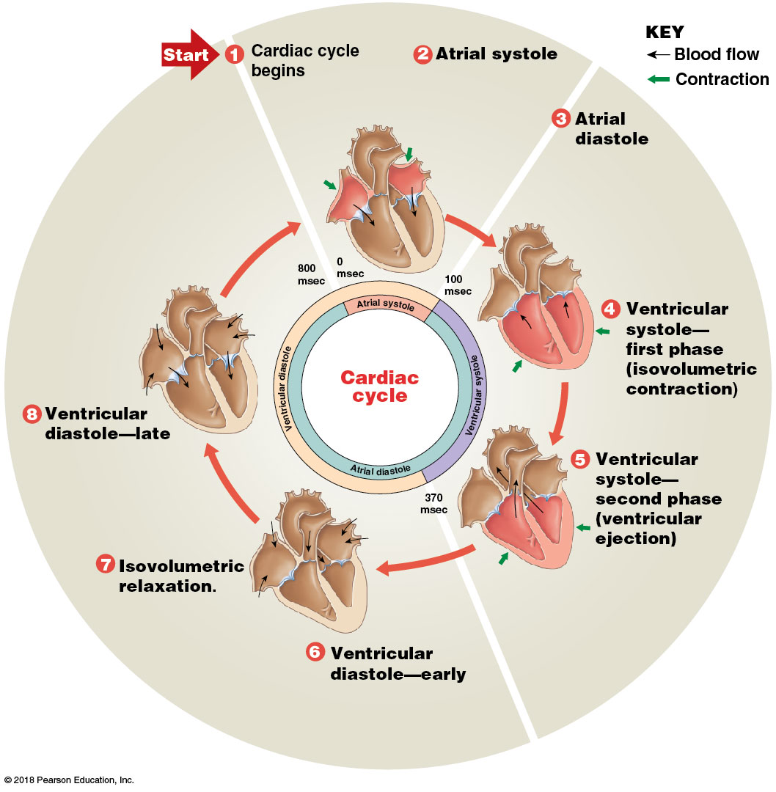
Module 18.10: The cardiac cycle creates pressure gradients that maintain blood flow
Phases of cardiac cycle (continued)
​Ventricular diastole—late. All chambers relaxed; AV valves open; ventricles fill passively to ~70%

Slide 81
SmartArt Video: The cardiac cycle

Slide 82
Module 18.10: The cardiac cycle creates pressure gradients that maintain blood flow
Pressure changes in aorta during the cardiac cycle
Increase in pressure with opening of aortic valve
Drop in pressure with closing of aortic valve
Followed by a short pressure rise as aortic elastic walls recoil
Produces a valley in pressure tracing called the dicrotic notch (dikrotos, double beating)

Slide 83
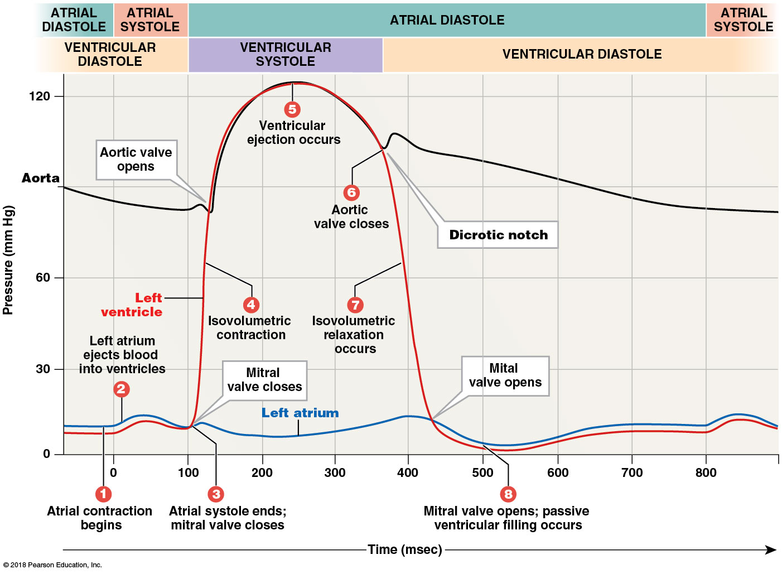
Pressure changes in aorta and left chambers during the cardiac cycle. Note the dicrotic notch, which occurs when the elastic walls of the aorta expand to receive incoming blood. The peak that follows shows the effect of elastic recoil.
Notes:
This is one of the most complex figures A&P students see. It is challenging for many of them. Help them interpret it by showing them the time scale and explaining that it is a plot of several things that occur simultaneously. Ask questions to direct them through interpretation of the image and be sure they understand each component individually and as it relates to the other parts. If students focus on the valve actions and understand why those occur, the rest begins to make sense.

Slide 84
Module 18.10: The cardiac cycle creates pressure gradients that maintain blood flow
Heart sounds
S₁ ( “lubb”)—when AV valves close; marks start of ventricular contraction
S₂ (“dupp”)—when semilunar valves close
S₃ and S₄—very faint; rarely heard in adults
S₃—blood flowing into ventricles
S₄—atrial contraction

Slide 85
Module 18.10: Review
List the phases of the cardiac cycle.
What are the two phases of ventricular systole?
Is the heart always pumping blood when pressure in the left ventricle is rising? Explain.
Learning Outcome: Explain the events of the cardiac cycle, and relate the heart sounds to specific events.

Slide 86
Module 18.11: Cardiac muscle cell contractions last longer than skeletal muscle fiber contractions primarily because of differences in calcium ion membrane permeability
Skeletal Muscle | Cardiac Muscle
Brief action potential; ends as short twitch contraction begins. Contraction ends when sarcoplasmic reticulum reclaims Ca²⁺ Short refractory period ends before peak tension develops Twitches can summate; tetanus can occur | Long action potential Ca²⁺ enters cells over prolonged period Long contraction (~250 msec) Refractory period continues into relaxation No tetanic contractions occur (heart couldn’t pump blood)
Notes:
Remind students of the role of Ca²⁺ in muscle contraction and relaxation, and review the refractory period. Also be sure they recall the meaning of twitch and tetany.
Additional resources: PhysioEx 9.1, Ex 6.1: Cardiac Muscle Refractory Period.

Slide 87
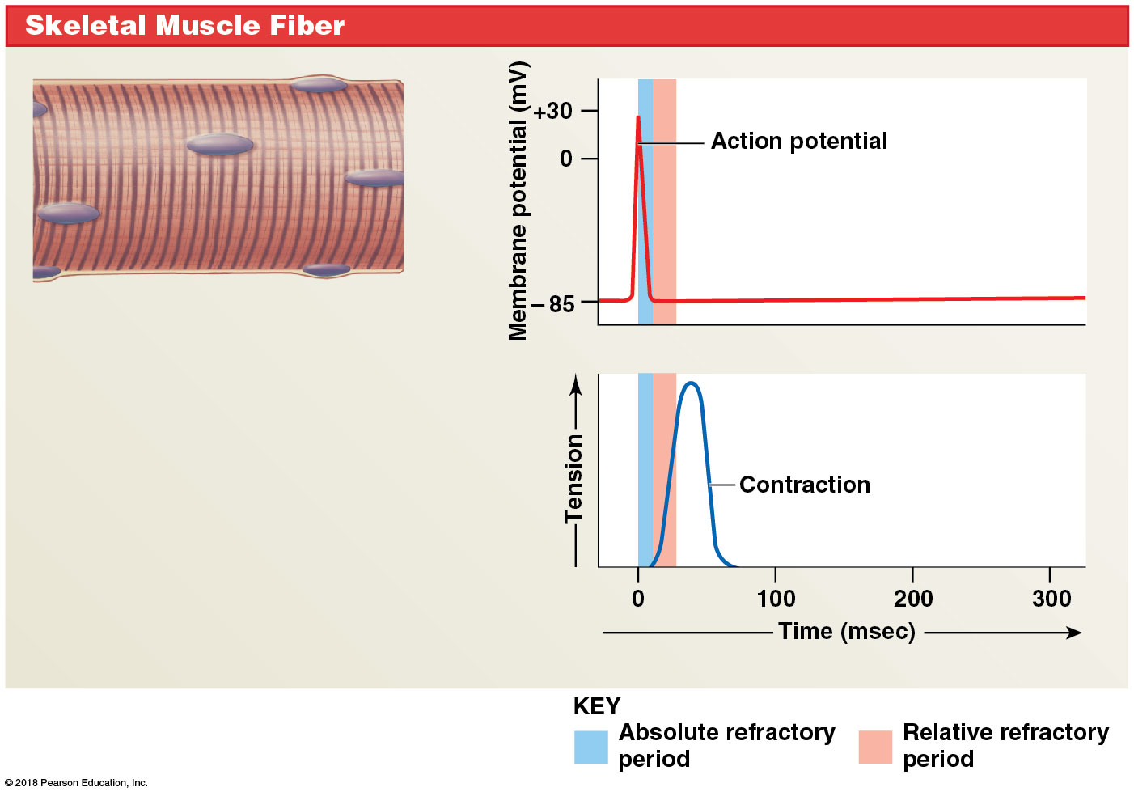
Skeletal muscle fiber contraction
Skeletal Muscle
Notes:
Note the short action potential, contraction, and refractory period.

Slide 88
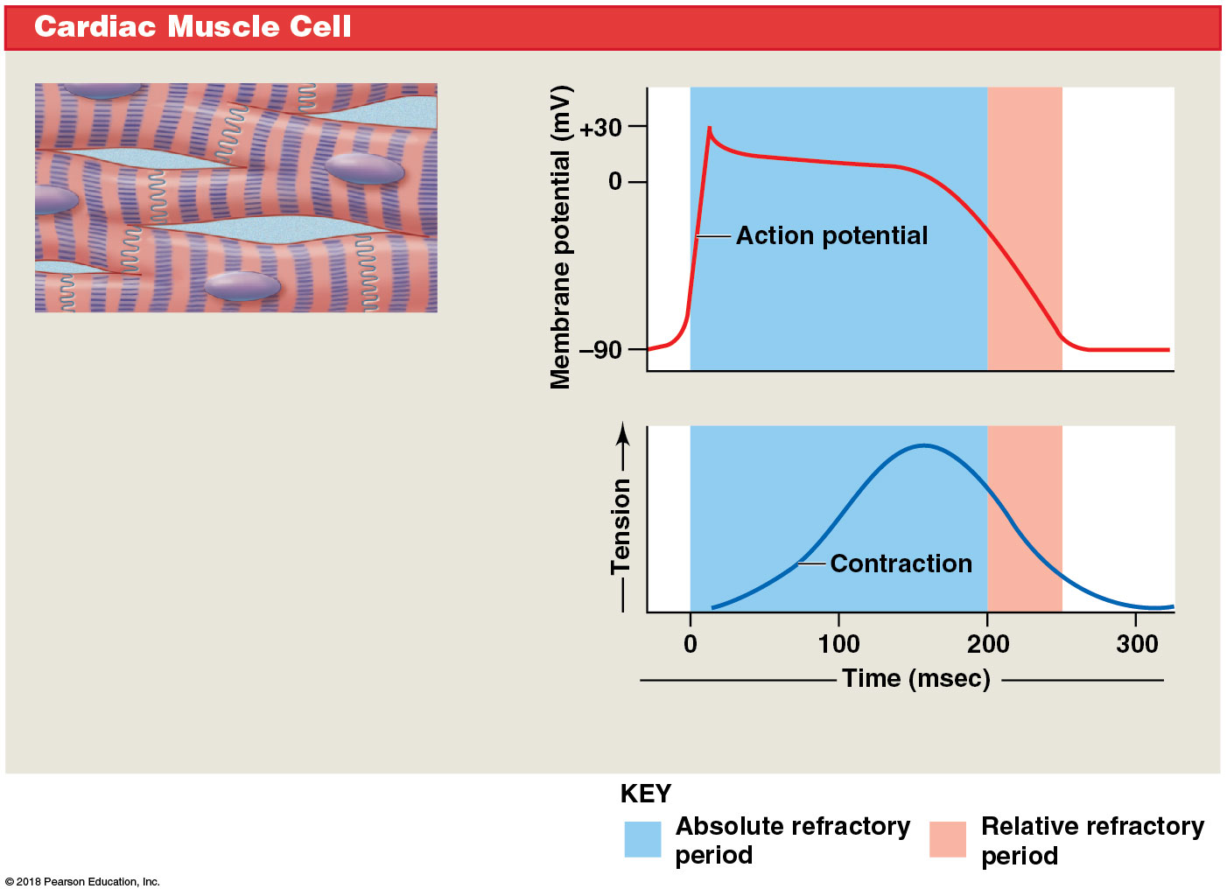
Cardiac muscle cell contraction
Skeletal Muscle
Notes:
Note the prolonged action potential that occurs because extracellular Ca²⁺ enters the cell for an extended period, maintaining the stimulation. The refractory period continues into relaxation, preventing summation and tetany so the heart can continue contracting to pump blood.

Slide 89
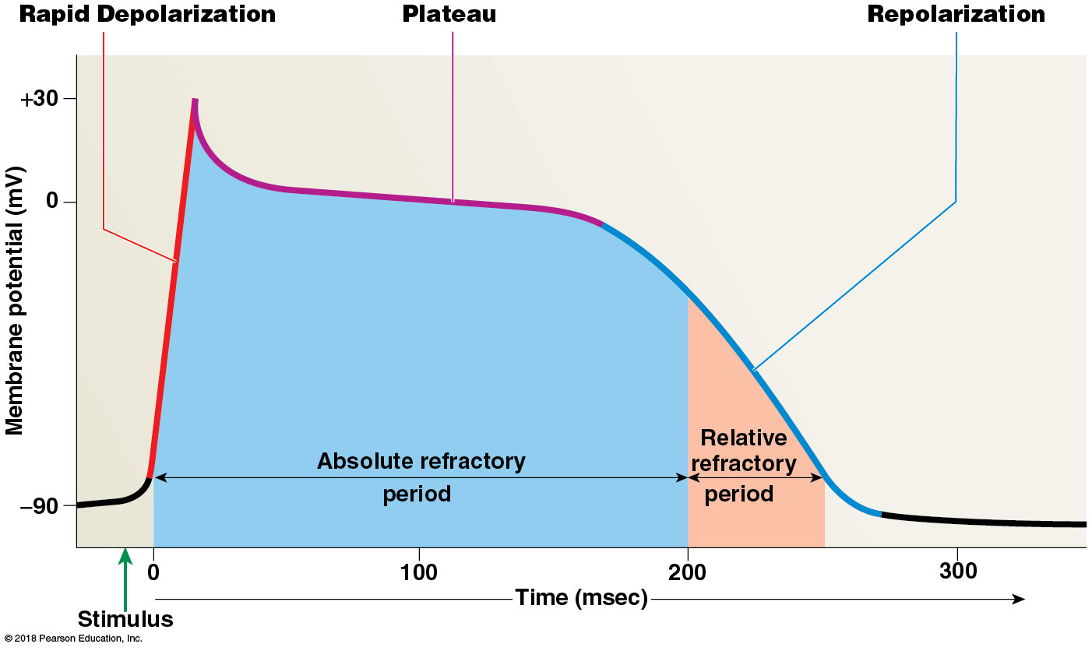
Module 18.11: Cardiac muscle cell contraction
Three stages of a cardiac muscle action potential
Rapid depolarization
Plateau
Repolarization

Slide 90
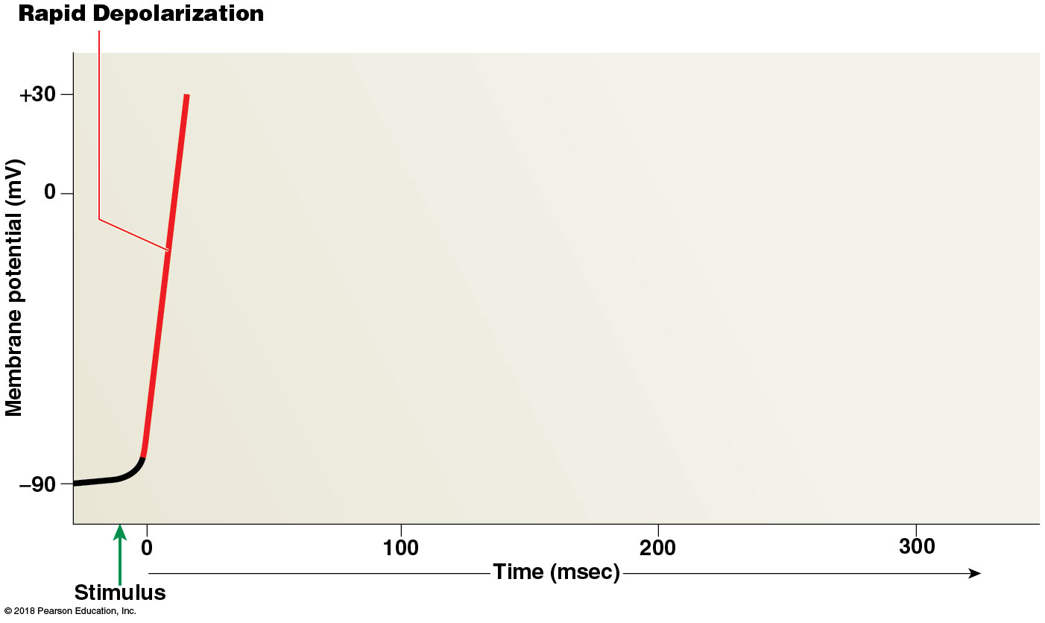
Module 18.11: Cardiac muscle cell contraction
​Rapid depolarization—similar to that in skeletal muscle
At threshold, voltage-gated fast sodium channels open
Massive, rapid Na⁺ influx
Channels open quickly and very briefly
Notes:
Before beginning this, if it has been some time since students learned the muscle system, consider reviewing the steps of action potential generation and muscle contraction.

Slide 91
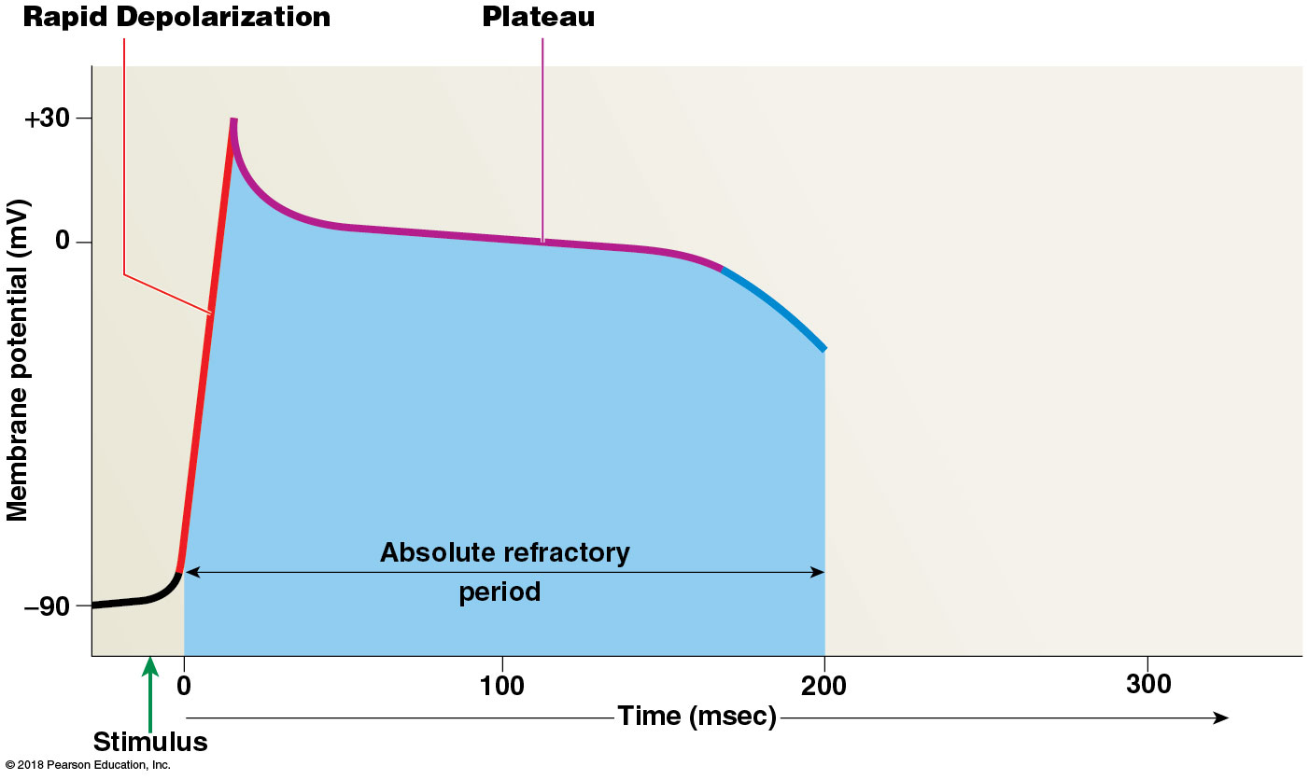
Module 18.11: Cardiac muscle cell contraction
​Plateau
Membrane potential stays near 0 mV due to 2 opposing factors:
Fast sodium channels close as potential nears +30 mV
Cell actively pumps Na⁺ out
Voltage-gated slow calcium channels open— Ca²⁺ influx (open slowly/stay open ~175 msec)

Slide 92
Module 18.11: Cardiac muscle cell contraction.
​Repolarization
Slow calcium channels close
Slow potassium channels open; K⁺ rushes out; causes rapid repolarization and restores resting potential

Slide 93
Module 18.11: Review
Why does tetany not occur in cardiac muscle?
List the three stages of an action potential in a cardiac muscle cell.
Describe slow calcium channels and the significance of their activity.
Learning Outcome: Describe an action potential in cardiac muscle, and explain the role of calcium ions.

Slide 94
Module 18.12: Electrical events of pacemaker cells and conducting cells establish the heart rate
Cardiac output (CO) = amount of blood pumped from the left ventricle each minute
Determined by heart rate and stroke volume
Precisely adjusted to meet needs of tissues
Notes:
Students often confuse stroke volume (volume ejected per contraction) and cardiac output (volume ejected per minute).
Additional resources: IP2—Electrical Activity of the Heart.

Slide 95
Module 18.12: Cardiac conducting system
To calculate cardiac output:
Cardiac Output = HR × SV
Heart rate (HR) = # contractions/minute (beats per minute)
Stroke volume = volume of blood pumped out of ventricle per contraction
By changing either or both HR and SV, cardiac output is precisely controlled to meet changing needs of tissues.

Slide 96
Module 18.12: Cardiac conducting system
Autorhythmicity = cardiac muscle’s ability to contract at its own pace independent of neural or hormonal stimulation
Conducting system = network of specialized cardiac muscle cells (pacemaker and conducting cells) that initiate/distribute a stimulus to contract
Components of conducting system:
Sinoatrial node (SA node)
Internodal pathways
Atrioventricular node (AV node)
AV bundle and bundle branches
Purkinje fibers

Slide 97
Module 18.12: Cardiac conducting system
Conducting system (continued)
​Sinoatrial (SA) node
= pacemaker
Each heartbeat begins with action potential generated here
In posterior wall of right atrium, near superior vena cava
Impulse is initiated here and spreads through adjacent cells
Average 60–100 bpm

Slide 98
Module 18.12: Cardiac conducting system
Conducting system (continued)
​Internodal pathways
Formed by conducting cells
Distribute signal through both atria

Slide 99
Module 18.12: Cardiac conducting system
Conducting system (continued)
​Atrioventricular (AV) node
At junction between atria and ventricles
Relays signals from atria to ventricles
Has pacemaker cells that can take over pacing if SA node fails
AV pacing is slower—40 to 60 bpm

Slide 100
Module 18.12: Cardiac conducting system
Conducting system (continued)
​AV bundle
Conducting cells transmit signal from AV node down through interventricular septum
Usually only electrical connection between atria/ ventricles

Slide 101
Module 18.12: Cardiac conducting system
Conducting system (continued)
​Bundle branches
Right and left branches
Left bundle branch larger
Conducting cells transmit signal to apex of heart, then spreading out in ventricular walls

Slide 102
Module 18.12: Cardiac conducting system
Conducting system (continued)
​Purkinje fibers
Radiate upward through ventricular walls
Large-diameter conducting cells
Propagate action potentials as fast as myelinated neurons
Stimulate ventricular myocardium and trigger contraction

Slide 103
Components of the cardiac conducting system

Slide 104
The cardiac conduction system’s coordination of the cardiac cycle
Notes:
Clarify for students that the electrical signals in the heart are self-generated, rather than coming from nerves, and be sure they understand that the electrical activity leads to the mechanical activity—contraction.

Slide 105
The cardiac conduction system’s coordination of the cardiac cycle
Notes:
Clarify for students that the electrical signals in the heart are self-generated, rather than coming from nerves, and be sure they understand that the electrical activity leads to the mechanical activity—contraction.

Slide 106
The cardiac conduction system’s coordination of the cardiac cycle

Slide 107
SmartArt Video: The conducting system of the heart

Slide 108
Module 18.12: Review
Define autorhythmicity.
If the cells of the SA node failed to function, how would the heart rate be affected?
Why is it important for impulses from the atria to be delayed at the AV node before they pass into the ventricles?
Learning Outcome: Describe the components and functions of the conducting system of the heart.

Slide 109
Module 18.13: Normal and abnormal cardiac activity can be detected in an electrocardiogram
Electrocardiogram (ECG or EKG)
Recording of heart’s electrical activities from body surface
To assess performance of nodal, conducting, and contractile components
If part of heart is damaged by heart attack, may see abnormal ECG pattern
Appearance varies with placement and number of electrodes (leads)

Slide 110
Module 18.13: ECG
Explanation of ECG features
P wave = atrial depolarization
Atria begin contracting ~25 msec after P wave starts

Slide 111
Module 18.13: ECG
Explanation of ECG features (continued)
QRS complex = ventricular depolarization
Larger wave due to larger ventricle muscle mass
Ventricles begin contracting shortly after R wave peak
Atrial repolarization also occurs now but is masked by QRS

Slide 112
Module 18.13: ECG
Explanation of ECG features (continued)
T wave = ventricular repolarization

Slide 113
Module 18.13: ECG
Explanation of ECG features (continued)
P–R interval
Period from start of atrial depolarization to start of ventricular depolarization
>200 msec may mean damage to conducting pathways or AV node

Slide 114
Module 18.13: ECG
Explanation of ECG features (continued)
Q–T interval
Time for ventricles to undergo a single cycle
May be lengthened by electrolyte disturbances, medications, conduction problems, coronary ischemia, myocardial damage

Slide 115
Module 18.13: ECG and arrhythmias
ECGs valuable for detecting/and diagnosing arrhythmias
Cardiac arrhythmias = abnormal patterns of cardiac electrical activity
About 5% of healthy people experience a few abnormal heartbeats each day
Not a clinical problem unless pumping efficiency is reduced

Slide 116
Module 18.13: Arrhythmias
Cardiac arrhythmias (continued)
Premature atrial contractions (PACs)
Often occur in healthy people
Normal atrial rhythm momentarily interrupted by “surprise” atrial contraction
Increased incidences caused by stress, caffeine, various drugs that increase permeability of the SA pacemakers
Normal ventricular contraction follows the atrial beat

Slide 117
Module 18.13: Arrhythmias
Cardiac arrhythmias (continued)
Paroxysmal atrial tachycardia (PAT)
Premature atrial contraction triggers flurry of atrial activity
Ventricles keep pace
Heart rate jumps to about 180 bpm

Slide 118
Module 18.13: Arrhythmias
Cardiac arrhythmias (continued)
Atrial fibrillation
Impulses move over atrial surface at up to 500 bpm
Atria quiver—not organized contraction
Ventricular rate cannot follow, may remain fairly normal
Atria nonfunctional, but ventricles still fill passively
Person may not realize there is an arrhythmia
Notes:
Although the heart will still pump blood, flow through the atria is sluggish. Due to this, people with A-fib have an elevated risk of forming blood clots. Consequently, they are usually placed on blood thinner medications to reduce their greater risk of heart attack, emboli, and stroke.

Slide 119
Module 18.13: Arrhythmias
Cardiac arrhythmias (continued)
Premature ventricular contractions (PVCs)
Purkinje cell or ventricular myocardial cell depolarizes; triggers premature contraction
Cell responsible called an ectopic pacemaker (pacemaker other than the SA node)
Single PVCs common, not dangerous
Frequency increased by epinephrine, stimulatory drugs, or ionic changes that depolarize cardiac muscle cells

Slide 120
Module 18.13: Arrhythmias
Cardiac arrhythmias (continued)
Ventricular tachycardia
Also known as VT or V-tach
Defined as four or more PVCs without intervening normal beats
Multiple PVCs and V-tach may indicate serious cardiac problems

Slide 121
Module 18.13: Arrhythmias
Cardiac arrhythmias (continued)
Ventricular fibrillation
Also known as VF or V-fib
Responsible for condition known as cardiac arrest
Rapidly fatal because ventricles quiver, but cannot pump any blood

Slide 122
Module 18.13: Review
Define electrocardiogram.
List the important features of the ECG, and indicate what each represents.
Why is ventricular fibrillation fatal?
Learning Outcome: Identify the electrical events shown on an electrocardiogram.

Slide 123
Module 18.14: The intrinsic heart rate can be altered by autonomic activity
Pacemaker potential
Pacemaker cells in SA/AV nodes cannot maintain a stable resting membrane potential; membrane drifts toward threshold
Pacemaker potential = the gradual spontaneous depolarization

Slide 124
Module 18.14: The intrinsic heart rate can be altered by autonomic activity
Pacemaker potential (continued)
Pacemaker potential in SA node cells occurs 80–100 times/min
Establishes heart rate
SA node brings AV nodal cells to threshold before they reach it on their own, thus SA node paces the heart

Slide 125
Module 18.14: Autonomic effects on heart rate
Parasympathetic influence
Parasympathetic stimulation decreases heart rate
ACh from parasympathetic neurons:
Opens K⁺ channels in plasma membrane
Hyperpolarizes membrane
Slows rate of spontaneous depolarization
Lengthens repolarization

Slide 126
Module 18.14: Autonomic effects on heart rate
Sympathetic influence
Sympathetic stimulation increases heart rate
Binding of norepinephrine to beta-1 receptors opens ion channels
Increases rate of depolarization
Decreases repolarization

Slide 127
Module 18.14: Autonomic effects on heart rate
Resting heart rate
Varies with age, general health, physical conditioning
Normal range is 60–100 bpm
Bradycardia
Heart rate slower than normal (<60 bpm)
Tachycardia
Heart rate faster than normal (>100 bpm)
Notes:
These are not always indicators of poor heart health. Well-trained athletes often have low resting heart rates because their hearts become more efficient through training. Heart rate also drops while sleeping, and it easily goes above 100 bpm during physical exertion to increase cardiac output.

Slide 128
Module 18.14: Autonomic effects on heart rate
Cardiac centers of the medulla oblongata
Cardioinhibitory center
Controls parasympathetic neurons; slows heart rate
Parasympathetic supply to heart via vagus nerve (X); synapse in cardiac plexus
Postganglionic fibers to SA/AV nodes, atrial musculature
Cardioacceleratory center
Controls sympathetic neurons; increases heart rate
Sympathetic innervation to heart via postganglionic fibers in cardiac nerves; innervate nodes, conducting system, atrial and ventricular myocardium

Slide 129
The cardiac centers and innervation of the heart

Slide 130
Module 18.14: Review
Compare bradycardia with tachycardia.
Describe the sites and actions of the cardioinhibitory and cardioacceleratory centers.
Caffeine has effects on conducting cells and contractile cells that are similar to those of NE. What effect would drinking large amounts of caffeinated beverages have on the heart rate?
Learning Outcome: Describe the factors affecting the heart rate.

Slide 131
Module 18.15: Stroke volume depends on the relationship between end-diastolic volume and end-systolic volume
Stroke volume analogy
Stroke volume can be compared to pumping water with a manual pump
Amount pumped varies with pump handle movement
Heart has two pumps (ventricles) that pump same volume
Can use single pump as model

Slide 132
Module 18.15: Stroke volume analogy
As pump handle raises, pressure in cylinder decreases; water enters through one-way valve. Corresponds to passive filling during ventricular diastole
Notes:
This series of slides is based on an analogy—be sure your students follow the analogy correctly.

Slide 133
Module 18.15: Stroke volume analogy
At the start of pumping (cardiac) cycle:
Water in pump cylinder = blood in ventricle at end of ventricular diastole or the end-diastolic volume (EDV)
Notes:
The terms end-diastolic volume and end-systolic volume intimidate some students, but not if they think about what the terms literally mean. End-diastolic volume is the volume at the very end of diastole, which is immediately before the ventricles contract. Put simply—it is the volume of blood in the ventricle when it is maximally full. Similarly, ESV is the volume in the ventricle at the end of systole. Put simply, it’s how much remains in the heart after contraction. EDV is the volume before contraction, ESV is what’s left after contraction.

Slide 134
Module 18.15: Stroke volume analogy
As the pump handle comes down, water is forced out.
Corresponds to ventricular ejection

Slide 135
Module 18.15: Stroke volume analogy
Handle fully depressed, water remaining in cylinder = blood in ventricles at end of systole, or end-systolic volume (ESV)
Amount of water pumped out = stroke volume
Stroke volume = EDV – ESV

Slide 136
Module 18.15: Factors affecting stroke volume
Factors affecting stroke volume
End-diastolic volume (EDV)
Venous return = amount of venous blood returned to the right atrium
Varies directly with blood volume, muscular activity, and rate of blood flow
Filling time = length of ventricular diastole; the longer it is, the more filling occurs (higher EDV)

Slide 137
Module 18.15: Factors affecting stroke volume
Factors affecting stroke volume (continued)
Preload = amount of myocardial stretch
Greater EDV causes greater preload; more stretching causes stronger contractions and more blood being ejected (Frank-Starling law of the heart)

Slide 138
Module 18.15: Factors affecting stroke volume
Factors affecting stroke volume
Influences on ESV
Contractility = amount of force produced during contraction at a given preload
Increased by sympathetic stimulation, some hormones (epinephrine, norepinephrine, thyroid hormone, glucagon)
Reduced by “beta blockers” and calcium channel blockers

Slide 139
Module 18.15: Factors affecting stroke volume
Factors affecting stroke volume (continued)
Afterload = ventricular tension required to open semilunar valves and empty
As afterload increases, stroke volume decreases
Afterload increases whenever blood flow is restricted, such as with vasoconstriction

Slide 140
Module 18.15: Review
Define end-diastolic volume (EDV) and end-systolic volume (ESV).
What effect would an increase in venous return have on the stroke volume?
What effect would an increase in sympathetic stimulation of the heart have on the end-systolic volume (ESV)?
Learning Outcome: Describe the variables that influence stroke volume.

Slide 141
Module 18.16: Cardiac output is regulated by adjustments in heart rate and stroke volume
Factors affecting cardiac output
Cardiac output varies widely to meet metabolic demands
Cardiac output can be changed by affecting either heart rate or stroke volume
Heart failure = condition in which the heart cannot meet the demands of peripheral tissues
Notes:
Additional resources: IP2—Cardiac Output.

Slide 142
Module 18.16: Cardiac output adjustment
Notes:
This is a complex figure so your students may benefit from going through it carefully together.

Slide 143
Module 18.15: Review
Define heart failure.
Compute Joe’s stroke volume if his end-systolic volume (ESV) is 40 mL and his end-diastolic volume (EDV) is 125 mL.
Learning Outcome: Explain how stroke volume and cardiac output are coordinated.

