Slide 2
Note to the Instructor:
For the third edition of Visual Anatomy & Physiology, we have updated our PowerPoints to fully integrate text and art. The pedagogy now more closely matches that of the textbook. The goal of this revised formatting is to help your students learn from the art more effectively. However, you will notice that the labels on the embedded PowerPoint art are not editable. You can easily import editable art by doing the following:
Copying slides from one slide set into another
You can easily copy the Label Edit art into the Lecture Presentations by using either the PowerPoint Slide Finder dialog box or Slide Sorter view. Using the Slide Finder dialog box allows you to explicitly retain the source formatting of the slides you insert.
Using the Slide Finder dialog box in PowerPoint:
Open the original slide set in PowerPoint.
On the Slides tab in Normal view, click the slide thumbnail that you want the copied slides to follow.
On the toolbar at the top of the window, click the drop down arrow on the New Slide tab. Select Reuse Slides.
Click Browse to look for the file; in the Browse dialog box, select the file, and then click Open.
If you want the new slides to keep their current formatting, in the Slide Finder dialog box, select the Keep source formatting checkbox. When this checkbox is cleared, the copied slides assume the formatting of the slide they are inserted after.
To insert selected slides: Click the slides you want to insert. Slides will place immediately after the slide you have selected in the Slides tab in Normal view.

Slide 3
Section 1: Functional Anatomy of Blood Vessels
Learning Outcomes
19.1 Distinguish between the pulmonary and systemic circuits, and identify afferent and efferent blood vessels.
19.2 Distinguish among the types of blood vessels on the basis of their structure and function.
19.3 Describe the structures of capillaries and their functions in the exchange of dissolved materials between blood and interstitial fluid.
19.4 Describe the venous system, and indicate the distribution of blood within the cardiovascular system.

Slide 4
Module 19.1: The heart pumps blood, in sequence, through the arteries, capillaries, and veins of the pulmonary and systemic circuits
Blood vessels
Blood vessels conduct blood between the heart and peripheral tissues
Arteries (carry blood away from the heart)
Also called efferent vessels
Veins (carry blood to the heart)
Also called afferent vessels
Capillaries (exchange substances between blood and tissues)
Interconnect smallest arteries and smallest veins

Slide 5
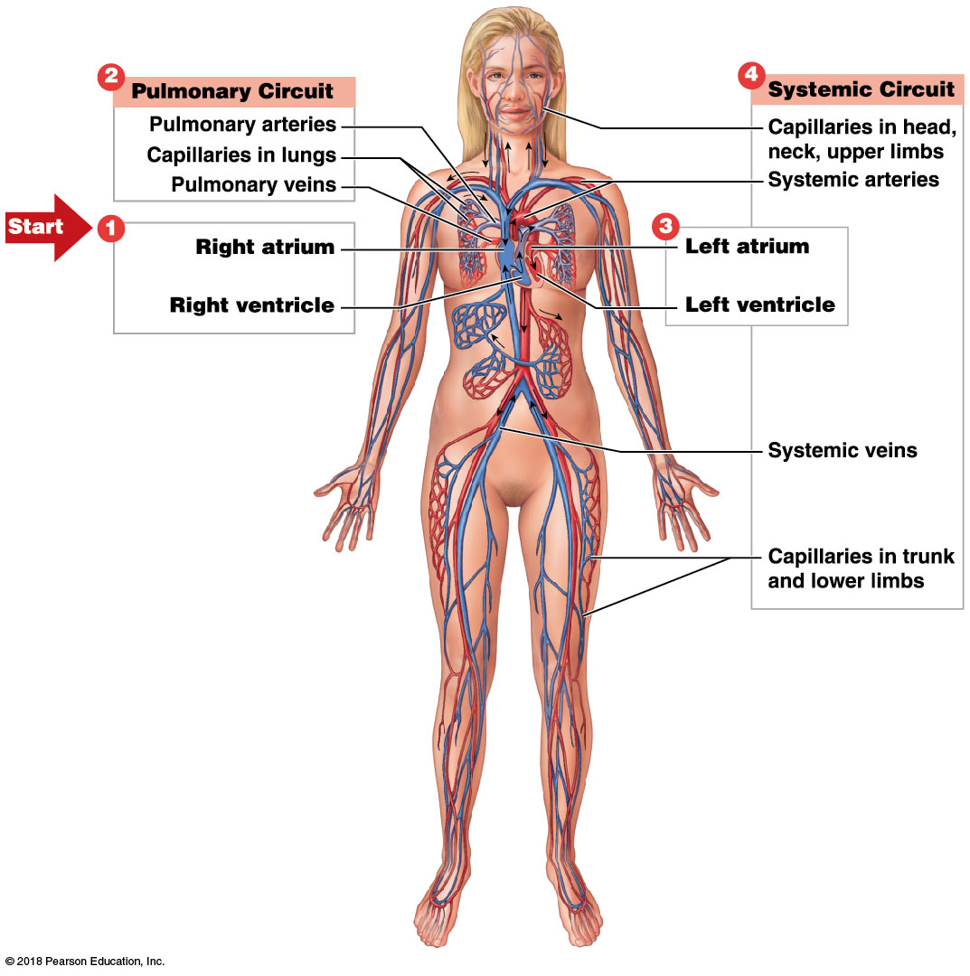
Module 19.1: Blood vessels and circuits
Two circuits
​Pulmonary circuit
To and from gas exchange surfaces in the lungs
​Systemic circuit
To and from rest of body

Slide 6
Module 19.1: Blood vessels and circuits
Circulation pathway through circuits
​Right atrium (entry chamber)
Collects blood from systemic circuit
To right ventricle to pulmonary circuit
​Pulmonary circuit
Pulmonary arteries to pulmonary capillaries to pulmonary veins

Slide 7
Module 19.1: Blood vessels and circuits
Circulation pathway through circuits (continued)
​Left atrium
Receives blood from pulmonary circuit
To left ventricle to systemic circuit
​Systemic circuit
Systemic arteries to systemic capillaries to systemic veins

Slide 8
Circulation pathway through the circuits

Slide 9
Module 19.1: Review
Describe the pulmonary circuit.
Describe the systemic circuit.
Which chamber of the heart receives blood from the systemic circuit?
Distinguish among efferent vessels, afferent vessels, and exchange vessels.
Learning Outcome: Distinguish between the pulmonary and systemic circuits, and identify afferent and efferent blood vessels.

Slide 10
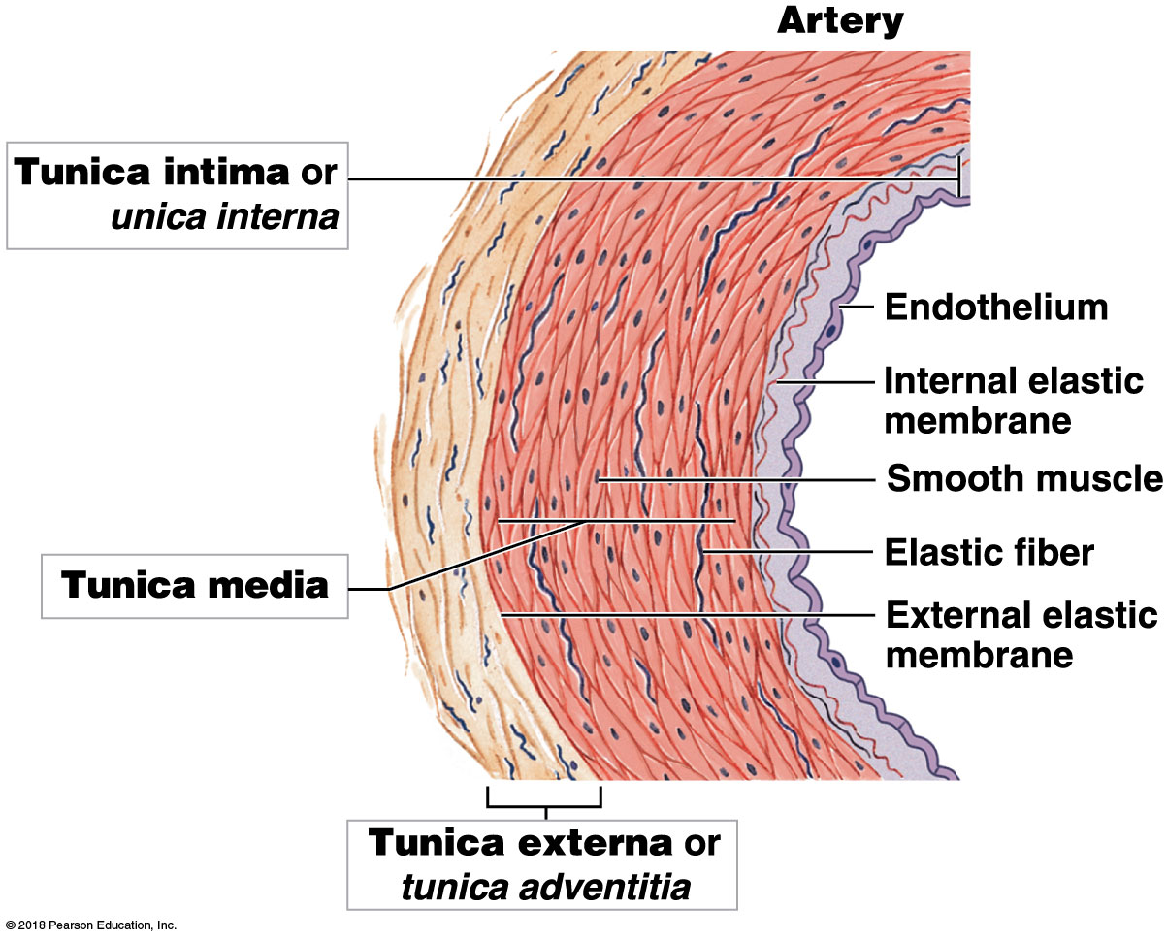
Module 19.2: Arteries and veins differ in the structure and thickness of their walls
Three layers of arteries and veins
​Tunica intima, or tunica interna
Innermost layer
Endothelial cells with connective tissue with elastic fibers
In arteries, outer margin has layer of elastic fibers (internal elastic membrane)
Notes:
Ask students which side of the image represents the inside of a vessel, and how they can tell. This gets them examining the image more closely and they should note the curvature and relate that to vessel structure, and hopefully they will gain better understanding of the names of the layers, instead of merely memorizing them.

Slide 11
Module 19.2: Arteries and veins
Three layers of arteries and veins (continued)
​Tunica media
Middle layer
Contains concentric sheets of smooth muscle
Contraction causes a decrease in vessel diameter, or vasoconstriction
Relaxation causes an increase in vessel diameter, or vasodilation
Separated from the tunica externa by the external elastic membrane

Slide 12
Module 19.2: Arteries and veins
Three layers of arteries and veins (continued)
​Tunica externa, or tunica adventitia
Outermost layer
Connective tissue sheath
In arteries, contains collagen and scattered elastic fibers
In veins, generally thicker than the tunica media
Contains networks of elastic fibers and bundles of smooth muscle cells
Anchors vessel to surrounding tissues

Slide 13
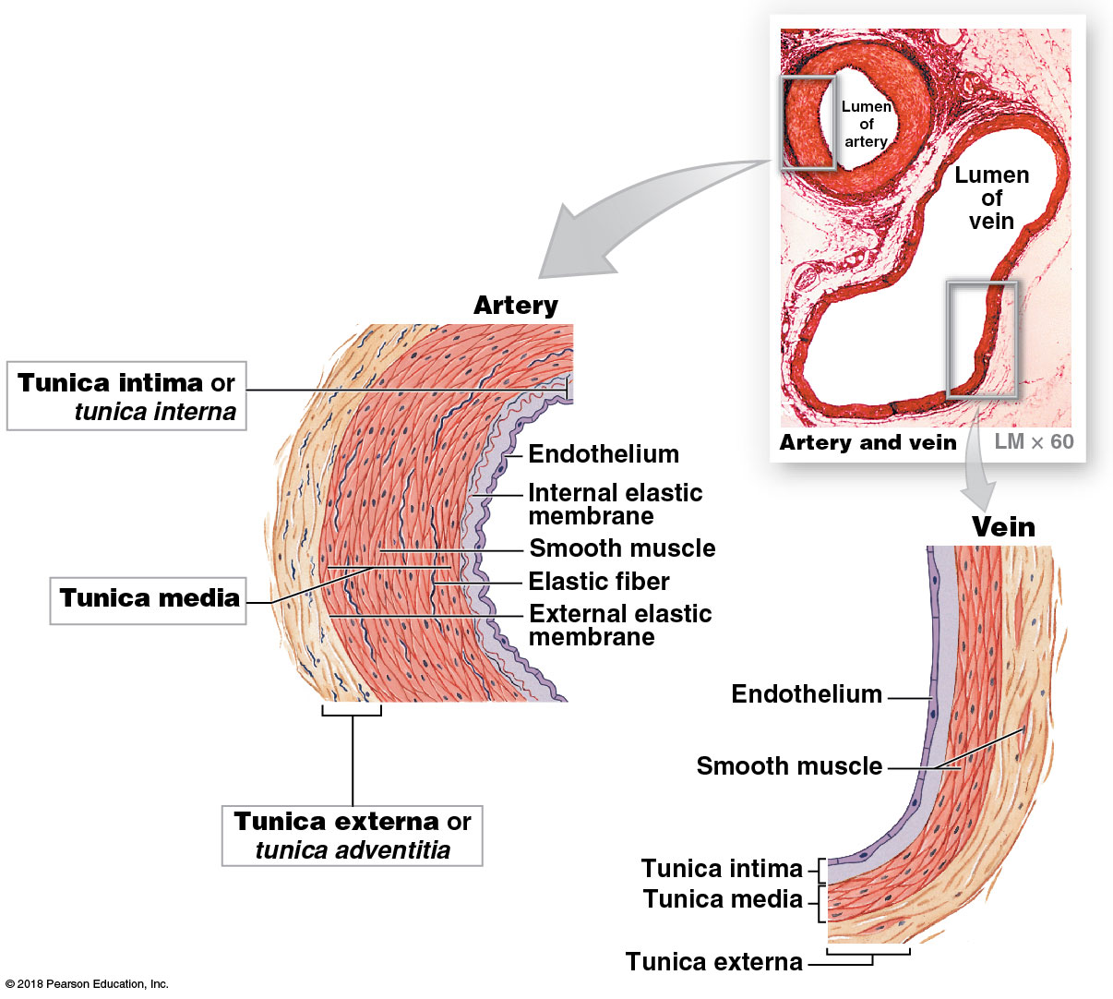
Blood vessel layers

Slide 14
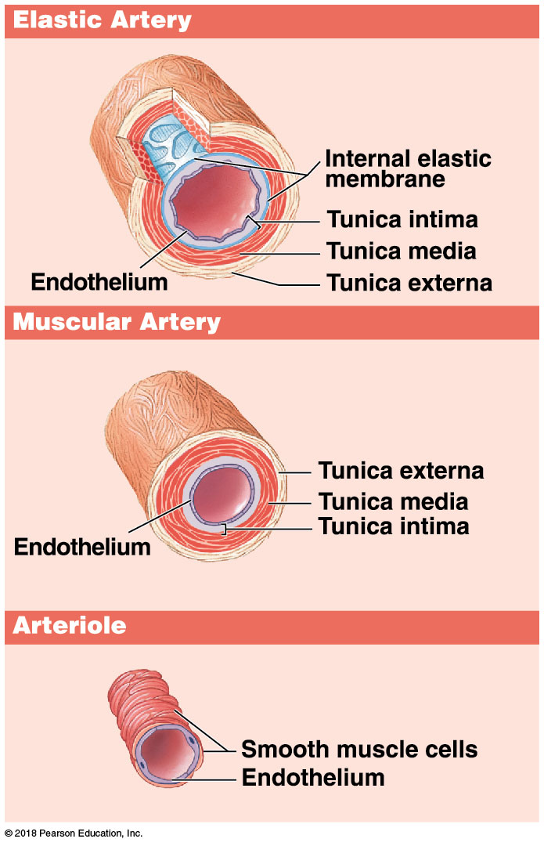
Module 19.2: Arteries and veins
Five general blood vessel classes
​Arteries
Elastic arteries
Large vessels close to the heart that stretch and recoil when heart beats
Include pulmonary trunk, aorta, and branches
Muscular arteries
Medium-sized arteries
Distribute blood to skeletal muscles and internal organs

Slide 15
Module 19.2: Arteries and veins
Five general blood vessel classes (continued)
​Arterioles
Poorly defined tunica externa
Tunica media is only 1–2 smooth muscle cells thick

Slide 16
Module 19.2: Arteries and veins
Five general blood vessel classes (continued)
​Capillaries
Only blood vessels to allow exchange between blood and interstitial fluid
Very thin walls allow easy diffusion
Notes:
Ask students to look at the image and determine what type of epithelium is shown. Ask why this is the best type for a capillary wall (simple squamous epithelium provides the thinnest barrier, allowing easy exchange across capillary walls).

Slide 17
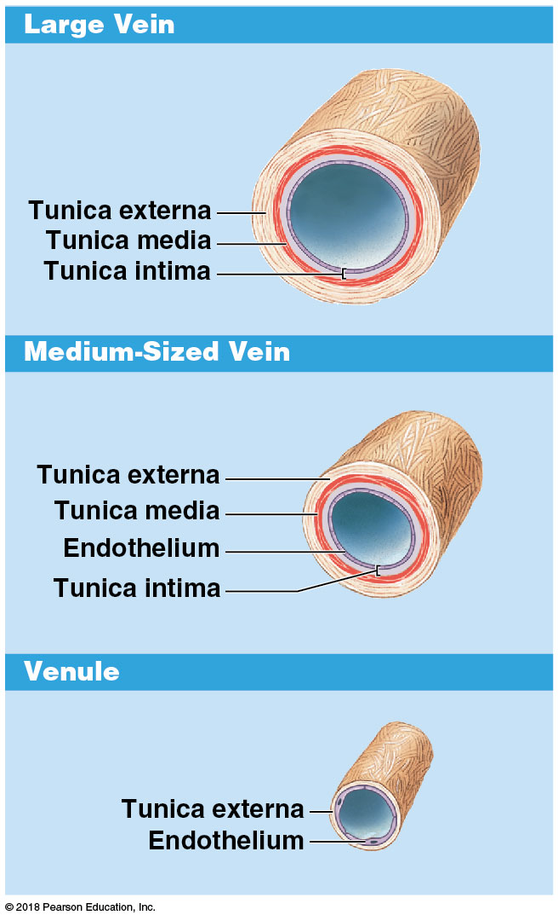
Module 19.2: Arteries and veins
Five general blood vessel classes (continued)
​Venules
Small veins
Those smaller than 50 µm lack a tunica media and resemble expanded capillaries
Collect blood from capillaries

Slide 18
Module 19.2: Arteries and veins
Five general blood vessel classes (continued)
​Veins
Medium-sized veins
Range from 2 to 9 mm in internal diameter
Thin tunica media with smooth muscle cells and collagen fibers
Thickest layer is tunica externa with longitudinal collagen and elastic fibers

Slide 19
Module 19.2: Arteries and veins
Five general blood vessel classes (continued)
​Veins (continued)
Large veins
Contain all three vessel wall layers
Thin tunica media surrounded by thick tunica externa
Include superior and inferior venae cavae and tributaries

Slide 20
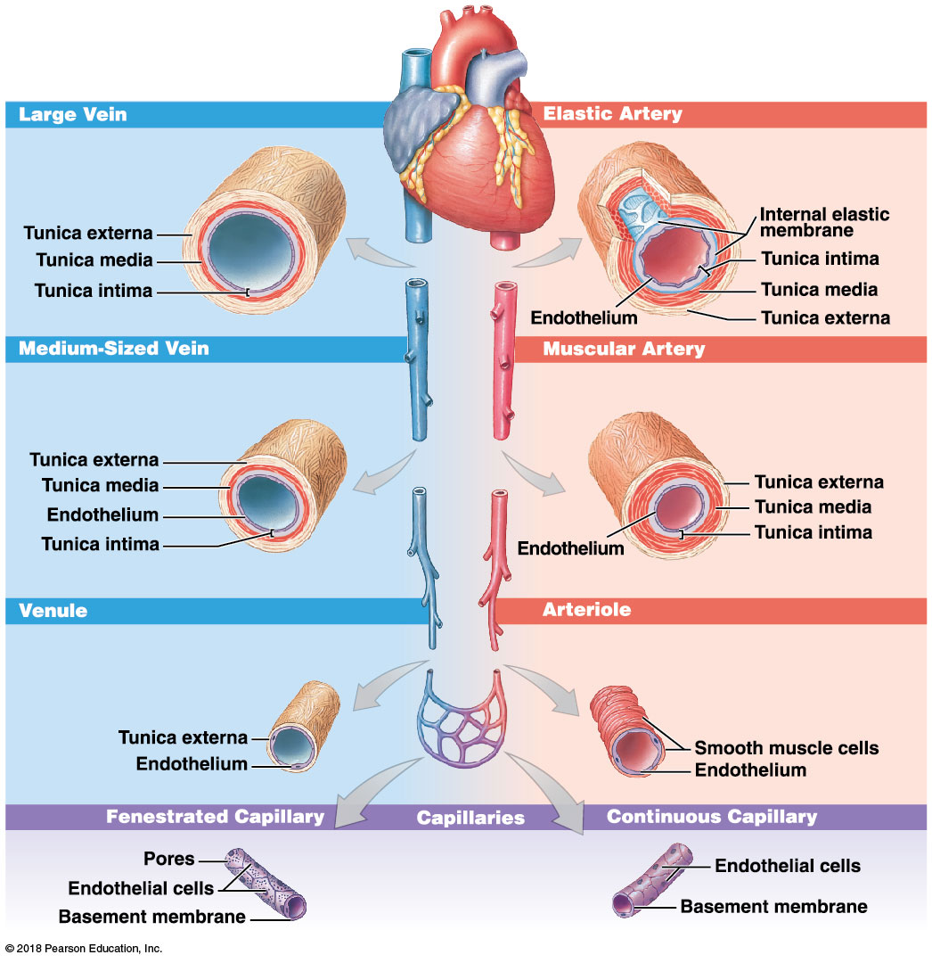
Blood vessels
Notes:
Because students tend to view images from left to right, some will see the veins on the left side and follow them down to the capillaries. Remind them to start at the heart with the arteries carrying blood away (right side) and to the capillaries, then it returns through the veins (left side).

Slide 21
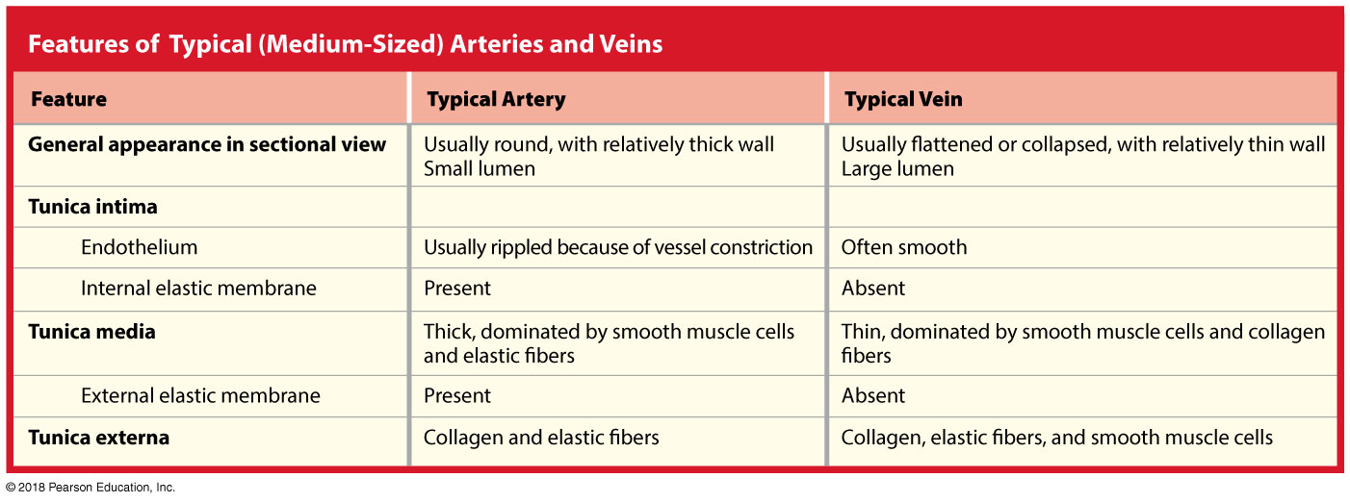

Slide 22
Module 19.2: Arteries and veins
Large vessel walls
Contain small arteries and veins for nourishment
Vasa vasorum, “vessels of vessels”

Slide 23
Module 19.2: Review
List the five general classes of blood vessels.
Describe a capillary.
Learning Outcome: Distinguish among the types of blood vessels on the basis of their structure and function.

Slide 24
Module 19.3: Capillary structure and capillary blood flow affect the rates of exchange between the blood and interstitial fluid
Typical capillary
Consists of a tube of endothelial cells with delicate basement membrane
Lacking both tunica media and tunica externa
Average diameter = 8 µm
About the same as a single RBC
Two major types
​Continuous capillaries
​Fenestrated capillaries

Slide 25
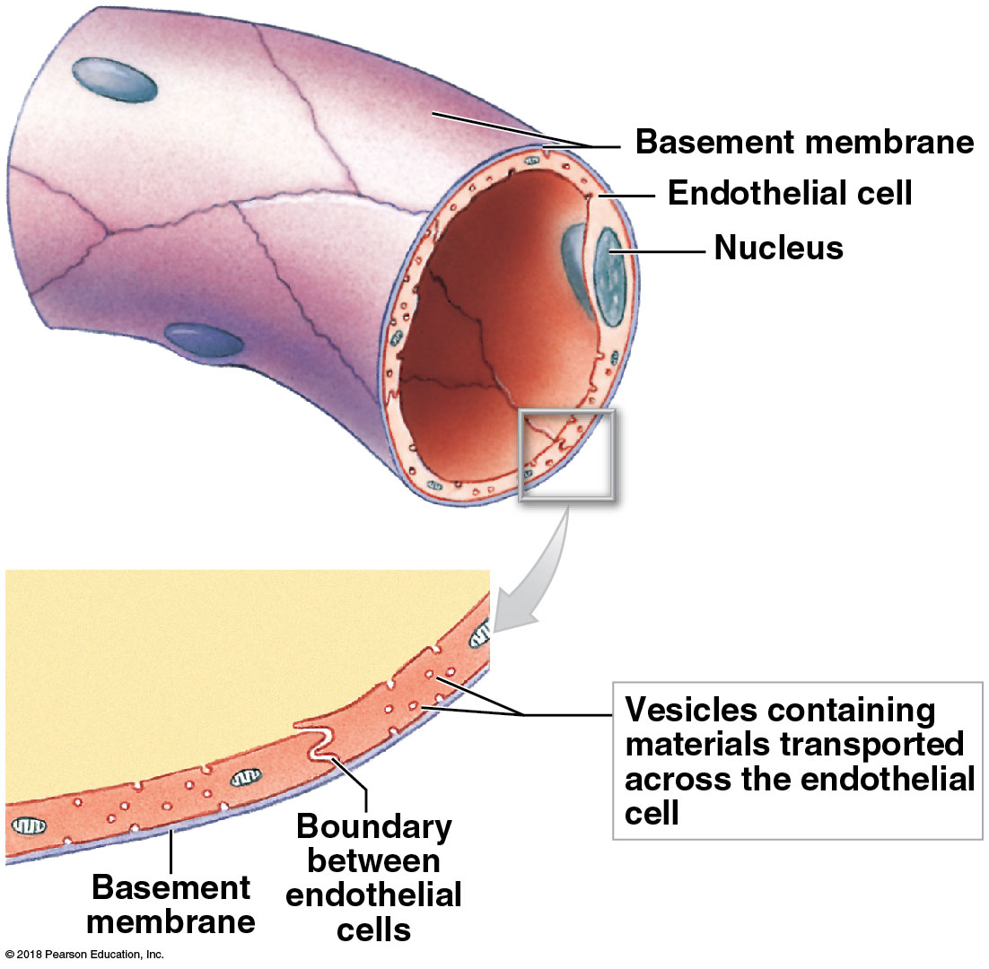
Module 19.3: Capillaries
Continuous capillary
Endothelium is a complete lining
Located throughout body in all tissues except epithelia and cartilage
Permits diffusion of water, small solutes, and lipid- soluble materials
Prevents loss of blood cells and plasma proteins
Some selective vesicular transport

Slide 26
Module 19.3: Capillaries
Continuous capillary (continued)
Specialized continuous capillaries in CNS and thymus have endothelial tight junctions
Enables restricted and regulated permeability

Slide 27
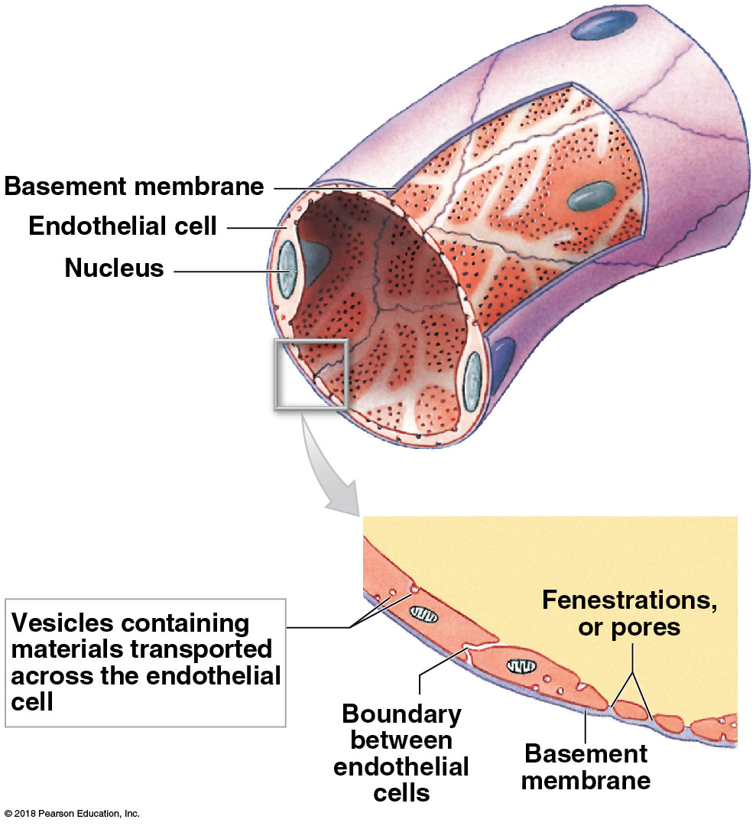
Module 19.3: Capillaries
Fenestrated (fenestra, window) capillary
Contains “windows,” or pores, penetrating endothelial lining
Permits rapid exchange of water and larger solutes

Slide 28
Module 19.3: Capillaries
Fenestrated capillary (continued)
Examples found in:
Choroid plexus of brain
Capillaries of hypothalamus, pituitary, pineal, and thyroid glands
Absorptive areas of intestinal tract
Kidney filtration sites

Slide 29
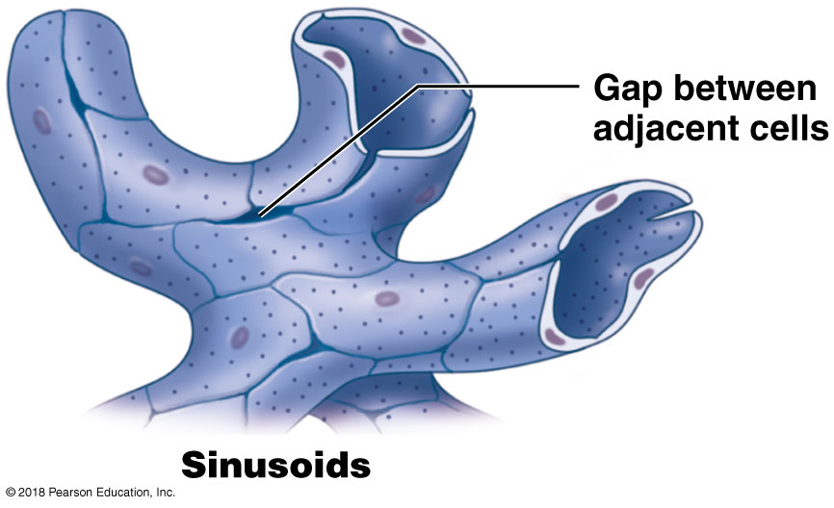
Module 19.3: Capillaries
Sinusoids (sinusoidal capillaries)
Resemble fenestrated capillaries that are flattened and irregularly shaped
Commonly have gaps between endothelial cells
Basement membrane is thin or absent

Slide 30
Module 19.3: Capillaries
Sinusoids (continued)
Permit more water and solute (plasma proteins) exchange
Occur in liver, bone marrow, spleen, and many endocrine organs

Slide 31
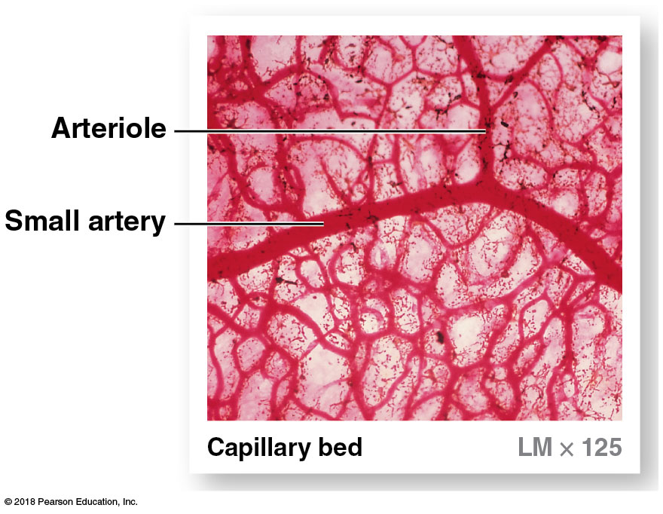
Module 19.3: Capillaries
Capillary bed
Interconnected network of capillaries
Contains several connections between arterioles and venules
Notes:
Note that individual capillaries are not labeled, so be sure students know what they are.

Slide 32
Module 19.3: Capillaries
Capillary bed (continued)
May be supplied by more than one artery
Multiple arteries called collaterals
Fuse before giving rise to arterioles
Fusion is an example of arterial anastomosis
Anastomosis is joining of blood vessels
Allows continuous delivery of blood to capillary bed even if one artery is blocked or compressed

Slide 33
Module 19.3: Capillaries
Capillary bed (continued)
Can be bypassed by arteriovenous anastomosis that directly connects arteriole to venule
Regulated by sympathetic innervation
Metarteriole, or precapillary arteriole
Initial segment of the connection passageway
Contains smooth muscle that can change the vessel’s diameter and adjust flow rate

Slide 34
Module 19.3: Capillaries
Capillary bed (continued)
Thoroughfare channel
Most direct passageway through capillary bed
Precapillary sphincters
Bands of smooth muscle that contract and relax to control flow into the capillary bed
Vasomotion
Cycles of contraction and relaxation

Slide 35
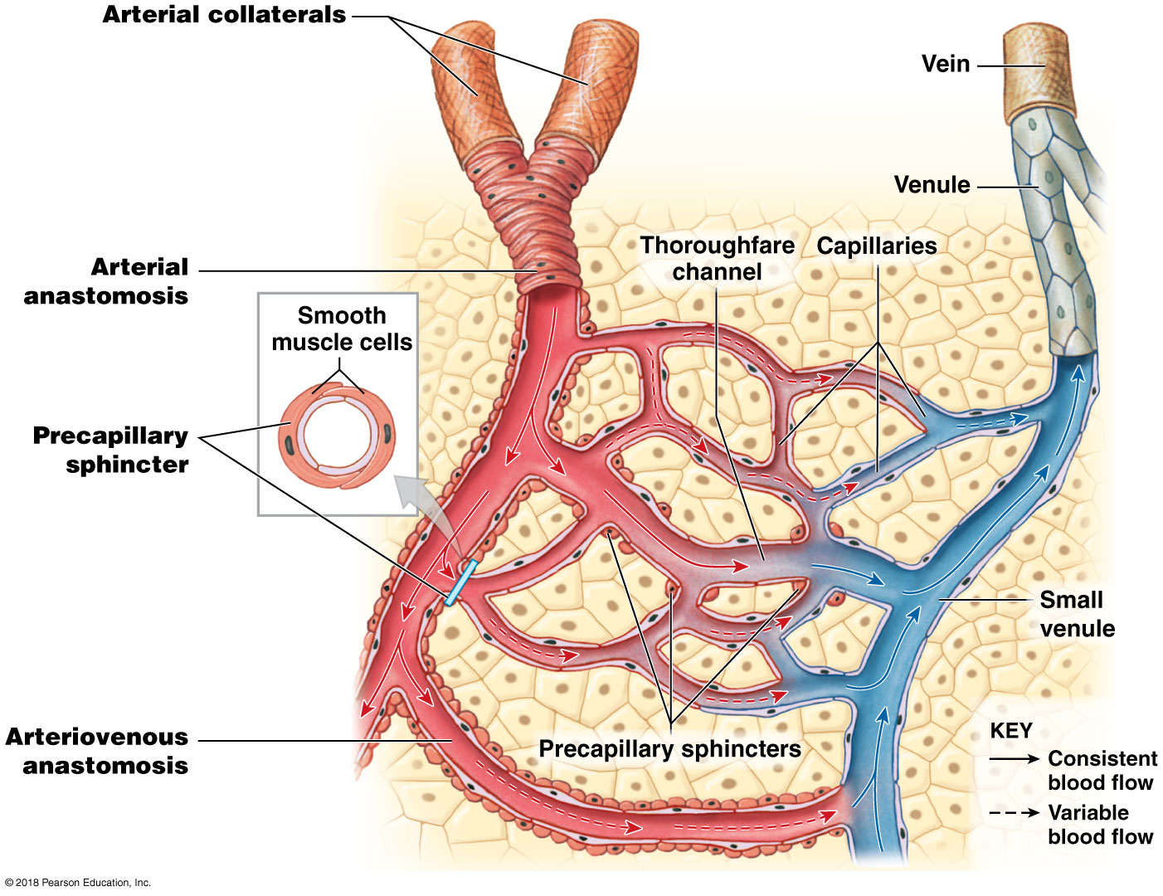
Capillary bed

Slide 36
Module 19.3: Review
Identify the two types of capillaries with a complete endothelium.
At what sites in the body are fenestrated capillaries located?
Learning Outcome: Describe the structures of capillaries and their functions in the exchange of dissolved materials between blood and interstitial fluid.

Slide 37
Module 19.4: The venous system has low pressures and contains almost two-thirds of the body’s blood volume
Pressure and blood flow in veins
Blood pressure in peripheral venules is <10 percent of that in ascending aorta (largest artery)
Mechanisms are needed to maintain flow of blood in veins against force of gravity
Valves
Folds of tunica intima projecting from vessel wall and pointing in the direction of blood flow
Ensure one-way flow of blood toward heart
Contraction of skeletal muscles
Notes:
Additional resource: PhysioEx 9.1—Ex 5.4; Blood Pressure and Blood Flow Rate.

Slide 38
Module 19.4: The venous system
Process of maintaining blood flow in veins
Contraction of skeletal muscles squeezes veins (and the blood within them)
Valves permit blood flow in one direction and prevent backflow of blood toward capillaries
If valves do not work properly, blood can pool in veins, causing distention and a range of effects
Mild discomfort and cosmetic problems, as with varicose veins (in thighs and legs)
Painful distortion of adjacent tissues, as in hemorrhoids (form in the venous networks of the anal canal)

Slide 39
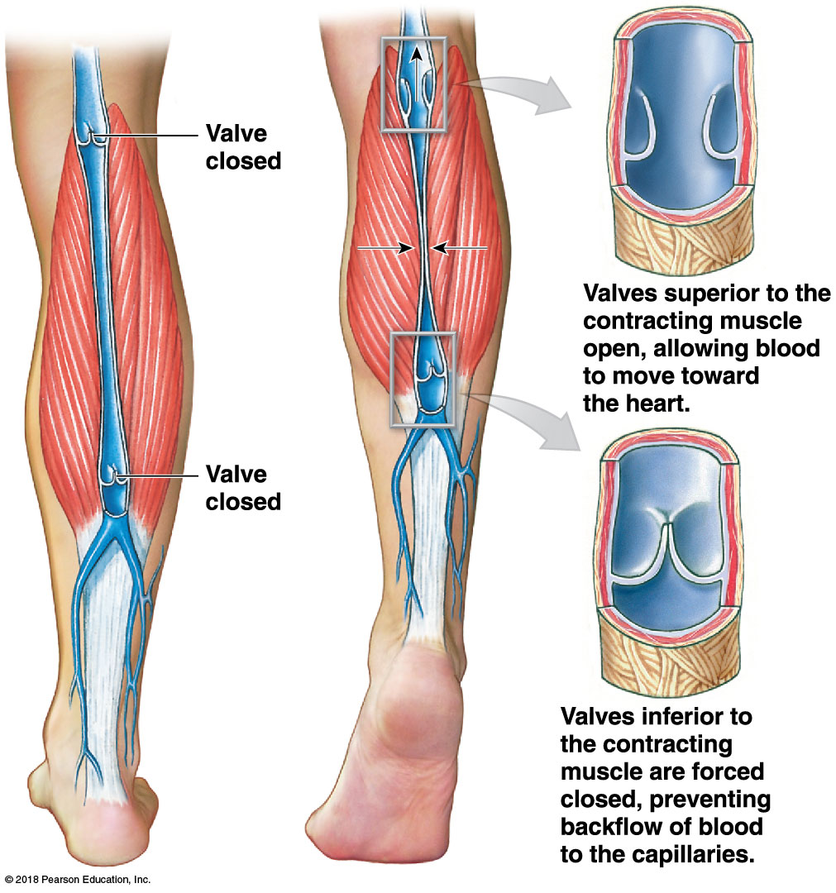
Veins have valves

Slide 40
Module 19.4: The venous system
Total blood volume distribution
Uneven distribution among arteries, veins, and capillaries
Systemic venous system contains 64 percent of total blood volume (~3.5 L)
Of that , ~1 L is in venous networks carrying blood from digestive organs to liver
Act as blood reservoirs
Systemic arteries contain 13 percent total blood volume
The remaining blood is in the systemic capillaries, heart, and pulmonary circuit

Slide 41
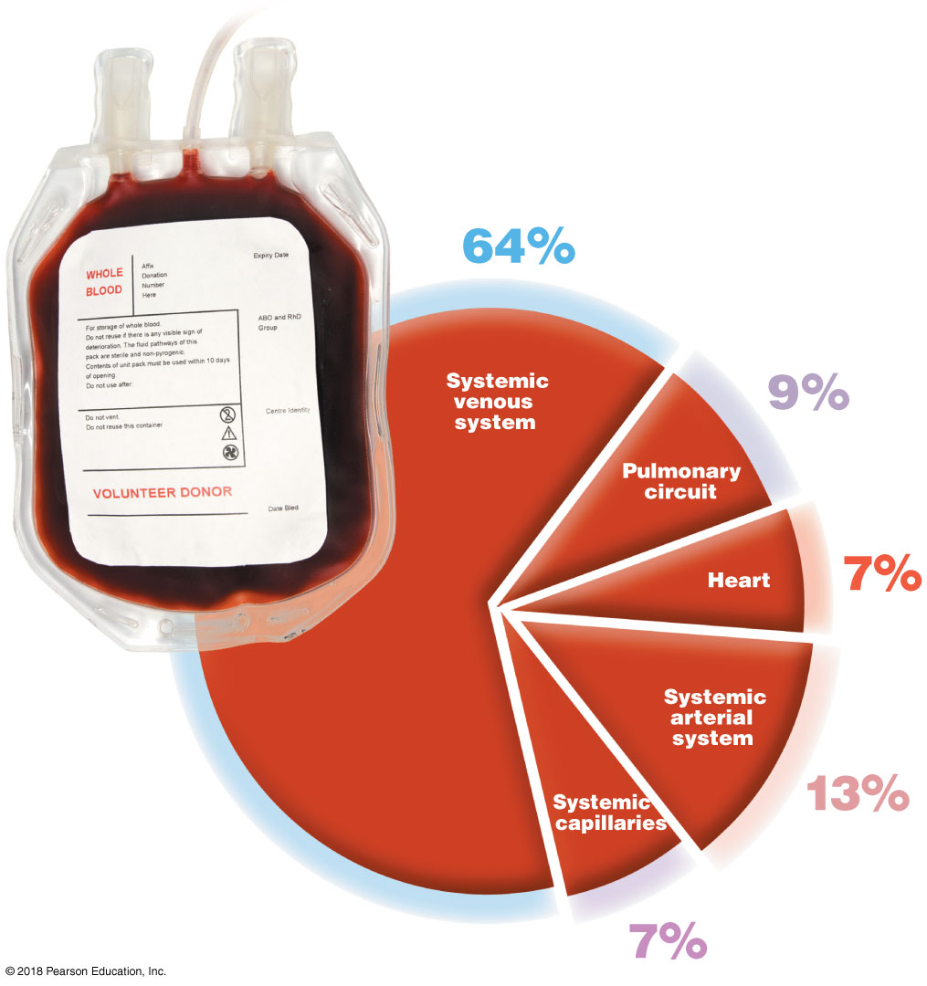
Distribution of body’s blood
Notes:
Although this is a simple pie chart, ask students questions to help give meaning to the numbers. Why is there so much more blood in the systemic circuit than in the pulmonary circuit? Which has the same percentage of the blood volume as the heart?

Slide 42
Module 19.4: The venous system
Venoconstriction
Contraction of smooth muscle fibers in veins
Reduces diameter of the veins and the amount of blood in the venous system
Method of maintaining blood volume in the arterial system even with a significant blood loss
Controlled by the vasomotor center in the medulla oblongata
Sympathetic nerves stimulate smooth muscles in medium-sized veins

Slide 43
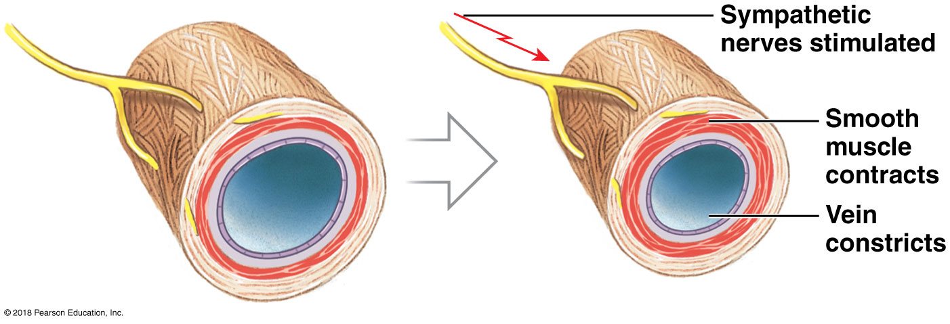
Venoconstriction

Slide 44
Module 19.4: Review
Why are valves located in veins but not in arteries?
How is blood pressure maintained in veins to counter the force of gravity?
Describe the distribution of total blood volume in the body.
What factors are involved in the formation of varicose veins?
Learning Outcome: Describe the venous system, and indicate the distribution of blood within the cardiovascular system.

Slide 45
Section 2: Coordination of Cardiac Output and Blood Flow
Learning Outcomes
19.5 Explain the effects of pressure, resistance, and venous return on cardiac output.
19.6 Describe the factors that influence total peripheral resistance.
19.7 Describe the factors that determine blood flow.
19.8 Describe the movement of fluids between capillaries and interstitial spaces.

Slide 46
Section 2: Coordination of Cardiac Output and Blood Flow
Learning Outcomes (continued)
19.9 Explain central regulation, autoregulation, and baroreceptor reflexes in response to changes in blood pressure and blood composition.
19.10 Explain the hormonal regulation of blood pressure and blood volume.
19.11 Describe the role of chemoreceptor reflexes in adjusting cardiovascular activity.

Slide 47
Section 2: Coordination of Cardiac Output and Blood Flow
Learning Outcomes (continued)
19.12 Explain how the cardiovascular system responds to the demands of exercise.
19.13 Clinical Module: Explain the body’s response to blood loss.

Slide 48
Module 19.5: Pressure, resistance, and venous return affect cardiac output
Cardiovascular regulation
Accomplished by adjusting both:
Cardiac output
Must generate enough pressure to force blood through miles of peripheral capillaries
Blood flow regulation within systemic and pulmonary circuits
Notes:
Additional resource: Mastering A&P—IP 2; Cardiac Output.

Slide 49
Module 19.5: Cardiovascular regulation
Cardiovascular regulation (continued)
Autoregulation acts locally
Central regulation
Involves neural and endocrine mechanisms
Makes coordinated adjustments to heart rate, stroke volume, peripheral resistance, and venous pressure so cardiac output is sufficient

Slide 50
Module 19.5: Cardiovascular regulation
Cardiovascular regulation (continued)
Pulsing of the heart generates pressure
Blood pressure
Pressure within the cardiovascular system as a whole
Arterial pressure is much higher than venous pressure
Must push blood greater distance through smaller vessels

Slide 51
Module 19.5: Cardiovascular regulation
Cardiovascular regulation (continued)
Flow through blood vessels is influenced by resistance
Force that opposes movement
Peripheral resistance
Resistance of the arterial system as a whole
Increases as vessels get smaller

Slide 52
Module 19.5: Cardiovascular regulation
Cardiovascular regulation (continued)
Blood flow in capillaries is very slow
Capillary pressure is very low
Allows plenty of time for capillary exchange
Diffusion between blood and interstitial fluid

Slide 53
Module 19.5: Cardiovascular regulation
Cardiovascular regulation (continued)
Blood pressure in veins is maintained by:
Valves
Muscular compression of peripheral veins
As blood moves toward the heart, vessels get larger, and resistance decreases
Venous return
Amount of blood arriving at the right atrium each minute
On average, equal to the cardiac output

Slide 54
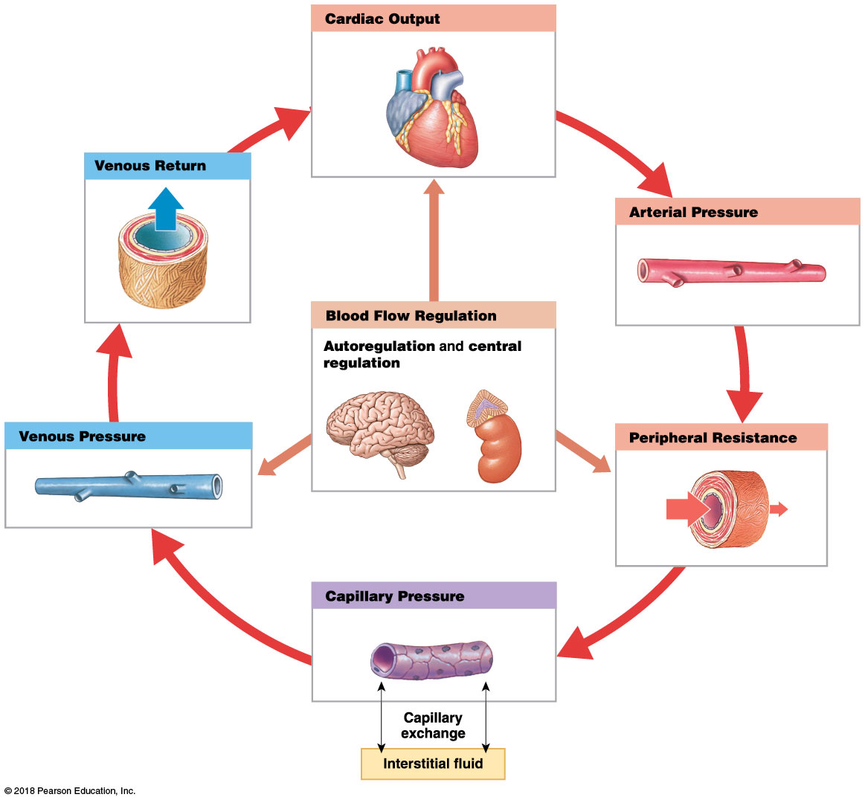
Cardiovascular regulation

Slide 55
Module 19.5: Review
Neural and endocrine regulatory mechanisms influence which factors?
Which is greater: arterial pressure or venous pressure?
Why is it beneficial for capillary pressure to be very low?
Learning Outcome: Explain the effects of pressure, resistance, and venous return on cardiac output.

Slide 56
Module 19.6: Vessel luminal diameter is the main source of resistance within the cardiovascular system
Total peripheral resistance
Resistance of entire cardiovascular system
Must be overcome by sufficient pressure from the heart in order for circulation to occur
Depends on three factors
​Vascular resistance
​Viscosity
​Turbulence
Notes:
Additional recourse: PhysioEx 9.1—Ex 5.1; Blood Vessel Radius and Blood Flow Rate.

Slide 57
Module 19.6: Factors affecting peripheral resistance
Total peripheral resistance (continued)
​Vascular resistance
Opposition to blood flow in vessels
Largest component of total peripheral resistance
Primarily results from friction between blood and vessel walls
Amount of friction depends on two factors
Vessel length
Vessel diameter

Slide 58
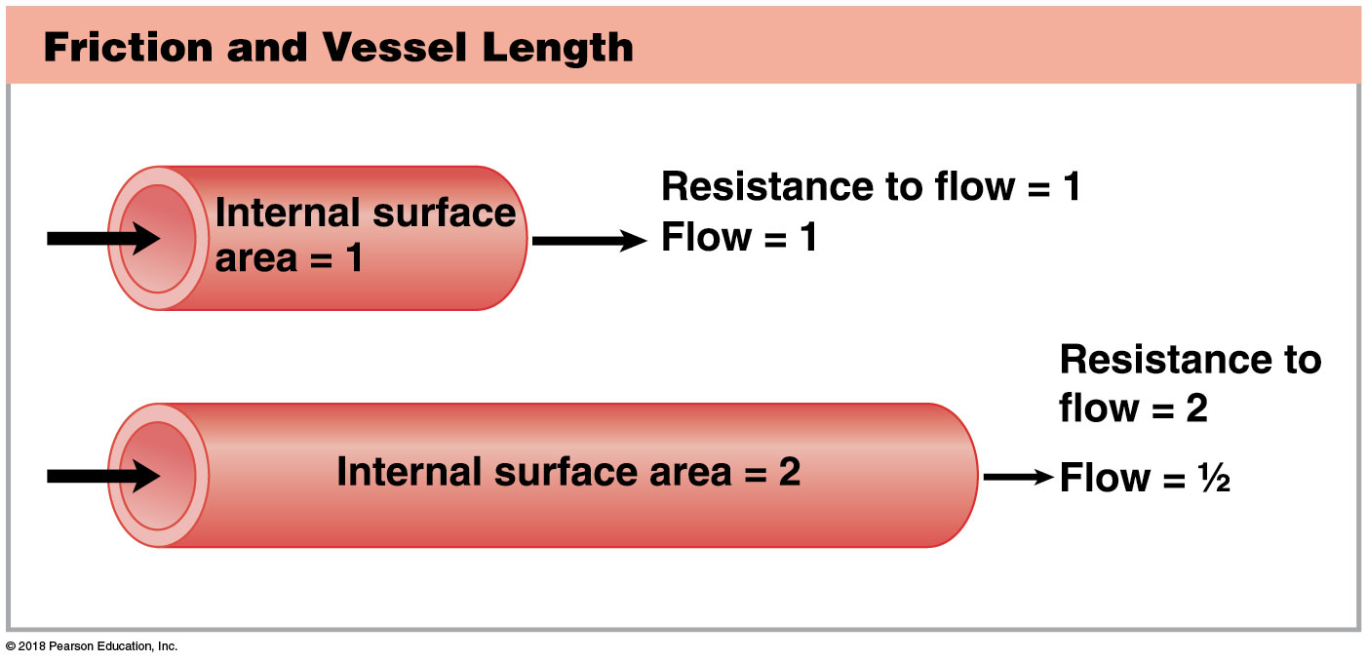
Module 19.6: Factors affecting peripheral resistance
Total peripheral resistance (continued)
​Vascular resistance (continued)
Vessel length
Friction occurs between vessel walls and moving blood
Increase in vessel length = increased surface area = increased in friction or resistance
Largest change occurs between birth and maturity

Slide 59
Module 19.6: Factors affecting peripheral resistance
Total peripheral resistance (continued)
​Vascular resistance (continued)
Vessel luminal diameter
Friction occurs between moving fluid layers
Layer closest to vessel wall is slowed most because of friction with endothelial surface
Effect gradually diminishes away from wall
In smaller vessels, more fluid volume is near wall, so higher resistance
In larger vessels, central region unaffected, so lower resistance
Notes:
Not all students will understand “vessel luminal diameter” so remind them what the lumen is and that it is the diameter of the lumen, not of the entire vessel, that determines resistance and, thus, flow and blood pressure.

Slide 60
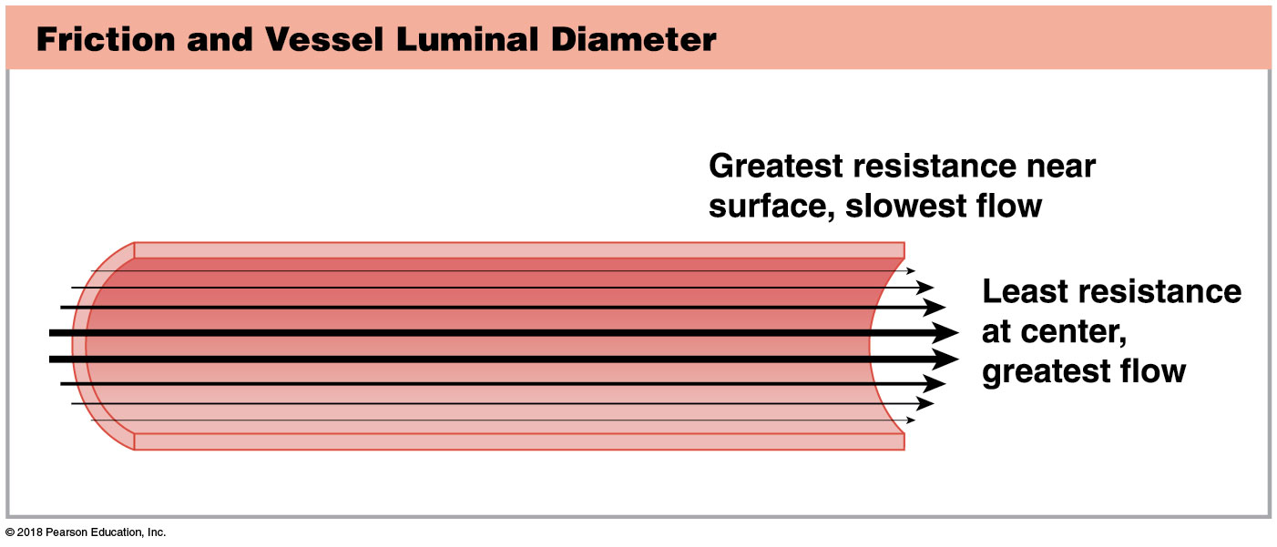
Friction and vessel luminal diameter
Notes:
As an analogy, have students think about the flow of water in a large river. In the center, the water flows quite rapidly, but near the edges—the riverbanks—it moves slower.

Slide 61
Module 19.6: Factors affecting peripheral resistance
Total peripheral resistance (continued)
​Vascular resistance (continued)
Vessel diameter (continued)
Diameter has a much larger effect on resistance compared to vessel length
R = 1/r⁴
Change in radius (r) affects resistance (R) to 4th power
Small change in diameter produces a large change in resistance
Vasomotor center controls peripheral resistance primarily by altering diameters of arterioles

Slide 62
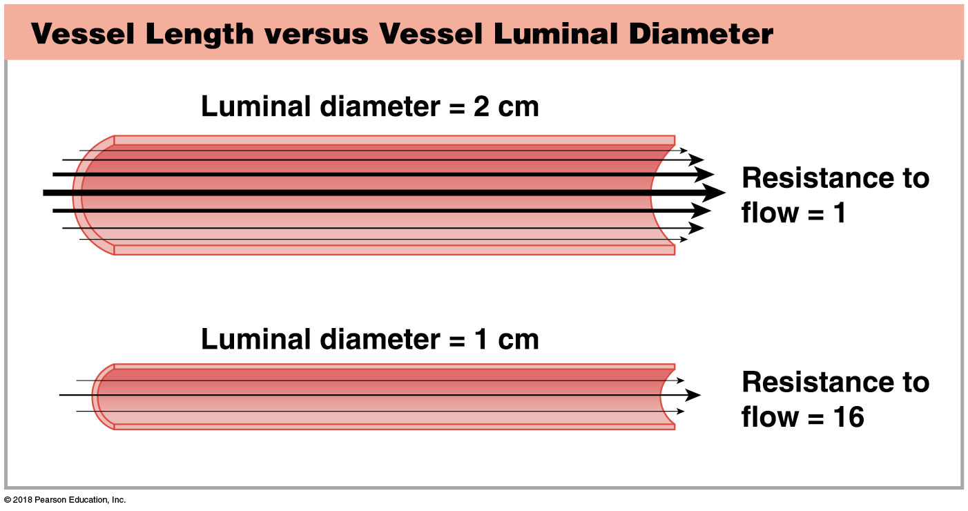
Vessel length versus vessel luminal diameter
Notes:
Students may want to see the math here. For the top image, the luminal diameter is 2 cm, so the radius is 1. Using the equation from the previous slide: R = 1/r⁴. 1⁴ = 1; 1 ÷ 1 = 1 so resistance is 1. In the bottom image, the diameter is 1 so the radius is 0.5, and 0.5⁴ = 0.0625 (0.5 x 0.5 x 0.5 x 0.5), and 1 ÷ 0.625 = 16.

Slide 63
Module 19.6: Factors affecting peripheral resistance
Total peripheral resistance (continued)
​Viscosity
Resistance to flow caused by interactions among molecules and suspended materials in a liquid
Low-viscosity fluids have lower resistance, so flow at low pressures
Example: water (viscosity 1.0)
High-viscosity fluids have higher resistance, so flow only at high pressures
Example: molasses (viscosity 300)

Slide 64
Module 19.6: Factors affecting peripheral resistance
Total peripheral resistance (continued)
​Viscosity (continued)
Blood viscosity is about five times that of water
Due to cells and plasma proteins
Viscosity is normally stable
Disorders affecting hematocrit or plasma composition change viscosity and affect peripheral resistance

Slide 65
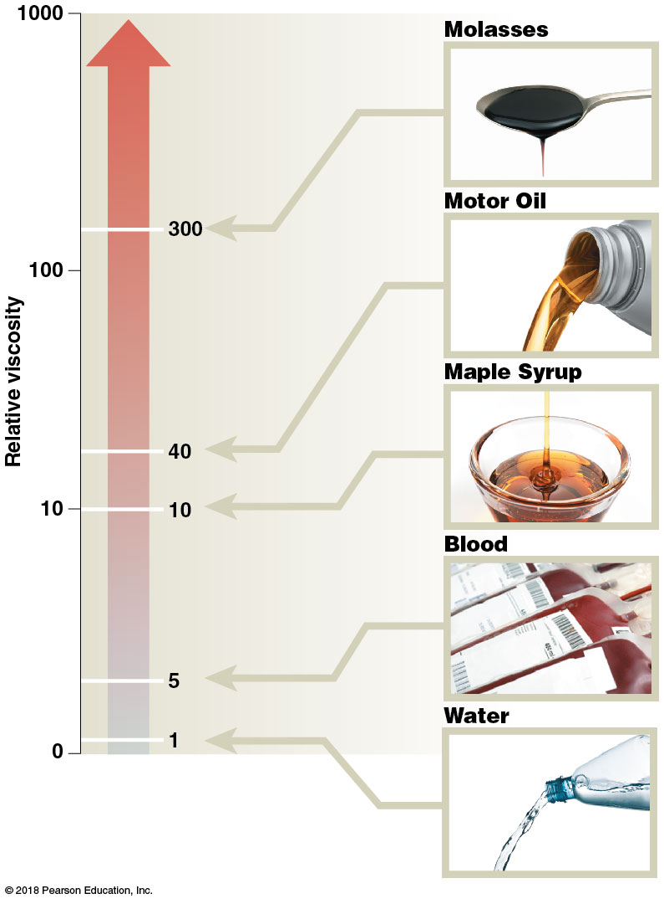
Viscosity

Slide 66
Module 19.6: Factors affecting peripheral resistance
Total peripheral resistance (continued)
​Turbulence
Type of fluid flow with eddies and swirls
Caused by high flow rates, irregular surfaces, and sudden changes in vessel diameter
Responsible for production of third and fourth heart sounds
Normal turbulent flow in the heart
Increased turbulence = increased resistance = slow blood flow

Slide 67
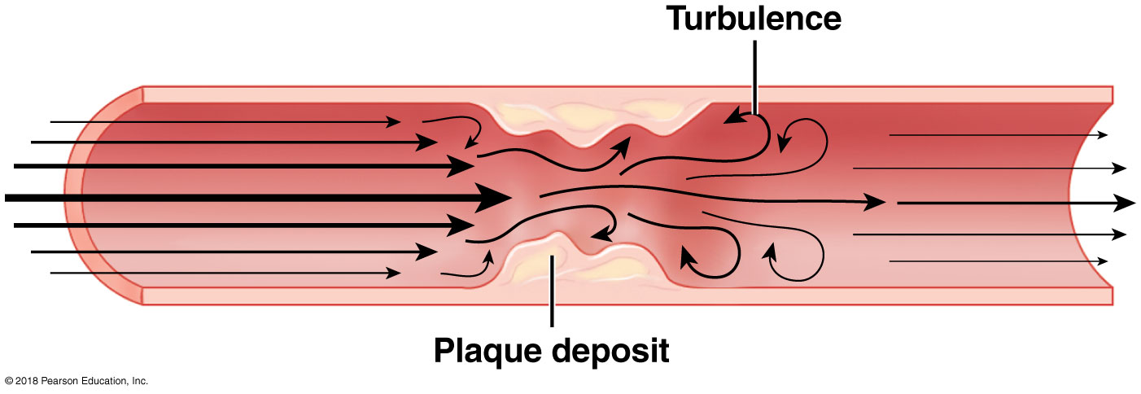
Turbulence
Notes:
Consider providing a photo that shows actual plaque within a blood vessel.

Slide 68
Module 19.6: Review
List the factors that contribute to total peripheral resistance.
Explain the equation R ∝ 1/r⁴.
Which would reduce peripheral resistance: an increase in vessel length or an increase in vessel diameter?
Learning Outcome: Describe the factors that influence total peripheral resistance.

Slide 69
Module 19.7: Blood flow is determined by the interplay between arterial pressure and peripheral resistance
Blood flow
Volume of blood flowing per unit of time through a vessel or group of vessels
Directly proportional to arterial pressure
Inversely proportional to peripheral resistance
More important than absolute pressure is the pressure gradient
Difference in pressure from one end of vessel to other
Largest gradient from base of the aorta and proximal end of capillary beds
Notes:
Additional resource: Mastering A&P—IP 2; Factors Affecting Blood Pressure.

Slide 70
Module 19.7: Factors affecting blood flow
Blood flow (continued)
Changes in diameter
From aorta to capillaries:
Blood vessels diverge and branch
Decreasing diameter increases resistance = decreased pressure = decreased flow
From capillaries to venae cavae:
Blood vessels converge to form larger vessels
Increasing diameter decreases resistance = increased flow

Slide 71
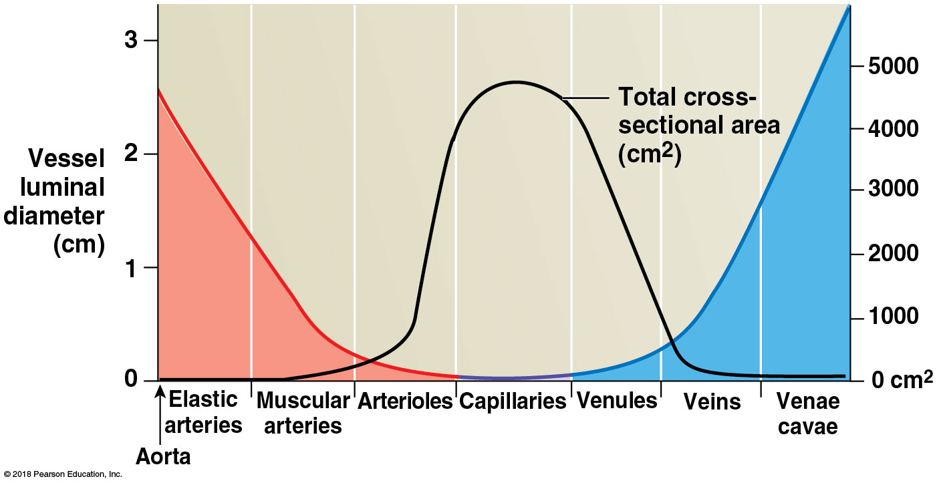
Vessel luminal diameter and cross-sectional area
Notes:
Many students struggle with graphs, so walk them through this, starting with what each component represents. The colored curve represents blood flow in each type of vessel, and blood flow is a rate(volume/time), so the lower the flow, the less blood that is passing through in a given time. Have students focus on the center of the graph to see that capillaries have the greatest total cross-sectional area but the lowest blood flow. Ask them to explain why the flow is lower in capillaries.

Slide 72
Module 19.7: Factors affecting blood flow
Blood flow (continued)
Changes in blood pressure
Highest pressure at the aorta
Heart generates pressure of about 120 mm Hg
Aorta cross-sectional area 4.5 cm²
Pressure drops at each branching in arterial system
Smaller, more numerous vessels produce more resistance, reducing pressure
At start of peripheral capillaries, pressure is 35 mm Hg
At the venules, pressure is 18 mm Hg

Slide 73
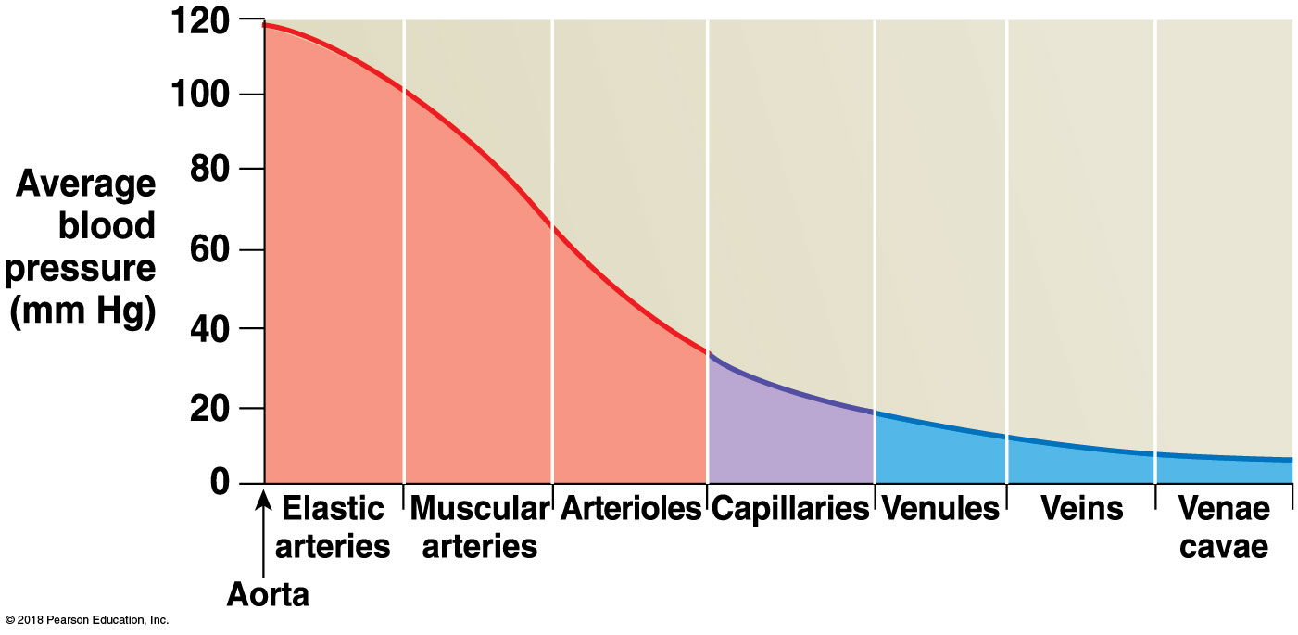
Blood pressure in the blood vessels
Notes:
Students often think flow and blood pressure are directly correlated so that they would both vary the same. This graph shows the continuous decrease in blood pressure as the blood moves farther from the heart, yet flow decreases to the capillaries and then increases in the veins. Have them ponder the reasons for this difference.

Slide 74
Module 19.7: Factors affecting blood flow
Blood flow (continued)
Changes in blood flow
Highest flow in the aorta
Highest blood pressure, largest diameter
Slowest in the capillaries
Smallest diameter
Slow flow important to allow exchange between blood and interstitial fluid
Flow accelerates in venous system
Due to larger diameter vessels = lower resistance

Slide 75
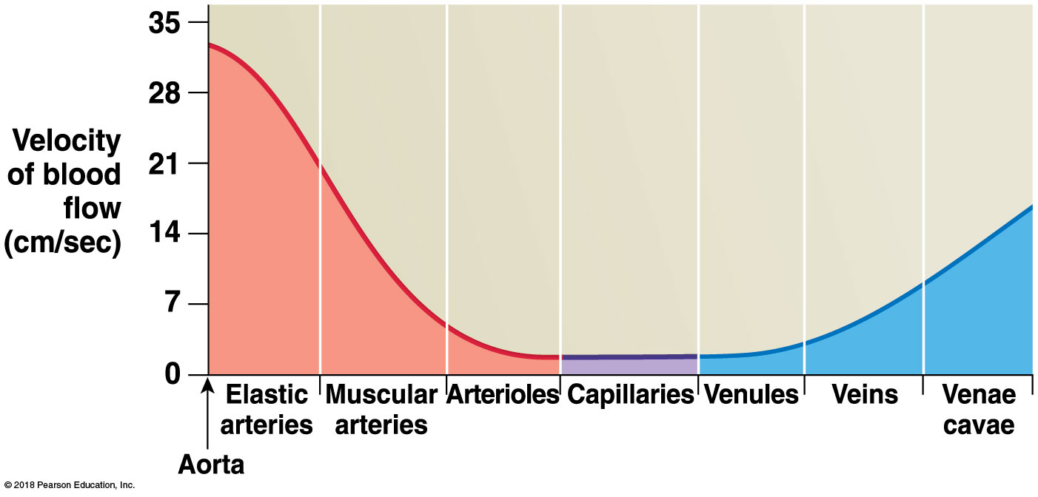
Blood flow in the blood vessels
Notes:
This graph shows blood velocity and is also a rate—distance traveled/time. It does correlate directly with blood flow. Thus, blood moves slowest through the capillaries. Ask students why this is an advantage.

Slide 76
Module 19.7: Factors affecting blood flow
Changes in arterial pressure
Rises during ventricular systole
Peak pressure measured during systole is the systolic pressure
Declines during ventricular diastole
Minimum pressure measured during diastole is the diastolic pressure
Commonly written with a “/” between pressures
Example: 120/90

Slide 77
Module 19.7: Factors affecting blood flow
Changes in arterial pressure (continued)
Pulse pressure
Difference between systolic and diastolic pressure
Example: 120 – 90 = 30 mm Hg
Mean arterial pressure (MAP)
Adding one-third of pulse pressure to diastolic pressure
Example: 90 + (120 – 90)/3 = 100 mm Hg

Slide 78
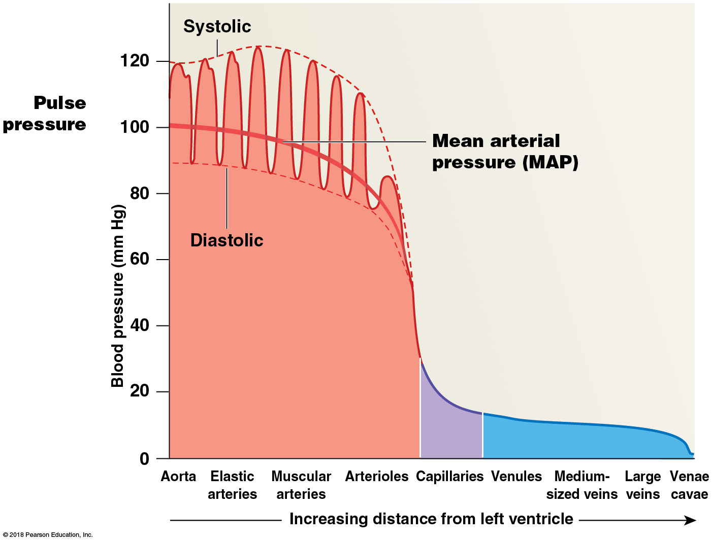
Pulse pressure
Notes:
Point out that systolic, diastolic, and pulse pressure are only shown in the arteries and ask students to explain why.

Slide 79
Module 19.7: Factors affecting blood flow
Capillary exchange
Involves a combination of diffusion, osmosis, and filtration
Capillary hydrostatic pressure (CHP)
Blood pressure within capillary beds
Provides driving force for filtration
Pushes water and small molecules out of the bloodstream into interstitial fluid
Larger molecules (such as plasma proteins) remain in blood

Slide 80
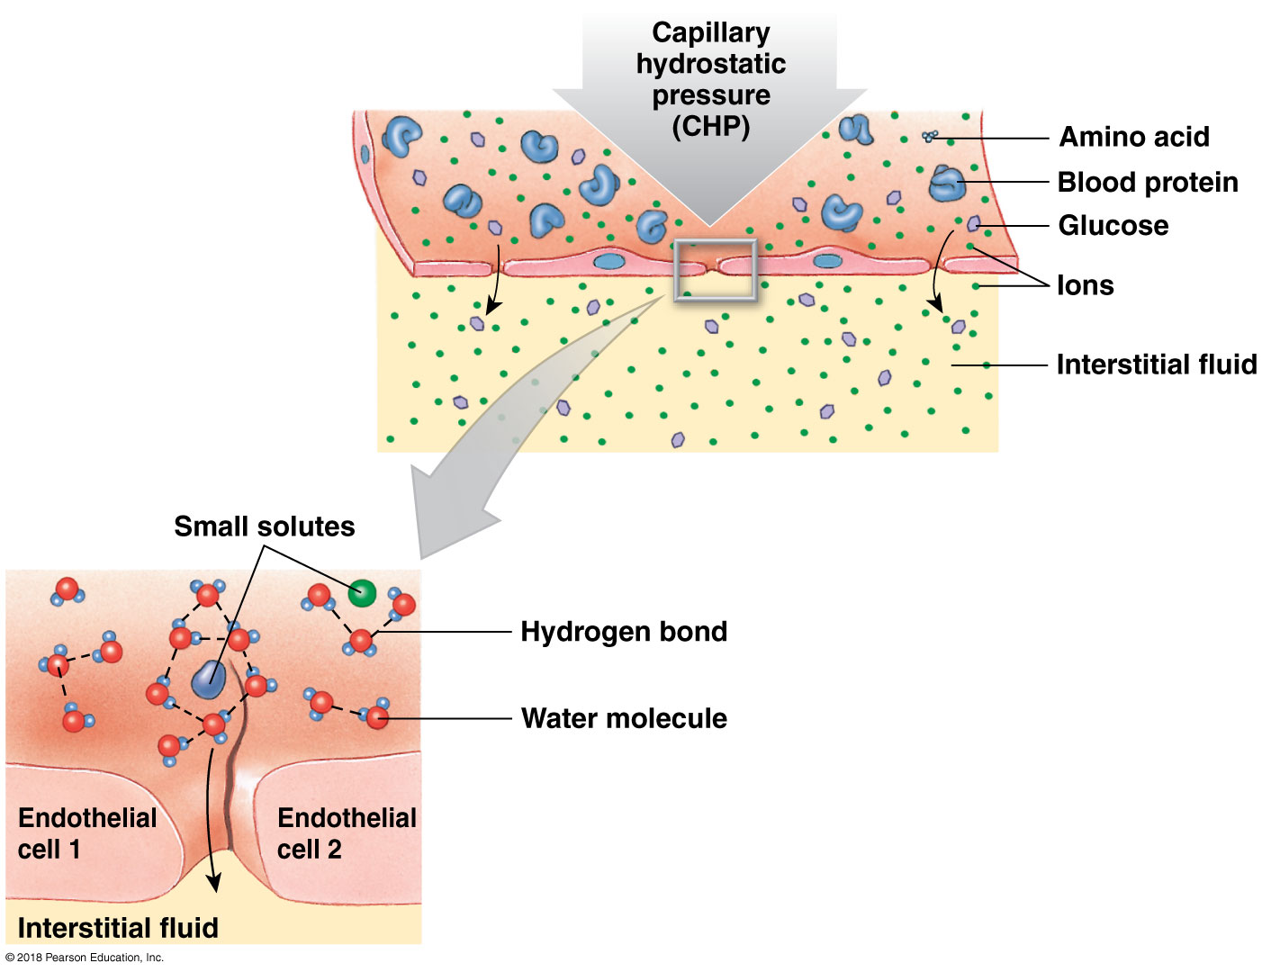
Capillary exchange

Slide 81
Module 19.7: Review
Define blood flow, and describe its relationship to blood pressure and peripheral resistance.
In a healthy person, where is blood pressure greater: in the aorta or in the inferior vena cava? Explain.
Calculate the mean arterial pressure for a person whose blood pressure is 125/70.
Learning Outcome: Describe the factors that determine blood flow.

Slide 82
Module 19.8: Capillary exchange is a dynamic process that includes diffusion, filtration, and reabsorption
Capillary exchange
Diffusion
Net movement of substances from an area of higher concentration to lower concentration
Occurs most rapidly when:
Distances are short
Concentration gradient is large
Ions or molecules involved are small
Occurs continuously across capillary walls, but transport mechanism varies for different substances

Slide 83
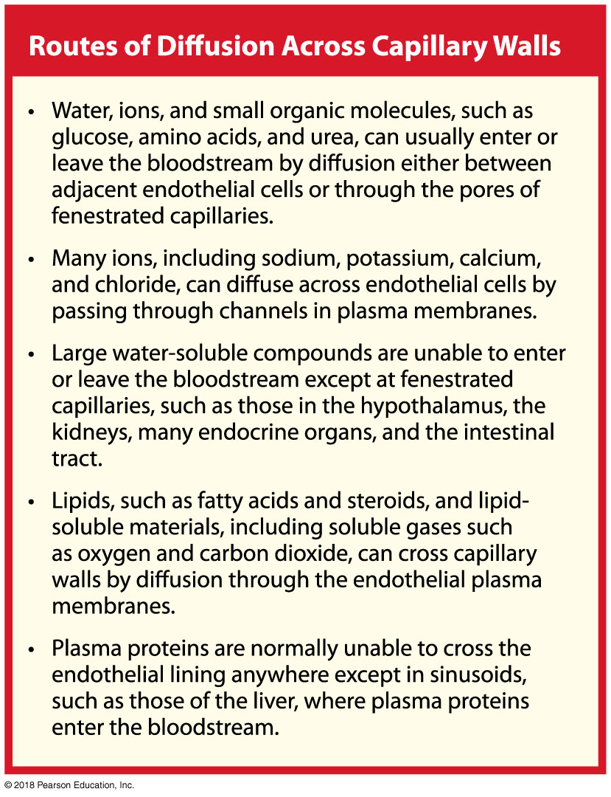

Slide 84
Module 19.8: Capillary exchange
At the arterial end of the capillary
Filtration predominates
Capillary hydrostatic pressure (CHP) is highest near arteriole
Causes water and small solutes to enter interstitial fluid
As filtration occurs, blood colloid osmotic pressure (BCOP) increases
Water leaves capillary, and plasma proteins remain
CHP decreases along capillary length
CHP > BCOP = fluid forced out of capillary

Slide 85
Module 19.8: Capillary exchange
At the arterial end of the capillary (continued)
Net filtration pressure (NFP)
Difference between capillary hydrostatic and blood colloid osmotic pressure
NFP = CHP – BCOP
Is positive at beginning of capillary
Filtration
Becomes negative by end of capillary
Reabsorption

Slide 86
Module 19.8: Capillary exchange
At roughly two-thirds of the way along the capillary
No net movement
Capillary hydrostatic pressure equals blood colloid osmotic pressure
NFP = CHP – BCOP = 0

Slide 87
Module 19.8: Capillary exchange
At the venule end of the capillary
Reabsorption predominates
Capillary hydrostatic pressure falls below blood colloid osmotic pressure
CHP < BCOP
Water moves into capillary
More water leaves bloodstream than is reabsorbed
Difference (about 3.6 L/day) enters the lymphatic vessels and is eventually returned to the venous system

Slide 88
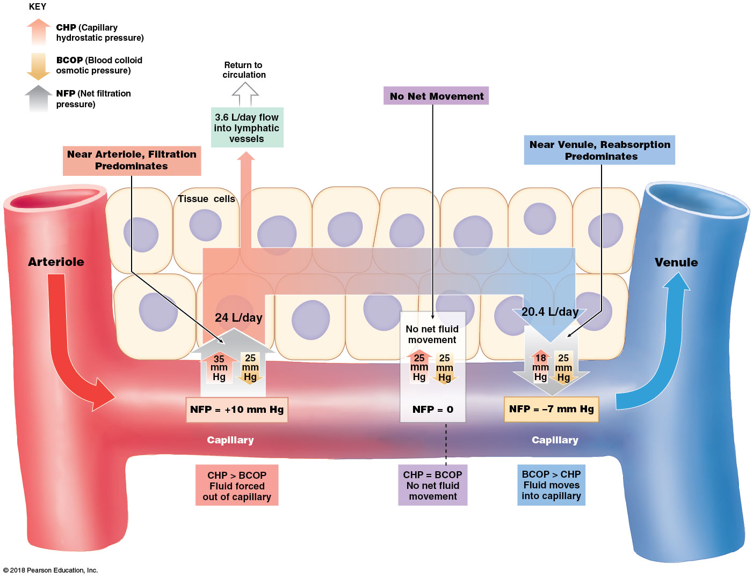
Filtration and absorption at capillaries
Notes:
This is a complex figure that will challenge many students. Start by pointing out the key in the upper left, which lists relevant abbreviations. Be sure they see the numbers for CHP and BCOP before they focus on the NFP. Remind them that the NFP determines the movements that occur, not vice versa.

Slide 89
Module 19.8: Capillary exchange
Possible variations in capillary exchange
Any condition that affects blood pressure or osmotic pressure of blood or interstitial fluid shifts balance of hydrostatic and osmotic forces

Slide 90
Module 19.8: Review
Under what general conditions would fluid move into a capillary?
Define edema.
Identify the conditions that would shift the balance between hydrostatic and osmotic forces.
Learning Outcome: Describe the movement of fluids between capillaries and interstitial spaces.

Slide 91
Module 19.9: Cardiovascular regulatory mechanisms respond to changes in blood pressure or blood chemistry
Homeostatic mechanisms
Ensure adequate tissue perfusion (blood flow through tissues)
Blood flow must match changes in demand for oxygen and nutrients
Two regulatory pathways
​Autoregulation
Occurs at local level
​Central regulation
Neural and endocrine control
Activated if autoregulation is ineffective

Slide 92
Module 19.9: Cardiovascular regulatory mechanisms
Two regulatory pathways
​Autoregulation
Involves local changes in blood flow within capillary beds
Regulated by precapillary sphincters in response to chemical changes in interstitial fluid
Vasodilators
Local chemicals that increase blood flow

Slide 93
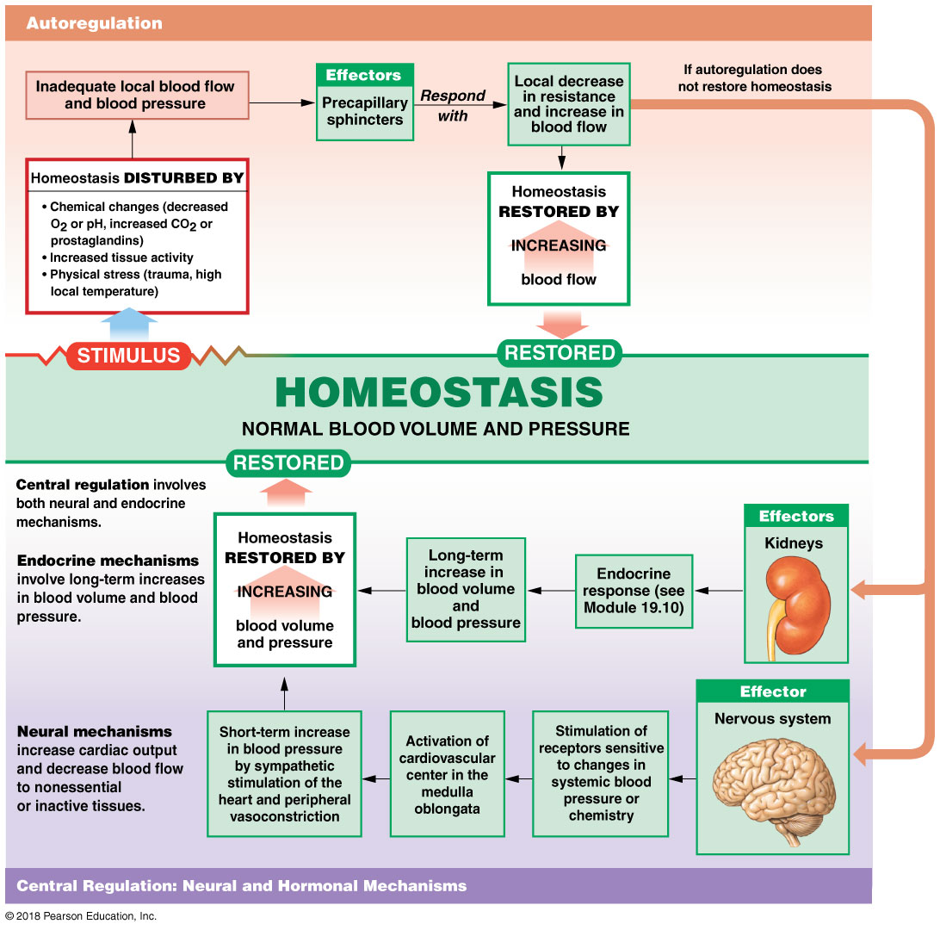
Autoregulation

Slide 94
Module 19.9: Cardiovascular regulatory mechanisms
Two regulatory pathways (continued)
​Central regulation
Involves both neural and endocrine mechanisms
Neural
Activation of cardioacceleratory center
Activation of vasomotor center (controls peripheral vasoconstriction)
Can increase cardiac output and reduce blood flow to nonessential or inactive tissues
Endocrine
Release of vasoconstrictor (primarily NE), producing long-term increases in blood pressure

Slide 95
Module 19.9: Cardiovascular regulatory mechanisms
Baroreceptor reflexes (baro-, pressure)
Respond to changes in blood pressure
Receptors are located in walls of:
Carotid sinuses
Aortic sinuses
Right atrium

Slide 96
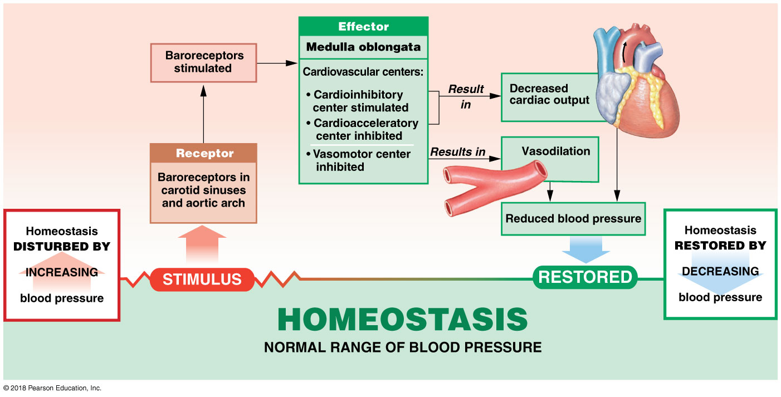
Baroreceptor reflex response to increased blood pressure

Slide 98
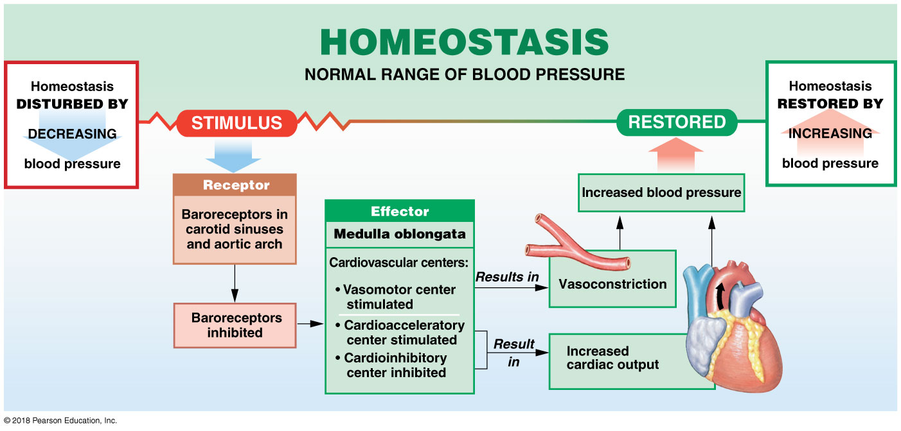
Baroreceptor reflex response to decreased blood pressure

Slide 99
Module 19.9: Review
Define tissue perfusion.
Describe autoregulation as it relates to cardiovascular function.
Explain the function of baroreceptor reflexes.
Learning Outcome: Explain central regulation, autoregulation, and baroreceptor reflexes in response to changes in blood pressure and blood composition.

Slide 100
Module 19.10: Endocrine responses to low blood pressure and low blood volume…
Endocrine responses
Provide short-term and long-term regulation of cardiovascular function
Utilize endocrine functions of:
The heart
The kidneys
The pituitary gland (antidiuretic hormone, or ADH)

Slide 101
Module 19.10: Endocrine responses to changes in blood pressure and volume
Hormonal response to low blood pressure and volume
Immediate response
Release of epinephrine (E) and norepinephrine (NE)
Released from the adrenal medullae
Other hormones important in the long-term response
Antidiuretic hormone (ADH)
Angiotensin II
Erythropoietin (EPO)
Aldosterone

Slide 102
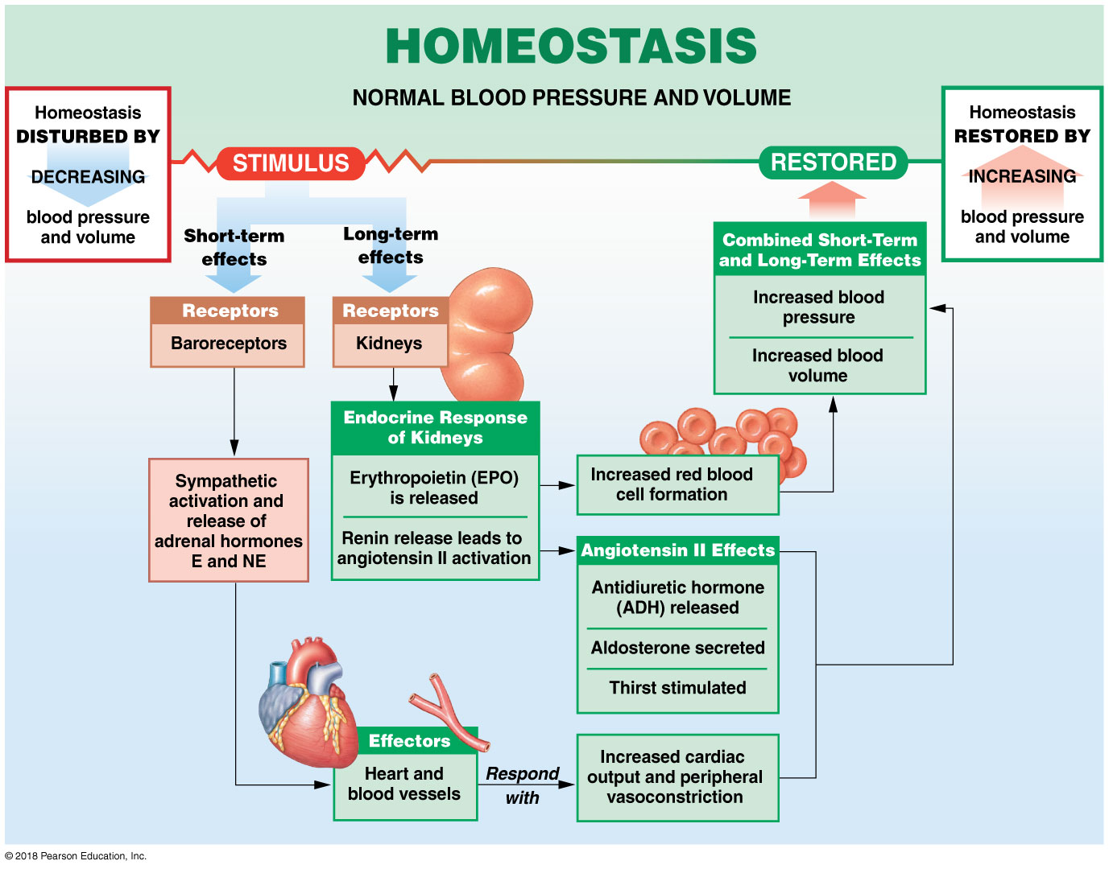
Endocrine response to decreased low blood pressure and volume

Slide 103
Module 19.10: ...are very different from those to high blood pressure and high blood volume
Hormonal response to high blood pressure and blood volume
High blood volume stretches the heart wall during diastole
Triggers release of natriuretic peptides
Atrial natriuretic peptide (natrium, sodium + ouresis, urination), or ANP
Released from right atrial walls
Brain natriuretic peptide, or BNP
Released from ventricular muscle cells
Decrease in blood volume and pressure = decreased stress on heart walls = decreased production of natriuretic peptides

Slide 104
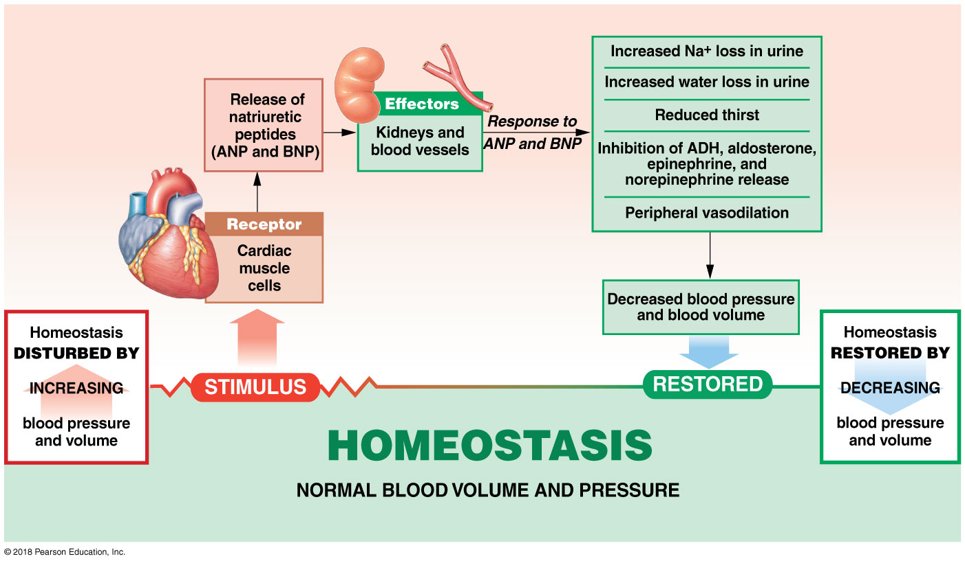
Endocrine response to increased low blood pressure and volume

Slide 105
Module 19.10: Review
Identify the hormones responsible for short-term regulation of decreasing blood pressure and blood volume.
How does the kidney respond to vasoconstriction of the renal artery?
Describe the roles of the natriuretic peptides.
Learning Outcome: Explain the hormonal regulation of blood pressure and blood volume.

Slide 106
Module 19.11: Chemoreceptors monitor the chemical composition of the blood and cerebrospinal fluid
Chemoreceptor reflexes
Respond to blood and CSF changes in:
Carbon dioxide
Oxygen
pH
Receptors located in:
Carotid bodies
Aortic bodies
Ventrolateral surface of medulla oblongata
Stimulation of receptors triggers coordinated adjustment in cardiovascular and respiratory activity

Slide 107
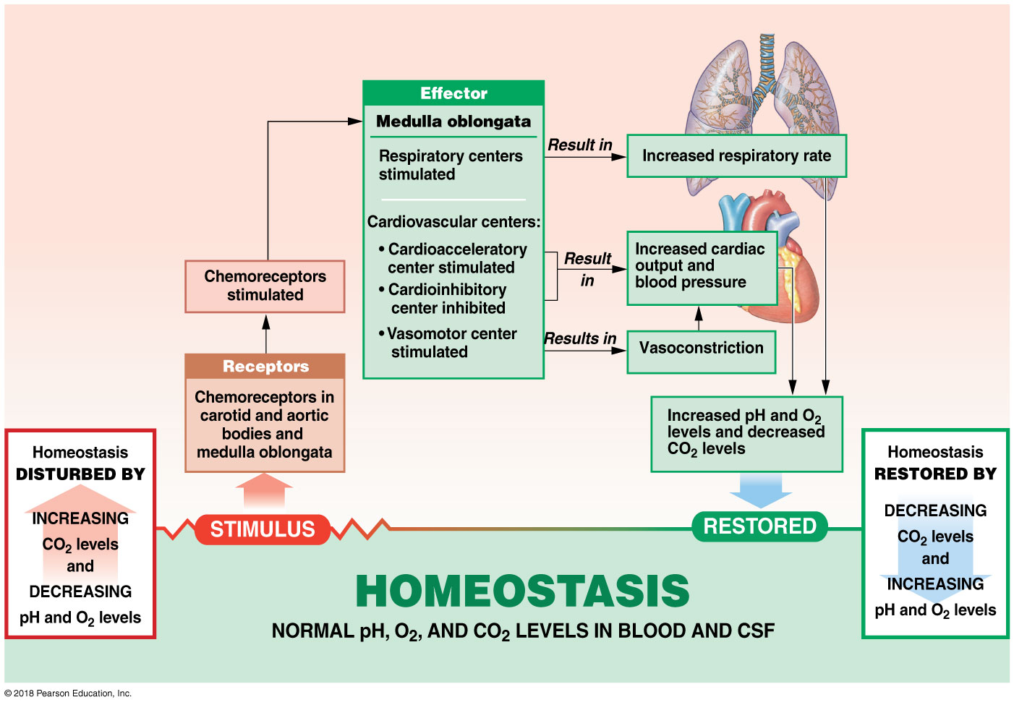
Effects of increasing CO₂ and decreasing pH and O₂ levels on cardiovascular system

Slide 108
Module 19.11: Review
Where are chemoreceptors located?
What is the function of chemoreceptor reflexes?
What effect does an increase in the respiratory rate have on CO₂ levels?
Learning Outcome: Describe the role of chemoreceptor reflexes in adjusting cardiovascular activity.

Slide 109
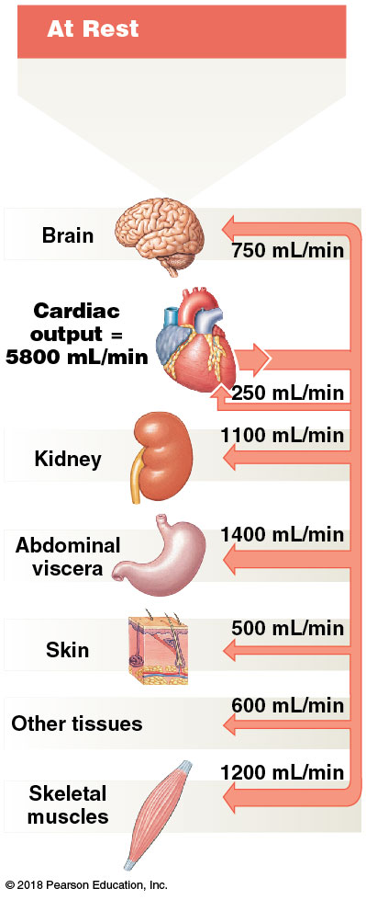
Module 19.12: The cardiovascular center makes extensive adjustments to cardiac output and blood distribution during exercise
Cardiovascular adjustments
At rest
Cardiac output = 5800 mL/min
Notes:
Have students start at the heart to see cardiac output (with the outgoing arrow); the other components indicate how the output is being distributed.

Slide 110
Module 19.12: Cardiovascular adjustments during exercise
Cardiovascular adjustments (continued)
During light exercise
Three changes take place
Vasodilation occurs, peripheral resistance drops, and capillary blood flow increases
Venous return increases with skeletal muscle contraction; increased respiration creates negative pressure in thoracic cavity, drawing blood back (respiratory pump)
Cardiac output increases to 9500 mL/min
Primarily due to venous return

Slide 111
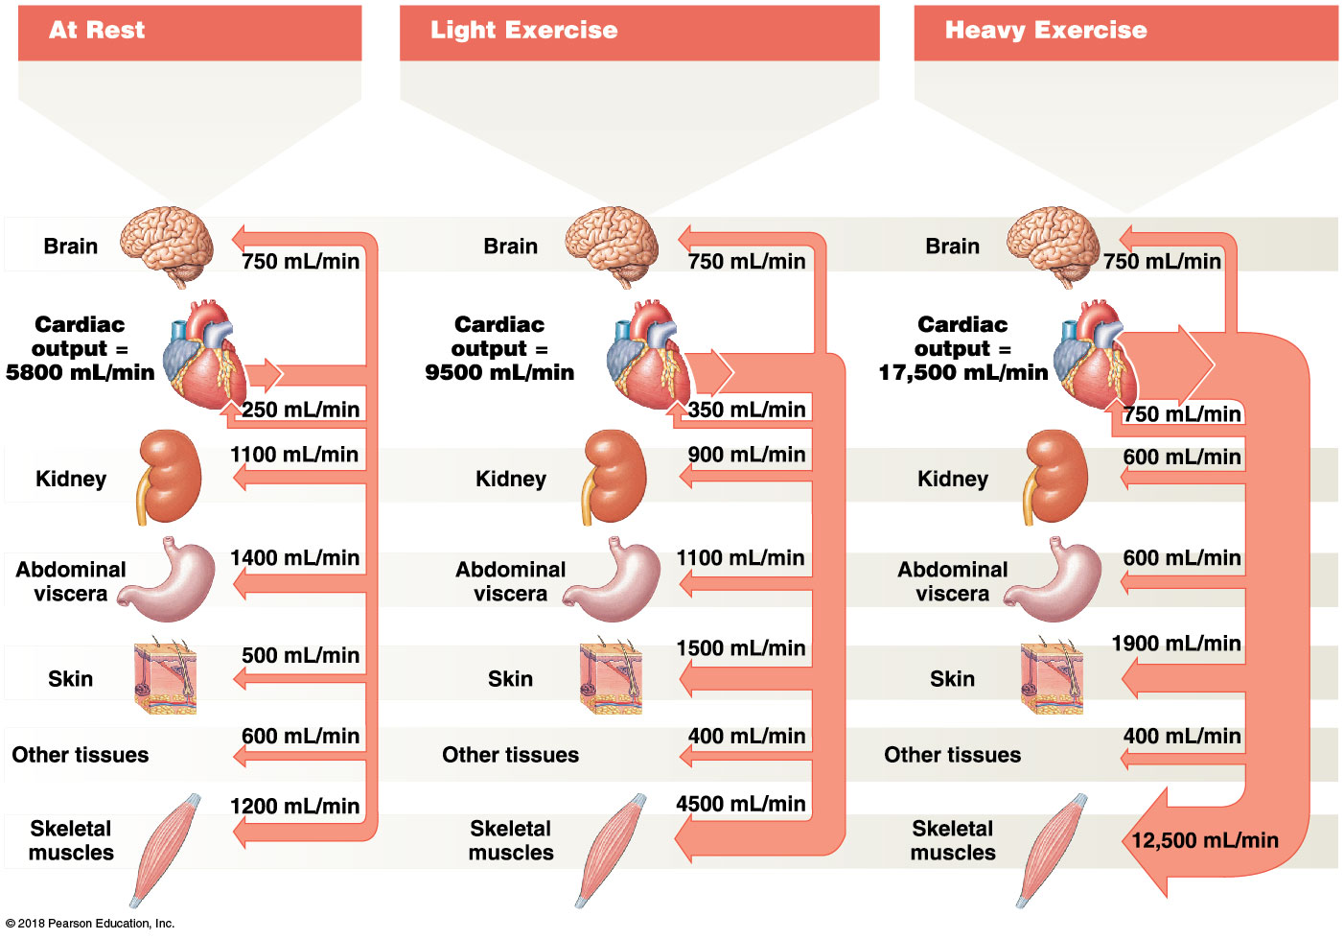
Light exercise

Slide 112
Module 19.12: Cardiovascular adjustments during exercise
Cardiovascular adjustments (continued)
During heavy exercise
Cardiac output approaches maximal levels (~17,500 mL/min)
Major changes in peripheral blood distribution allow large increase in flow to skeletal muscles without overall decrease in systemic blood pressure
Increased flow to skeletal muscles
Increased flow to skin (promotes heat loss)
Reduced flow to digestive viscera and kidneys
Brain blood flow remains unchanged

Slide 113
Heavy exercise

Slide 114
Module 19.12: Cardiovascular adjustments during exercise
Cardiovascular adjustments (continued)
Cardiovascular performance improves with training
Trained athletes have bigger hearts and stroke volumes
Can maintain normal blood flow with lower heart rate (as low as 32 bpm)
Maximal cardiac output can be 50 percent higher than in nonathletes

Slide 115
Module 19.12: Review
Describe the respiratory pump.
Describe the changes in cardiac output and blood flow during exercise.
Learning Outcome: Explain how the cardiovascular system responds to the demands of exercise.

Slide 116
Module 19.13: Clinical Module: Short-term and long-term mechanisms compensate for a reduction in blood volume
Compensation mechanisms
When hemostasis fails to prevent significant blood loss, entire cardiovascular system adjusts to compensate
Immediate problem is maintenance of blood pressure and peripheral blood flow
Long-term problem is restoration of blood volume
Mechanisms can cope with blood losses equal to ~30 percent of total blood volume

Slide 119
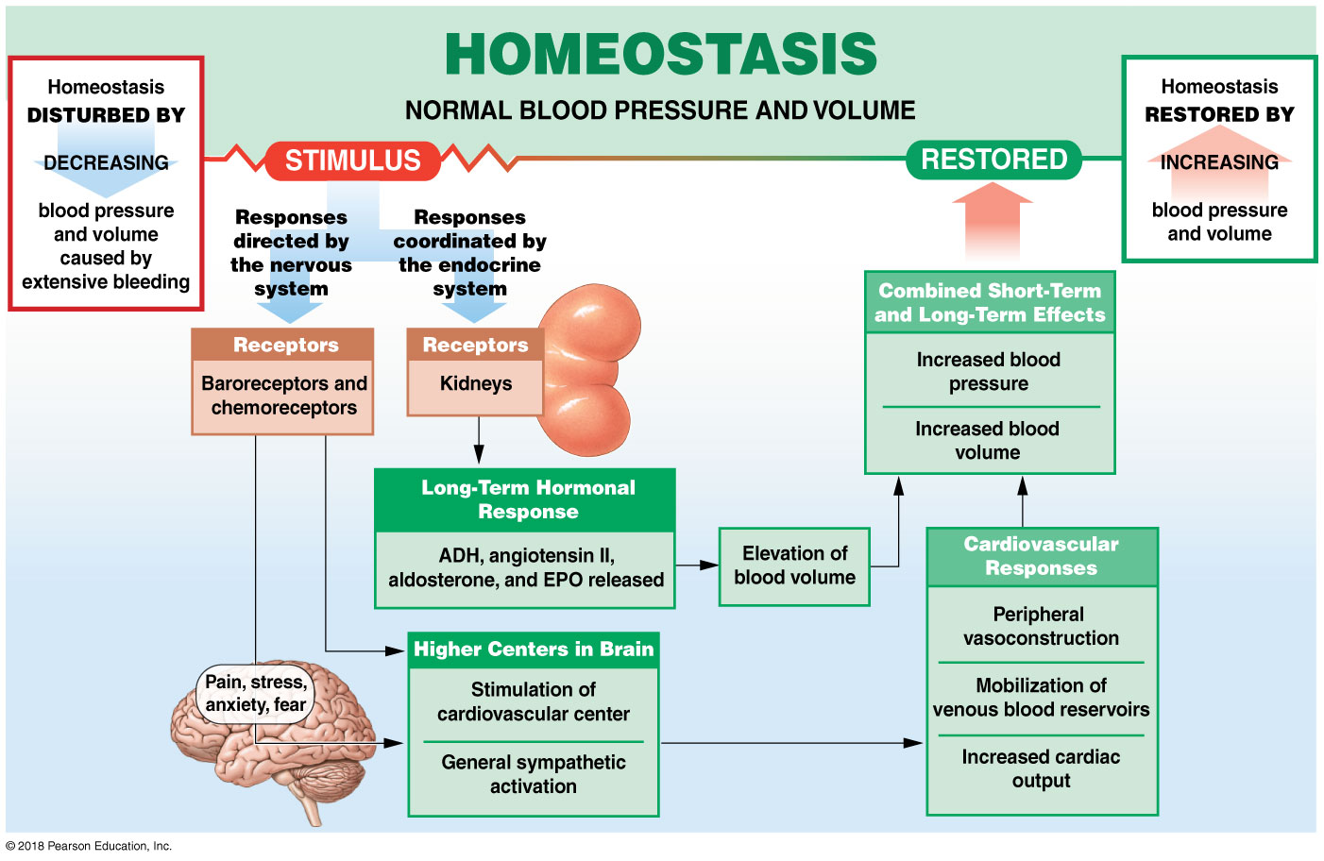
Homeostatic response to decreased blood pressure and volume due to extensive bleeding

Slide 120
Module 19.13: Responses to blood loss
Shock
Acute cardiovascular crisis marked by:
Low blood pressure (hypotension)
Inadequate peripheral blood flow
Most common causes are hemorrhaging and heart damage (as in heart attack)
Normal homeostatic mechanisms cannot compensate
Circulatory shock
Positive feedback loops beginning when blood loss >35 percent

Slide 121
Module 19.13: Responses to blood loss
Shock (continued)
Progressive shock
Blood volume drops by more than 35 percent
Despite sustained vasoconstriction and mobilized venous reserves:
Blood pressure remains low
Venous return reduced
Cardiac output inadequate

Slide 122
Module 19.13: Responses to blood loss
Shock (continued)
Progressive shock (continued)
Low cardiac output reduces blood flow to heart
Damages myocardium
Leads to further reduction to cardiac output

Slide 123
Module 19.13: Responses to blood loss
Shock (continued)
Progressive shock (continued)
Reduced cardiac output accelerates oxygen starvation in tissues
Local chemical changes promote intravascular clotting
Further restricts peripheral blood flow

Slide 124
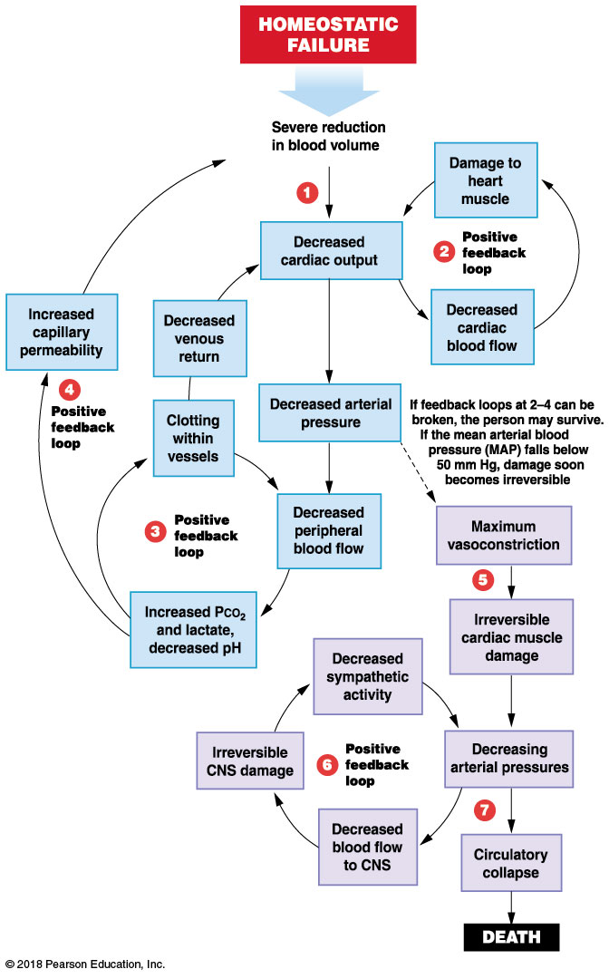
Module 19.13: Responses to blood loss
Shock (continued)
​Progressive shock (continued)
Local pH changes increase capillary permeability
Further reducing blood volume

Slide 125
Module 19.13: Responses to blood loss
Shock (continued)
Irreversible shock
Carotid baroreceptors trigger vasomotor centers
Sympathetic output causes widespread vasoconstriction
Reduces peripheral circulation but increases brain blood flow temporarily

Slide 126
Module 19.13: Responses to blood loss
Shock (continued)
Irreversible shock (continued)
Without treatment, blood pressure will again decline
Heart is now seriously damaged, and cardiac output declines

Slide 127
Module 19.13: Responses to blood loss
Shock (continued)
Irreversible shock (continued)
​Circulatory collapse
Occurs when arteriolar smooth muscles and precapillary sphincters cannot contract
Leads to:
Widespread vasodilation
Immediate and fatal decrease in blood pressure
Cessation of blood flow

Slide 128
Shock

Slide 129
Module 19.13: Review
Identify the compensatory mechanisms that respond to blood loss.
Name the immediate and long-term problems related to hemorrhage.
Describe circulatory shock, progressive shock, and irreversible shock.
Learning Outcome: Explain the body’s response to blood loss.

Slide 130
Section 3: Patterns of Blood Flow
Learning Outcomes
19.14 Distinguish between vasculogenesis and angiogenesis.
19.15 Identify the major arteries and veins of the pulmonary circuit, and name the areas each serves.
19.16 Identify the major arteries and veins of the systemic circuit, and name the areas each serves.
19.17 Identify the branches of the aortic arch and the branches of the superior vena cava, and name the areas each serves.

Slide 131
Section 3: Patterns of Blood Flow
Learning Outcomes (continued)
19.18 Identify the branches of the carotid arteries and the branches of the external jugular veins, and name the areas each serves.
19.19 Identify the branches of the internal carotid and vertebral arteries and the branches of the internal jugular veins, and name the areas each serves.
19.20 Identify the branches of the descending aorta and the branches of the venae cavae, and name the areas each serves.

Slide 132
Section 3: Patterns of Blood Flow
Learning Outcomes (continued)
19.21 Identify the branches of the visceral arterial vessels and the venous branches of the hepatic portal system, and name the areas each serves.
19.22 Identify the branches of the common iliac arteries and the branches of the common iliac veins, and name the areas each serves.
19.23 Describe the pathways taken by oxygenated blood and deoxygenated blood in the systemic circuit.

Slide 133
Section 3: Patterns of Blood Flow
Learning Outcomes (continued)
19.24 Clinical Module: Identify the differences between fetal and adult circulation patterns, identify changes in blood flow patterns at birth, and list common congenital heart problems.

Slide 134
Module 19.14: New blood vessels form through vasculogenesis and angiogenesis
Blood vessel formation involves two processes
​Vasculogenesis
Formation of the first blood vessels by precursor endothelial cells called hemangioblasts
Around day 7 of embryonic development, begin by forming blood islands in the yolk sac
Hemangioblasts in the center of blood island differentiate into hematopoietic stem cells
Give rise to all other blood cells

Slide 135
Module 19.14: New blood vessels form through vasculogenesis and angiogenesis
Blood vessel formation involves two processes
​Vasculogenesis (continued)
Hemangioblasts in periphery become angioblasts
Combine to form first blood vessels
Angioblasts remodel blood islands into primitive capillary networks, then into larger vessel networks

Slide 136
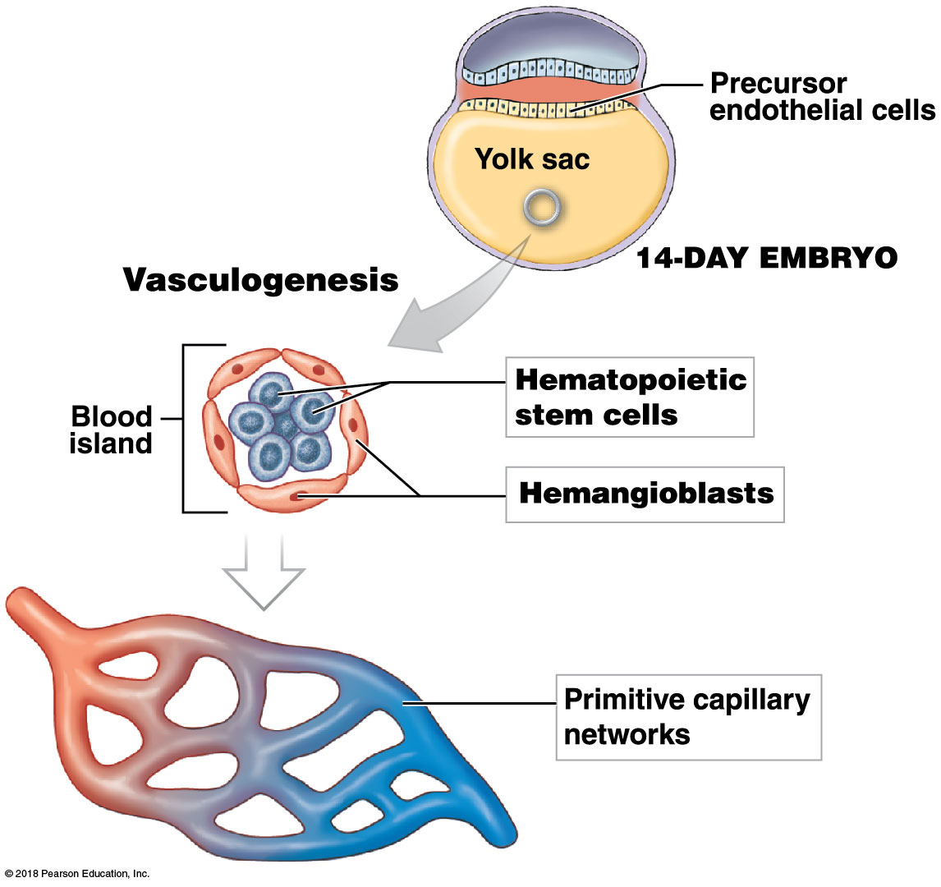
Vasculogenesis
Notes:
Students should view this image from the top (14 day embryo) down (4 week embryo).

Slide 137
Module 19.14: Vasculogenesis and angiogenesis
Blood vessel formation involves two processes (continued)
​Vasculogenesis (continued)
Cardinal veins
Series of venous channels that will form the superior and inferior venae cavae
Aortic arches
Series of arterial channels that will form the carotid arteries, aortic arch, and part of pulmonary arteries
Dorsal aorta
Becomes the descending aorta

Slide 138
Module 19.14: Vasculogenesis and angiogenesis
Blood vessel formation involves two processes (continued)
​Angiogenesis
Growth of new blood vessels from preexisting vessels
Dorsal aorta and cardinal veins formed by vasculogenesis
Further growth of blood vessels occurs through angiogenesis

Slide 139
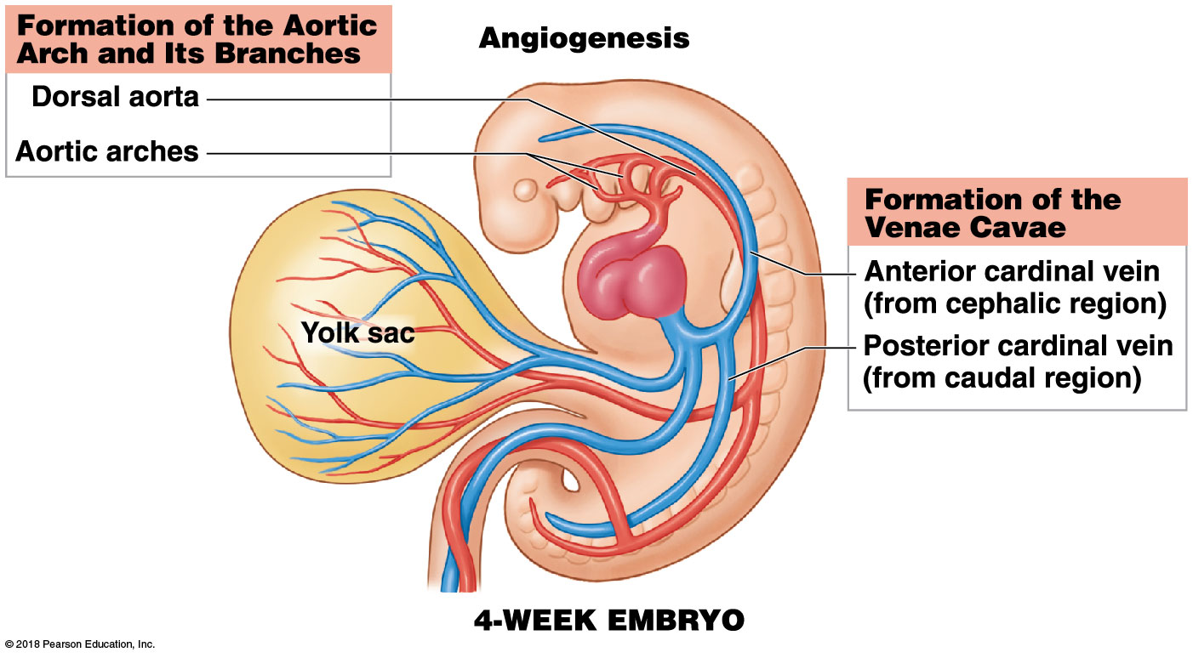
Formation of the aortic arch and its branches

Slide 140
Module 19.14: Review
What are blood islands, and from which cells do they form?
What is the function of hemangioblasts?
Learning Outcome: Distinguish between vasculogenesis and angiogenesis.

Slide 141
Module 19.15: The pulmonary circuit carries deoxygenated blood from the right ventricle to the lungs and returns oxygenated blood to the left atrium
Circuit review
Pulmonary circuit
Composed of arteries and veins that transport blood between the heart and lungs
Begins at the right ventricle; ends at the left atrium
Systemic circuit
Transports oxygenated blood to all organs and tissues
Begins at the left ventricle; ends at the right atrium

Slide 142
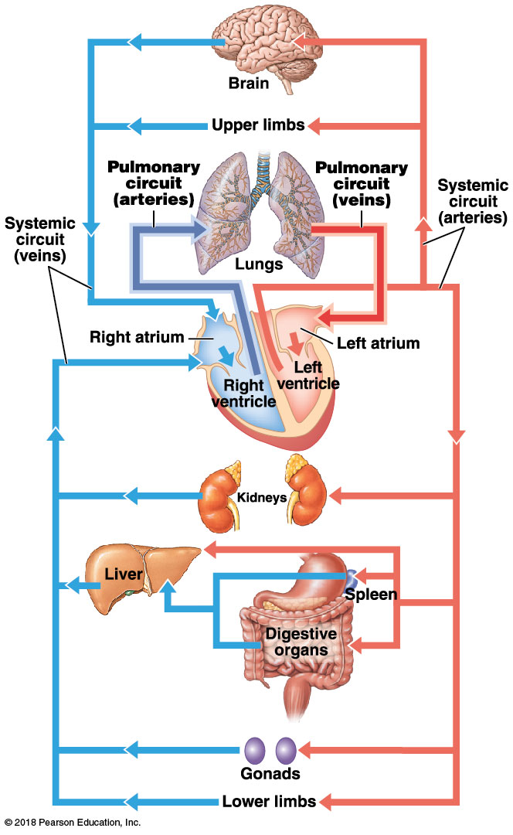
Pulmonary and systemic circuits
Notes:
Have students begin at the heart and follow the arrows on the right side of the heart (left side of image) first, and then do the same for the left side of the heart.

Slide 143
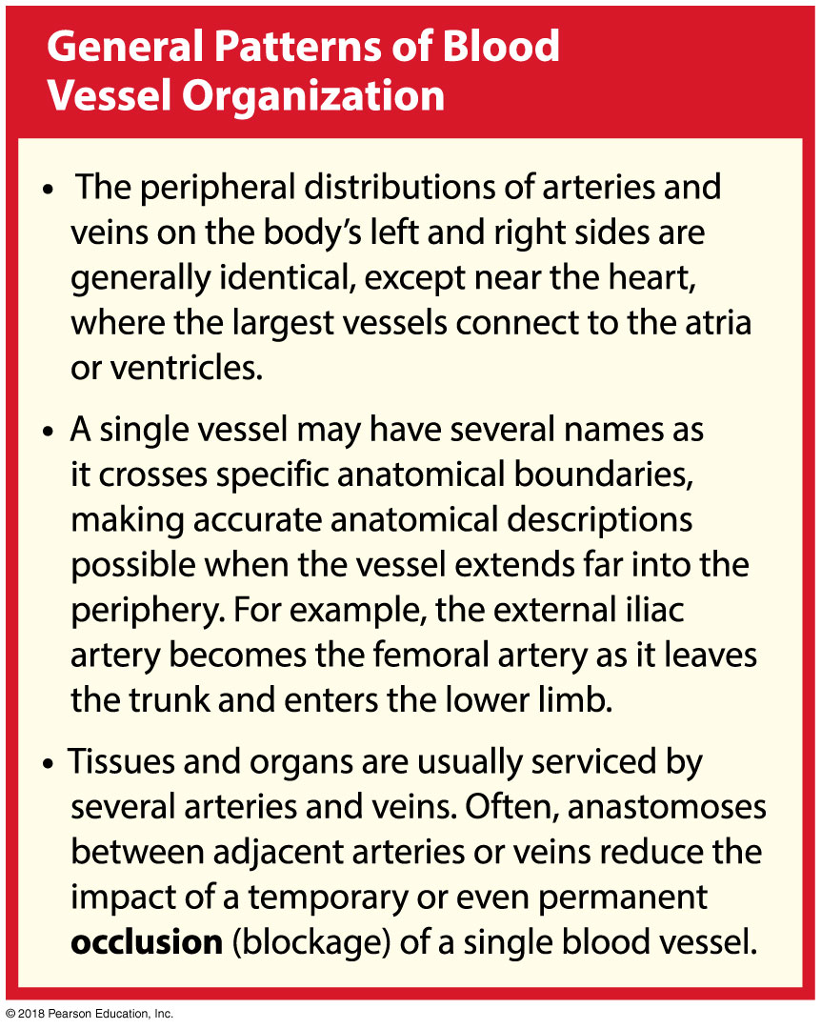

Slide 144
Module 19.15: The pulmonary circuit
Pulmonary circuit
Arteries of pulmonary circuit differ from those in systemic circuit
Pulmonary trunk (large artery coming out of the right ventricle) branches into:
Right and left pulmonary arteries, which branch into:
Smaller arteries and pulmonary arterioles supplying:
Alveolar capillaries around alveoli (air pockets), where gas exchange occurs
Oxygenated blood returns along small venules that join to form:
Pulmonary veins (two right and two left) which drain into the left atrium

Slide 145
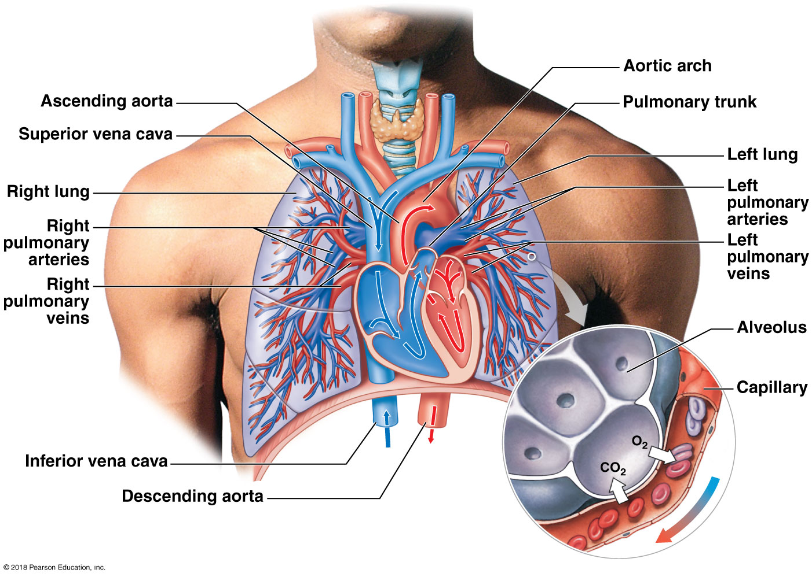
Pulmonary circuit
Notes:
Use this image to reinforce the concept that artery is a directional term and does not always indicate oxygenation. Ask students what color the pulmonary arteries and veins are and what that says about the oxygenation of the blood within each. Also, be sure students see the very small circle in the left lung indicating the location of the structures depicted in the blow-up image. Also point out to them the change in the scale; they are moving from the gross to the microscopic level.

Slide 146
Module 19.15: Review
Compare the oxygen content in the two circulatory circuits.
Briefly describe the general patterns of blood vessel organization.
Trace a drop of blood through the lungs, beginning at the right ventricle and ending at the left atrium.
Learning Outcome: Identify the major arteries and veins of the pulmonary circuit, and name the areas each serves.

Slide 147
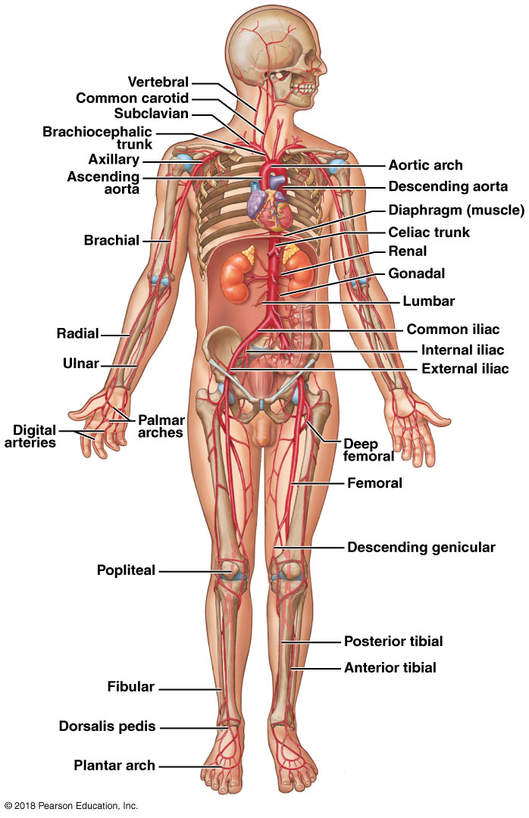
Module 19.16: The arteries and veins of the systemic circuit operate in parallel, and the major vessels often have similar names
Systemic vessels
Arterial system
All vessels originate from the aorta (the largest elastic artery) extending from the left ventricle
Most arteries are paired (left and right)
Notes:
Additional resource for arteries and veins: PAL 3.0—Human Cadaver: Cardiovascular System and Anatomical Models: Cardiovascular System.

Slide 148
Module 19.16: Systemic vessels
Systemic vessels (continued)
Venous system
All vessels drain into:
Superior vena cava
From head, neck, chest, and upper limbs
Inferior vena cava
From all structures inferior to the diaphragm (trunk and lower limbs)

Slide 149
Module 19.16: Systemic vessels
Systemic vessels (continued)
Arteries and veins usually similar on both sides of body
One significant difference between arteries and veins is distribution in the neck and limbs
Arteries: deep in skin, protected by bones and soft tissues

Slide 150
Module 19.16: Systemic vessels
Systemic vessels (continued)
One significant difference between arteries and veins is distribution in the neck and limbs (continued)
Veins: generally two sets, one deep and one superficial
Important in controlling body temperature
Venous blood flows superficially in hot weather to radiate heat
Venous blood flows deep in cold weather to conserve heat

Slide 151
Module 19.16: Review
Identify the largest artery in the body.
Name the two large veins that collect blood from the systemic circuit.
Besides containing valves, cite another major difference between the arterial and venous systems.
Learning Outcome: Identify the major arteries and veins of the systemic circuit, and name the areas each serves.

Slide 152
Module 19.17: Arteries and veins of the upper limb
Arteries
Branches of the aortic arch
Three elastic arteries
​Brachiocephalic trunk
Branches into:
Right subclavian artery (to right arm and chest)
Right common carotid artery (to right side of head and neck)
​Left common carotid artery (to left side of head and neck)
​Left subclavian artery (to left arm and chest)

Slide 153
Module 19.17: Arteries and veins of the upper limb
Arteries (continued)
Branches of the right subclavian artery
In the thoracic cavity
Internal thoracic artery (internal mammary artery)
Supplies pericardium and anterior chest wall
Vertebral artery
Supplies brain and spinal cord

Slide 154
Module 19.17: Arteries and veins of the upper limb
Arteries (continued)
Branches of the right subclavian artery (continued)
Arteries of the arm
Continuation of the subclavian artery
Axillary artery (crosses axilla to enter arm)
Brachial artery (supplies upper limb)
In the upper arm, gives rise to:
Deep brachial artery (supplies deep arm structures)
Ulnar collateral arteries (supply elbow area)

Slide 155
Module 19.17: Arteries and veins of the upper limb
Arteries (continued)
Branches of the right subclavian artery (continued)
Arteries of the forearm (branches of the brachial artery)
Radial artery (follows the radius)
Ulnar artery (follows the ulna)
Radial and ulnar arteries fuse to form superficial and deep palmar arches (supply blood to the hand)
Palmar arches branch into digital arteries supplying thumb and fingers

Slide 156
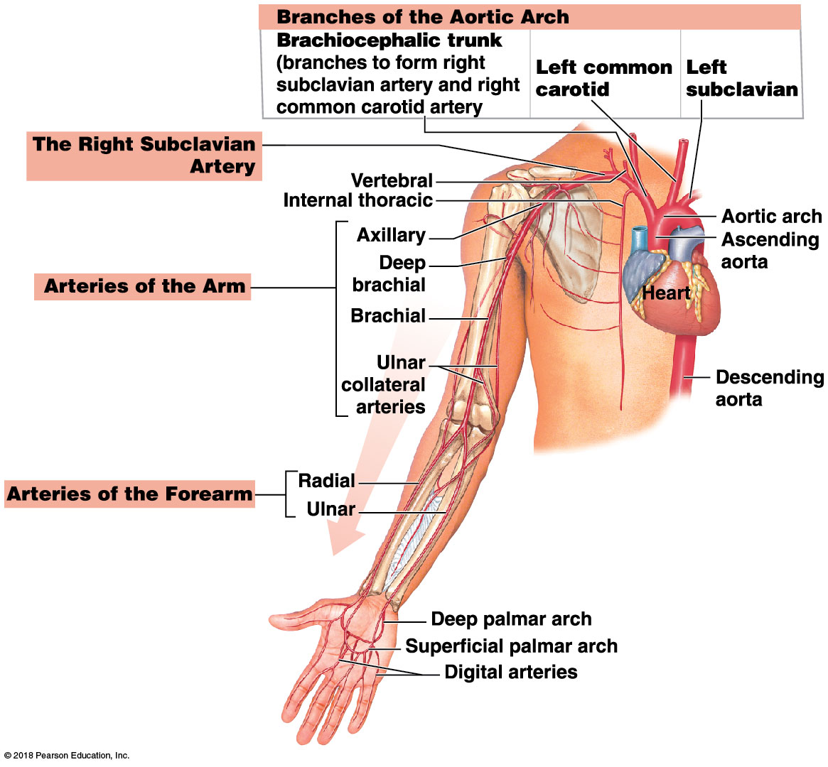
Arteries of the upper limb

Slide 157
Module 19.17: Arteries and veins of the upper limb
Veins
Draining into the right subclavian vein
From the digital veins in the fingers and thumb, blood drains into veins of the hand and forearm
Deep palmar arch, which drains into the:
Ulnar vein
Radial vein
Superficial palmar arch, which drains into the:
Cephalic vein
Median antebrachial vein
Basilic vein

Slide 158
Module 19.17: Arteries and veins of the upper limb
Veins (continued)
Draining into the right subclavian vein (continued)
The cephalic and basilic veins are interconnected by the medial cubital vein (typical location for collecting venous blood sample)
In the arm
Cephalic vein extends along the lateral side of the arm
Brachial vein merges with the basilic vein
Becomes the axillary vein as it enters axilla
Cephalic vein joins the axillary vein to form the right subclavian vein

Slide 159
Module 19.17: Arteries and veins of the upper limb
Veins (continued)
Veins of the neck
External jugular vein
Drains superficial structures of the head and neck
Internal jugular vein
Drains deep structures of the head and neck
Vertebral vein
Drains the cervical spinal cord and posterior surface of the skull

Slide 160
Module 19.17: Arteries and veins of the upper limb
Veins (continued)
Veins draining into superior vena cava (SVC)
Internal thoracic vein
Collects blood from intercostal veins
Drains into the brachiocephalic vein
Brachiocephalic vein
Forms at junction of the jugular and subclavian veins
Also receives blood from the vertebral and internal thoracic veins
Right and left brachiocephalic veins join to form the superior vena cava
Drains blood into the right atrium of the heart

Slide 161
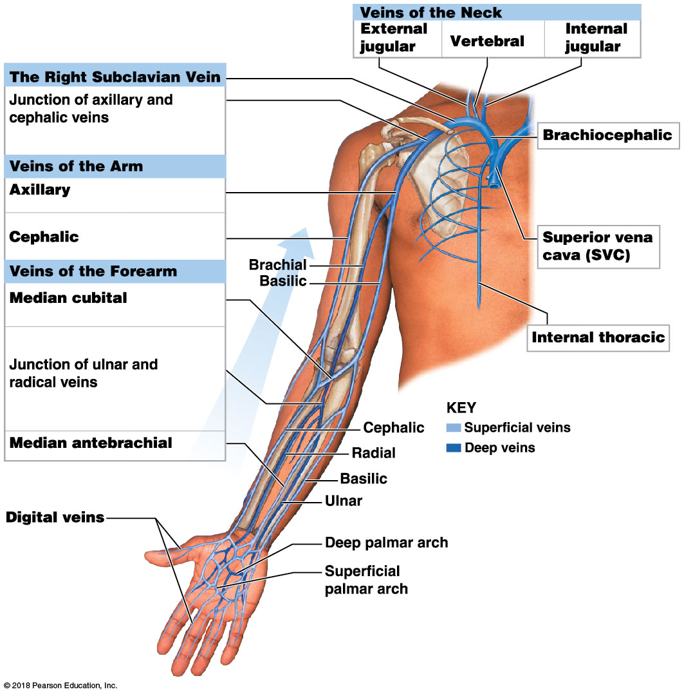
Veins of the upper limb

Slide 162
Module 19.17: Review
Name the two arteries formed by the division of the brachiocephalic trunk.
A blockage of which branch of the aortic arch would interfere with blood flow to the left arm?
Whenever Thor gets angry, a large vein bulges in the lateral region of his neck. Which vein is this?
Learning Outcome: Identify the branches of the aortic arch and the branches of the superior vena cava, and name the areas each serves.

Slide 163
Module 19.18: The external carotid arteries supply the neck, lower jaw, and face, and the internal carotid and vertebral arteries supply the brain . . .
Arteries
Common carotid artery
Supplies blood to face, neck, and brain
Branches
External carotid artery
Supplies neck, esophagus, pharynx, larynx, lower jaw, cranium, and face on that side
Internal carotid artery
Supplies brain and eyes
Carotid sinus at base of the internal carotid artery contains baroreceptors monitoring blood pressure

Slide 164
Module 19.18: Arteries of the head and neck
Arteries (continued)
Vertebral artery
From the subclavian artery, ascends within the transverse foramina of the cervical vertebrae
Left and right vertebral arteries
Enter the cranium at the foramen magnum
Fuse to form the basilar artery along the ventral surface of the medulla oblongata

Slide 165
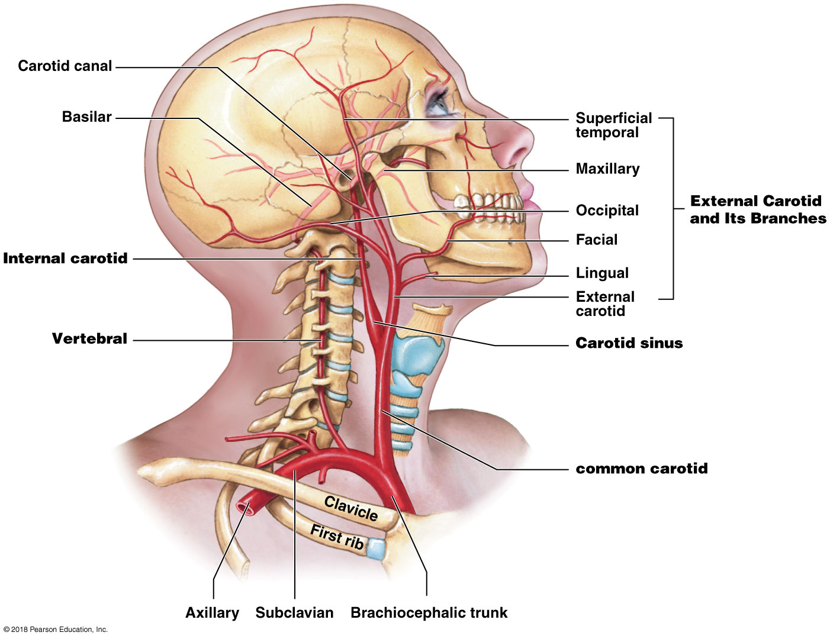
Arteries of the head and neck

Slide 166
Module 19.18: . . . while the external jugular veins drain the regions supplied by the external carotid arteries, and the internal jugular veins drain the brain
Veins
External jugular vein
Formed by the maxillary and temporal veins
Drains the cranium, face, lower jaw, and neck on that side
Internal jugular vein
Drains various cranial venous sinuses
Exits skull through the jugular foramen

Slide 167
Module 19.18: Veins of the head and neck
Veins (continued)
Vertebral vein
Drains the cervical spinal cord and posterior skull surface
Passes through the transverse foramina of the cervical vertebrae
The external jugular, internal jugular, and vertebral veins merge with the subclavian vein to form the brachiocephalic vein

Slide 168
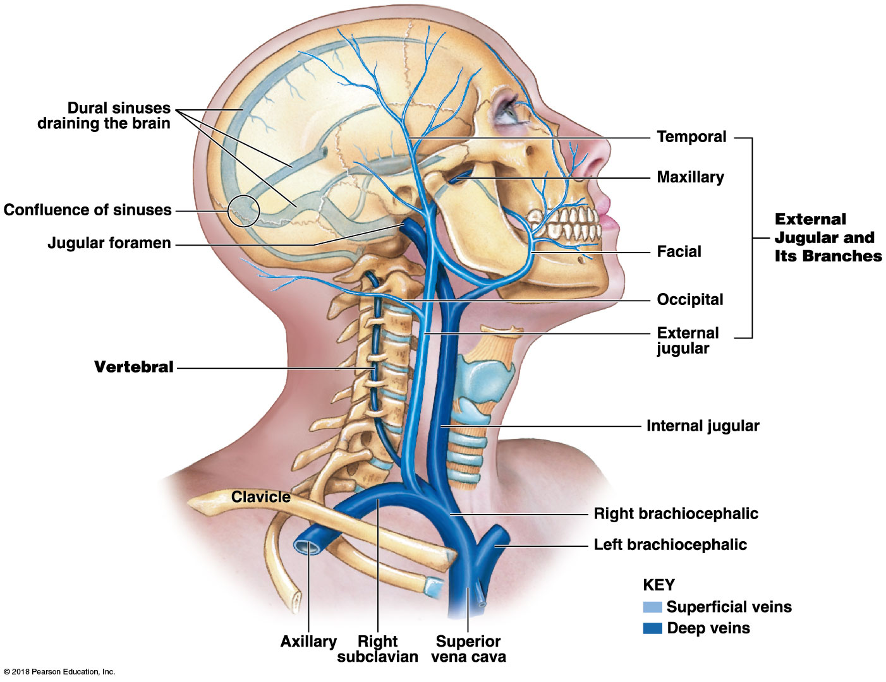
Veins of the head and neck

Slide 169
Module 19.18: Review
Identify the branches of the external carotid artery.
Name the arterial structure in the neck region that contains baroreceptors.
Identify the veins that combine to form the brachiocephalic vein.
Learning Outcome: Identify the branches of the carotid arteries and the branches of the external jugular veins, and name the areas each serves.

Slide 170
Module 19.19: The internal carotid arteries and the vertebral arteries supply the brain . . .
Arteries
Internal carotid arteries supply anterior half of the cerebrum
Branches of internal carotid artery
​Ophthalmic artery to the eyes
​Anterior cerebral artery to the frontal and parietal lobes of brain
​Middle cerebral artery to the midbrain and lateral surfaces of cerebral hemispheres
Vertebral and basilar arteries supply rest of the brain

Slide 171
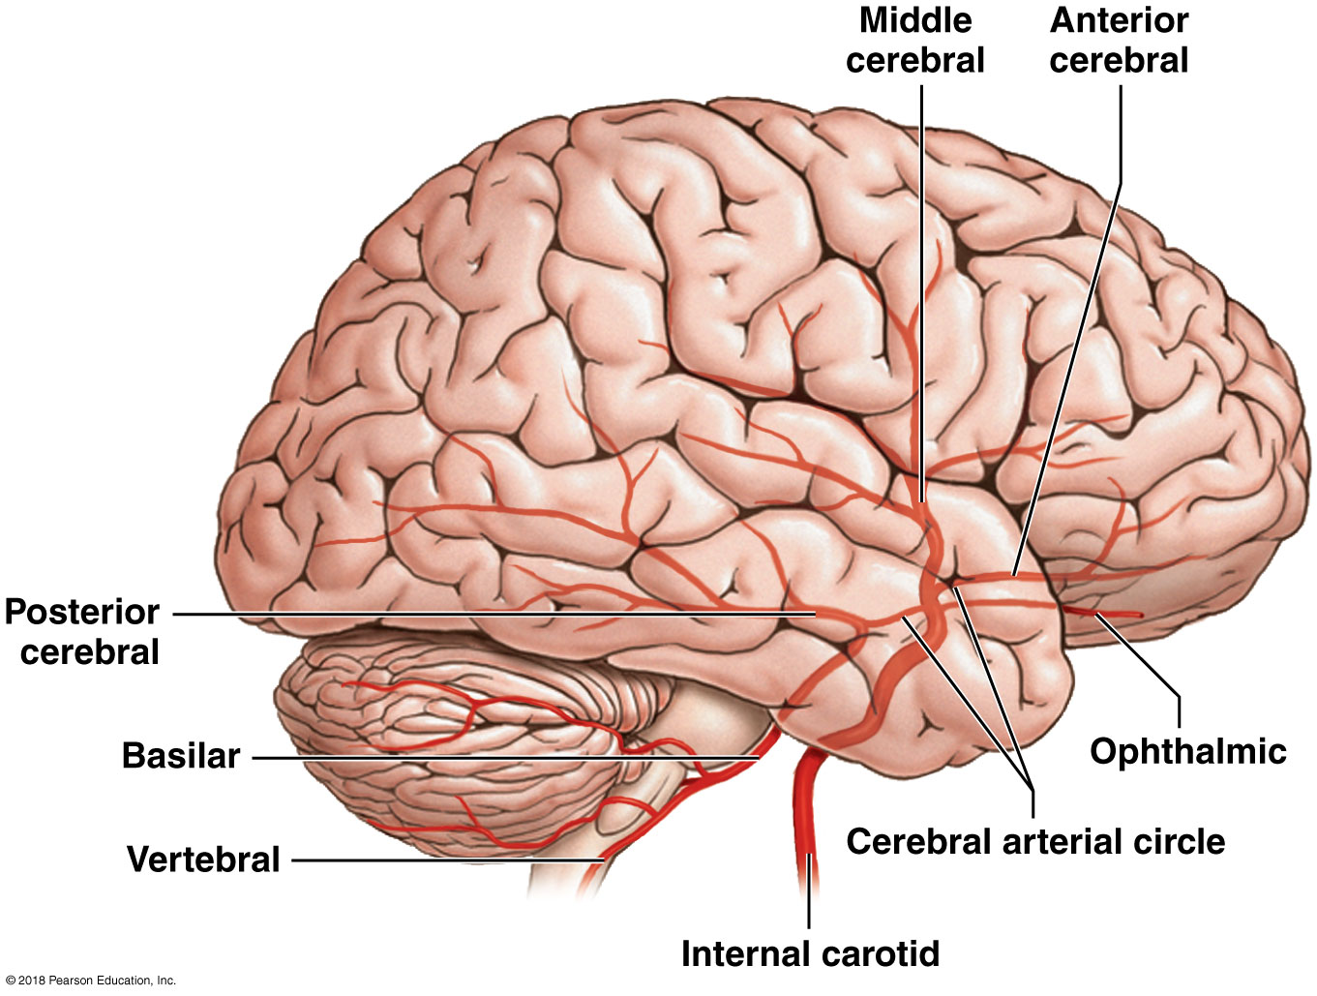
Arterial branches of the internal jugular and vertebral arteries

Slide 172
Module 19.19: Arteries of the brain
Arteries (continued)
Cerebral arterial circle (circle of Willis)
Ring-shaped anastomosis
Formed by internal carotid arteries and basilar artery
Encircles infundibulum of pituitary gland
Arrangement reduces likelihood of serious interruption of cerebral blood flow
Basilar artery divides into the posterior cerebral arteries
Branch into posterior communicating arteries

Slide 173
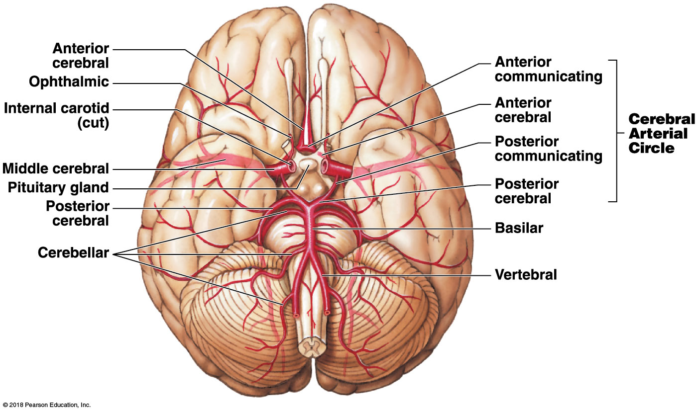
Arteries of the brain
Notes:
Point out that the two vertebral arteries unite to form the basilar artery, and walk students through the connections between the basilar artery and the two internal carotid arteries so they see all the branches that form the complete circle. Ask them to explain how a patient might have 90 percent occlusion in, say, the right internal carotid artery and yet suffer little or no cognitive impairment.

Slide 174
Module 19.19: . . . which is drained by the dural sinuses and the internal jugular vein
Veins
Superficial cerebral veins and small veins of the brain stem drain into network of dural sinuses
Superior sagittal sinus is the largest dural sinus
Deep cerebral veins drain into the great cerebral vein
Great cerebral vein drains into the straight sinus
Other small cerebral veins and veins from the orbit drain into the cavernous sinus

Slide 175
Module 19.19: Veins of the brain
Veins (continued)
Vertebral vein
Receives blood from transverse sinus, occipital sinus, superficial veins of the skull, and veins draining the cervical vertebrae

Slide 176
Veins of the brain

Slide 177
Module 19.19: Veins of the brain
Veins (continued)
Cavernous sinus empties into two petrosal sinuses
They drain into the transverse sinus
Sigmoid sinuses
Formed at convergence of the transverse sinus, straight sinus, and superior sagittal sinus
Penetrate skull at the jugular foramina as the internal jugular vein

Slide 178
Veins of the brain

Slide 179
Module 19.19: Review
Name the three branches of the internal carotid artery.
Describe the structure and function of the cerebral arterial circle.
Name the veins that drain the dural sinuses of the brain.
Learning Outcome: Identify the branches of the internal carotid and vertebral arteries and the branches of the internal jugular veins, and name the areas each serves.

Slide 180
Module 19.20: The regions supplied by the descending aorta . . .
Arteries
Descending aorta continues from the aortic arch
Diaphragm divides the descending aorta into:
Thoracic aorta
Abdominal aorta

Slide 181
Module 19.20: Arteries of the trunk
Arteries (continued)
Somatic branches of thoracic aorta
Intercostal arteries
Supply chest muscles and vertebral column
Superior phrenic arteries
Supply the superior surface of the diaphragm

Slide 182
Module 19.20: Arteries of the trunk
Arteries (continued)
Visceral branches of thoracic aorta (supply the organs of the chest)
Bronchial arteries
Supply lung tissues not involved in gas exchange
Esophageal arteries
Supply the esophagus
Mediastinal arteries
Supply tissues of the mediastinum
Pericardial arteries
Supply the pericardium

Slide 183
Arteries of the trunk

Slide 184
Module 19.20: Arteries of the trunk
Arteries (continued)
Major paired branches of the abdominal aorta
Inferior phrenic arteries (supply the inferior diaphragm and esophagus)
Adrenal arteries (supply the adrenal glands)
Renal arteries (supply the kidneys)
Gonadal arteries (supply the gonads)
Called testicular arteries in males
Called ovarian arteries in females
Lumbar arteries (supply the vertebrae, spinal cord, abdominal wall)

Slide 185
Module 19.20: Arteries of the trunk
Arteries (continued)
Major unpaired branches of the abdominal aorta
Celiac trunk (three branches)
Left gastric artery (stomach and inferior esophagus)
Splenic artery (spleen and stomach arteries)
Common hepatic artery (arteries to liver, stomach, gallbladder, and proximal small intestine)
Superior mesenteric artery (pancreas, duodenum, most of large intestine)
Inferior mesenteric artery (colon and rectum)

Slide 186
Module 19.20: . . .are drained by the superior and inferior venae cavae
Veins
Superior vena cava drains blood from the head, neck, shoulders, chest, and upper limbs
Major collecting vessels of the trunk
Azygos vein (major branch of superior vena cava)
Hemiazygos vein (drains into the azygos vein; may drain into left brachiocephalic vein)
Notes:
If you teach from cadavers, it is important to realize that there is tremendous variation in the azygos system. Not everyone has a hemiazygos, and many bodies also have an accessory hemiazygos; those two branches will always be to the left of the vertebral column, and the hemiazygos crosses to enter the azygos on the right. In the absence of a hemiazygos, the azygos begins on the left and crosses the vertebral column as it ascends. The key is that the azygos is always present and ends with the azygos arch curving into the superior vena cava high on the right side.

Slide 187
Module 19.20: Veins of the trunk
Veins (continued)
Drainage into the azygos vein and hemiazgos vein from the:
​Intercostal veins (chest muscles)
​Esophageal veins (inferior esophagus)
​Bronchial veins (passageways of lungs)
​Mediastinal veins (mediastinal structures)

Slide 188
Veins of the trunk

Slide 189
Module 19.20: Veins of the trunk
Veins (continued)
The inferior vena cava collects most of the blood inferior to the diaphragm
Major tributaries of inferior vena cava
Lumbar veins (lumbar portion of abdomen)
Gonadal (ovarian or testicular) veins (gonads)
Hepatic veins (liver)
Renal veins (kidneys)
Largest branches of the inferior vena cava

Slide 190
Module 19.20: Veins of the trunk
Veins (continued)
Major tributaries of inferior vena cava (continued)
Adrenal veins (adrenal glands)
Phrenic veins (diaphragm)
Only the right phrenic vein drains into the inferior vena cava
The left phrenic vein drains into the left renal vein
Notes:
Note that the left phrenic, adrenal, and gonadal veins all drain into the left renal, whereas their counterparts on the right side drain directly into the inferior vena cava.

Slide 191
Module 19.20: Review
Which vessel collects most of the venous blood inferior to the diaphragm?
Identify the major branches of the inferior vena cava.
Grace is in an automobile accident, and her celiac trunk is ruptured. Which organs will be affected most directly by this injury?
Learning Outcome: Identify the branches of the descending aorta and the branches of the venae cavae, and name the areas each serves.

Slide 192
Module 19.21: The viscera supplied by the celiac trunk and mesenteric arteries . . .
Arteries
The celiac trunk
Divides into the common hepatic artery, left gastric artery, and splenic artery
Branches of the common hepatic artery
Hepatic artery proper (liver)
Cystic (gallbladder)
Gastroduodenal (stomach and duodenum)
Right gastric (stomach)
Right gastro-epiploic (stomach and duodenum)
Superior pancreaticoduodenal (duodenum)

Slide 193
Module 19.21: Arteries of the viscera
Arteries (continued)
Superior mesenteric artery
Supplies the pancreas, duodenum, small intestine, and most of large intestine with these branches:
Inferior pancreaticoduodenal (pancreas and duodenum)
Right colic (large intestine)
Ileocolic (large intestine)
Middle colic (large intestine)
Intestinal arteries (small intestine)

Slide 194
Module 19.21: Arteries of the viscera
Arteries (continued)
Inferior mesenteric artery
Supplies the terminal portions of the colon and rectum with these branches:
Left colic (colon)
Sigmoid (colon)
Rectal (rectum)
Branches of the splenic artery
Left gastro-epiploic (stomach)
Pancreatic (pancreas)

Slide 195
Arteries of the viscera

Slide 196
Module 19.21: . . . are drained by the branches of the hepatic portal vein
Veins
Hepatic portal vein formed by fusion of:
​Superior mesenteric vein (carries the largest volume of blood and the most nutrients)
​Inferior mesenteric vein
​Splenic vein
Also receives blood from:
Left and right gastric veins
Cystic vein
Notes:
Note that in most bodies, the inferior mesenteric vein drains into the splenic v., and then the splenic v. and superior mesenteric v. join to form the hepatic portal vein.

Slide 197
Module 19.21: Veins of the viscera
Veins (continued)
Circulatory pattern called the hepatic portal system
Directs blood with absorbed nutrients from the digestive system to liver for processing

Slide 198
Module 19.21: Veins of the viscera
Veins (continued)
Branches of the superior mesenteric vein
Pancreaticoduodenal
Middle colic (transverse colon)
Right colic (ascending colon)
Ileocolic (Ileum and ascending colon)
Intestinal (small intestine)

Slide 199
Module 19.21: Veins of the viscera
Veins (continued)
Branches of the splenic vein
Left gastro-epiploic (stomach)
Right gastro-epiploic (stomach)
Pancreatic
Branches of the inferior mesenteric vein
Left colic (descending colon)
Sigmoid (sigmoid colon)
Superior rectal (rectum)

Slide 200
Veins of the viscera

Slide 201
Module 19.21: Review
List the unpaired branches of the abdominal aorta that supply blood to the visceral organs.
Identify the three veins that merge to form the hepatic portal vein.
Identify two veins that carry blood away from the stomach.
Describe the function of the hepatic portal system, and name its primary vessel.
Learning Outcome: Identify the branches of the visceral arterial vessels and the venous branches of the hepatic portal system, and name the areas each serves.

Slide 202
Module 19.22: The pelvis and lower limbs are supplied by branches of the common iliac arteries . . .
Arteries
Abdominal aorta divides to form right and left common iliac arteries
Each common iliac artery branches into an internal and external iliac artery
Internal iliac artery
Supplies the urinary bladder, internal and external walls of the pelvis, external genitalia, medial side of the thigh
In females, also supplies the uterus and vagina

Slide 203
Module 19.22: Arteries of the lower limb
Arteries (continued)
Branches of the common iliac artery (continued)
External iliac artery
As it enter the lower limb, becomes the femoral artery
Femoral artery branches off to form the deep femoral artery
Deep femoral artery forms the femoral circumflex arteries (supply ventral and lateral skin and deep muscles of the thigh)

Slide 204
Module 19.22: Arteries of the lower limb
Arteries (continued)
Branches of the common iliac artery (continued)
External iliac artery (continued)
Femoral artery changes name to popliteal artery posterior to the knee joint
Popliteal artery branches to form:
Posterior tibial artery
Gives rise to the fibular artery
Also called the peroneal (perone, fibula) artery
Anterior tibial artery
Descending genicular artery is another branch off the femoral artery

Slide 205
Module 19.22: Arteries of the lower limb
Arteries (continued)
Arteries of the foot
Supply distal portions of the foot and digital arteries of the toes
Tibial and fibular arteries interconnect by the anastomoses of the:
Dorsal pedis
Dorsal arch
Plantar arch

Slide 206
Arteries of the lower limb

Slide 207
Module 19.22: . . . and drained by branches of the common iliac veins
Veins
Plantar venous arch delivers blood to deep veins
Anterior tibial, posterior tibial, fibular (peroneal)
Dorsal venous arch collects blood from capillaries on superior surface of foot and digital veins of toes
Drains into superficial veins
Great saphenous vein and small saphenous vein

Slide 208
Module 19.22: Veins of the lower limb
Veins (continued)
Small saphenous vein merges with popliteal vein at the knee to form the femoral vein
Femoral vein receives blood from:
Great saphenous vein
​Deep femoral vein (drains from deeper structures in the thigh)
​Femoral circumflex vein (drains region around the neck and head of the femur)
Femoral vein penetrates body wall and becomes the external iliac vein in the pelvic cavity

Slide 209
Module 19.22: Veins of the lower limb
Veins (continued)
External iliac veins
Receive blood from lower limbs, pelvis, and lower abdomen
Internal iliac veins
Drain the pelvic organs
Formed by fusion of gluteal, internal pudendal, obturator, and lateral sacral veins
At inner surface of the ilium, external and internal iliac veins fuse to form common iliac veins

Slide 210
Veins of the lower limb

Slide 211
Module 19.22: Review
Name the first two branches of the common iliac artery.
The plantar venous arch carries blood to which three veins?
A blood clot that blocks the popliteal vein would interfere with blood flow in which other veins?
Learning Outcome: Identify the branches of the common iliac arteries and the branches of the common iliac veins, and name the areas each serves.

Slide 212
Blood supply to the upper limbs
Notes:
For this and the next slide, remind students that the systemic circuit begins with blood pumped from the left ventricle, and that is where they should begin in these images.

Slide 213
Blood supply to the systemic circuit

Slide 214
Blood supply from the common iliacs
Notes:
For this image, students should start at the abdominal aorta.

Slide 215
Blood return from the upper limbs

Slide 216
Thoracic blood return to the heart

Slide 217
Blood return from the abdomen and pelvis

Slide 218
Blood return from the lower limbs

Slide 219
Module 19.23: Review
Trace the path of a drop of blood from the left ventricle to the right hip joint.
Trace the path of a drop of blood from the right forearm to the right atrium.
Learning Outcome: Describe the pathways taken by oxygenated and deoxygenated blood in the systemic circuit.

Slide 220
Module 19.24: Clinical Module: The pattern of blood flow through the fetal heart and the systemic circuit must change at birth
Fetal circulation
Umbilical arteries
Pair of arteries that carry blood from the fetus to the placenta
Run from the internal iliac arteries into the umbilical cord
Umbilical vein
Carries blood from the placenta
Brings oxygen and nutrients
Drains into the ductus venosus
All umbilical vessels degenerate after birth
Remnants remain as fibrous cords

Slide 221
Module 19.24: Fetal circulation and congenital defects
Fetal circulation (continued)
Ductus venosus
Vascular connection to veins within the liver
Collects blood from liver and from umbilical vein
Empties into inferior vena cava
Foramen ovale, or interatrial opening
Allows blood to pass from right atrium to left atrium
Bypasses pulmonary circuit
Has one-way valve to prevent backflow
Ductus arteriosus
Bypass between pulmonary trunk and aorta
Sends blood from right ventricle to systemic circuit

Slide 222
Fetal blood flow

Slide 223
Module 19.24: Fetal circulation and congenital defects
Changes in circulation at birth
Are due to expansion of the pulmonary blood vessels and resulting pressure changes
Increasing pressure in the left atrium closes foramen ovale
Remnant of the foramen ovale is a shallow depression called the fossa ovalis

Slide 224
Module 19.24: Fetal circulation and congenital defects
Changes in circulation at birth (continued)
Rising oxygen levels cause ductus arteriosus to constrict and close
Remnant of the ductus arteriosus is a fibrous cord called the ligamentum arteriosum

Slide 225
Module 19.24: Fetal circulation and congenital defects
Congenital defects
Ventricular septal defects
Openings in interventricular septum
Most common congenital heart problem
Affect 0.12 percent of newborns
Causes mixing of oxygenated and deoxygenated blood

Slide 226
Module 19.24: Fetal circulation and congenital defects
Congenital defects (continued)
Patent foramen ovale
Passageway remains open
Blood recirculates through pulmonary circuit
“Left-to-right shunt”
Normal oxygen content, but left ventricle must work harder to provide adequate systemic flow
Patent ductus arteriosus
Passageway remains open
“Right-to-left shunt”
Blood is not adequately oxygenated, and skin is bluish

Slide 227
Patent foramen ovale and patent ductus arteriosus

Slide 228
Module 19.24: Fetal circulation and congenital defects
Congenital defects (continued)
Tetralogy of Fallot
Complex group of defects
Affects 0.10 percent of newborn infants
Four defects involved
Pulmonary trunk is abnormally narrow (pulmonary stenosis)
Interventricular septum is incomplete
Aorta originates where interventricular septum normally ends
Right ventricle is enlarged
Both ventricles thicken because of increased workload

Slide 229
Tetralogy of Fallot

Slide 230
Module 19.24: Fetal circulation and congenital defects
Congenital defects (continued)
Atrioventricular septal defect
Both atria and ventricles are incompletely separated
Variable results depending on extent of defect
May affect atrioventricular valves
Most commonly affects infants with Down syndrome
Disorder caused by presence of an extra copy of chromosome 21

Slide 231
Atrioventricular septal defect

Slide 232
Module 19.24: Fetal circulation and congenital defects
Congenital defects (continued)
Transposition of the great vessels
Aorta is connected to right ventricle
Pulmonary artery is connected to left ventricle
Affects 0.05 percent of newborn infants

Slide 233
Module 19.24: Review
Describe the pattern of fetal blood flow to and from the placenta.
Identify the six structures that are vital to fetal circulation but cease to function at birth, and describe what becomes of these structures.
Compare a ventricular septal defect with tetralogy of Fallot.
Learning Outcome: Describe the differences between fetal and adult circulation patterns, and identify changes in blood flow patterns at birth, and list common congenital heart problems.

